Slide 1
EIC Project News
E.C. Aschenauer (BNL), R. Ent (JLab)
Co-Associate Directors for the EIC Experimental Program
ePIC Bi-Weekly
October 4th, 2024

Slide 2
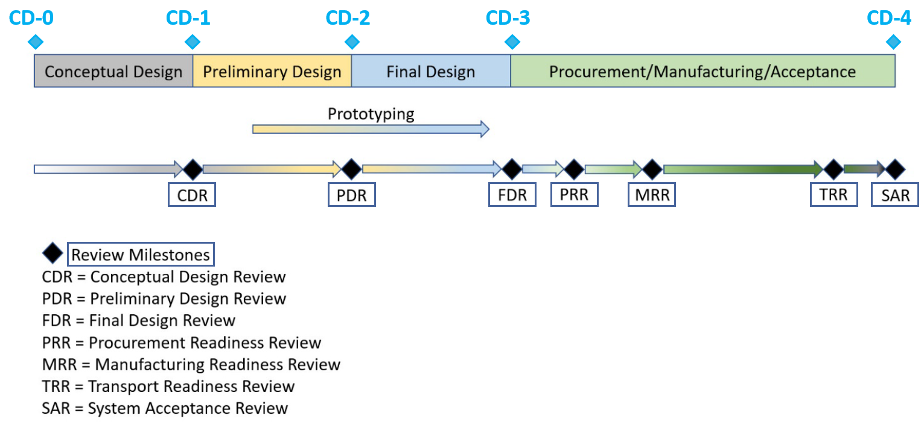
On we go: ePIC Detector Path to CD-3B and to CD-2/3C
Detector Design Reviews (organized by the EIC Project):
PDR2: IR Integration and Auxiliary Detectors – February 12, 2024 – main emphasis on baseline choices and progress
PDR1: Tracking Detectors – 20-21 March 2024 – main emphasis on baseline tracking layout, if we are on track and plans
PDR2: Electronics/DAQ – June 10 -11, 2024 – continuation of PDR1 to ensure we are on track and show progress
PDR: Integration, Infrastructure and Installation – July 15, 2024 – barrel and endcaps flux return steel
PDR2: Barrel EM Cal – September 19th – emphasis on mechanical design & AstroPix readiness
PDR2: Particle Identification Detectors – Winter 2024/25 (late January or February 2025 for pfRICH/hpDIRC/dRICH, TOF later)
FDR: Backward & Forward EM Calorimetry, Barrel & Forward HCAL – Fall 2024 → Winter 2024 (late January or February 2025)
PDR2: Polarimetry – timescale TBD (but before CD-2)
FDR for any potential CD-3B scope:
Magnet Power Supply – May 28th 2024
VTRx+/lpGBT add ½ day to electronics/DAQ PDR2 on June 11th 2024
Magnet Steel October 16th 2024
BNL Off-Project Dependency review Experimental Program August 22-23, 2024
Detector Advisory Committee Meetings 2024/2025:
June 21, 2024: 8th DAC meeting - strategic advice on the planning
for the construction phase of the ePIC detector
August 28-29, 2024: 9th DAC meeting - Annual advice on detector R&D status and FY25 completion needs
Spring 2025: 10th DAC meeting - Comprehensive look of DAC to design status and readiness for CD-2.
Software & Computing Reviews (organized by the host labs):
ePIC Detector Software Infrastructure Review https://indico.bnl.gov/event/16676/ – August 22-23, 2022
ePIC Software & Computing review by host labs https://indico.bnl.gov/event/20481/ – October 19-20, 2023
ePIC Software & Computing review (by host labs) – September 26-27, 2024

Slide 3
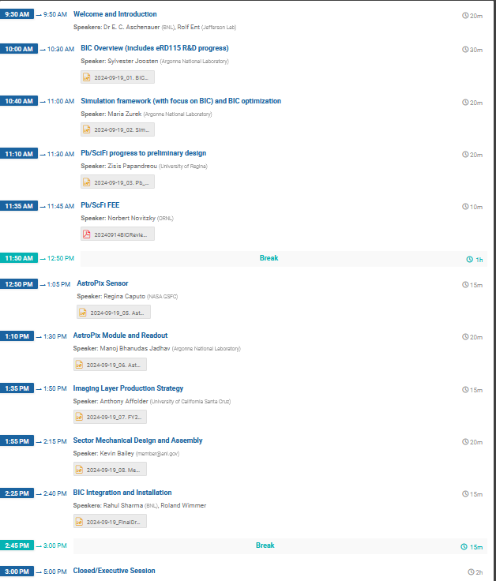
Incremental Preliminary Design and Safety Review of the ePIC Barrel Imaging EMCal - Agenda
Reviewers:
Stefania Beole (UniTo)
Pierluigi Campana (INFN-LNF)
Roman Poeschl (IJCLAB/IN2P3)
Lars Schmitt (GSI) – Unfortunately not
Review:
Thursday Sept. 19th 2024
Closeout:
Thursday Sept 26, 2024 @8-8:30am EDT

Slide 4
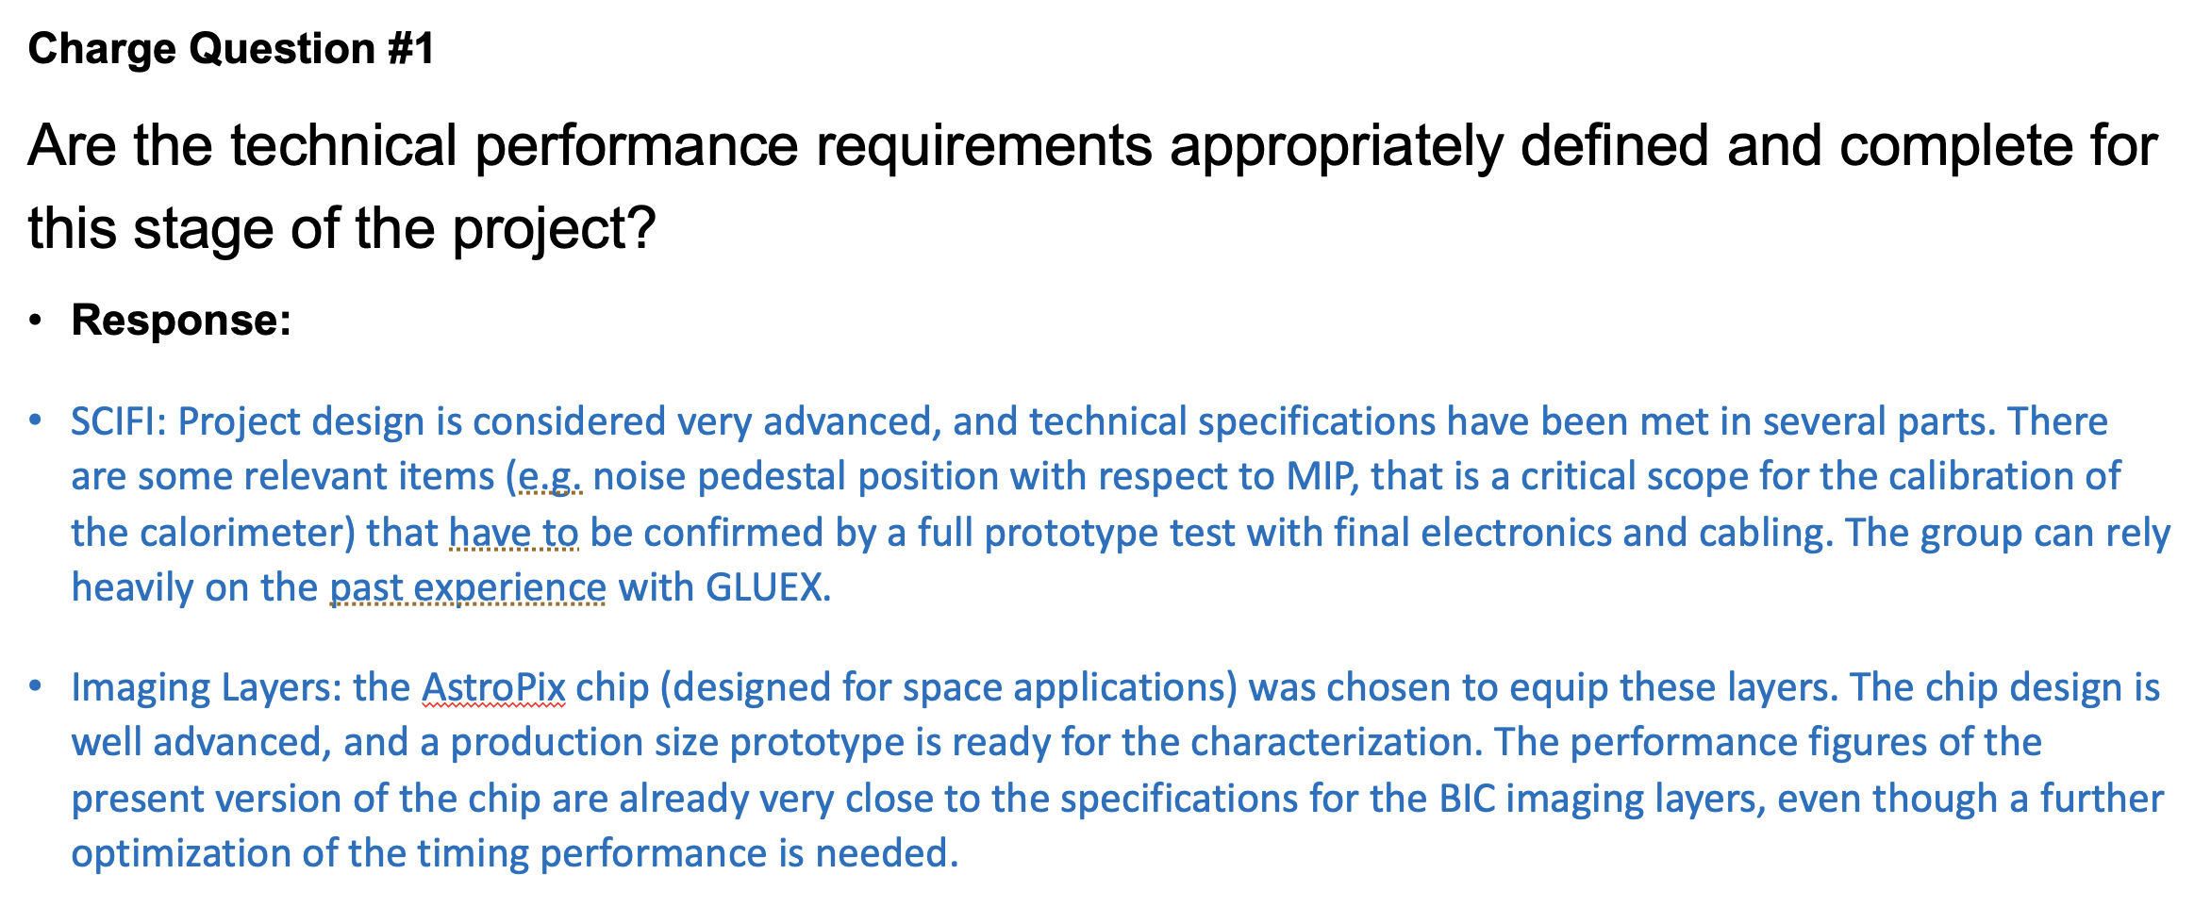
BIC Review Closeout

Slide 5
Final Design Review of the Mechanical Design for the Endcaps of ePIC (“FDR”) – Charge
We are ready to proceed with the Final Design Review of the mechanical design for the endcaps of ePIC. The main purpose of this Final Design Review is to assess the construction readiness to procure the magnet steel that serves as flux return for the magnet, in order to initiate their Long Lead Procurement.
FDR for our last new CD-3B item. The steel is such that we can full-field test and accept the magnet.
For this Final Design Review, you are asked to address the following questions:
Are the technical performance requirements and subsystem interfaces for the mechanical structures of the endcaps complete and documented?
Do the design and specifications meet the performance requirements with a low risk of cost increases, schedule delays, and technical problems?
Are the fabrication and assembly plans consistent with the overall project and detector schedule?
Are the plans for integration in the overall BNL infrastructure appropriately developed to initiate the endcap magnet steel procurement?
Have previous review recommendations been adequately addressed to initiate the procurement?
Have ES&H and QA considerations been adequately incorporated in the design and procurement planning?
Is the procurement approach sound and the procurement schedule credible?
Please address these questions point-by-point.

Slide 6
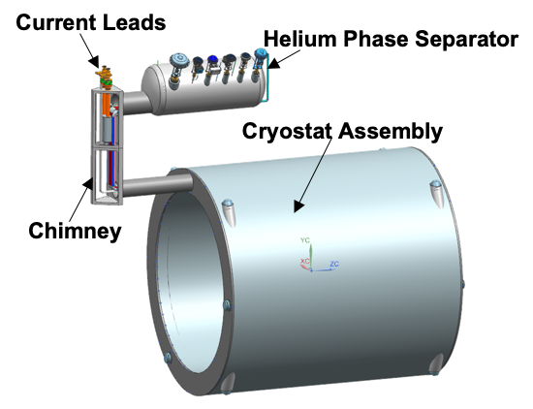
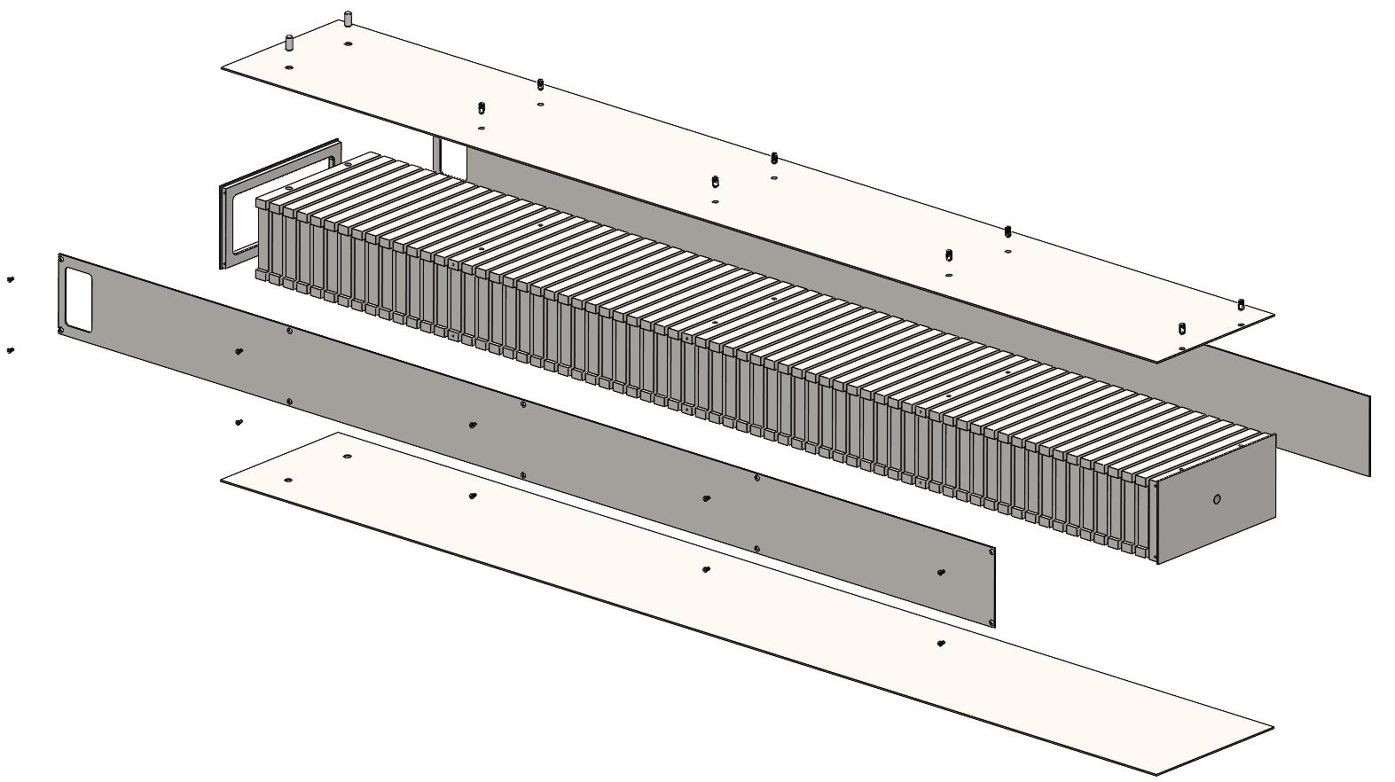
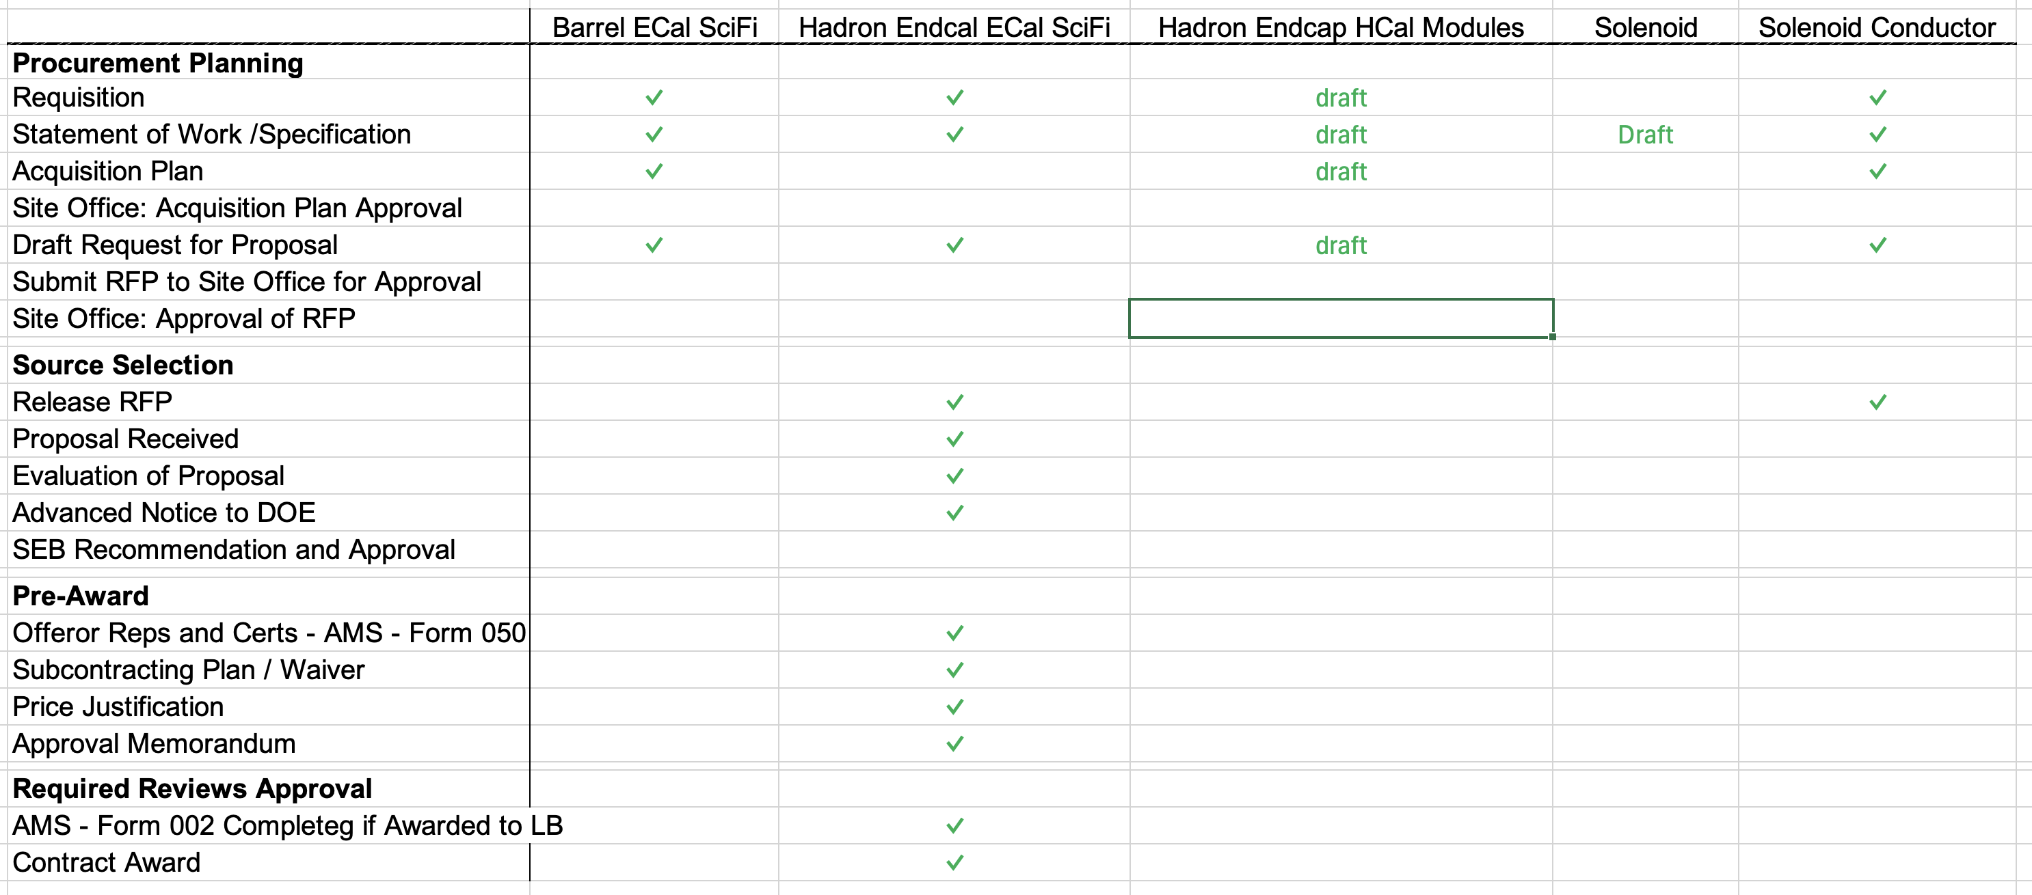
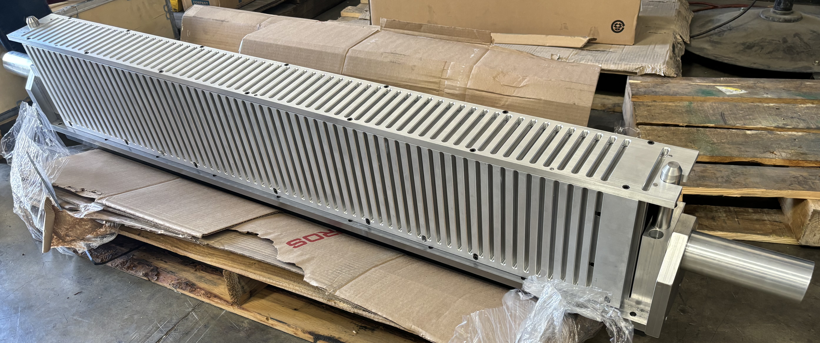
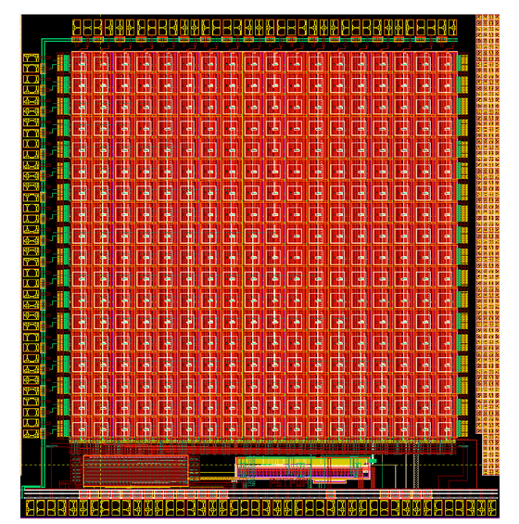
Status CD-3A Scope for Detector Systems
Detector Systems CD-3A Scope
WBS 6.10.05: Scintillating Fibers for the Detector Barrel and Forward EM Calorimeters
CD-3A scope is 1125 km and 750 km, respectively, first of four phases
WBS 6.10.06: Steel Plates, Casing Steel and Electron-Welding for the Detector Forward Hadronic Calorimeter
CD-3A scope: 650 8M modules of 1066 modules
WBS 6.10.07: Detector Solenoid Magnet Design and Fabrication and Conductor
CD-3A scope is for the conductor and the full magnet construction.
Will be In-kind

Slide 7
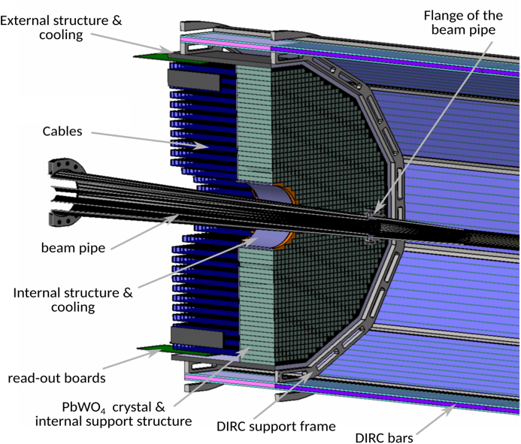
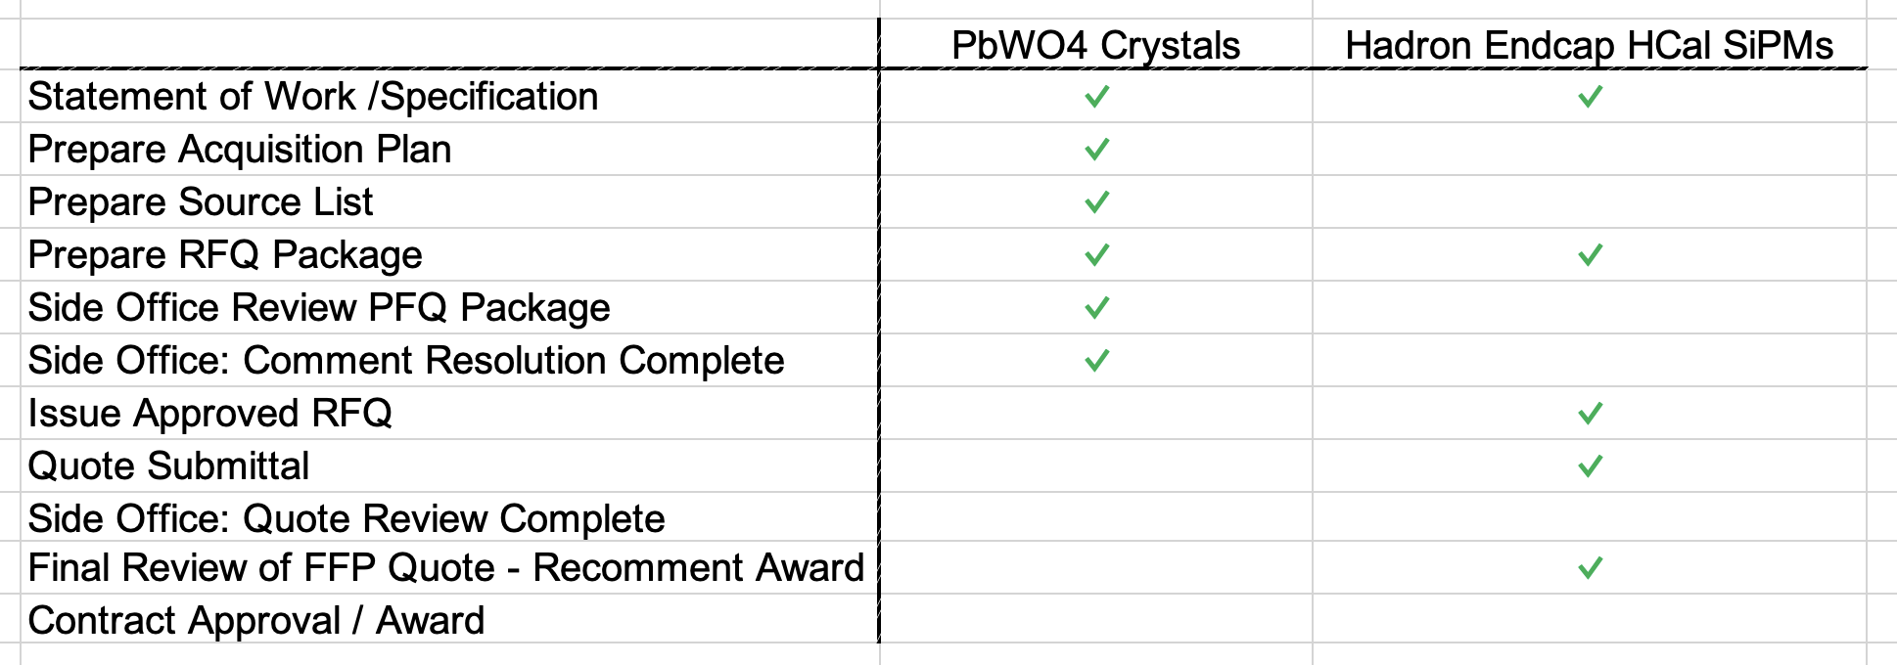
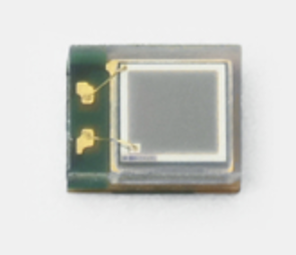
Status CD-3A Scope for Detector Systems
Detector Systems CD-3A Scope
WBS 6.10.05: Lead Tungstate Crystals for the Detector Backward EM Calorimeter
CD-3A scope is first two years of procurements (1500 pieces)
WBS 6.10.06: Silicon Photomultipliers for the Detector Foward Hadronic Calorimeter
CD-3A scope is one phase (321K SiPMs) out of two for the forward Hadron Calorimeter

Slide 8
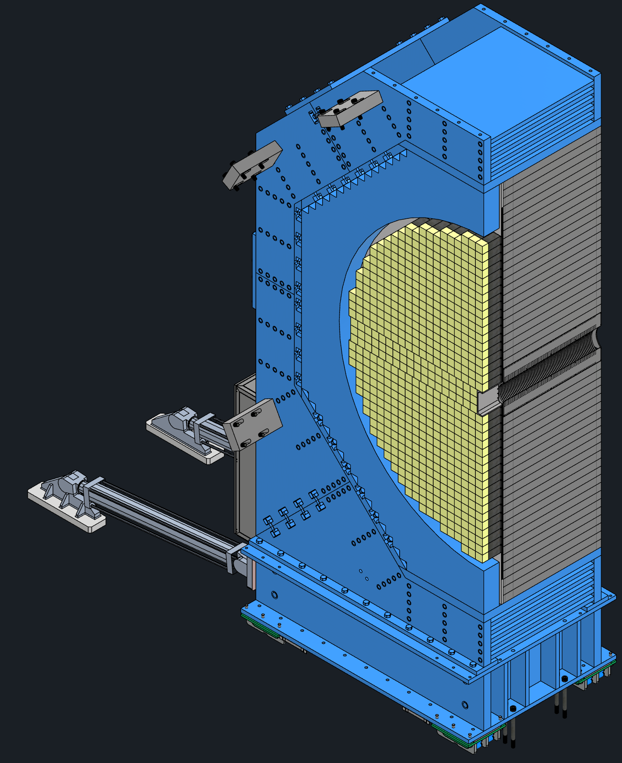
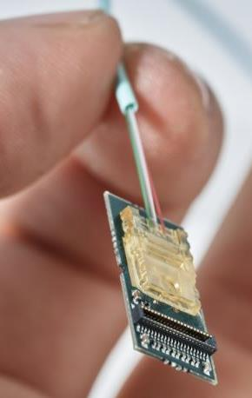
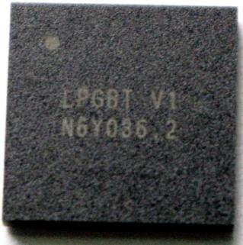
Long-Lead Procurement CD-3B Scope
Continuation of CD-3A Scope
WBS 6.10.05: Lead Tungstate Crystals for the Detector Backward EM Calorimeter
1000 pieces next step to complete the 3000 needed
WBS 6.10.05: Scintillating Fibers for the Detector Barrel and Forward EM Calorimeters
2nd phase of 4 phases → 1264 km and 1065 km, respectively out of the 4900 km and 3000 km
WBS 6.10.06: Steel Plates, machining, coating and welding of the Towers for the Detector Forward Hadronic Calorimeter
the next 200 units out of the 1066 total 8M towers
New Items:
WBS 6.10.07: Detector Solenoid Magnet Power Supply
Required for operation of the magnet at its design field which is required for the magnet acceptance
Reduces schedule risk due to competing project schedules → installation accelerator vs. experimental equipment
WBS 6.10.10: Flux Return Steel for the Electron and Hadron Endcap Structures
50% of needed magnet steel → first phase hadron endcap flux return steel
Required for operation of the magnet at its design field which is required for the magnet acceptance
WBS 6.10.08/09: VTRx+/lpGBT for MAPS tracker, dRICH and other subsystems to ensure homogenization
Includes 5500 Versatile Link Plus Transceivers (VTRx+) and 1500 Low Power GigaBit Transceivers (lpGBT)
Take advantage from the planned production run by CERN, reduces cost and schedule risks as the alternative would be to develop a new design with new electronic components

Slide 9
Directors Review Timeline
Completed

Slide 10
9th Detector Advisory Committee meeting
6.10.02 Detector & R&D and Physics Design
This was the fourth Detector Advisory Committee meeting looking at detector R&D, after earlier versions to look at the transition of the earlier EIC-related detector R&D program and initiate the FY22 project detector R&D and have them advise on R&D progress and priorities for FY23, FY24 and FY25.
The 9th Detector Advisory Committee meeting of August 28-29, 2024, to give advice on the detector R&D is posted at: https://indico.bnl.gov/event/24086/. The closeout report is posted here also.
This was the last year of formal project detector R&D, many of our detector R&D milestones have been completed or are near-completion. Some of the later Si/ASIC-related engineering runs are foreseen as Engineering and Design continuations.
Thanks to all, we have made quite some progress in a large variety of foreseen ePIC detector technologies and are by virtue of this well set up for the future CD-2 baselining.

Slide 11
9th Detector Advisory Committee meeting
What is the follow-up status?
We have converged with the EIC Management Team on available EIC “Other Project Costs” detector R&D funding for FY25
we plan to fund (as much as we can) eRD102, eRD108, eRD109 (v2), eRD110, eRD113 (v2)
We plan to fund eRD112 (v2) from PED funding in FY25. this was checked with the eRD112 contact person(s)
We have received permission from the EIC Management Team to recolor OPC funds we did not get to implement the detector R&D plan (due to the late FY22 start) as PED in FY25 and FY26
These affect chip-related engineering runs
We plan to fund (as much as we can) areas from the eRD109 (ASICs), eRD112 (AC-LGAD) and eRD113 (SVT) that were included in the v1 eRD1xx submissions.
Some move to FY26 given FY25 PED funding availability, but at first glimpse this can work.
We have completed the budget planning (including what comes through BNL and what through JLab, roughly 50/50) and plan to start on the contracts now.
For some eRD activities the main contact persons have been contacted already, and they can start work on providing the procurement documentation input for BNL and JLab.

Slide 12
Increased Communication with DSCs
Initiated a new series of meetings with the DSCs to discuss:
mechanical and electronics/readout integration questions, topics are services, cooling envelop issues and so on
Meetings:
Wednesdays 8:00 to 9:00 am (EDT)
Fridays 11:00 am to 12:00 pm or 12:00 to 1:00 pm on Fridays with ePIC general meeting
Meetings last and this week:
ToF
dRICH
MPGD
backward HCal (today)
We will meet with all DSCs and then start over
got a lot of praise for this meetings as it helps to avoid misunderstandings, resolve questions fast and move forward on decisions, which are outstanding for a long time.
Some examples: agreed services for barrel ToF can go to both sides, will look if we can reduce ~2 cm of vacuum flange outer size behind dRICH, …

