Slide 1
ePIC Collaboration News
J. Lajoie, S. Dalla Torre
October 4, 2024

Slide 2
Hey John, start the recording….

Slide 3
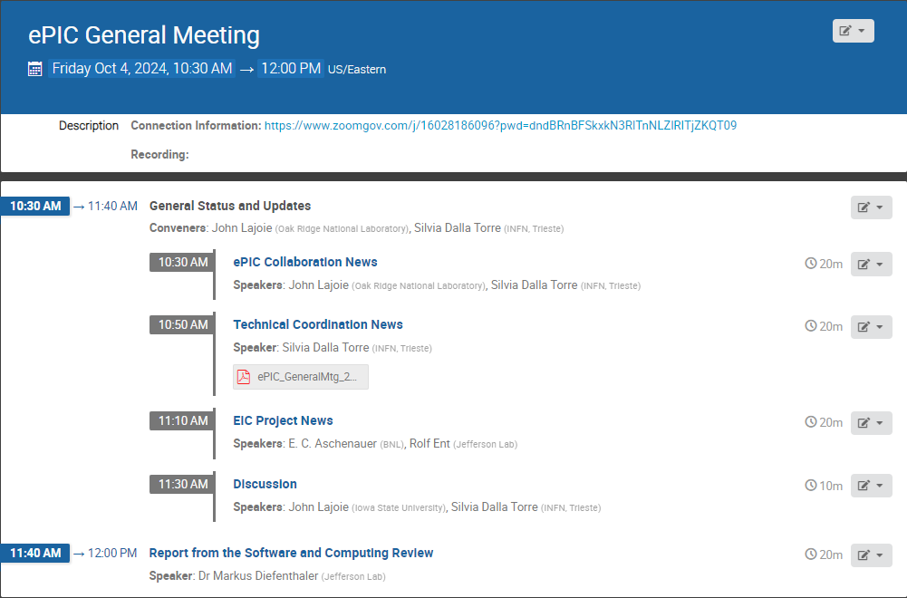
Agenda

Slide 4
News from the SP Office
EIC Strategy Mtg August 21st
ePIC Early Physics Workshop Sept. 13, 2024
FDR: Magnet Flux Return Steel
(poss. CD-3B scope) October 16, 2024
Everything is continuing at a fast pace coming out of the Lehigh Collaboration Meeting!
ePIC draft pre-TDR Version 1 December 1, 2024
Detector Advisory Committee R&D Meeting
August 28-28th
ePIC Software and Computing Review Sept. 26-27th
Frascati Collab. Mtg. Jan 2025
Lehigh Collab. Mtg. July 2024
PDR2: Barrel EMCal
September 19th
ePIC draft pre-TDR Version 0 Sept. 29, 2024
Directors Review for CD-3B/Status Review
October 22-24
EIC Project CD-3B/Status Review January 7-9th, 2025
EIC “Host” Lab User Experience Workshop
August 26th
(see Project News talk by Elke/Rolf)

Slide 5
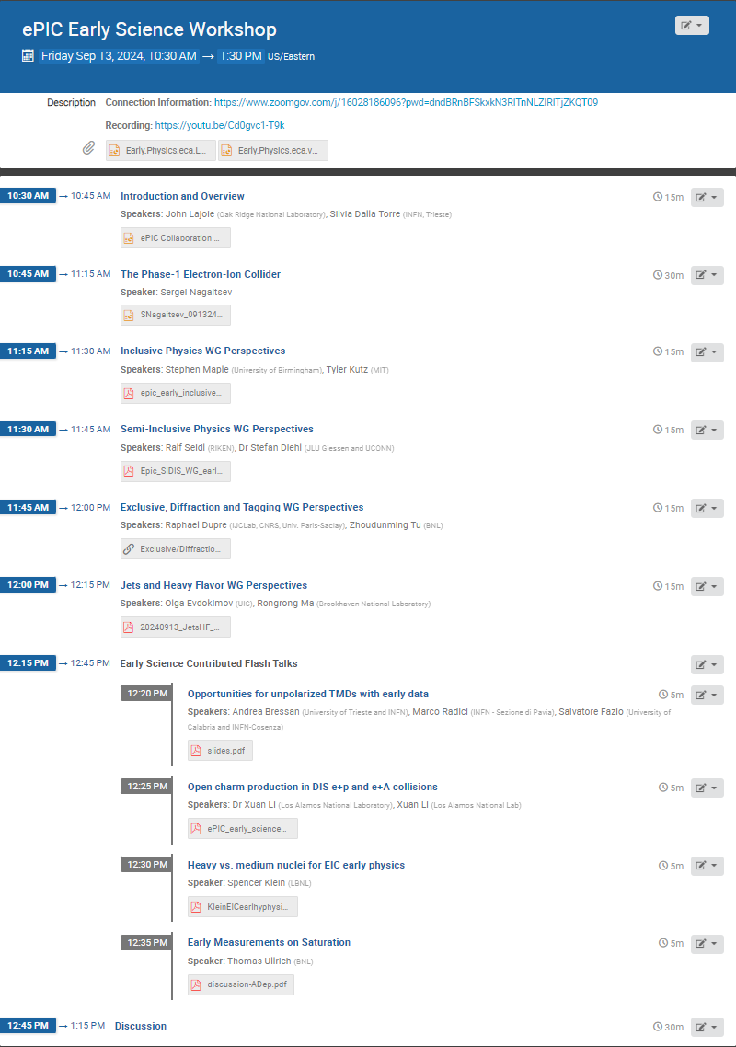
Early Science Workshop
Held September 13 @ 10:30AM ET
https://indico.bnl.gov/event/24432/
Great participation! – peaked at 79 participants on Zoom, 105 unique participants overall.
Excellent introductory talk by Sergei Nagaitsev (EIC Technical Director), followed by perspectives from PWG’s and contributed talks. Elke’s slides and lumi projections also posted.
Slides and recording available on Indico
Plan to follow up in Analysis Meetings, plenary session at Collaboration Meeting, possible in-person meeting next spring.
Summary from Rosi in 9/19 GM…

Slide 6
High-Level Messages
The collaboration is motivated to engage in defining the EIC early science program.
The capabilities of the EIC will come on slowly, with additional capabilities and performance coming online steadily throughout the Phase-1 program.
We are commissioning a new collider and a new experiment!
General message from the PWG’s is that the strawman proposal is a good start on EIC science:
Year-2 program (e-d) is greatly enhanced with addition of some forward instrumentation (off-momentum detectors)
Ongoing discussion of eA running for saturation physics, but machine constraints are very real

Slide 7
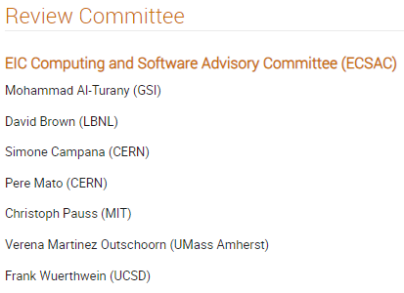
Software and Computing Review
Sep 26 – 27, 2024
Catholic University of America
A very successful and productive review!
More on this in the talk from Markus later this meeting…

Slide 8
preTDR Version 0!
Executing the plan from the Jan. 2024 Collaboration Meeting:
process design phase
structuring the
effort
draft ePIC pre-TDR
ePIC pre-TDR (CD-2)
writing
(TDR/notes)
Preparing papers for
publication
Mid Jan.24
Mid Mar.24
Early 2025
Version 0
Sept. 30, 2024
Version 1
Dec. 1, 2024
Silvia will say more in the TC News talk – the collaboration really stepped up for this first milestone in the TDR process!

Slide 9
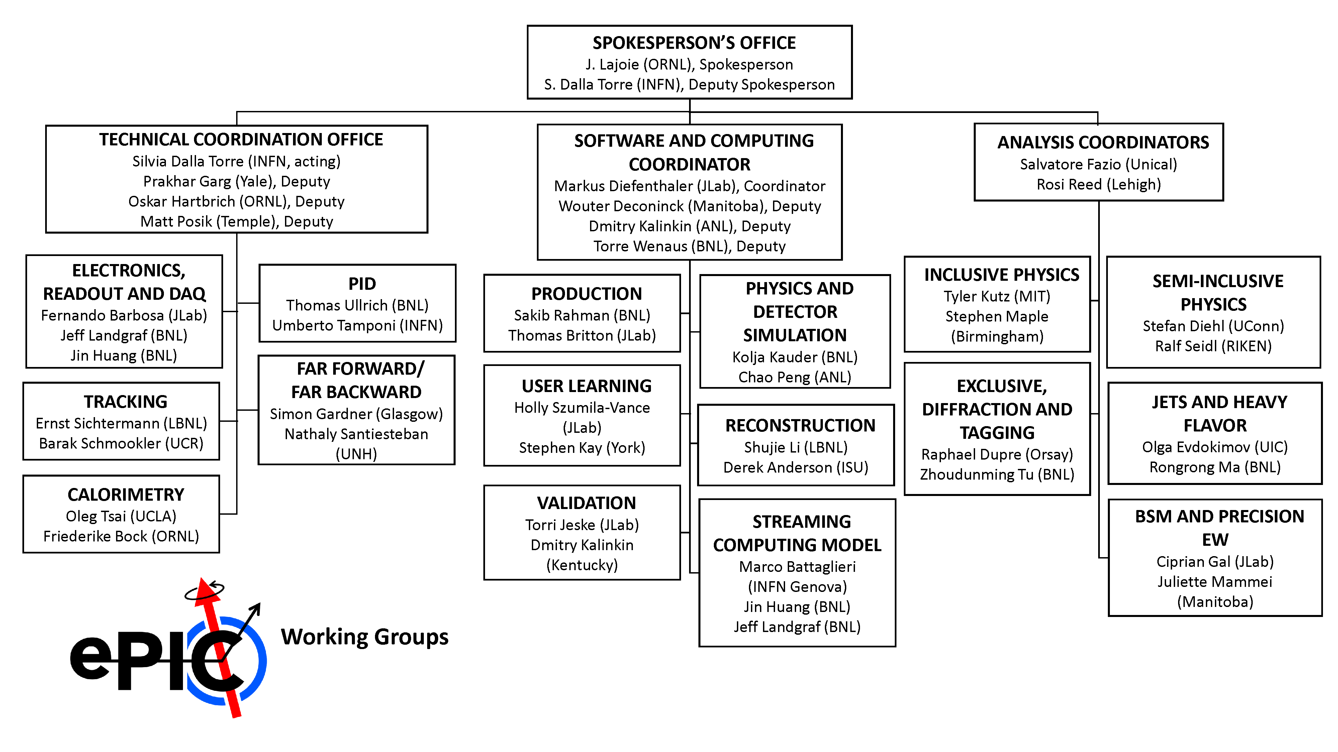
Change to FFWD/FBKWD CC Working Group
Nathaly Santiesteban has asked to step down from her convener role.
Held discussions with the DSC’s and L3 CAM. Communications between the efforts are good, need more joint meetings with AC-LGAD TOF and physics PWG’s.
The FFWD/FBKWD efforts are somewhat different in that they are relatively small and tightly integrated with the project.
After careful considerations, the SP Office has decided to dissolve the FFWD/FBKWD CC WG.
Many thanks to Nathaly and Simon for their service!

Slide 10
Software Tutorial Series
We welcome suggestions for future tutorials.
Next Tutorial: Working with Simulation Output Presenter: Stephen Kay (University of York) Date: Thursday, September 12 Time: Delivered twice on this date to cover multiple time zones
10:00 a.m. (BST) for Africa, Asia, Australia, and Europe: https://indico.bnl.gov/event/24623/
4:00 p.m. (BST) for Africa, Europe, North America, and South America: https://indico.bnl.gov/event/24624/
20+ participants!
Present “Working with Simulation Output” on a bi-monthly basis:
Focus on a different “special” item each time.
Next, early November.
Trial new format of live help desk at same time as tutorials, one week before/after tutorial
5th September and 19th September
Upcoming Tutorial: Validation and Benchmarking Presenter: Zachary Sweger (UC Davis) Date: Thursday, October 3 Time:
1:00 p.m. (EDT): https://indico.bnl.gov/event/24625/
5 participants!

Slide 11
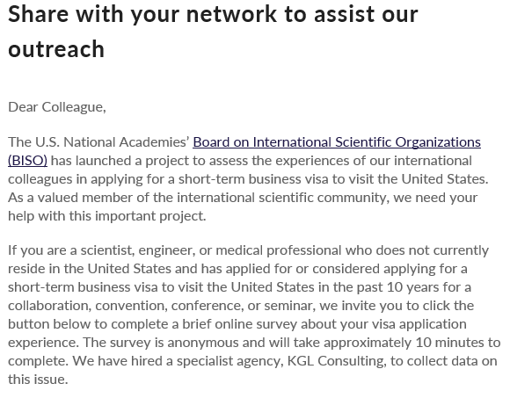
NAS Survey
Participate in Survey
thanks to Alex Jentsch for bringing this to our attention

Slide 12
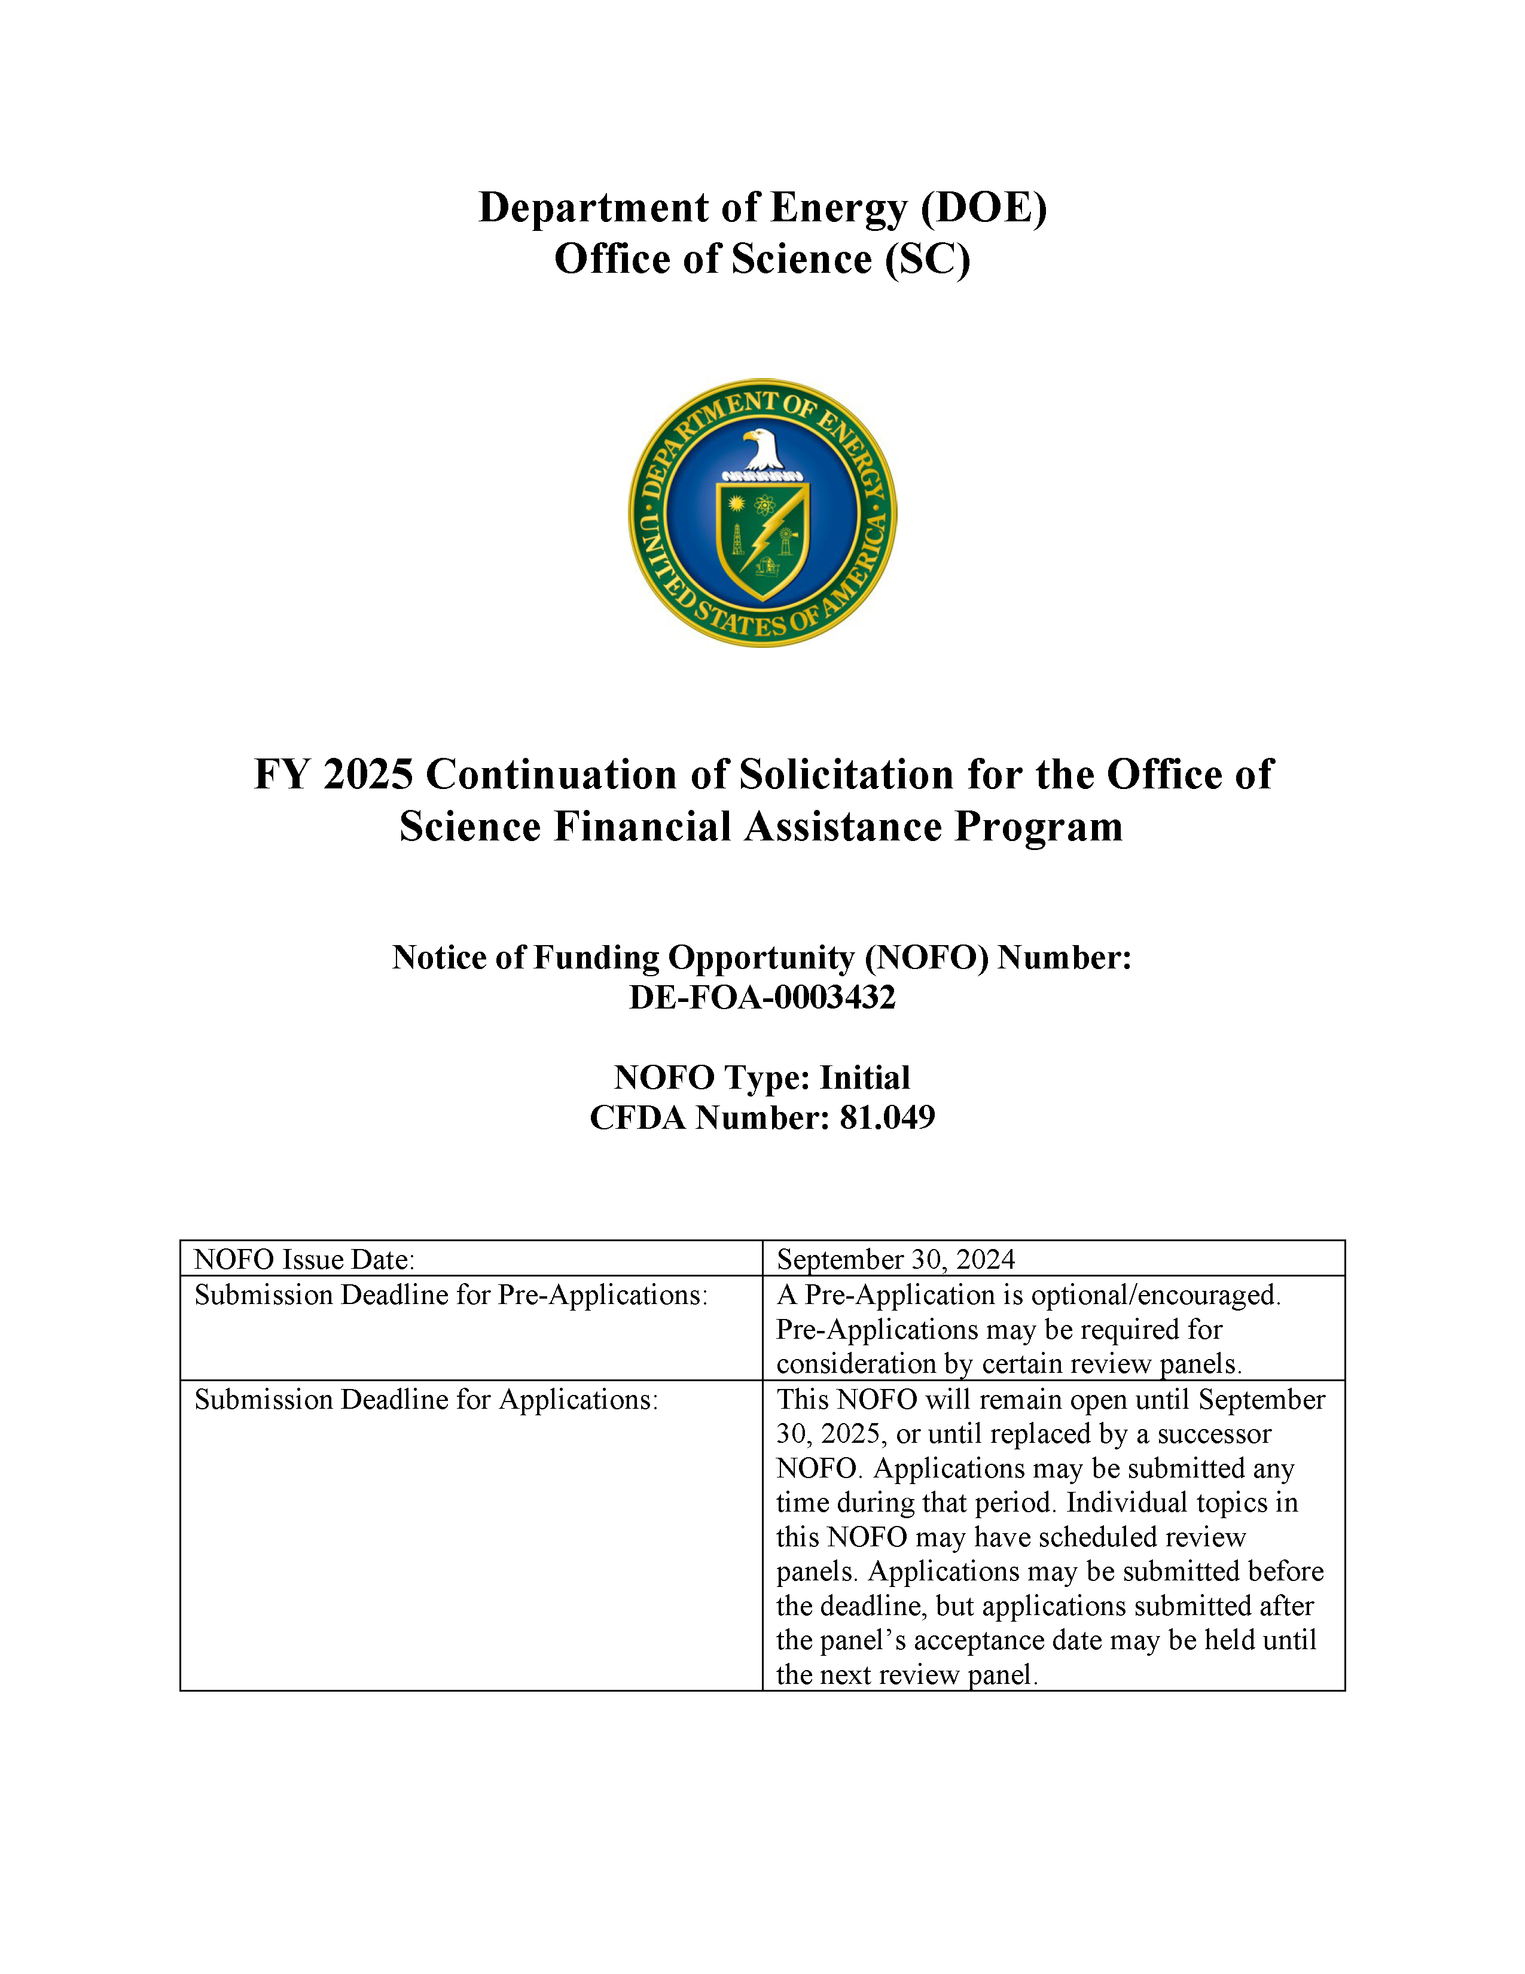
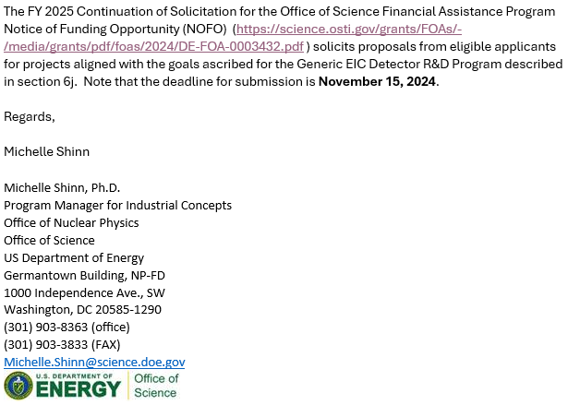
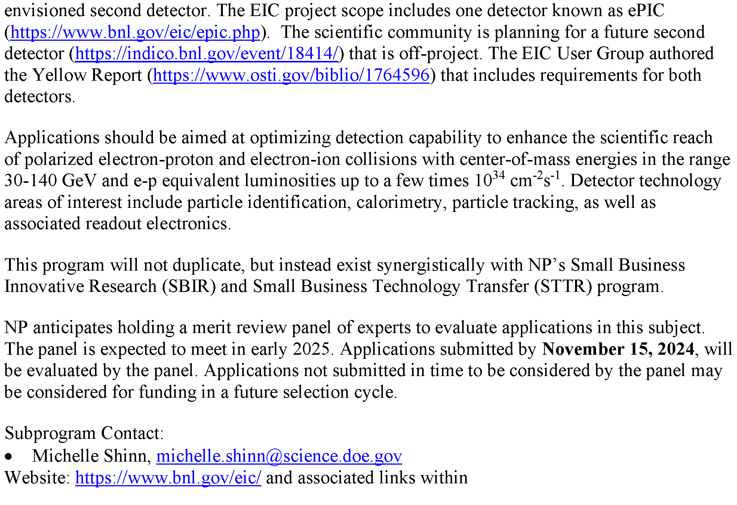
DOE FY25 NOFO – Generic EIC R&D
This is not exactly a replacement for the previous EIC Generic R&D Program, it is a different thing. Proposals will have to compete directly with other DOE initiatives.
The scope and quality of the proposals will need to have a broader, more general appeal than before.
It is not clear how international institutions could be involved, will work to clarify this.
Any work under this program will have to be decoupled from any existing EIC R&D/PED work.
Discussions have taken place within the EICUG SC to organize a meeting of interested parties.
https://science.osti.gov/grants/FOAs/-/media/grants/pdf/foas/2024/DE-FOA-0003432.pdf

Slide 13
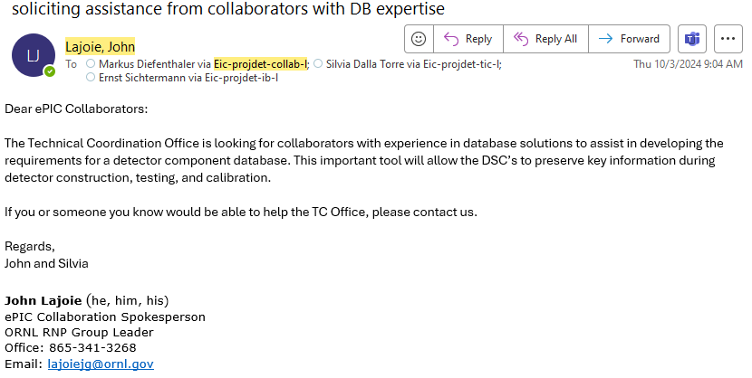
Call for Support with Database Solutions

Slide 14
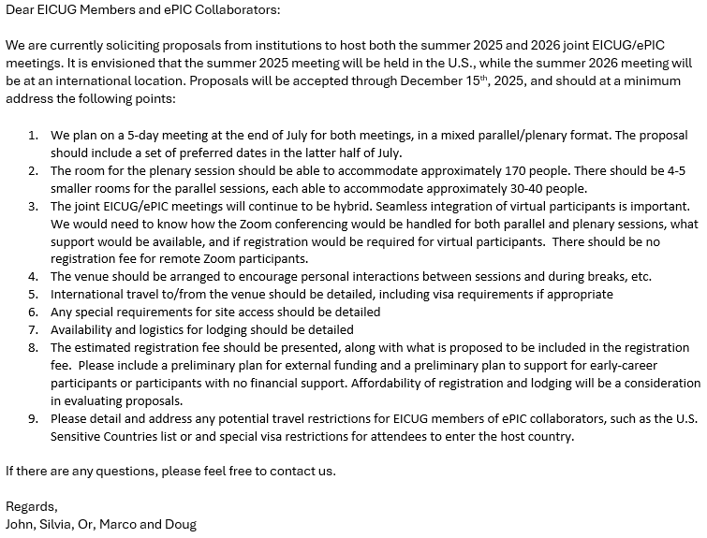
Future Collaboration Meetings
After consultation with the coordinators and EICUG SC, we agreed on:
Jan 2025 (ePIC) – Frascati (already planned)
Summer 2025 (EICUG/ePIC) – U.S.
Jan 2026 (ePIC) – U.S.
Summer 2026 (EICUG/ePIC) – International
A joint call has been issued for the Summer 2025/26 joint meetings, and a call for the Jan 2026 ePIC meeting will be issued soon
Allows the community and host sites to plan ahead
Sent to ePIC Collaboration and EICUG Users Sept 27, 2024
Note the “double”

Slide 15
Jan 2025 Collaboration Meeting
Indico under construction and registration coming soon (next ~week)
US National Lab folks – register early!
University of Rome Tor Vergata & INFN
January 20-24th, 2025
Via Frascati (Roman Hills)
https://agenda.infn.it/event/43344/
Call for workfest proposals will be sent out ASAP (I mean it this time).

Slide 16
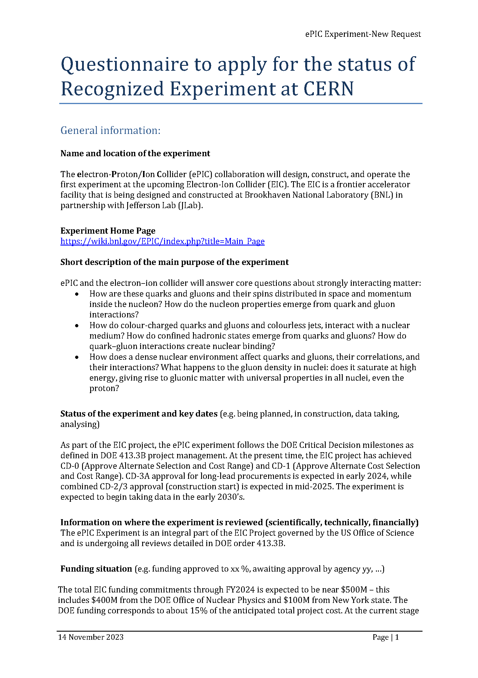
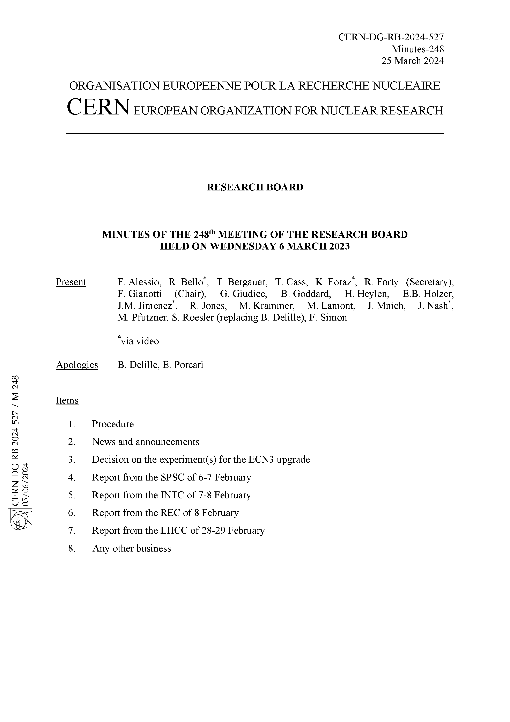
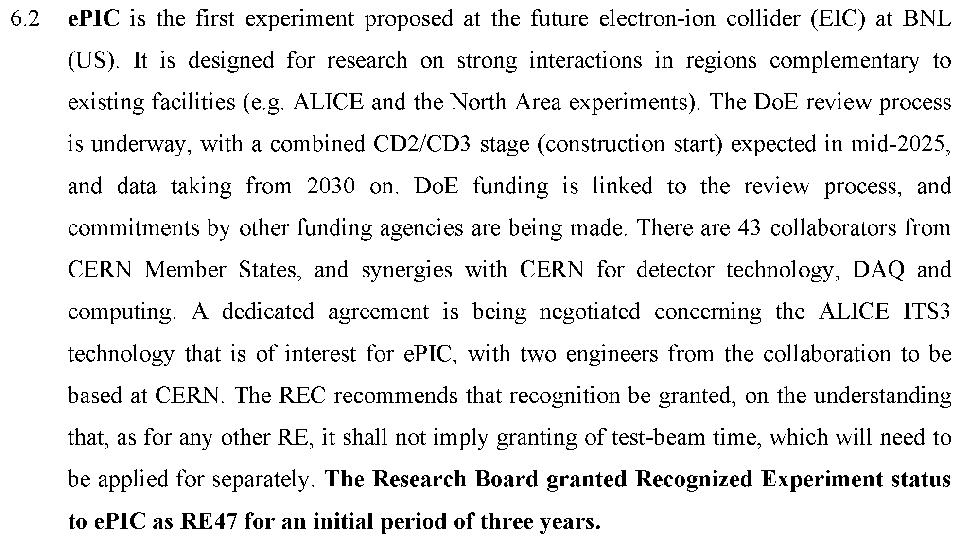
CERN Recognized Experiment
Progress on Recognized Experiment status:
8/23 email from Helge Meinhard:
Followed up with Zoom call 9/3
Received a draft of the MOU 10/4 – need to review and provide a collab list with countries and cities for each institution.
“I'm pleased to report that the administrative hurdles are out of the way,
I'll reach out to all experiments REC considered earlier this year.”

Slide 17
Summary
ePIC is making great progress on our 2024 goals!
Next General Meeting – Friday, Nov. 1st, 10:30AM ET
No GM on Oct 17th
Next Collaboration Council Meeting – Friday, Nov. 8th, 10:30AM ET

Slide 19
DRAFT Jan. 2025 Collab. Meeting Plan
Monday
Jan. 20th
Tuesday
Jan. 21st
Wednesday
Jan. 22nd
Thursday
Jan. 23rd
Friday
Jan. 24th
Plenary 1
Parallel/ Workfest 1
Early Science
Parallel/ Workfest 3
Parallel/ Workfest 4
Morning
Plenary 2
Parallel/ Workfest 2
Excursion
Collaboration Council
Plenary 3
(incl. self-proposed)
Afternoon
NOTE: Parallel/Workfest summaries will not be part of Plenary 3, but instead will be delivered as a Zoom session the following week.
Call for workfest proposals will be sent out ASAP (I mean it this time).

Slide 20
ePIC Resources
Public Website - https://www.bnl.gov/eic/epic.php
Mailing Lists – https://lists.bnl.gov/mailman/listinfo
Indico Agenda - https://indico.bnl.gov/category/402/
ePIC Software and Computing: https://indico.bnl.gov/category/435/
Wiki - https://wiki.bnl.gov/EPIC
ePIC Software Training:
Landing Page: https://eic.github.io/documentation/landingpage.html
Tutorials: https://eic.github.io/documentation/tutorials.html
Mattermost: https://chat.epic-eic.org
ePIC Zenodo Community: https://zenodo.org/communities/epic

Slide 21
EICUG Membership
The EICUG is a vital organization to promote the interests of the EIC community!
Without the EICUG we would never have gotten far enough to form ePIC!
Please register your institution!
Check with your EICUG IB representative to get registered as a member
https://www.eicug.org/content/join.html

