Slide 1
EIC Project News
E.C. Aschenauer (BNL), R. Ent (JLab)
Co-Associate Directors for the EIC Experimental Program
ePIC Bi-Weekly
November 1st, 2024
Completed

Slide 2
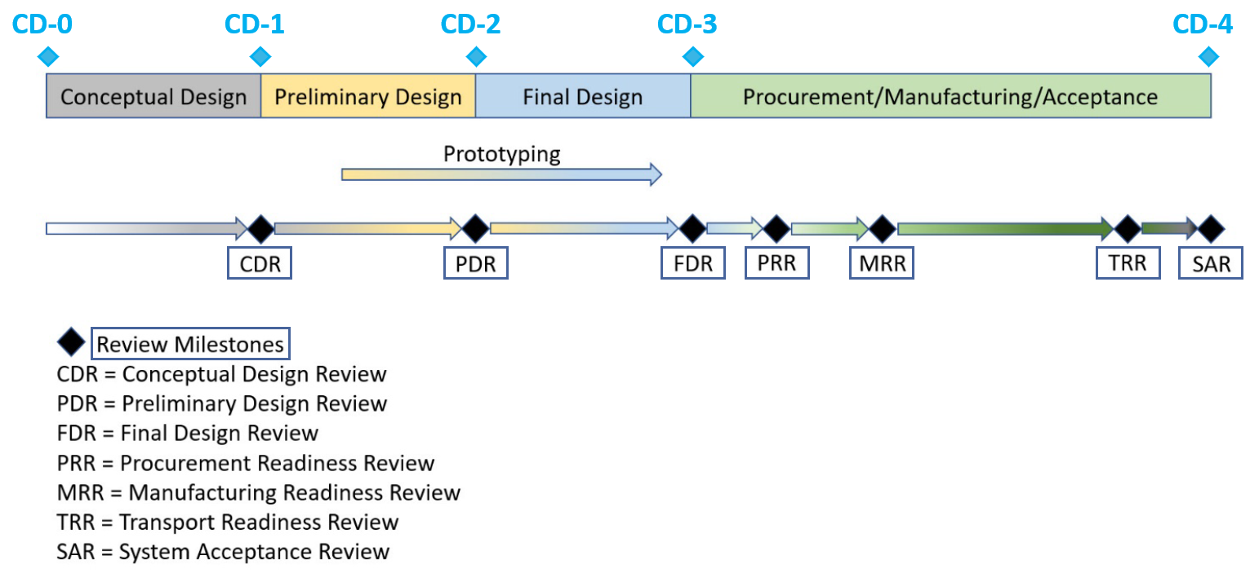
On we go: ePIC Detector Path to CD-3B and to CD-2/3C
Detector Design Reviews (organized by the EIC Project):
PDR2: IR Integration and Auxiliary Detectors – February 12, 2024 – main emphasis on baseline choices and progress
PDR1: Tracking Detectors – 20-21 March 2024 – main emphasis on baseline tracking layout, if we are on track and plans
PDR2: Electronics/DAQ – June 10 -11, 2024 – continuation of PDR1 to ensure we are on track and show progress
PDR: Integration, Infrastructure and Installation – July 15, 2024 – barrel and endcaps flux return steel
PDR2: Barrel EM Cal – September 19th – emphasis on mechanical design & AstroPix readiness
PDR2: Particle Identification Detectors – Winter 2024/25 (late January or February 2025 for pfRICH/hpDIRC/dRICH, TOF later)
FDR: Backward & Forward EM Calorimetry, Barrel & Forward HCAL – Winter 2024 (late January or February 2025)
PDR2: Polarimetry – timescale TBD (but before CD-2)
FDR for any potential CD-3B scope:
Magnet Power Supply – May 28th 2024
VTRx+/lpGBT add ½ day to electronics/DAQ PDR2 on June 11th 2024
Magnet Steel October 16th 2024
BNL Off-Project Dependency review Experimental Program August 22-23, 2024
Detector Advisory Committee Meetings 2024/2025:
June 21, 2024: 8th DAC meeting - strategic advice on the planning
for the construction phase of the ePIC detector
August 28-29, 2024: 9th DAC meeting - Annual advice on detector R&D status and FY25 completion needs
Spring 2025: 10th DAC meeting - Comprehensive look of DAC to design status and readiness for CD-2.
Software & Computing Reviews (organized by the host labs):
ePIC Detector Software Infrastructure Review https://indico.bnl.gov/event/16676/ – August 22-23, 2022
ePIC Software & Computing review by host labs https://indico.bnl.gov/event/20481/ – October 19-20, 2023
ePIC Software & Computing review (by host labs) – September 26-27, 2024

Slide 3
9th Detector Advisory Committee meeting follow-up completed
What is the status?
We have converged with the EIC Management Team on available EIC “Other Project Costs” detector R&D funding for FY25
we plan to fund (as much as we can) eRD102, eRD108, eRD109 (v2), eRD110, eRD113 (v2)
We plan to fund eRD112 (v2) from PED funding in FY25. this was checked with the eRD112 contact person(s)
We have received permission from the EIC Management Team to recolor OPC funds we did not get to implement the detector R&D plan (due to the late FY22 start) as PED in FY25 and FY26
These affect chip-related engineering runs
We plan to fund (as much as we can) areas from the eRD109 (ASICs), eRD112 (AC-LGAD) and eRD113 (SVT) that were included in the v1 eRD1xx submissions.
Some move to FY26 given FY25 PED funding availability, but at first glimpse this can work.
We have completed the budget planning (including what comes through BNL and what through JLab, roughly 50/50) and have started on the contracts.
For all eRD activities the main contact persons have been contacted, with guidance on what is in the R&D assumption and the rough plans for what transitions to PED. [Complication: Continuing Resolution]
Please work on providing the procurement documentation input for BNL and JLab.

Slide 4
Final Design Review of the Mechanical Design for the Endcaps of ePIC (“FDR”) – Charge
We are ready to proceed with the Final Design Review of the mechanical design for the endcaps of ePIC. The main purpose of this Final Design Review is to assess the construction readiness to procure the magnet steel that serves as flux return for the magnet, in order to initiate their Long Lead Procurement.
FDR for our last new CD-3B item. The steel is such that we can full-field test and accept the magnet.
For this Final Design Review, you are asked to address the following questions:
Are the technical performance requirements and subsystem interfaces for the mechanical structures of the endcaps complete and documented?
Do the design and specifications meet the performance requirements with a low risk of cost increases, schedule delays, and technical problems?
Are the fabrication and assembly plans consistent with the overall project and detector schedule?
Are the plans for integration in the overall BNL infrastructure appropriately developed to initiate the endcap magnet steel procurement?
Have previous review recommendations been adequately addressed to initiate the procurement?
Have ES&H and QA considerations been adequately incorporated in the design and procurement planning?
Is the procurement approach sound and the procurement schedule credible?
Please address these questions point-by-point.

Slide 5
Final Design Review of the Mechanical Design for the Endcaps of ePIC
Executive Summary
It is obvious that a large quantity of quality work has been accomplished since the previous review in July. Professional and detailed presentations were given. Overall, it appears the project is in good shape to proceed with End Cap procurements after the Procurement Readiness Review (PRR) that will be held in 2025.
Reponses to Charge Questions
Charge Question #1:
Are the technical performance requirements and subsystem interfaces for the mechanical structures of the endcaps complete and documented?
Response: Yes, but the documents still need to be finalized and signed off. Work has been done to determine the interfaces with the accelerator components (flanges, magnets, beamline components, etc…) but it would be advantageous to formalize an Interface Control Document (ICD) to eliminate any misunderstandings.
Charge Question #2
Do the design and specifications meet the performance requirements with a low risk of cost increases, schedule delays, and technical problems?
Response: Yes, but prior to the PRR all drawings and specifications need final sign off and formal release for fabrication.
Charge Question #3
Are the fabrication and assembly plans consistent with the overall project and detector schedule?
Response: Yes, plans and schedules appear reasonable. With dependencies on other groups for a successful and timely installation, close coordination with all groups outside the detector (ie Survey and Alignment) should be coordinated ahead of time.

Slide 6
Final Design Review of the Mechanical Design for the Endcaps of ePIC
Reponses to Charge Questions
Charge Question #4
Are the plans for integration in the overall BNL infrastructure appropriately developed to initiate the endcap magnet steel procurement?
Response: Yes, any modifications needed for the floor to support the detector should not affect the steel procurement significantly. The infrastructure SOW should be finalized and include all loading considerations. Other known interfaces have been considered in the design.
Charge Question #5
Have previous review recommendations been adequately addressed to initiate the procurement?
Response: Yes. Requests for budgetary quotes have been placed for both endcaps based on the current drawings and at least one estimate has been received. 4 more are expected soon. If others are not received, a bottoms-up estimate may be needed. Requirements documents have been produced but still need to be signed off and controlled. Partial deliveries are not needed for end caps to meet the current installation schedule.
Charge Question #6
Have ES&H and QA considerations been adequately incorporated in the design and procurement planning?
Response: Yes, ES&H and QA are now included in regular meetings.
Charge Question #7
Is the procurement approach of the EIC project sound and will result in a credible procurement schedule?
Response: Yes for End Cap components. A lump sum fixed price contract based on build to print (SOW and drawings) is straight forward.

Slide 7
Final Design Review of the Mechanical Design for the Endcaps of ePIC
Comments
12 of them, mainly good advice to fold in, on shims, loads, assembly, adding drilled & tapped holes, …
Recommendations
In order to reduce the possibility of interference with components outside the detector area, an ICD with the EIC Accelerator group needs to be developed. It should be signed off by all affected parties and treated as a controlled document.
All drawings, specifications and SOWs should be signed and released prior to the PRR.
Conclusion
Overall, it appears the project will be in good shape to proceed with End Cap procurements after the PRR which will be held in 2025.

Slide 8
Directors Review Timeline
Completed

Slide 9
Directors Review October 22-24, 2024

Slide 10
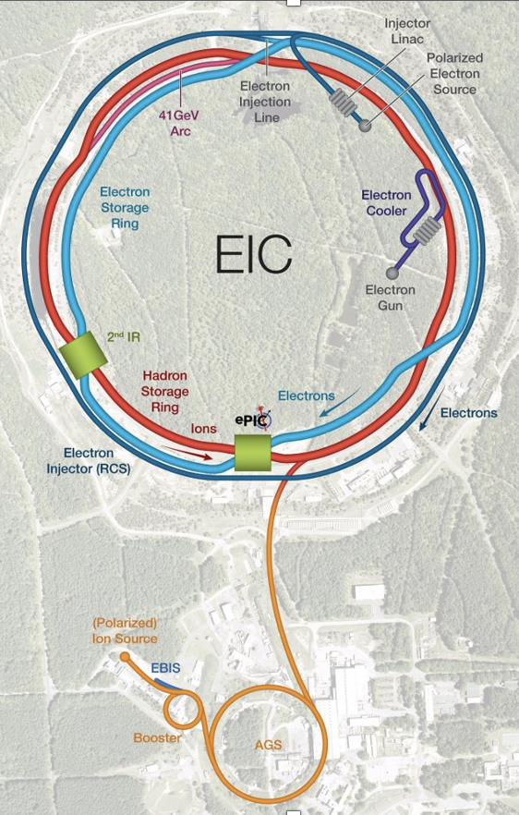
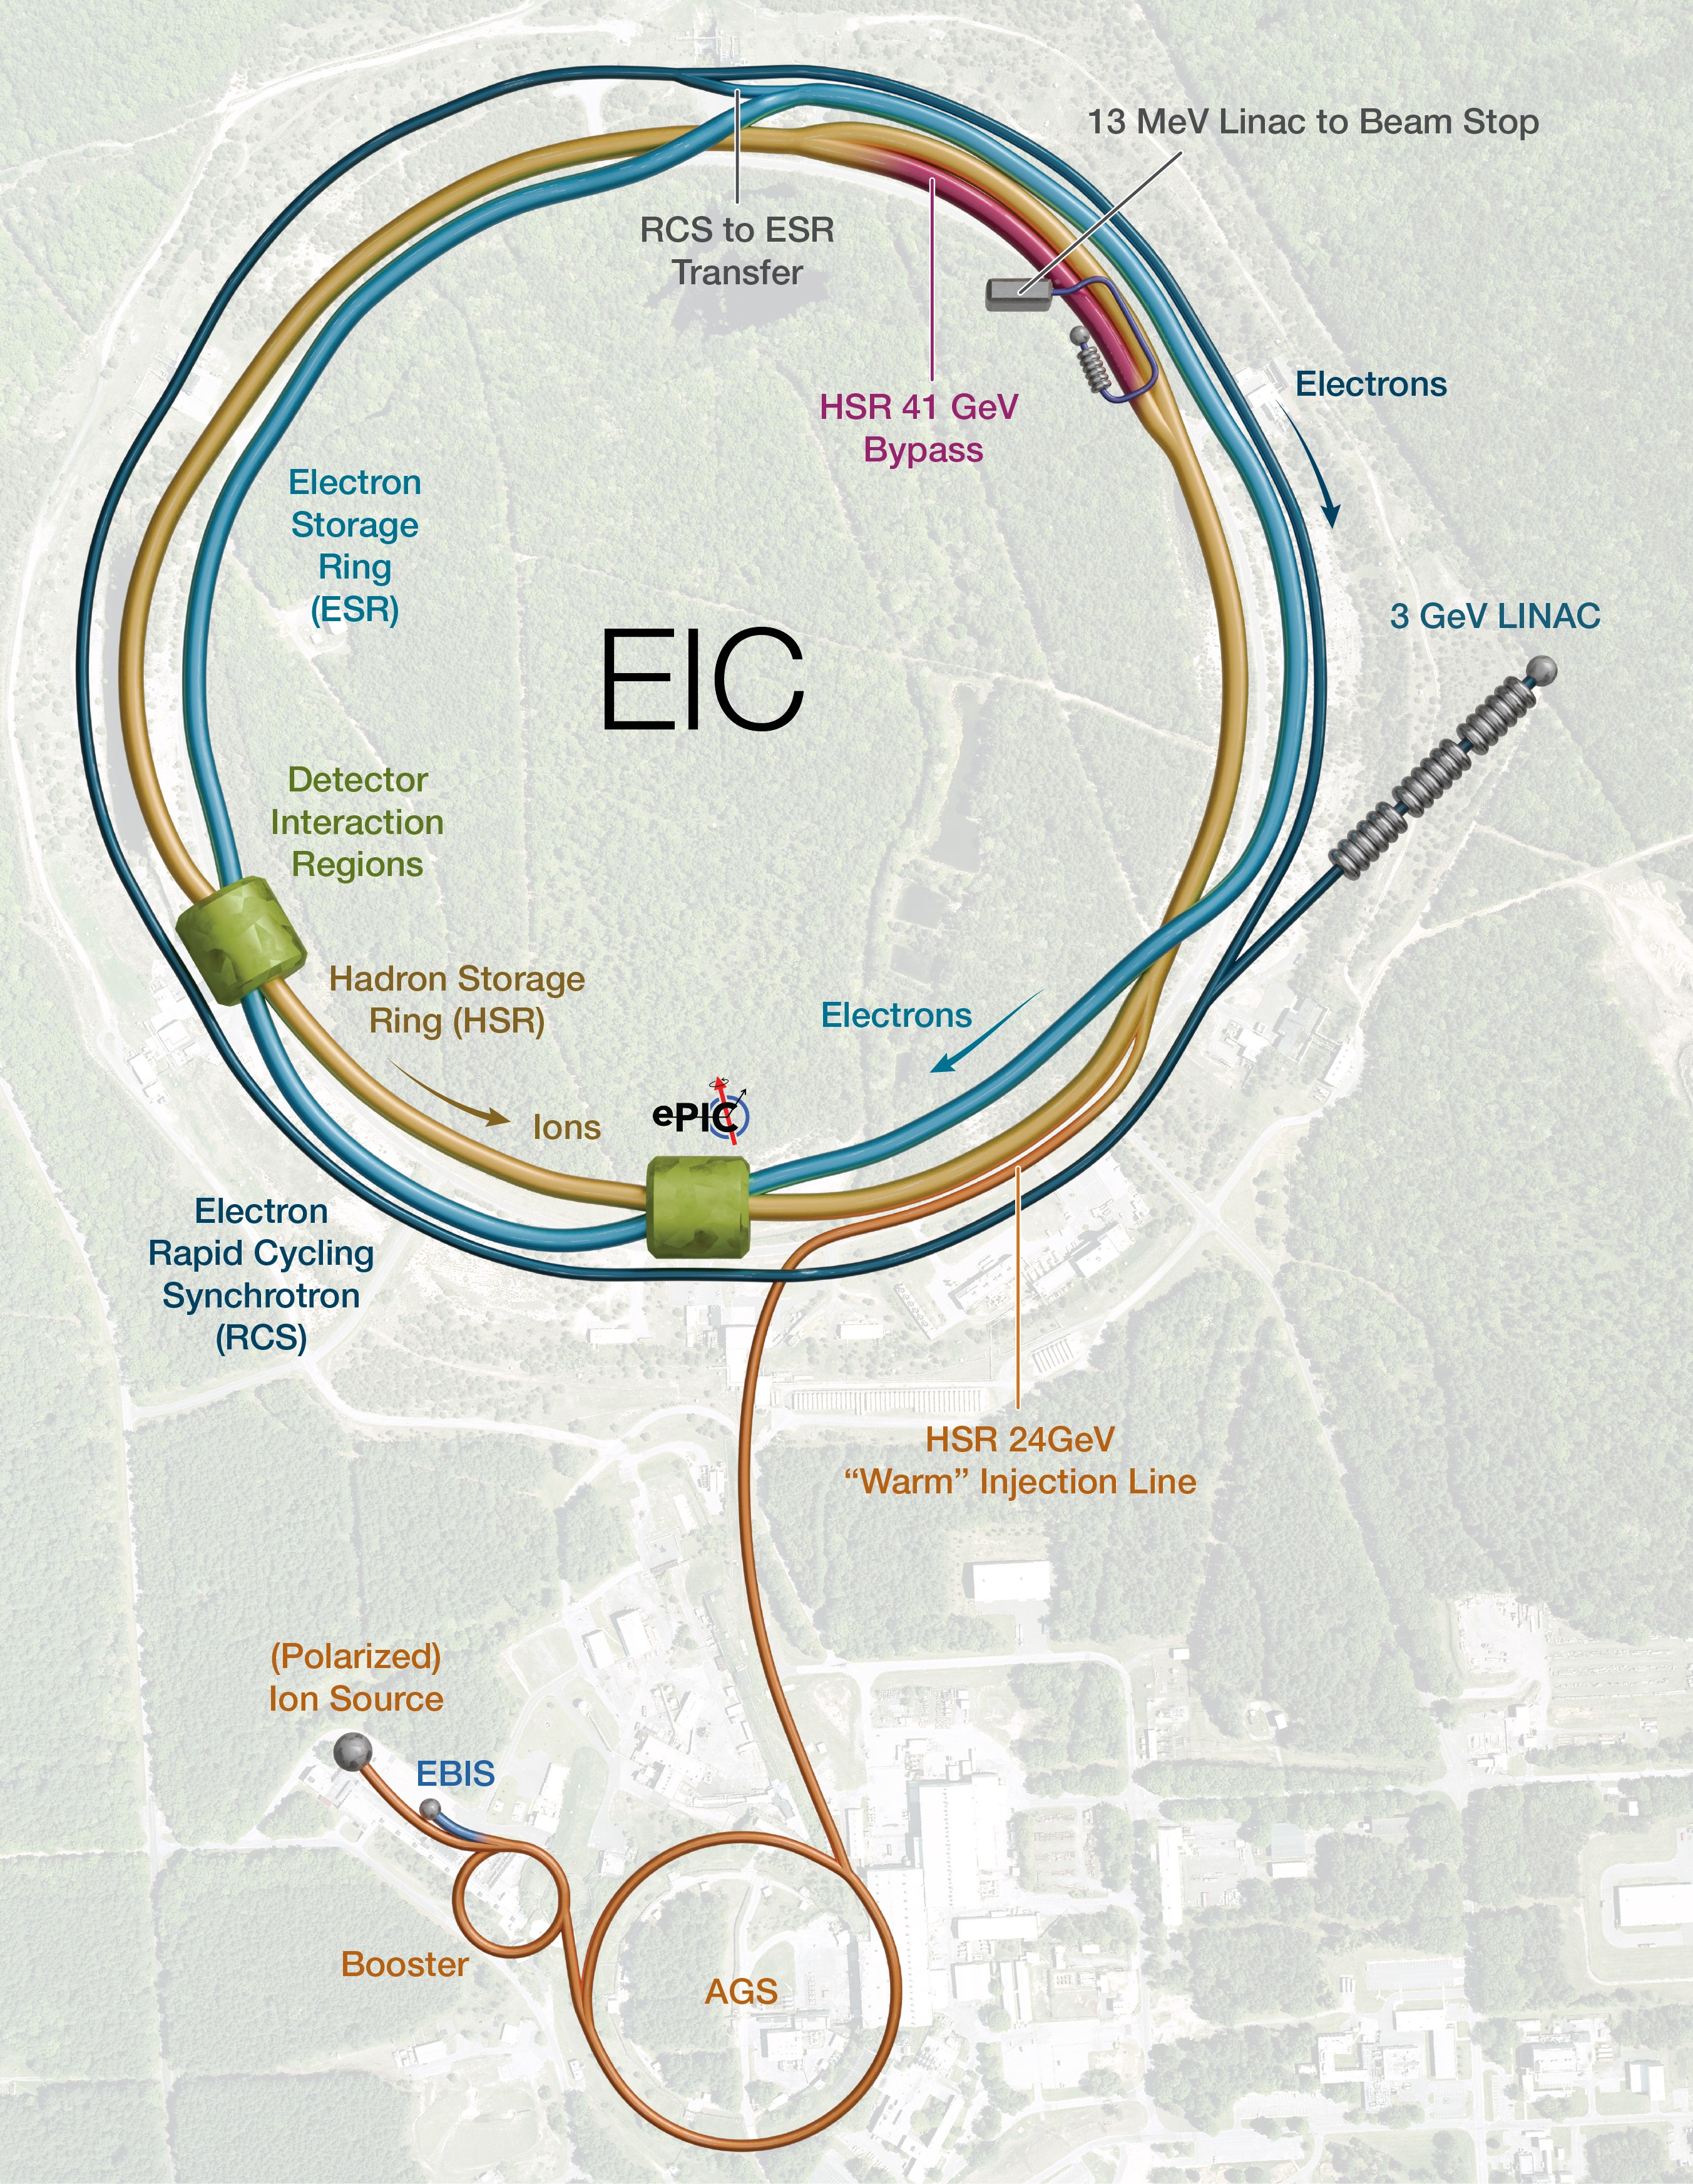
Scope
The Scope of the Project includes:
Hadron Storage Ring (HSR)
to be built by maximizing re-use of RHIC hadron rings components.
Electron Rapid Cycling Synchrotron (RCS).
Electron Storage Ring (ESR).
High luminosity Interaction Region (IR).
One Detector and its equipment.
Infrastructure systems necessary to enable installation and operation of the particle accelerator, storage rings, and target instruments.
Evolution in the Accelerator Layout
Accelerator
Detector
Infrastructure

Slide 11
Directors Review Committee
 | Mark Reichanadter, Co-Chairperson, Retired SLAC
 | Patricia McBride, Co-Chairperson, FNAL
 | SC1 |  | SC2 |  | SC3 |  | SC4
 | Injectors |  | Collider |  | Global Accelerator Systems |  | Detector Systems
 | (WBS 6.03, Hadron Injectors ) |  | (WBS 6.02, 6.04, 6.05, 6.06 ) |  | (WBS 6.07, 6.08 & 6.09 ) |  | (WBS 6.10)
* | Timur Shaftan, BNL | * | Alexander Valishev, FNAL | * | Sang-Ho Kim, ORNL | * | Gabriella, Carini, BNL
 | Kathy Harkay, ANL |  | Wolfram Fischer, BNL |  | Joe Delong, SLAC |  | Anna Macchiolo, CMS/Zurich
 | Eliana Gianfelice-Wendt, FNAL |  | Steve Gourlay, FNAL |  | Eric Fauve, SLAC |  | Tim Whitlach, JLAB
 | James Safranek, SLAC |  | Georg Hoffstaetter, Cornell |  | Mike Kelly, ANL
 | John Schmerge, SLAC |  | John Seeman, SLAC |  | Mathew Howell, ORNL
 |  |  |  |  | Jerry Leibfritz, FNAL
 |  |  |  |  | Slava Yakovlev, FNAL
 | SC5 |  | SC6 |  | SC7
 | Infrastructure |  | Cost and Schedule |  | Project Management
 | (WBS 6.11) |  |  |  | (WBS 6.01, 6.12, Off-Project)
* | Marty Fallier, BNL (ret) | * | Kathy Bailey, ORNL | * | Jennifer Fortner, BNL
 | Steve Dixon, FNAL |  | Jared Spradling, ORNL |  | Mario Cubillo, BNL
 | Canon Cheung, SLAC |  | Lorri Stapleton, FNAL |  | Paul Derwent, FNAL
 | Keith Orr, LANL |  | Kathryn Southworth, ORNL |  | Diane Hatton, BNL (ret)
 |  |  |  |  | Crystal Schrof, ORNL (ret)

Slide 12
Directors Review High-Level Summary
In the wording of someone else:
A message from Jim Fast, EIC Deputy Associate Project Manager
The project held a CD-3B and Annual Status Director’s Review at BNL October 22-24.
The review team endorsed the CD-3B package but felt that the effort towards CD-2 would likely not converge to accommodate as CD-2 approval in Q2FY26. The project received 31 recommendations and a large number of comments – many reflecting the challenges to get to CD-2 from making technical decisions about the electron injector complex to developing plans for sub-projects and finally to developing the detailed project documentation for the baseline at CD-2.
Note from Elke & Rolf: for detector itself we do not change our planning, we always had assumed a CD-2/CD-3C and a year later a CD-3 – all our/ePIC work aims at CD-3/start of construction.

Slide 13
SC4 – Detector Systems
Findings
The detector project has significant (and growing) international contributions.
Critical agreements are not still in place (e.g., with CERN).
The solenoid is planned as an in-kind contribution. The formal agreement is being prepared.
Design changes in the machine may impact the detector design and associated infrastructure.
DIRC bars from BaBar are being re-purposed. A backup plan exists.
Integration, installation, and infrastructure (III) 3D models are maintained and controlled by the project team.
The detector team is using 60% maturity for PDRs (expected for CD2 too). The project appears to be using 70%.

Slide 14
SC4 – Detector Systems
Comments
The sub-committee appreciated the effort the team put in preparation of the review. The project seems to advance well.
Talks were very informative and clearly mapped to the charge questions. Their length and breadth could be optimized to focus strictly on the review questions.
The project is complex. It would be beneficial to provide opportunities for the reviewers to be more informed about the detector before the actual review meetings (e.g., pre-review walkthroughs of the material provided).
The detector scope is large and requires tight coordination and control by the leading team. The team is doing a great job, and we encourage the project to ensure they have adequate and continuous support.
The detector relies on a significant fraction of in-kind contributions. It is good for the project but carries complexity and risks. A clear line of responsibility should be maintained.
International contracting, enforcing deliverables, possible conflicting priorities, ASME, etc.
Similarly, the detector depends on off-project deliverables. This also adds complexity and risks.

Slide 15
SC4 – Detector Systems
Comments
Integration and interfaces with the collider, which is in-process of changing design, may have impact of the detector baseline.
The detector project complexity is increased because the RCS beamline is adjacent to the solenoid magnet of the detector. This requires additional flux return steel to the magnet which in turn increases the weight significantly. This does necessitate reevaluation of the floor structure. A change in the RCS beamline may alleviate cost and schedule. Finalizing this (and all relevant elements) early is important.
Breaking of the project in sub-projects may impact seamless integration and interface with detector components and introduces additional risks.
None of the major findings impacts CD-3A/B. Procurements for CD-3A is progressing well and the need for CD-3B items was well justified.
Changes (collider design and sub-projects) may impact readiness for CD-2. The detector team is engaged and aware of risks and challenges.

Slide 16
SC4 – Detector Systems
Comments
Simulations were added upon request. They provided more confidence regarding the performance of the detector. It would be beneficial having an extended report capturing the full (global) performance of the detector available before CD-2 (e.g., in the TDR).
New, very large area silicon detectors carry risks (e.g., Astropix) associated with scalability and availability of technology.
A plan for bake-out of the beampipe was presented with no obvious show-stopper. Further optimization is being pursued and additional testing is beneficial.
Expertise and personnel in control of specific critical steps (e.g., chip design verification) is critical and often a limiting factor and has to be taken into account in the schedule.
Dependence on possibly ‘oversubscribed’ laboratories for board production of the MPGDs (e.g., CERN) is a risk. It may be mitigated with early procurement.
New avenues to manufacture AC-LGAD may require several iterations and backup options should remain open.
Given the balance of NRECs versus wafers costs, additional procurement of ASIC wafers and fabrications (iterations) is encouraged.
Steel for the endcap are based on one estimate. A second estimate was significantly higher. Additional evaluations of the cost, after further estimates come in, may be needed.
Results of the first engineering test article of HRPPDs are promising. A second engineering run is encouraged to mitigate risk.

Slide 17
SC4 – Detector Systems
Recommendations
Ensure timely and proper finalization of agreements and in-kind contributions.
For labs management: provide continued support for contracts and agreements ​
Complete programs that were developed to retire risks (e.g., research, project engineering development).
Contracts should be put in place expeditiously to ensure completion
Evaluation of prototype chips, testing full-chain systems, thermo-mechanical validation are necessary to proceed with the project
Formalize control and management structure to capture interfaces with accelerator design changes and other sub-system by CD-2.

Slide 18
SC4 – Detector Systems
Response to Assigned Charge Questions
Is the project team effectively executing the current work, including the CD-3A performance baseline, and are technical issues bring proactively addressed? Yes. CD-3A contracts are being placed. No show-stopper expected.
Are R&D and design efforts mitigating technical risks, particularly in strong hadron cooling? Mostly. The R&D programs were adequately used to mitigate risks for several detector components. In a few areas technical risks are still present.
Are proposed CD-3B long-lead procurements appropriate, and do they support project risk mitigation? Have the proposed CD-3B long-lead procurements completed final designs? Are estimates for proposed CD-3B long-lead procurements appropriate? Can these procurements be tracked properly? Yes. Completion of supporting documents is on track for OPA review.
Is the project making adequate progress in developing the performance baseline? Is the project scope defined well and logically? Are the schedule and cost estimates credible? Do plans include adequate scope, schedule, and cost contingency? Yes. Schedule contingency seems good.
Is the project being properly managed? Are risks being effectively managed? Is a management team in place to successfully execute the project including the CD-3A scope, the proposed CD-3B scope, and the preparation of the CD-2 performance baseline? Are roles and responsibilities documented and understood? Yes. The management of the detectors relies on maintaining a complex balance with the ePIC collaboration.
Has the project satisfactorily addressed recommendations from previous DOE SC reviews? Mostly. Some are not yet closed as they are related to CD-2.
Is the project ready for CD-3B approval? Yes, but they still need to have final sign-off on drawings and specifications.

Slide 19
Upcoming Resource Review Board meeting
November 12+13 @ BNL (note: all RRB info is online)
Confirmed attendance: DOE/NP, NSF, Canada, Czech, France/CEA & France/IN2P3, Italy/INFN, Japan, Korea, Taiwan, UK/SFC
Agenda pretty general nowadays:
Session with Welcome, Goals, Advisory Board reports
EIC Project session
ePIC session (spokesperson, TC, CC)
Action Items followup:
Host labs and User Expectations
International Computing Model and Governance – WG Report
Common Funds – WG Report
Global Strategy – WG Report
Comments by Members & Observers
Preparation for the next RRB meeting (Spring 2025)

Slide 21
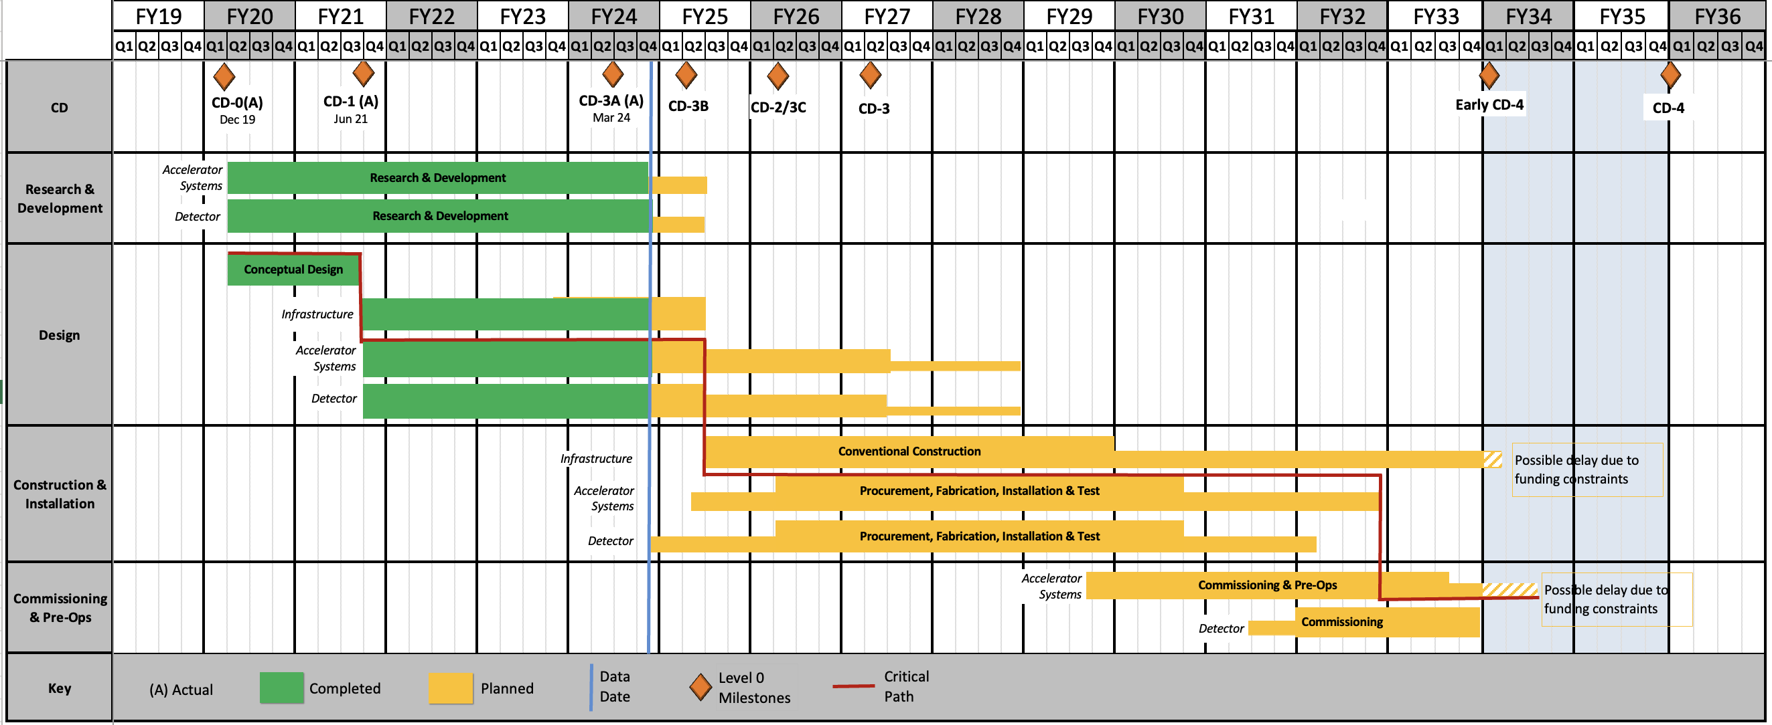
Schedule
Under finalization for CD-2; Mostly Technically Driven after FY2027.
Project phases/sub-projects will allow to start the science program @ Early CD-4
RHIC Operations is planned for the end of CY2025
Since CD-1, the critical path is on the Accelerator systems.

Slide 22
Funding History Post CD-1
CD-1 Approval Jun-2021 (IPR Jan-21): Cost Range $1.7B-$2.8B
FY2021
Project Request $43M
Actual $30M
FY2022
Project Request $100M
Actual $44.8M - Ramp-up slowed due to funding constraints
Inflation Reduction Act (IRA) $138.24M - Sept-2022
FY2023
Project Request $90M
Actual $70M
FY2024
Project Request $181M
Actual $98M
FY2025
Project Request $150M (minimum) – $219M (maximum)
President’ Budget Request $113M, House Mark $128M, and Senate Mark $138M.

