Slide 1
ePIC Collaboration News
J. Lajoie, S. Dalla Torre
November 1, 2024

Slide 2
Hey John, start the recording….

Slide 3
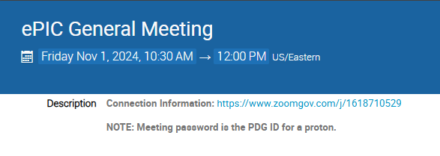
New Zoom Link
The Zoom link for the General Meeting now requires a password
We decided to do this after a TIC meeting was Zoom-bombed
All our Indico pages are public, so this offers another hurdle for a would-be bomber (not a guarantee)
Old link had password embedded to allow one-click access
Hopefully this is not overly cumbersome for our collaborators

Slide 4
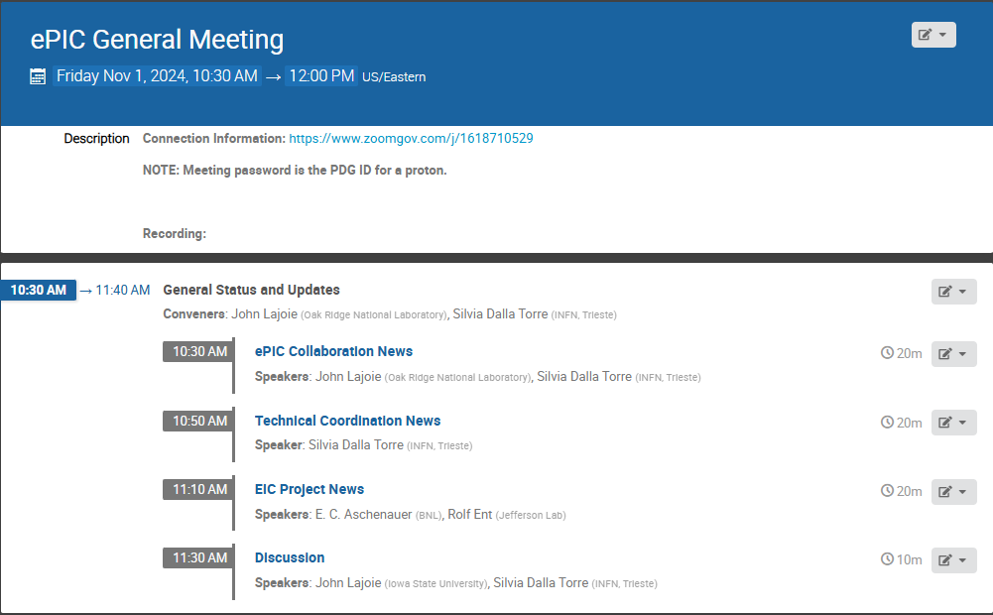
Agenda
The “standard” agenda – but lots of things to talk about since it has been a while since we last met!

Slide 5
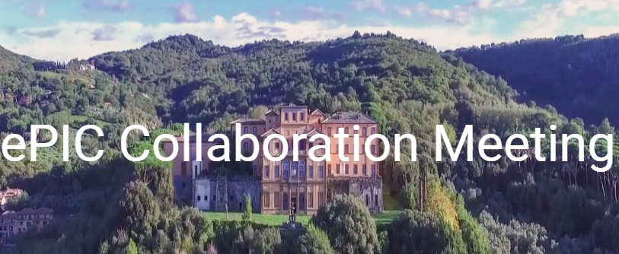
News from the SP Office
ePIC draft pre-TDR Version 1 December 1, 2024
EIC Strategy Mtg August 21st
ePIC Early Physics Workshop Sept. 13, 2024
FDR: Magnet Flux Return Steel
(poss. CD-3B scope) October 16, 2024
(see Project News talk by Elke/Rolf)
Detector Advisory Committee R&D Meeting
August 28-28th
ePIC Software and Computing Review Sept. 26-27th
Lehigh Collab. Mtg. July 2024
Frascati, Jan 20-24,2025
PDR2: Barrel EMCal
September 19th
ePIC draft pre-TDR Version 0.1 Sept. 30, 2024
Directors Review for CD-3B/Status Review
October 22-24
EIC Project CD-3B/Status Review January 7-9th, 2025
EIC “Host” Lab User Experience Workshop
August 26th

Slide 6
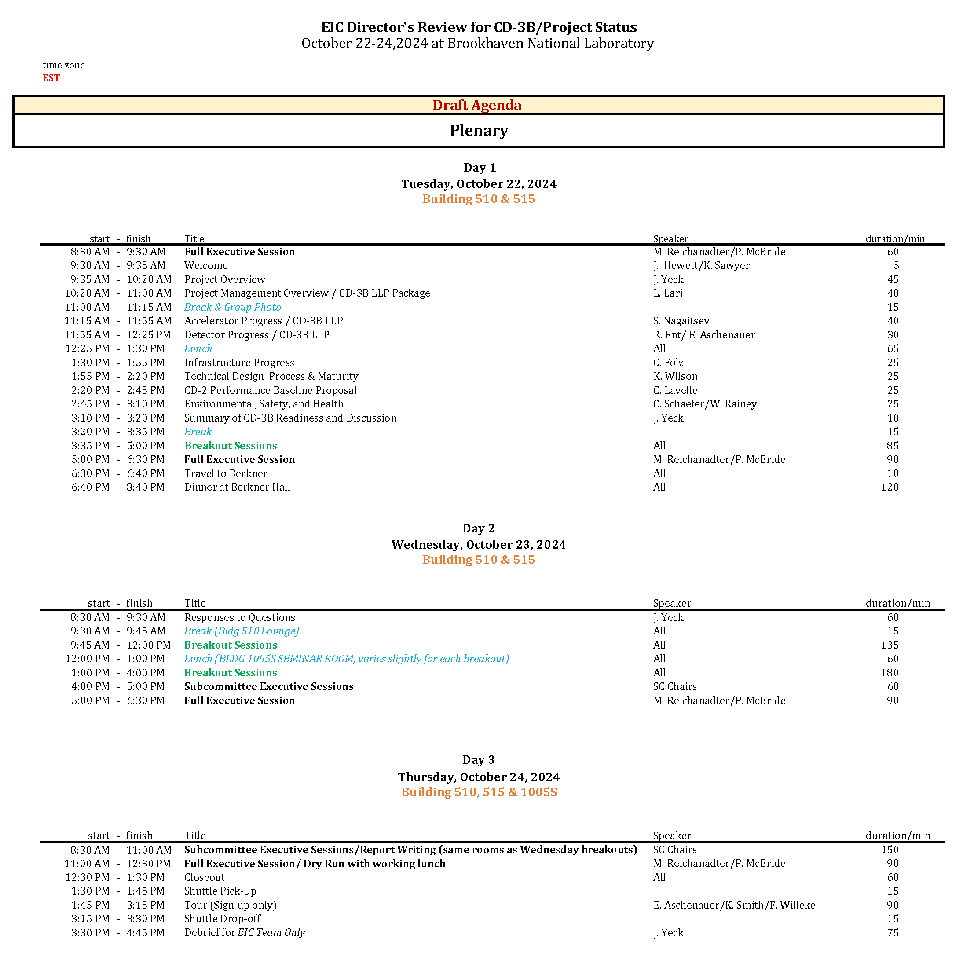
Comment on the CD-3B Director’s Review
The review was a huge effort by the Project CAMs and Collaboration DSL/DSTC’s.
And Elke and Rolf!!
The presentations were well-organized and very effectively communicated the enormous progress since the last review.
Congratulations everyone!
“The detector scope is large and requires tight coordination and control by the leading team. The team is doing a great job, and we encourage the project to ensure they have adequate and continuous support.”

Slide 7
preTDR Version 0.1! – On to Version 1.0!
Executing the plan from the Jan. 2024 Collaboration Meeting:
process design phase
structuring the
effort
draft ePIC pre-TDR
ePIC pre-TDR (CD-2)
writing
(TDR/notes)
Preparing papers for
publication
Mid Jan.24
Mid Mar.24
Early 2025
Version 0.1
Sept. 30, 2024
Version 1
Dec. 1, 2024
Silvia will say more in the TC News talk – the collaboration really stepped up for this first milestone in the TDR process!

Slide 8
Jan 2025 Collaboration Meeting
University of Rome Tor Vergata & INFN
January 20-24th, 2025
Via Frascati (Roman Hills)
https://agenda.infn.it/event/43344/
Registration is available now!
US National Lab folks – register early!

Slide 9
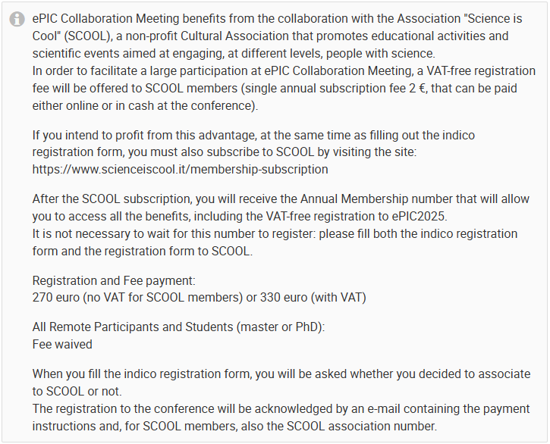
Death and Taxes
Associating your registration with SCOOL membership (2€) waives VAT taxes. (SCOOL is a non-profit entity.)
INFN and the University can’t accept money from individuals, so they need a partner. If they use a private company, they can avoid VAT but then pay 22% in fees…

Slide 10
January 2025 Collab. Meeting Plan
Monday
Jan. 20th
Tuesday
Jan. 21st
Wednesday
Jan. 22nd
Thursday
Jan. 23rd
Friday
Jan. 24th
Plenary 1
Parallel/ Workfest 1
Early Science
Parallel/ Workfest 3
Parallel/ Workfest 4
Morning
Plenary 2
Parallel/ Workfest 2
Excursion
Collaboration Council
Plenary 3
(incl. self-proposed)
Afternoon
NOTE: Parallel/Workfest summaries will not be part of Plenary 3, but instead will be delivered as a Zoom session the following weeks.

Slide 11
Workfests @ Jan 2025 Collaboration Meeting
Workfest solicitation sent to collaboration Oct 10th (due Oct. 31st)
Following previous practice, this is an open call for workest/parallel session proposals. We encourage people to work with the WG, CC WG and DSC leadership, and to develop proposals that encourage interactions and exchange between different groups – take advantage to the opportunity presented by having a large number of your colleagues present in-person! In developing the proposal, we suggest that focusing on a deliverable can create a theme and a focus that makes good use of the in-person opportunity. For example, a lot of progress can be made in a short time with a focus on a specific design issue like cooling, or a specific simulation or reconstruction issue.
In planning for a workfest/parallel session, consider the question "What goals will this workfest achieve that a regular working group virtual meeting cannot achieve?" It may be helpful to even consider a pre-collaboration meeting virtual prep meeting to make optimal use of the in-person time at the collaboration meeting.
Looking to focus on specific issues where we can make progress at the workfest.
Working to announce workfests shortly so people can make plans.

Slide 12
Looking Forward…
The Jan 2024 meeting at ANL established the goals and priorities for the collaboration for the coming year.
At the Summer 2024 meeting at Lehigh we took stock of where we were on the roadmap, made adjustments, and began the early science discussions.
The meeting in Frascati in Jan 2025 will come immediately after the EIC Project CD-3B review. We will again discuss the goals and priorities for the collaboration in the coming year.

Slide 13
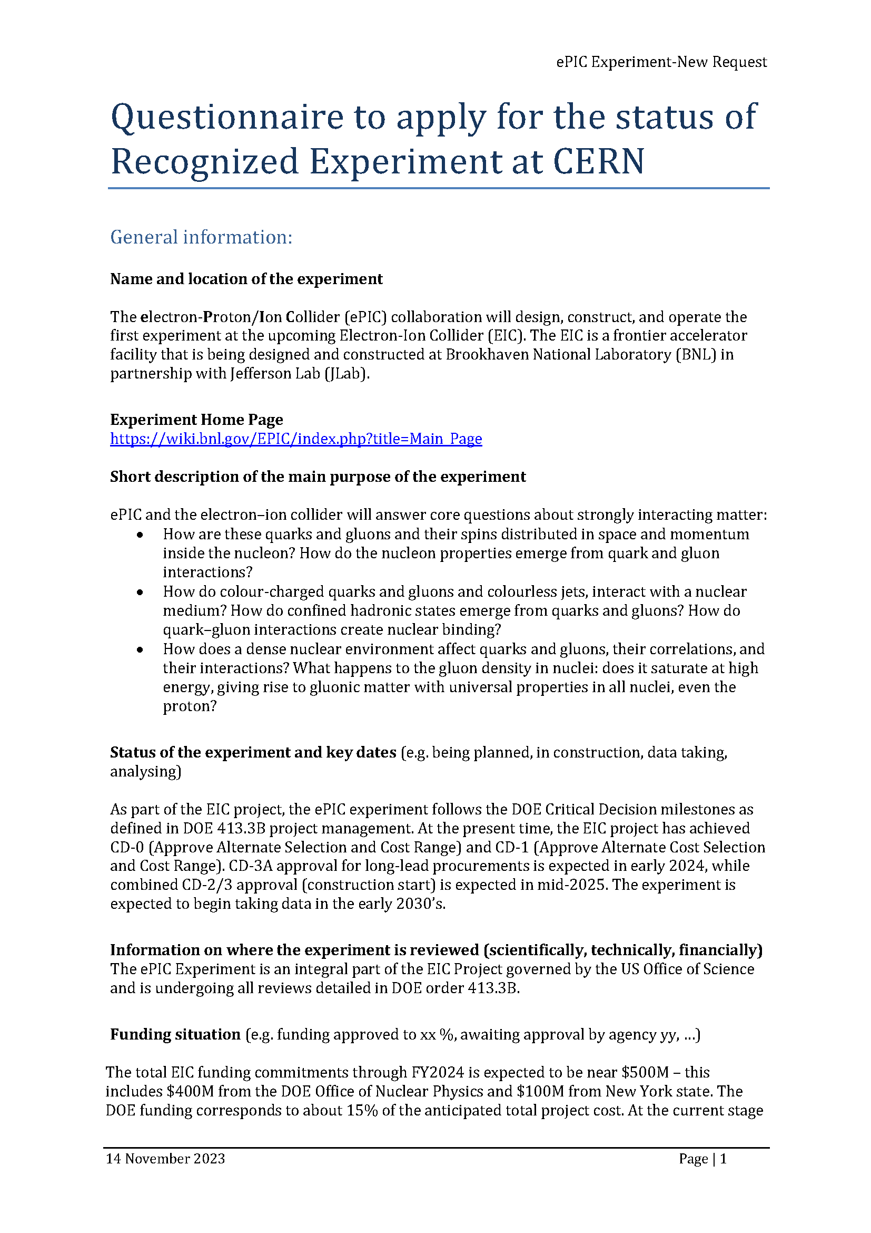
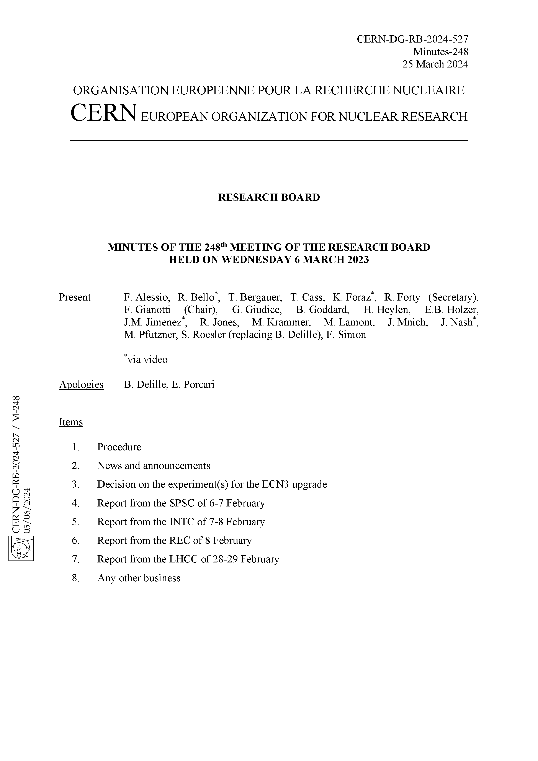
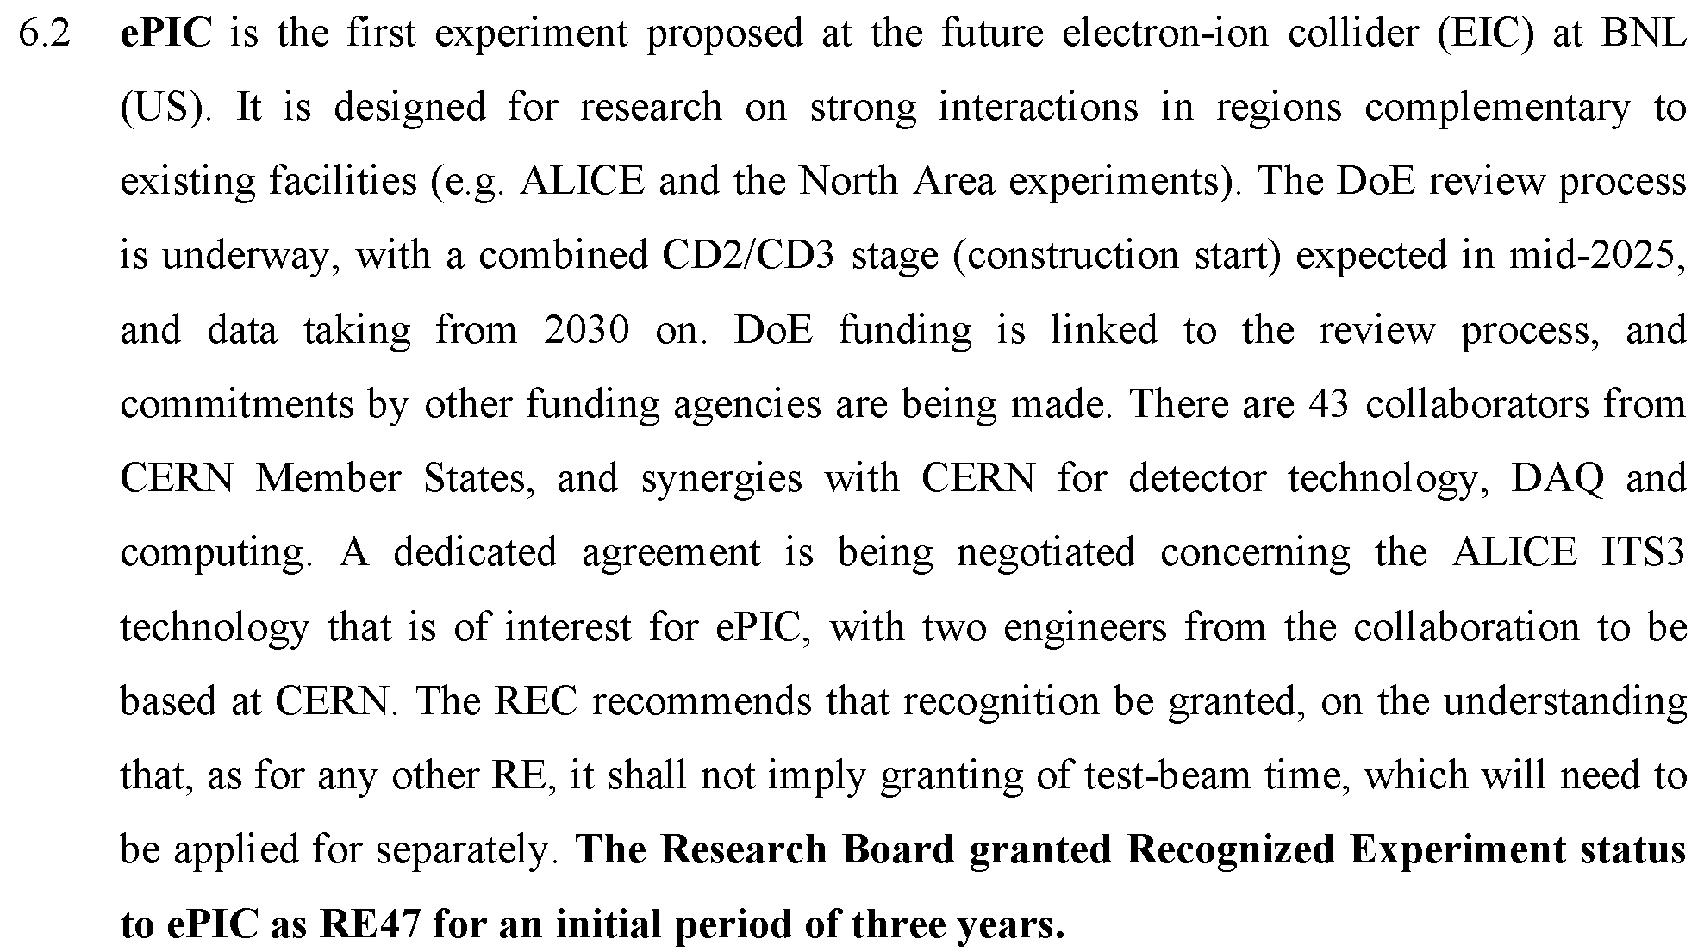
CERN Recognized Experiment
The CERN Recognized Experiment MOU is in the signature process (J. Mnich -> Silvia -> JGL)

Slide 14
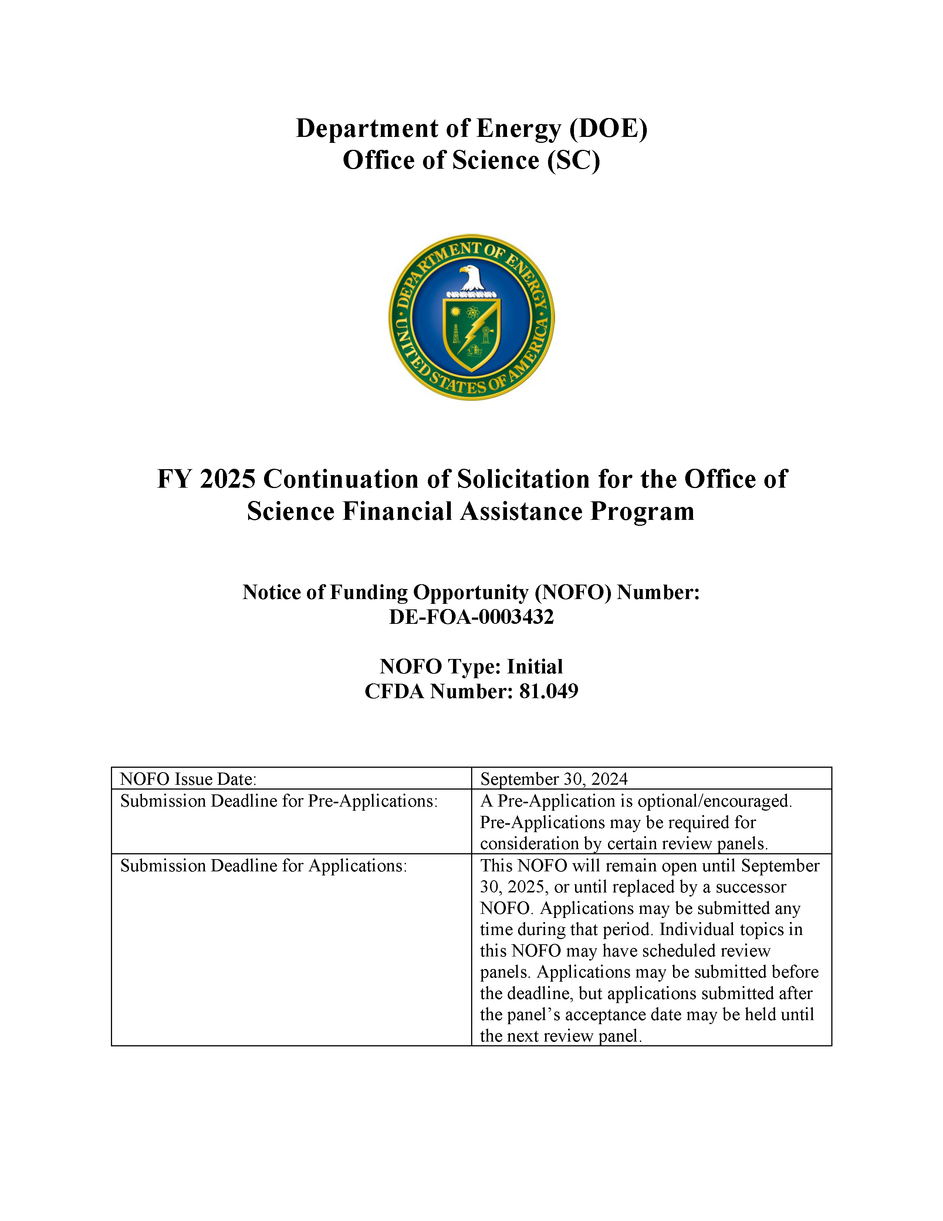
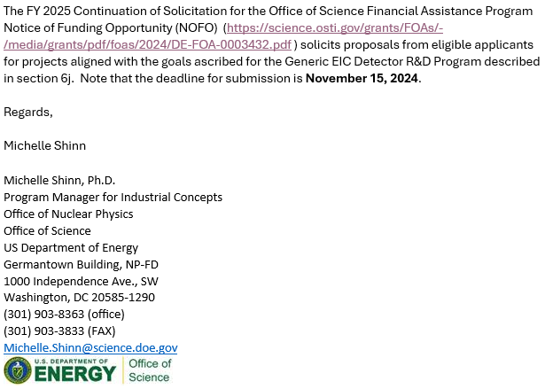
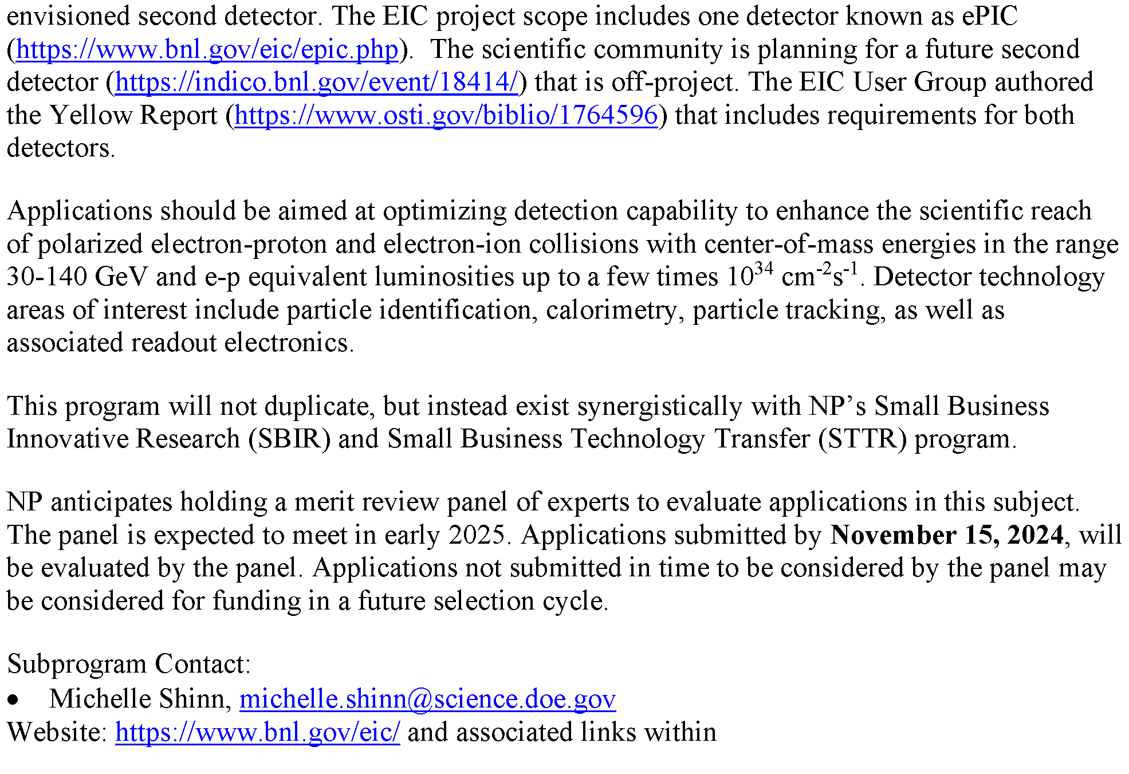
DOE FY25 NOFO – Generic EIC R&D
Q&A with Michelle Shinn at JLab-EIC meeting this morning!
Recording will be posted.
https://science.osti.gov/grants/FOAs/-/media/grants/pdf/foas/2024/DE-FOA-0003432.pdf

Slide 15
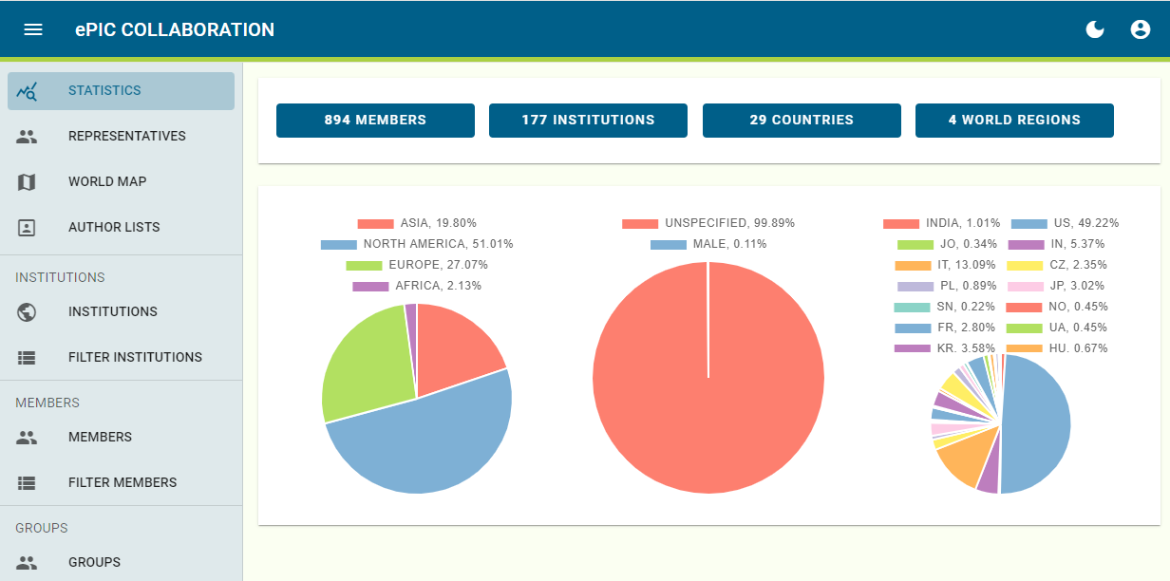
ePIC Phone Book is “live”
Currently available at epic-eic.org
Federated (InCommon Comanage) required to verify identity
Collaboration already familiar with InCommon Federation (Indico)
InCommon Comanage adds a layer that allows you to associate multiple identities
May not have seen much use in Indico yet since pages are public?
Institutions can be registered in eduGAIN.org (free), use CERN membership, or a BNL account.
Discussions have centered on what information should be public and what should be private.
e.g. gender identity, …
Need to set requirements for SDCC

Slide 16
Draft for Levels of Phone Book Access
PRINCIPLE: Define access levels, and allowed access at each level. Anything not explicitly allowed is not available.
Protects new information as it is added.
Draft access levels:
PUBLIC:
Ability to search for name and get email and institution, or search by email and get name and institution
Members can opt out of public access
Is public access necessary?
ePIC MEMBER:
An “ePIC member” is defined by being present and active in the ePIC Phone Book
Full ability to view name, email, institution, and WG/DSC affiliation of members
Can view membership by institution
ePIC CC MEMBER:
As ePIC Member, but can view all information for their individual members of their institution
ePIC MANAGEMENT:
Defined as SP and CC leadership (includes Committee Chairs, Coordinators)
Full access to view all member information
ADMIN:
Full read/write access to all information, individual and institution
Your feedback is needed!

Slide 17
What’s Next…
Communicate requirements to BNL SDCC
Collaboration 2025 membership survey
Update the collaboration database

Slide 18
Upcoming Collaboration Council Meeting
Friday, Nov. 8th @ 10:30AM
Status of policies
Opportunity to discuss membership survey/Q&A for CC members
https://indico.bnl.gov/event/24841/

Slide 19
Summary
Collaboration and Project are making great strides!
Next General Meeting – Thursday, Nov. 14th, 7:30PM ET
Next Collaboration Council Meeting – Friday, Nov. 8th, 10:30AM ET
EIC RRB Meeting Nov. 12-13th @ BNL

Slide 21
ePIC Resources
Public Website - https://www.bnl.gov/eic/epic.php
Mailing Lists – https://lists.bnl.gov/mailman/listinfo
Indico Agenda - https://indico.bnl.gov/category/402/
ePIC Software and Computing: https://indico.bnl.gov/category/435/
Wiki - https://wiki.bnl.gov/EPIC
ePIC Software Training:
Landing Page: https://eic.github.io/documentation/landingpage.html
Tutorials: https://eic.github.io/documentation/tutorials.html
Mattermost: https://chat.epic-eic.org
ePIC Zenodo Community: https://zenodo.org/communities/epic

Slide 22
EICUG Membership
The EICUG is a vital organization to promote the interests of the EIC community!
Without the EICUG we would never have gotten far enough to form ePIC!
Please register your institution!
Check with your EICUG IB representative to get registered as a member
https://www.eicug.org/content/join.html

Slide 23
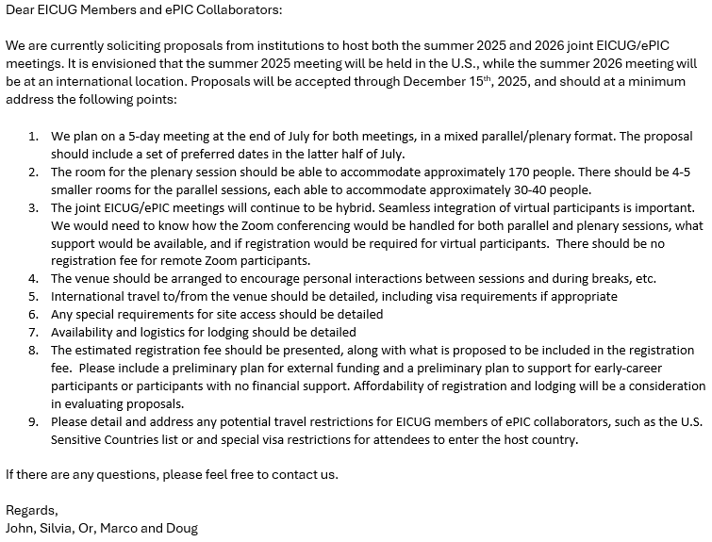
Future Collaboration Meetings
After consultation with the coordinators and EICUG SC, we agreed on:
Jan 2025 (ePIC) – Frascati (already planned)
Summer 2025 (EICUG/ePIC) – U.S.
Jan 2026 (ePIC) – U.S.
Summer 2026 (EICUG/ePIC) – International
A joint call has been issued for the Summer 2025/26 joint meetings, and a call for the Jan 2026 ePIC meeting will be issued soon
Allows the community and host sites to plan ahead
Sent to ePIC Collaboration and EICUG Users Sept 27, 2024
Note the “double”

Slide 24
Federated Login Flow
Slide from Eric Lancon

