Slide 1
ePIC Collaboration News
J. Lajoie, S. Dalla Torre
December 6, 2024

Slide 2
Hey John, start the recording….

Slide 3
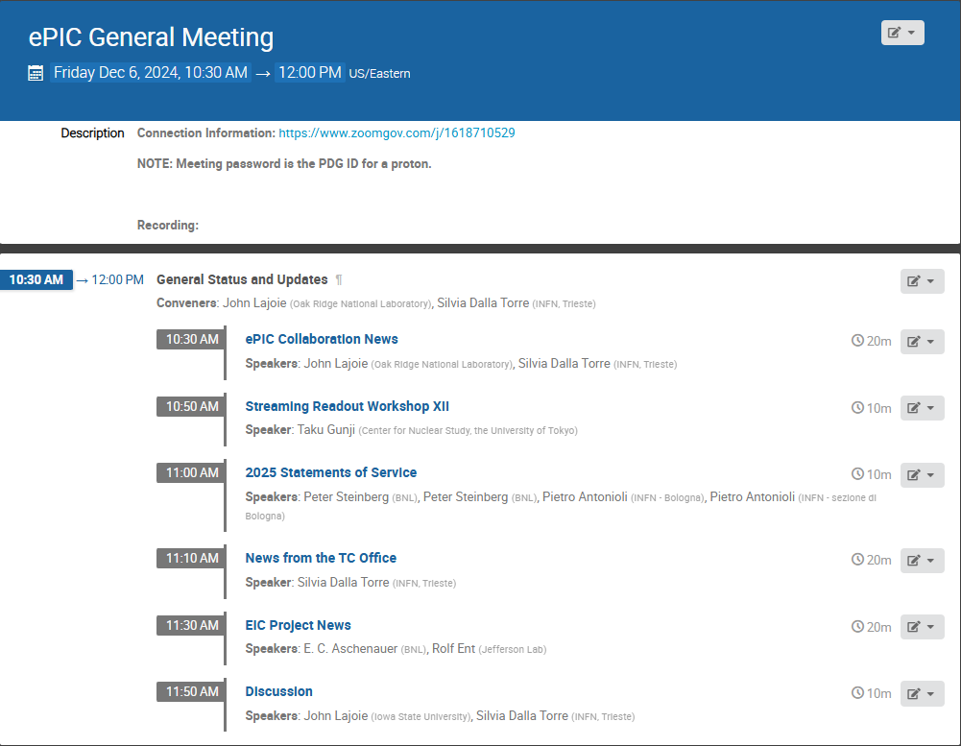
Agenda
The “standard” agenda plus some extras – lots of things to talk about since it has been a while since we last met!

Slide 4
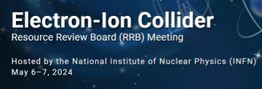
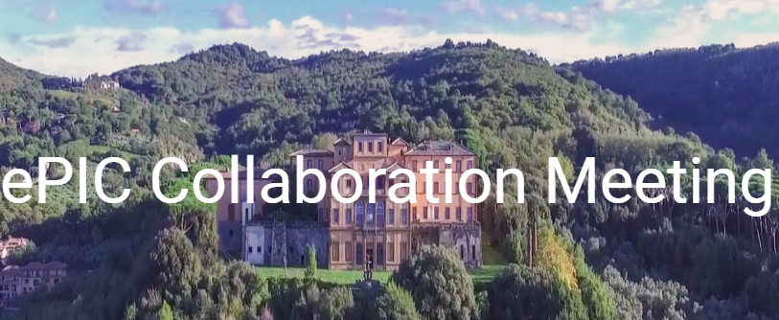
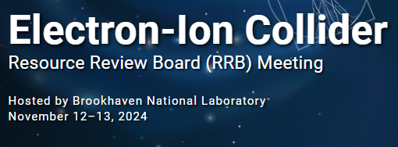
News from the SP Office
More on this in TC Office News
EIC Strategy Mtg August 21st
ePIC Early Physics Workshop Sept. 13, 2024
FDR: Magnet Flux Return Steel
(CD-3B scope) October 16, 2024
ePIC draft pre-TDR Version 1 December 6, 2024
Detector Advisory Committee R&D Meeting
August 28-28th
ePIC Software and Computing Review Sept. 26-27th
EIC Project CD-3B/Status Review January 7-9th, 2025
3rd EIC RRB Meeting May 6-7
Frascati, Jan 20-24,2025
Lehigh Collab. Mtg. July 2024
PDR2: Barrel EMCal
September 19th
ePIC draft pre-TDR Version 0.1 Sept. 30, 2024
4th EIC RRB Meeting Nov 12-13
EIC “Host” Lab User Experience Workshop
August 26th
Directors Review for CD-3B/Status Review
October 22-24
More on this in Project News

Slide 5
preTDR Version 1.0!
Executing the plan from the Jan. 2024 Collaboration Meeting:
process design phase
structuring the
effort
draft ePIC pre-TDR
ePIC pre-TDR (CD-2)
writing
(TDR/notes)
Preparing papers for
publication
Mid Jan.24
Mid Mar.24
Early 2025
Version 0.1
Sept. 30, 2024
Version 1
Dec. 6, 2024
Silvia will say more in the TC News talk. If you think about how the landscape had changed since the ANL collaboration meeting it really is quite stunning. Despite all this the collaboration set a goal and worked steadily towards that goal all year.
Congratulations and thank you to all those involved in preparing the pre-TDR this year!

Slide 6
Jan 2025 Collaboration Meeting
University of Rome Tor Vergata & INFN
January 20-24th, 2025
Via Frascati (Roman Hills)
https://agenda.infn.it/event/43344/
Registration is available now!
US National Lab folks – register early!

Slide 7
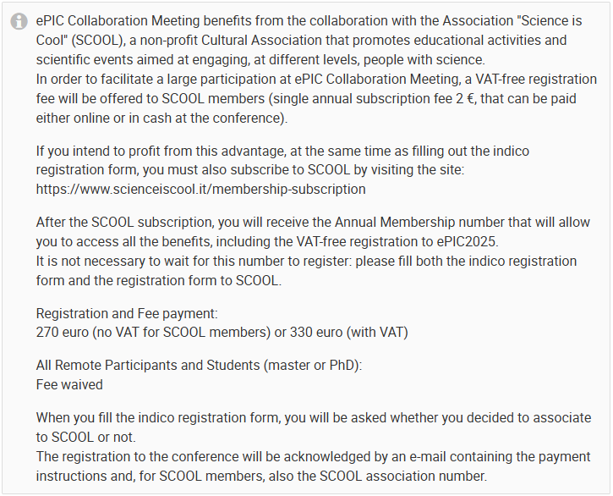
Death and Taxes
Associating your registration with SCOOL membership (2€) waives VAT taxes. (SCOOL is a non-profit entity.)
INFN and the University can’t accept money from individuals, so they need a partner. If they use a private company, they can avoid VAT but then pay 22% in fees…

Slide 8
Theme of the Collaboration Meeting
The Jan 2024 meeting at ANL established the goals and priorities for the collaboration for the coming year.
At the Summer 2024 meeting at Lehigh we took stock of where we were on the roadmap, made adjustments, and began the early science discussions.
The meeting in Frascati in Jan 2025 will come immediately after the EIC Project CD-3B review. We will again discuss the goals and set priorities for the collaboration in the coming year.

Slide 9
How do we set priorities?
Collaboration Priorities:
e.g.: TDR, machine backgrounds, track projection resolution, early physics projections, AI integration, streaming computing model, …
Priorities should be defined at the collaboration level and flow down to more specific actions/priorities at the coordinator office levels.
These need to be a bit refined/specific, can’t just be global like “Integration”
Ideally, they have a deliverable, like a document or a specific result that removes a block to progress, etc.
Coordinator actions/priorities support collaboration priorities
Avoid stove piping!
Coordination ensured by starting with the top-level priority
TC Office Priorities
S&C Priorities
AC Priorities

Slide 10
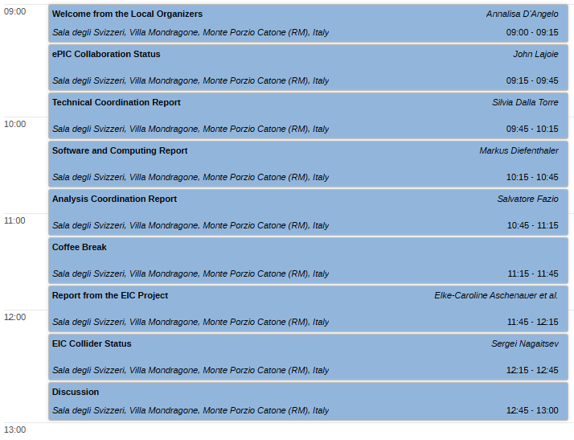
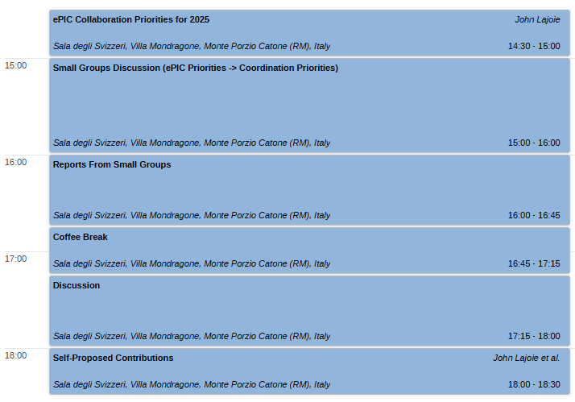
Agenda – Monday, Jan. 20th
The discussions on Monday afternoon will be extremely important! Come with your thoughts and ideas.

Slide 11
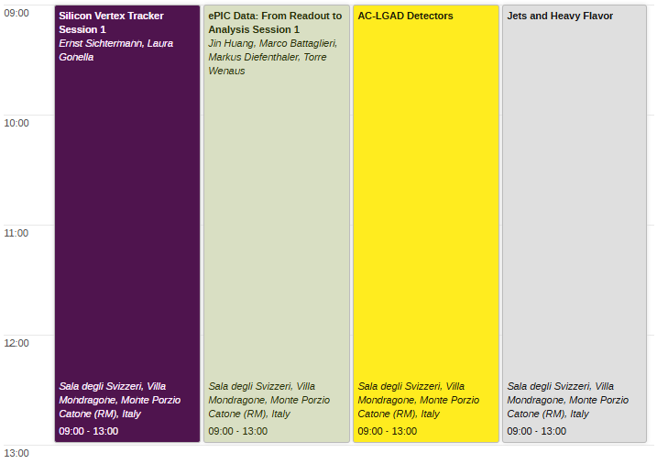
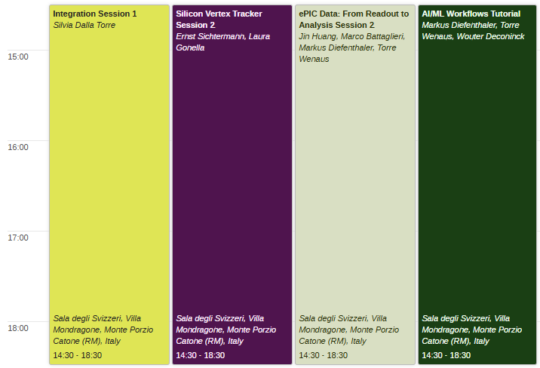
Agenda – Tuesday, Jan. 21st
Workfest descriptions at:
https://agenda.infn.it/event/43344/page/9444-workfest-descriptions

Slide 12
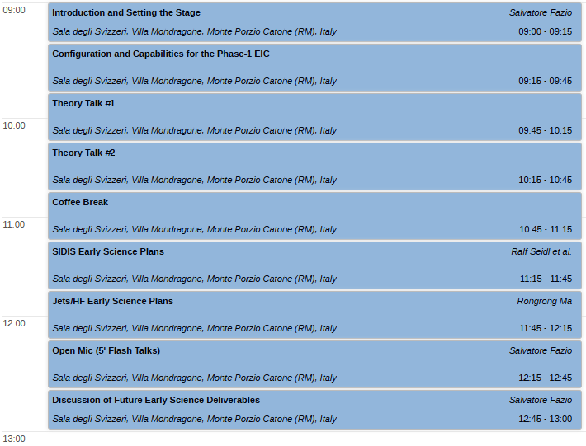
Agenda – Wednesday, Jan 22nd
Early Science Workshop organized by Salvatore Fazio and Rosi Reed.
Excursion Wednesday afternoon.

Slide 13
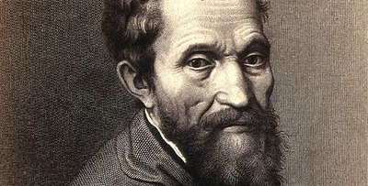
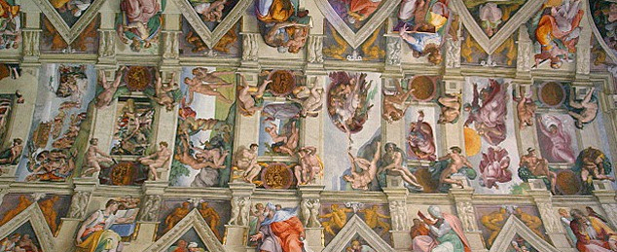
Social Program
A guided tour of the Musei Vaticani and Sistine Chapel will take place on Wednesday January 22nd afternoon.
Visitors will be taken through the beautiful Vatican buildings, and will enjoy the artistic, historical, and cultural richness within their walls, not to mention the frescoes by Michelangelo in the Sistine Chapel and the Raphael Rooms.
The guided tour is not included in the conference fee: tickets can be bought until December 15th 11:00 pm CET through the registration form.
For further information and assistance please contact Mariachiara Lupi -mariachiara.lupi@gmail.com)

Slide 14
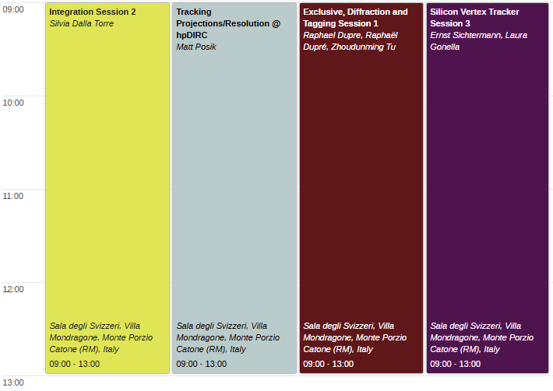
Agenda – Thursday Jan. 23rd
Collaboration Council Meeting
Thursday afternoon.
Conference dinner Thursday evening “will be enriched with high quality wines”

Slide 15
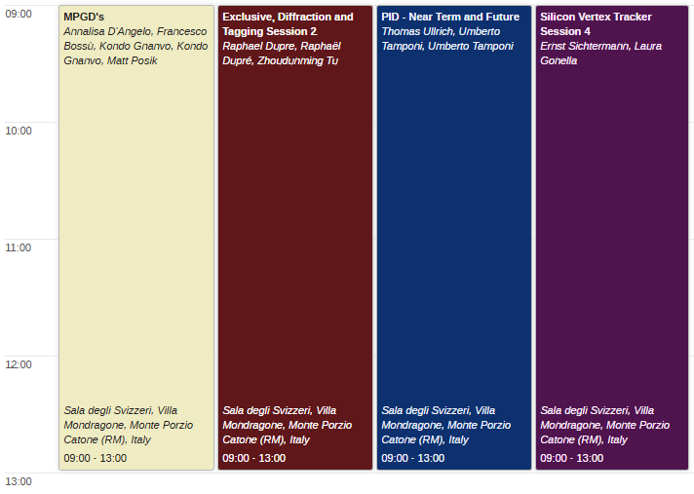
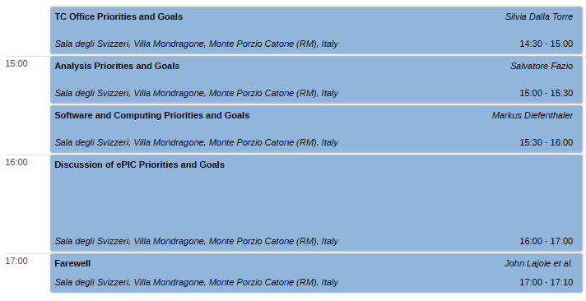
Agenda Friday, Jan. 24th
On Friday afternoon, we will return to the discussion of priorities and goals.
No workfest summaries! We’ll schedule a special online session for workfest summaries in the weeks following the collaboration meeting.

Slide 16
ePIC Contests
Several contests are being considered and may be announced soon:
ePIC Photo Contest:
Organized with the support of the ePIC-EICUG outreach group
Contact Marta Ruspa (ruspa@to.infn.it)
ePIC Poster Contest:
Organized by the ePIC Early Career Group with Elke

Slide 17
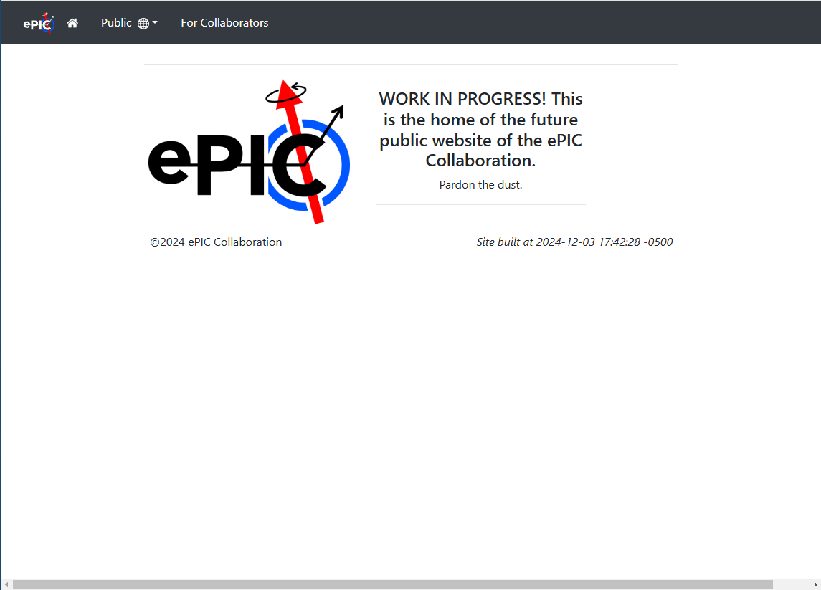
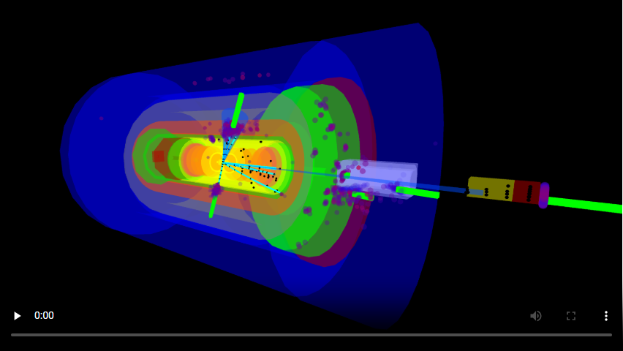
ePIC Website Migration
https://www.epic-eic.org/
Migrating content from the ePIC Wiki to the new website
Wiki will still exist to provide WG areas, etc.
Website will contain more static information.
Includes public and collaboration areas
Many thanks to Maxim Potekhin!
Working to add streaming video of a ePIC event display from Sean Preins - https://www.jlab.org/video/epic-3d-animations

Slide 18
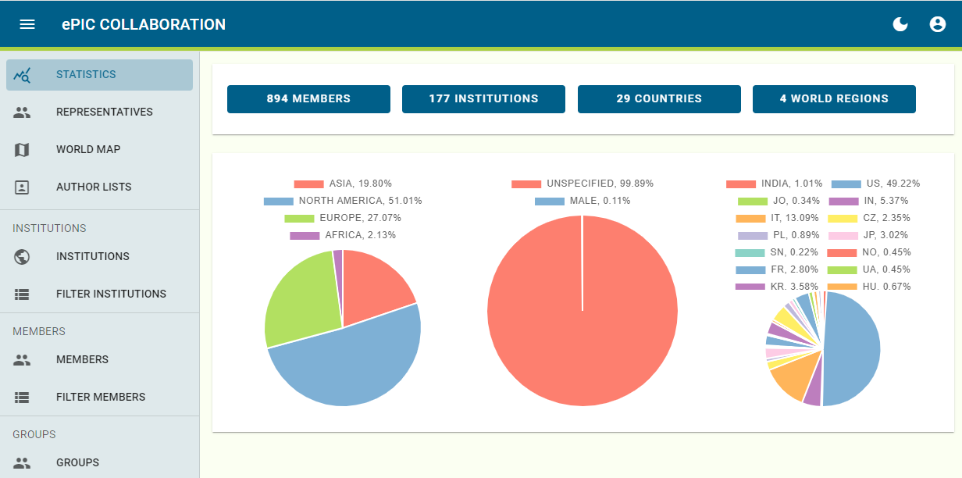
ePIC Phone Book is “live”
Currently available at epic-eic.org
Federated (InCommon Comanage) required to verify identity
Collaboration already familiar with InCommon Federation (Indico)
InCommon Comanage adds a layer that allows you to associate multiple identities
May not have seen much use in Indico yet since pages are public?
Institutions can be registered in eduGAIN.org (free), use CERN membership, or a BNL account.
Access requirements set for SDCC
Set public, ePIC levels of access to protect personal information

Slide 19
Invitation to the Second ePIC AI Town Hall
Purpose
Showcase the breadth and depth of AI activities within the ePIC collaboration.
Format
Anyone is welcome to present two slides about an AI activity connected to ePIC:
The first slide should introduce the scope and goals of the activity.
The second slide should summarize its current status.
If you are interested in presenting, please reach out to Markus Diefenthaler.
Meeting Details
Date and Time: Wednesday, December 11, at 11:00 a.m. (EST)
Agenda and Zoom Information: https://indico.bnl.gov/event/25802/

Slide 20
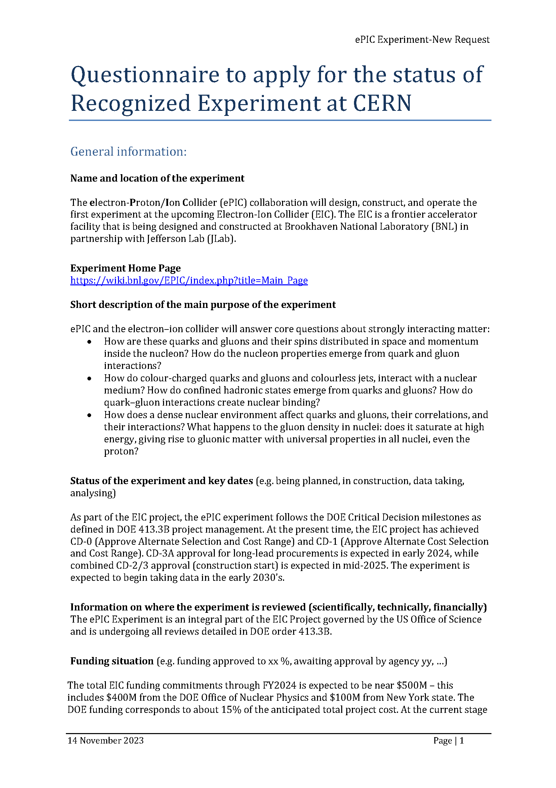
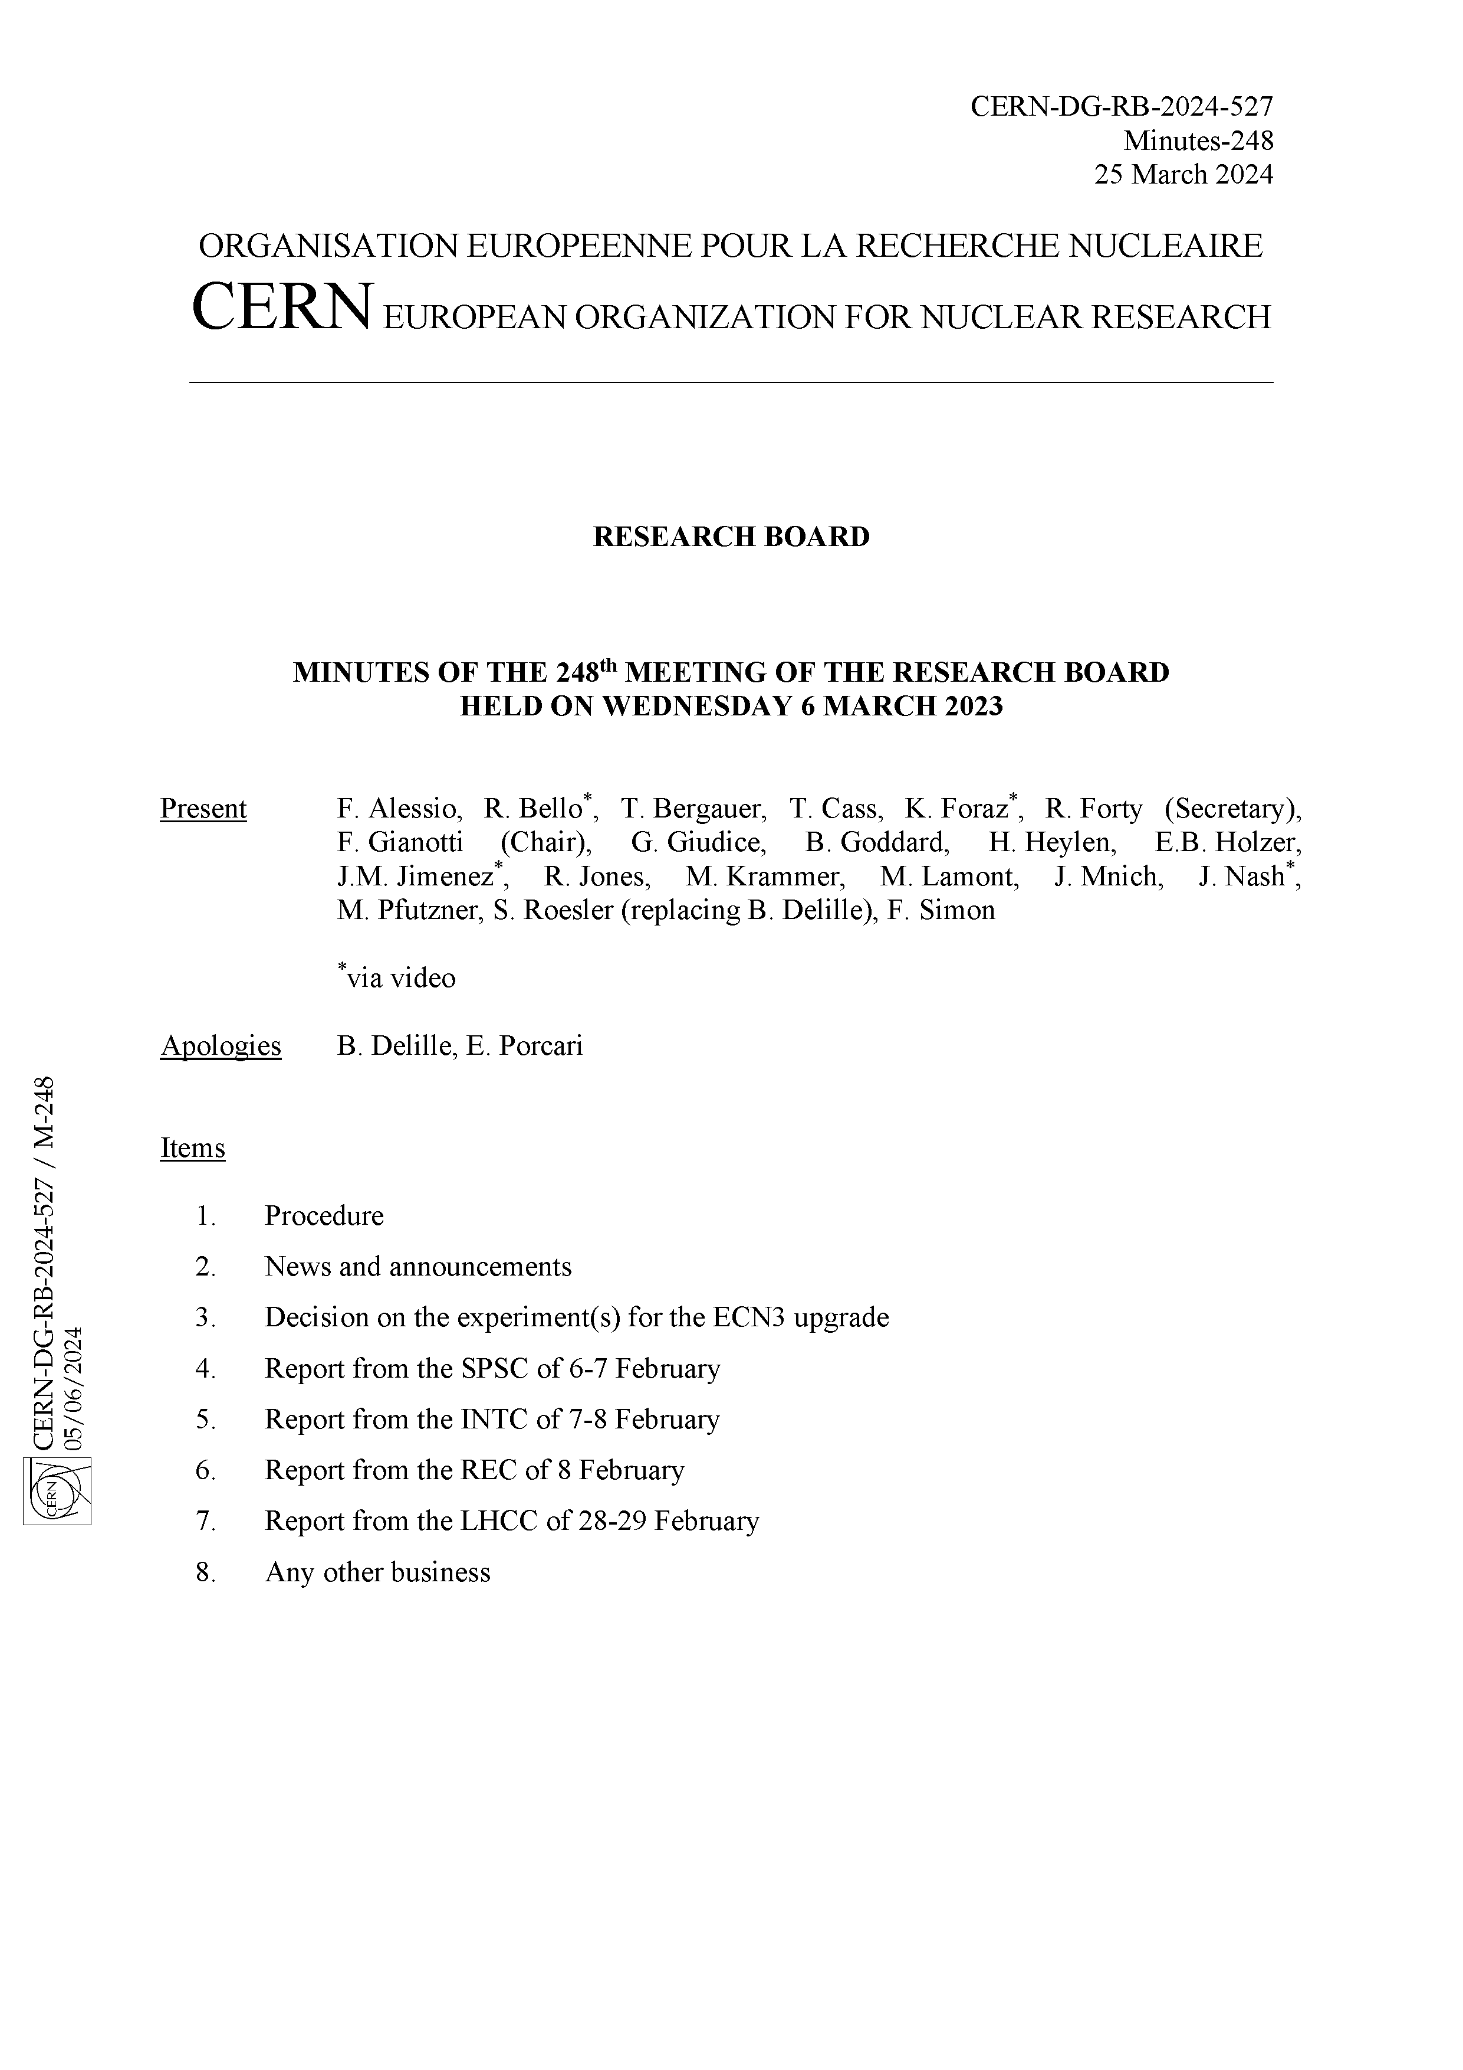
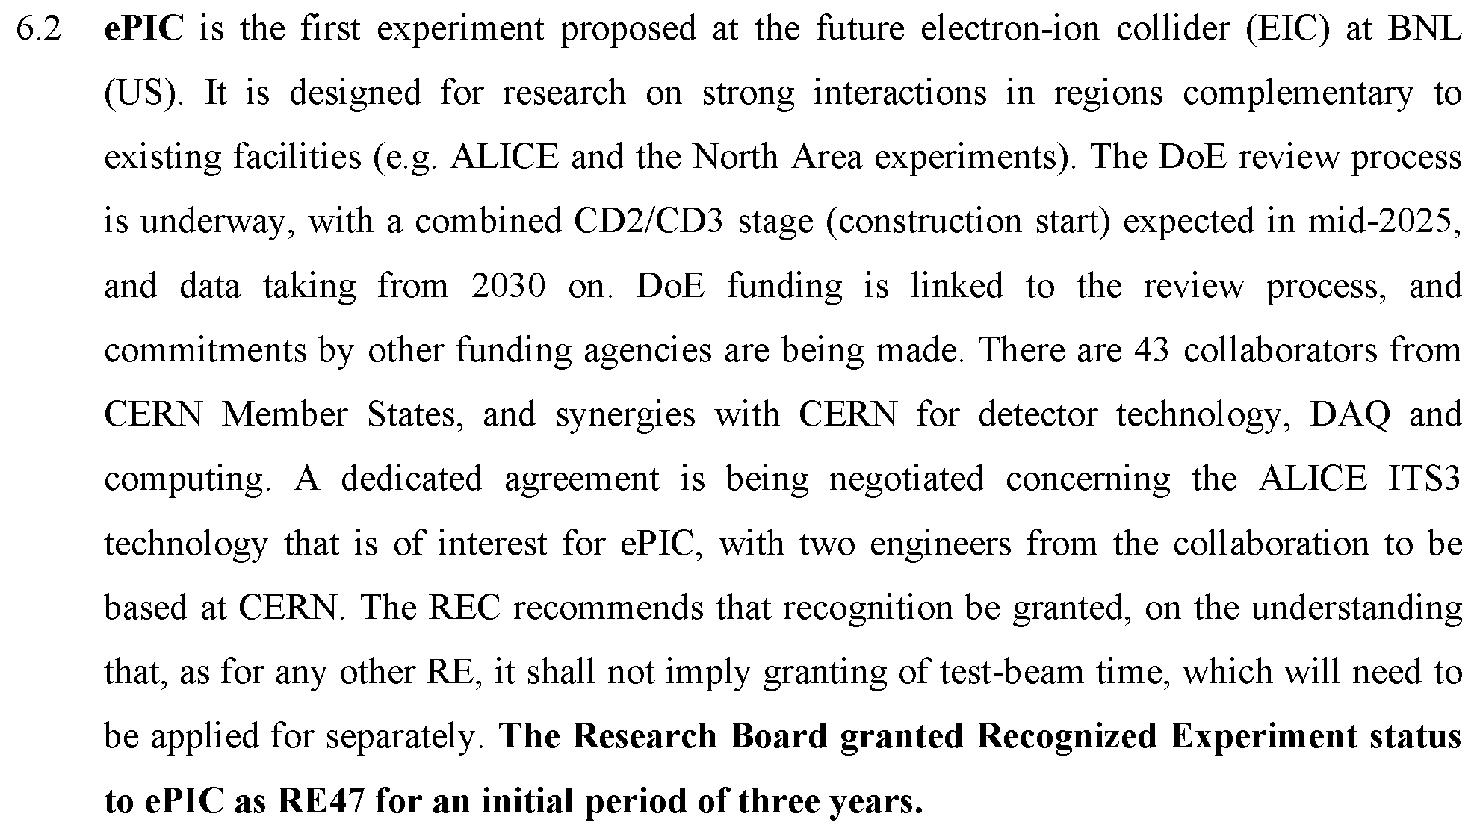
CERN Recognized Experiment
The CERN Recognized Experiment MOU is signed by all parties.
ePIC collaborators are be able to:
Establish team accounts
Register as CERN users
Apply for test beam time as ePIC
SIGNED

Slide 21
Summary
Register for the ePIC Collaboration Meeting by December 31st
Excursion deadline is December 15th!
Next Executive Board Meeting – Friday, Dec. 13th at 10:00AM ET
Next General Meeting – Thursday, Dec. 19th, 7:30PM ET
Statements of Service due December 31st (prefer December 15th)

Slide 23
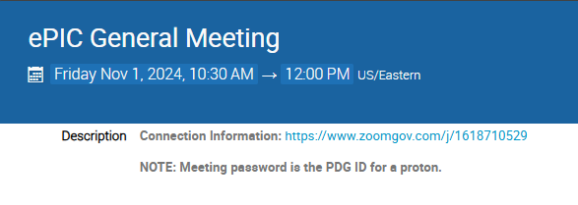
New Zoom Link
The Zoom link for the General Meeting now requires a password
We decided to do this after a TIC meeting was Zoom-bombed
All our Indico pages are public, so this offers another hurdle for a would-be bomber (not a guarantee)
Old link had password embedded to allow one-click access
Hopefully this is not overly cumbersome for our collaborators

Slide 24
ePIC Resources
Public Website - https://www.bnl.gov/eic/epic.php
Mailing Lists – https://lists.bnl.gov/mailman/listinfo
Indico Agenda - https://indico.bnl.gov/category/402/
ePIC Software and Computing: https://indico.bnl.gov/category/435/
Wiki - https://wiki.bnl.gov/EPIC
ePIC Software Training:
Landing Page: https://eic.github.io/documentation/landingpage.html
Tutorials: https://eic.github.io/documentation/tutorials.html
Mattermost: https://chat.epic-eic.org
ePIC Zenodo Community: https://zenodo.org/communities/epic

Slide 25
EICUG Membership
The EICUG is a vital organization to promote the interests of the EIC community!
Without the EICUG we would never have gotten far enough to form ePIC!
Please register your institution!
Check with your EICUG IB representative to get registered as a member
https://www.eicug.org/content/join.html

Slide 26
Federated Login Flow
Slide from Eric Lancon

Slide 27
January 2025 Collab. Meeting Plan
Monday
Jan. 20th
Tuesday
Jan. 21st
Wednesday
Jan. 22nd
Thursday
Jan. 23rd
Friday
Jan. 24th
Plenary 1
Parallel/ Workfest 1
Early Science
Parallel/ Workfest 3
Parallel/ Workfest 4
Morning
Plenary 2
(incl. Contributed)
Parallel/ Workfest 2
Excursion
Collaboration Council
Plenary 3
Afternoon
NOTE: Parallel/Workfest summaries will not be part of Plenary 3, but instead will be delivered as a Zoom session the following weeks.

Slide 28
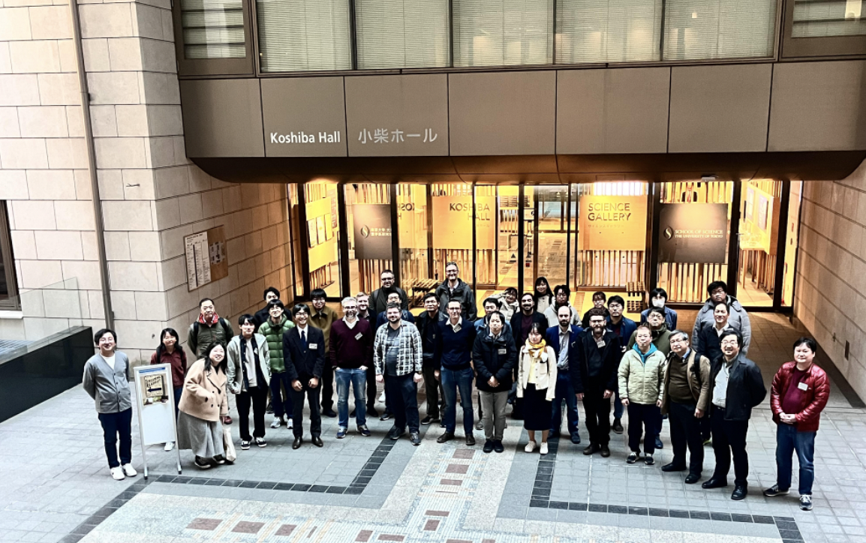
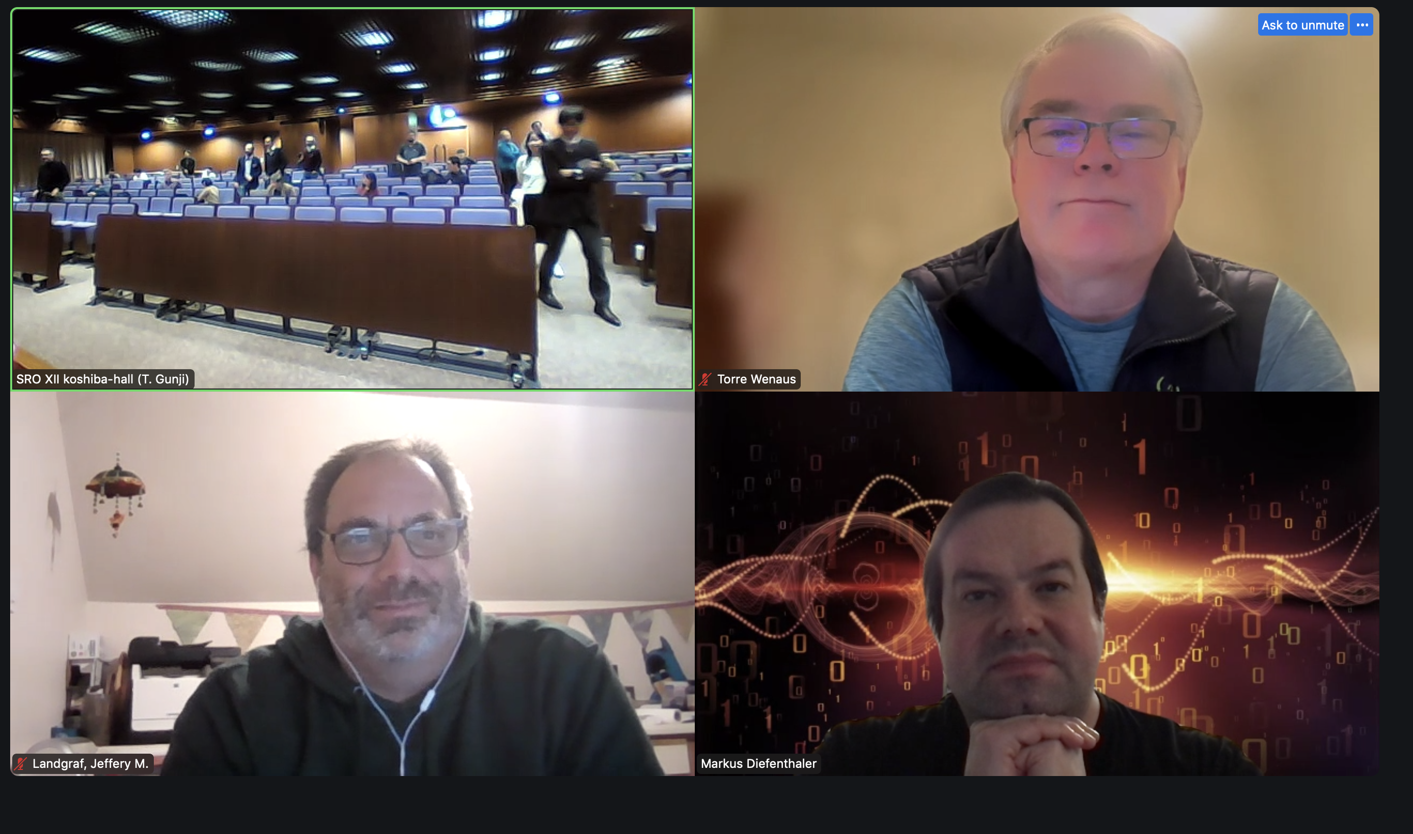
Streaming readout workshop XII@Tokyo
Slide from Taku Gunji
https://indico.bnl.gov/event/24286
12/2-12/4 @ University of Tokyo
T. Gunji (chair), M. Battaglieri, J. Bernauer, A. Camsonne, M. Diefenthaler, C. Fanelli, T. Horn, Y. Goto, et al.
107 registrants (44 in-person)
Successful in-depth discussion on
Streaming DAQ experiences at many facilities
ePIC SRO and Computing
Orchestration of data processing
AI/ML in SRO from AI4EIC
SRO ASICs
Hardware Acceleration
Collaboration on future Streaming Readout & Computing
Next one will be at Catania, Italy

Slide 29
2025 Statements of Service
A key part of our Membership Policy
https://zenodo.org/records/13693927
Forms are due December 31st (preferred by December 15th)
Several errors have been uncovered:
Missing M.S. Student category added
Software & Computing WG’s were missing
Calorimetry CC WG was missing
Names of DSC are now as stated in the official documentation
Several new tasks are also available following inputs received, including aspects of the whole detector integration reflecting work of several engineers at BNL or specific roles as convener of a WG of conference char.
Pietro and Peter have been working hard to revise and verify a new version of the form
New forms were sent to CC members yesterday 12/5
You should be able to copy and paste from the old form

