Slide 1
Memo from Jim Yeck, Project Director, Dec 11 2024
Optimization of the Electron Injector – The decision was made to remove the Rapid Cycling Synchrotron (RCS) from the RHIC/EIC tunnel. The preliminary RCS concept is a new 1.4-km ring, located near Interaction Region 4. The cost and performance optimization of the entire injector (linac and RCS) will continue into the Spring of 2025. The justification for the decision and the plan for advancing the electron injector design and for addressing the full implication of this important change will be presented at the DOE review in early January. Sergei Nagaitsev, EIC Technical Director, is the primary point of contact for questions.
Strategy for Project Delivery – (not part of this charge)
Early Science Program – (not part of this charge)
Beam Cooling – The project is no longer planning to implement Strong Hadron Cooling within the scope of the line-item construction project. Low Energy Cooling will be added to the scope of the line-item project. These changes are responsive to the concerns raised in earlier DOE reviews and result in lower technical performance risk and reduced construction cost. The justification for these decisions will be presented at the DOE review. Following the DOE review we will implement the changes in our planning documentation.

Slide 2
Strategy for Electron Injector System
Slides from various draft SC-1 Injector Session
presentations for January 2025 DOE OPA Review

Slide 3
EIS Performance Goals
Provide bunches with appropriate emittances, charge and polarization at the necessary cycle rate to meet the needs of the Electron Storage Ring (ESR) and the physics program.
Generate and accelerate polarized electrons to 5, 10 GeV with 85% polarization
Deliver 7 nC bunches at 5 and 10 GeV ( 1 bunch per second)
Need to fill ESR in under 20 min 1160 buckets x 1 sec ~ 19.33 min
Provide Path to upgrade:
Increase bunch charge to 28 nC/bunch at 5 and 10 GeV
Deliver 11nC at 18 GeV
290 buckets x 1 sec~ 4.8 min
Match ESR Emittances

Slide 4
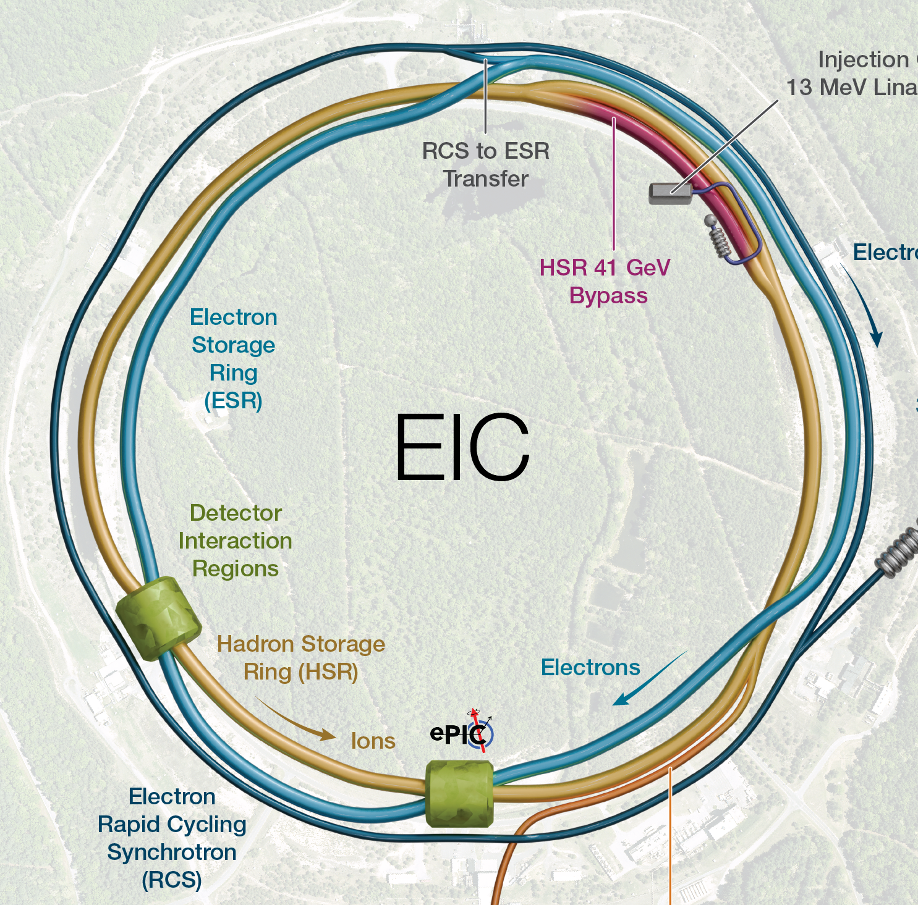
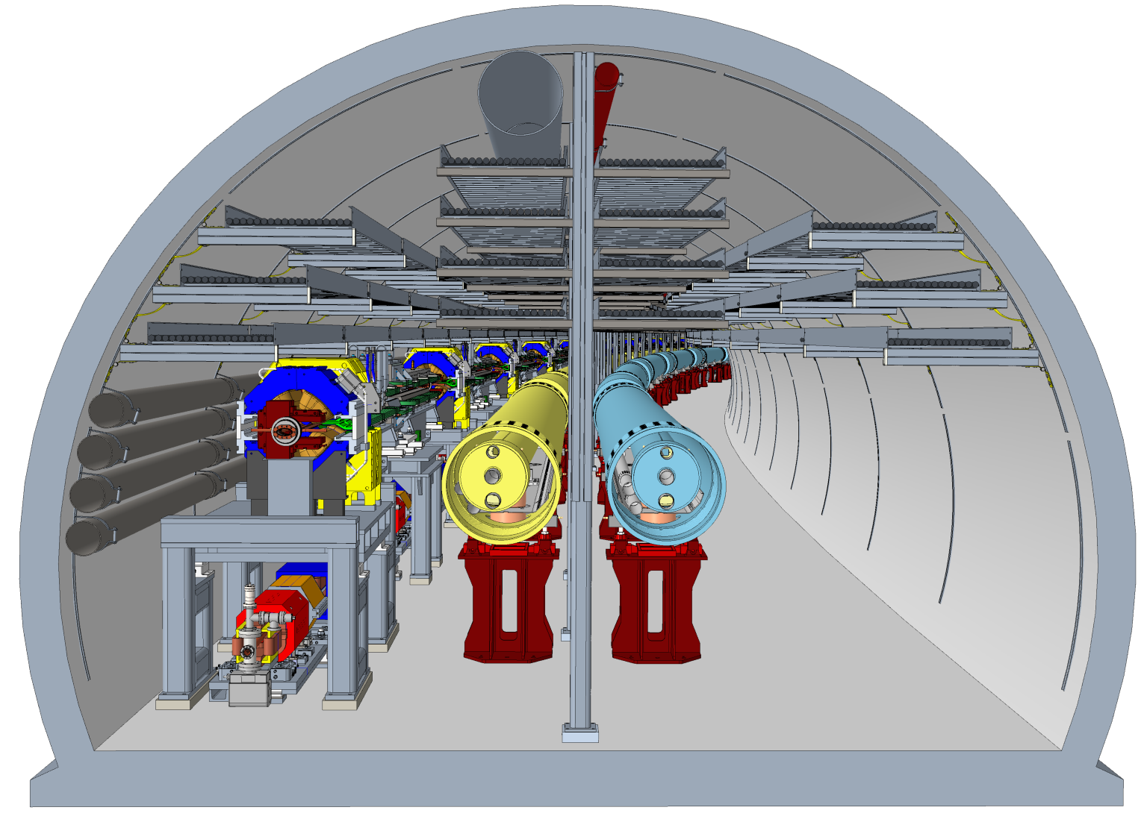
RCS Issues, in a nutshell…
The EIC needs an RCS in order to deliver on project requirements and expectations.
The RCS placement into the existing RHIC tunnel is leading to a highly non-optimal design. Also, presents a challenge to installation and future EIC operations (maintenance and servicing of the RCS).
Tunnel at Sector 1 (with the 41-GeV bypass)

Slide 5
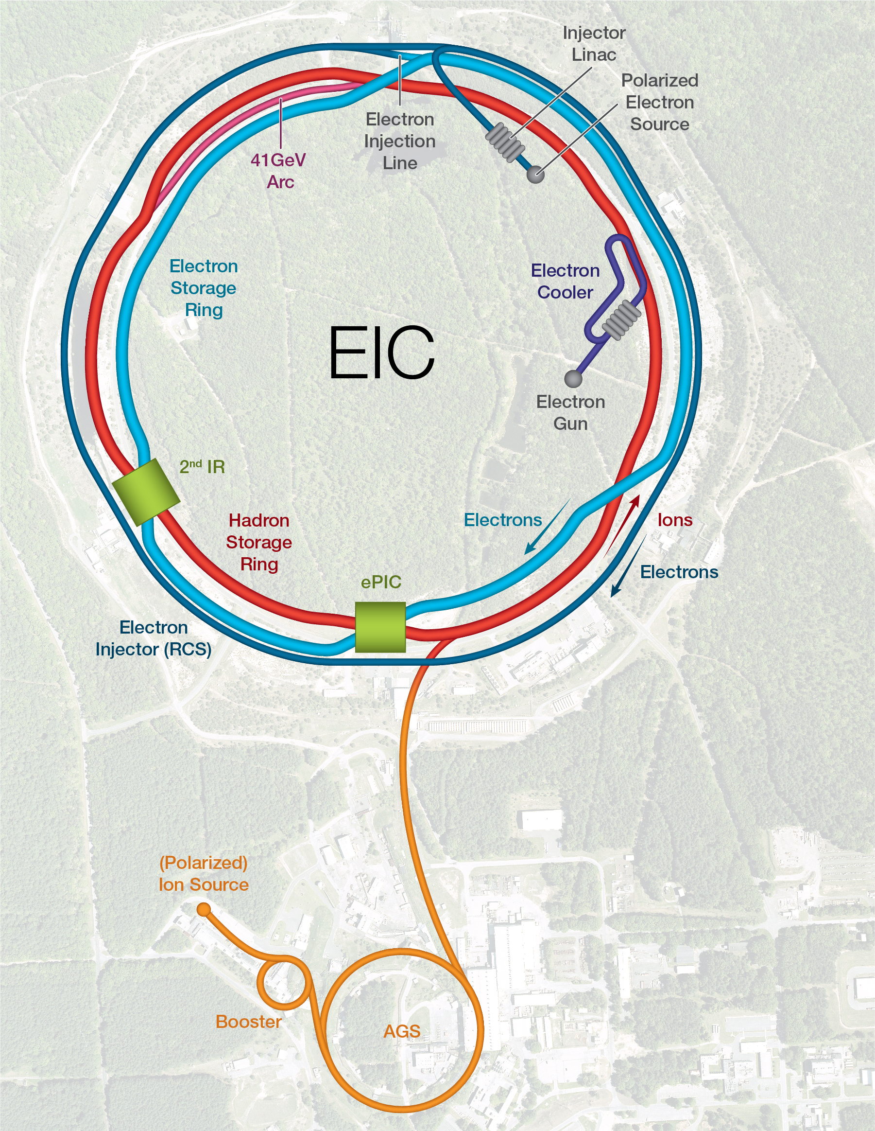
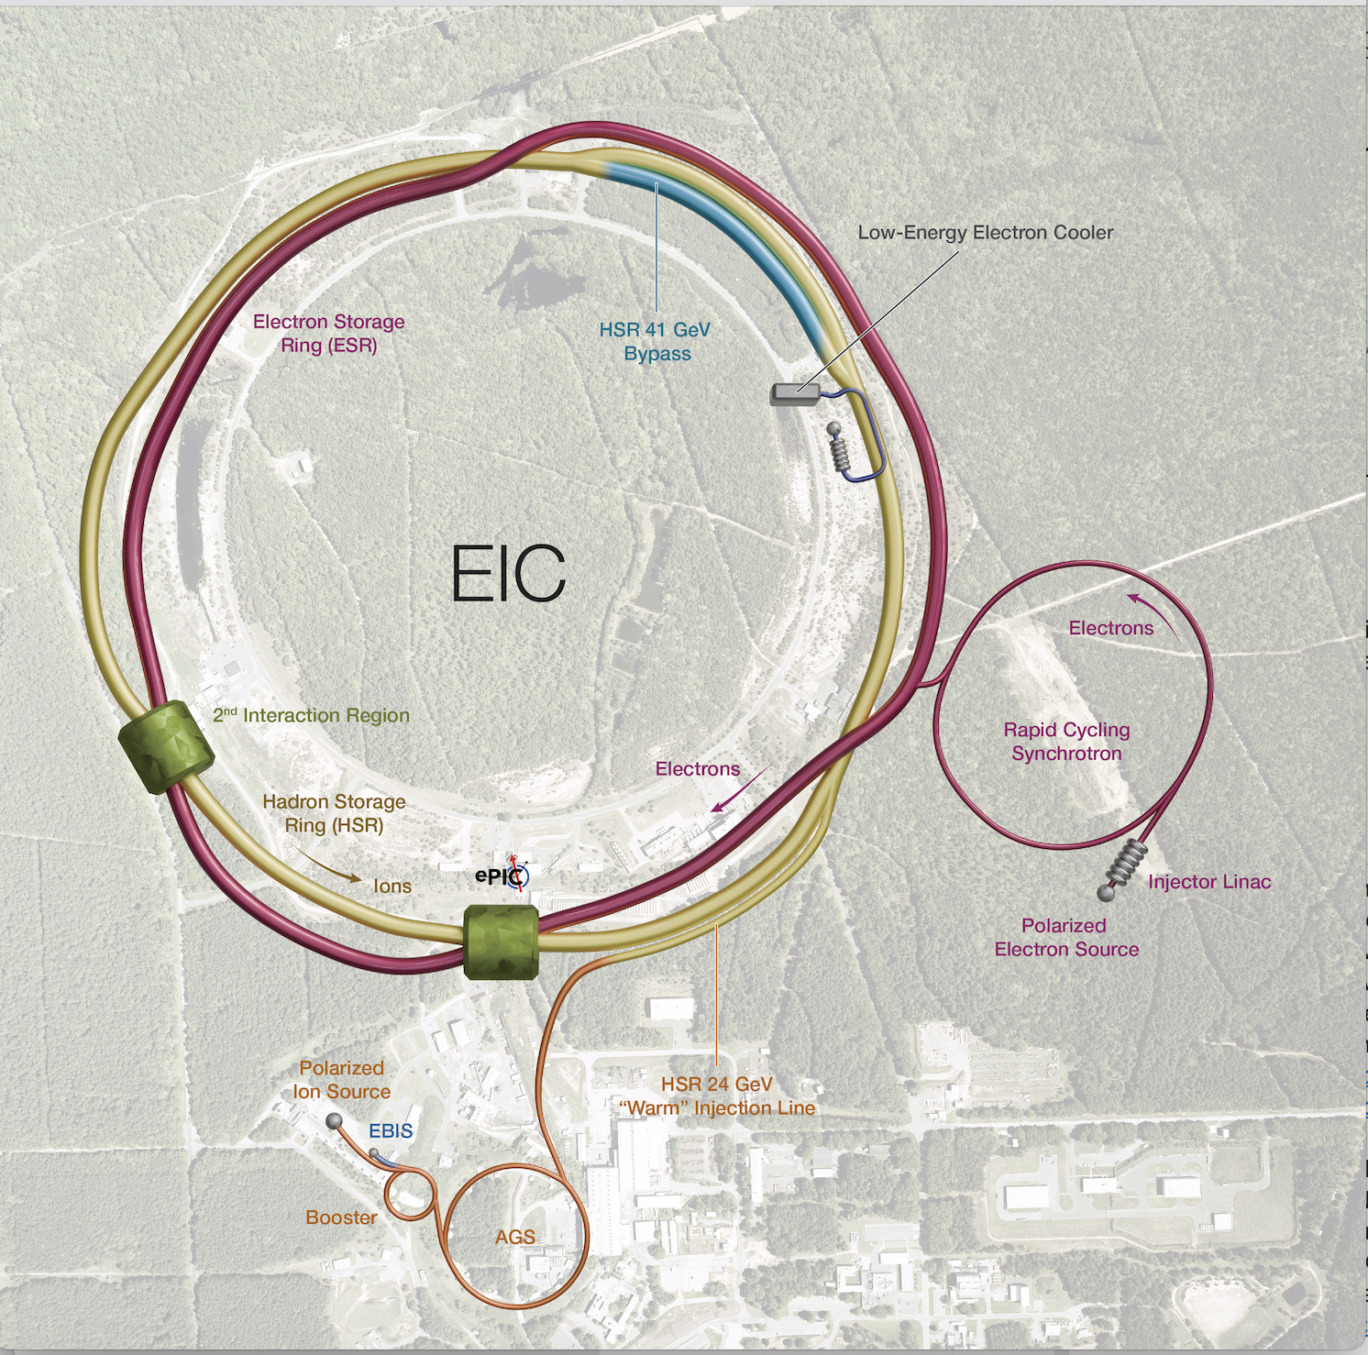
Moving RCS out of RHIC Tunnel

Slide 6
New Concept of the Electron Injector
RCS
ESR
CDR baseline
400 MeV linac @ 2.8 GHz Normal conducting RF
7 nC bunch injection
3.8 km circ.
In RHIC tunnel
Swap out
Swap out
New Concept
f_{RF} = 591 MHz
750 MeV linac @ 1.3 GHz Superconducting RF
RF
RF
7 nC bunch injection
ESR
Improvements from baseline
Increased RCS dipole field from 56 G to 290 G to avoid large magnetic field error at below 200 G.
Increased RCS injection energy to reduce beam affected by eddy current induced magnetic field.
Lower linac frequency to open high charge (>10nC) bunch option
Add spin rotation option at low energy
RCS
Frequency ratio 11:5
In RHIC tunnel
1.4 km circ.
Swap out
f_{RF} = 591 MHz
RF
RF

Slide 7
EIS Approach with RCS out of RHIC tunnel
Pre-injector: Front End → delivers up 7.5 nC of bunch charge with 88% polarization
Pre-injector: SRF LINAC → accelerates 1 bunch to 750 MeV
RCS: Accelerate from 750 MeV to 5 and 10 GeV energy delivering one bunch of 7 nC every second. This will fill ESR in under 20 min.
EIS is capable of being cycled up to 4 times per acceleration cycle (5Hz)
Path to 18 GeV and 28 nC bunch charge:
Path to reach 18 GeV with 11nC and high polarization → RF installation and Power supply upgrade
Path to achieve 28 nC/bunch in the RCS using accumulator ring: BAR (Beam Accumulator Ring)

Slide 8
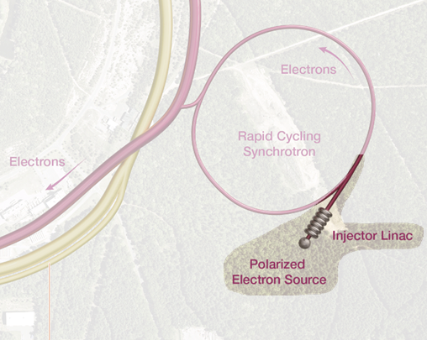
Introduction to the New Pre-injector
Envelop:
From polarized electron gun to end of the Linac to RCS (LTR) transfer line
Scope interface defined at RCS septum entrance
The major components of the electron pre-injector are listed in the picture above
IR04

Slide 9
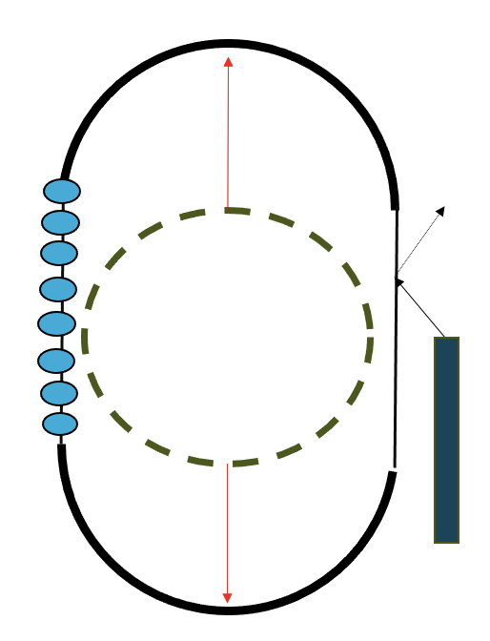
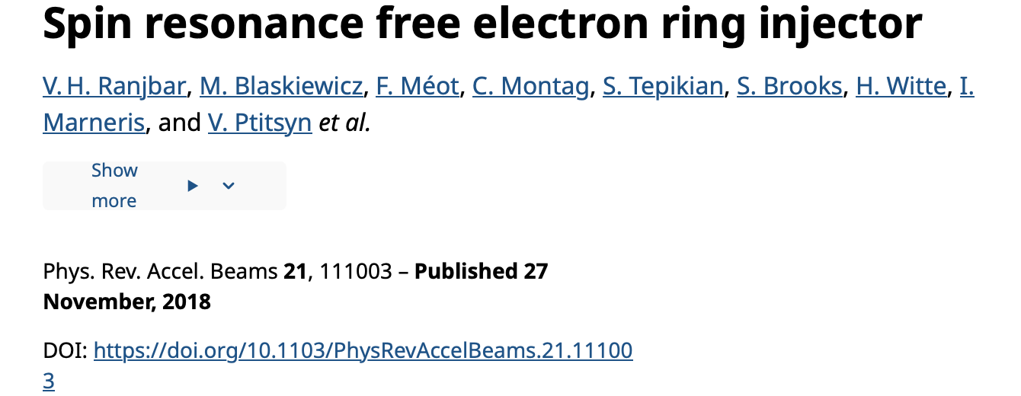
RCS Lattice Layout and Spin Transparent Design
Need room for the ability to install up to 130 MV of RF voltage and accommodate injection and extraction
However this will spoil the high periodicity of we need to avoid the impact of depolarizing spin resonances i.e. with a race track design the periodicity “P” would be 2 and we would see intrinsic and strong imperfections in our range of energy acceleration.
To avoid breaking spin periodicity the vertical phase advance across straight to 2*PI*N. (the original RCS spin transparent concept). We choose 4PI.

Slide 10
Strategy for Hadron Cooling
Slides from S. Nagaitsev (Technical Director) draft plenary
for January 2025 DOE OPA Review
(Basically the same as presented at November 2024 Director’s Review)

Slide 11
Recommendations from Nov 2023 DOE Review
Develop a plan in case strong hadron cooling (both SHC-CeC and SHC-REC) performance falls below expectations; present at the next OPA Review. ​ We concur. See next slides ​
Develop a plan for a focused program of the RHIC end-of-run beam studies as part of APEX with a goal to address potential issues and provide input to further mitigation of the EIC performance risks; report to NP by May 2024.
See V. Ptitsyn’s talk (SC2)​ at CD-3B DOE OPA Review (January 2025)

Slide 12
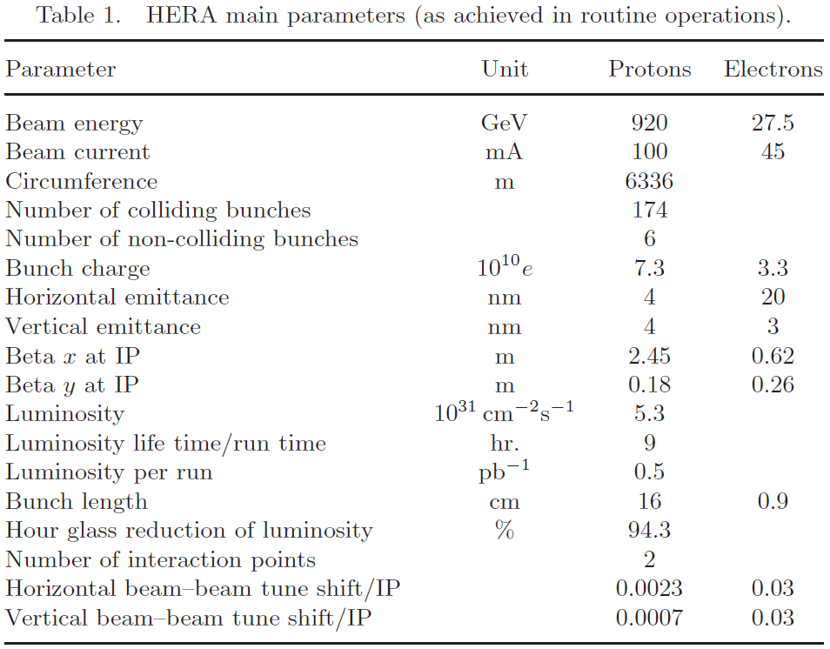
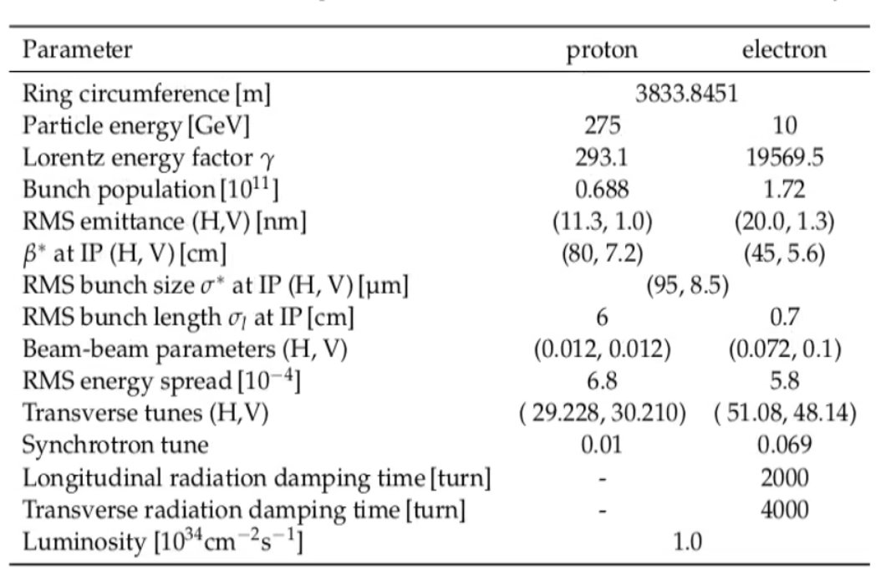
Why is beam cooling so important for the EIC?
EIC main parameters
Compared to HERA, the EIC design implements two new critical ideas:
Flat proton bunches at collisions (to match the electron beam dimensions) – this helps with the peak luminosity
Continuous proton beam cooling during collisions to maintain matched beam dimensions – this helps with the average luminosity

Slide 13
SHC: Background Info
2021: The EIC CDR focuses on SHC as a preferred alternative to (1) create flat bunches and (2) maintain emittance during collisions.
2023: We realize that SHC is too slow to create flat bunches at collision energy. Added a low-energy electron cooler (13 MeV) at injection, combined with SHC-CEC.
2024: SHC has remaining unresolved technical challenges. We developed a detailed luminosity model with and without SHC at collisions. Model assumes flat bunches, created by a low-energy electron cooler.
HSR Magnets
CS2 ~60m
(SHC Kicker)
HSR SHC Chicane
CS1 ~60m
(SHC Modulator)
HSR Magnets
HSR Magnets
PreCooler 13 MeV
U- turn
Electron beam direction
SHC 55-150 MeV
Electron beam direction
SHC/Precooler shared returning ERL loop
IP2
E=13, 55, 150 MeV
Notes:
Challenges: 1. cooling theory has been done in longitudinal plane. However transverse emittance effect on cooling rate is not fully understood yet.
2. Cooling requires the generating and preservation of low shot noise electron beam, which has not been fully demonstrated
3. The requirement for synchronization of both beam is crucial for high bandwidth strong hadron cooling, which has not been fully demonstrated

Slide 14
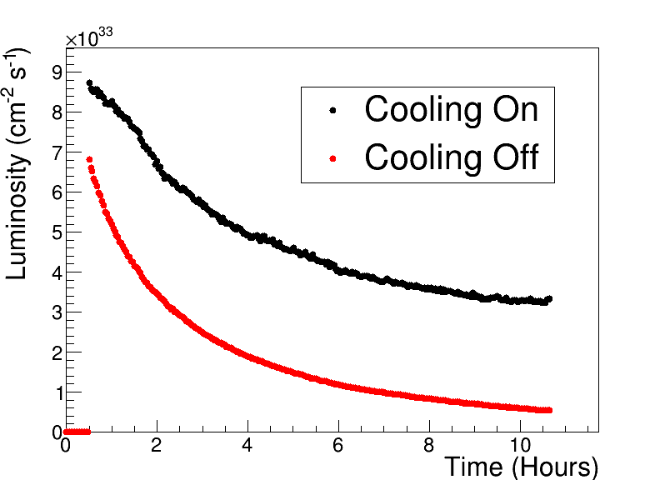
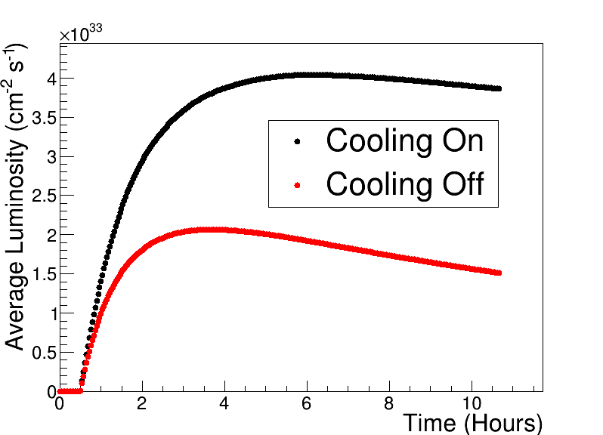
Luminosities w/wo SHC for 275 GeV p on 10 GeV e (example)
Starting collisions with “flat” proton bunches
See W. Bergan’s talk in SC2
SHC
SHC
ESR fill
Each store starts with 30 min precooling and 30 min to fill the ESR ring (~1200 bunches);
In addition, we assume a 2-hour turnaround time for filling hadrons, precooling, and ramping

Slide 15
Producing ‘flat’ Proton Bunches
See A. Fedotov’s talk in SC2 at January 2025 DOE OPA Review
RF diagnostics line with Deflecting cavity
180°Dipole
(U-turn)
LEReC Cooling Solenoids
180° Dipole
Spectrometer
Mu-metal shielding
Quad
cooling
RF diagnostic
hadron
hadron
hadron
e⁻
HSR
e⁻
HSR
IR2 layout
(all within the
existing RHIC
Tunnel)
e⁻
extraction
transport
injection
Injector test
SC Quad
PM
Cathode transport
PM
PM
Solenoids
Laser
197 MHz
130 kW Beam Dump
Extraction line
900 kW Beam Dump
4x 591 MHz
NCRF correction Cavities
DC Gun
400kV
Injector/linac
Test line
24MHz
RF cavity
16x 197 MHz
NCRF LINAC
Not to scale

Slide 16
Strategy for Hadron Cooling
The SHC-related risk was identified as ‘HIGH’; much attention to SHC at previous reviews.
To mitigate this risk, we are adding an injection electron cooler for hadrons (at 25 GeV/u) to create ‘flat’ bunches. This is a proven and tested technology. We propose to remove the SHC system from the project baseline.
The average luminosity would drop by a factor of 2 per our model, but the CD0 luminosity goals (10³³ – 10³⁴ cm⁻²sec⁻¹) can still be met even without the SHC system.
This downgrades the hadron cooling risk from HIGH (SHC) to LOW (Injection cooler).
The High-Energy Cooling technology development will continue as an R&D program, supported by the EIC Accelerator Collaboration. Will remain as an injection cooler performance risk mitigation strategy to be funded with project contingency, if triggered.

