Slide 1
Plans for Early Science
E.C. Aschenauer (BNL), R. Ent (JLab)
Co-Associate Directors for the Experimental Program
EIC Project Strategy Workshop
August 21, 2024

Slide 2


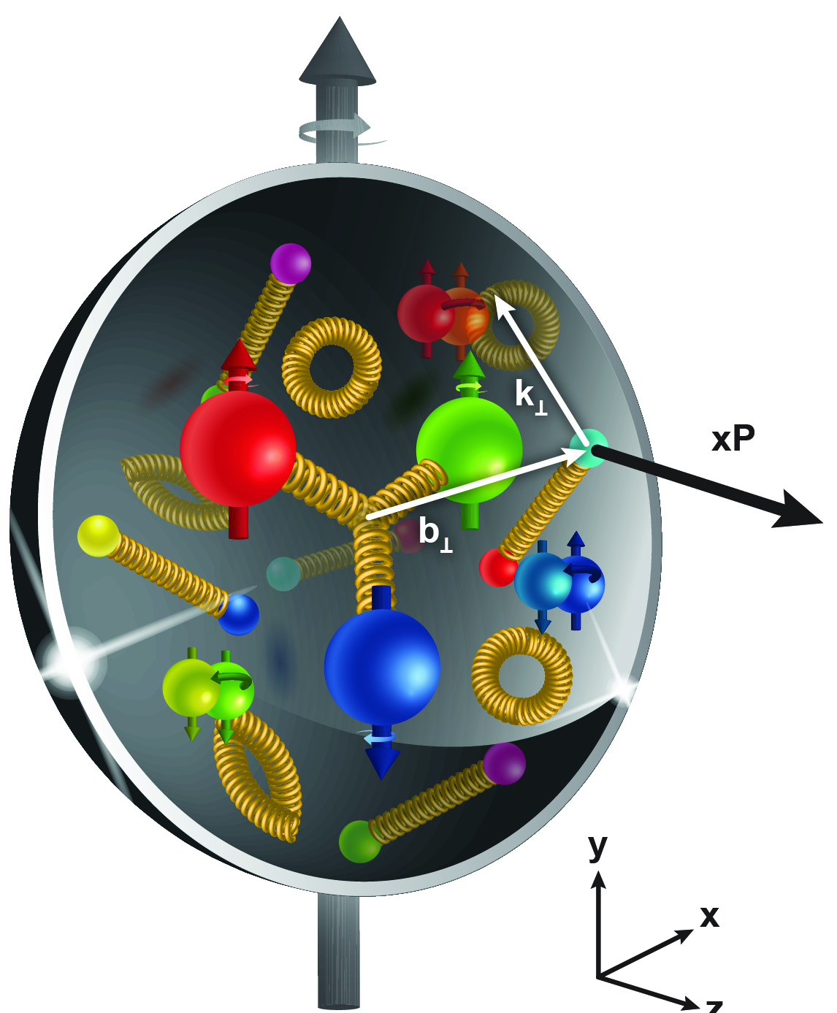
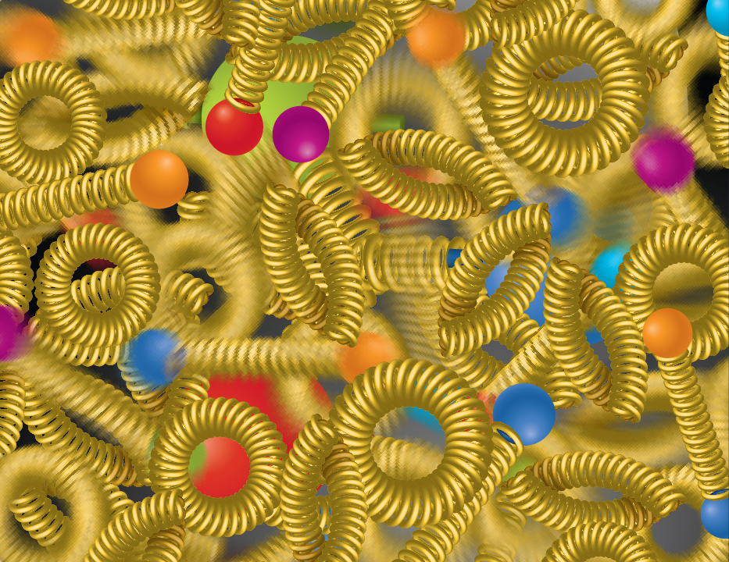
EIC Science Pillars
SPIN is one of the fundamental properties of matter.
All elementary particles, but the Higgs carry spin.
Spin cannot be explained by a static picture of the proton
It is the interplay between the intrinsic properties and interactions of quarks and gluons
The EIC will unravel the different contribution from the quarks, gluons and orbital angular momentum.
Does the mass of visible matter emerge from quark-gluon interactions?
Atom: Binding/Mass =
0.00000001
Nucleus: Binding/Mass =
0.01
Proton: Binding/Mass =
100
For the proton the EIC will determine an important term contributing to the proton mass, the so-called “QCD trace anomaly
How are the quarks and gluon distributed in space and momentum inside the nucleon & nuclei?
How do the nucleon properties emerge from them and their interactions?
How can we understand their dynamical origin in QCD?
What is the relation to Confinement
Is the structure of a free and bound nucleon the same?
How do quarks and gluons, interact with a nuclear medium?
How do the confined hadronic states emerge from these quarks and gluons?
How do the quark-gluon interactions create nuclear binding?
How many gluons can fit in a proton?
How does a dense nuclear environment affect the quarks and gluons, their correlations, and their interactions?
What happens to the gluon density in nuclei? Does it saturate at high energy?
?
gluon
splitting
=
gluon
recombination

Slide 3
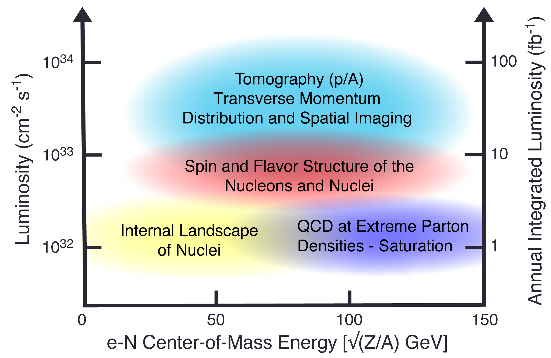


EIC Science Reach
Spin
Mass
3D Imaging
Quarks, Gluons & Nuclei
Dense gluon systems

Slide 4
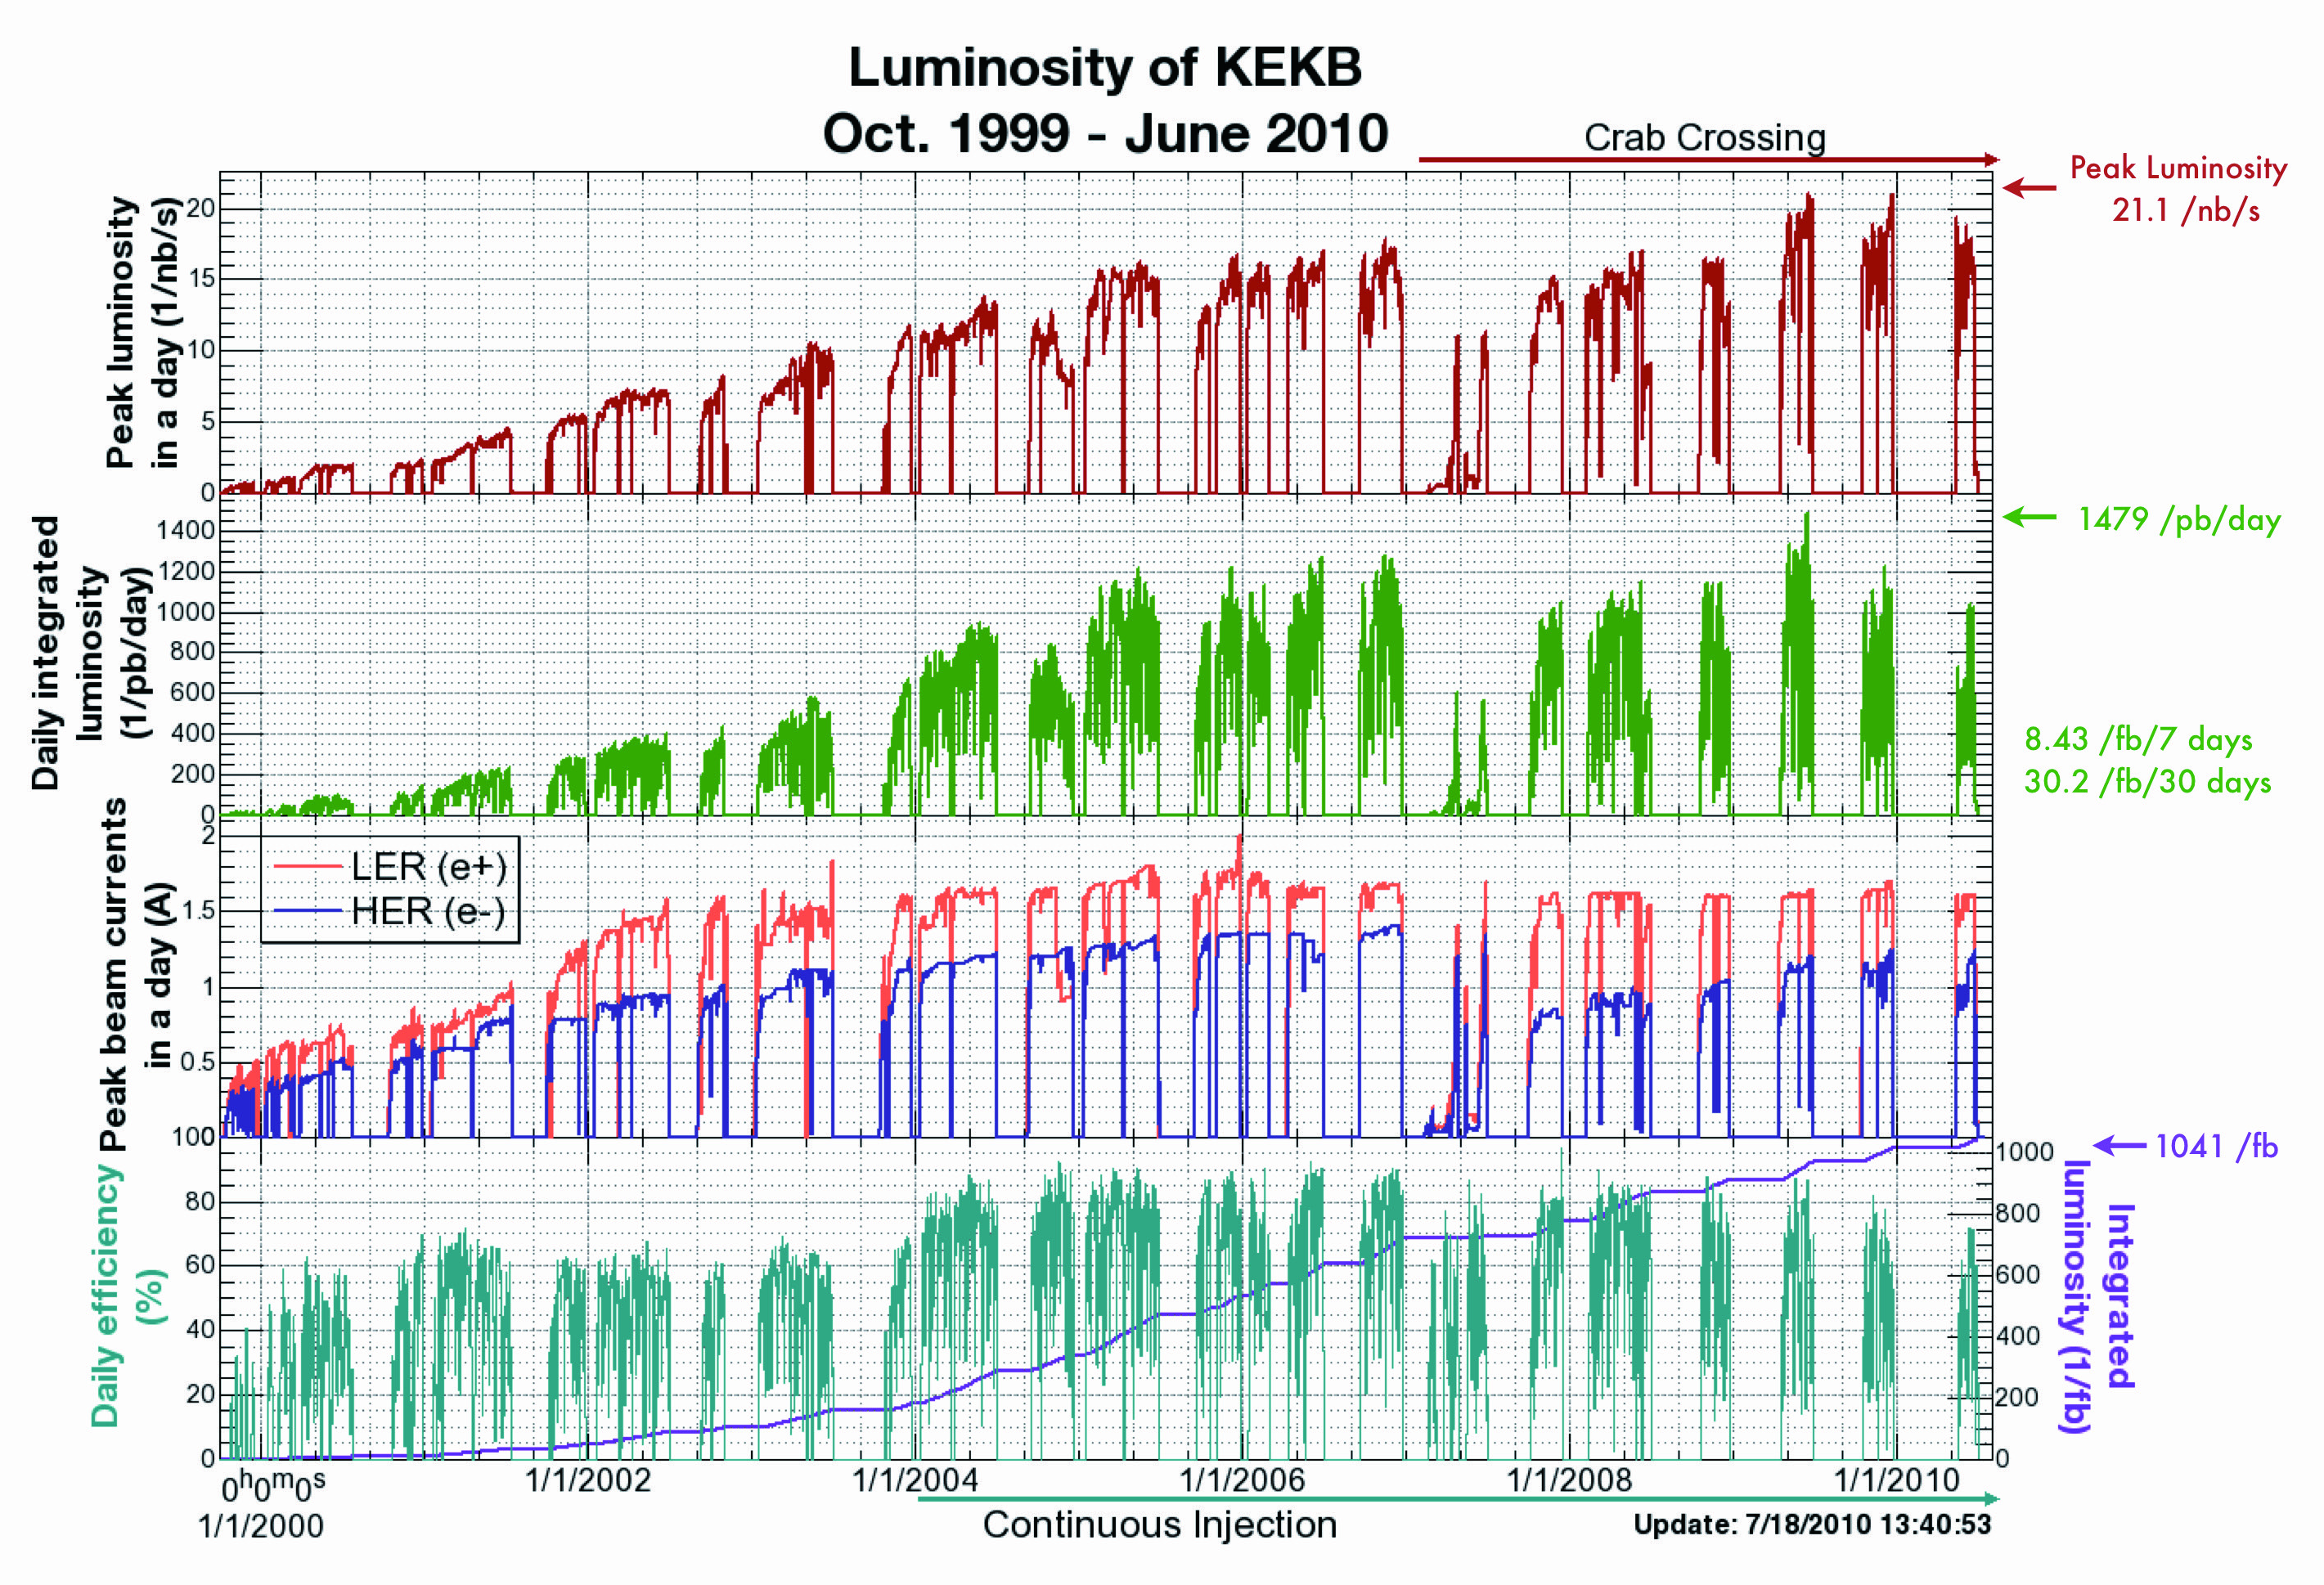
Real experience ramping up a high current collider

Slide 5
Accelerator at Day One and Ultimate
RCS:
7nC / bunch change injection scheme
5 – 10 GeV polarized e- to reach 28 nC / bunch and 18 GeV electrons
ESR:
7nC / bunch
5 – 10 GeV polarized e- add more RF cavities to reach 28 nC / bunch and 18 GeV electrons
HSR:
100 – 250 GeV polarized p update PS to reach 275 GeV protons and 110 GeV/u nuclei
100 GeV/u nuclear beams add 41 GeV bypass to get full HSR beam energy capabilities
pre-cooling at injection add strong hadron cooling to achieve ultimate beam parameters
and integrated luminosity
Proposal for the Day-One Physics and the initial years of science is driven by
  Start of the promised NSAC/NAS science program
  Alignment with expected order of commissioning the collider and ramp up of performance that comes with gain of operational experience
  Having access to new physics results early to get high impact publications, i.e. PRLs, ……

Slide 6
Initial thoughts on the EIC Commissioning Strategy
Use the same beams as for Year-1 ‘First Science’
Prefer ~130 GeV/u, which corresponds to a ‘centered’ hadron beam (path length difference ΔR ~ 0, this is achieved for a beam where Z ~ 0.5A).
Do not want to exceed the present RHIC maximum dipole fields (corresponds to 250 GeV protons or 833 T-m)
  At present, the limit is due to the DX magnets (combining dipoles at the IRs). These will be removed for EIC and the main dipoles are capable of 275 GeV proton field.
Unpolarized Electrons
Since the electron revolution frequency is fixed, the hadron orbit must be adjusted with energy to keep the collisions synchronized.
→ Our proposal for Year-1 ‘First Science’ would be to
run Ruthenium or Copper ions. Both already used
in RHIC.
3He
p
Zr
d
Au,
p
U
Ru
Cu

Slide 7
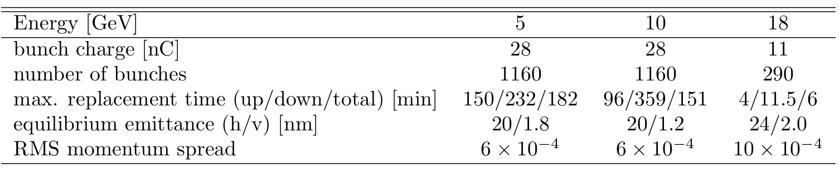
Initial thoughts on the EIC Commissioning Strategy
Advantage of 5 and 10 GeV?
we want polarization as early as possible, depolarization time due to the Sokolov-Ternov effect is small
max allowable replacement time for 10 GeV 360 mins (85% → 70%) for the preferred polarization state and 96 mins for opposite direction
→ proposal run only the preferred spin state per fill
  Consequence: need to flip the ESR spin rotators between fills to keep systematics small → possible; optics does not depend on spin rotator polarity and in the shadow of filling the HSR we change spin rotator polarity in ESR
Maximum replacement times (= max. allowable storage times in ESR) are based on 85% injected polarization and 70% time averaged polarization

Slide 8
Original Proposal for EIC Science Program in the First Years
Year - 1
Start with Phase 1 EIC
New capability
Commission electron polarization in parallel
Run:
10 GeV electrons on 115 GeV/u heavy ion beams (Ru or Cu)
→ Physics:
gives world-wide new data on nPDFs and a first look on saturation

Slide 9
Original Proposal for EIC Science Program in the First Years
Year - 1
Year - 2
Start with Phase 1 EIC
New Capability:
Commission electron polarization in parallel
Run:
10 GeV electrons on 115 GeV/u heavy ion beams (Ru or Cu)
→ Physics:
gives world-wide new data on nPDFs and a first look on saturation
Start with Phase 1 EIC
Commission electron polarization in parallel
New Capability:
Commission hadron polarization in parallel
Run:
10 GeV electrons on 130 GeV/u deuterium
Physics:
gives world-wide new data → critical baseline for nPDFs and saturation
free vs. bound proton structure
Run:
Last weeks 10 GeV electrons and 100 GeV polarized protons
Physics:
first look to 3d imaging of the proton

Slide 10
Original Proposal for EIC Science Program in the First Years
Year - 1
Year - 2
Year - 3
Start with Phase 1 EIC
New Capability:
Commission electron polarization in parallel
Run:
10 GeV electrons on 115 GeV/u heavy ion beams (Ru or Cu)
→ Physics:
gives world-wide new data on nPDFs and a first look on saturation
Start with Phase 1 EIC
Commission electron polarization in parallel
New Capability:
Commission hadron polarization in parallel
Run:
10 GeV electrons on 130 GeV/u Deuterium
Physics:
gives world-wide new data → critical baseline for nPDFs and saturation
free vs. bound proton structure
Run:
Last weeks 10 GeV electrons and 100 GeV polarized protons
Physics:
first look to 3d imaging of the proton
Start with Phase 1 EIC
Commission electron polarization in parallel
Commission hadron polarization in parallel
New Capability:
Commission running with hadron spin rotators
Run:
10 GeV electrons on 130 GeV transverse polarized protons
Physics:
3d imaging of the proton / mass of the nucleon
Run:
Last weeks switch to longitudinal proton polarization
Physics:
first look helicity structure of the proton – unravel quark, gluon and orbital angular contributions

Slide 11
Original Proposal for EIC Science Program in the First Years
Year - 1
Year - 2
Year - 3
Year - 4
Start with Phase 1 EIC
New Capability:
Commission electron polarization in parallel
Run:
10 GeV electrons and 115 GeV/u heavy ion beams (Ru or Cu)
→ Physics:
gives world-wide new data on nPDFs and a first look on saturation
Start with Phase 1 EIC
Commission electron polarization in parallel
New Capability:
Commission hadron polarization in parallel
Run:
10 GeV electrons and 130 GeV/u Deuterium
Physics:
gives world-wide new data → critical baseline for nPDFs and saturation
free vs. bound proton structure
Run:
Last weeks 10 GeV electrons and 100 GeV polarized protons
Physics:
first look to 3d imaging of the proton
Start with Phase 1 EIC
Commission electron polarization in parallel
Commission hadron polarization in parallel
New Capability:
Commission running with hadron spin rotators
Run:
10 GeV electrons and 130 GeV transverse polarized protons
Physics:
3d imaging of the proton / mass of the nucleon
Run:
Last weeks switch to longitudinal proton polarization
Physics:
first look helicity structure of the proton – unravel quark, gluon and orbital angular contributions
Start with Phase 1 EIC
Commission electron polarization in parallel
Commission hadron polarization in parallel
Commission running with hadron spin rotators
New Capability:
Commission hadron accelerator to operate with not centered orbits
Run:
10 GeV electrons and 250 GeV transverse and longitudinal polarized protons
Physics:
3d imaging of the proton at low x
helicity structure of the proton – unravel quark, gluon and orbital angular contributions

Slide 12
Original Proposal for EIC Science Program in the First Years
Year - 1
Year - 2
Year - 3
Year - 4
Year - 5
Start with Phase 1 EIC
New Capability:
Commission electron polarization in parallel
Run:
10 GeV electrons and 115 GeV/u heavy ion beams (Ru or Cu)
→ Physics:
gives world-wide new data on nPDFs and a first look on saturation
Start with Phase 1 EIC
Commission electron polarization in parallel
New Capability:
Commission hadron polarization in parallel
Run:
10 GeV electrons and 130 GeV/u Deuterium
Physics:
gives world-wide new data → critical baseline for nPDFs and saturation
free vs. bound proton structure
Run:
Last weeks 10 GeV electrons and 100 GeV polarized protons
Physics:
first look to 3d imaging of the proton
Start with Phase 1 EIC
Commission electron polarization in parallel
Commission hadron polarization in parallel
New Capability:
Commission running with hadron spin rotators
Run:
10 GeV electrons and 130 GeV transverse polarized protons
Physics:
3d imaging of the proton / mass of the nucleon
Run:
Last weeks switch to longitudinal proton polarization
Physics:
first look helicity structure of the proton – unravel quark, gluon and orbital angular contributions
Start with Phase 1 EIC
Commission electron polarization in parallel
Commission hadron polarization in parallel
Commission running with hadron spin rotators
New Capability:
Commission hadron accelerator to operate with not centered orbits
Run:
10 GeV electrons and 250 GeV transverse and longitudinal polarized protons
Physics:
3d imaging of the proton at low x
helicity structure of the proton – unravel quark, gluon and orbital angular contributions
Start with Phase 1 EIC
Commission electron polarization in parallel
Commission hadron polarization in parallel
Commission running with hadron spin rotators
Commission hadron accelerator to operate with not centered orbits
Run:
10 GeV electrons and 166 GeV transverse and longitudinal polarized He-3
Physics:
3d imaging of the nucleons → flavor separation
helicity structure of the nucleon– unravel helicities for different quark flavors
first look to nuclear binding

Slide 13
Proposal for EIC Science Program in the First Years
Year - 1
Year - 2
Year - 3
Year - 4
Year - 5
Start with Phase 1 EIC
New Capability:
Commission electron polarization in parallel
Run:
10 GeV electrons on 115 GeV/u heavy ion beams (Ru or Cu)
→ Physics:
gives world-wide new data on nPDFs and a first look on saturation
Start with Phase 1 EIC
Commission electron polarization in parallel
New Capability:
Commission hadron polarization in parallel
Run:
10 GeV electrons on 130 GeV/u Deuterium
Physics:
gives world-wide new data → critical baseline for nPDFs and saturation
free vs. bound proton structure
Run:
Last weeks 10 GeV electrons and 100 GeV polarized protons
Physics:
first look to 3d imaging of the proton
Start with Phase 1 EIC
Commission electron polarization in parallel
Commission hadron polarization in parallel
New Capability:
Commission running with hadron spin rotators
Run:
10 GeV electrons on 130 GeV transverse polarized protons
Physics:
3d imaging of the proton / mass of the nucleon
Run:
Last weeks switch to longitudinal proton polarization
Physics:
first look helicity structure of the proton – unravel quark, gluon and orbital angular contributions
Start with Phase 1 EIC
Commission electron polarization in parallel
Commission hadron polarization in parallel
Commission running with hadron spin rotators
New Capability:
Commission hadron accelerator to operate with not centered orbits
Run:
10 GeV electrons on 250 GeV transverse and longitudinal polarized protons
Physics:
3d imaging of the proton at low x
helicity structure of the proton – unravel quark, gluon and orbital angular contributions
Start with Phase 1 EIC
Commission electron polarization in parallel
Commission hadron polarization in parallel
Commission running with hadron spin rotators
Commission hadron accelerator to operate with not centered orbits
Run:
10 GeV electrons on 166 GeV transverse and longitudinal polarized He-3
Physics:
3d imaging of the nucleons → flavor separation
helicity structure of the nucleon– unravel helicities for different quark flavors
first look to nuclear binding
Time to install additional ESR RF and HSR PS to
reach design Current and max. Energies

Slide 14
Original Proposal for EIC Science Program in the First Years
Year - 5
Year - 6
Year - 7
Start with Phase 1 EIC
Commission electron polarization in parallel
Commission hadron polarization in parallel
Commission running with hadron spin rotators
Commission hadron accelerator to operate with not centered orbits
Run:
10 GeV electrons on 166 GeV transverse and longitudinal polarized He-3
Physics:
3d imaging of the nucleons → flavor separation
helicity structure of the nucleon– unravel helicities for different quark flavors
first look to nuclear binding
Start with Phase 1 EIC
Commission electron polarization in parallel
Commission hadron polarization in parallel
Commission running with hadron spin rotators
Commission hadron accelerator to operate with not centered orbits
New Capability:
Commission ESR & HSR at max. energy and beam currents
Run:
18 GeV polarized electrons on 110 GeV/u Au (Pb) beams
Physics:
ultimate x-Q² reach for saturation physics
Start with Phase 1 EIC
Commission electron polarization in parallel
Commission hadron polarization in parallel
Commission running with hadron spin rotators
Commission hadron accelerator to operate with not centered orbits
Commission ESR & HSR at max. energy and beam currents
New Capability:
Operate HSR with 41 GeV bypass
Run:
5 GeV polarized electrons on 41 GeV transverse polarized proton beams
Physics:
first look to moderate-x 3d imaging and Kaon structure/ mass

Slide 15
Updated Proposal to account for Comments
during EIC-UG/ePIC Summer Meeting

Slide 16
Proposal for EIC Science Program in the First Years
Year - 1
Year - 2
Year - 3
Year - 4
Year - 5
Start with Phase 1 EIC
New Capability:
Commission electron polarization in parallel
Run:
10 GeV electrons on 115 GeV/u heavy ion beams (Ru or Cu)
→ Physics:
gives world-wide new data on nPDFs, NFF and a first look on saturation
Start with Phase 1 EIC
Commission electron polarization in parallel
New Capability:
Commission hadron polarization in parallel
Run:
10 GeV electrons on 130 GeV/u Deuterium
Physics:
gives world-wide new data → critical baseline for nPDFs and saturation
free vs. bound proton structure
Run:
Last weeks 10 GeV electrons and 100 GeV polarized protons
Physics:
first look to 3d imaging of the proton
Start with Phase 1 EIC
Commission electron polarization in parallel
Commission hadron polarization in parallel
New Capability:
Commission running with hadron spin rotators
Run:
10 GeV electrons on 130 GeV transverse polarized protons
Physics:
3d imaging of the proton / mass of the nucleon
Run:
Last weeks switch to longitudinal proton polarization
Physics:
first look helicity structure of the proton – unravel quark, gluon and orbital angular contributions
Start with Phase 1 EIC
Commission electron polarization in parallel
Commission hadron polarization in parallel
Commission running with hadron spin rotators
New Capability:
Commission hadron accelerator to operate with not centered orbits
Run:
10 GeV electrons on 100 GeV Au
→ Physics:
gives world-wide new data on A-dep.of nPDFs, nFF and saturation
Run:
10 GeV electrons on 250 GeV transverse and longitudinal polarized protons
Physics:
3d imaging of the proton at low x
helicity structure of the proton – unravel quark, gluon and orbital angular contributions
Start with Phase 1 EIC
Commission electron polarization in parallel
Commission hadron polarization in parallel
Commission running with hadron spin rotators
Commission hadron accelerator to operate with not centered orbits
Run:
10 GeV electrons on 100 GeV Au
→ Physics:
gives world-wide new data on A-dep.of nPDFs, nFF and saturation
Run:
10 GeV electrons on 166 GeV transverse and longitudinal polarized He-3
Physics:
3d imaging of the nucleons → flavor separation
helicity structure of the nucleon– unravel helicities for different quark flavors
first look to nuclear binding
Time to install additional ESR RF and HSR PS to
reach design Current and max. Energies

Slide 17
Proposal for EIC Science Program in the First Years
Year - 5
Year - 6
Year - 7
Start with Phase 1 EIC
Commission electron polarization in parallel
Commission hadron polarization in parallel
Commission running with hadron spin rotators
Commission hadron accelerator to operate with not centered orbits
Run:
10 GeV electrons on 100 GeV Au
→ Physics:
gives world-wide new data on A-dep.of nPDFs, nFF and saturation
Run:
10 GeV electrons on 166 GeV transverse and longitudinal polarized He-3
Physics:
3d imaging of the nucleons → flavor separation
helicity structure of the nucleon– unravel helicities for different quark flavors
first look to nuclear binding
Start with Phase 1 EIC
Commission electron polarization in parallel
Commission hadron polarization in parallel
Commission running with hadron spin rotators
Commission hadron accelerator to operate with not centered orbits
New Capability:
Commission ESR & HSR at max. energy and beam currents
Run:
18 GeV polarized electrons on 275 GeV/u polarized (longitudinal & transverse) proton beams
Physics:
3d imaging of the proton at low x
helicity structure of the proton – unravel quark, gluon and orbital angular contributions
Start with Phase 1 EIC
Commission electron polarization in parallel
Commission hadron polarization in parallel
Commission running with hadron spin rotators
Commission hadron accelerator to operate with not centered orbits
Commission ESR & HSR at max. energy and beam currents
New Capability:
Operate HSR with 41 GeV bypass
Run:
5 GeV polarized electrons on 41 GeV transverse polarized proton beams
Physics:
first look to moderate-x 3d imaging and Kaon structure/ mass

Slide 18
Summary
There is a science program with many world-first possible based on the phase-1 machine
  → All the NAS/NSAC Science topics can be started
Proposal for EIC Science Program in the First Years has been developed and presented to the ePIC collaboration / EIC-UG in the July meeting
  The proposal was well received
  → One comment was to have an eA run again earlier than year-6. See backup slides 20-21 as one option.
ePIC is holding a dedicated meeting on “early” science followed by others 13th of September

Slide 19


Slide 20


