Slide 1
Modular RICH Simulation and Beam Test Result
Cheuk-Ping Wong
Georgia State University
10-10-2016

Slide 2
Beam and Detector Setup
Simulation
Beam Test
Beam
120 GeV proton
Toward the center of detector perpendicularly
1,000 events
Detector
Marco’s agel (n=1.03)
Fresnel lens
Mirror set
Beam
120 GeV proton
Toward the center of detector perpendicularly
~1200 events
Detector
Marco’s agel (n=1.03)
Fresnel lens
Mirror set

Slide 3
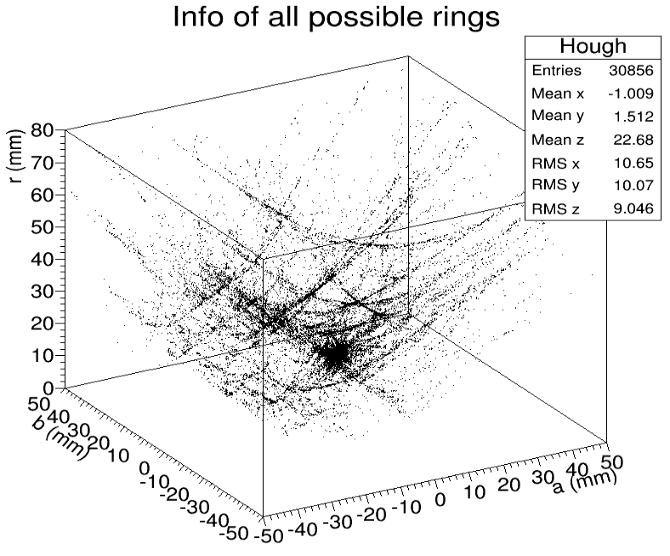
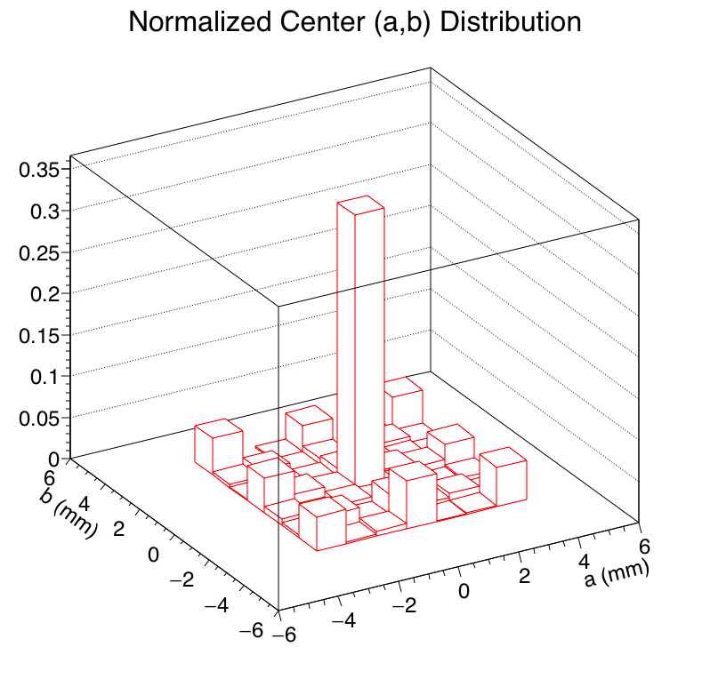
Ring Finder Analysis Procedure
Accumulated Data of Entire Run

Slide 4
Ring Finder Algorithm Update
No Chopping on center position
When filling 3D (a,b,r) histogram
Center position(a,b) cut:
If (|a|>3mm or |b|>3mm) skip;
Not considered
✘
✘

Slide 5
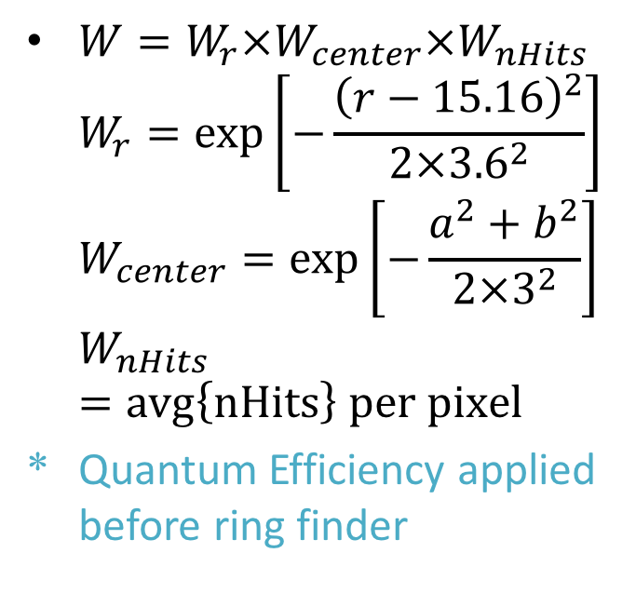
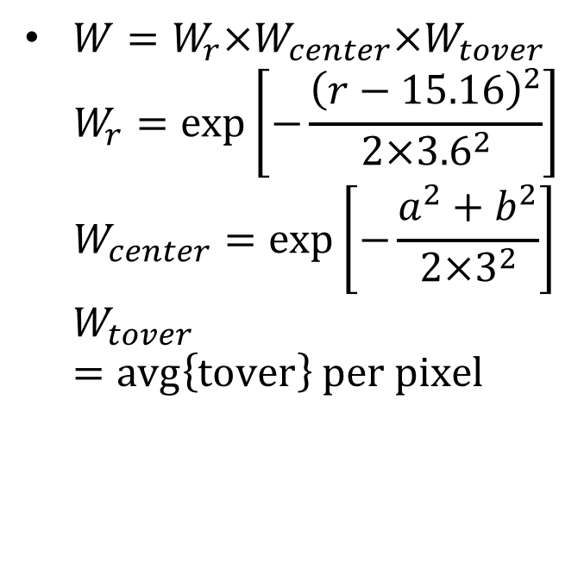
Ring Finder Algorithm
Expected value and uncertainty
from simulation result
Suppose Cherenkov rings are centered on the sensor plane
Simulation
Run 70
$W=W_{r}×W_{center}×W_{nHits}$ $W_{r}=\exp\left[−\frac{{\left(r−15.16\right)}^{2}}{2×{3.6}^{2}}\right]$ $W_{center}=\exp\left[−\frac{a^{2}+b^{2}}{2×3^{2}}\right]$ $W_{nHits}=\text{avg}\left\{\text{nHits}\right\} \text{per} \text{pixel}$
Quantum Efficiency applied before ring finder
$W=W_{r}×W_{center}×W_{tover}$ $W_{r}=\exp\left[−\frac{{\left(r−15.16\right)}^{2}}{2×{3.6}^{2}}\right]$ $W_{center}=\exp\left[−\frac{a^{2}+b^{2}}{2×3^{2}}\right]$ $W_{tover}=\text{avg}\left\{\text{tover}\right\} \text{per} \text{pixel}$
tover: Time over threshold, signal amplitude

Slide 6
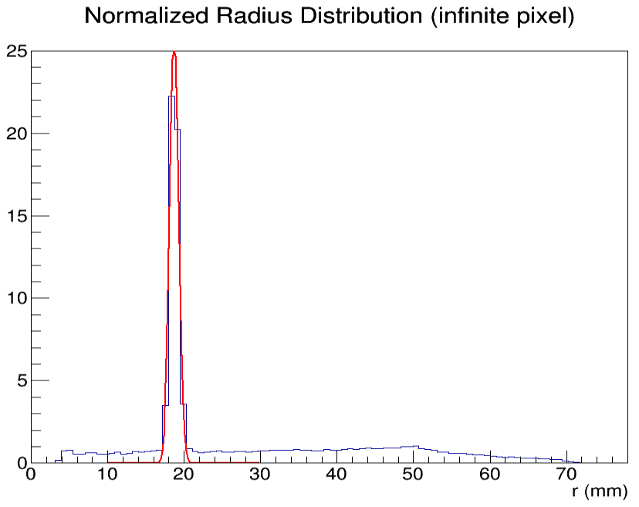
Radius (in each event) Distribution
Sensor 2
Sensor 1
r_{expected}
r≈18.7±0.60 mm
3.54mm
Radius of each photon hit from simulation result.
No Q.E. applied
Sensor 3
Sensor 4
Not on scale
r_{expected} =18.7-3.54 (gap) ±0.60 ±3 (half of single pixel size)
=15.16 ±3.6mm

Slide 7
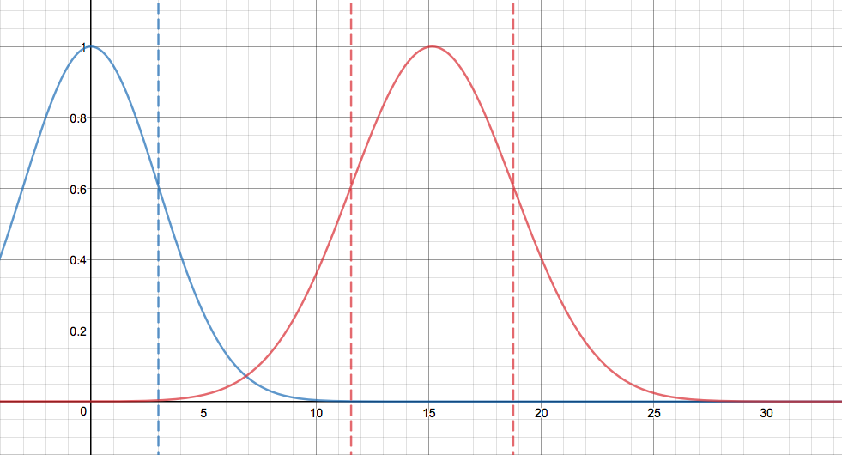
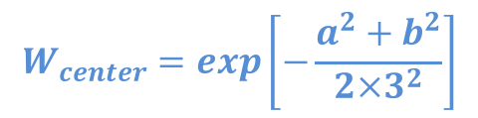
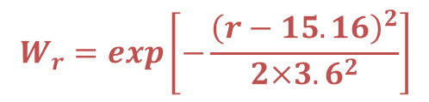
Weight Functions
$$W_{center}=\exp\left[−\frac{a^{2}+b^{2}}{2×3^{2}}\right]$$
$$W_{r}=\exp\left[−\frac{{\left(r−15.16\right)}^{2}}{2×{3.6}^{2}}\right]$$
√(a²+b²) (mm) / r (mm)

Slide 8
Event Displays from Simulation
Num of hits

Slide 9
Event Displays from Beam Test Data
Signal Amplitude

Slide 10
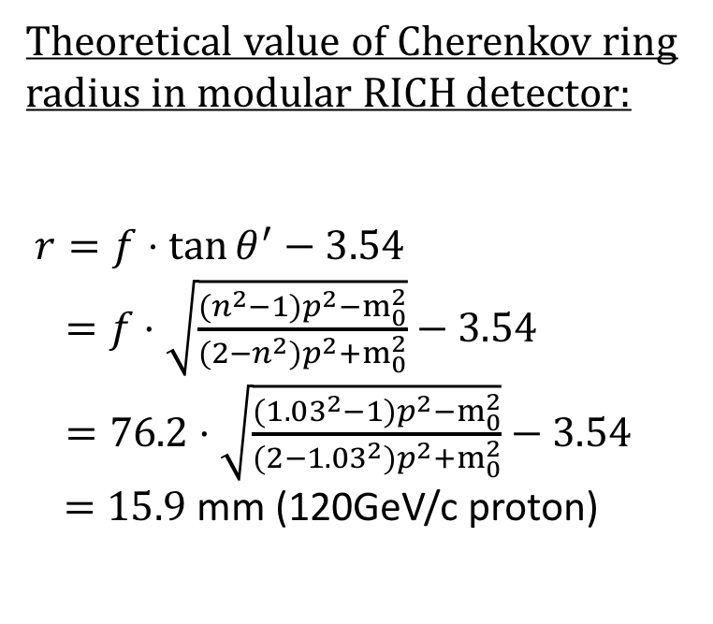
Cherenkov Ring Radius
Focal plane
Aerogel
Air
Theoretical value of Cherenkov ring radius in modular RICH detector:
$r=f⋅\tan{θ^{′}}−3.54$
$=f⋅\sqrt{\frac{{(n}^{2}{−1)p}^{2}−m_{0}^{2}}{\left(2−n^{2}\right)p^{2}+m_{0}^{2}}}−3.54$
$=76.2⋅\sqrt{\frac{{(1.03}^{2}{−1)p}^{2}−m_{0}^{2}}{\left(2−{1.03}^{2}\right)p^{2}+m_{0}^{2}}}−3.54$ $=15.9$ mm (120GeV/c proton)
Proportional to focal length
Sensor plane setup
Cherenkov photons
θ’
r
θ
θ
θ’
Incident particle
f
lens
Ring size is independent on thickness of the aerogel or air gap

Slide 11
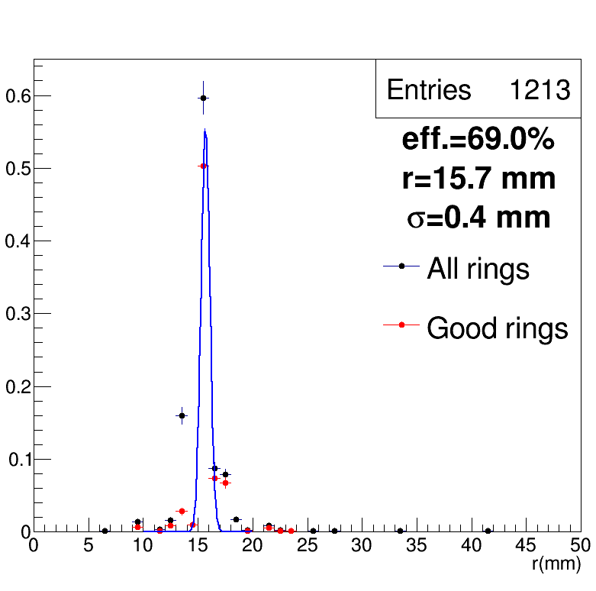
Cherenkov Ring Radius
Simulation
Beam Test
Good ring:
radius is within expected range
Distance from the sensor center to the ring center is within 3mm
Notes:
Since the Ring Finder algorithm will always give a a ring. We have to evaluate the found rings properties.

Slide 12
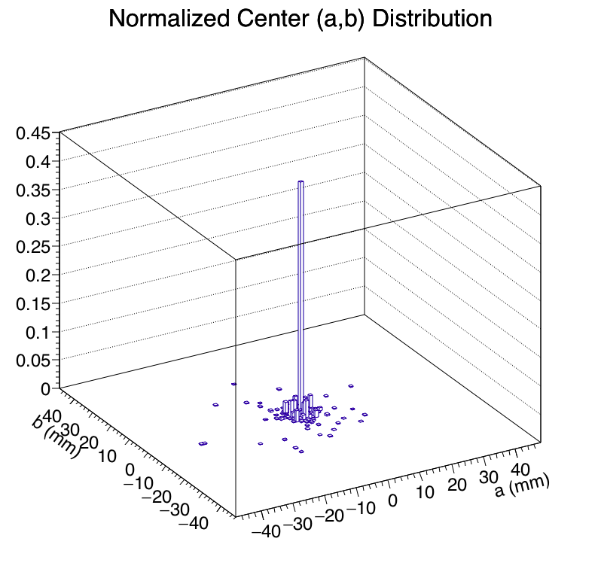
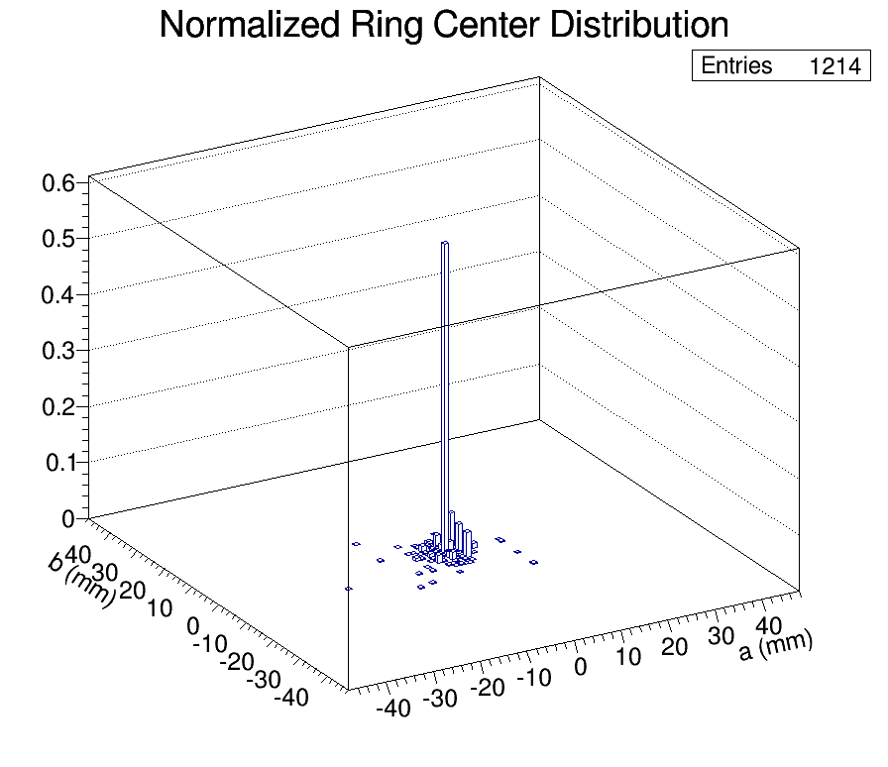
Center Distribution
Simulation
Run 70

Slide 13
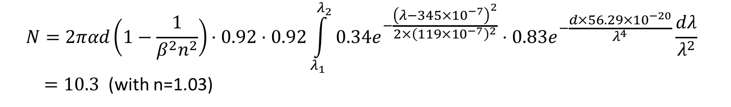
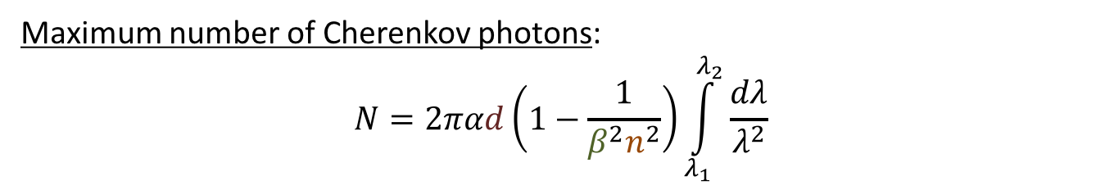
Number of Cherenkov Photons per Event
Maximum number of Cherenkov photons:
$$N=2παd\left(1−\frac{1}{β^{2}n^{2}}\right)\int_{λ_{1}}^{λ_{2}}{\frac{dλ}{λ^{2}}}$$
Fine structure const.
Thickness of radiator
β=v/c
Refractive index of radiator
Estimated number of Cherenkov photons in modular RICH detector:
Fresnel lens transmission
Sensor quantum efficiency
$$N=2παd\left(1−\frac{1}{β^{2}n^{2}}\right)⋅0.92⋅0.92\int_{λ_{1}}^{λ_{2}}{0.34e^{−\frac{{\left(λ−345×{10}^{−7}\right)}^{2}}{2×{\left(119×{10}^{−7}\right)}^{2}}}⋅0.83e^{−\frac{d×56.29×{10}^{−20}}{λ^{4}}}}\frac{dλ}{λ^{2}}$$
$=10.3$ (with n=1.03)
Aerogel transmission
Glass window transmission

Slide 14
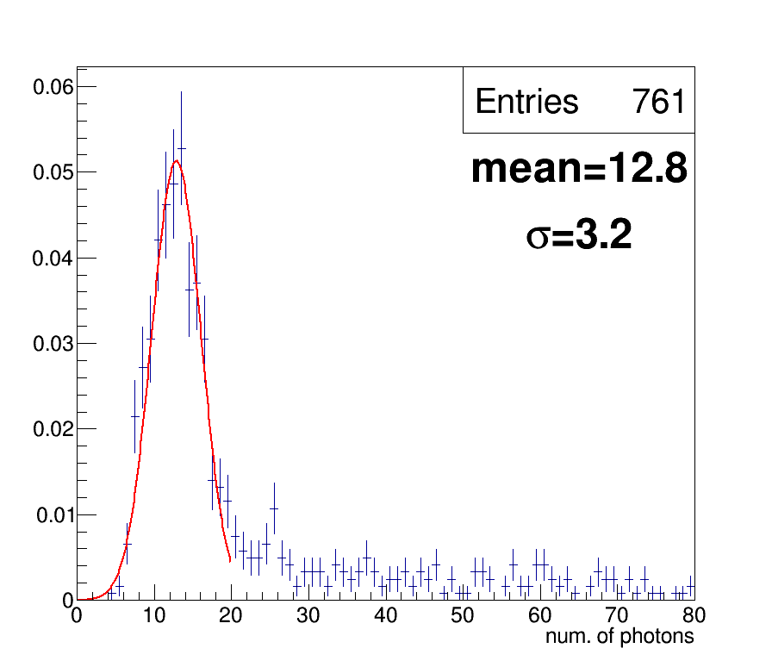
Number of Cherenkov Photons per Event
Simulation
Beam Test
Only consider the events that give good rings
Notes:
Agree with theoretical number

Slide 15
Summary
Ring Finder Algorithm is applied on beam test data
 | Theoretical number | Simulation | Beam Test
Cherenkov Ring Radius | 15.9mm | 15.5±0.1 mm | 15.7±0.4 mm
Num. of Cherenkov Photons | 10.33 | 11.0±2.8 | 12.8±3.2
Efficiency | / | 74.0% | 69.0%

