Slide 1
Performance Study of a Prototype Modular RICH Detector for EIC Experiments
Cheuk-Ping Wong
Georgia State University
For eRD14 Collaboration

Slide 2
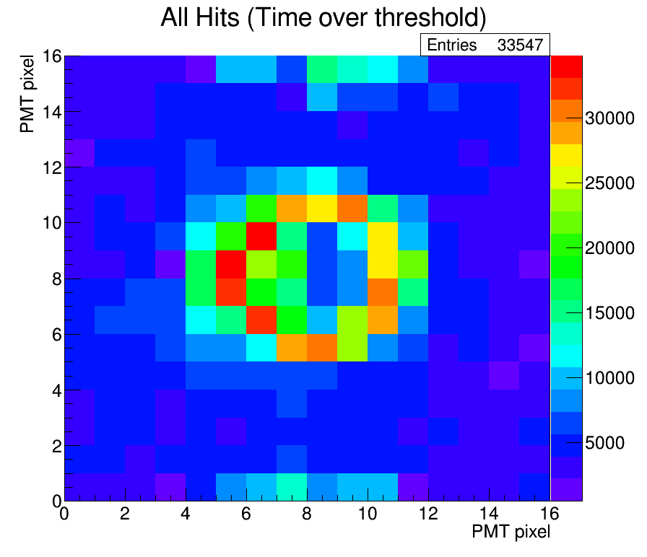
Outline
Electron Ion Collider
Prototype and Beam test
Detector Design
Beam Test Setup
Result
Ring Finder Algorithm
Cherenkov Ring Radius
Number of Cherenkov Photons
Future Works
Accumulated hit map from simulation (left) and beam test (right) results

Slide 3
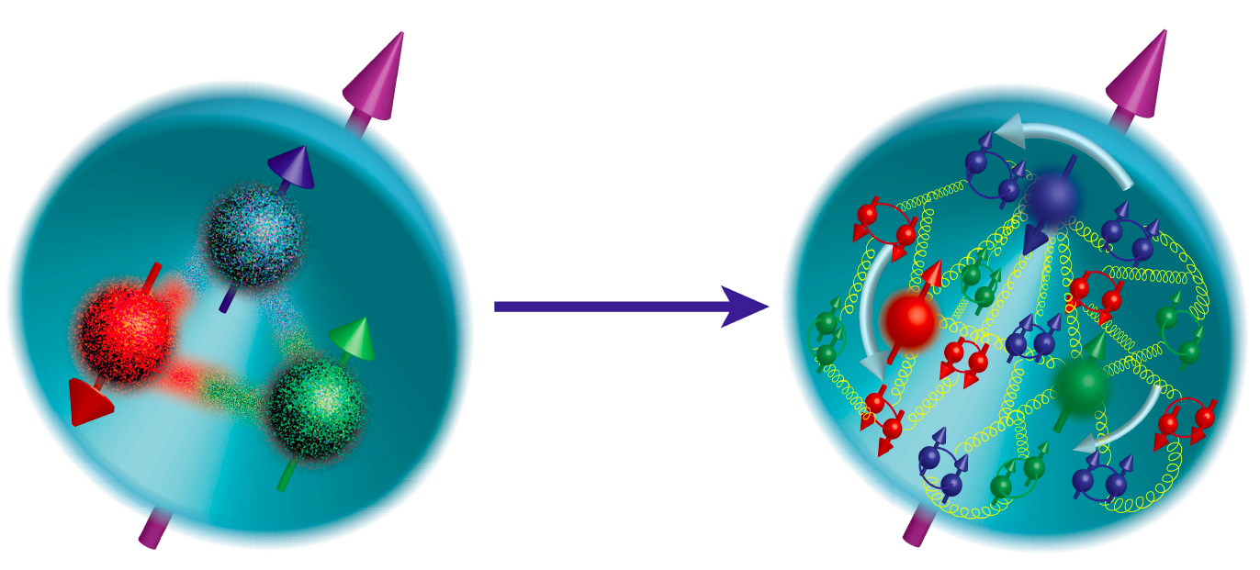
Electron Ion Collider (EIC)
Advance the knowledge of nucleon structure
Final kaon and pion products
SIDIS
3D tomography of nucleon
Gluon Saturation
Gluon distribution inside proton

Slide 4
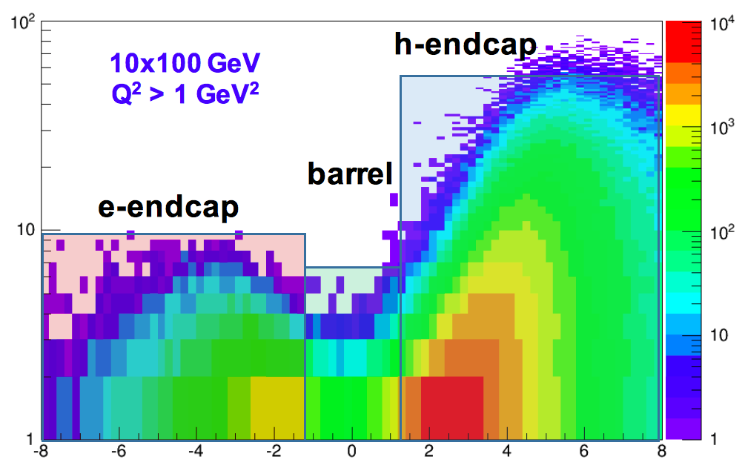
Hadron Products Kinematic in EIC
Final hadron energy (GeV)
Modular RICH
rapidity
Notes:
10 GeV e- vs 100 GeV proton
Thick radiator become a problem when there are fringe field

Slide 5
Prototype and Beam Test

Slide 6
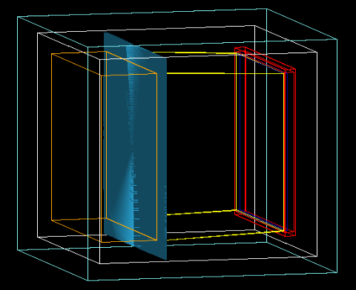
Design of 1st Modular RICH Prototype
Aerogel | Thickness = 3.3cm Refractive index n = 1.03
Fresnel Lens | 262 grooves Focal length f = 7.62cm
Mirror set | On four sides: top, bottom, left and right
Sensor plane | Effective area = 9.6cm x 9.6cm Pixel size = 6mm x 6mm
mirror
Fresnel lens
Sensor and readout
mirror
Aerogel
Acrylic box
Hollow space
Notes:
Design of the 1st prototype

Slide 7
Lens Based Design
Focal plane
Focal plane
Advantages of lens-based design:
Transform circle plane image to a ring image → Sharper signal
For all incident particles that move parallel to the z axis of the detector, the ring which is off center will be shifted toward to the center of the sensor plane
Cherenkov photons
r
Cherenkov photons
r
θ
θ
θ
θ
Incident particle
Incident particle
f
f
lens
lens
w/ Fresnel lens
w/o Fresnel lens
w/ Fresnel lens
w/o Fresnel lens

Slide 8
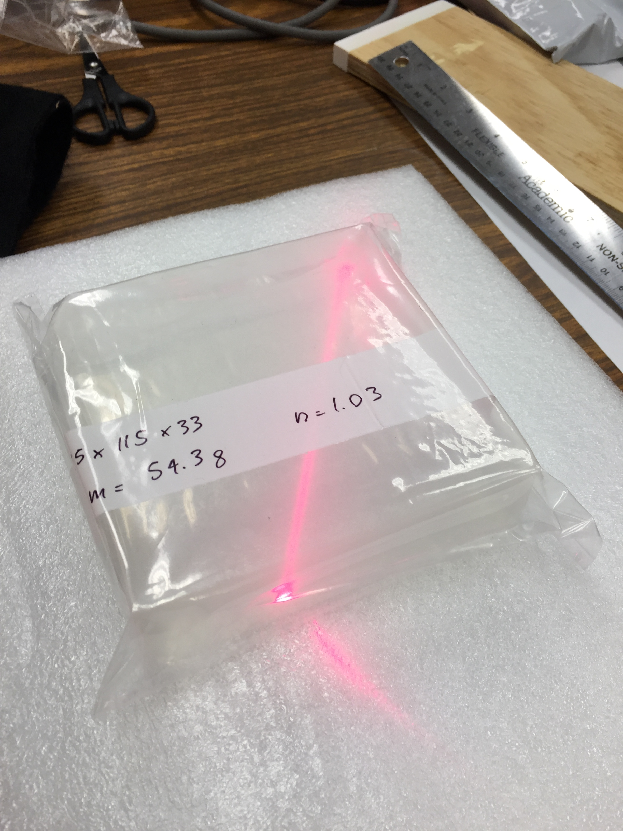
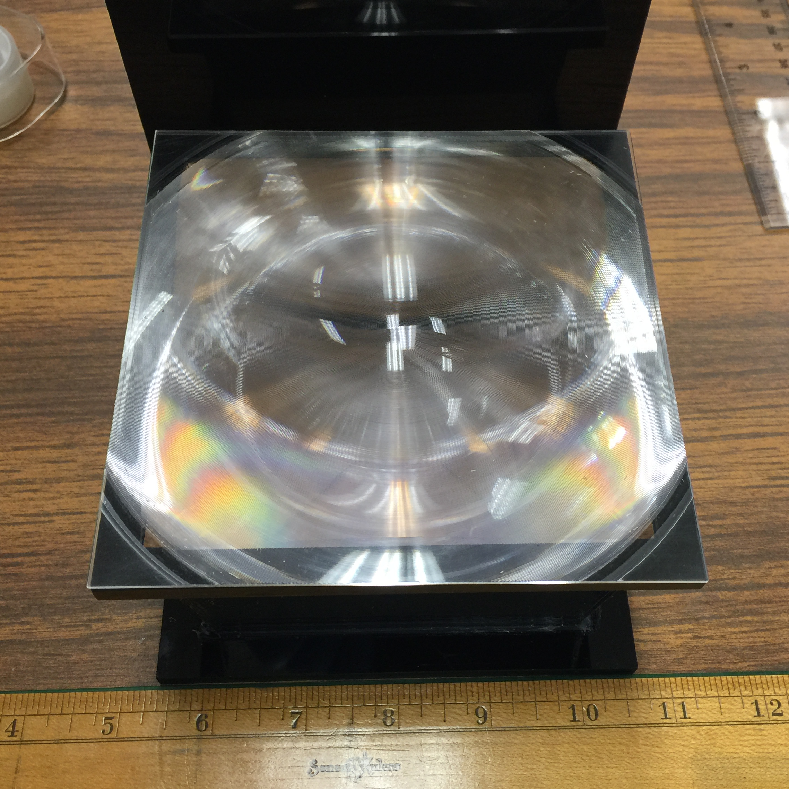
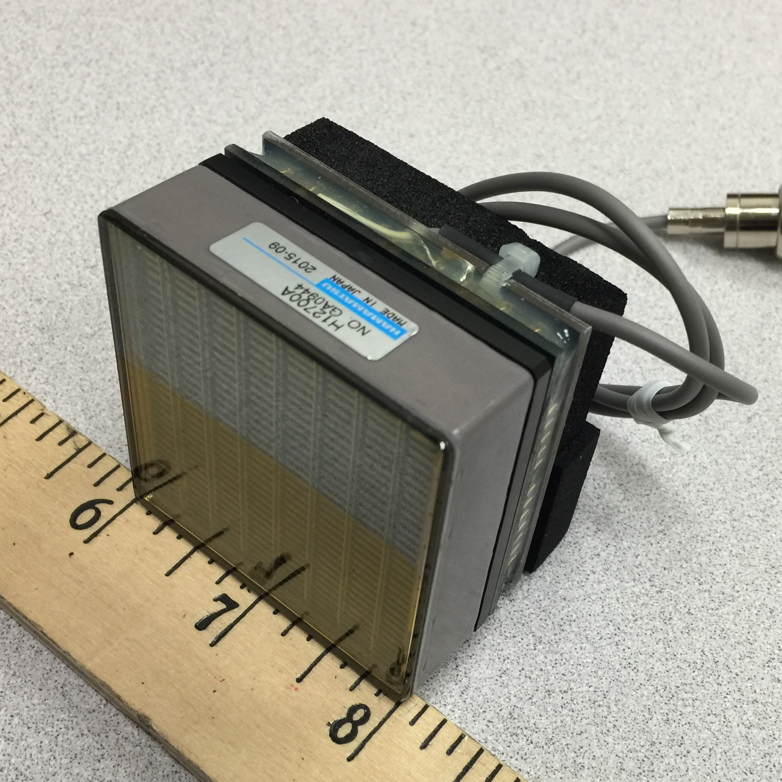
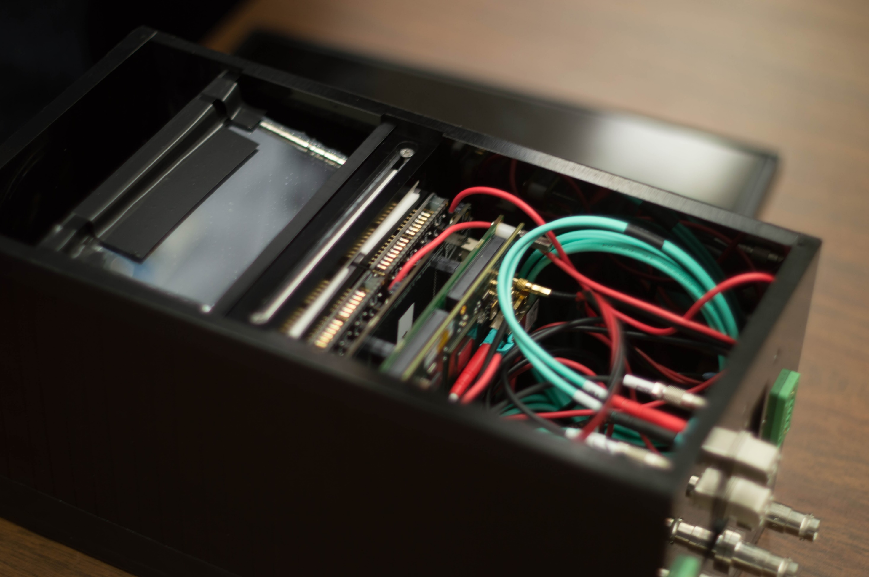
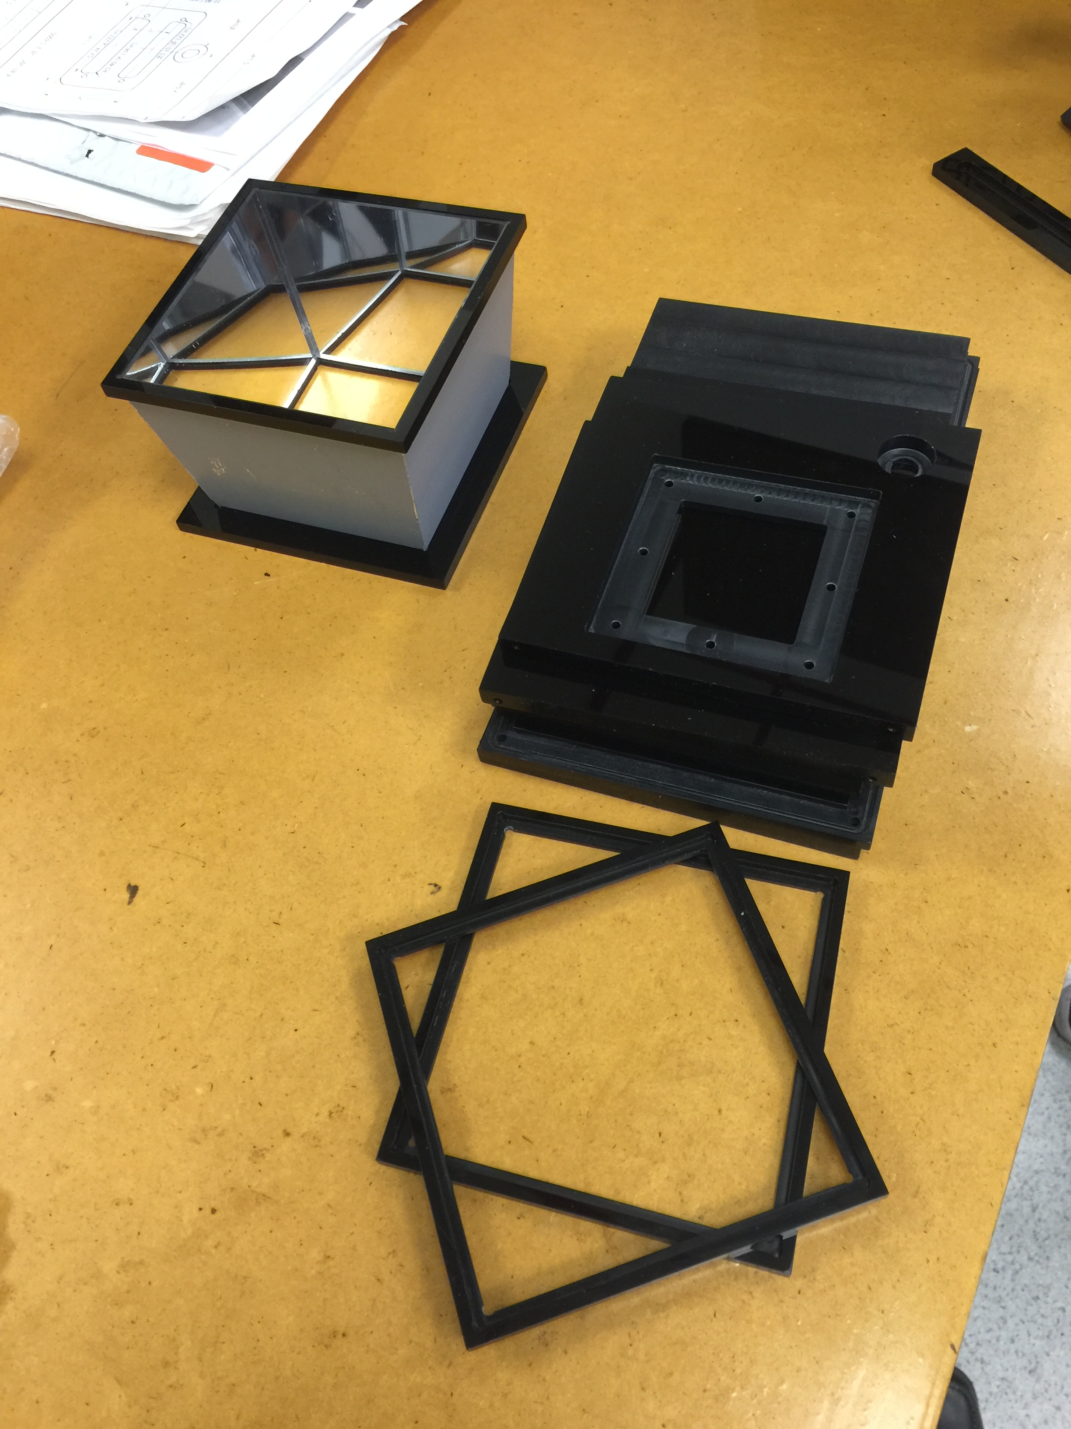
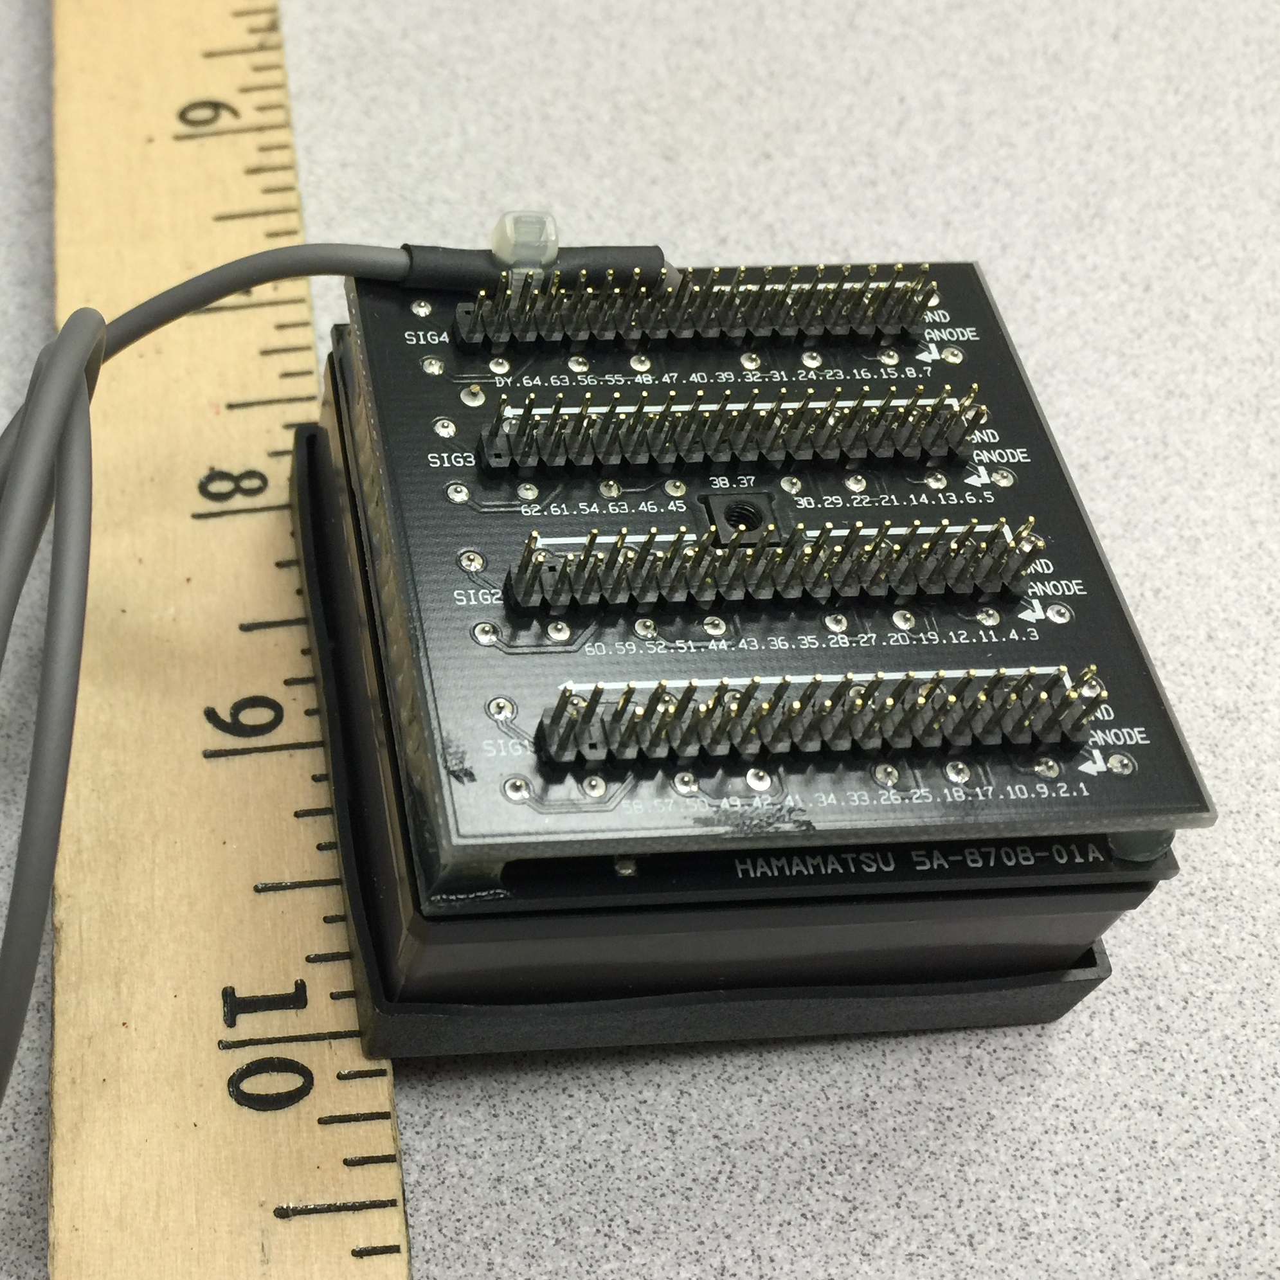
1st Prototype
Front
Aerogel
Fresnel Lens
&
Mirror Set
Photon Sensor
&
Readout Electronics
Back
Notes:
Hamamatsu mutianode pmt.
Cover sensor plane

Slide 9
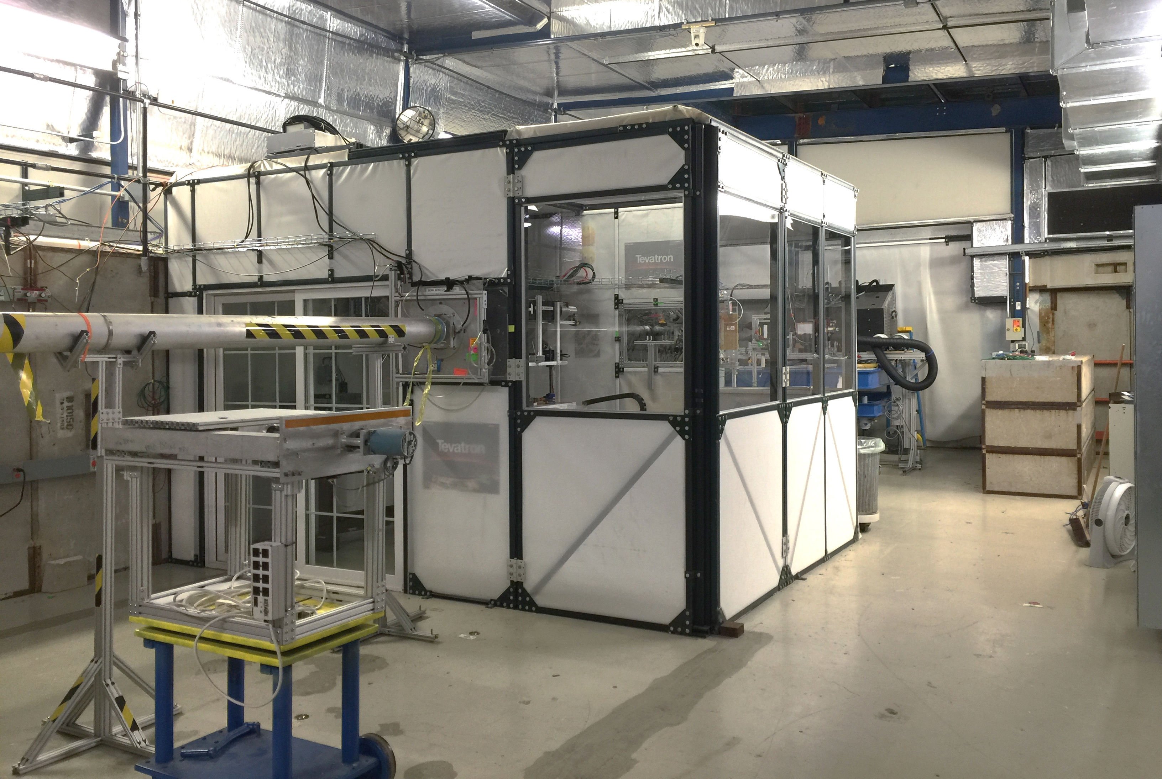
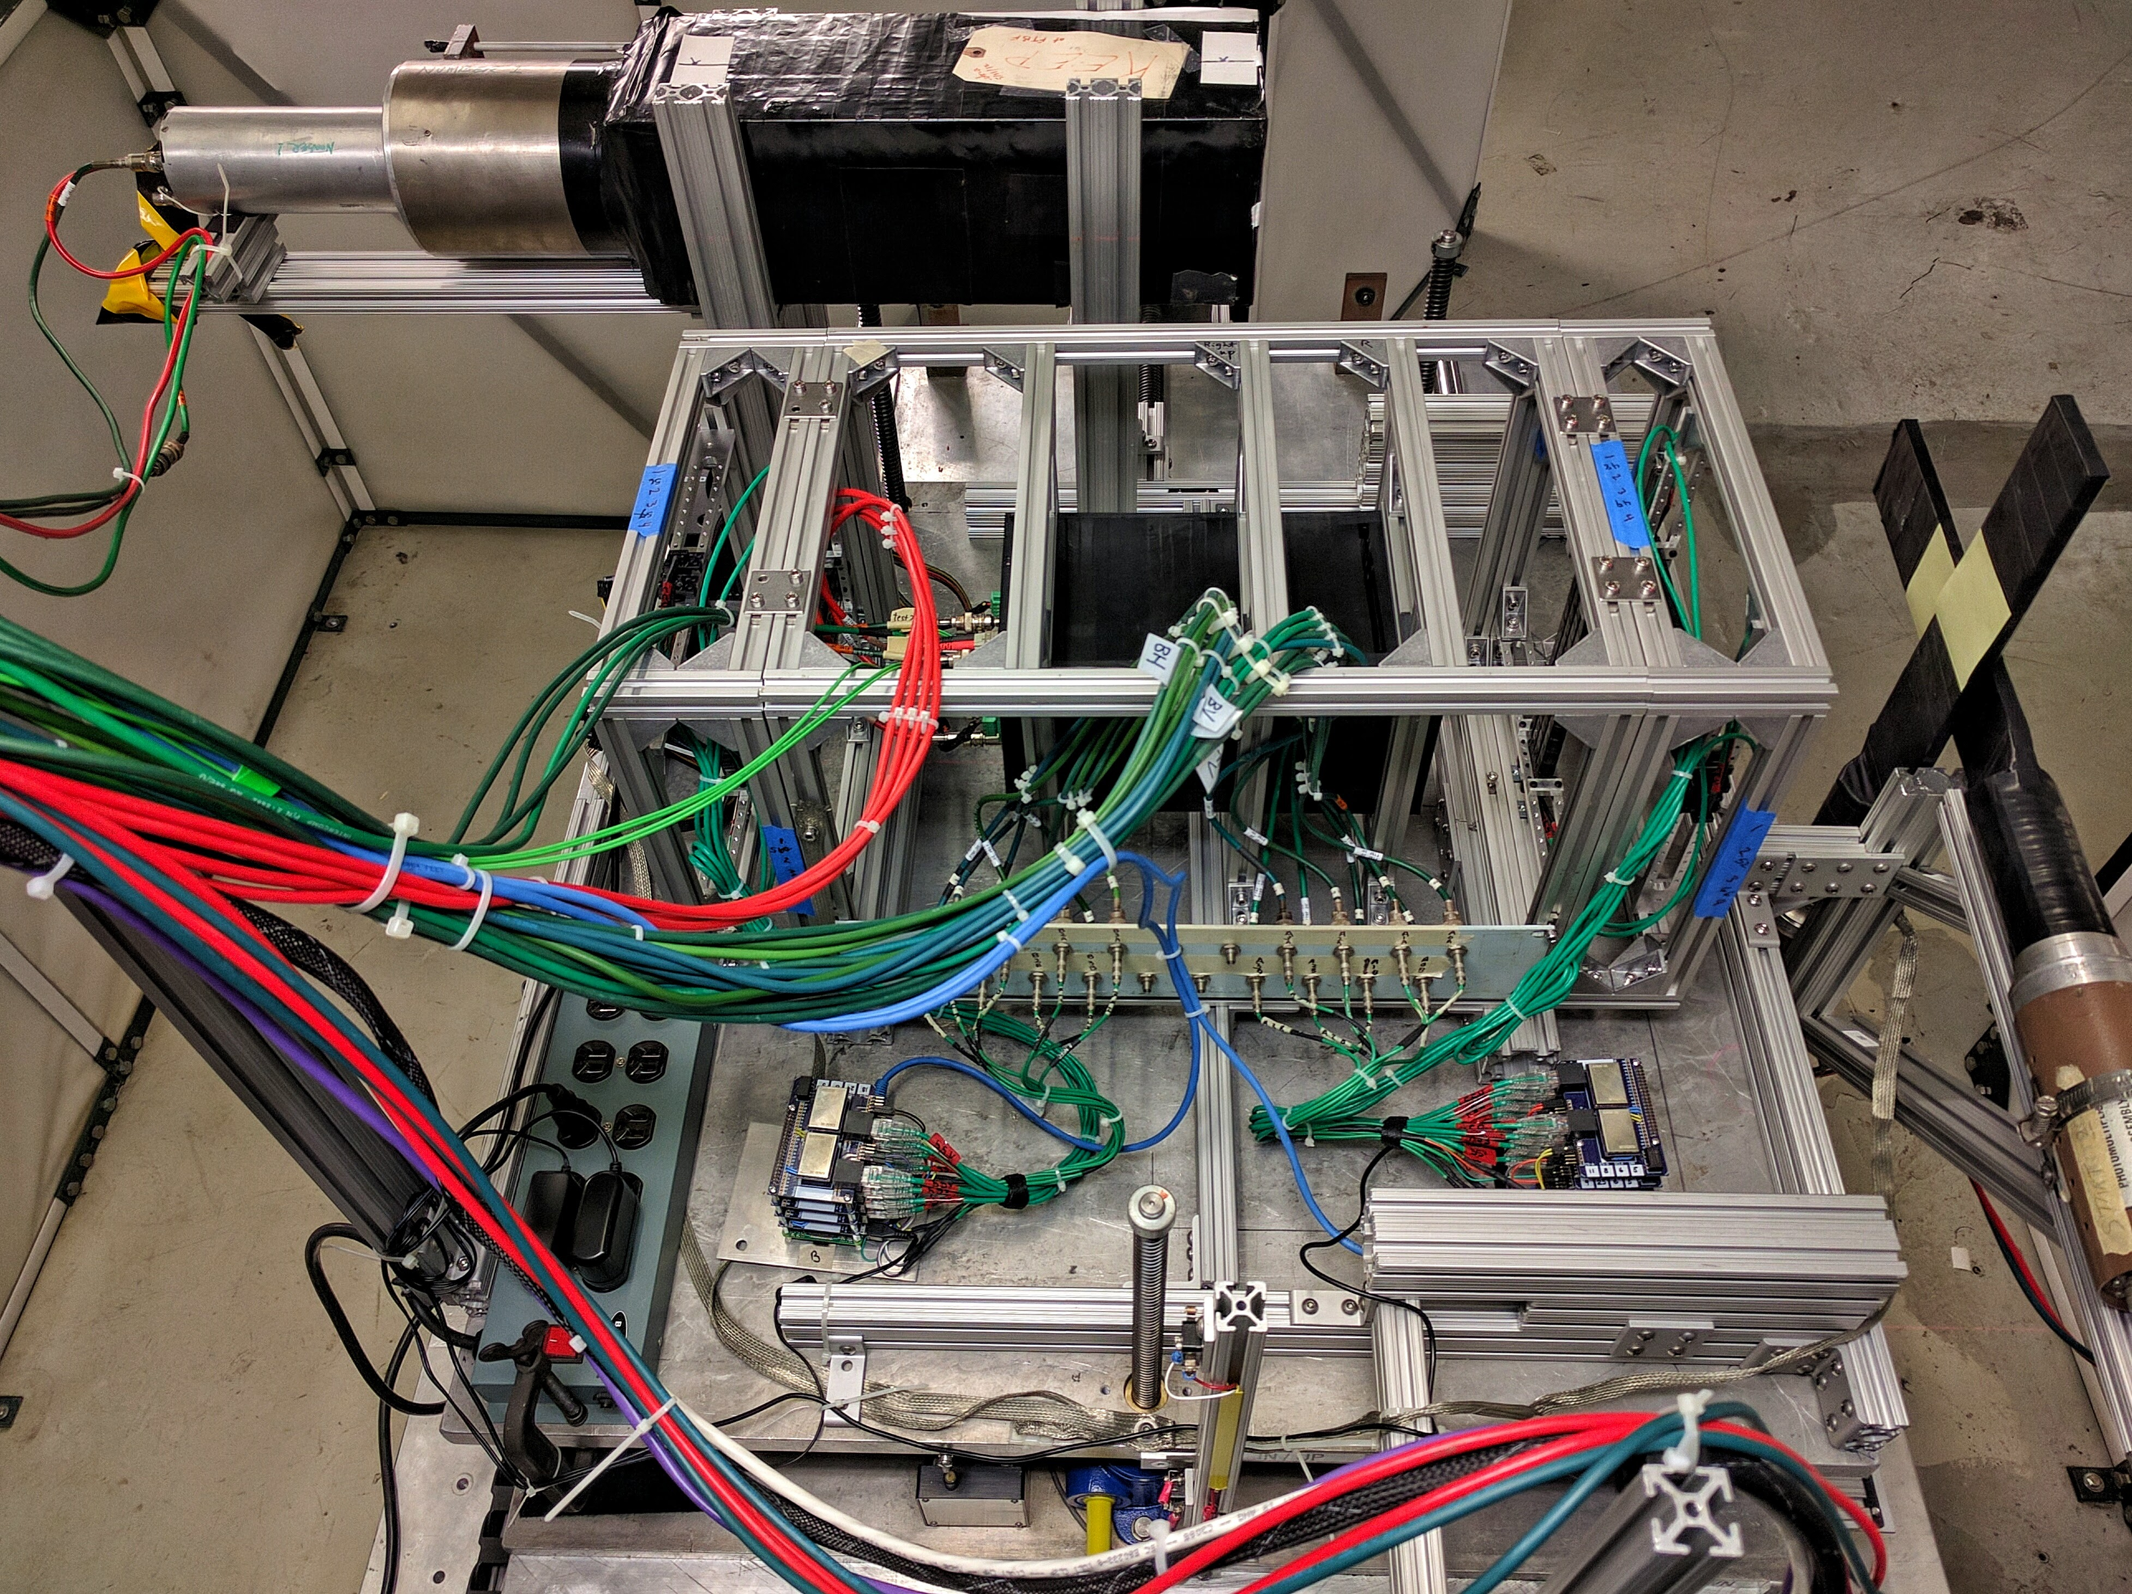
Beam Test Setup at Fermilab
mRICH
Beam pipe
M6 facility
Mtest facility
Beam test setup
MTest facility at Fermilab
120 GeV primary proton beam
Low energy (down to 1 GeV) secondary pions, muons and electrons
Notes:
Verify working principle of modular RICH detector
Ring Radius
Number of Cherenkov Photons

Slide 10
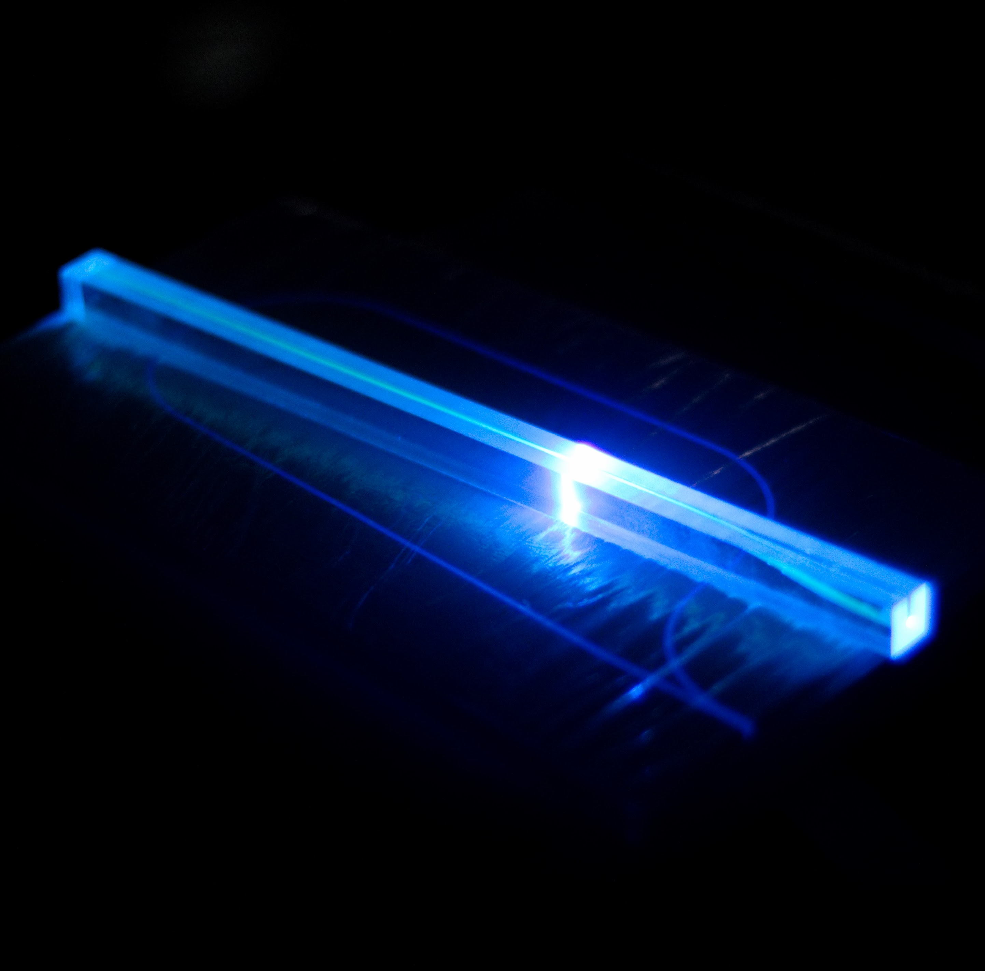
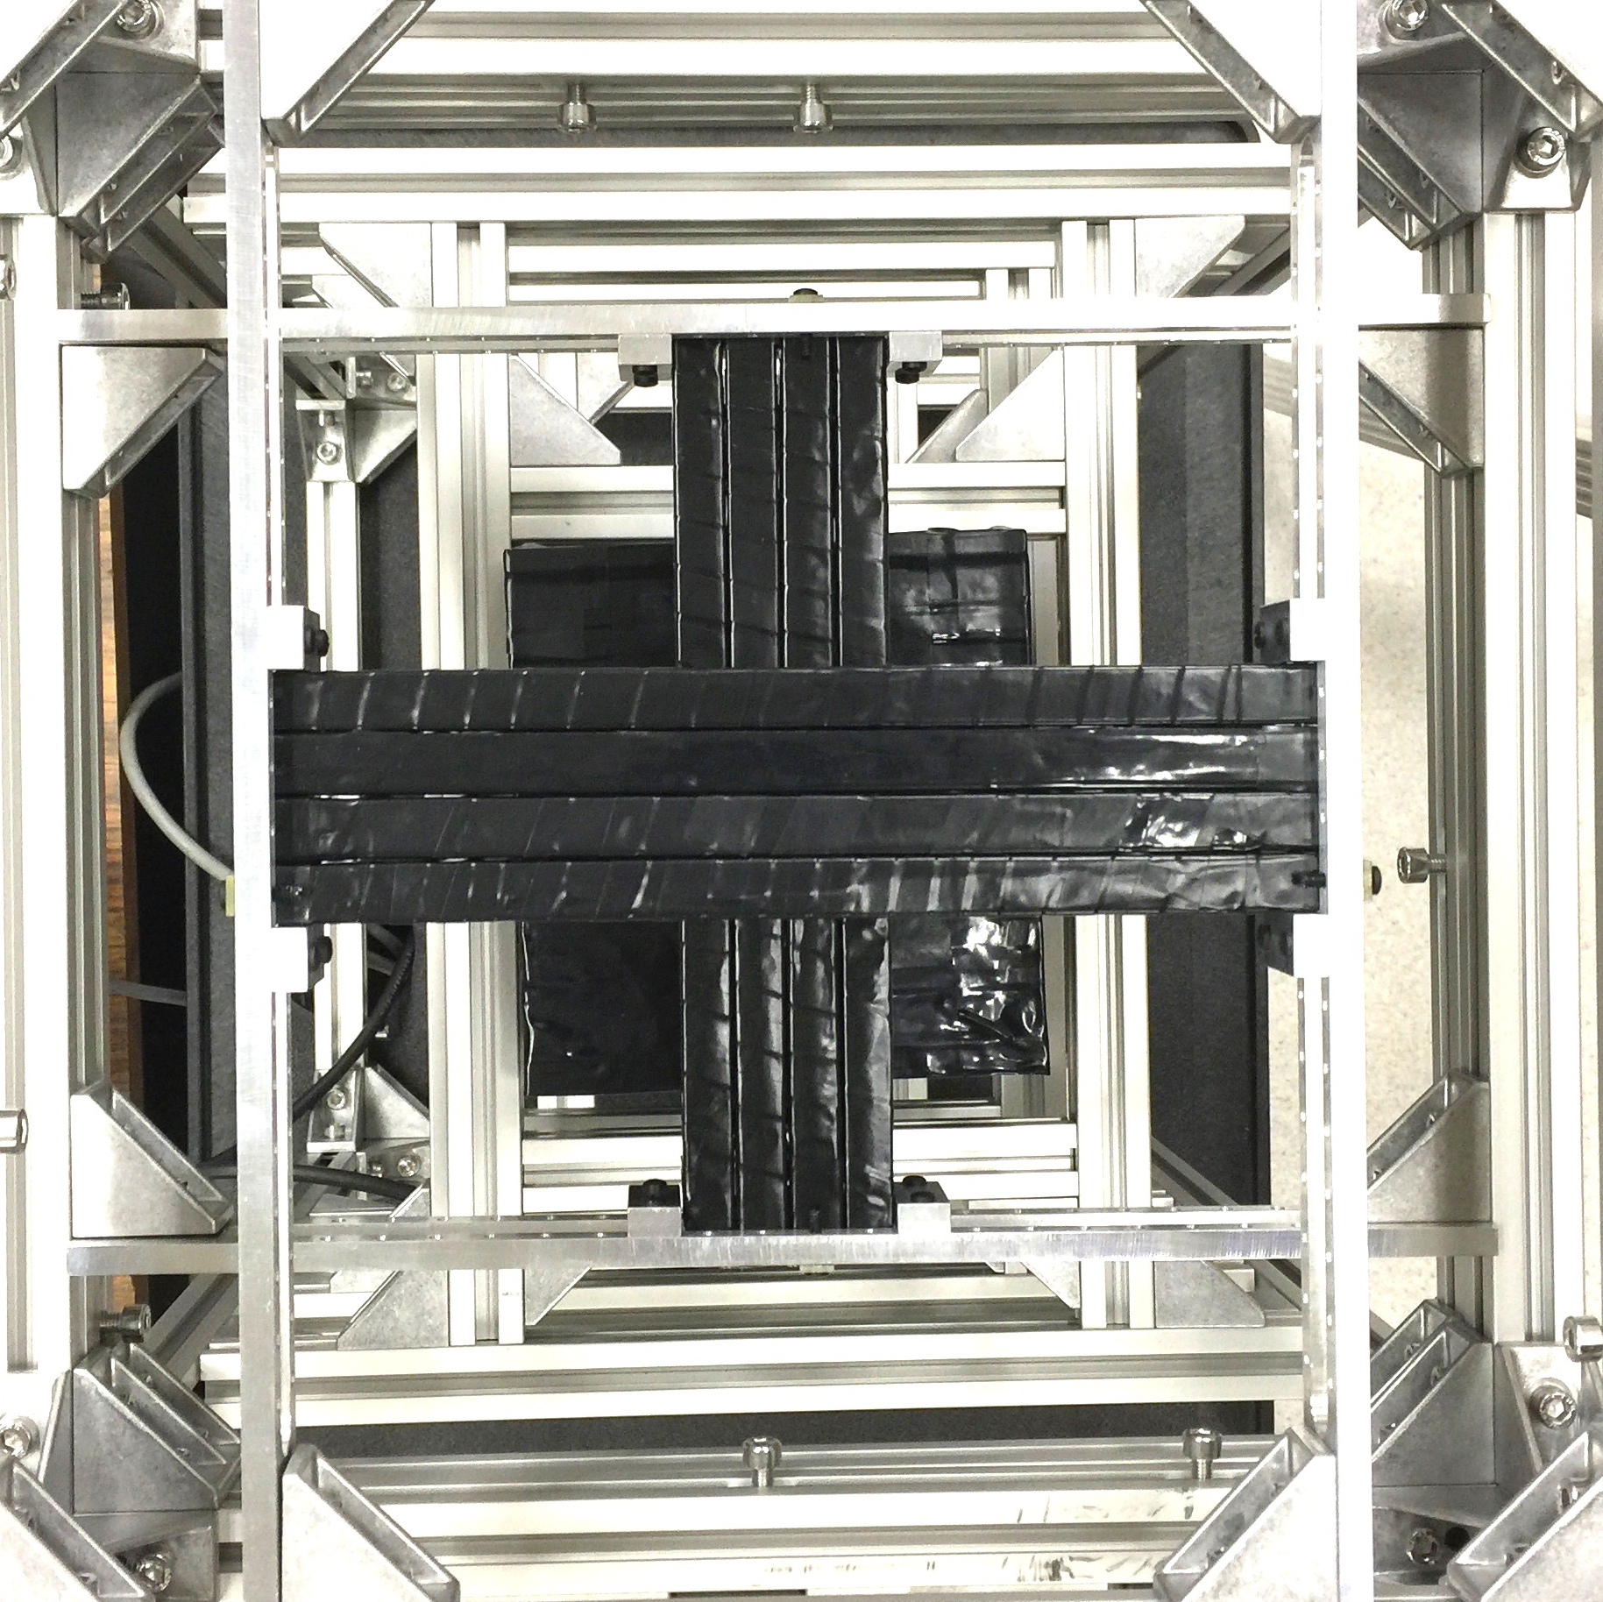
Beam Test Setup
Hodoscope
Beam direction
Hodoscope
mRICH
triggers

Slide 11
Beam Test Configurations
 | 120 GeV Proton | 8 GeV pion | 4 GeV pion
Full Setup with n=1.03 Aerogel | ✓ | ✓ | ✓
Full Setup with n=1.02 Aerogel | ✓
Without Mirror | ✓
Small beam size → quick tool for detector alignment

Slide 12
Result

Slide 13
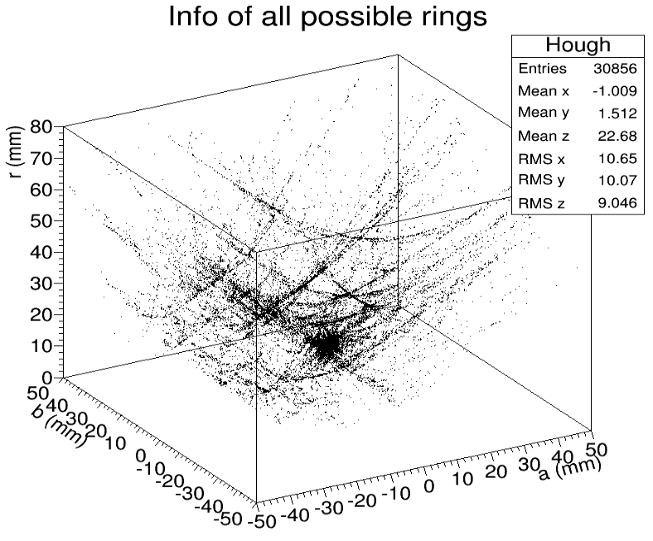
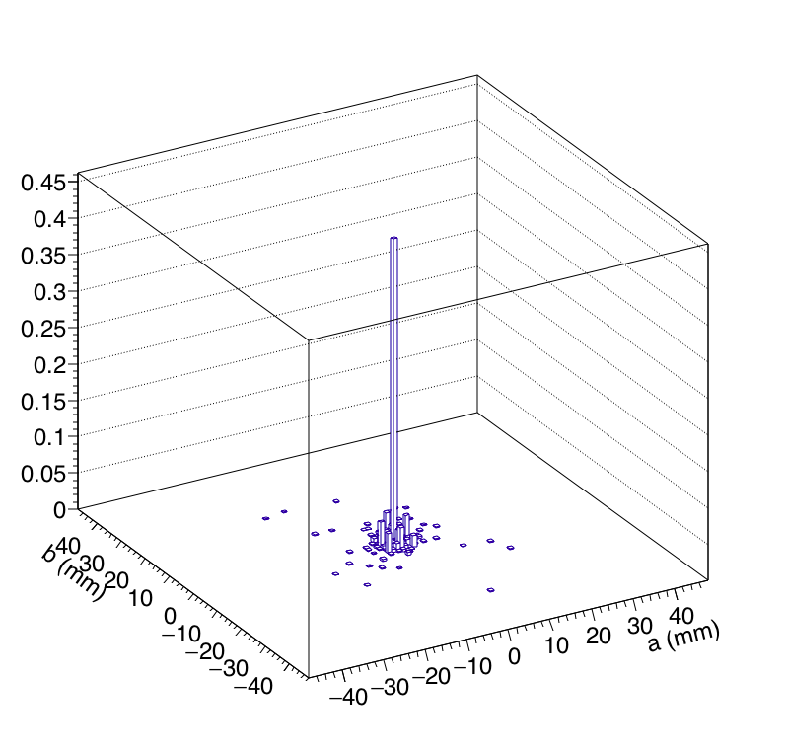
Ring Finder Analysis
Hough Transform Algorithm
Accumulated Data of Entire Run
Ring Center Position

Slide 14
Cherenkov Ring Image Reconstruction
Simulation
Beam test
Num. of photon
Pixel amplitude
Notes:
Example of typical rings

Slide 15
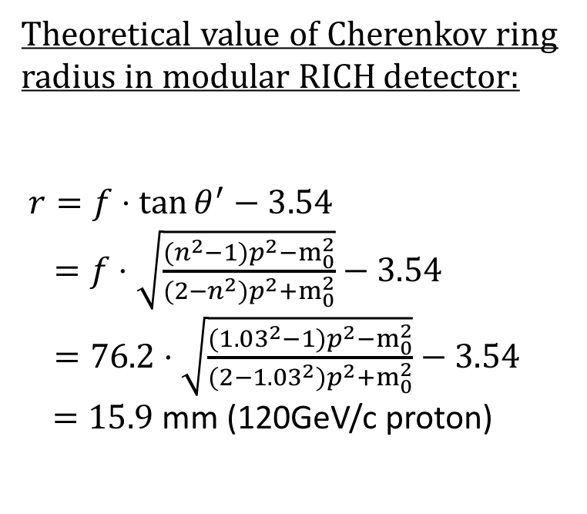
Cherenkov Ring Radius
Focal plane
Aerogel
Air
Theoretical value of Cherenkov ring radius in modular RICH detector:
$r=f⋅\tan{θ^{′}}−3.54$
$=f⋅\sqrt{\frac{{(n}^{2}{−1)p}^{2}−m_{0}^{2}}{\left(2−n^{2}\right)p^{2}+m_{0}^{2}}}−3.54$
$=76.2⋅\sqrt{\frac{{(1.03}^{2}{−1)p}^{2}−m_{0}^{2}}{\left(2−{1.03}^{2}\right)p^{2}+m_{0}^{2}}}−3.54$ $=15.9$ mm (120GeV/c proton)
Proportional to focal length
Sensor plane setup
Cherenkov photons
θ’
r
θ
θ
θ’
Incident particle
f
lens
Ring size is independent on thickness of the aerogel or air gap

Slide 16
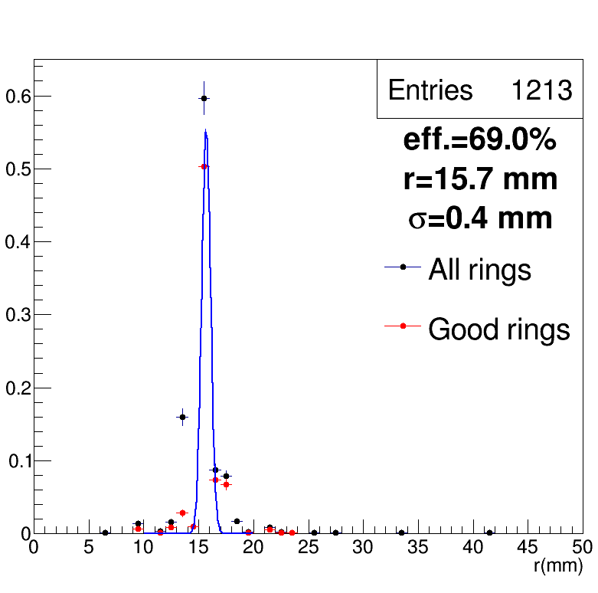
Cherenkov Ring Radius
Simulation
Beam Test
Good ring:
radius is within expected range
Distance from the sensor center to the ring center is within 3mm
Notes:
Since the Ring Finder algorithm will always give a a ring. We have to evaluate the found rings properties.

Slide 17
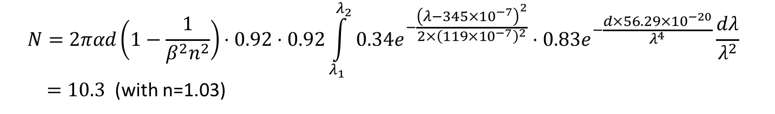
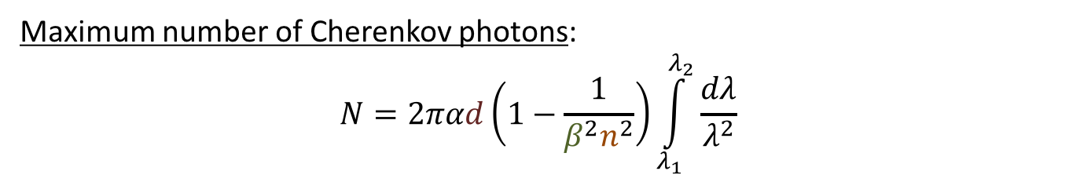
Number of Cherenkov Photons per Event
Maximum number of Cherenkov photons:
$$N=2παd\left(1−\frac{1}{β^{2}n^{2}}\right)\int_{λ_{1}}^{λ_{2}}{\frac{dλ}{λ^{2}}}$$
Fine structure const.
Thickness of radiator
β=v/c
Refractive index of radiator
Estimated number of Cherenkov photons in modular RICH detector:
Fresnel lens transmission
Sensor quantum efficiency
$$N=2παd\left(1−\frac{1}{β^{2}n^{2}}\right)⋅0.92⋅0.92\int_{λ_{1}}^{λ_{2}}{0.34e^{−\frac{{\left(λ−345×{10}^{−7}\right)}^{2}}{2×{\left(119×{10}^{−7}\right)}^{2}}}⋅0.83e^{−\frac{d×56.29×{10}^{−20}}{λ^{4}}}}\frac{dλ}{λ^{2}}$$
$=10.3$ (with n=1.03)
Aerogel transmission
Glass window transmission

Slide 18
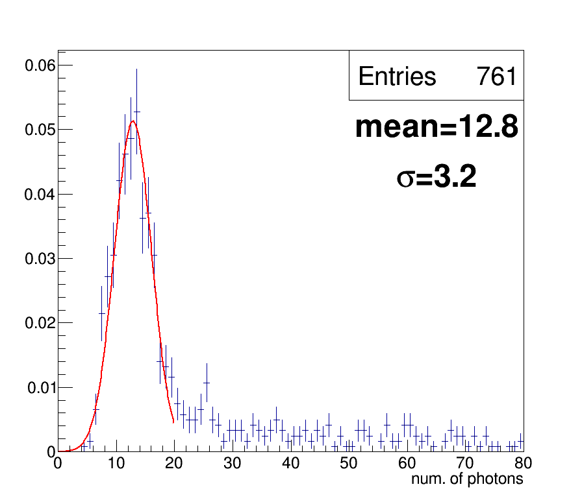
Number of Cherenkov Photons per Event
Simulation
Beam Test
Only consider the events that give good rings
Notes:
Agree with theoretical number

Slide 19
Summary
 | Theoretical number | Simulation | Beam Test
Cherenkov Ring Radius | 15.9mm | 15.5±0.1 mm | 15.7±0.4 mm
Num. of Cherenkov Photons | 10.33 | 11.0±2.8 | 12.8±3.2
Efficiency | / | 74.0% | 69.0%
Beam test result agrees with simulation result

Slide 20
Future Work

Slide 21
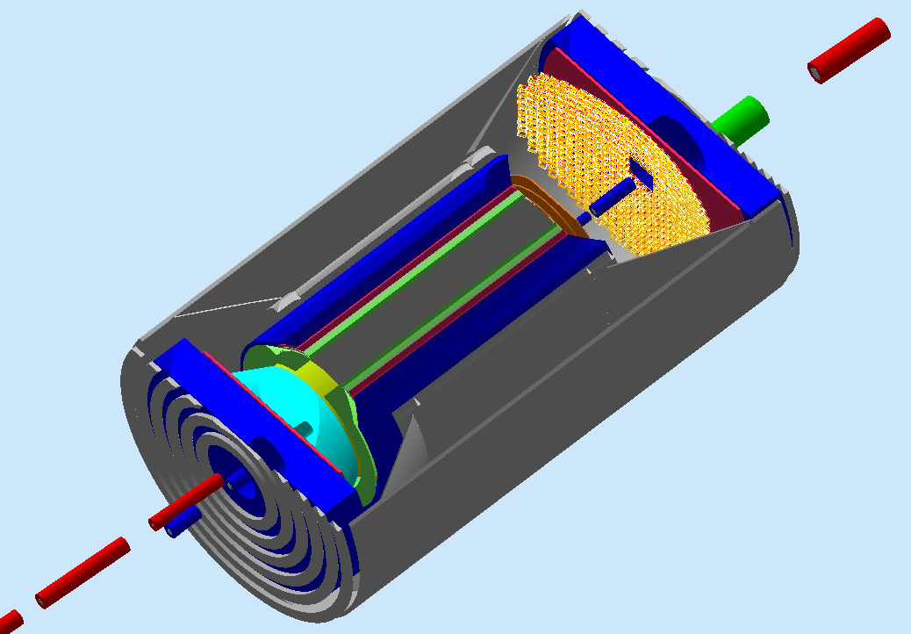
Simulation Study
Implement Pythyia simulation data to modular RICH detector
Integrate modular rich detector in EIC
mRICH wall on electron endcap in GEMC simulation

Slide 22
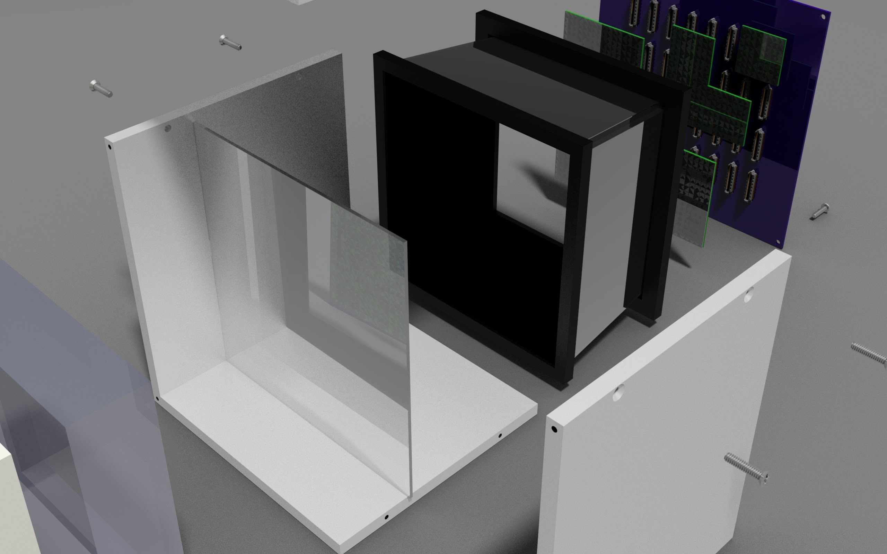
Next Prototype
1st prototype | 2nd prototype
Acrylic box | Aluminum box
Including readout electronics | Decouple optical and electronics section to prevent overheating
Sensor pixel size = 6x6mm² | Sensor size
Multianode PMT | PMT / MPPC array
Fresnel lens focal length =3” | Fresnel lens focal length =6”
Notes:
opaque

Slide 23
eRD14 Collaborators
Abilene Christian University
Argonne National Lab
Brookhaven National Lab
Catholic University of America
College of William & Mary
Duke University
Georgia State University
GSI Helmholtzzentrum für Schwerionenforschung GmbH
Howard University
INFN, Sezione di Ferrara
INFN, Sezione di Roma
Istituto Superiore di Sanità
Jefferson Lab
Los Alamos National Lab
Old Dominion University
Universidad Técnica Federico Santa María
University of Illinois
University of New Mexico
University of South Carolina
Yale University

Slide 24
Back Up

Slide 25
Cherenkov Ring Size from Simulation

Slide 26
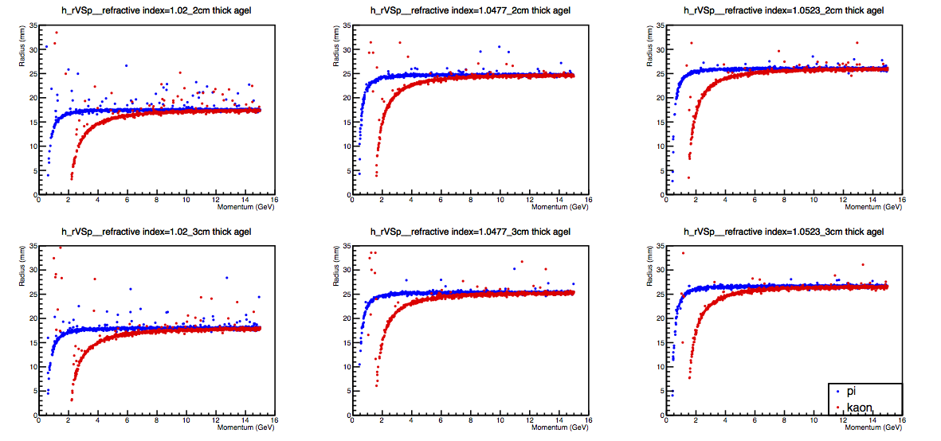
Cherenkov ring radius from different refractive indice of aerogel
Refractive index=1.02
Refractive index=1.047
-- Pion
-- Kaon

Slide 27
Desired Pixel Size
Ring from pion
1 pixel size
Aerogel n=1.03
Ring from kaon
Naive case :
required pixel size = Difference in diameter between Cherenkov rings emitted by pion and kaon
Notes:
GSU_NP_GrpMeeting 20160520

Slide 28
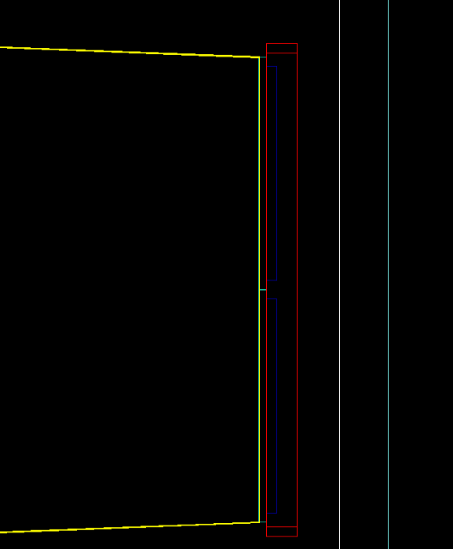
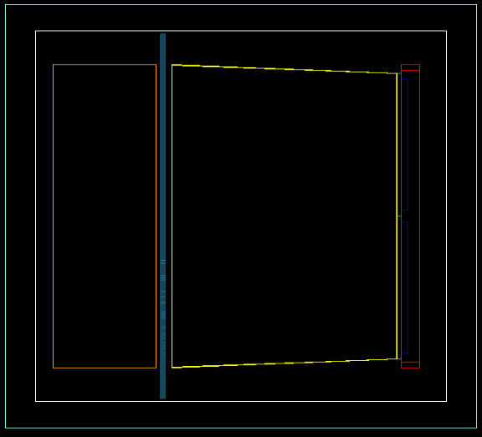
Details of Detector Setup
4 glass windows
Sensor plane viewed from the back
sensor
4 sensors
1 mm
Side view
sensor
1 mm
2mm
52 mm
2mm
Glass window
48 mm

Slide 29
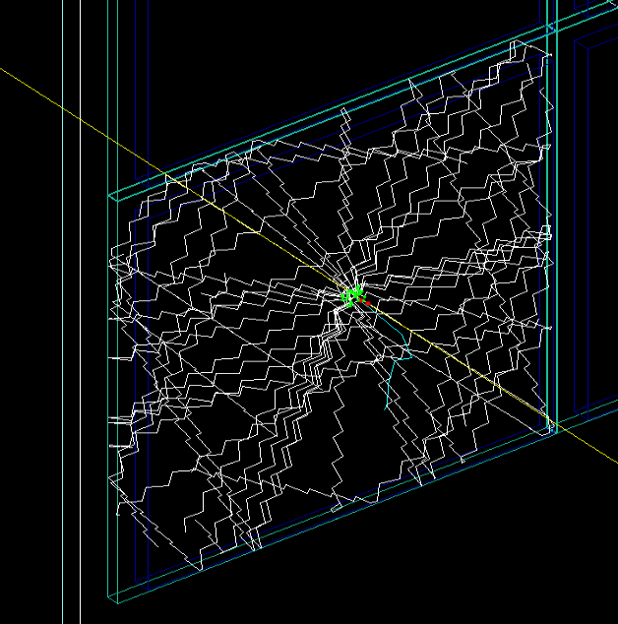
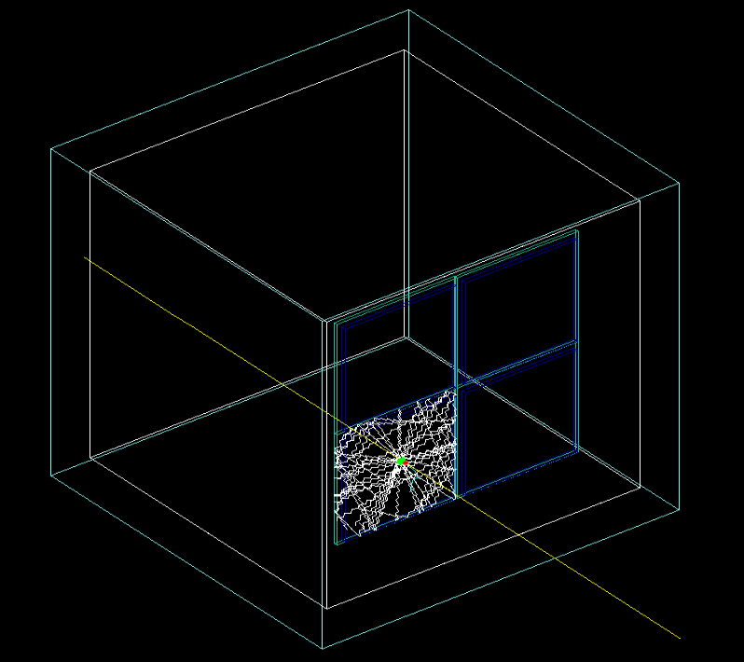
Internal Reflection inside Glass Window
Material | Pyrex glass (Borosilicate glass)
Density | 2.23 g/cm³
Refractive index | 1.47
transmittance | 92% in 400-700nm wavelength region

Slide 30
Event Display Comparison
Simulation (1,000 events)
Beam test result (1,214 events)
Num. of photon
Pixel amplitude
Notes:
Accumulated Hit from the e

Slide 31
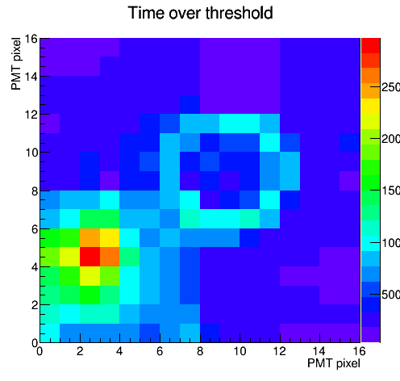
Event Display Comparison
Simulation
Beam Test

Slide 32
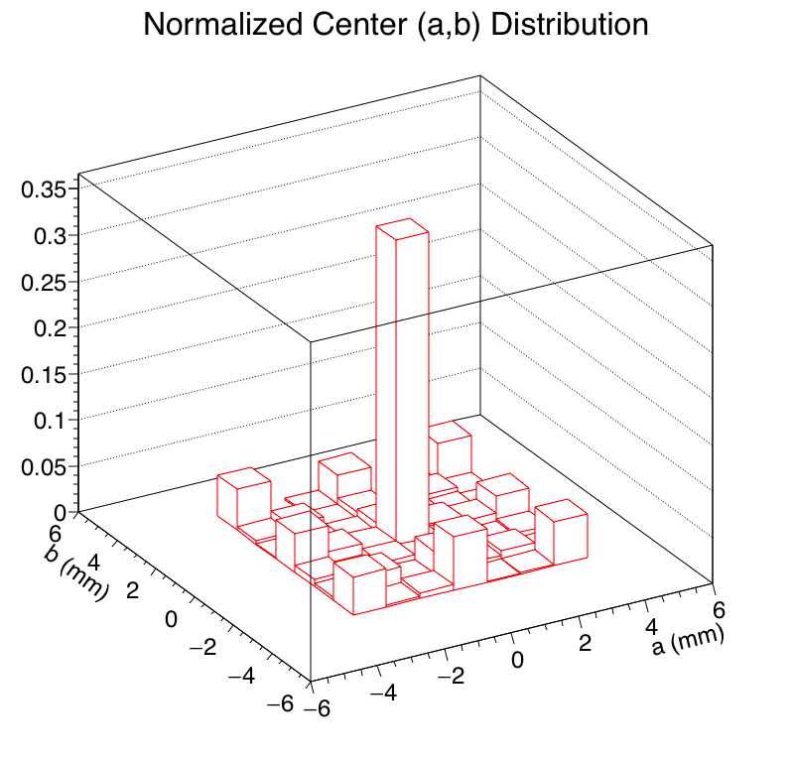
Ring Finder Analysis Procedure
Hough Transform Algorithm
Accumulated Data of Entire Run

Slide 33
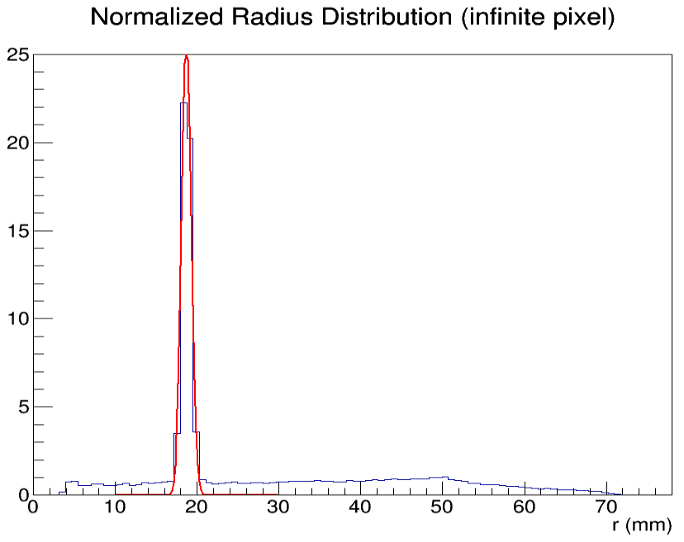
Radius (in each event) Distribution
Sensor 2
Sensor 1
r_{expected}
r≈18.7±0.60 mm
3.54mm
Radius of each photon hit from simulation result.
No Q.E. applied
Sensor 3
Sensor 4
Not on scale
r_{expected} =18.7-3.54 (gap) ±0.60 ±3 (half of single pixel size)
=15.2 ±3.6mm

Slide 34
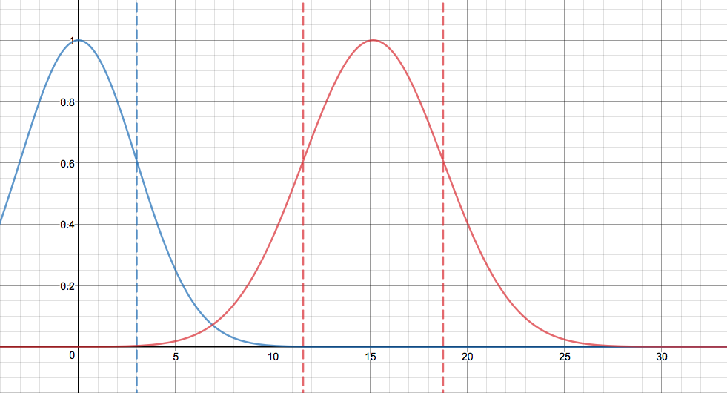
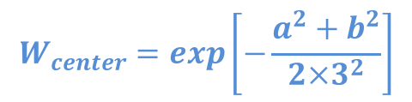
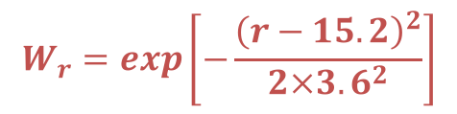
Weight Functions
$$W_{center}=\exp\left[−\frac{a^{2}+b^{2}}{2×3^{2}}\right]$$
$$W_{r}=\exp\left[−\frac{{\left(r−15.2\right)}^{2}}{2×{3.6}^{2}}\right]$$
√(a²+b²) (mm) / r (mm)

Slide 35
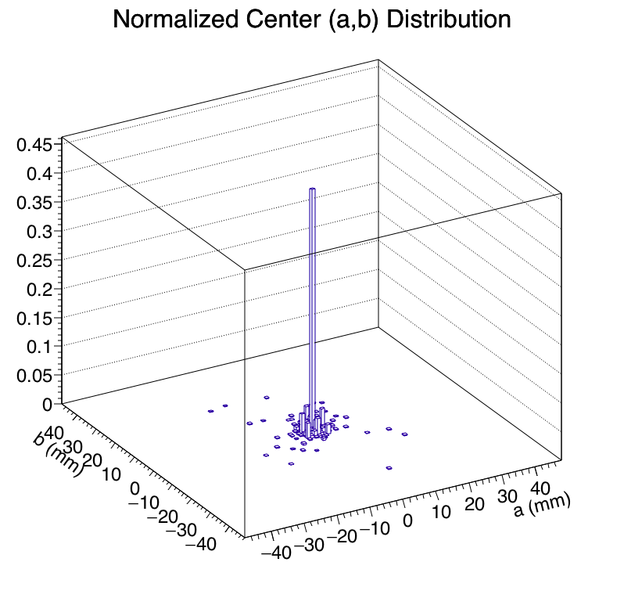
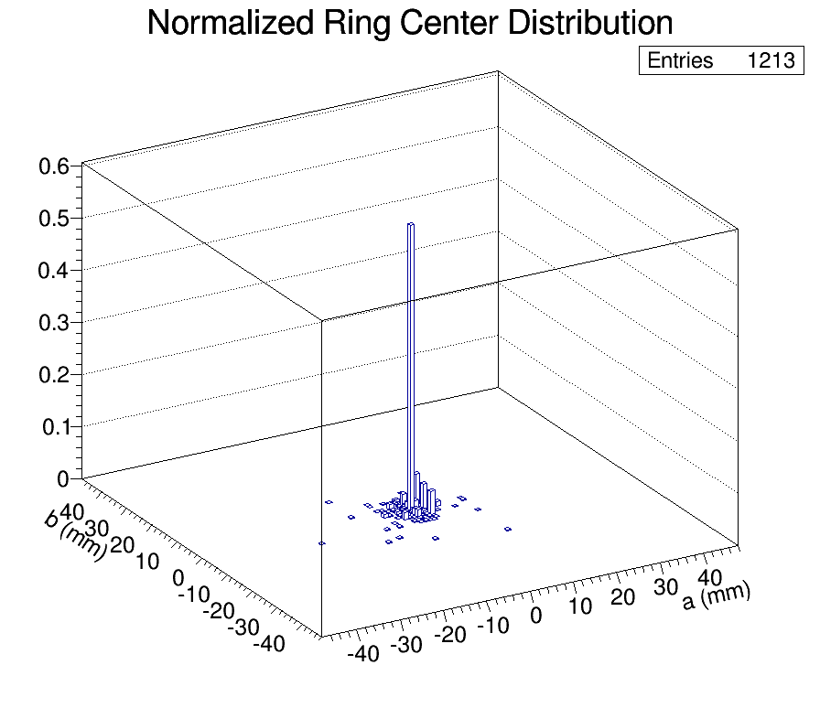
Center Position (a,b)
Simulation
Beam Test

