Slide 1
International Computing Model and Governance
Alexei Klimentov
aak@bnl.gov
Amber Boehnlein
amber@jlab.org

Slide 2
Session Outlook
The challenges of EIC Computing
EIC Software and Computing Joint Institute (ECSJI*) : scope and responsibilities
May 2024 RRB recommendation
EIC International Computing Organization timeline and status
ePIC Software&Computing and ECSJI review by the EIC Computing and Software Advisory Committee (September 26-27, 2024)
Open questions and topics for discussion
* List of abbreviations and glossary

Slide 3
EIC Computing Challenges
The EIC Computing and Software are unique in a number of important respects*
globally distributed computing, streaming computing model, two host Labs are symmetric peers for post-E0 processing, …
processing,…)
ePIC Collaboration
EIC computing components
are independent and
inconsistent
Effectively elaborates streaming model. Needs computing for simulation and services (today)
EIC Computing & Software Joint Institute (ECSJI) aims to provide efficient support for EIC computing and proposes an organisation that ensures robust support for EIC experiments, accelerator simulations and theorists in computing and software, while recognising organisational differences at host laboratories.
Two Host Labs
EIC computing components are coherent, but with grey areas
Need to support Echelon0 & Echelon1/2
Computing and Users
EIC Project
Computing is not part of the EIC project. But it needs simulations (e.g. , computing) for its detector (and accelerator) optimization.
It is needed today.
The EIC Project: machine and the detector will be ready on time
DAQ is part of the project, Computing and Software (services) are not
EIC computing
components evolve
independently
ePIC Collaboration : Organize collaboration effort and requirements, define
a computing model, work in close contact with ECSJI and international partners
* Markus talk

Slide 4
EIC Computing and Software Joint Institute
Brookhaven National Laboratory and Thomas Jefferson National Accelerator Facility, as Electron-Ion Collider host labs, have established a collaborative entity, the EIC Computing and Software Joint Institute (ECSJI). The Institute reports to the host Labs and the host Labs delegate functions to ECSJI (for instance, organize SW&C review)
This joint institute is designed to support the computing and software needs and activities of the EIC.
The Institute was created fall of 2023
ECSJI leverages complementary expertise at the two labs and provides needed visibility to the respective lab management and stakeholders.
The advantages of such a structure also include increased reliability and availability of resources for the ePIC collaboration and other future collaborations.
The success of the EIC, an international scientific endeavor, will benefit from contributions from international partners towards its computing effort.
To facilitate efficient coordination, the Institute will administer the EIC International Computing Organization (EICO), which will include all the contributors to the EIC computing effort.
ECSJI charter (link)

Slide 5
ESCJI : Scope
The Institute will provide for EIC computing and software matters:
A single entity to interface with the EIC project, the ePIC collaboration, theoreticians, and future collaborators.
Execution of host lab responsibilities (link).
Maintenance of service level agreements and statements of work outlining the host labs’ contribution to the ePIC collaboration concerning computing resources, services, and personnel assigned to work on ePIC computing and software deliverables.
A coordinating body for interacting with international partners, providing computing resources as in-kind contributions, including:
Assessing resources.
Managing the agreements with the sites delivering resources (including service levels).
Facilitating and assessing the delivery against the agreements.
The scope may evolve over time and the organization of the institute as well

Slide 6
EIC Computing Organization & Governance
EIC Project
[& EIC Committees]
EIC Computing Council
EIC Resources Review Board
BNL and JLab Mgmt & ePIC spokesperson
Funding Agencies
EIC Computing & Software
Joint Institute
ePIC SW&Computing
Computing & Software Advisory Committee
Management
M.Al-Turany (GSI)
D.Brown (LBNL)
S.Campana (CERN)
V.Martinez-Outchoorn (UMass)
P.Mato (CERN)
C.Paus (MIT)
F.Wuerthwein (UCSD)
Two ECSJI co-directors
[nominated by BNL and JLAB]
EIC International Computing Organization
A.Boehnlein (JLab)
A.Klimentov* (BNL)
Set Up
The proposed governance structure designed to facilitate communication, coordination, escalation of issues, and conflict resolution.
EICO Management Board
ePIC (Experiments) & Computing Centers
TBD
Activity areas & Forums
in red – new member
*) A.Klimentov took over from E.Lancon in April’24
Many thanks to Eric for his excellent work and his crucial role in setting up the Institute.
Technical Experts and Areas Coordinators

Slide 7
EIC Computing Organization & Governance.
Computing Council (ECC)
Review the ECSJI strategic direction and support leadership in managing effective interfaces of the ECSJI to the EIC project and ePIC collaboration.
Authority: Approve the ECSJI strategic direction, leadership changes, annual budgets, resource allocations, and performance milestones.
The Institute Management [two co-directors, each nominated by one lab]
ECSJI co-directors have regular meetings with host labs management
To discuss how Computing and Software activities (personpower and resources) are supported by Labs
ECSJI co-directors have regular meetings with ePIC (spokesperson and deputy, SW&C coordinator) and EIC Management (Co-Associate Directors for the EIC Experimental Program)
Typically, bi-weekly – address host Labs < == > ePIC and host Labs < == > EIC project issues
Duties and accountability:
The management is responsible for organizing the Institute to deliver defined responsibilities.
The management will maintain a multi-year operation plan for the host labs, providing matrixed staff members to support activities.
Institute management will provide a yearly report to the host labs’ management.

Slide 8
EIC Computing Organization & Governance. Cont’d
May – November 2024 activities
SW&Computing review was organized (September 2024)
Presented EIC computing at BNL EIC experimental project dependencies review (August 2024)
Work closely with Echelon0 (DAQ) and ePIC SW&C on computing and networking matters
Discussion(s) with WLCG Management about coherent steps and EIC – (HL) LHC computing organization
ECSJI co-director(s) have been invited to participate in ePIC/EIC topical meetings
Collaborative tools development for the experiment and EIC project
ePIC data streaming model
AI/ML for EIC
DAQ computing, networking and streaming model
Positive SW developments and coordination between ePIC SW&C and ECSJI
Establishing EICO (next slides)
FY’25 Priorities
EICO Charter (ready by the next RRB)
EICO Management Board composition and EICO technical activity areas and forums
International Computing integration : pledge and opportunistic resources
FY’24 SW&C review recommendations and organize FY’25 SW&C review with focus on technical decisions and timeline for ePIC computing model implementation

Slide 9
May 2024 RRB Recommendations
Echelon 1 is funded by DOE-NP; Echelon 2 & 3 are extraordinary and IKC. Develop mechanism to determine needs and what the pledges will be.
Under discussion by EICO, ECSJI and ePIC SW&C Coordination
Topical discussion next week (Nov 19, 2024)
International Funding agencies will look into their existing computing infrastructure and its alignment with EIC Echelon 2.
RRB develops its vision for EIC computing and governance.
Clarify the relationships with the RRB, EICO, and ECSJI.
Establish EICO by the next RRB.
Review of ePIC computing model will be scheduled by next fall before the next RRB
Further development of an overall governance structure (RRB, EICJI, computing, experiment, EIC project). Develop task force to prioritize outreach action proposals and working group to develop communication strategies

Slide 10
ePIC Computing Model and ECSJI Review
Computing and Software Advisory Committee (ECSAC)
The ECSAC is chartered to propose advice, guidance, and counsel on the strategy and objectives of the Institute and of the EIC International Computing Organization.
ECSAC has members from US Laboratories, US Universities and International Laboratories (CERN, GSI)
The ePIC Computing Model and ECSJI review by ECSAC was held in September 2024, this was the second review, the first one was held in October 2023
Review charge (link)
Review timetable (link, and agenda)
Review recommendations
Review highlights → next talk by Markus Diefenthaler (for ePIC SW&C and ECSJI)

Slide 11
International Computing Organization
International Computing Organization (EICO)
The establishment of EICO is in progress and it is done together with ePIC and the international partners involved in the EIC.
The EICO is led by the Institute's co-directors and administered by the ECSJI. Its purpose is to provide computing resources and infrastructure to the ePIC collaboration and potentially address other computing needs related to the EIC.
EICO Management board composition : Reps from ePIC and International Partners
EICO Management Board provides the main technical directions for EIC Computing Technical Activity Areas
EICO organizes AHM and other meetings
EICO defines activity areas and technical forums
EICO collects ePIC requirements, produce accounting reports and supervises SLA
all monitoring of resources will be done by ECSJI and reported to the computing council
LHC

Slide 12
International Computing Organization Timeline
July-August : primary scientist(s) and/or contact(s) from a funding partner involved in the EIC were contacted (many thanks to Rolf Ent)
If you are interested in being a partner in providing computing resources for the EIC, we would like you to nominate a computing contact.
These computing contacts would work with Amber Boehnlein and Alexei Klimentov to gather and distil input on how we can best integrate funding partners into the ePIC computing model, and to develop a strategy on how best to integrate computing and detector contributions for oversight by an RRB.
August-September : the initial list of topics and preparatory meetings, including F2F meetings
September 26-27 : ePIC SW&C & ECSJI review
October 15, EICO kick-off meeting
Countries and Computing Contacts
Canada - Wouter Deconinck (Manitoba)
Czech Rep
France– Carlos Munoz Camacho and Francesco Bossu (IN2P3 & IRFU)
India
Israel
Italy – Andrea Bressan (Trieste), Domenico Elia (Bari)
Japan - Taku Gunji (Tokyo)
Korea
Taiwan - Eric Yen from Academia Sinica Grid Center (ASGC)
UK – one ePIC contact (Peter Jones (Birmingham)) and one GridPP contact (Roger Jones (Lancaster)). Have had preparatory meetings including Jon Hays (IRIS), Pete Clarke and Dave Britton (GridPP), and Roger Jones (Lancaster, GridPP/ATLAS rep.).
LHC

Slide 13
International Computing Organization Timeline. Cont’d
October-November : EICO topical weekly meetings (notes)
ePIC streaming model
Echelon2 roles and responsibilities / number of Echelon2 sites
Archival requirements to Echelon2 sites
Opportunistic and pledge resources (and pledges definition)
Transition from opportunistic to dedicated resources
EICO Management Board
ECSJI and ECSAC relations
ECSJI and EICO relations
ePIC computing needs (Nov 19, 2024)
…and computing shares per country starting from simulation and design activities through to eventual running
Some topics for EICO charter
New institutes in EICO, pledges and MoUs, US University clusters
LHC

Slide 14
ECSJI and EICO Timeline | BNL and TJNAF Jointly Leading Process to Select Project Detector
2023 | ECSJI created | Autumn
 | ECSAC established | October
 | 1st ePIC & ECSJI SW&C review by ECSAC | October
2024 | ePIC streaming model | March
 | Process to set up EICO (identify possible international partners) | Summer
 | 2nd ePIC & ECSJI SW&C review by ECSAC | September
 | EICO charter discussion : ECSJI ;ePIC ; EICO | Fall 2024
2025-26 | Establish EICO Management Board Write the EICO Charter Work on agreements legal content, Identify signing authorities in various countries Establish accounting mechanism for contributions to EIC computing | Winter’25 Spring’25
 | Resources planning for short and long-term | 2025-2026
 | ePIC streaming model refinement | Summer’25
 | 3rd ePIC & ECSJI SW&C review by ECSAC | October’25
2027-28 | Finalize agreements legal content | April’27
 | Start agreements signing process | Fall’27
 | 4th ePIC & ECSJI review by ECSAC Planning Data and Networking Data Challenges (including international partners) | October’27 Fall 2027-28
2029-32 | Agreements are signed 5th ePIC & ECSJI review by ECSAC | 2029 October’29
 | Echelon0, 1, 2 Data Challenges (aligned with DAQ challenges) | 2030-2031
 | Full Dress rehearsal μ and Commissioning Runs | Q2 2031 Q2-Q4 2032

Slide 15
EIC International Computing Organization Status
ECSJI and ePIC management are collaborating with international partners for writing EICO charter.
In Jul-Sep contacted international partners in 10 countries
Representatives from 6 countries are actively participating in EICO meetings
Strong overlap with LHC computing centers in many countries
Computing centers of Canada, Italy, Japan and UK were already included in large-scale simulation efforts for the EIC.
Regular ECSJI, EICO and ePIC SW&C Coordination meetings started in October after SW&C review
The following points will be discussed at the next meetings:
Organization of funding for Nuclear Physics computing at the national level.
Structure of computing for the EIC and for ePIC within each respective country.
Existing support and commitment for EIC computing.
Schedule and the specified level of contribution for formalizing contributions to EIC computing through agreements.
ePIC Computing Model
EICO charter
The ECSJI may apply for observer status to the WLCG
It was discussed with WLCG and WLCG is in favor of this
ECSJI can get observer/partner status at WLCG
Evolution of the WLCG towards a federation of autonomous computing institutes (LHC, DUNE, Belle II, EIC, SKA,…) is under discussion [WLCG long-term strategy and evolution was discussed at DESY meeting in May 2024]
Utilization of WLCG network infrastructure by EIC computing is one of the topics to be addressed
Follow-up discussions will be aligned with the EIC-RRB cadence

Slide 16
Topics for the Discussion and Open Questions
RRB vision for EIC computing and governance
The relationships with the RRB, EICO, and ECSJI
Computing Resources Scrutiny Group
WLCG C-RSG mandate
ECSAC recommendations (SW&C review in September 2024)
US Universities computing resources and their participation in Echelon2
ECSJI role to manage joint funding in this case
Short- and long term staffing needs
Dedicated SW&C effort
Topics to be addressed in EICO charter

Slide 17
Backup Slides

Slide 18
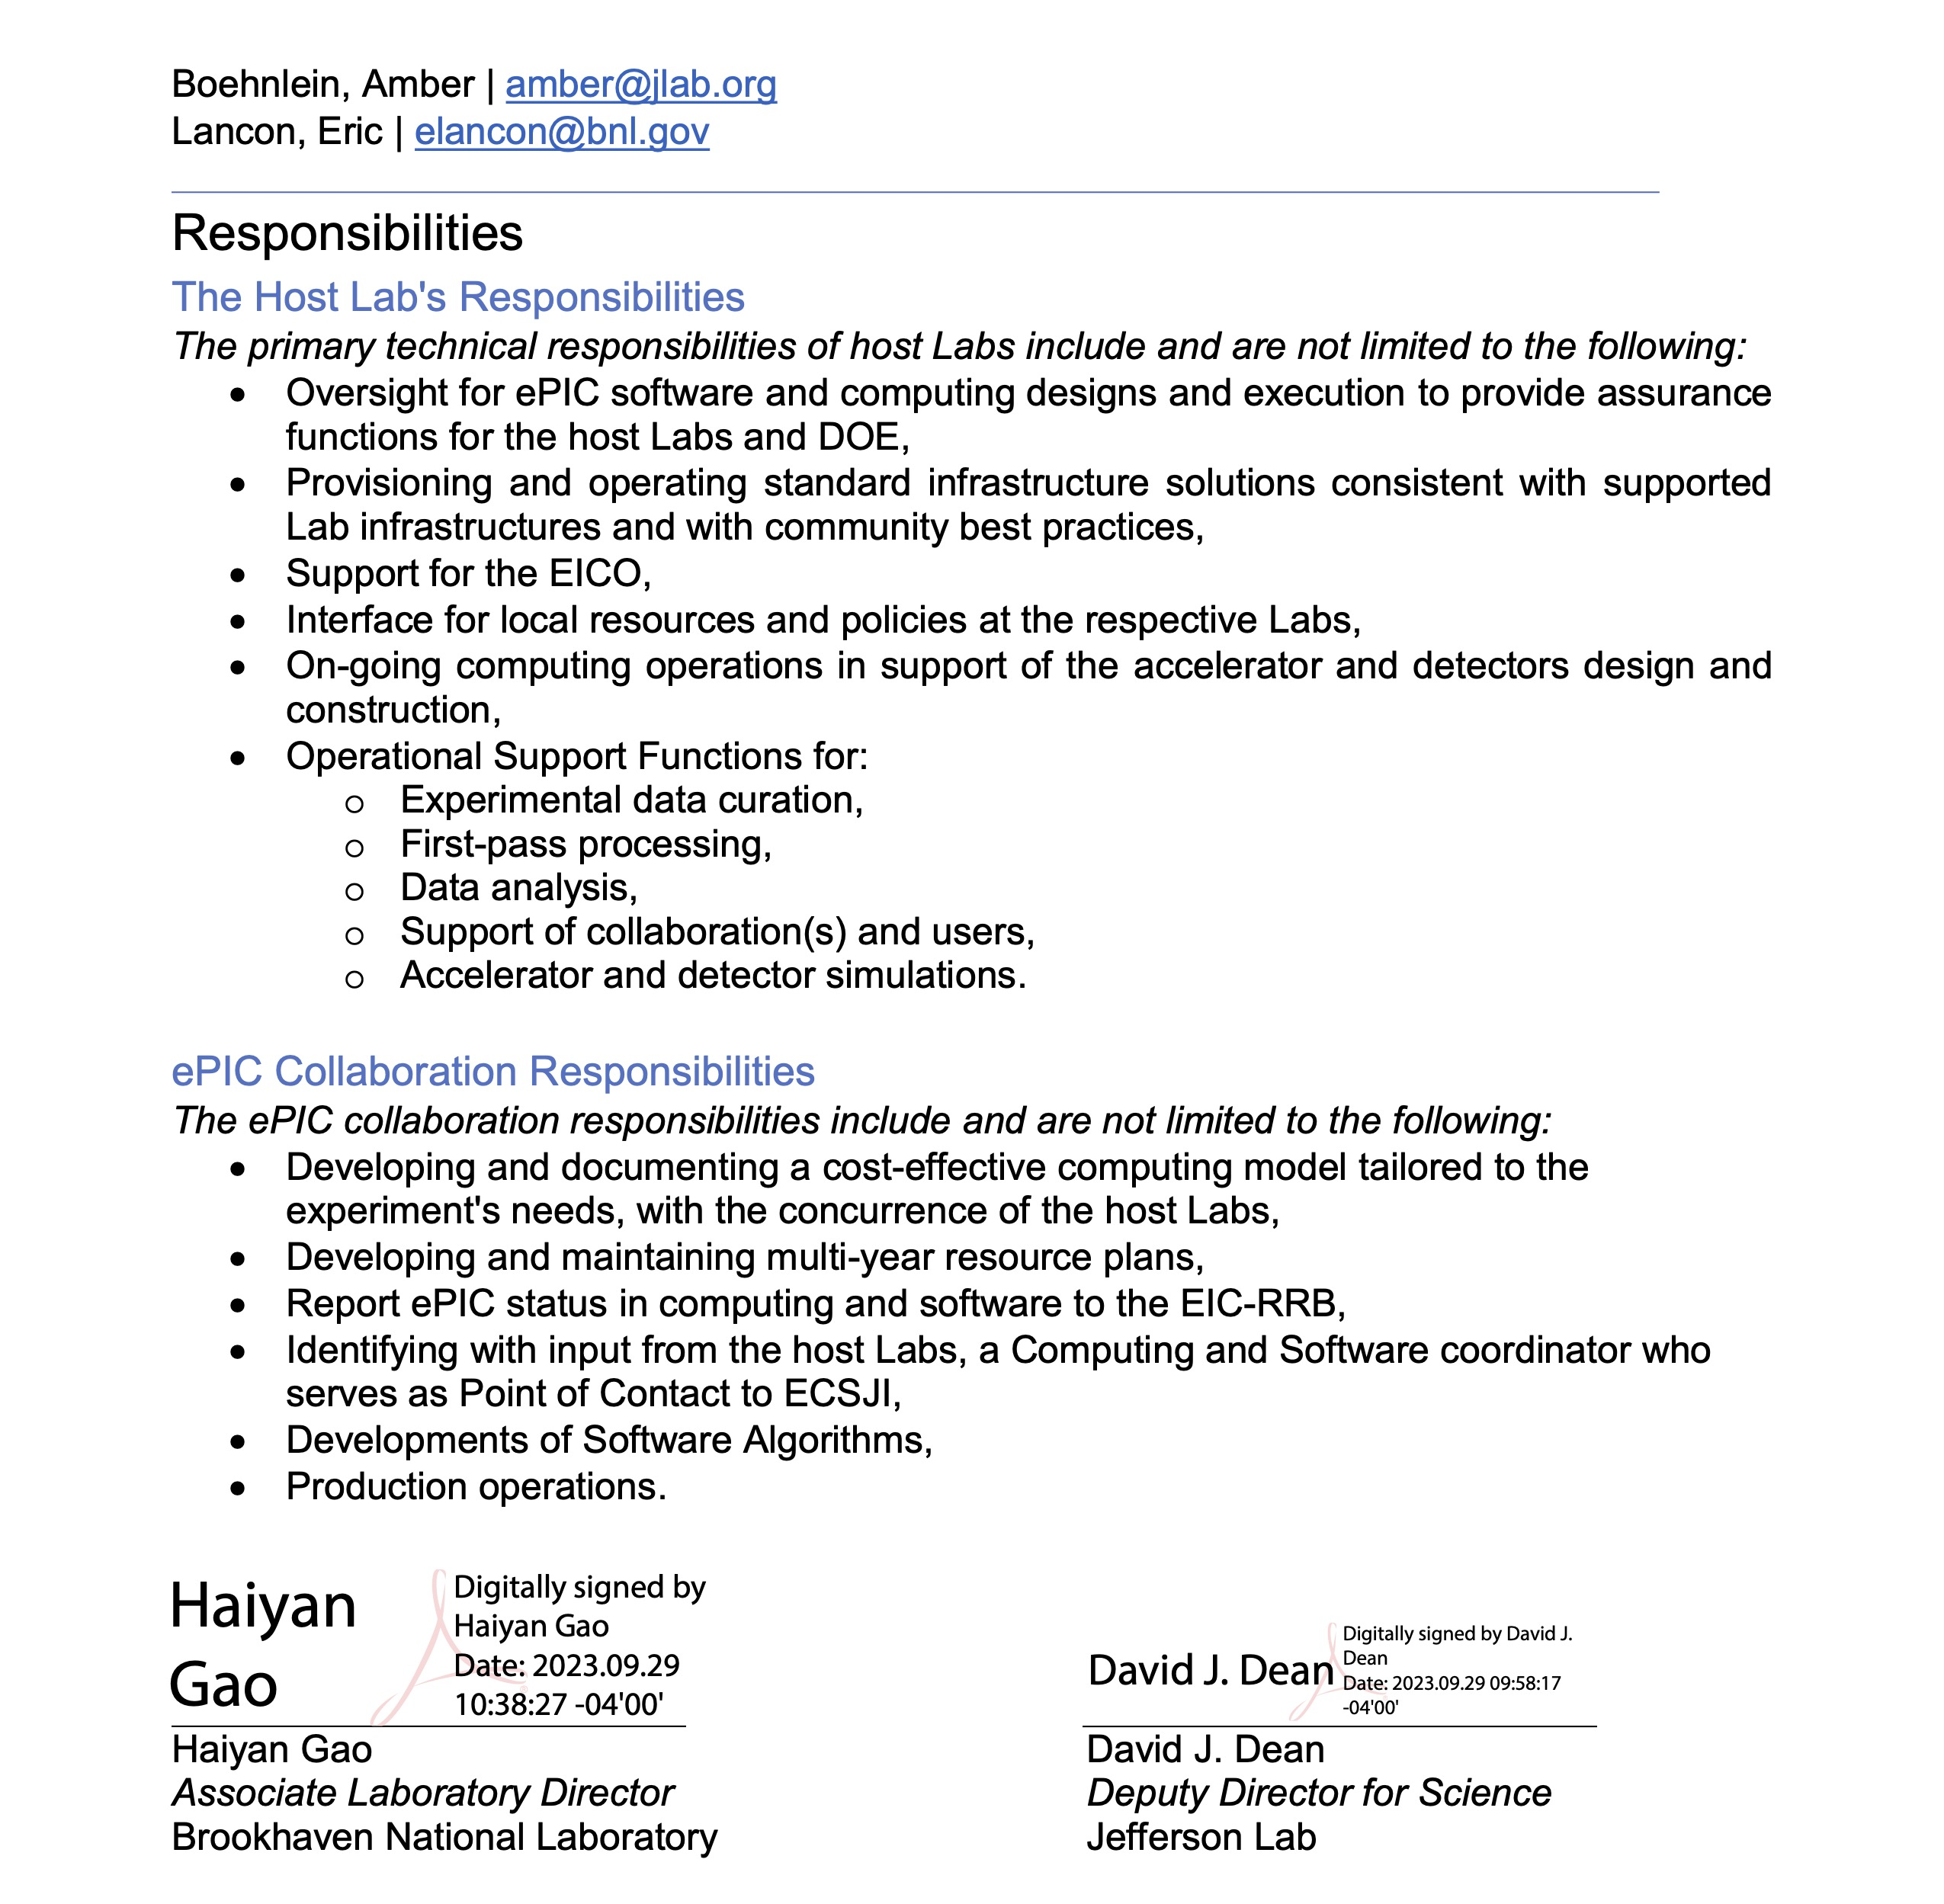
The EIC Computing and Software Joint Institute was created fall of 2023

Slide 19
The primary technical responsibilities of host Labs
Oversight for ePIC software and computing designs and execution to provide assurance functions for the host labs and DOE.
Provisioning and operating standard infrastructure solutions consistent with supported lab infrastructures and community best practices.
Support for the EIC International Computing Organization.
Interface for local resources and policies at the respective labs.
On-going computing operations in support of the accelerator and detector design and construction.
Operational support functions for:
Experimental data curation.
First-pass processing.
Data analysis.
Support of collaboration(s) and users.
Accelerator and detector simulations .

Slide 20
WLCG Computing Resources Scrutiny Group
The purpose of the C-RSG is to inform the decisions of the Computing Resources Review Board (C-RRB) for the LHC experiments.
According to the WLCG, MoU the starting point of the scrutiny is the request information presented at the spring C-RRB meeting and any guidance that the C-RRB cares to give. From that moment the CRSG enters into a sustained dialogue with each experiment seeking to understand to what extent the computing resource requests are well motivated. The recommendations are presented in the RRB autumn meeting.
Every year the CRSG should scrutinize
The resource accounting figures for the preceding year
The use the experiments made of these resources
The overall request for resources for every experiment for the following year and forecasts for the subsequent two years
The CRSG shall also examine the match between the refereed requests and the pledges from the Institutions.
The CRSG shall make recommendations concerning apparent under-funding This is the first time that such an independent and detailed scrutiny of the computing yearly request is carried out.

Slide 21
Glossary and Abbreviations
AHM – All Hands Meeting
AI4EIC --- Artificial Intelligence for the Electron Ion Collider
CM – Computing Model
E0, E1, E2 – Echelon0, 1, 2 sites according to ePIC computing model
ECC - EIC Computing Council
ECSAC – EIC Computing and Software Advisory Committee
EICO – EIC International Computing Organization
ESCJI – EIC Software and Computing Joint Institute
HL-LHC – High Luminosity LHC Run
I&I – installation and integration
IKC – in-kind contribution
OSG - Open Science Grid (NSF supported computing consortium)
SLA – Service Level Agreement
SW&C – Software and Computng
WLCG – World LHC Computing Grid

