Slide 1
Signal Processing Adjustment in PDHD APA1
Wenqiang Gu, Xuyang Ning

Slide 2
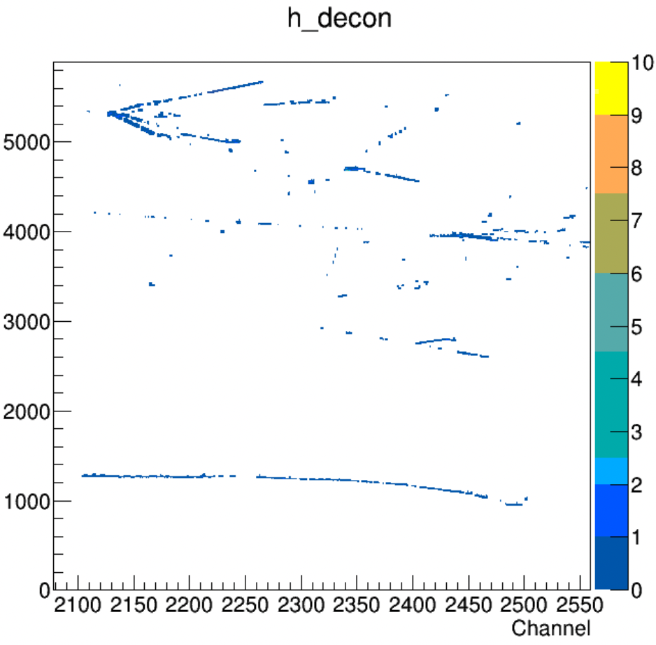
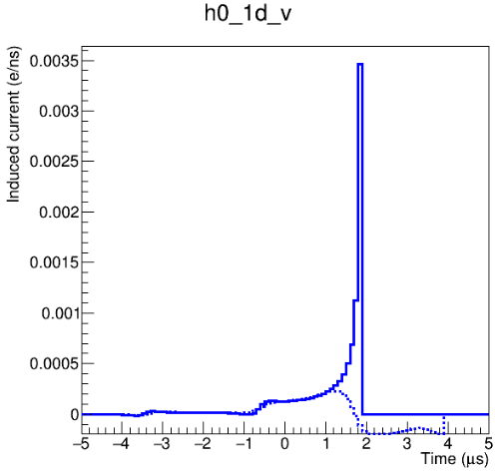
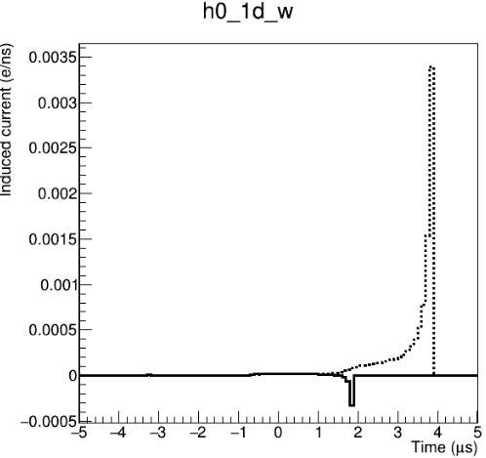
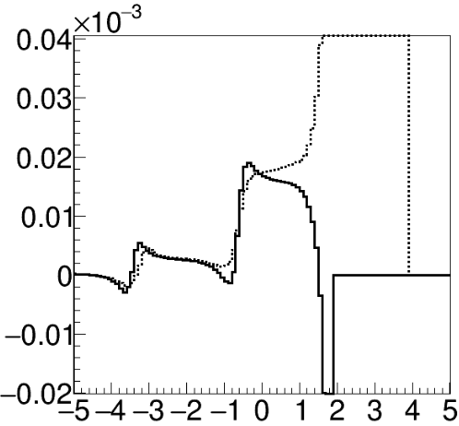
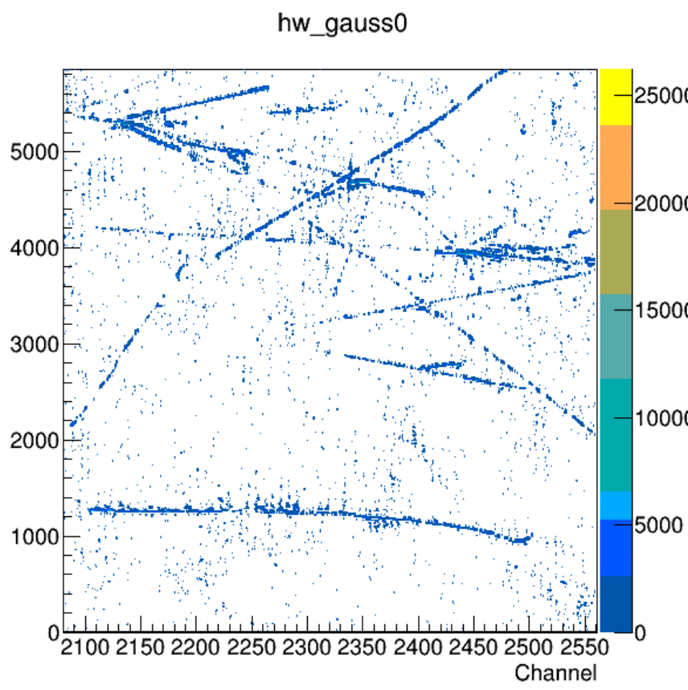
Recap
V plane
W plane
max current: 2.3E-4
Update FR + tight ROI threshold
max current: 1.9E-5
Field response (FR) was recalculated for APA1
Signal processing in APA1 improved with a lower tight-ROI thres. (2.5 r.m.s)

Slide 3
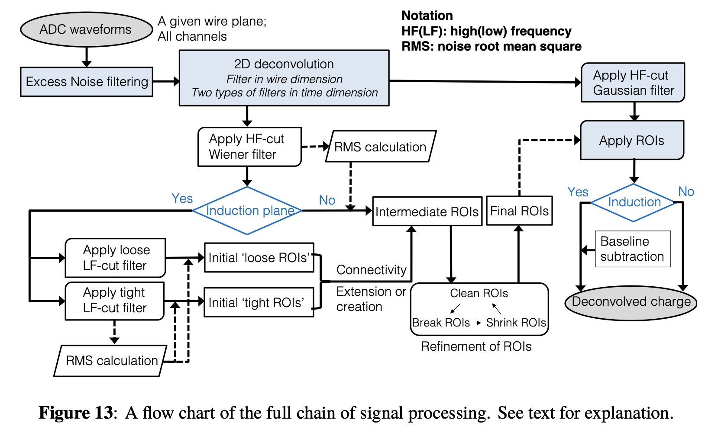
Plans for improving SigProc in APA 1
Correct workflow of induction and collection for APA 1
V view: iplane=1, but collection
W view: iplane=2, but induction
Recalculate Wiener filter for ROI finding
Need a data-driven noise model
Adjust thresholds for tight/loose ROI and ROI refinement
Today’s topic
Wire-Cell’s SigProc workflow

Slide 4
Ind./col. separation in OmnibusSigProc
SigProc is done per anode plane within OmnibusSigProc, plane IDs are used at many components:
OspChan::plane, m_r_data[iplane], FieldReponse::planes[iplane]
Separation of loose / tight ROI finding, e.g. `if (iplane!=2) …`
Member functions of ROI_formation, ROI_refinement
Productive discussion: https://github.com/WireCell/wire-cell-toolkit/issues/322
Conclusion: it would be a heavy refactorization if we want to rewrite the ind./col. separation entirely

Slide 5
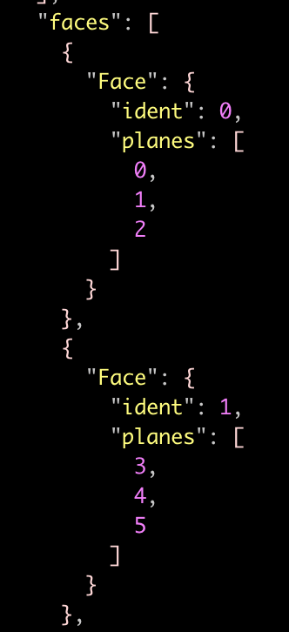
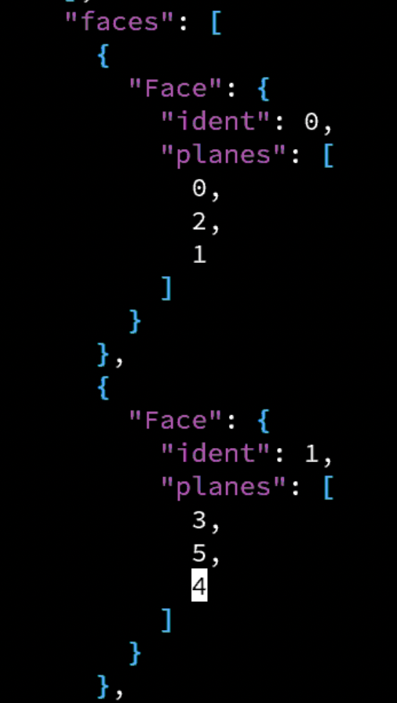
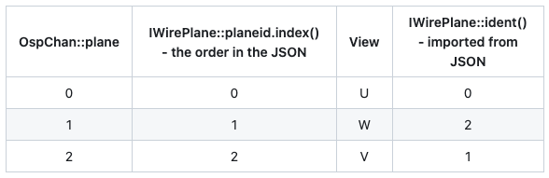
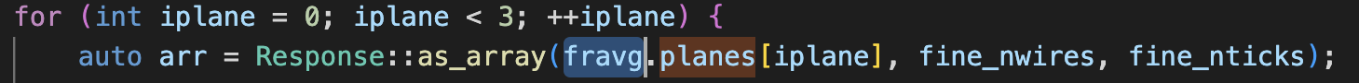
A light-weight solution: swap V & W
Inside OmnibusSigproc, we can hack the problem by
Swapping two planes’ order (V & W) in the wire geometry JSON for APA1
Swapping plane ident label in the field response JSON for APA1
Replace w/ a function call
PlaneResponse* FieldReponse:: plane(int )
Wire Geometry JSON

Slide 6
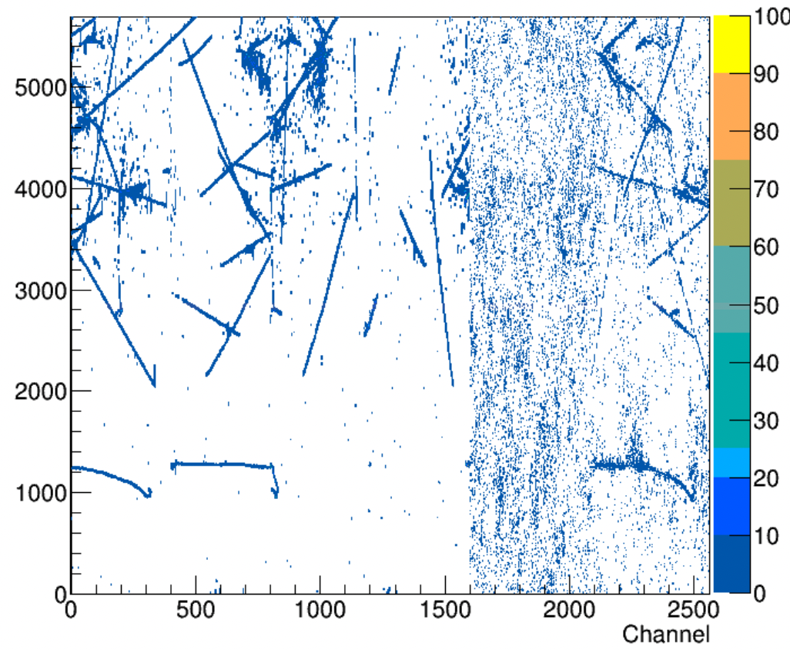
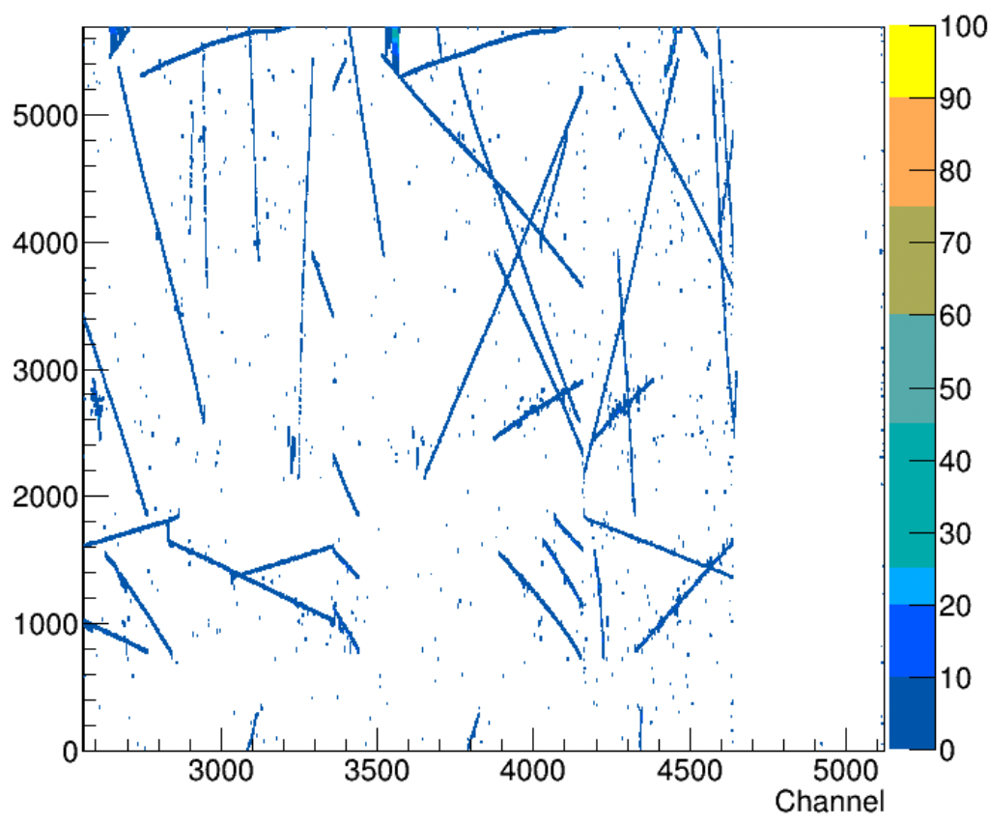
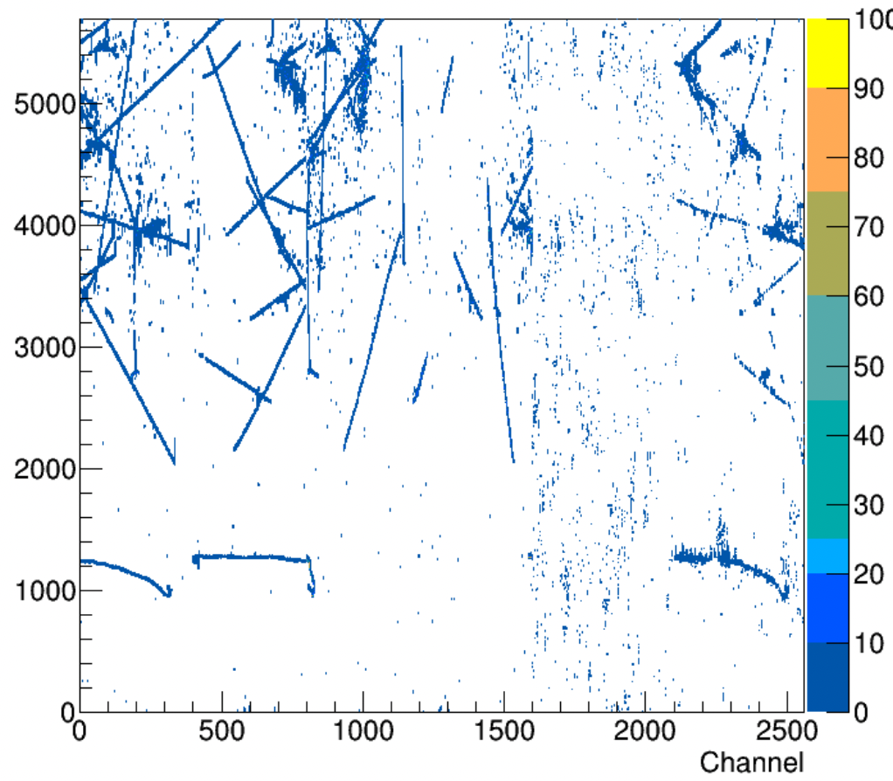
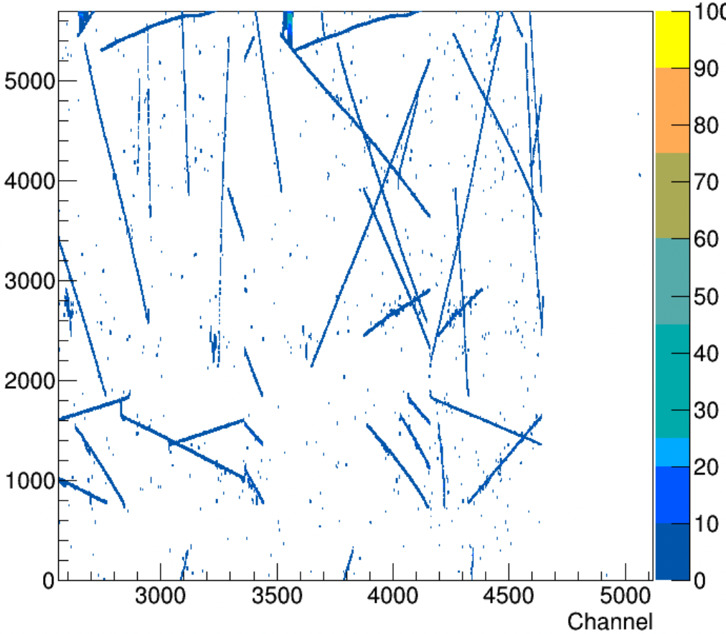
Comparison of SigProc results
Default
Consistent SigProc result after swapping
Do not expect identical or better result as we will optimize it later
Swapped V & W

Slide 7
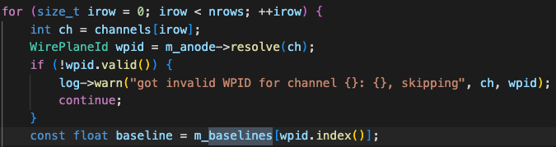

Impact on simulation
Caveat: Please limit the V&W swapping trick to within OmnibusSigProc.
The ImpactPlaneResponse class loads FR with a function call of plane ident number, which is externally configured from tools.jsonnet. So we can bypass the index problem with a proper configuration
However, `WirePlaneId::index()` is widely used in other places, the swapped W in APA1 would have index() == 1
Many of those returned value of index() would be used commonly without a separation of APAs
ImapctPlaneResponse.cxx
Digitizer.cxx

Slide 8
Plans for improving SigProc in APA 1
Correct workflow of induction and collection for APA 1
V view: iplane=1, but collection
W view: iplane=2, but induction
Recalculate Wiener filter for ROI finding
Need a data-driven noise model
Adjust thresholds for tight/loose ROI and ROI refinement
Wire-Cell’s SigProc workflow

Slide 9
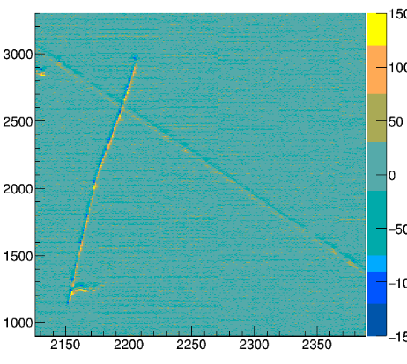
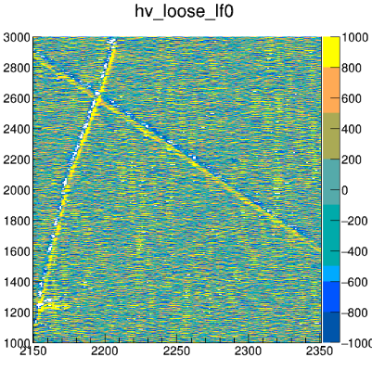
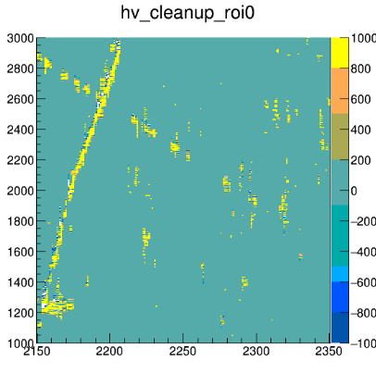
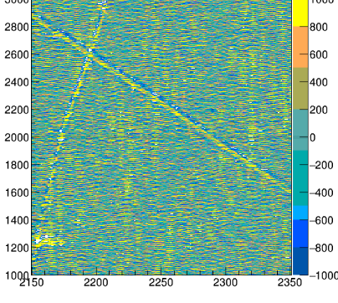
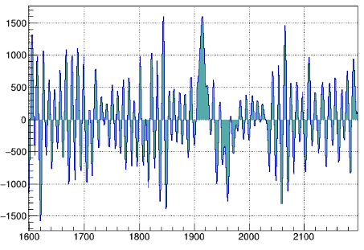
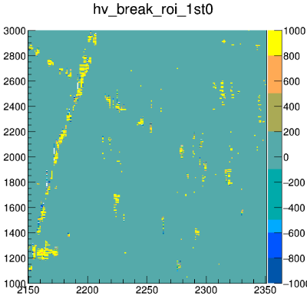
Raw ( W in APA1)
Tight LF
Loose LF
Cleanup ROIs
Cleanup ROIs: to ensure bin content inside ROIs is above threshold (th_factor=3)
Loose ROIs are clustered according to connectivity info
A loose ROI cluster is removed if none of its loose ROIs contain tight ROIs
Break ROIs
It appears that broken tracks emerge at the stage of Cleanup ROIs, but the Wiener Filter is not suitable in the decon result with loose/tight LF
Notes:
tight, loose, cleanup, MP2/MP3, break (1&2), shrink, extend

Slide 10
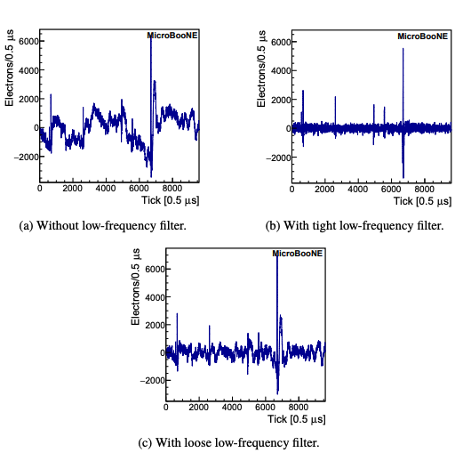
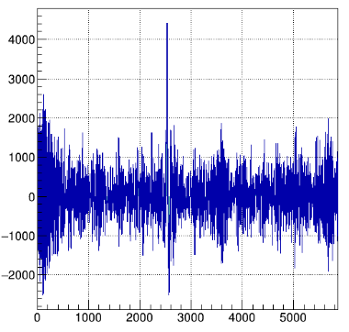
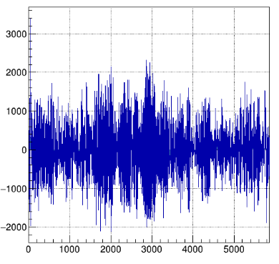
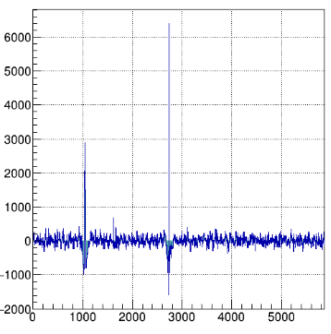
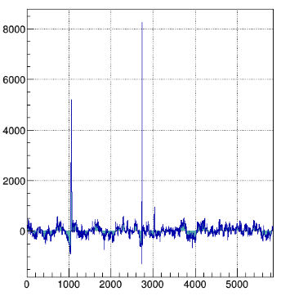
tight LF
(𝛕 = 0.014/0.06)
loose LF
(𝛕 = 0.002)
PDHD APA1 W
tight LF
(𝛕 = 0.014/0.06)
loose LF
(𝛕 = 0.002)
MicroBooNE
PDHD APA1 U
Notes:
Need to strengen HF? ”Wiener_tight_V” // hack for APA1 W

Slide 11
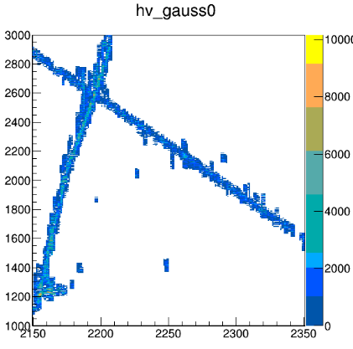
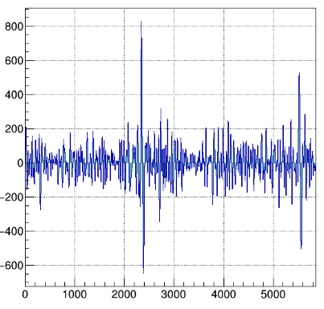
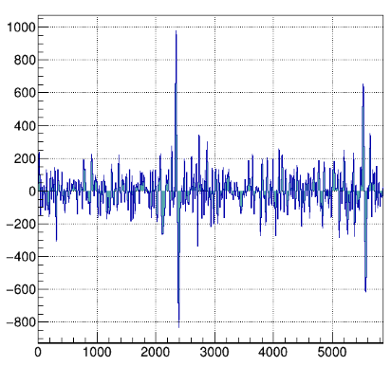
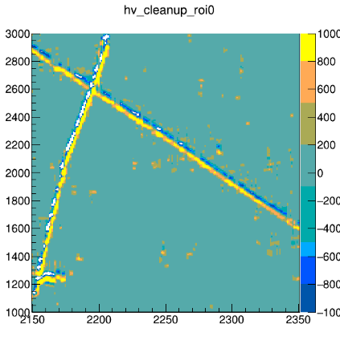
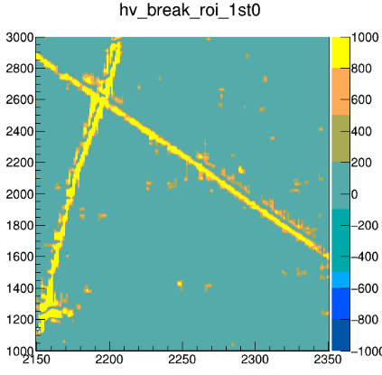
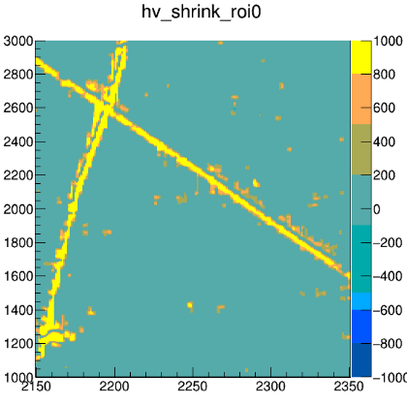
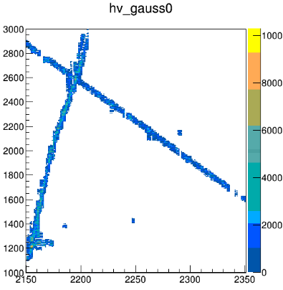
hf("Wiener_tight_V", {
sigma: 0.1596568 * wc.megahertz,
power: 4.36125 }),
sigma: 0.05 MHz
(Just a quick check, not optimized, need to recalculate with a data-driven noise model)
r_th_factor: 0.5
tight LF
loose LF
r_th_factor: 3

Slide 12
Summary and plan
Proposed a light-weight solution for properly treating the induction-W plane in ProtoDUNE HD’s APA1
The minor change would be limited to PDHD with a protection, e.g.,
Plan to optimize the signal processing for PDHD
Recalculate Wiener filter with a data-driven noise model
Optimize with various thresholds for ROI determination
Further Optimize with DNN ROI
Need to understand the SigProc efficiency/bias with simulation
bool m_load_fr_with_plane_ident; // configurable, default false
Array::array_xxf arr;
if (m_load_fr_with_plane_ident) {
// Load correct field responses for swapped V&W planes in PDHD APA1. See:
// https://github.com/WireCell/wire-cell-toolkit/issues/322
arr = Response::as_array(*(fravg.plane(iplane)), fine_nwires, fine_nticks);
}
else {
arr = Response::as_array(fravg.planes[iplane], fine_nwires, fine_nticks);
}

