Slide 1

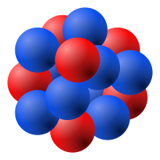
SiPM Noise Simulation
y
HENRY KLEST
P
Aug. 9, 2024
All copyright infringement is my own ☺

Slide 2
The Challenge
SiPMs are noisy
  Single-photon signals at O(MHz)
  Even worse once irradiated
Since the SciFi readout is longitudinally segmented, calibration of individual channels can be challenging
The MIP peak provides an ideal signal to use for a channel-by-channel calibration
Want to keep the signal amplitude of the MIP above the noise floor from the SiPMs

Slide 3
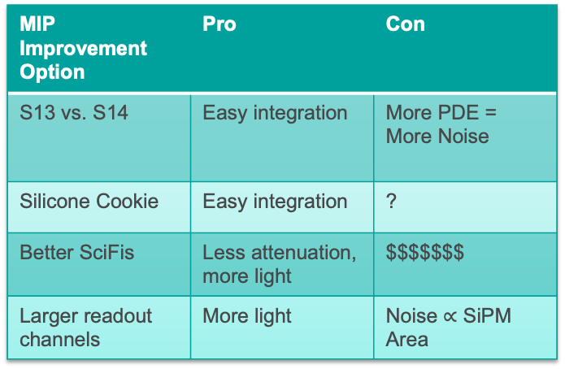
The Mitigation Strategies
Reduce the SiPM noise per channel, or increase the MIP signal per channel
Noise Reduction Option | Pro | Con
S13 vs. S14 | Easy integration | Less Noise = Worse PDE
Reduce Temperature | Strong noise reduction | Hard integration
Replace SiPMs | Fresh sensors | $$$
Anneal SiPMs | Undo radiation damage | Hard integration(?)
Smaller readout channels | Better granularity | MIP shrinks too
MIP Improvement Option | Pro | Con
S13 vs. S14 | Easy integration | More PDE = More Noise
Silicone Cookie | Easy integration | ?
Better SciFis | Less attenuation, more light | $$$$$$$
Larger readout channels | More light | Noise $∝$ SiPM Area
For more detail on these, see our session in the Jan. collaboration meeting

Slide 4
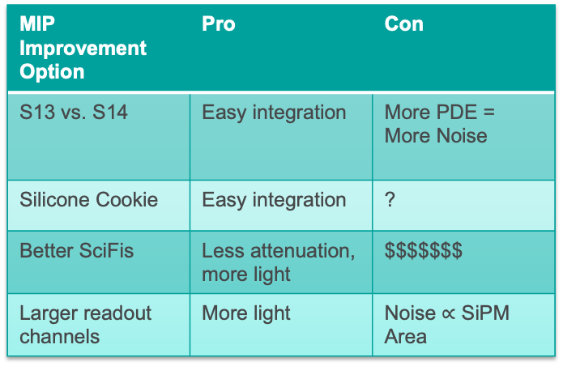
The Mitigation Strategies
Reduce the SiPM noise per channel, or increase the MIP signal per channel
Noise Reduction Option | Pro | Con
S13 vs. S14 | Easy integration | Less Noise = Worse PDE
Reduce Temperature | Strong noise reduction | Hard integration
Replace SiPMs | Fresh sensors | $$$
Anneal SiPMs | Undo radiation damage | Hard integration(?)
Smaller readout channels | Better granularity | MIP shrinks too
MIP Improvement Option | Pro | Con
S13 vs. S14 | Easy integration | More PDE = More Noise
Silicone Cookie | Easy integration | ?
Better SciFis | Less attenuation, more light | $$$$$$$
Larger readout channels | More light | Noise $∝$ SiPM Area
Let’s investigate these options a bit more…

Slide 5
Readout Channel Splitting
Investigate the effect of splitting our current 1.2 x 1.2 cm² channels into 2 or 4
DCR scales as SiPM area while MIP signal scales as path length
  Splitting in four reduces DCR by a factor of 4, signal by a factor of 2
  Splitting in two reduces DCR by a factor of 2, keeps MIP signal ~ the same
DCR is not linearly proportional to where can you set your threshold, needs to be simulated!
  DCR proportional to mean of pedestal, but we need to know the sigma!
Additional benefits of smaller channels:
  Reduces pulse size going into HGCROC
  Improves granularity for e/pi separation
  Reduces needed light guide length (?)
Splitting in two = sum orange + blue and green+purple
12 mm
12 mm

Slide 6
Readout Channel Splitting
Investigate the effect of splitting our current 1.2 x 1.2 cm² channels into 2 or 4
DCR scales as SiPM area while MIP signal scales as path length
  Splitting in four reduces DCR by a factor of 4, signal by a factor of 2
  Splitting in two reduces DCR by a factor of 2, keeps MIP signal ~ the same
DCR is not linearly proportional to where can you set your threshold, needs to be simulated!
  DCR proportional to mean of pedestal, but we need to know the sigma!
Additional benefits of smaller channels:
  Reduces pulse size going into HGCROC
  Improves granularity for e/pi separation
  Reduces needed light guide length (?)
Splitting in two = sum orange + blue and green+purple
12 mm
12 mm
This is probably worth a whole other talk…

Slide 7
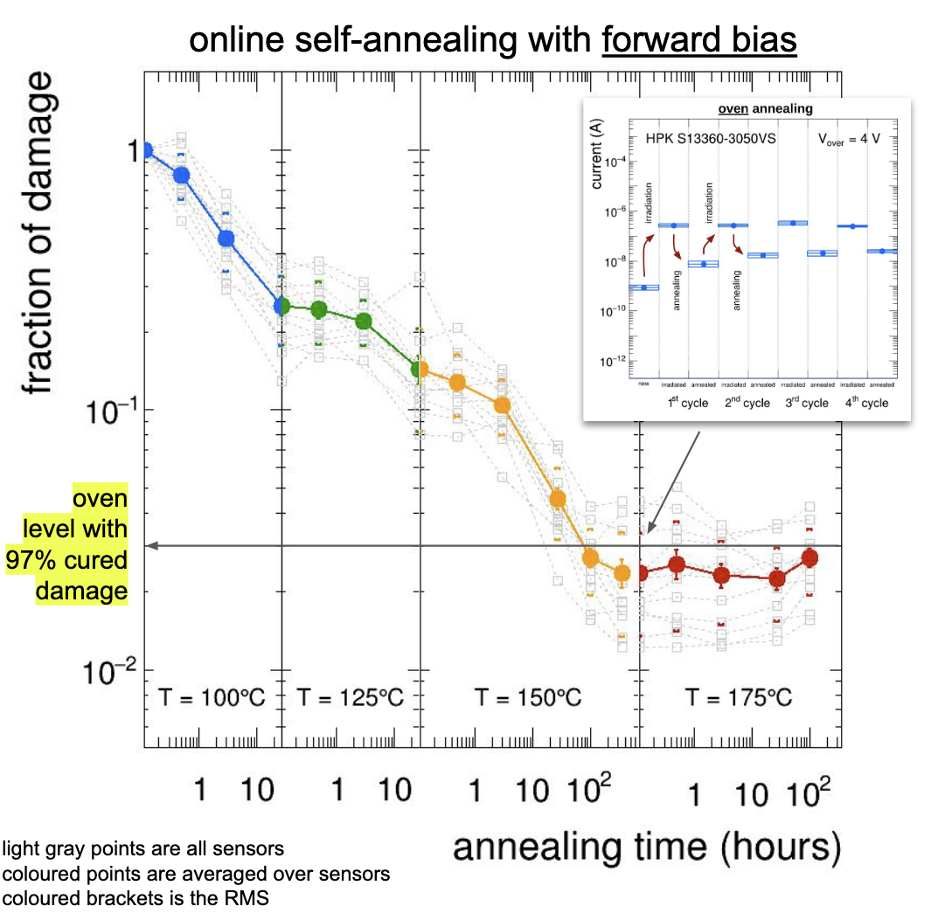

A word on annealing…
INFN Bologna successfully tested in-situ annealing via forward-bias of the SiPM
  Run a current through the diode until it heats to the desired temperature
This provides a convenient alternative to removing the SiPMs from the detector and putting them in an oven!
Achieved a factor ~50 (!!!) reduction in dark current after several days of heating at 150° C
  Very attractive option for us
  IF we can integrate it in the ESB
“Fraction of damage” = $\frac{Dark Current Post Rad.}{Dark Current Post Rad. \& Annealing}$
Click here for Roberto's talk

Slide 8
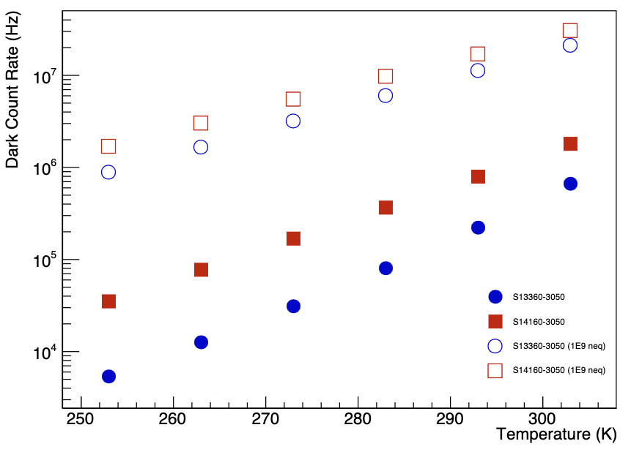
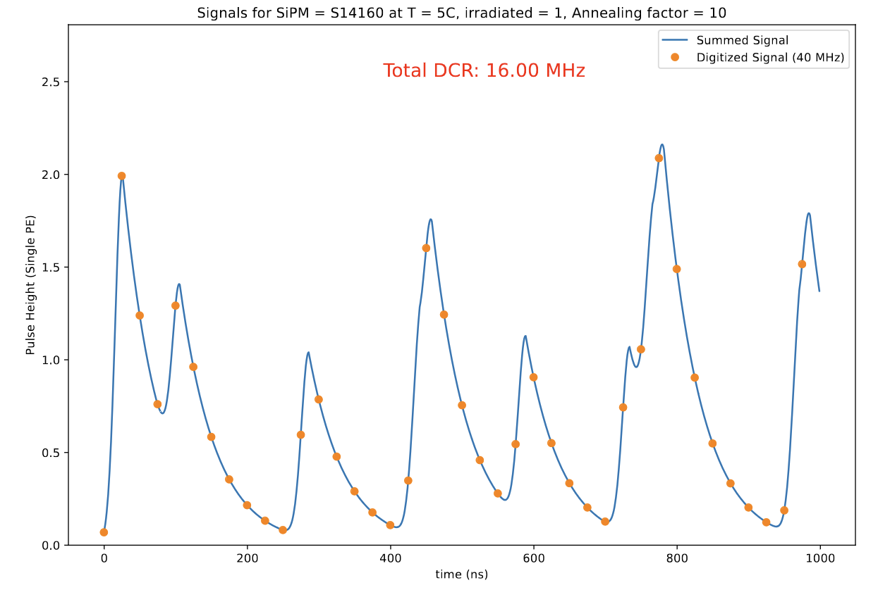
Simulation Technique
Throw waveforms at the dark count rates supplied to us by INFN Bologna for S14160-3050 SiPMs
  Various temperatures provided
  Both unirradiated and irradiated with 1E9 1 MeV neutron equivalent dose
Include the crosstalk numbers supplied by Hamamatsu
  This is important to determine the sigma of the noise!
Focus on irradiated sensors, since this is the concerning case for the MIP

Slide 9
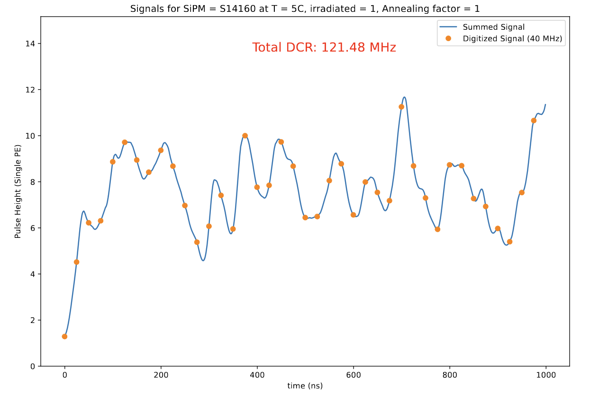
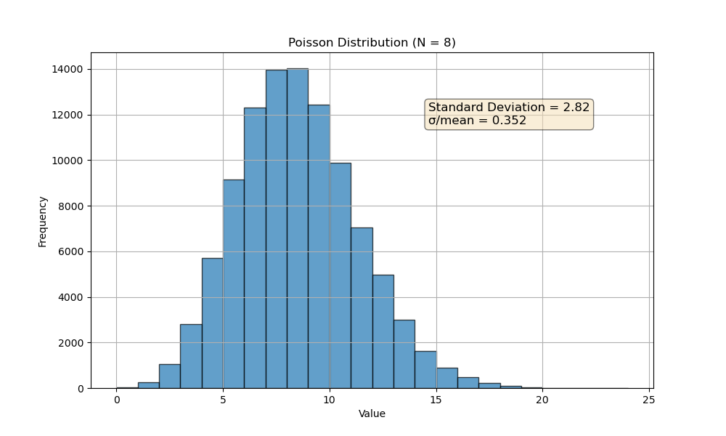
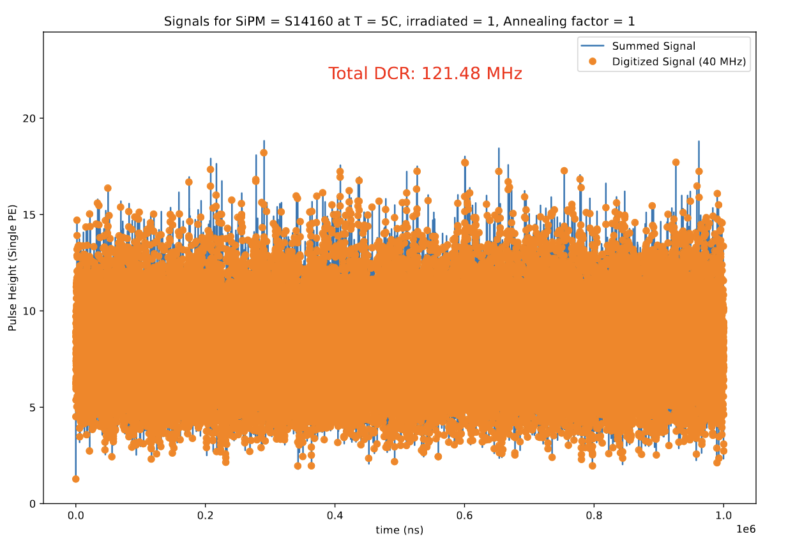
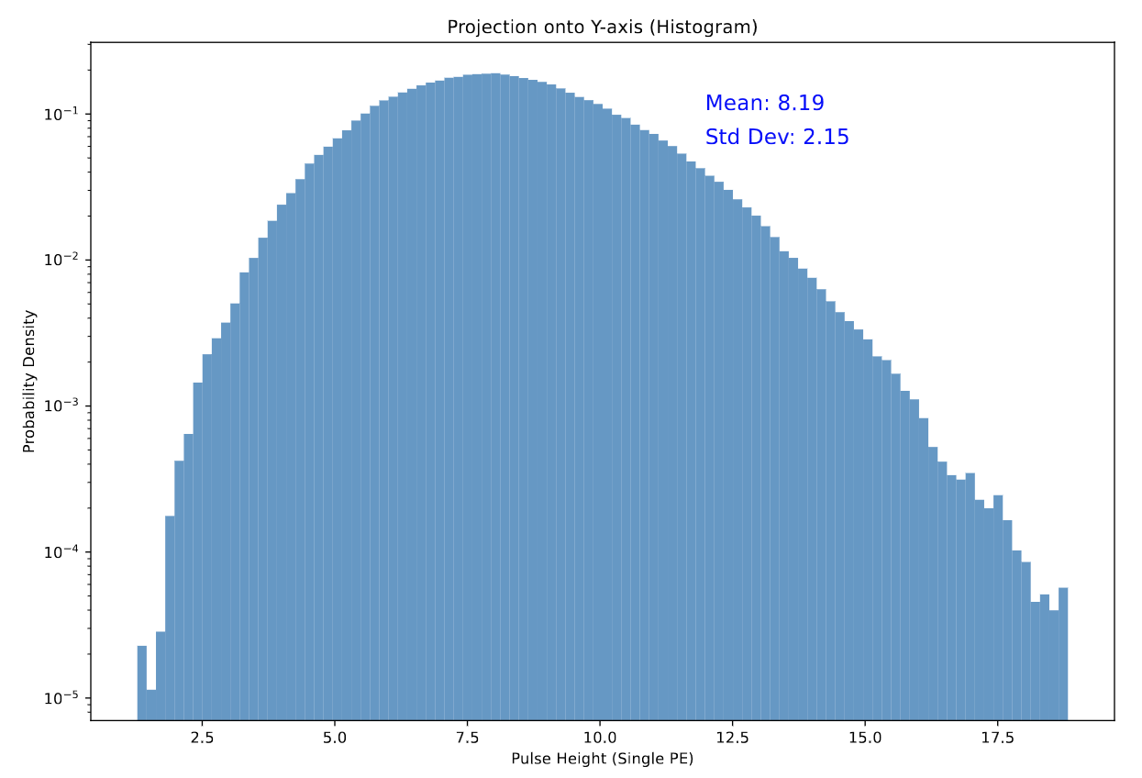
Baseline – 12 x 12 mm²
Strawman MIP
<N_{pe}> = 8
12x12 mm²
S14, 5°C, 1E9 Irradiated, No annealing

Slide 10
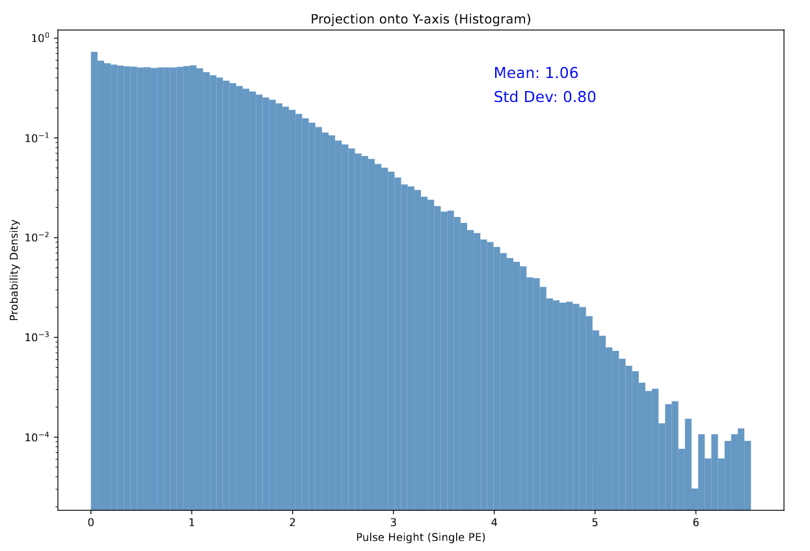
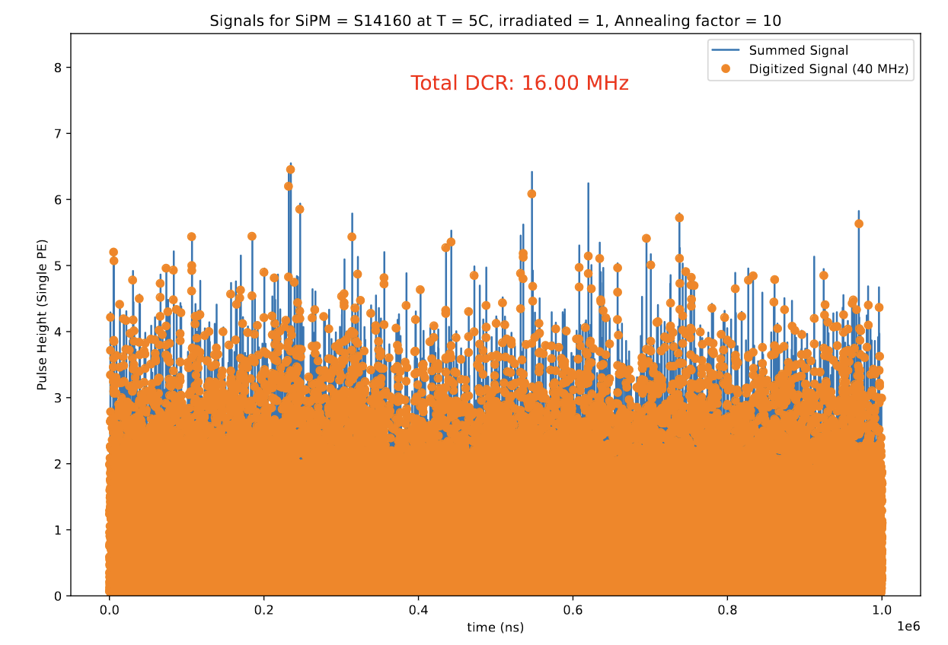
Baseline – 12 x 12 mm²
Strawman MIP
<N_{pe}> = 8
12x12 mm²
S14, 5°C, 1E9 Irradiated, annealing factor 10

Slide 11
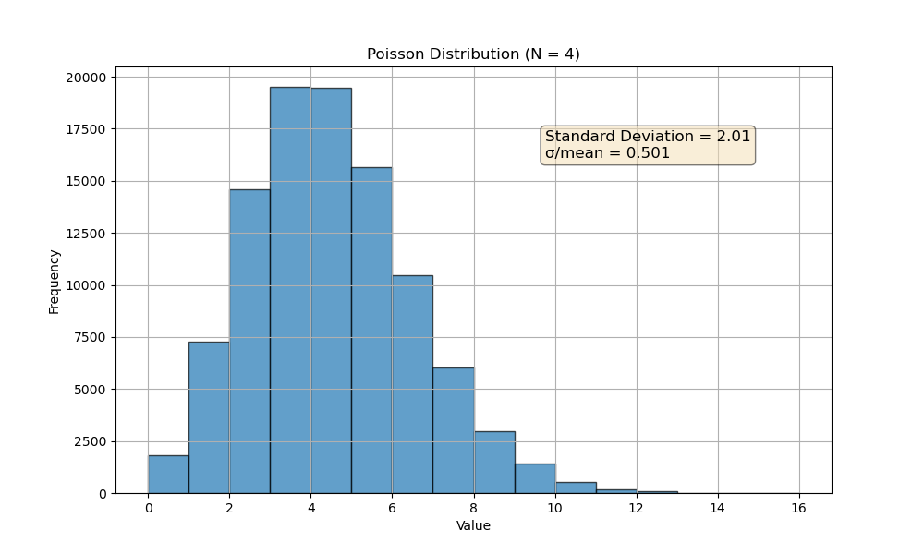
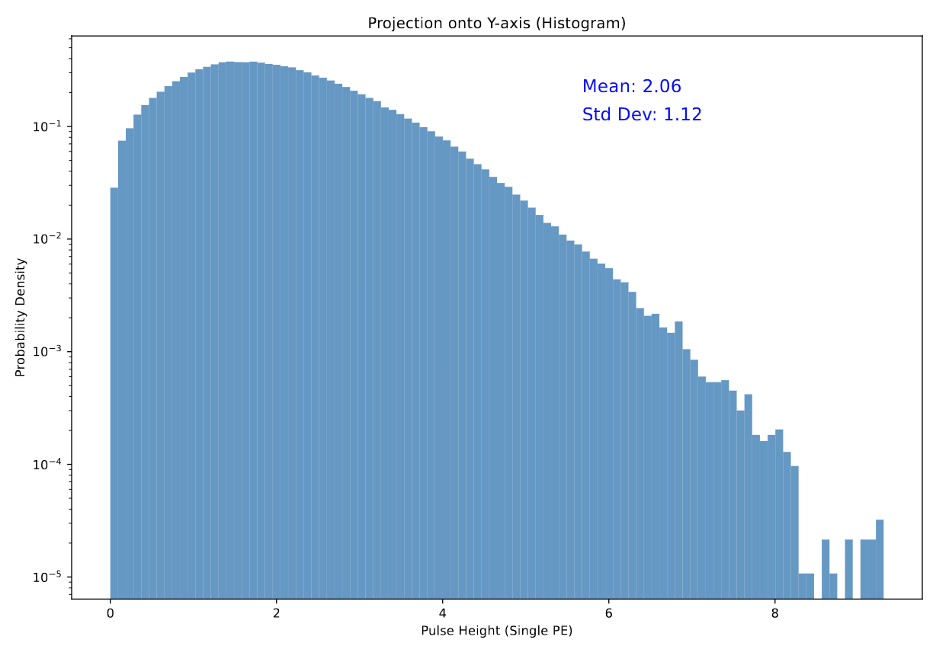
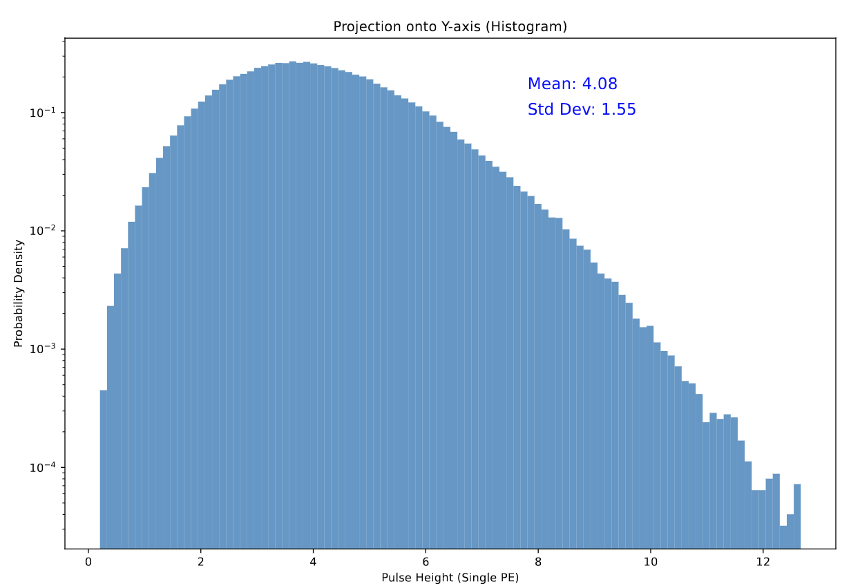
Strawman MIP
<N_{pe}> = 4
Strawman MIP
<N_{pe}> = 8
_{MIP 1.7 “σ” above noise}
_{MIP 2.5 “σ” above noise}
6x6 mm²
S14, 5°C, 1E9 Irradiated, No annealing
6x12 mm²
S14, 5°C, 1E9 Irradiated, No annealing

Slide 12
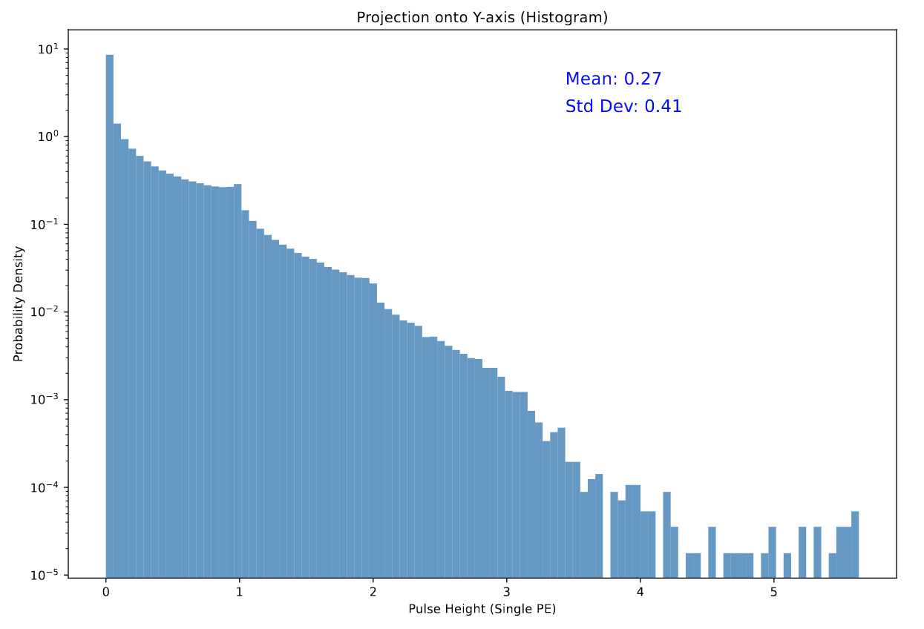
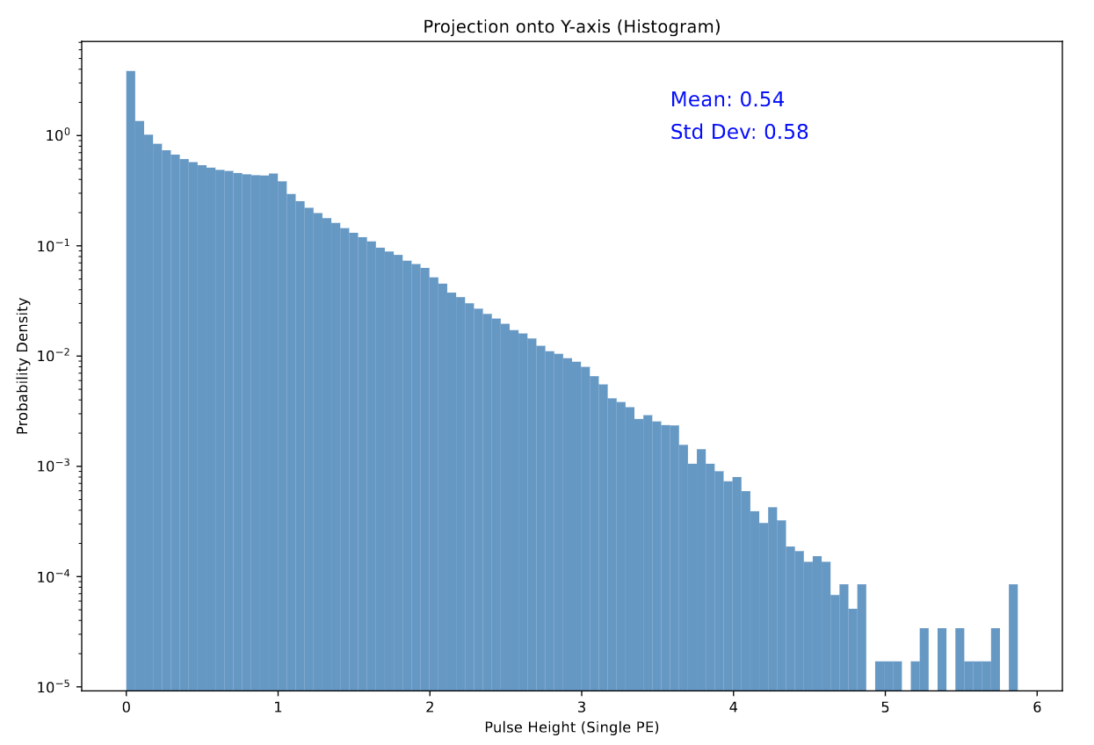
Strawman MIP
<N_{pe}> = 4
Strawman MIP
<N_{pe}> = 8
6x12 mm²
S14, 5°C, 1E9 Irradiated, annealing factor 10
6x6 mm²
S14, 5°C, 1E9 Irradiated, annealing factor 10
_{MIP 9.1 “σ” above noise}
_{MIP 12.9 “σ” above noise}

Slide 13
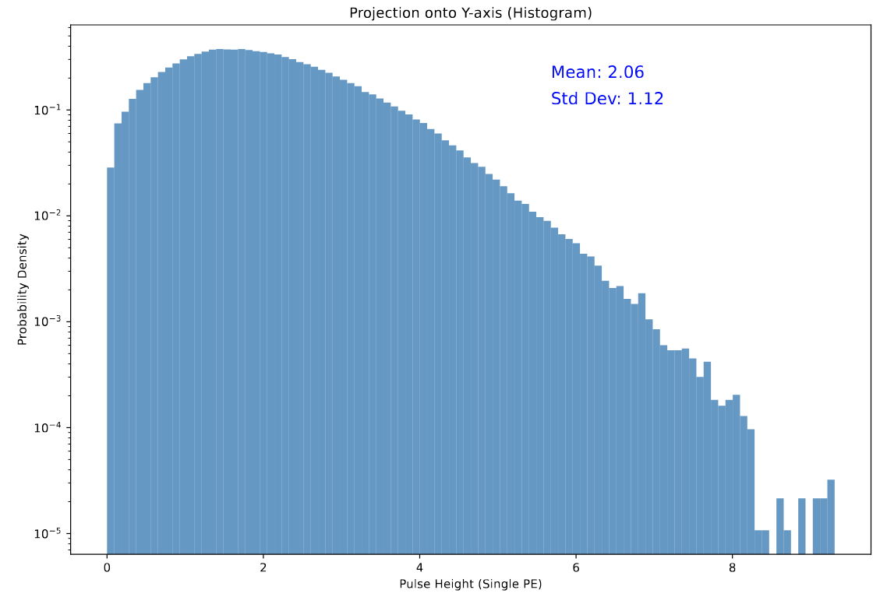
To go even further…
Note that this case will only really be true for field-off runs of the collider
  Cosmics will rarely hit in the “aligned” orientation
Strawman MIP
<N_{pe}> = 8
12 mm
12 mm
3x12 mm²
S14, 5°C, 1E9 Irradiated, annealing factor 1
_{MIP 5.3 “σ” above noise}

Slide 14
To go even further…
Note that this case will only really be true for field-off runs of the collider
  Cosmics will rarely hit in the “aligned” orientation
Strawman MIP
<N_{pe}> = 8
12 mm
3x12 mm²
S14, 5°C, 1E9 Irradiated, annealing factor 10
_{MIP 18.9 “σ” above noise}
12 mm

Slide 15
Conclusions
If the annealing factor of 10 can be achieved, all schemes seem acceptable
  If not, the 12 mm x 12 mm and 6 mm x 6 mm are in trouble, 6 mm x 12 mm looks okay still
  The 6x12 mm option provides decent headroom at little cost
    Requires individual 6x6mm SiPMs and not arrays
Caveats
  We assumed as our strawman an average of 8 p.e. for the MIP
    Single-clad Kuraray was something like 6.4 p.e. on average in Maria’s previous sims, Luxium was 5.1 p.e.
    Tegan’s light guide studies suggest we gain more from the silicone cookie than we assumed at that time
    6.4 would be okay for the 2x1 split
  No investigation of splitting effect on signal shape!
    For fixed external circuitry, the smaller arrays will have faster signals (SiPM capacitance)
    This will reduce their sigma somewhat, but shorter signals will have fewer useful ADC samples in HGCROC

Slide 16
Backup

Slide 17
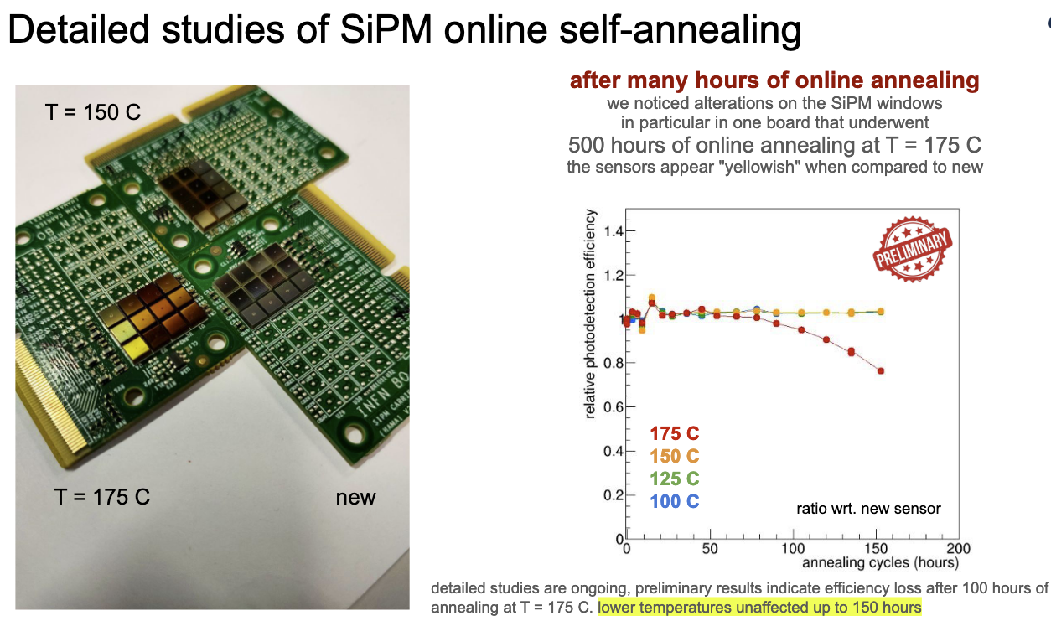

Slide 18
Backup Backup (January)

Slide 19
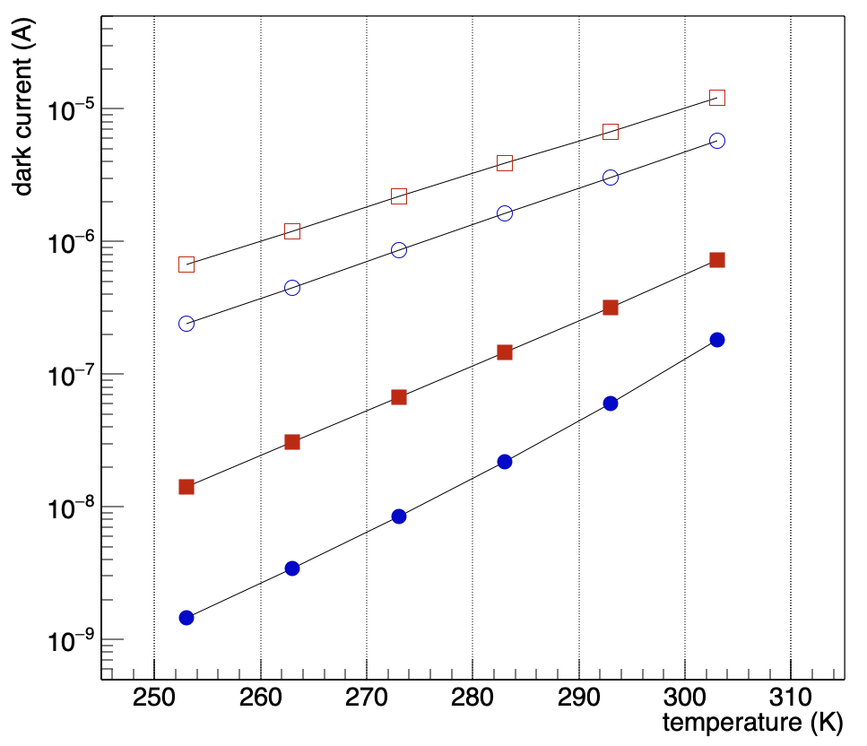
Dark Currents from INFN Measurements
Scale currents by gain & q_{e} to get a dark count rate
  This is a bit naïve, but Roberto indicated it should be alright
Order of magnitude increase after 1E9 1 MeV neq dose
  Our conservative estimate of dose for lifetime of experiment was 3E10

Slide 20
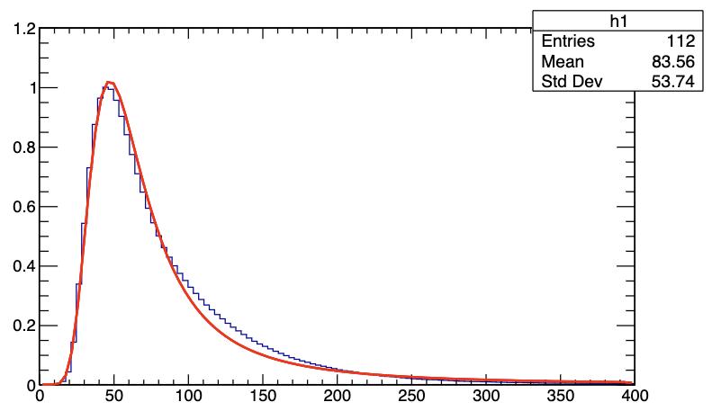
HGCROC Signals
Pulse from charge injection tests on HGCROC
  Kindly supplied by Norbert
  Digitized much faster than HGCROC actually digitizes
  Landau fit
  Peak set to 1 photoelectron
For now, I just do the stupid thing and throw these distributions with the frequency of the DCR
The reality of how often we will see hits from noise will depend on what ADC value we call a “hit”

Slide 21
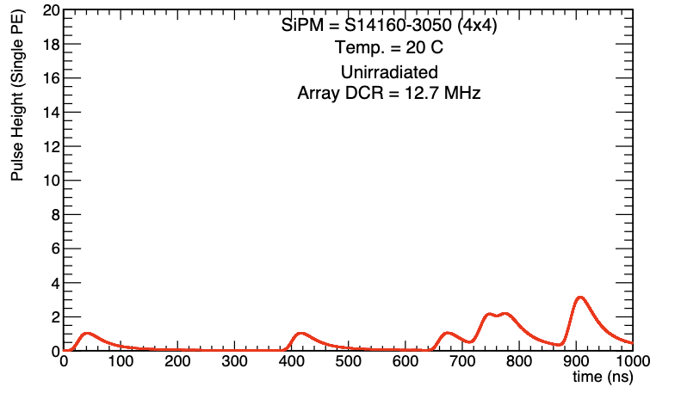
Waveforms
Created by Monte Carlo which throws Landau distributions with parameters taken from the HGCROC charge injection signal at different time slices with probability defined by the DCR
Crosstalk produces pulses 2x or 3x as high as the standard single-photon pulse
  Here a 7% crosstalk probability is assumed for both S14160 and S13360
  Final crosstalk numbers will depend on the optical coupling to the lightguide

Slide 22
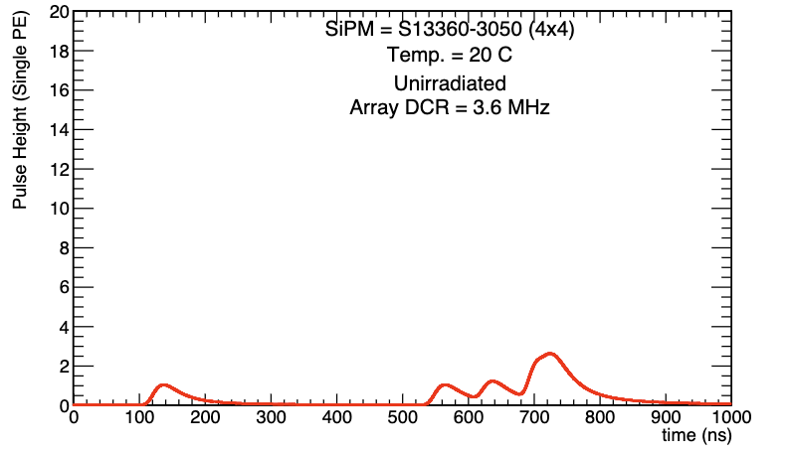

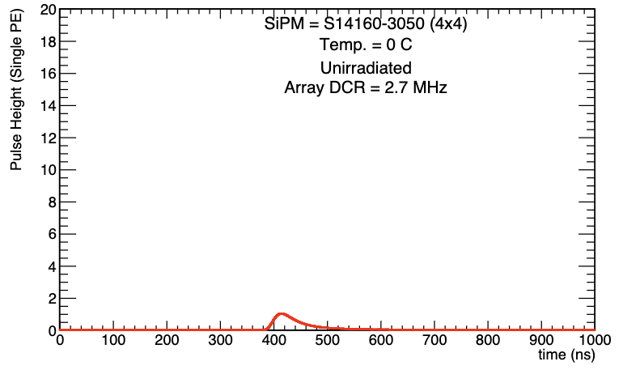
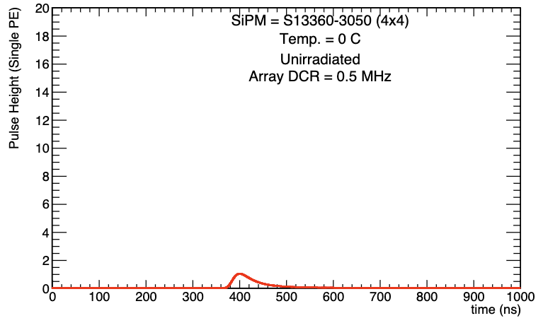
Temperature Dependence
Both sensors look reasonably good before irradiation, could easily set a threshold at 4 or 5 p.e.

Slide 23
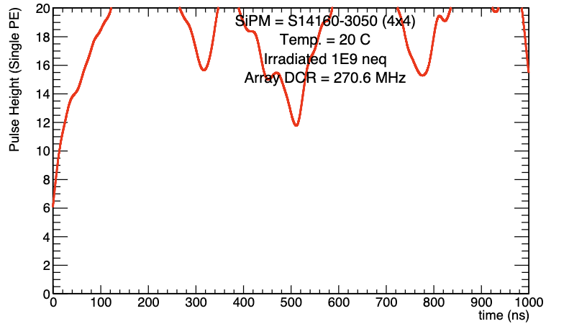
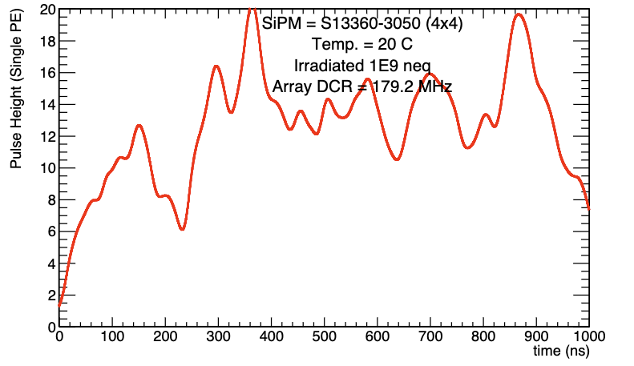

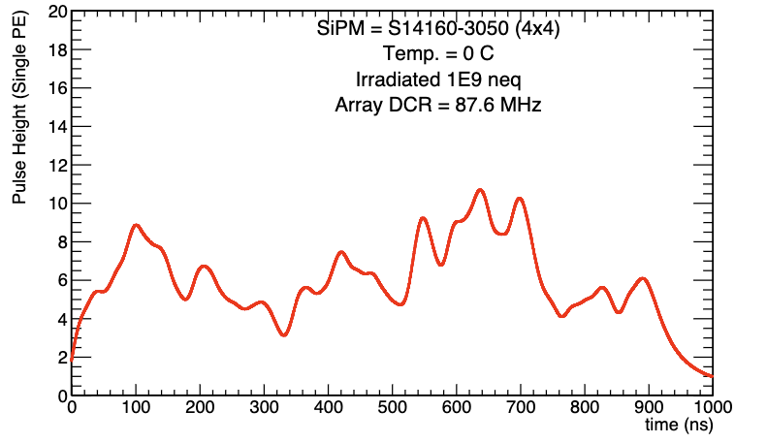
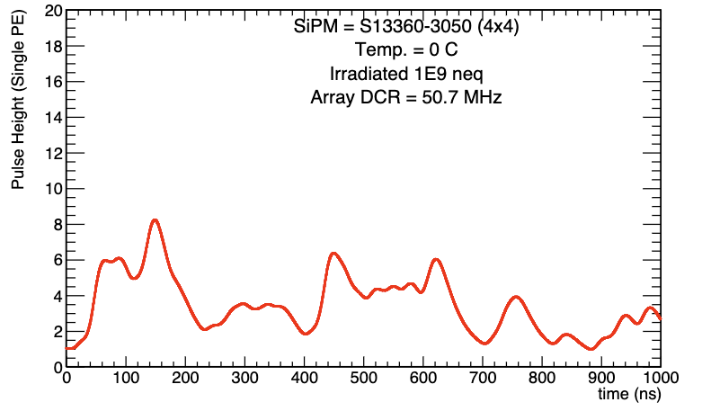
Radiation Damage
0 °C not cool enough to save the MIP for either SiPM after 1E9 1 MeV neq dose
This assumes that the dark current produced by irradiation translates directly into dark counts, which is the worst case scenario
Keep in mind that this represents only ~1/30th of the 10-year expected dose

Slide 24

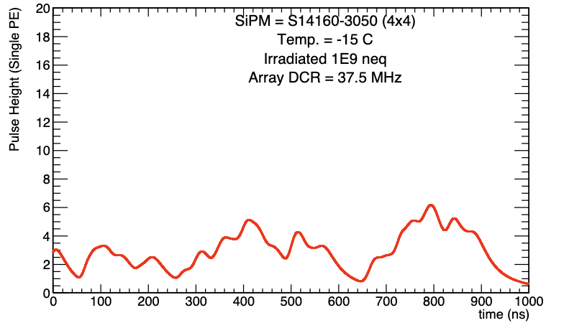
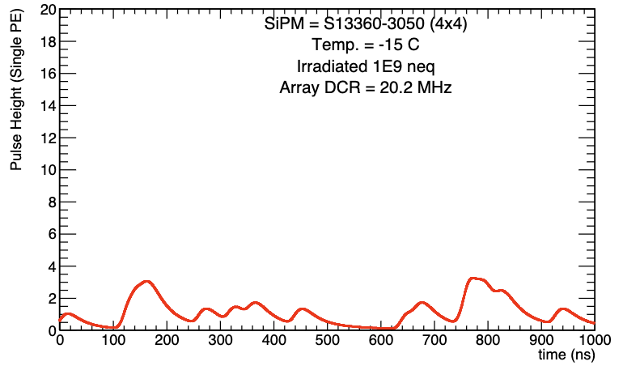
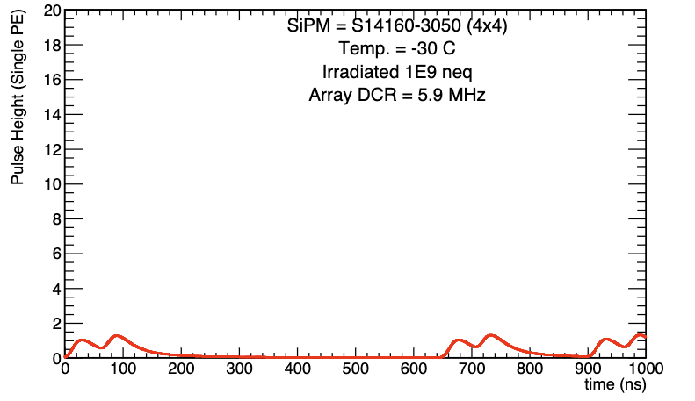
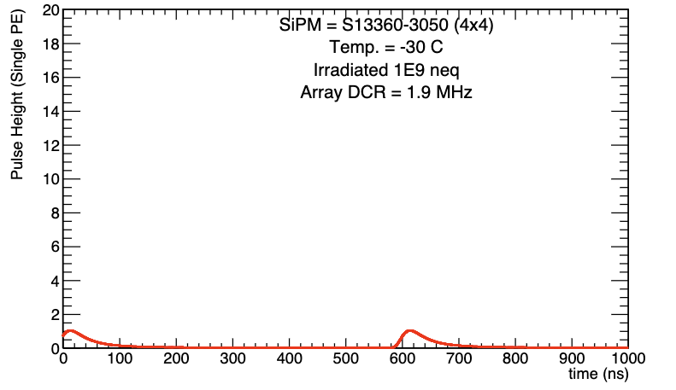
-30 °C
Sub-Zero
Looks acceptable, as expected since -30C is the nominal temperature for the single-photon counting in the dRICH
DCR is an exponential function of temperature
Integration of sub-zero cooling would likely be very challenging, but in principle possible since the dRICH is already doing it

Slide 25
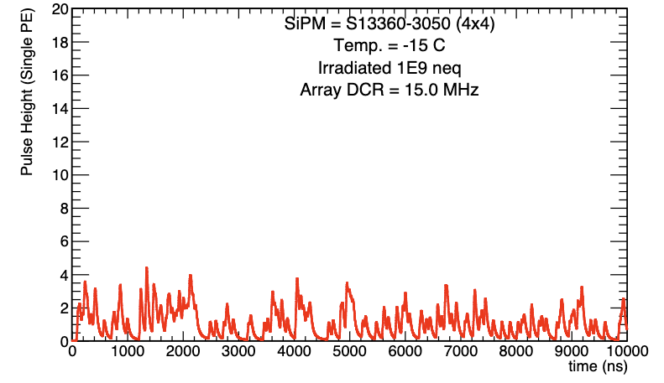
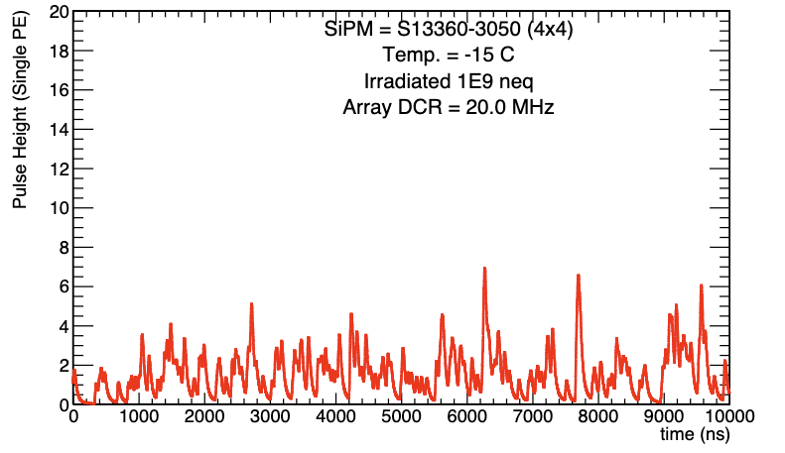
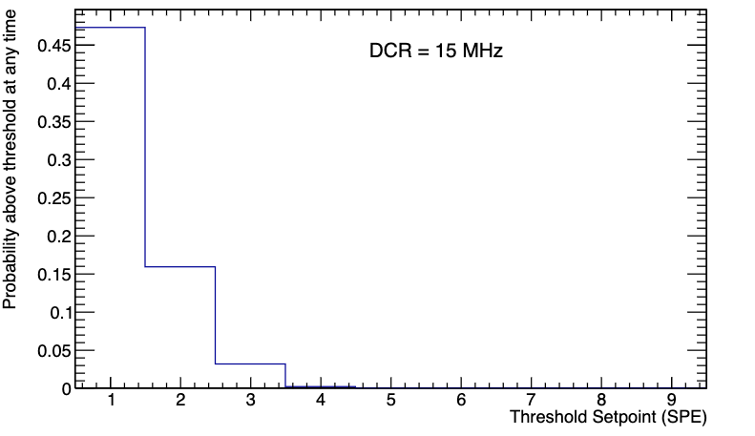
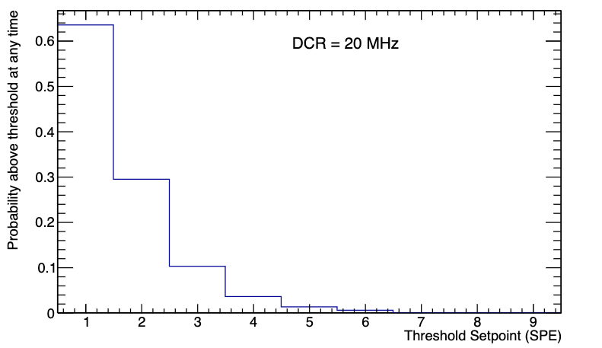
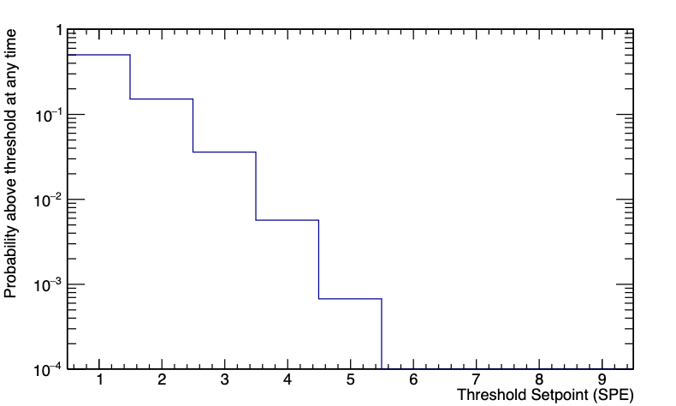
Threshold
HGCROC will report information whenever the analog input is above a threshold
Given HGCROC pulse shapes, seems that something like ~15 MHz could be a reasonable goal for maximum DCR
  In 100 μs, expect analog signal above a 5 N_{pe} threshold ~0.05% of the time

Slide 26
Summing Channels
How can we reach 15 MHz?
  What matters for keeping the MIP is that there are less than 15 MHz of noise in the area that the MIP photons are hitting
Splitting the 4x4 array into four optically isolated 2x2 arrays could ~half the noise on the MIP
  Set thresholds at ~ ¼ the value of the 4x4 array
  Four light guides covering smaller areas
  Unlike a shower, the MIP energy deposit in the SciFi can be approximated as a line
    Will typically send all its photons to ~two of the four SiPMs!
  Half the surface area of active SiPM means half the noise

Slide 27
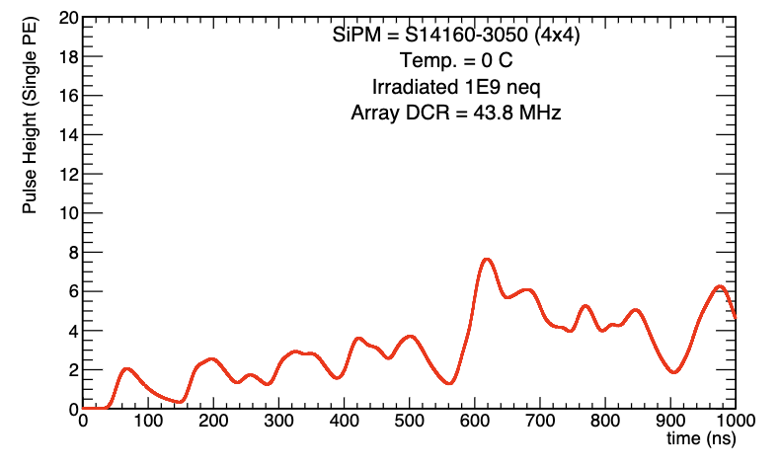
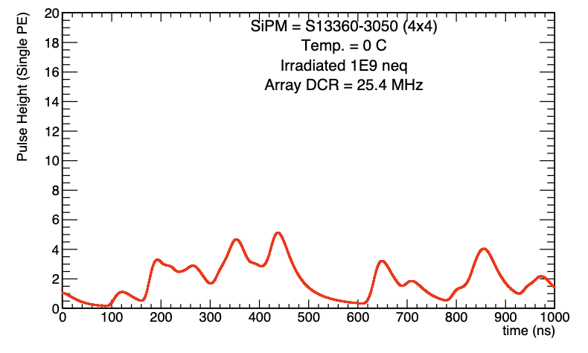
Discussion
2
Even with splitting readout channels from 4x4 summed to 2x2 summed, can’t reach 15 MHz for irradiated SiPMs even at 0 °C
  1x1 channels? 5760*16 = 92k readout channels
Effects of annealing between runs not considered
  Time heals all wounds
  Some studies show 1 month of sitting at room temp. after proton irradiation can decrease dark current by a factor of 2
Or do as Craig Woody said and use the MIP to cross-calibrate in the early stages of the experiment, then trust that calibration once the MIP is below threshold
2

Slide 28
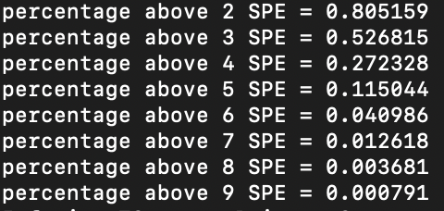
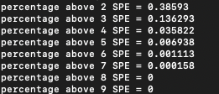
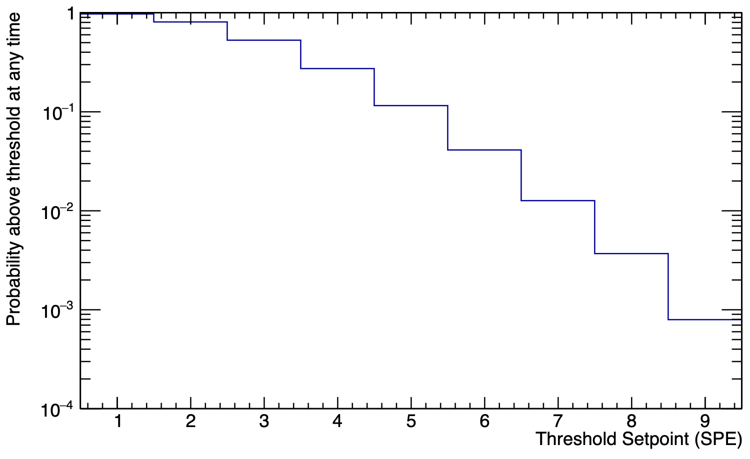
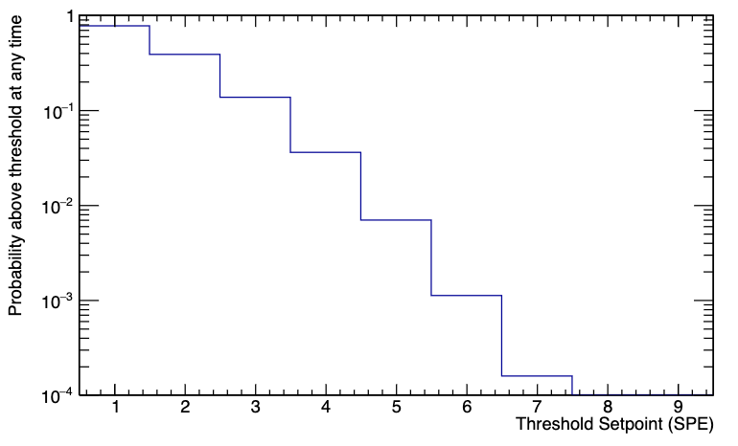
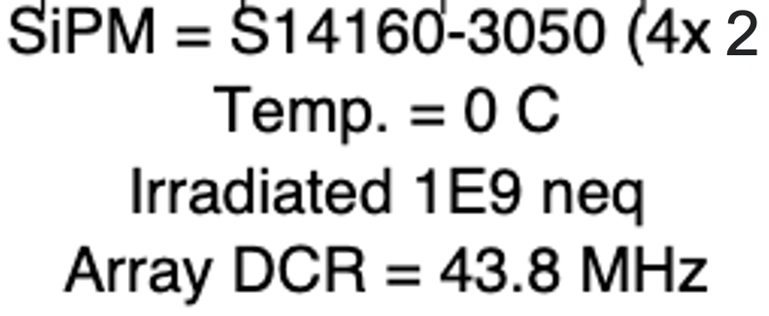
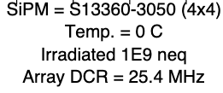
Fraction of time spent above a threshold of N_{SPE} (1 ms simulated)
2
Per channel, expect 11% of samples to be above a 5 p.e. threshold (4.4 MHz)
Per channel, expect 0.6% of samples to be above a 5 p.e. threshold (0.24 MHz)
Ignoring time binning effects

Slide 29
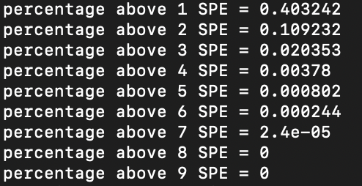
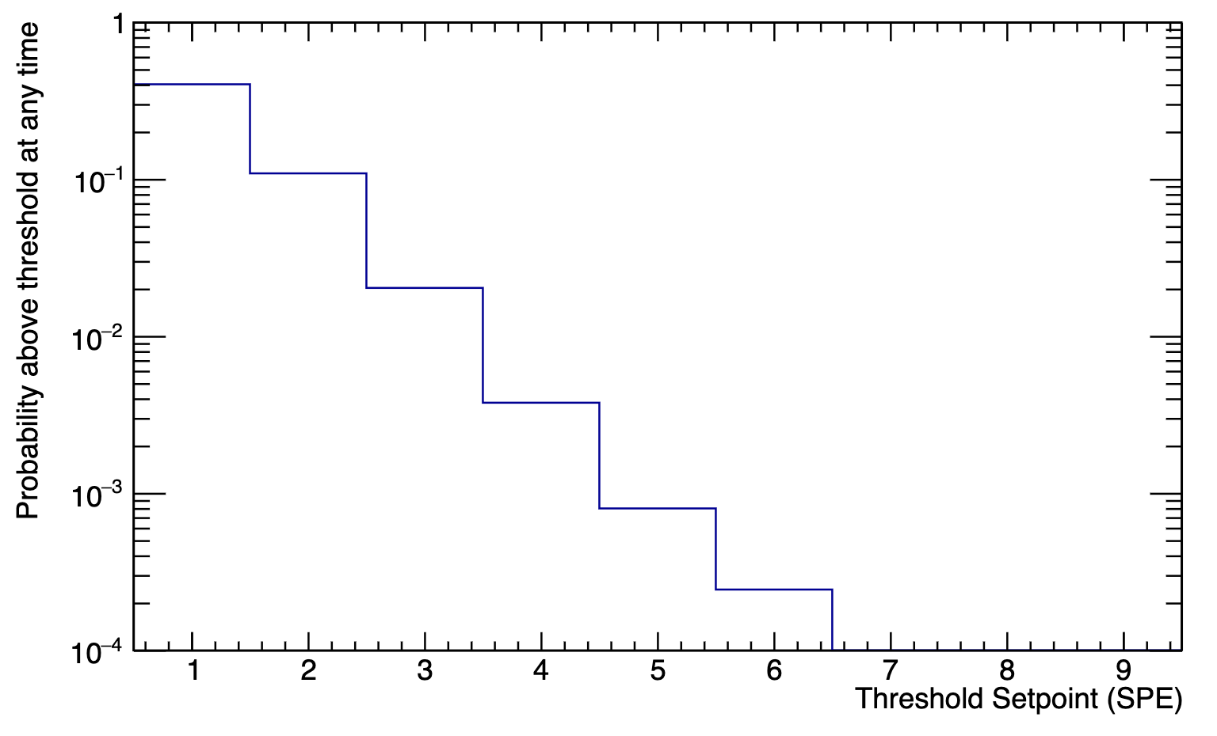
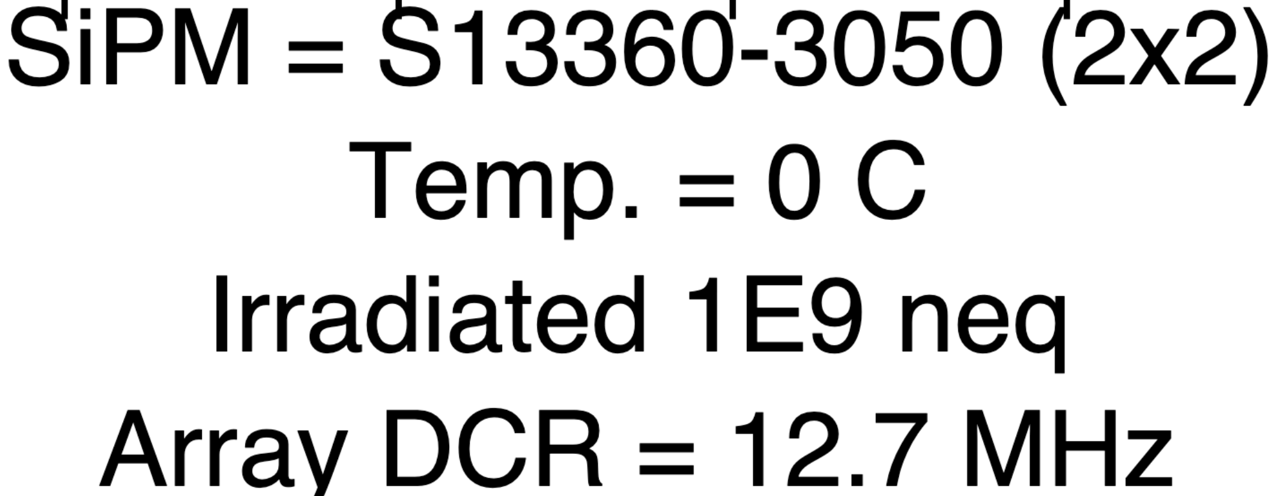
HGCROC Bandwidth
2x2 array in 100 μs
HGCROC sends 32 bits/hit
Currently each HGCROC has 2 x 1.28 Gbps links
Max hit rate above threshold: 80 MHz for all channels on that HGCROC
Anticipate 60 Channels/HGCROC
Max hit rate of ~1.3 MHz/channel can be passed on by HGCROC
  For irradiated S13360 with readout split into 2x2, expect total DCR/channel of 12.7 MHz, want a threshold at ~2-3 SPE
    Above 2 PE 10% of the time ~ 4 MHz
    above 3 PE 2% of the time ~ 0.8 MHz
    Cross-talk has much larger effect on operation at lower thresholds
  Rate/channel situation is slightly worse for split readout due to cross-talk

Slide 30
Conclusion
With measurements from INFN and HGCROC signals, made some first estimates for what waveforms will look like
Irradiated sensors very likely to lose the MIP without intervention
  Additional cooling
  Annealing
  Further splitting of channels
Caveats:
  Dark Current to DCR conversion
  Pulse shapes will depend on how many SiPMs are ganged together
  No room-temperature annealing effect

Slide 31
BACKUP

Slide 32
HGCROC ADC Resolution
Resolution of 0.4 fC ~ 2500 electrons
Much smaller than the signal from a single SPAD firing in the SiPM
  S13360 Gain 1.7E6
  S14160 Gain 2.5E6

Slide 33
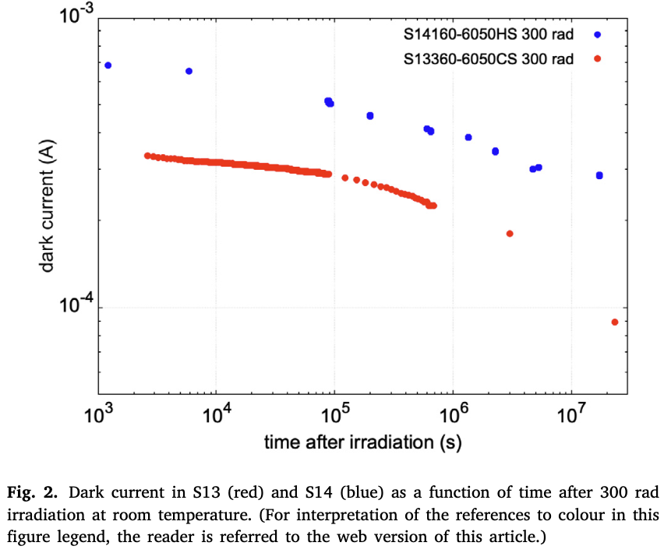

Slide 34



Slide 35


CONSIDERATIONS
Photon detection efficiency
Noise
  Low dark count rate necessary to see small signals from e.g. MIPs
  Low crosstalk & afterpulsing preferable
Pulse shape
  Fast rise time for z-position resolution
    Time-projection Calorimeter (TPC)
  Short tail to reduce signal pileup
  Consistent over time
  Proportional to N_{pe}
Consider the performance in the BIC of Hamamatsu S13660 and S14160 Series
  Biggest challenge is seeing the MIP at midrapidity, use this as a benchmark

Slide 36



PDE
Kuraray Fiber
PDE important to minimize statistical error on energy measurement & maximize efficiency for small signals
50 micron pixel size chosen
  Trade off between geometric efficiency & saturation point
Relevant wavelengths determined by emission spectrum of scintillating fibers
  Both SiPMs peak in PDE near the emission peak around 450 nm
S14160 peaks at ~50% PDE
S13360 peaks at ~40% PDE
In PDE, S14160 series wins
S14160
S13360

Slide 37



NOISE
Specification | S13360-3050 (3x3 mm) | S14160-3050 (3x3 mm)
DCR (Typ.) | 500 kHz | 1 MHz***
Crosstalk (%) | 3 | 7
Dark count rate (DCR) determines threshold
  MIPs at midrapidity will generate 3-6 N_{pe} on average
    Would be good to have threshold slightly below MIP
DCR above a few 10s of MHz will endanger the MIP
*** Estimated, differing values in literature
Signal will gang 1.2 cm x 1.2 cm area (16 3x3 mm or 4 6x6 mm)
  DCR for one BIC channel will be ~16x value in table
Plan to test S14160 SiPMs at ANL & Regina

Slide 38



PULSE SHAPE
Appears that S14160 has fast rise time, slower fall time than S13360
  Challenging to compare between papers due to differences in readout
  Will soon compare the two in an identical setup at ANL
Should converge on a reasonable target for these parameters based on physics
  Keeping the MIP, low energy ɣ
Fast rise time improves position resolution in z-direction
  If not limited by other factors like readout or scintillation decay
Fast fall time reduces pileup of signals (and dark counts)
  Shape will depend heavily on the readout circuit
“Short” fall time
“Nominal” fall time
“long” fall time
Similar to HGCROC Default

Slide 39

S13360 S14160
✅
✅
✅
✅
✅
✅
✅
✅
❌
✅
~
✅
✅
❌❓
❌
✅
✅
✅
✅
✅
✅
✅
✅
✅
✅
✅
✅
✅

Slide 40
OPEN/DISCUSSION QUESTIONS
What DCR can we really tolerate?
  Depends on signal shape, shorter fall time better
  With HGCROC-length signals, 10 MHz too large if threshold is 3 N_{pe}
Do we want to actively temperature control the SiPMs?
  Maintain a constant DCR by decreasing temp as rad damage accumulates
  More effective with S13360 series than S14160
If we go with the S13360 series, how can we compensate the loss in PDE?
Does the lower operating voltage of the S14160 series benefit us?

Slide 41



Slide 42


PDE: GlueX SiPM Parameters
PDE ~33%
The Hamamatsu specification sheets provide the recommended operating voltage for a nominal gain of 7.5 × 10⁵ , although our measurements indicate lower gains (Fig. 4a). We determined that this operational voltage on average corresponds to 0.9 V above breakdown; to obtain our setting at an overvoltage of 1.4 V, we added 0.5 V and then adjusted for temperature.
Hamamatsu Multi-Pixel Photon Counter (MPPC) S12045(X):
16 x 3600 pixels (50 um)
https://arxiv.org/abs/1801.03088

Slide 43



Pixel Size and Number of Pixels
Defined by photoelectron statistics and energy range to be measured
Energy measurement ranges in BECal:
Shall provide photon measurements up to 10 GeV (F-DET-ECAL-BAR.2) and down to 100 MeV (F-DET-ECAL.9)
Shall provide electron ID up to 50 GeV and down to 1 GeV and below (F-DET-ECAL-BAR.1)
  Electron energy measurement needed for e/π separation only (straightforward at high energies)
Reasonable performance for MIPs needed for calibration and for muon ID
Largest energy deposit occurs for particles at large η (steep angle) where the pathlength in a cell is maximal and the attenuation is minimal.
ePIC GEANT4 simulation
10 GeV photons at η ~ -1.7
ePIC GEANT4 simulation
19 GeV electrons at η ~ -1.7
ePIC GEANT4 simulation
50 GeV electrons at η ~ 1.4
extreme case
4.3 GeV
7.1 GeV
13.5 GeV

Slide 44


Photoelectron statistics
2023 Hall D, Baby BCal, 3.9 GeV e⁺
From our 2023 Hall D tests using GlueX SiPMs and double-clad Kuraray fibers: 1000 phe/GeV per side for showers at the center of the Baby BCAL prototype
Corrected for attenuation: 1077 phe/GeV* per side
We can scale these results for the ePIC Barrel ECal*:
x 1.5 factor improvement in SiPM photon detection efficiency
x 1.16 factor to account for better optical coupling
x 0.69 reduction accounting for single-clad Kuraray fibers
This gives ~ 1239 phe/GeV per side (fully corrected for attenuation)
10 GeV ɣ at η ~ -1.7: 5560 phe → 9.8 % max SiPM occupancy
19 GeV e⁻ at η ~ -1.7: 9181 phe → 16.1 % max SiPM occupancy
50 GeV e⁻ at η ~ 1.4 (most extreme case): 17456 phe → 30.1% max SiPM occupancy
1000 phe/GeV
per side
not corrected
for 29 cm
atten.
2008 Hall B beam test, photons
660 phe/GeV
per side
not corrected
for 195 cm atten.
Well below the region where large nonlinearities in the SiPM response are expected in almost all cases.
Small non-linear effects possible for some ultra-high energy electrons, which is acceptable (e-π separation straightforward).
* See backup slide for the attenuation length measurement and
extraction of those factors

Slide 45


Slide 46
NOISE
Specification | S13360-3050 (3x3 mm) | S14160-3050 (3x3 mm)
DCR (Typ.) | 500 kHz | 1 MHz***
Crosstalk (%) | 3 | 7
Dark count rate (DCR) determines threshold
  MIPs at midrapidity will generate 3-6 N_{pe} on average
    Would be good to have threshold slightly below MIP
DCR above a few 10s of MHz will endanger the MIP
*** Differing values in literature
Signal will gang 1.2 cm x 1.2 cm area (16 3x3 mm or 4 6x6 mm)
  DCR for one BIC channel will be ~16x value in table
Plan to test S14160 SiPMs at ANL & Regina

Slide 47




S13360-3050 (3x3 mm)
S14160-3050 (3x3 mm)

Slide 48


PULSE SHAPE
Pulse shape strongly defined by how signals are handled
S14160 has faster rise time, slower fall time
Larger SiPMs (6x6 mm) have ~2x longer fall times due to capacitance
  Can we mitigate this in our ganging scheme?

Slide 49
NOISE
Literature seems divided on noise characteristics of S14160 series
  Plan to test S14160 SiPMs at ANL & Regina
Dark count rate (DCR) determines threshold
  MIPs at midrapidity will generate 3-6 N_{pe} on average
    Would be good to have threshold slightly below MIP
DCR above a few 10s of MHz at the readout will swamp the MIP

Slide 50


WAVEFORMS
Parameterize S14161 waveform based on presentation from AMS-100 (here)
Exponential rise and exponential fall
  Different time constants
Pulse height around 0.045 mV
  Take this as 1 Npe

Slide 51
WAVEFORMS
Agreement not good but also not so terrible
Tail a bit wider in the data
Good enough for now

Slide 52

WAVEFORMS
Agreement not good but also not so terrible
Tail a bit wider in the data
Good enough for now

Slide 53

WAVEFORMS
Agreement not good but also not so terrible
Tail a bit wider in the data
Good enough for now

Slide 54


Slide 55

WAVEFORMS
Monte Carlo throwing signals with expected rate
  32 MHz
  1 microsecond
Crosstalk probability of 7% included (should it be, or is it included in the number from Hamamatsu?)
  Up to two crosstalk hits
    3 and greater is a less than 1% effect
Line drawn at 3 * single photoelectron peak

Slide 56

HITS IN HGCROC WINDOW
Take 25 ns window of HGCROC
Poissonian distribution with a mean of 0.8
  25 ns * 32 MHz
If threshold is set to 3 * SPE pulse height, 4% of time bins will be triggered
  4% of the channels of the detector will be active in ToT mode at any given time

Slide 57



Threshold of 3 p.e. likely excluded if DCR reaches 100 MHz
  This also poses an issue because we can’t get around it with timing cuts in the same way as the dRICH, the detector could have a signal at any time
    Bunch crossings every 10 ns, shorter than light propagation time

Slide 58
Threshold (p.e.) | Prob. Above threshold @ 1 MHz | Prob. Above threshold @ 10 MHz | Prob. Above threshold @ 30 MHz | Prob. Above threshold @ 50 MHz | Prob. Above threshold @ 100 MHz
2 | 0.01% | 2% | 29% | 69% | 99%
3 | 0.0005% | 0.3% | 8% | 36% | 94%
4 | 0% | 0.04% | 1.7% | 14% | 79%
5 | 0% | 0.005% | 0.2% | 4% | 57%
6 | 0% | 0%* | 0.03% | 1.1% | 35%
7 | 0% | 0%* | 0.005% | 0.4% | 17%
Numerical uncertainty of 0.03%

Slide 59


Slide 60

TEMPERATURE DEPENDENCE
Conventional wisdom is that DCR is halved for every decrease of 10° C
“Single-channel” here refers to 1/16 of a 4x4 array (S14161-6050HS-04)
  DCR numbers for ganged array should be 16x higher
To reach the ~4 MHz of GlueX with S14161-6050HS-04, need to go to -20° C or lower
Proton irradiation of SiPM arrays for POLAR-2

Slide 61

TEMPERATURE DEPENDENCE
The authors of this paper report that DCR of the S14161 is 60% higher than S13361 at 25° C, and a factor of 5 higher at -20° C
  The DCR of the S14161 is apparently a much slower function of temperature
  This is bad, because it renders less effective the only handle we have over the DCR
  On the flip side, probably the DCR increases less if we go above 25° C…
On such a critical point, should consult an expert (Hamamatsu directly?) to see if this behavior is expected or not

Slide 62

RADIATION DAMAGE
Proton irradiation of SiPM arrays for POLAR-2
Pre-radiation DCR around 3 MHz (single channel)
  At 3V overvoltage
After ~200 Rad of proton radiation (and two months of waiting), DCR larger by factor of 4
  Half our expected dose

Slide 63


RADIATION DAMAGE
If we take the numbers provided in this paper seriously, expect 192 MHz of DCR after 200 Rad of radiation damage at room temperature
This is clearly too large, likely would swamp the MIP
  Threshold would need to be set at something like 9 Npe or higher

Slide 64


S14161
S13361

