Slide 1
Agenda
(https://indico.bnl.gov/conferenceDisplay.py?confId=2450)
Installation procedures again …
Status Reports / Discussion:
Steel preparation (lack of technicians)
Power Supply Preparation/Dump Resistor
Quench Protection / DAQ Preparation
Cryo Preparation
Valve Box Extension (how are the shops doing?)
Mag. Measurements

Slide 2
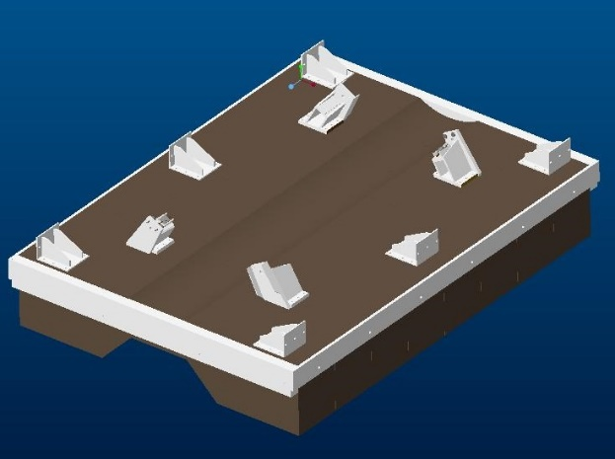
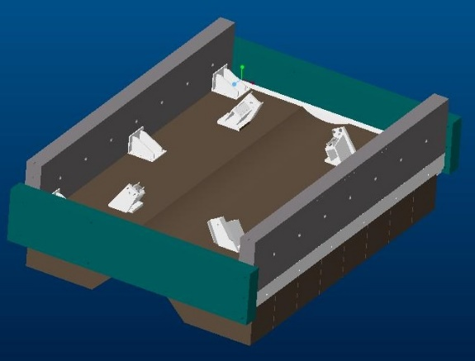
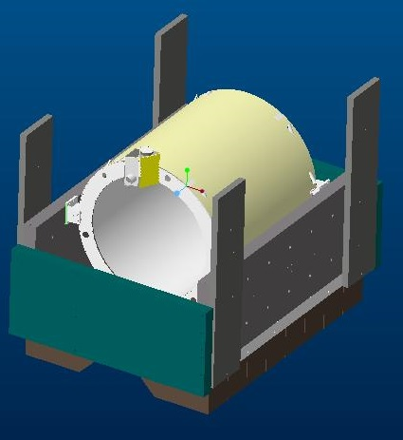
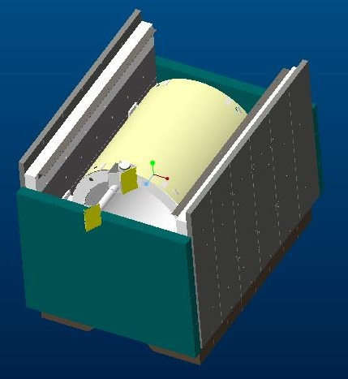
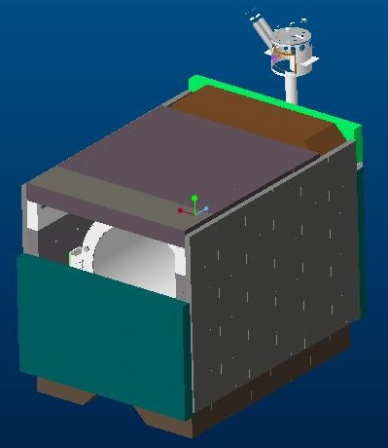
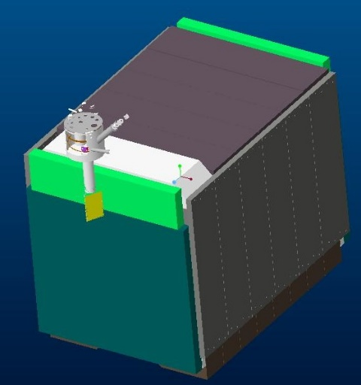
ASSEMBLY SEQUENCE
STEP 1
STEP 2
STEP 3
STEP 5
STEP 4
STEP 6
Cables through the Extension should be connected before raising the Extension.
A platform as in the Low Field Test will be added to support the Valve Box.

Slide 3
BACKUP

Slide 4

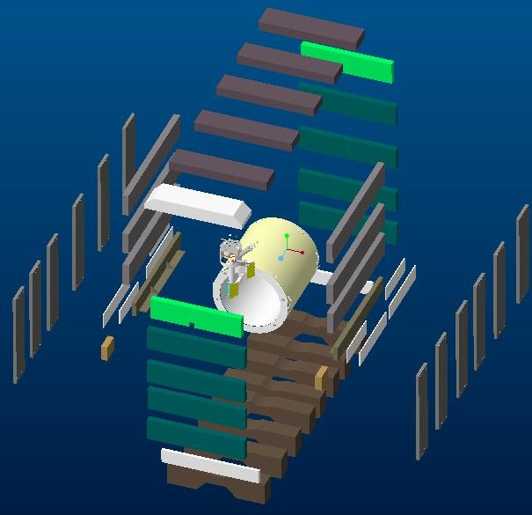
sPHENIX FULL FIELD TEST
FFT ASEMBLY

Slide 5
sPHENIX FULL FIELD TEST

