Slide 1
Two new PRs for the swapped V&W planes in PDHD APA1
Wenqiang Gu, Xuyang Ning
More readings about the APA1 treatment in WCT: https://indico.bnl.gov/event/24488/ (talk by Wenqiang)

Slide 2
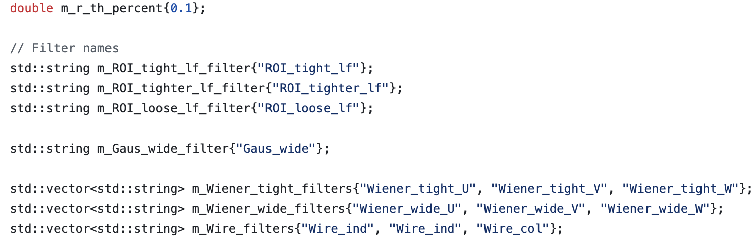
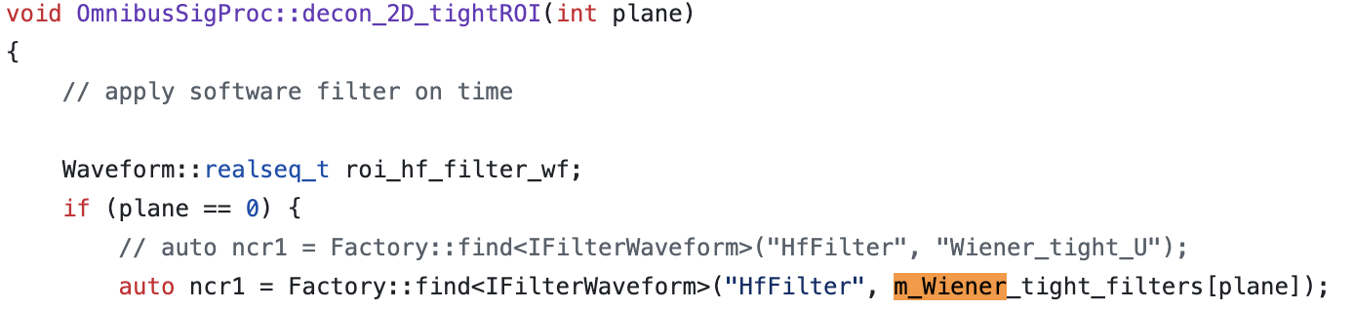
https://github.com/WireCell/wire-cell-toolkit/pull/325
// OmnibusSigProc.h
// OmnibusSigProc.cxx

Slide 3
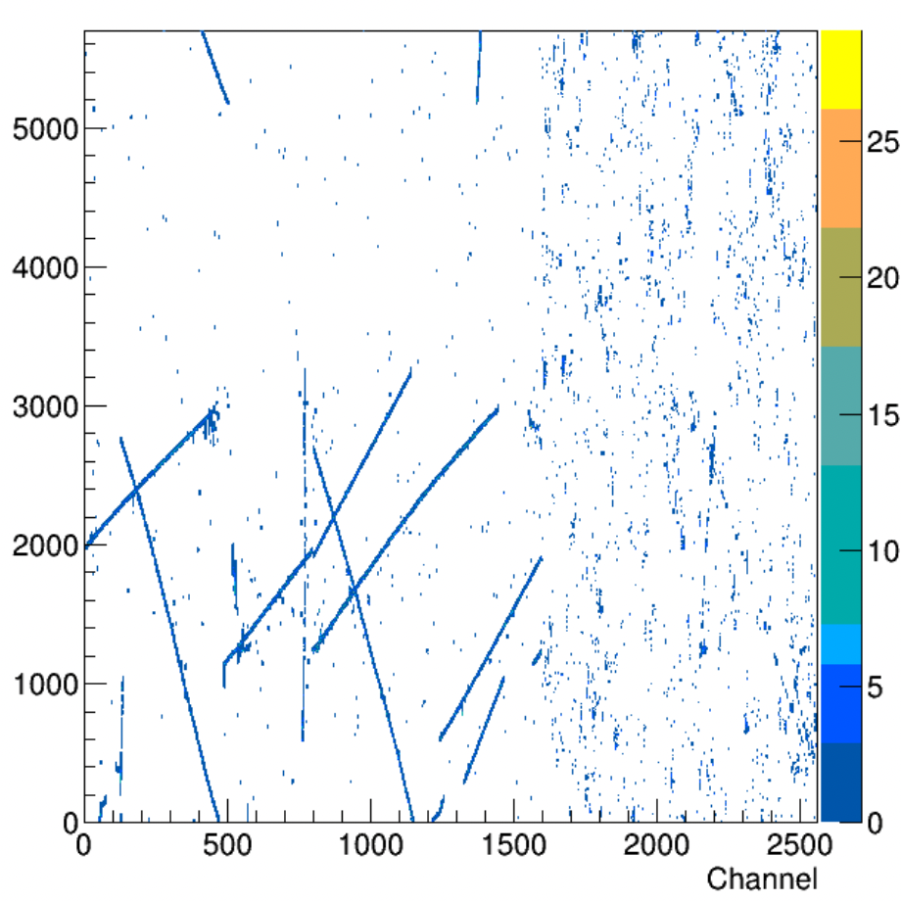
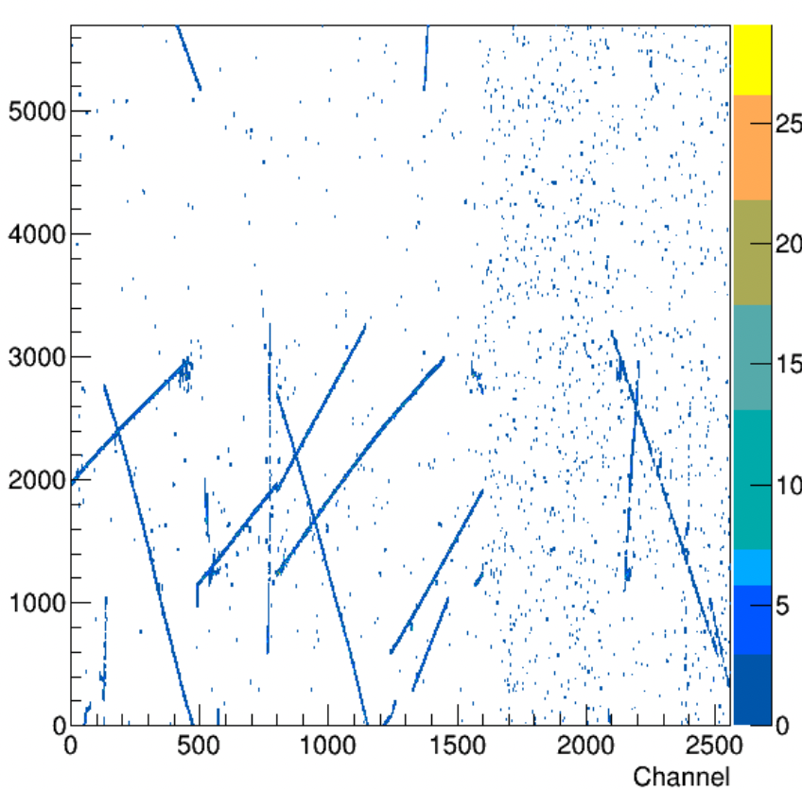
// sp.jsonnet
Wiener_tight_filters: if anode.data.ident==0
then ["Wiener_tight_U_APA1",
"Wiener_tight_W_APA1",
"Wiener_tight_V_APA1"]
else ["Wiener_tight_U",
"Wiener_tight_V",
"Wiener_tight_W"],

Slide 4
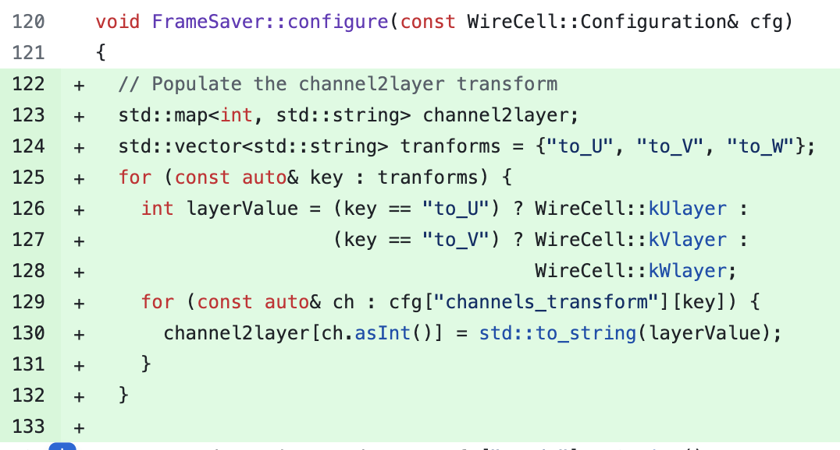
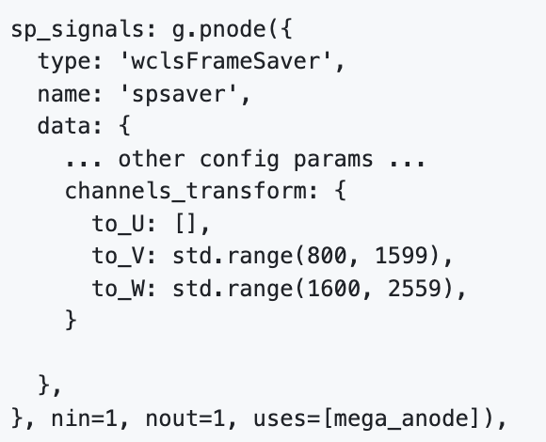
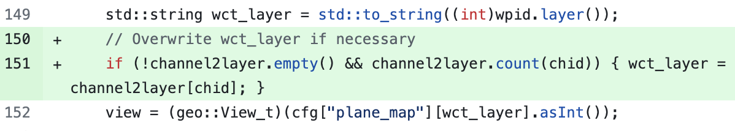
https://github.com/LArSoft/larwirecell/pull/47
// wcls-sp.jsonnet

Slide 5
Plan this week
We will ask Haiwang to make new release for WCT/larwirecell
Framework wise, it’s ready for signal processing with a special treatment of APA1
Plan to tune the wiener filters for different APAs this week

