Slide 1
pfRICH Sensor Plate Prototype
Simon Snydersmith, Pau Simpson Crusafon, Ian Holda, Sushrut Karmarkar, Andreas Jung
19 August 2024

Slide 2
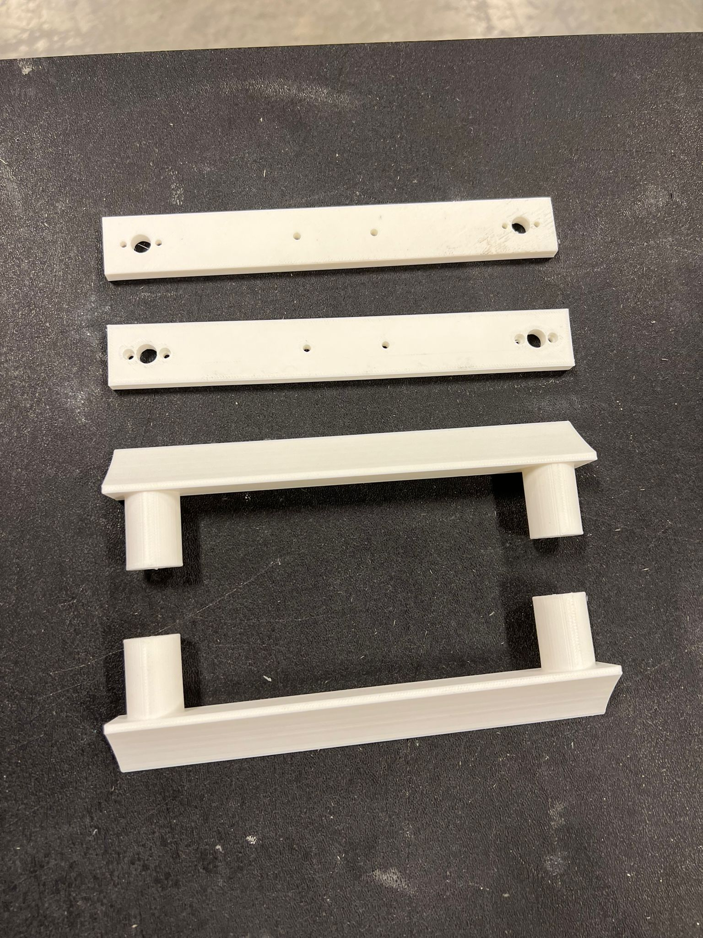
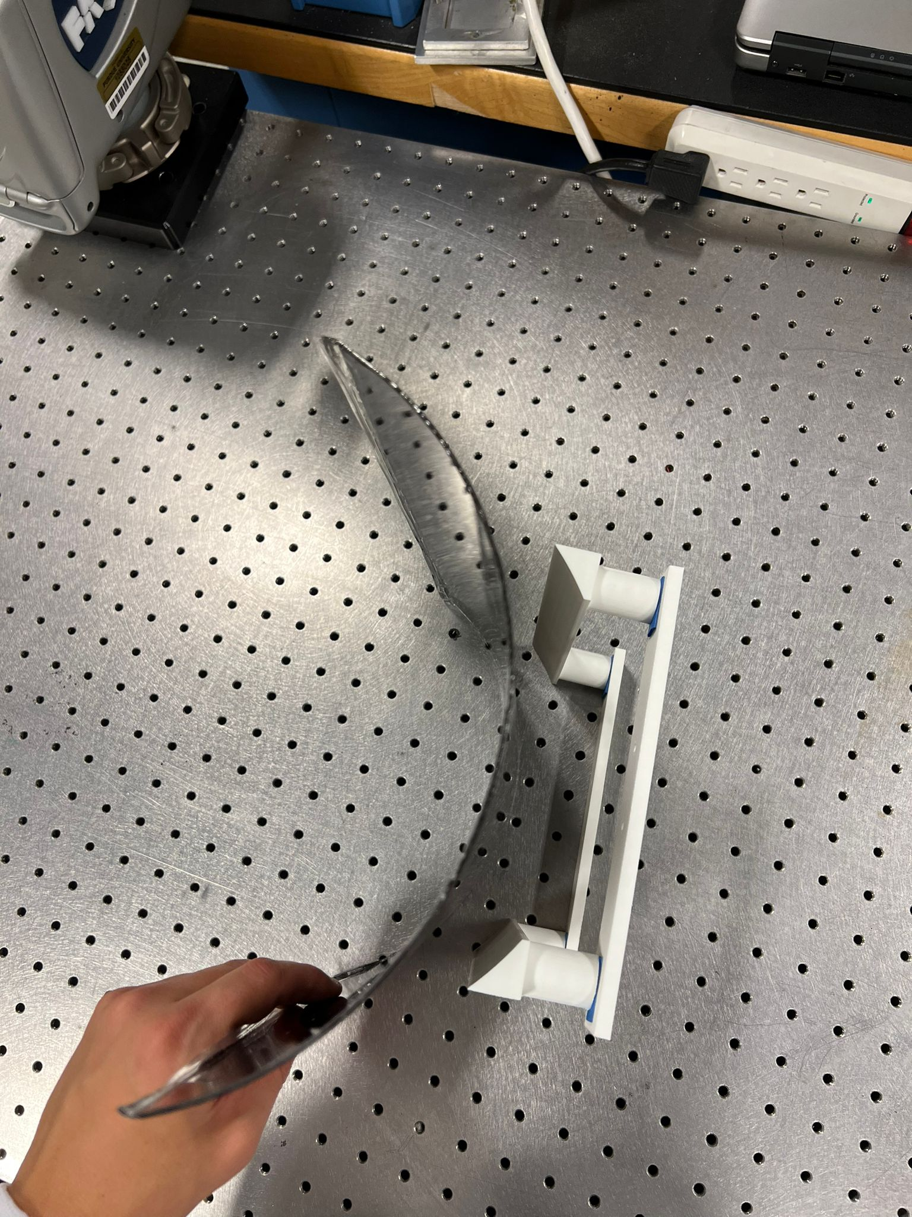
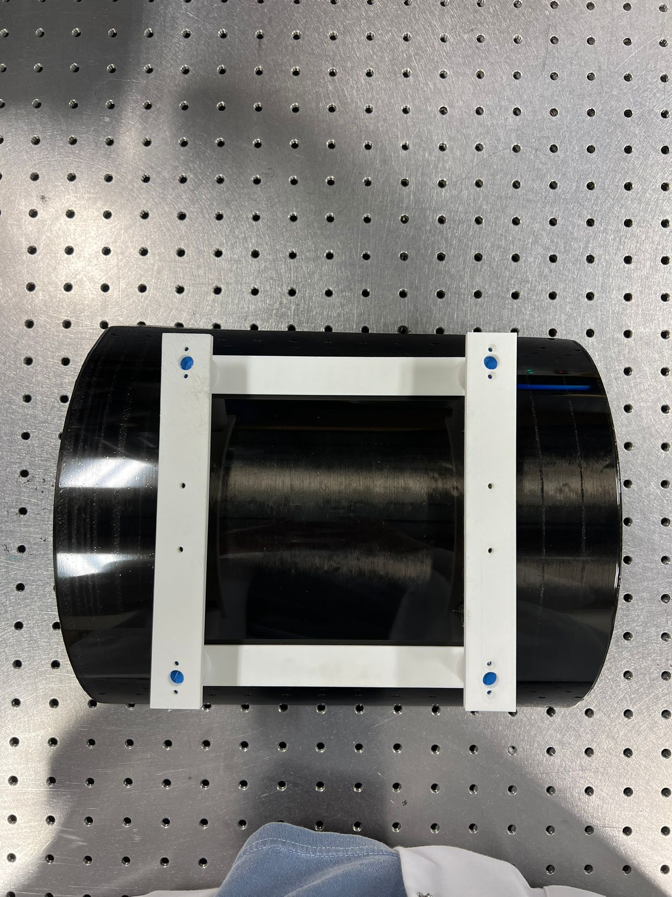
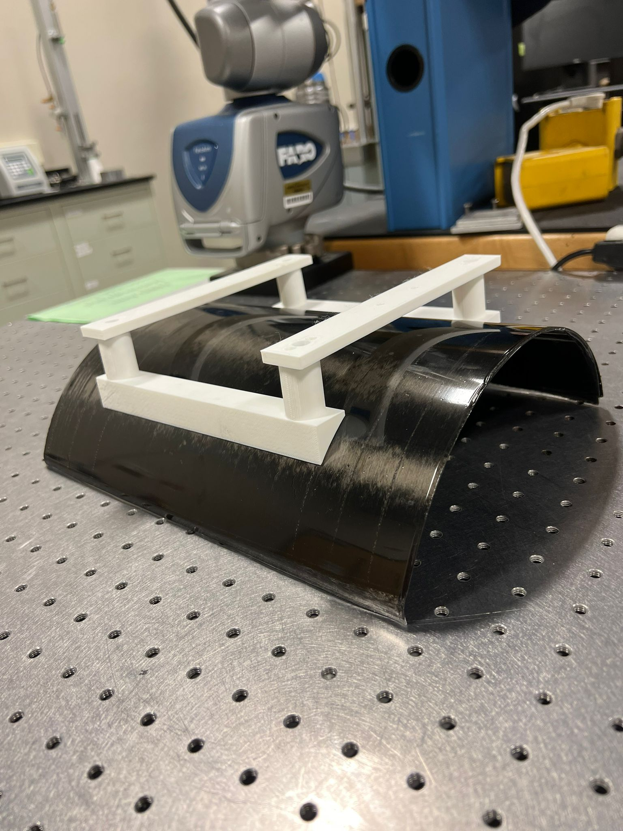
First co-cure with Lexan on a curved substrate
This is the concave inside with lexan co-cured with the backing CFRP plate.
Shipping to SBU today!

Slide 3
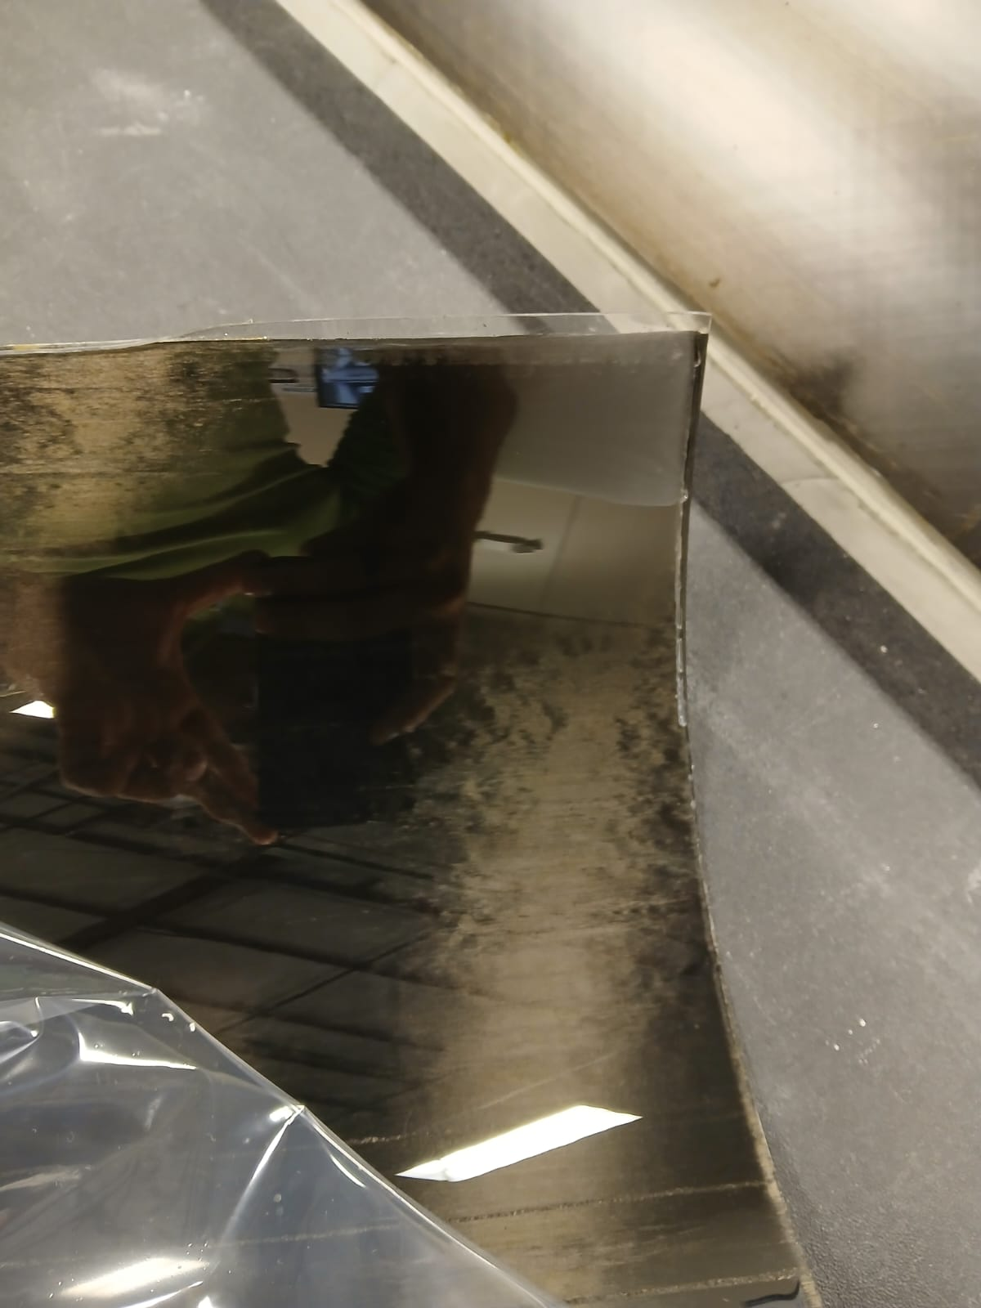
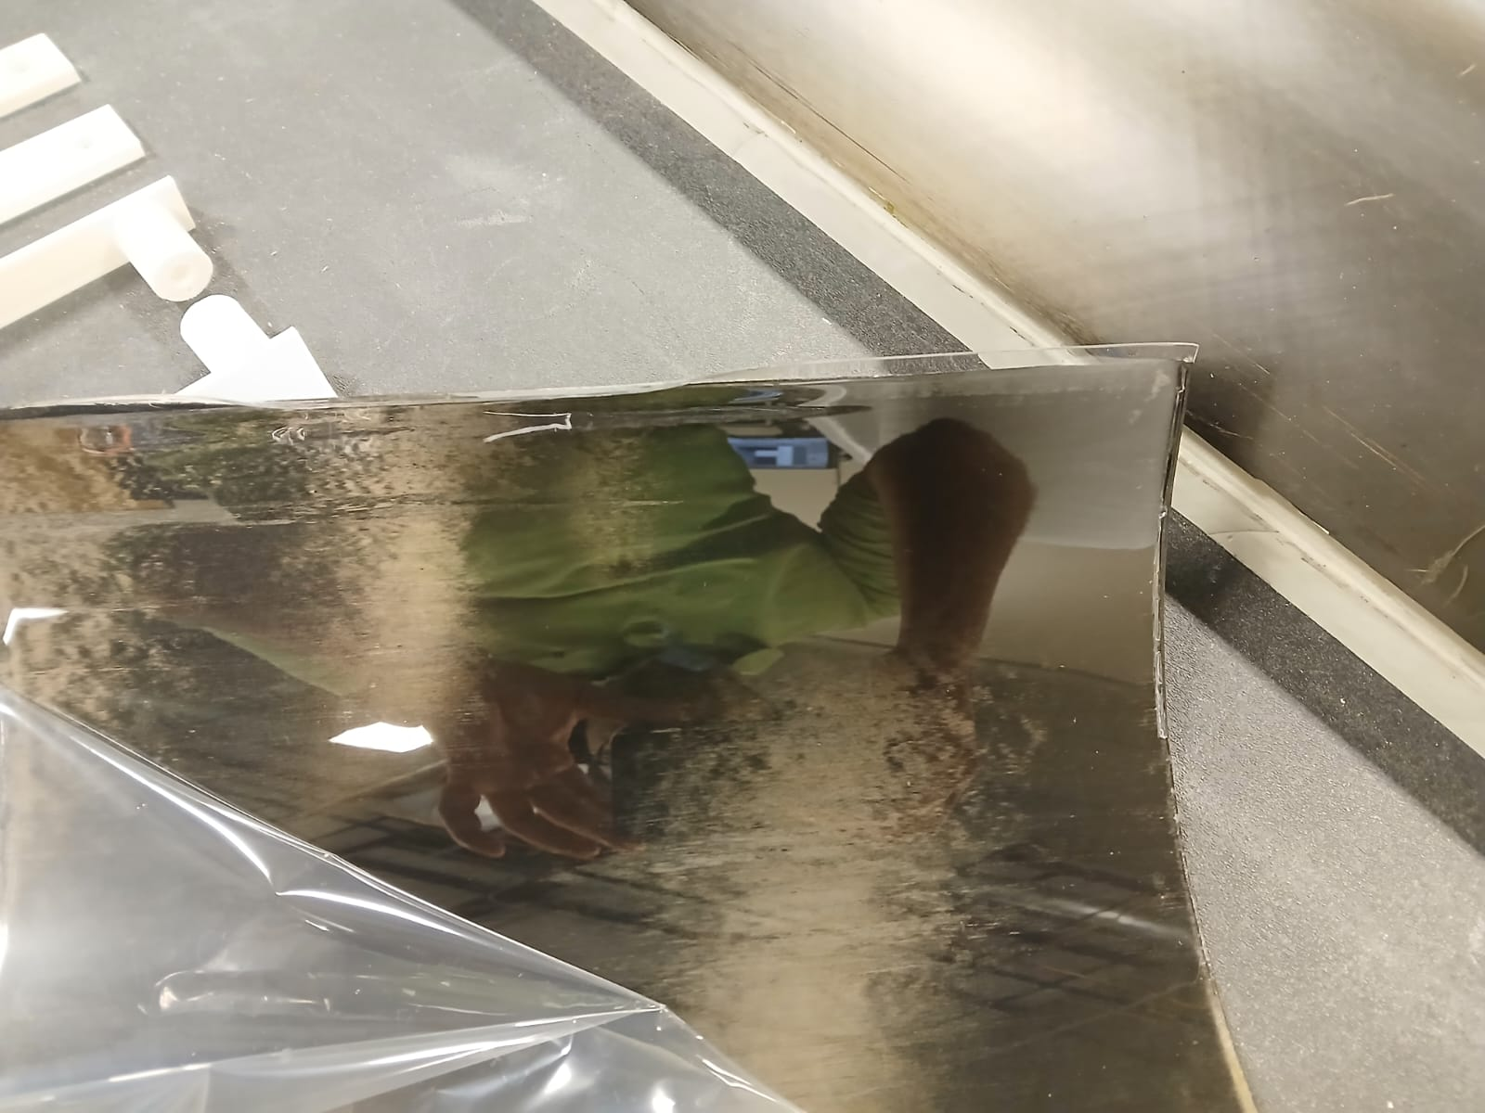
Good / minimal to no waviness on curved co-bond

