Slide 1
Electronics & DAQ WG
Fernando Barbosa (JLab)
15 August 2024

Slide 2
Welcome & News
  VTRX+, lpGBT procurements for CD-3B
  Discussion
  AOB
  Final production of VTRX+ modules starts ~May 2025, ends December 2026:
    CERN and EIC.
  CERN maintains a level of stock of lpGBTs for their own support; availability to others depend on current needs.

Slide 3
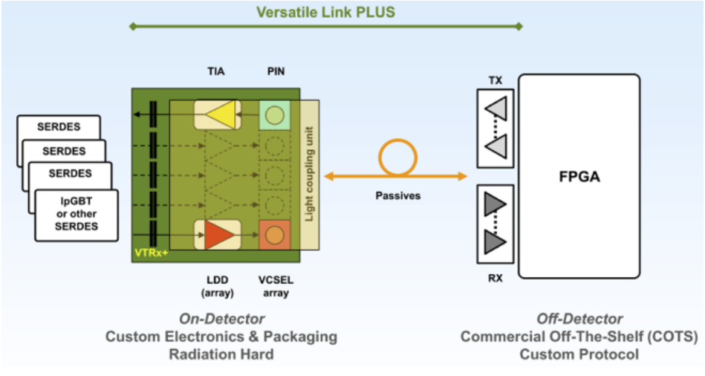
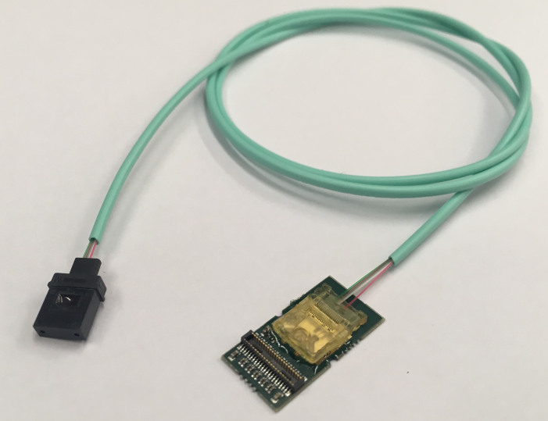
VTRX+ – Versatile Link+ Transceiver
Charge 1, 2
Tx Data rate up to 10.24 Gbps.
Rx Data rate up to 5.12 Gbps.
Power consumption up to 320 mW.
Fiber pigtail length [200 mm to 1000 mm], to be specified by customer. Low Smoke Halogen-Free Polymer.
Radiation Hard.
Magnetic field up to 4 T.

Slide 4
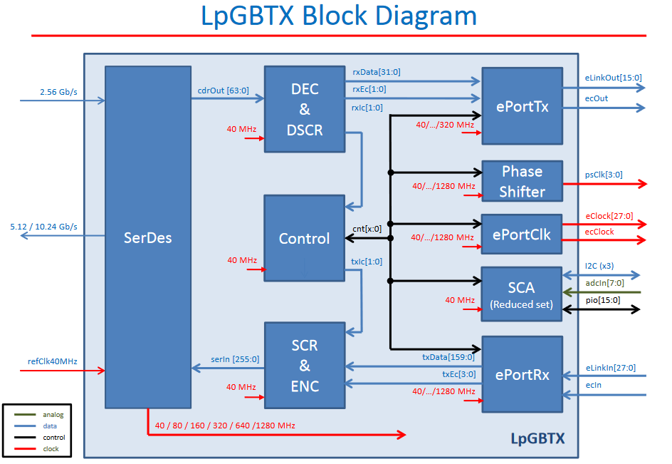
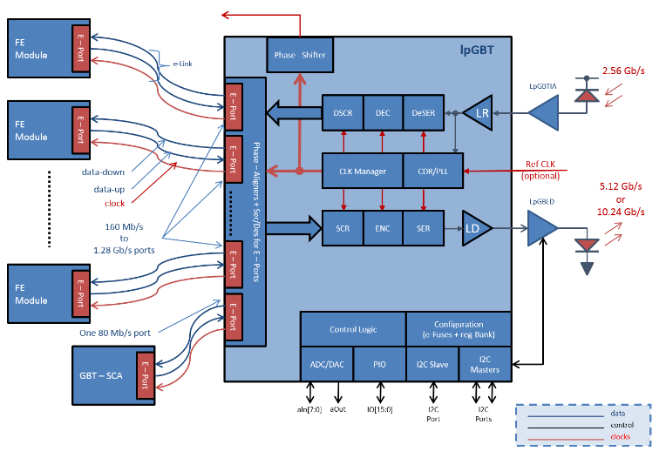
lpGBT – Low Power Giga-bit Transceiver
Charge 1, 2
Application
Replaced with VTRX+
Operation up to 12.24 Gbps Input [Up-link, elink up to 1.28 Gbps], and up to 2.56 Gbps Output [Down-link, elink up to 320 Mbps].
Power consumption up to 750 mW.
Clock spec: 40 MHz ± 1 MHz, (Jo has tested at significantly different clock settings with no issues) [added for this WG meeting]
Radiation hardness to 200 Mrad TID, SEU robust.
BGA, 9 mm x 9 mm x1.24 mm.

Slide 5
 | VTRX+ | lpGBT | Submitted | Note
SVT | 2000 | 250 | 4/5/2024 | In P6; CD-3B; Supported by FDR.
dRICH | 1500 |  | 4/5/2024 | In P6; CD-3B; Supported by FDR; FPGA provides function of lpGBT.
MPGDs | 1000 |  | 8/9/2024 | Driven by homogeneity; SALSA provides function of lpGBT.
TOFs | 400 | 400 | 8/9/2024 | Driven by homogeneity.
pfRICH | 136 | 136 | 8/9/2024 | Driven by homogeneity.
RP | 128 | 128 | 8/9/2024 | Driven by homogeneity; Follows AC-LGAD developments.
OMD | 72 | 72 | 8/9/2024 | Driven by homogeneity; Follows AC-LGAD developments.
B0 Tracker | 168 | 168 | 8/9/2024 | Driven by homogeneity; Follows AC-LGAD developments.
Lumi-PS | 72 | 72 | 8/9/2024 | Driven by homogeneity; Follows AC-LGAD developments.
various | 24 | 274 | 8/9/2024 | Driven by homogeneity.
TOTAL | 5500 | 1500
  Newly added quantities are cost neutral, i.e. use funds from P6 construction activities from respective sub-detectors.
  No further procurements of these devices are possible from EIC project.
  CERN will accept orders for additional quantities until the start of production (~May 2025), e.g. in-kind contributions from institutions.

