Slide 1
Multi-Group Channel Filters
Wenqiang Gu, Brett Viren

Slide 2
Motivation
https://github.com/WireCell/wire-cell-toolkit/issues/327
Given the half-FEMB negative pulse issue in PDHD, we would like to implement a “grouped filter” similar to Coherent Noise Filter
The channel groups would be different from Coherent Noise groups
However, OmnibusNoiseFilter currently only supports a single set of channel groups and a set of filters.
Current Implementation
Proposal
{Channel Groups #1} ⇔ {Group Filters #1}
{Channel Groups} ⇔ {Group Filters}
{Channel Groups #2} ⇔ {Group Filters #2}
{Channel Groups #2} ⇔ {Group Filters #2}

Slide 3
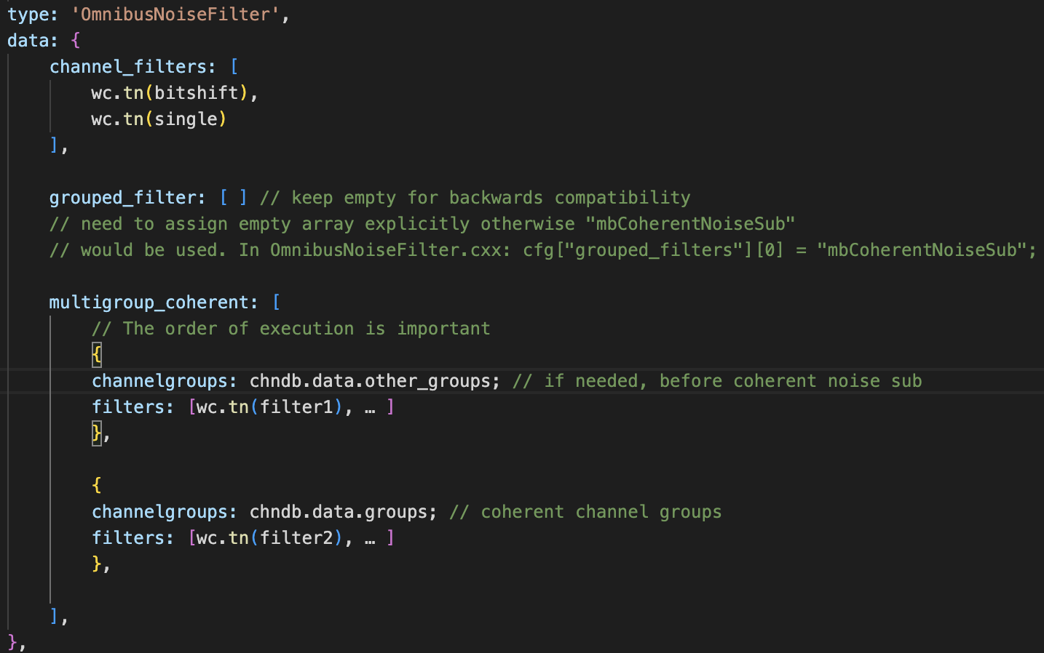
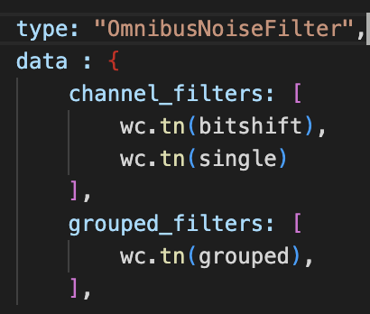
Changes in WireCell configuration interface
First, we want to maintain backwards compatibility, so that other experiments can still run their wirecell configuration without any change
Proposal
uboone/nf.jsonnet

Slide 4
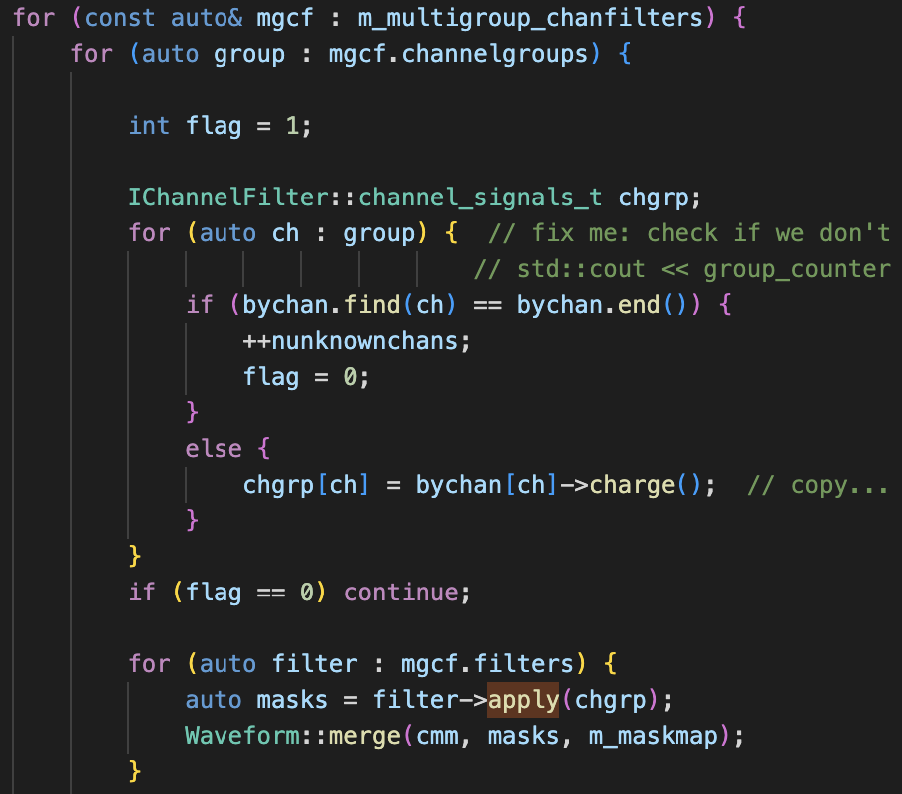
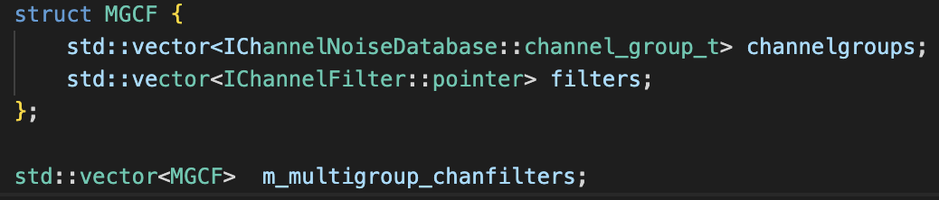
Implementation in OmnibusNoiseFilter
A new layer
Same logic as ”grouped filter” with an added layer to loop over all grouped filters
MGCF (Multi-Group Channel Filter)

Slide 5
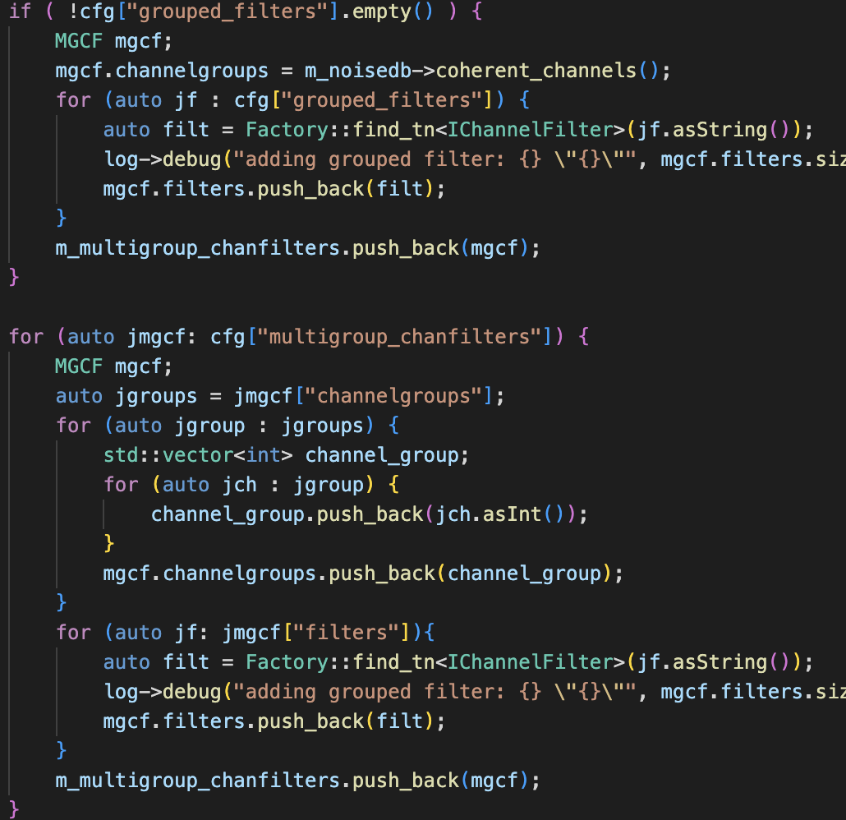
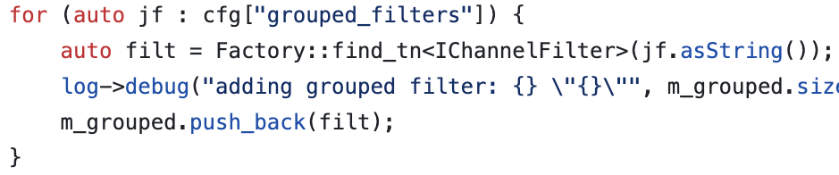
Backwards compatibility

Slide 6
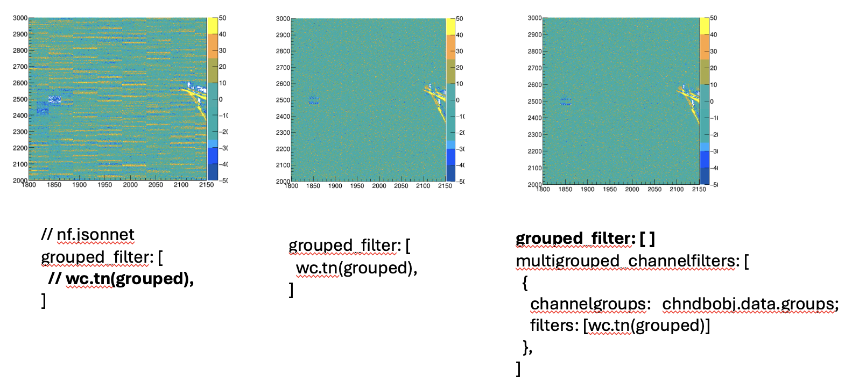
Summary
Submitted a PR for expanding the grouped filter interface to accept multi-group channel filter (MGCF)
https://github.com/WireCell/wire-cell-toolkit/pull/328
All updates are backwards compatible. We encourage you to try the new interface
PDHD data

Slide 7
Bonus: remove OmnibusNoiseDB?
Within OmnibusNoiseFilter, it appears that we don’t need OmnibusNoiseDB as the only purpose is to get a group of channel for “bad channels” and “coherent channels”
Actual implementation of each noise filter (e.g., mbCoherentNoiseSub) requires NoiseDB
We can pass those two channel groups purely through jsonnet configuration

