Slide 1
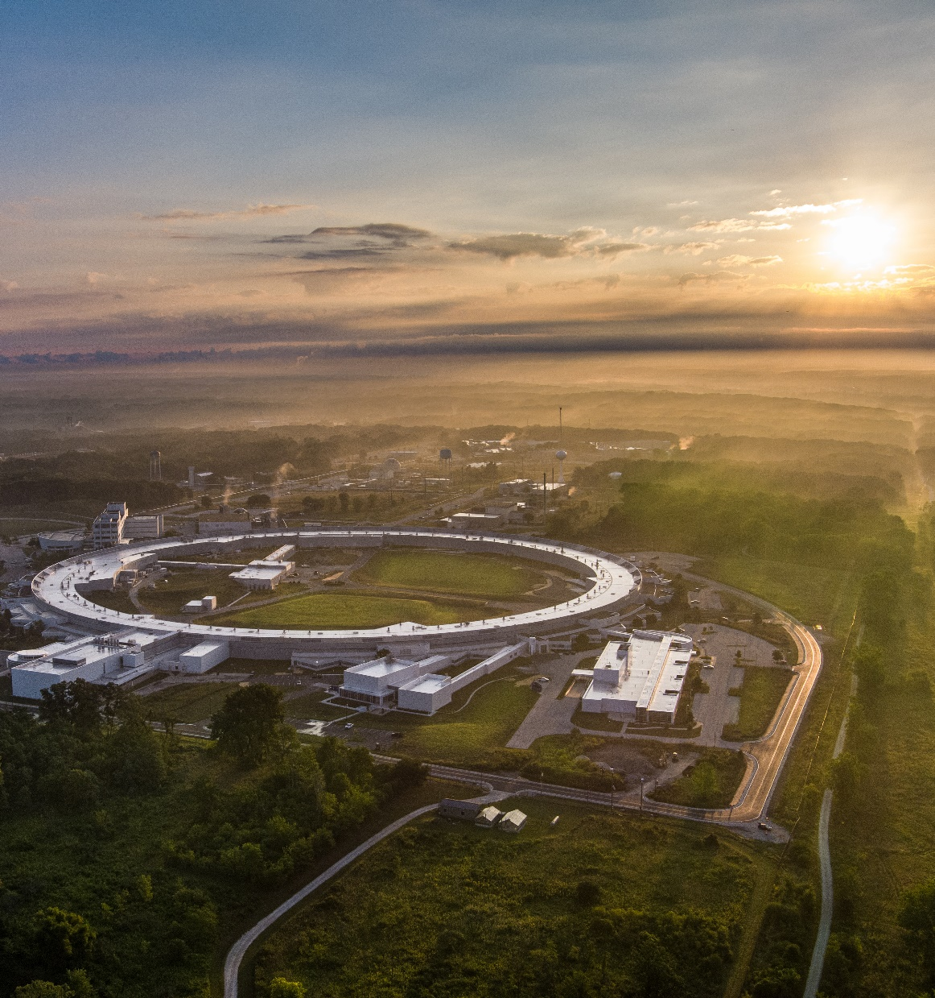
Experience with the 420.2D USI Process
08 October 2024
John Quintana Deputy Associate Laboratory Director for Operations, Photon Sciences

Slide 2
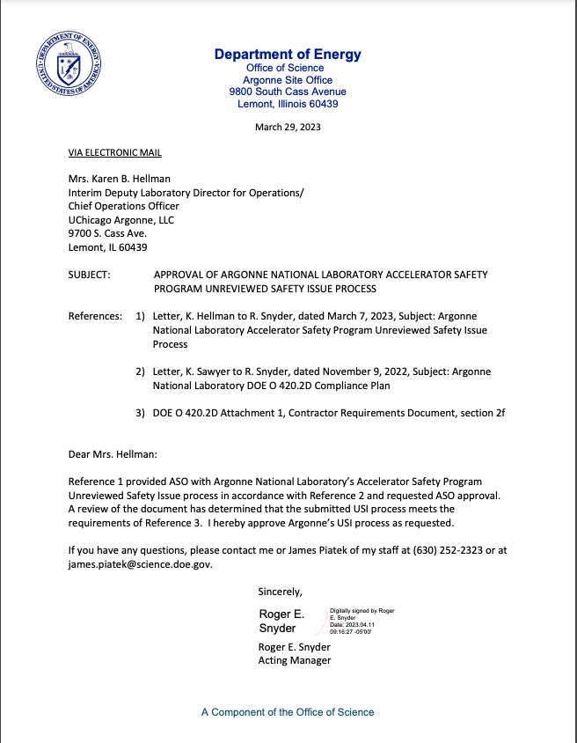
Argonne’s USI 420.2D Implementation
“Unreviewed Safety Issue Process”
Process revised in accordance with new requirements.
“significant” language gone.
Risk considered in SAD/ASE not USI/RSI
Simpler, more understandable process for Argonne accelerator operators.
Targeted solely on what is in the Safety Analysis and the DOE approved Accelerator Safety Envelope.
Triggers actions for potential Safety Envelope Violations
DOE approval on 29 March 2023.

Slide 3
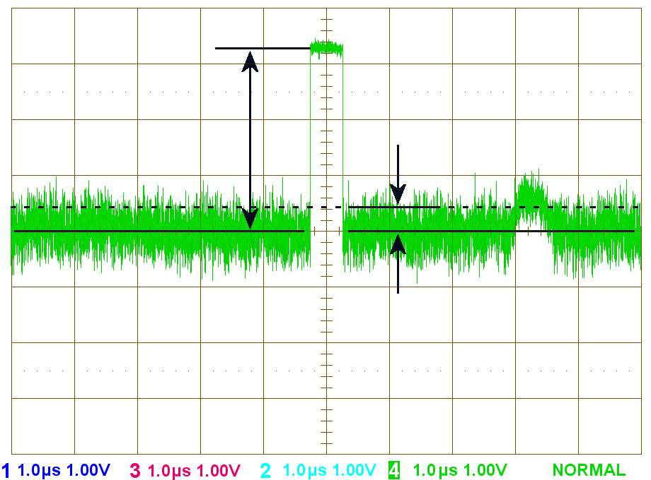
Key considerations
Focus on “Change Management” for proposed changes
USI Process is really part of the operational change management process. Screening questions targeted at Operational Behavior and Operational Events.
Realize, new “USI/RSI” is different than old ”USI”. (e.g. USI’s no longer electrostatic (i.e. +/-))
RSI’s review USI and trigger ACTIONS (SAD change, DOE approval etc…) as function of evaluation.
“Screen In” vs “Screen Out” and rely on existing processes to threshold the USI/RSI.
Use “equivalent change” definition in DOE-STD-1073-2016 as part of design to help with “Screen In” to RSI.
Try to make “when to do” an RSI clear and avoid overanalyzing too many “noisy zeros” (RSI with no action).

Slide 4
USI and RSI : Language Matters
Are USI’s and RSI’s positive or negative?
USIs can’t be polar. They are unreviewed. At best they are indeterminate.
RSIs will depend on local interpretation and definition
Suggest that a “positive” RSI is any RSI that triggers an action not necessarily one that reveals a situation that requires DOE action under 420.2D.

Slide 5
Basic USI Process Flow
Contractor Actions Driven by RSI
Anticipated or Discovered Changes
Screen In through normal processes (Design, Operations Meetings, Event Notification)
USI
Review change through USI Process
RSI
RSI Actions that trigger DOE Approval in accordance with 420.2D
Generate RSI and Identify Actions

Slide 6
RSI’s Have Four Sections
RSI is the evaluation of the USI.
Describe the item of concern (i.e. what is the Unreviewed Safety Issue)
Review the USI against the SAD and ASE.
Describe the Conclusion of the Analysis
Identify any actions Derived from the Conclusion
Actions That Trigger DOE approval
ASE change or violation
Discovery of new Accelerator Hazard
etc…
Contractor Actions
Do nothing, execute the change
Revise SAD
Execute an Improvement Opportunity
Revise Procedure
etc …

Slide 7
Experience To Date
7 USI/RSI Determinations at APS. 1 in Draft for ATLAs
All RSI’s are forwarded to DOE Facility Representative as part of Contractor Assurance.
If an RSI gave us a DOE action, this would trigger more formal communication with the ASO for recovery.
Our USI Form is “Klunky” while contains the elements will be revised as part of continuous improvement.
USI Process is a change management process that revolves around the SAD/ASE.
Inherently difficult to understand if SAD/ASE formats are different
Argonne is revising SADs/ASES to a more consistent approach across the site.

Slide 8
Acknowledgements
This work used resources of the Advanced Photon Source, a U.S. Department of Energy (DOE) Office of Science user facility operated for the DOE Office of Science by Argonne National Laboratory under Contract No. DE-AC02-06CH11357.

