Slide 1
BNL Peer Review for Operational Advancement (PROActive) Review:
Sharon Kohler, BSA Associate Lab Director, ESH
Sean Tabone, BHSO Operations Division Director
October 8, 2024

Slide 2
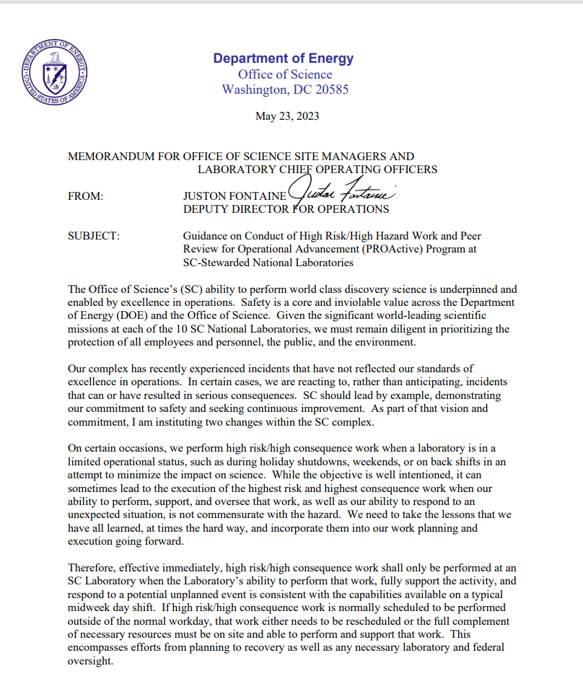
PROActive Review Office of Science Peer Review for Operational Advancement
Consistent focus theme in each “cycle” of peer reviews
High-Hazard Energy Control
DOE Site Office Manager and Chief Operating Officer determine review charge/scope, size and composition of review team, timing and duration of the review
Review committee to be comprised of skilled laboratory practitioners with participation of SC federal staff, as necessary
Engagements are not intended to be “compliance reviews” and therefore NO Findings
Reviews identify observations, opportunities for improvement and lessons learned
Accountability for follow-up rests with the Site Office and Lab Management

Slide 3
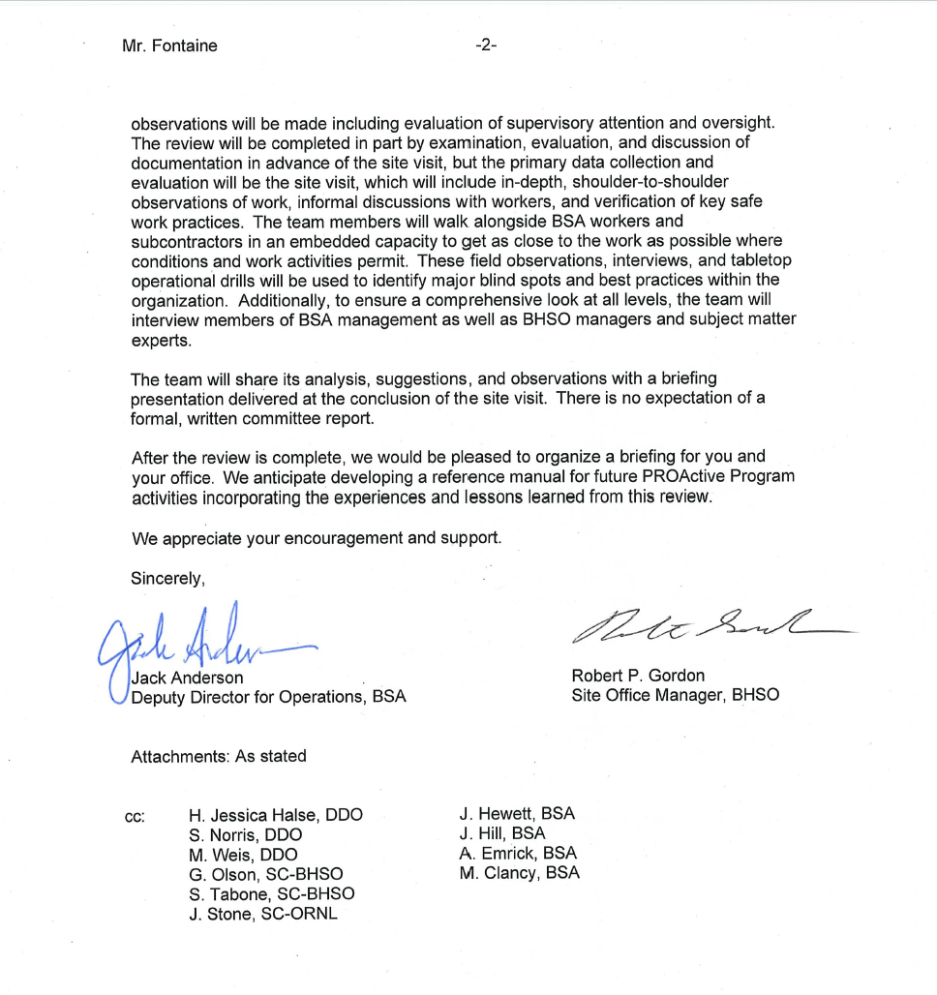
BNL PROActive Review November 2023
Work practices and behaviors in the field
Hazardous energy control
and safety
Review focus
High risk work activities
Safety culture/management engagement & field presence
Work planning and control
Collider-Accelerator Operations, Facilities & Operations, Construction
Institutional learning

Slide 4
BNL PROActive Review Team
Jimmy Stone – Leader ORNL, Former Director Facilities & Operations
Andy Erickson LANL, Program Director Utilities & Infrastructure
John Gearhart ORNL, Director Environment, Safety, Health, & Quality
Matt Green DOE, SSO Safety Engineer
Boris Ilinets SLAC, Chief Electrical Engineer, Facilities & Operations
Mark Jeffers FNAL, Director Facilities & Operations
Mike Masters ORNL, Senior Mission Support, Facilities & Operations
Mike Pierce ORNL, Division Director Research Reactors
John Powell ORNL, Former Director ESH&Q
Russ Sawvel AMES, Occupational Safety Specialist, Electrical AHJ
Jim Serafin ORNL, Division Director Facilities Management
Mike Stafford ORNL, Division Director Nuclear & Radiological Protection
Rae Sharp-Geiger LANL, Chief Operating Officer Physical Sciences
Melkie Tega DOE, Electrical Engineer, Office of Safety & Security
Ann Weaver ORNL, Director Facilities & Operations
Haley Wetzel PPPL, Safety Engineer
BNL PROActive Review Team provided Significant Value:
Engaged with more than 300 staff
Diverse viewpoints presented by an experienced team
Expansion of network - made us aware of additional people and resources

Slide 5
Observations: Overarching Themes
The new Leadership Team has a unique opportunity to make substantive improvements to several long-standing Laboratory challenges
While the transition to nuclear operations for isotope production is widely recognized as a challenging high priority, an institutional resource loaded project plan does not yet exist
Change management is a sitewide challenge
Space & infrastructure not being managed as strategic Laboratory asset
Overly complex processes reduce efficiency of getting work done
BNL PROActive Review team defined overarching themes with 1 or 2 slides with additional context and examples for each theme

Slide 6
PROActive Theme 1 High-Level Response
New Leadership has Opportunity to Address Long-Standing Challenges
Strategic Retreat – Vision, Priorities
Each ALD presented top two (Infrastructure investments, Accelerator Safety, Nuclear, Future of Work, Operational Efficiency, Recruiting)
Additional Key Staffing – Planning, Performance and Quality Management Director, CAD Chief Operations Officer
ESH, F&O “Strengths, Weaknesses, Opportunities, and Threats” (SWOT) analysis and critical staffing plan
Conduct CAD workshop to discuss and break down stovepipes and inconsistent processes/procedures
Evaluate deployed staffing model for ESH, Quality, and ESH Manager roles

Slide 7
PROActive Theme 2 High-Level Responses
Transition to Nuclear Operations for Isotope Production
Establish Nuclear Safety Division and staffing
Structure of Nuclear program and staffing plan including matrixed functions
Charge a committee with implementation
Create and publish a transition dashboard (continue to evolve)
Create an Advisory Board
Regular Senior Leadership briefings
Created War Room – ALDs
Live Dashboard - access to all stakeholders so one source of info
Created a detailed project plan for phase 1

Slide 8
PROActive Theme 3 High-Level Responses
Change Management Challenges (also identified in Accelerator Assist Visit)
Assigned an Interim PPQM Director
Realigned Office of Institutional Improvement and Change Management to be better aligned with institutional risks and priorities
Change Management
Consulting with Change practitioners at other Labs
Change Management discussion as part of CAS workshop
Utilize the Battelle CoP to aide in strengthening BNL’s Change Management processes.

Slide 9
PROActive Theme 4 High-Level Responses
Space and Infrastructure Management
Develop an approach to increase space funding
Identify and address critical resource needs
Assign work based on mission need priorities
Create space planning strategy based on refreshed staff hybrid/remote work expectations

Slide 10
PROActive Theme 5 High-Level Responses
Process Complexity and Efficiency
QMO work with Senior Leadership to possibly reinvigorate the use of Human & Operational Improvement (HOP) principles across the institution.
F&O workflow processes to be streamlined to reduce complexity.
Developing a process to engage the Operations Council to better identify key issues for Senior Leadership based on data.
PPQM will work with Senior Leadership to review the set of Lab-wide Committees (starting with CAS committees) and make changes as needed

