Slide 1
Technical Qualification Program Overview
2024 Accelerator Safety Conference

Slide 2
TQP Origin
DOE O 426.1, Department of Energy Federal Technical Capabilities
PURPOSE. To define requirements and responsibilities for implementing the Department of Energy (DOE) Technical Qualification Program (TQP). The TQP, in concert with existing DOE Human Capital and Line Management processes, supports DOE’s commitment to recruiting, deploying, developing, and retaining a technically competent workforce that will accomplish DOE missions in a safe and efficient manner. The Federal Technical Capabilities Panel (FTCP) provides support and strategic vision for implementation of the TQP, and supports DOE Line Management in identifying and addressing department-wide issues that may adversely impact the objectives of this Order.

Slide 3
FTCP/TQP Applicability
Departmental Applicability. This Order applies to any DOE organization, including National Nuclear Security Administration (NNSA) that performs functions related to the safe operation of defense nuclear facilities. This Order does not apply to other DOE formal qualification program requirements, such as the Project Management Career Development Program. DOE employees whose duties and responsibilities could affect the safe operation of defense nuclear facilities are required to participate in the DOE TQP.
Additional positions may be designated as TQP positions at the discretion of the Headquarters (HQ) or Field Element Managers (FEM). This could include positions that involve oversight of non-defense nuclear facilities, other high hazard non-nuclear facilities, or other positions important to the mission of DOE as determined by the HQ or FEM.

Slide 4
FTCP/TQP Structure
DOE and NNSA sites each have an Agent on the FTC Panel
NTC Director is FTC Panel Chair
NTC is home to the FTCP Support Office and eTQP (system)
Over 1,400 Federal personnel in TQP
Over 20 functional area qualification standards
18 months to get qualified prior to performing Federal oversight
Maintain qualification through continuing training
Qualifying Officials (QO) perform competency and MPA verification

Slide 5
Qualification Standards
Consist of knowledge competencies and mandatory performance activities (MPA)
Developed with SMEs and Support Office, approved by FTCP Agents (FAQS) or site Agent (PSQS, JSQS, OSQS)
Meet with QO to discuss and/or demonstrate proficiency
All require exam, oral board, facility walk-through, or other final qualifying activity

Slide 6
Accelerator Safety FAQS
Qualification standard and evaluation guide are drafted
Once published, will be assigned to Federal oversight personnel
Topical areas:
Accelerator Safety Fundamentals
Accelerator Safety Oversight Regulatory Requirements
Accelerator Safety Oversight Program Approval
Accelerator Safety Oversight Program Performance

Slide 7
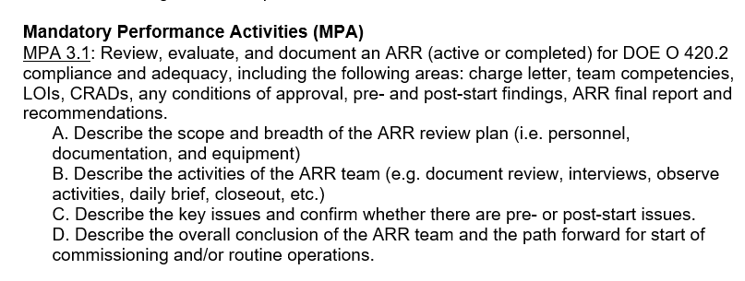
Sample competencies and MPAs from Accelerator Safety FAQS (draft)

Slide 8
Impact of Accelerator Safety FAQS
Participation in TQP, a rigorous competency verification program
Specific competencies and tasks tailored to accelerator safety oversight
Ensures oversight personnel have the specific knowledge and competencies to successfully perform their job duties and responsibilities
Establishes a common qualification for Federal personnel in this role

Slide 9
Questions?

