Slide 1
Changing Demographics at National Labs: Loss of Experience
Addressing the Challenges and Strategies for Workforce Sustainability
Presented by: Bryan Mason – BNL Accelerator Safety SME
October 8, 2024

Slide 2
Introduction
Overview:
Importance of workforce demographics in national labs.
Potential impact of losing personnel experienced in operations and safety.
Objective:
Discuss retirement trends, workforce demographics, and strategies for knowledge retention.

Slide 3
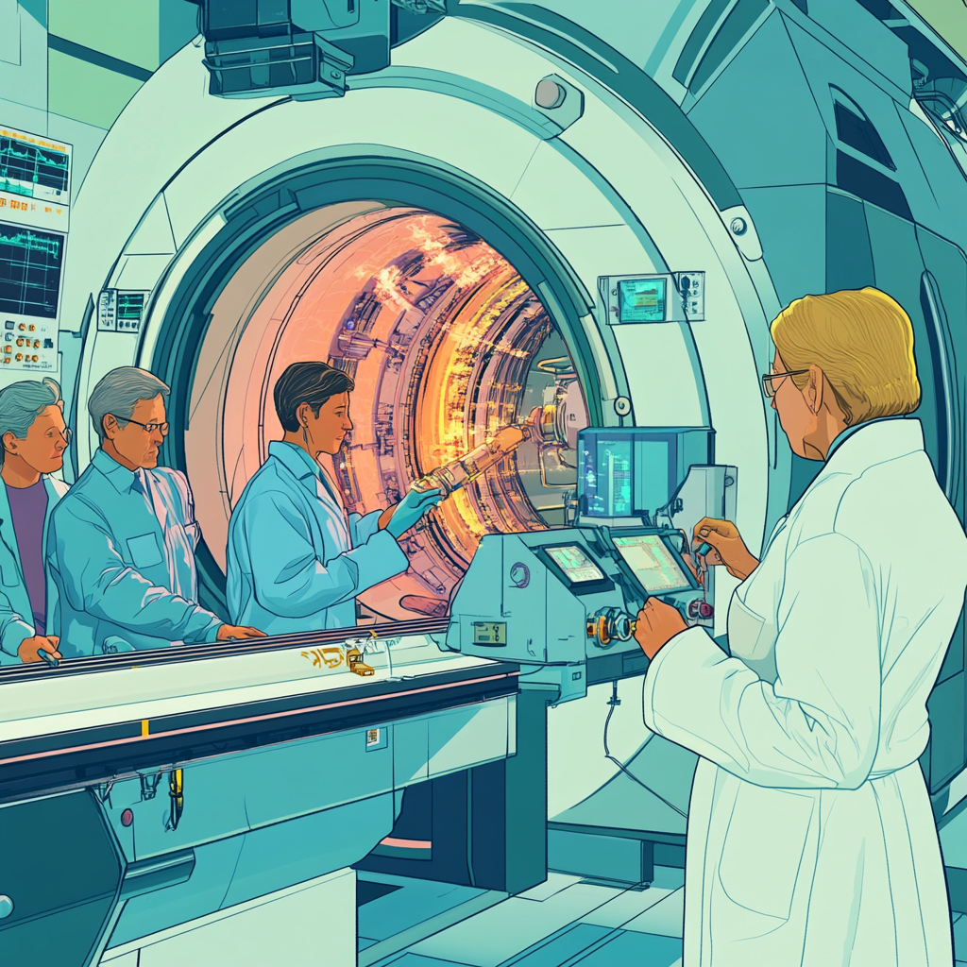
Workforce Demographics Data
Age Distribution:
Average Age (BNL): Approximately 48 years.
Workforce Over 55 Years Old (average):
~16% in non-senior levels
~ 37% overall
~58% in senior levels
Experience Gap:
Fewer mid-career professionals to bridge the experience divide.
Experience Levels:
Years of Service:
Over 58% have ~ 20+ years of service.
New Hires:
Recruitment needs to keep pace with retirements, or there will be potential expertise shortages.

Slide 4
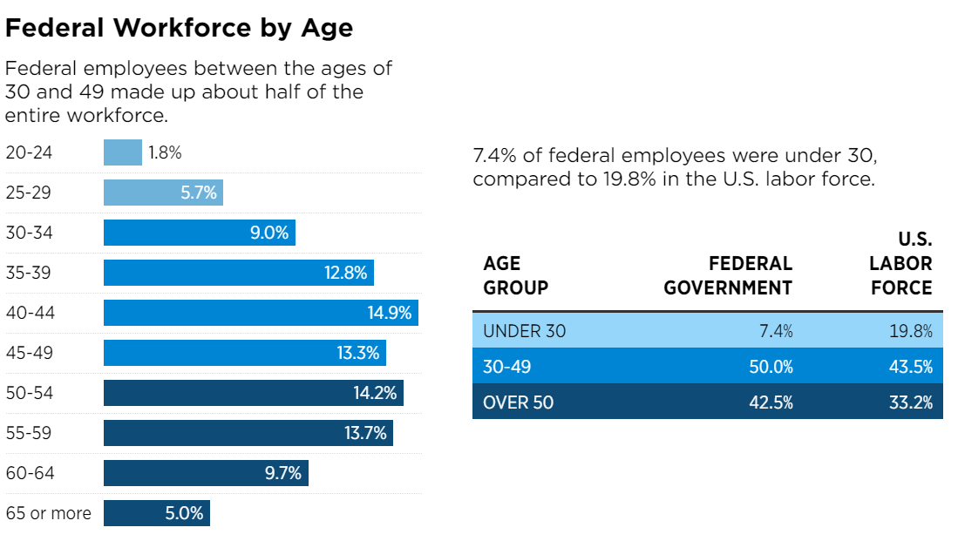
Workforce Demographics Data
Brookhaven National Laboratory Data for FY 2024
Category | Avg Age Years | Avg Yrs Service | Total Over 55 Years Old
Engineer/Scientific Associate | 32.7 | 4.6 | 3.7%
Engineer/Scientific Associate Senior | 53.5 | 18.2 | 49.4%
Research Staff | 41.2 | 7.4 | 7.2%
Research Staff Senior | 56.0 | 19.6 | 48.3%
Technical Support | 48.9 | 11.2 | 38.8%
Technical Support Senior | 59.3 | 24.5 | 76.7%

Slide 5
BNL Workforce Age Distribution

Slide 6
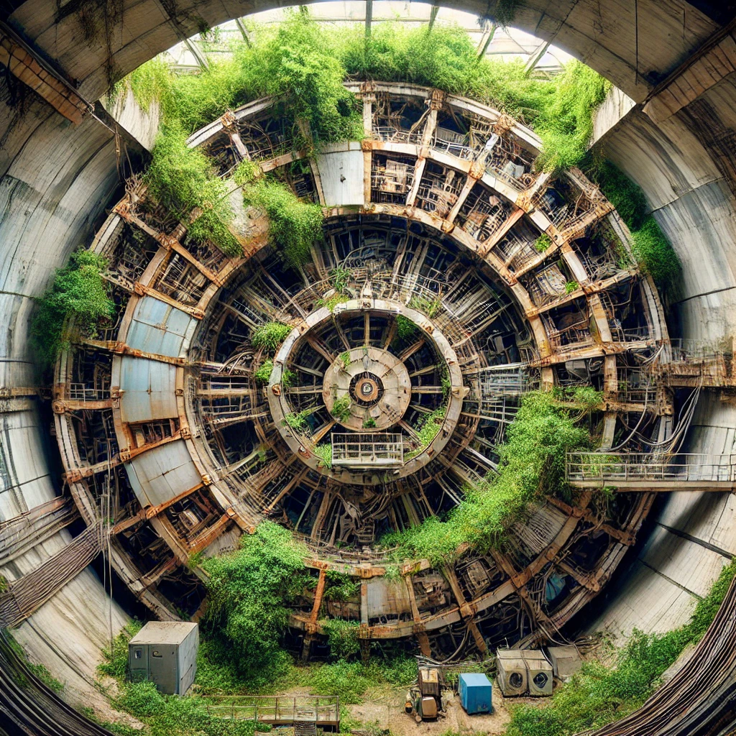
Aging Workforce at National Labs
Retirement Wave:
Significant number of experienced professionals are nearing retirement, leading to potential loss of institutional knowledge and expertise
The "lynchpin" phenomenon
Only a handful of workers hold critical operational knowledge
Impact on Expertise:
Risk of losing critical institutional knowledge, especially in specialized areas like accelerator safety

Slide 7
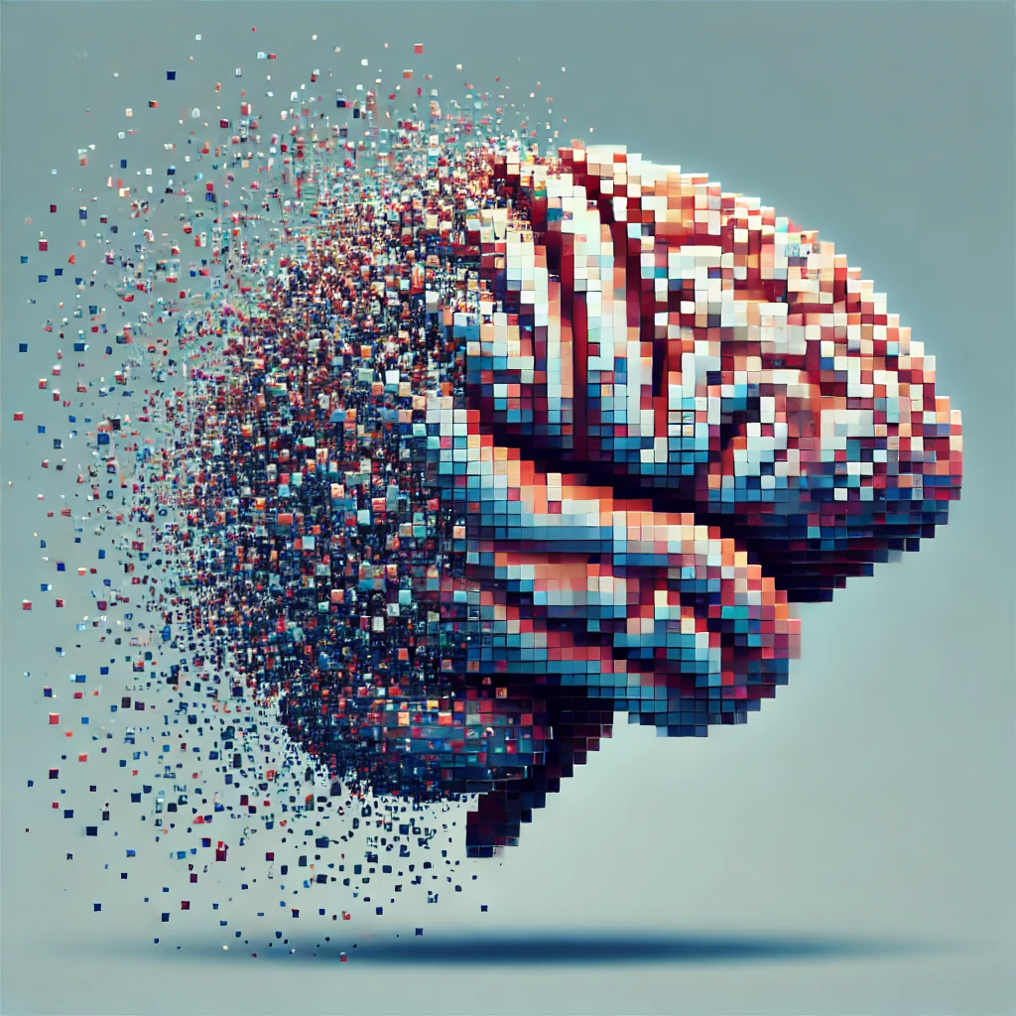
Specific Examples of Knowledge Loss
Radiological Control Managers:
Long-serving RCMs possess deep expertise in regulatory compliance, radiation protection standards (like 10 CFR 835), and emergency protocols. Their retirement could lead to gaps in maintaining safety protocols and ensuring compliance​.
Health Physicists:
Senior health physicists with decades of experience are crucial in calculating and managing radiation dosimetry, shielding design, and waste management. Their departure could result in slower response times and decision-making in radiological emergencies​​.
Accelerator Safety Experts:
Accelerator safety professionals have years of specialized knowledge about DOE Order 420.2D for accelerator operations. As they retire, the nuanced understanding of safety procedures and complex accelerator facility hazards may be lost​.
Facility Engineers:
Experienced engineers who manage the unique infrastructure of national labs (cooling systems, radiation shielding, etc.) have developed tailored solutions over the years. Their departure might delay problem-solving for technical malfunctions due to a lack of documented knowledge​.

Slide 8
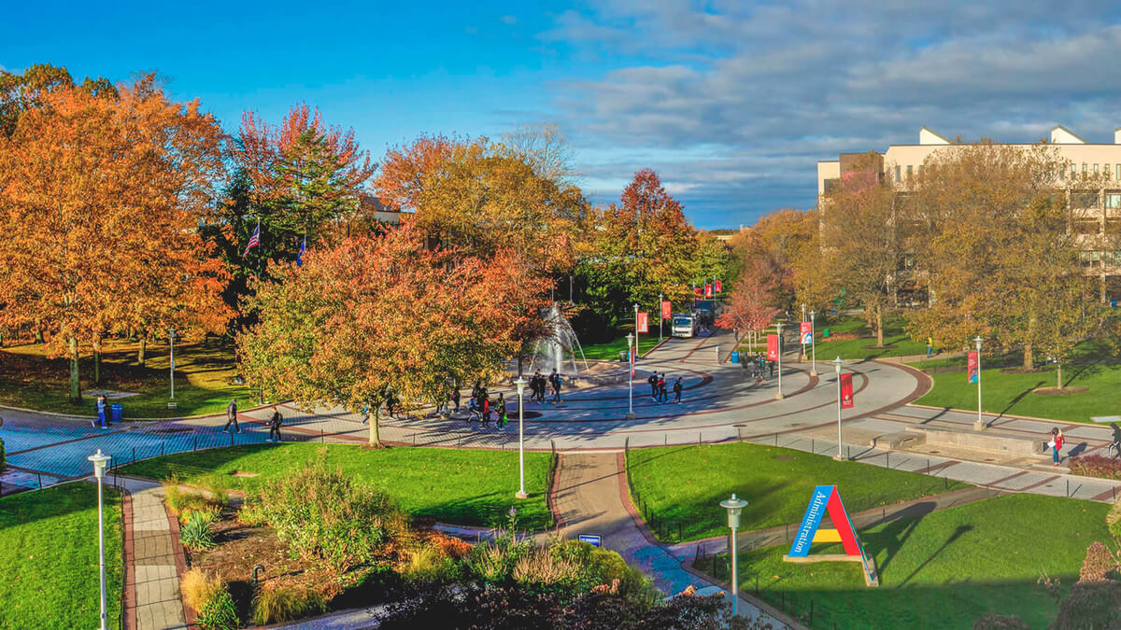
Institutional Knowledge Retention
Challenges:
Knowledge Loss:
Valuable knowledge not fully documented or easily transferred.
Safety Implications:
Impact on the effectiveness of safety protocols and risk management.
Strategies for Knowledge Retention:
Mentorship Programs:
Experienced employees train and guide newer staff.
Knowledge Management Systems:
Developing comprehensive databases and documentation practices.
Succession Planning:
Identifying key positions and preparing successors through targeted training.

Slide 9
Recruitment and Workforce Development
Attracting New Talent:
Partnerships with Universities:
Collaborations to attract graduates and promote careers in national labs.
Internship Programs:
Offering internships and co-op programs to engage students early.
Retention Efforts:
Professional Development:
Continuous learning opportunities to enhance skills.
Work-Life Balance Initiatives:
Flexible work arrangements to improve job satisfaction.

Slide 10
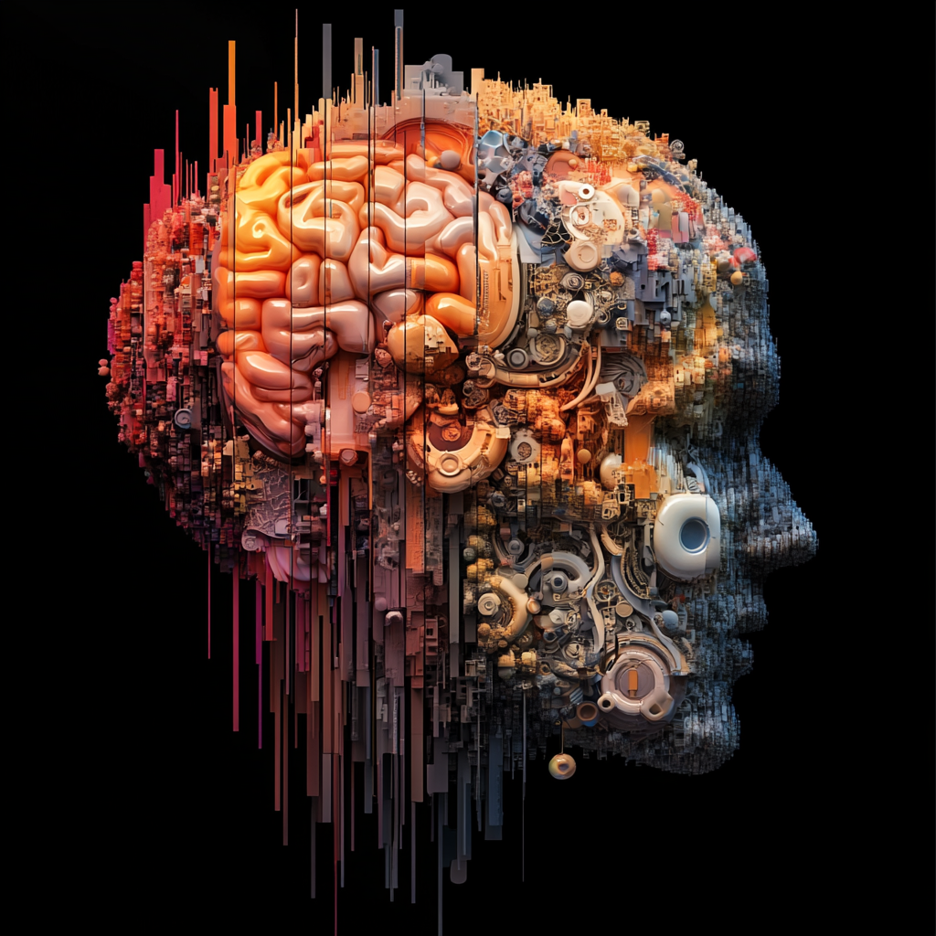
Recommendations for Knowledge Retention
Implement Structured Mentorship Programs:
Facilitate knowledge transfer from seasoned professionals to newer employees.
Create cross-generational project teams that mix seasoned experts with new hires, ensuring continuous knowledge transfer through collaborative work on real projects.
Enhance Recruitment Strategies:
Increase outreach to attract a diverse pool of candidates.
Explore utilizing established recruitment and development processes for scientific staff as a model for attracting and developing support staff.
Develop Comprehensive Succession Plans:
Identify potential retirees and plan for seamless transitions.
Implement succession planning with overlapping tenure, enabling new hires to learn directly from departing staff through job shadowing and co-leading tasks.

Slide 11
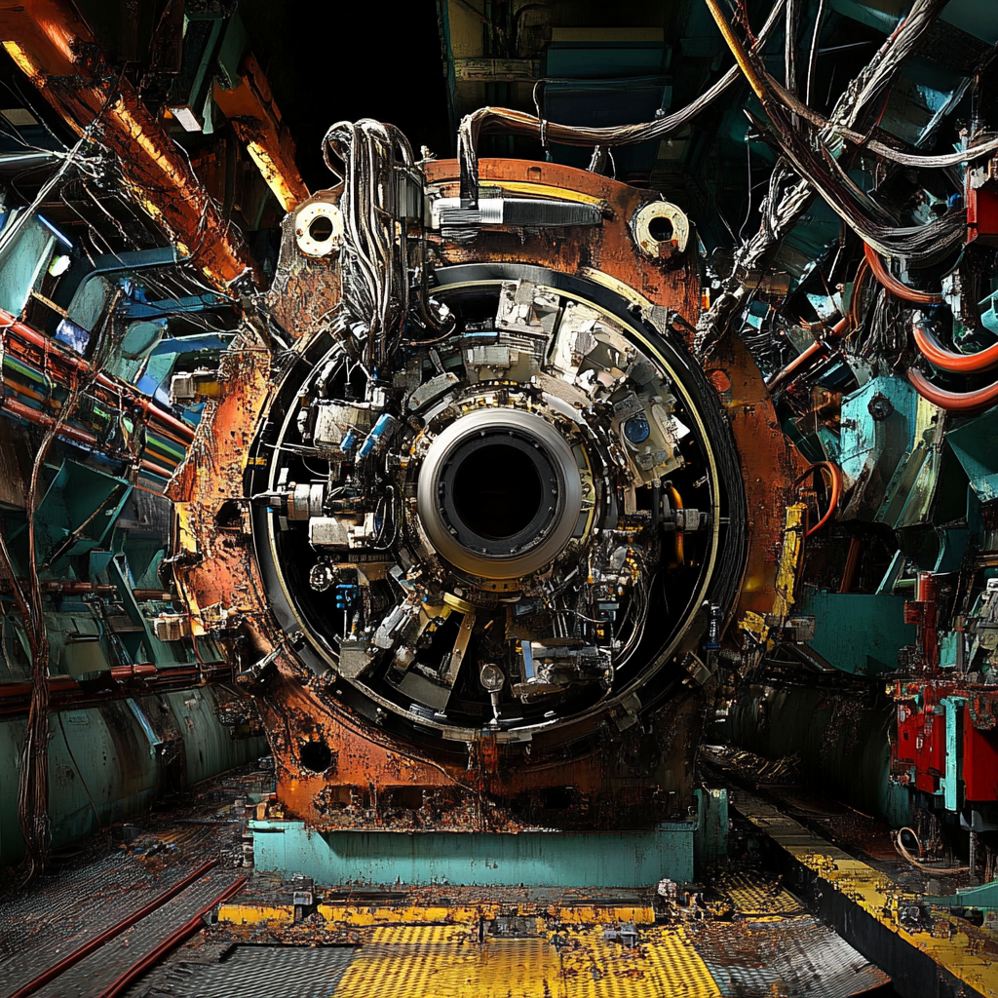
Conclusion
Urgency:
Emphasize the need to address changing demographics to ensure sustainability and continuity in operations
Mitigation:
Proactive measures can reduce risks associated with the loss of experienced personnel.
Call to Action:
Encourage immediate implementation of strategies to retain institutional knowledge.
Notes:
In conclusion, the DOE national labs are facing a significant challenge with the impending retirement of a large portion of their experienced workforce. Addressing this through targeted recruitment, structured knowledge transfer programs, and mentorship will be critical to maintaining operational continuity and scientific innovation in the coming years.

Slide 12
Useful Links
LP Strategic Partnership Project... | U.S. DOE Office of Science (SC) (osti.gov)
Science Undergraduate Laboratory... | U.S. DOE Office of Science (SC) (osti.gov)
Stipend-based Internships | Department of Energy
Technology Transfer Execution Plan | Department of Energy
The Community College Internship Program at NREL | NREL
Nuclear Safety Training and Workforce Development Program Amendment 001 - NEUP - Nuclear Energy University Program (inl.gov)
BNL | Monday Memo | Lab Launches Technician Community of Practice to Foster Growth

Slide 14
Q&A
Open floor for questions and discussions
For Breakout Session?
Discuss the efforts being made to attract new talent into the field of health physics and accelerator safety.
Include any recent DOE initiatives, internship programs, or collaborations with universities​.

Slide 15
Thank You
Contact Information:
Bryan Mason – BNL Accelerator Safety SME
bmason@bnl.gov

Slide 16
References
Department of Energy Reports:
DOE Workforce Trends and Demographics Reports.
DOE Human Capital Strategic Plan.
Government Accountability Office (GAO):
Reports on DOE workforce planning and challenges.
Brookhaven National Laboratory Publications:
Annual Reports.
HR Demographics Data (Internal).
Industry Studies:
National Academies' reports on the scientific workforce.
Studies by professional organizations like the American Physical Society.

