Slide 1
SLAC RGD Program under DOE Order 420.2D
DOE Accelerator Safety Workshop
October 10, 2024
Ryan Ford
Health Physicist Radiation Protection Deputy Department Head
SLAC National Accelerator Laboratory

Slide 2
Outline
Radiation Generating Device – Accelerator Interface
Major changes to revised directive
Overview of Key Definitions within 420.2D
Contractor Requirements Document (CRD) 2a, 2b
Devices
RGD’s (≤ 10 MeV)
Accelerators (> 10 MeV)
Devices that have changed classification, or were given special consideration, and how we manage them
Questions

Slide 3
FAQ
What are the major changes in the revised directive?
The applicability and intent have been clarified however, the overall approach to accelerator safety management has not changed. Additions to the Order include a new set of pre-approved exemptions and equivalencies, tailored requirements for low powered accelerators that were previously exempt or undefined, updated approval authorities, updated definitions, and a requirement for the Unreviewed Safety Issue (USI) process to be approved by DOE…
Can a site use the Lab’s Rad Protection and ISM Programs in place of the equivalencies in the Order?
Yes, provided the Site Office can confirm the existence of an appropriate crosswalk of the referenced institutional programs with requirements in 2.a through 2.c of the CRD for accelerators operated below 10 MeV.
(ESH Manual, RPP, RP Procedures)

Slide 4
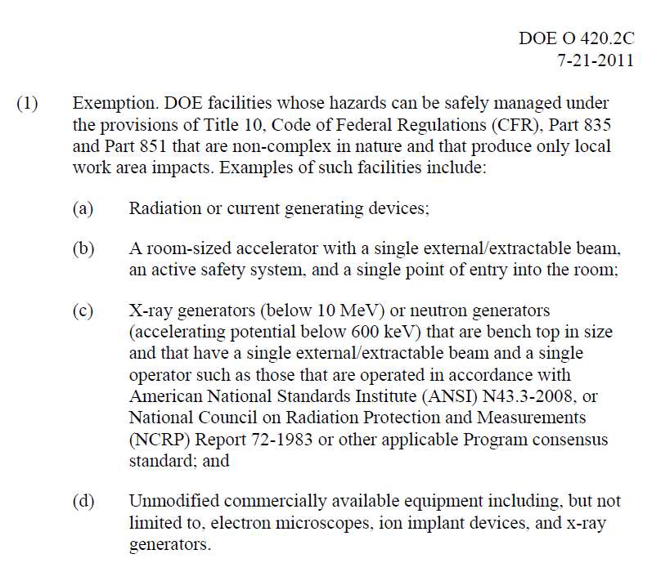
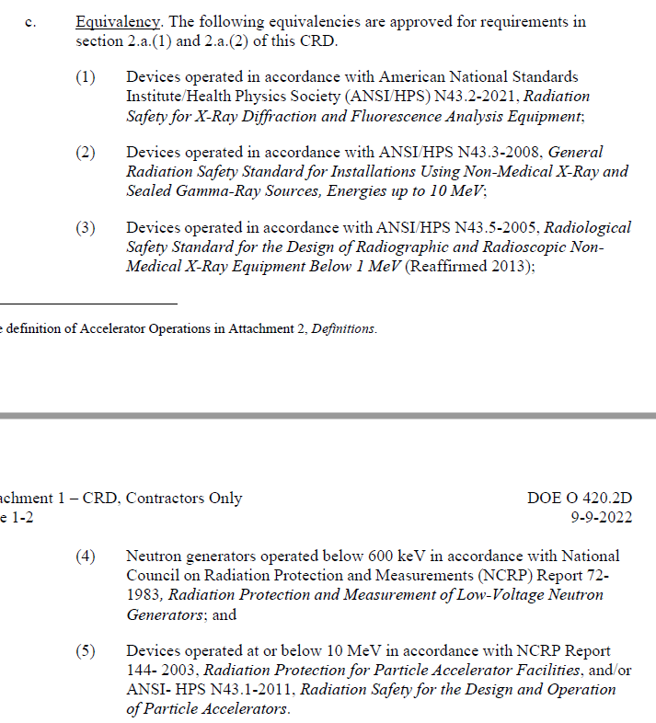
Overview of Key Definitions
420.2C
420.2D

Slide 5
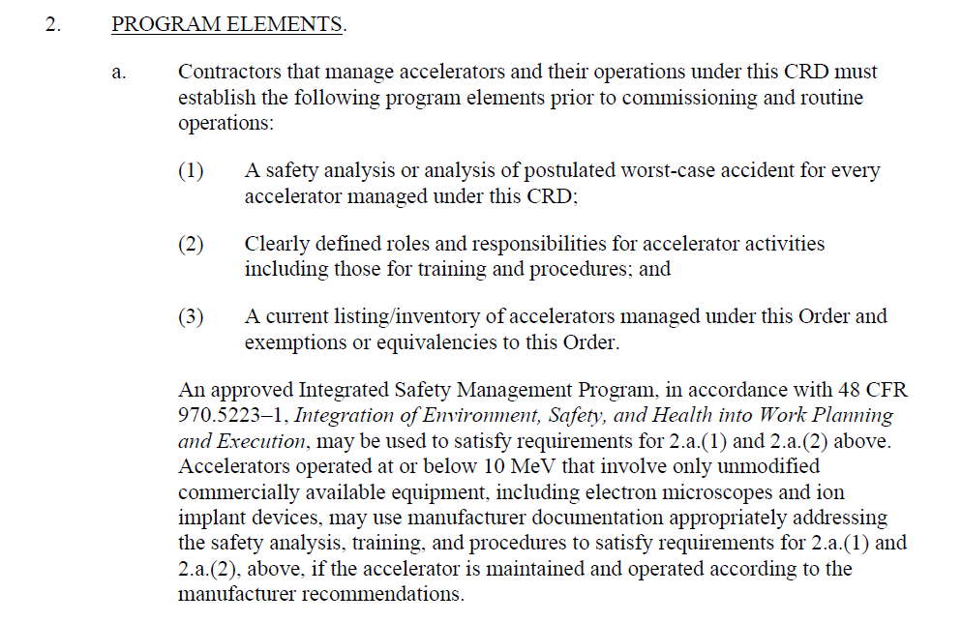
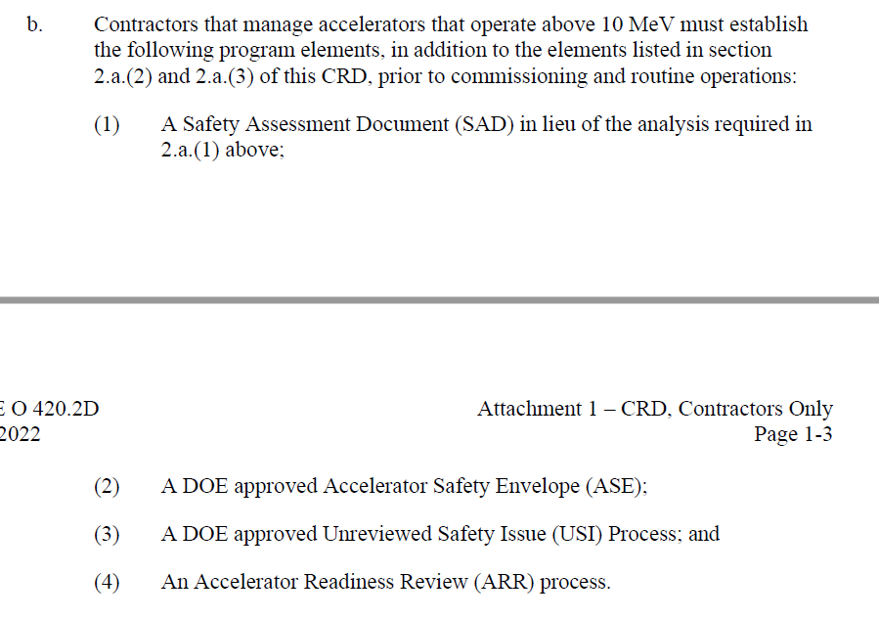
420.2D Contractor Requirements Document
2a. (accelerators ≤ 10 MeV)
2b. (accelerators > 10 MeV)
RGD

Slide 6
Definition of RGD
DOE G 441.1-1C and SLAC RGD PM
*Radiation-Generating Device (RGD): Collective term for devices which produce ionizing radiation, including small particle accelerators used for single purpose applications which produce ionizing radiation (e.g., neutron generators, analytical X-ray machines, cabinet X-ray machines, radiography and soil density gauges, etc.), electron-generating devices that incidentally produce X-rays (e.g., klystrons, electron arc welders, scanning electron microscopes, electron microscopes), and any equipment that contains one or more sealed radioactive sources used as irradiators.

Slide 7
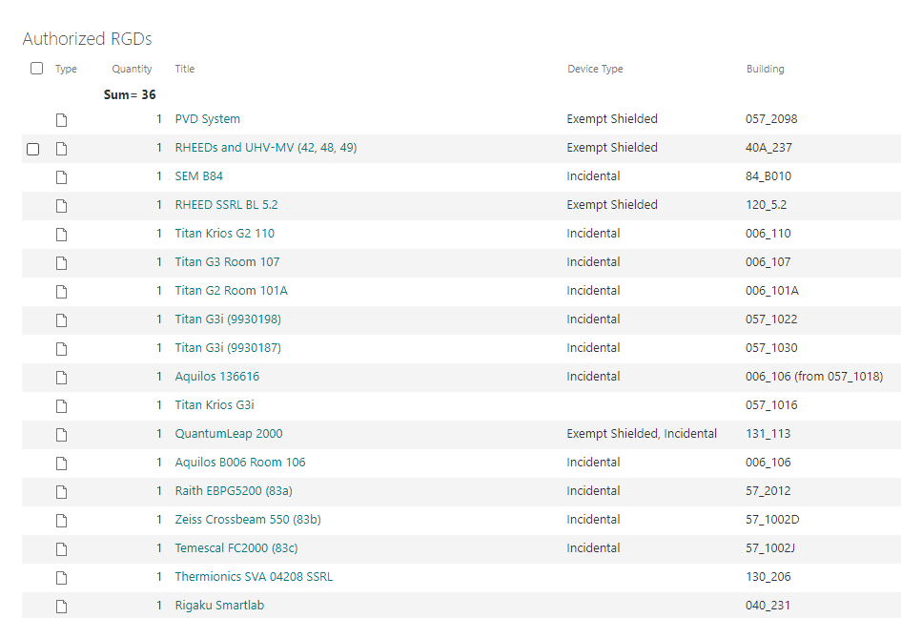
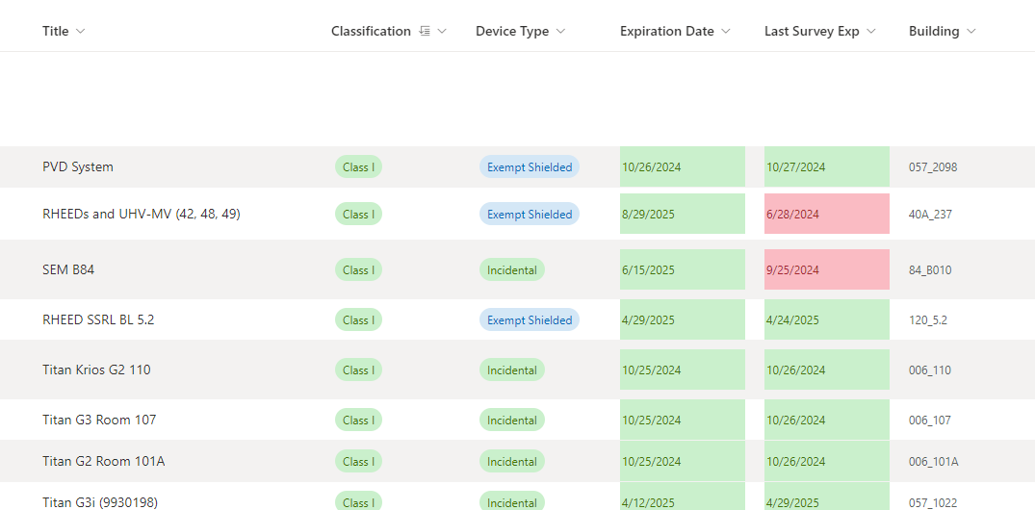
2.a.(3): RGD Inventory – Sharepoint List
General View accessible within SLAC
Detail View accessible within RP

Slide 8
Devices < 10 MeV
General Types
Klystrons in the test lab managed under the test lab’s procedures.
Electron microscopes including cryoEM
Vapor deposition machines used for plating surfaces
X-ray fluorescence analyzers
Cabinet systems with x-ray gun
Laser systems which produce x-rays
SLAC has two facilities in which laser-target operations can generate ionizing radiation
Particles are accelerated to energies well below 10 MeV in S10 and FACET-II facilities
SLAC has managed these devices as RGDs
For S10 and FACET-II, SLAC is using its approved ISM program (RGD program under SLAC RPP) to satisfy requirements for 2.a.(1) and 2.a.(2)
Industrial Radiography, Moisture/Density Gauges

Slide 9
Accelerators > 10 MeV
LCLS-I (normal conducting)
LCLS-II (superconducting)
SPEAR/SSRL accelerator and synchrotron light source
NLCTA

Slide 10
Devices which required additional consideration
Klystrons in accelerators are managed with the accelerator, SAD was revised. ~160 in LAF
Klystrons in the Test Lab remain as RGD and managed under procedures (ISM including TL procedures, and RGD Program Manual). ~8 test stands in various stages of use including window testing and gallery returns.
Matter in Extreme Conditions (MEC, changed to accelerator from RGD)
Originally considered a room-sized accelerator under the previous Order (420.2C Exemption).
Previously authorized via Radiation Generating Device Authorization Sheet (RGDAS). Now part of a SAD/ASE and authorized via Beam Authorization Sheet (BAS).
Energy increased from < 10 MeV to > 10 MeV with a high power BAS. LAF ASE covers MEC high power. USI was issued to cover this new mode of operation.
ASTA < 10 MeV but managed as accelerator
Complexity, interlocked, provide consistency with other accelerators site wide.
SAD and ASE was revised (LCLS) to include ASTA.

Slide 11
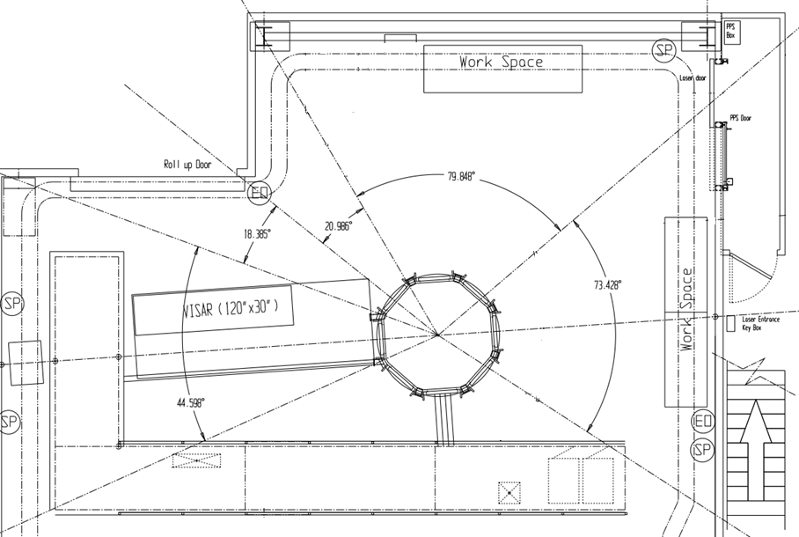
MEC Short-Pulse Laser Facility in LCLS Hutch 6
1 J in 40 fs, maximum intensity up to ~10²⁰ W/cm²
Maximum 1 J and 5 Hz
Can generate Radiation Area
Interlocked Access Control System
Interlocked radiation monitor
H6 HPS
Interlocked radiation monitor
Two Stoppers
Attenuator
Local shielding that is experiment dependent

Slide 12
Conclusions
SLAC manages accelerators ≤ 10 MeV as Radiation Generating Devices, using the RGD PM as part of the Integrated Safety Management Plan. Some exceptions apply.
SLAC has approximately 30 active RGDs most of which are low-hazard (commercially available and off the shelf, no measurable radiation outside of the enclosure).
RGDs are classified as I – V depending on hazard level, and consistent with area classification definitions (Controlled Area/CA, Radiologically Controlled Area/RCA, Radiation Area/RA, etc.).
A graded approach was used to determine controls to mitigate the hazards, and the controls are tabulated in the RGD PM.
RGDs are authorized using a Radiation Generating Device Authorization Sheet that is normally re-issued annually. An exception may be an experiment with a duration less than 1 year.

Slide 13
Backup

Slide 14
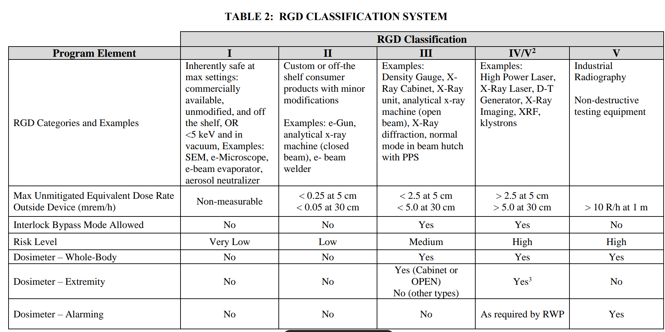
Table 2 Excerpt

Slide 15
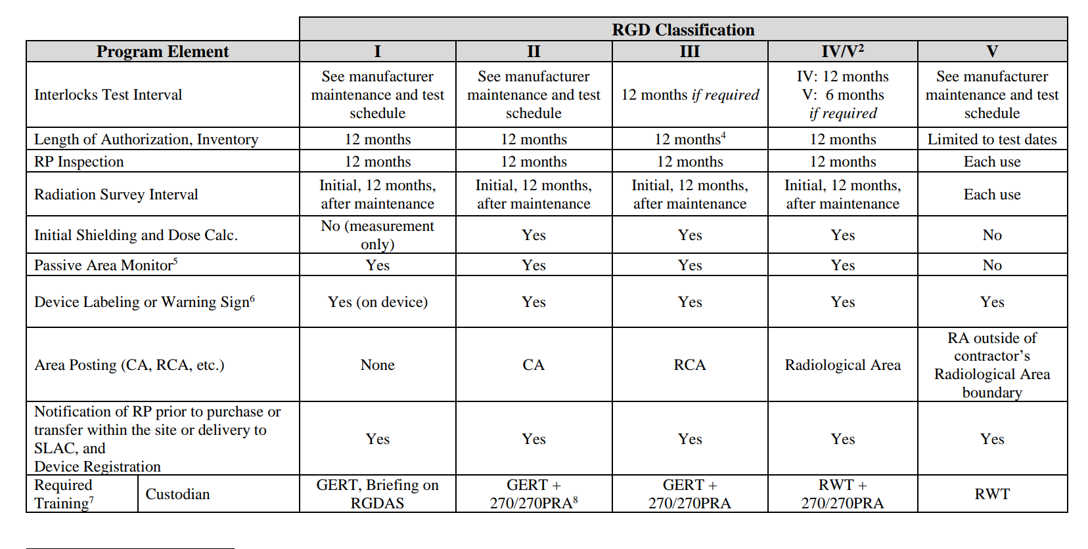
Table 2

Slide 16
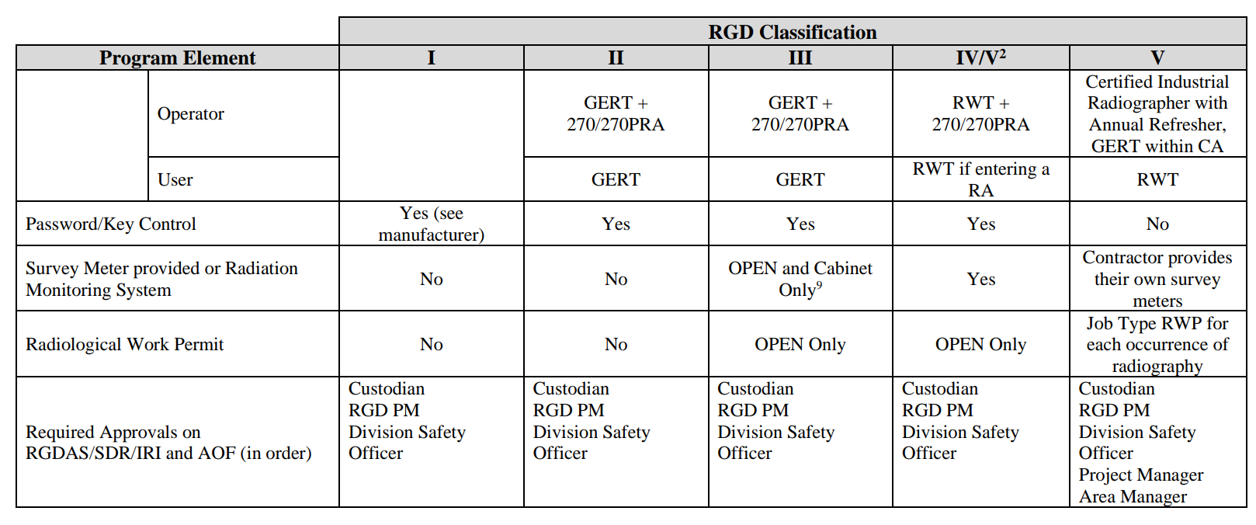
Table 2

Slide 18
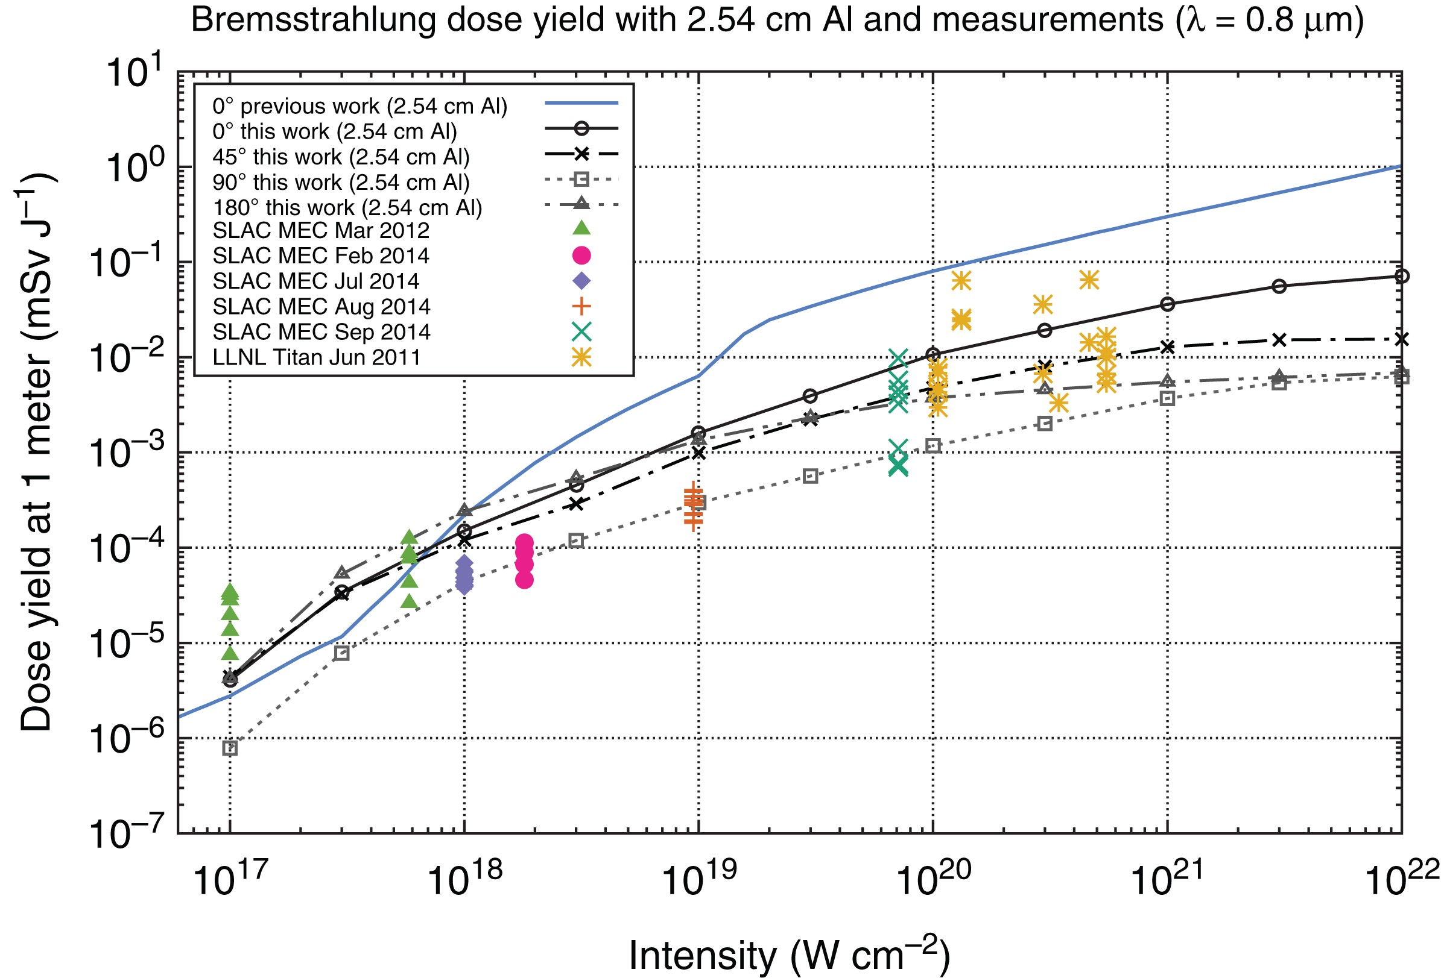
Interaction of a high-intensity laser with the matter in vacuum creates a plasma on the surface of the target, and subsequent interaction between the laser pulse and the plasma can accelerate electrons and/or protons to tens and even hundreds of MeV in energy
SLAC has characterized the radiation hazards and develop controls for these types of experiments
Notes:
Figure 8. The bremsstrahlung dose yields in this work from EPOCH and FLUKA calculations agree well with measurement data from SLAC MEC and Titan LLNL. Curves represent the bremsstrahlung dose yield with 2.54 cm Al shielding and in the 0°, 45°, 90° and 180° directions and at 1 m. The measurements were taken outside the target chamber at varying angles and elevation (hence, the vertical spread). Differences between the dose yield curves and measurements are due to target chamber attenuation, measurement angle, target Z, target thickness, detector sensitivity and uncertainties in the laser beam characterization as described below.
Unless provided in the caption above, the following copyright applies to the content of this slide: Published by Oxford University Press 2016. This work is written by (a) US Government employee(s) and is in the public domain in the US.

Slide 19
RGD Program Manual FO-035
FO-35, RGD Program Manual, was revised in July 2023 to be in compliance with DOE O 420.2D
Based on crosswalk between RGD program (RCM and FO-35) and 10 CFR 835 and its Guide 441.1-1C
Includes inputs from Custodians, Safety Officers, ESH Coordinators, and ESH
Content
Definitions, general requirements
Roles and Responsibilities (PM, Custodians, Operators/Users)
Controls, procedure for authorization
Configuration Control
Forms
Signage
Table 2
SLAC Classification System and all requirements

Slide 20
RGD Program Management at SLAC
Devices ≤ 10 MeV are classified as Radiation Generating Devices at SLAC
Devices do not generate Radiological Areas (not subject to O420.2D) are also managed under RGD program
Safety of RGDs are managed under the RP RGD program in compliance with 10 CFR 835
Follow the approved RP Program and ISM for sections 2.a.(1) and 2.a.(2)
Still subject to O420.2D sections 2.a.(3) and 2.c
RGD program is managed by an RP Program Manager and one Health Physicist

Slide 21
SLAC Approach for 420.2D Implementation
Reviewed SLAC accelerators, components and devices for applicability of ASO definitions and requirements
Updated the inventory of accelerators and devices
Used description in CRD 2.a that allows for use of an approved Integrated Safety Management (ISM) Program to satisfy requirements 2.a.(1) and 2.a.(2) for devices ≤ 10 MeV
SLAC uses its Radiation Generating Device (RGD) program, in compliance with 10 CFR 835, for management of devices ≤ 10 MeV
2.a.(3): inventory and 2.c: program review still apply
Reviewed changes in SAD requirements under 420.2D and are currently updating SADs/ASEs as appropriate
Hazards from …residual radioactivity associated with beam operations,…
… contamination, and airborne dispersion as appropriate …
Identify and analyze non-accelerator specific hazards which could serve as initiators or contributors to other evaluated accelerator accidents
Reviewed, revised and submitted the USI program description to Site Office

