Slide 1
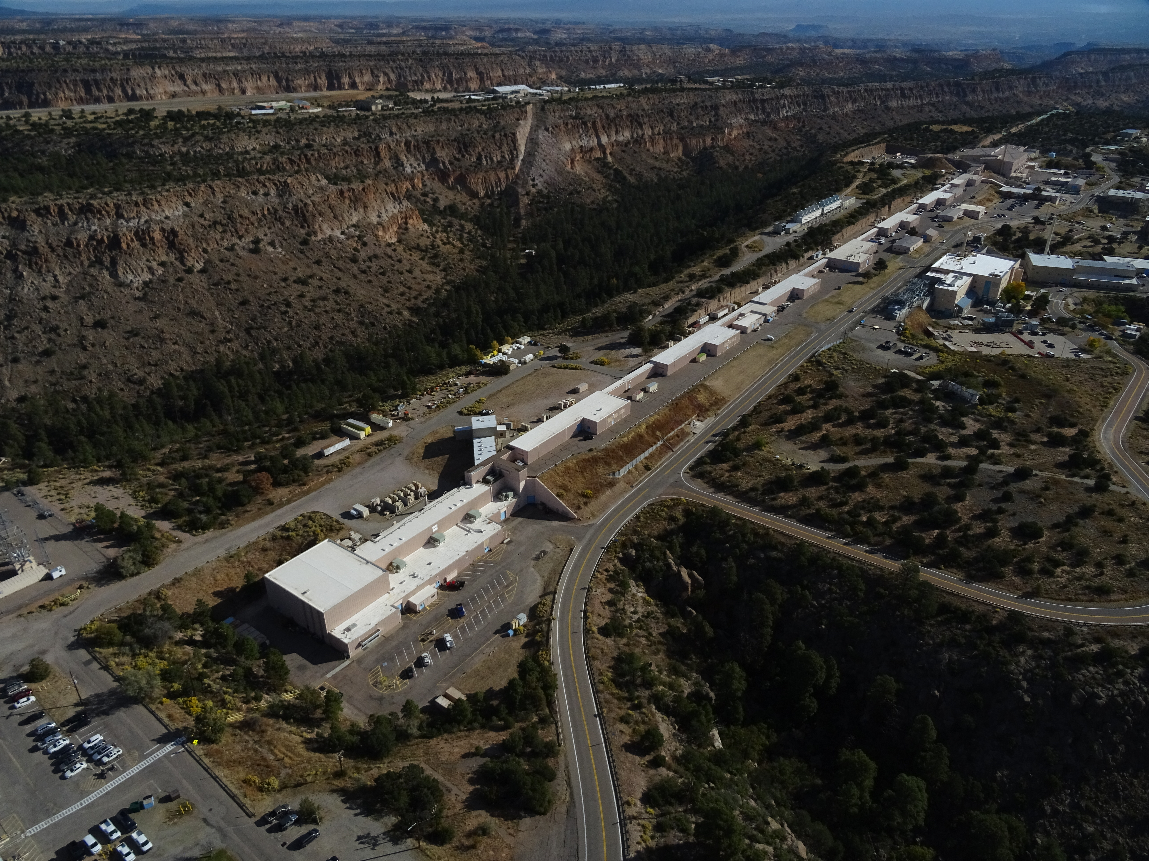
Safety Basis - Overview of Contractor Authorization Basis Document Review Process & Experiences
Mark Gulley
Accelerator Operations & Technology Division
Deputy Division Leader for Operations
Co-contributors: Jeremy Conlin, Joe Dabney, Greg Smith, Sarah White, Tim Orr, Debbie Trujillo
October 9, 2024 LA-UR-24-30778
Managed by Triad National Security, LLC., for the U.S. Department of Energy’s NNSA.

Slide 2
Los Alamos National Laboratory (LANL) Overview
LANL is one of three labs that falls under the National Nuclear Security Administration (NNSA).
While we have two major 420.2D accelerators at LANL, they are part of a much larger lab organization with multiple missions and numerous internal interactions.
As an example, LANL has an institutional Safety Basis Division, which, along with working on the various Nuclear Facilities, is the institutional owner for safety basis documentation for the lab’s accelerator facilities.
The impact of moving from 420.2C to 420.2D compliance for both LANSCE and DARHT is not onerous.

Slide 3
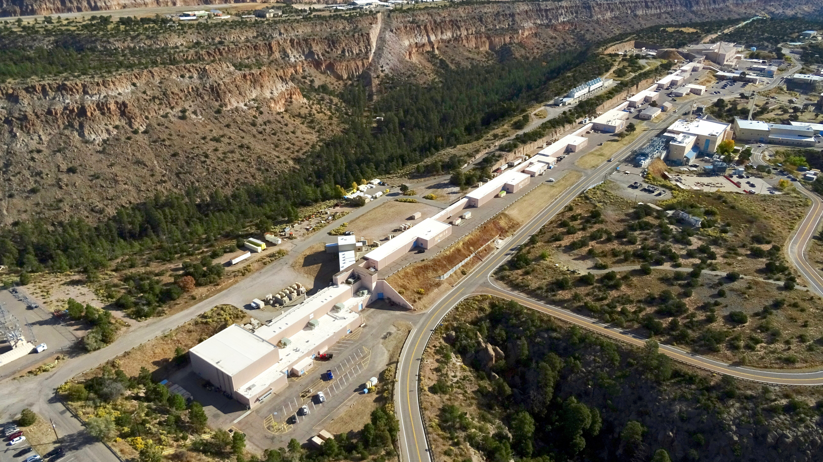
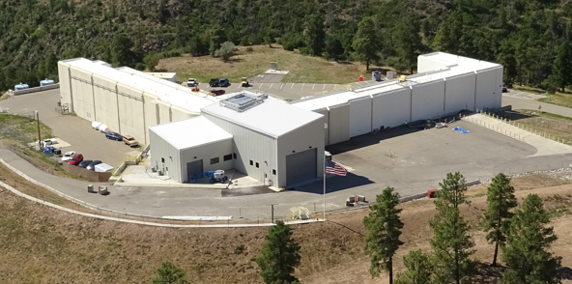
LANSCE and DARHT – Established Accelerators with Mature Safety Bases Processes

Slide 4
LANL went from 2 to 4 accelerators with 420.2D
At LANL, we have two small accelerators that fell under the RGD requirements prior to 420.2D.
Institutionally we’re getting them set up as 420.2D accelerators (SAD, ASE, other requirements).
This is taking time and effort to wrap our collective heads around; despite having LANSCE and DARHT, all the small accelerators were below the ASO requirements (so we are on the learning curve for a new safety basis process for a small machine beyond RGD requirements).
We institutionally are having to sort this out with our field office and our Safety Basis organization.
The LANL organization owning these two machines is not one of our historical “formal” accelerator operations orgs.

Slide 5
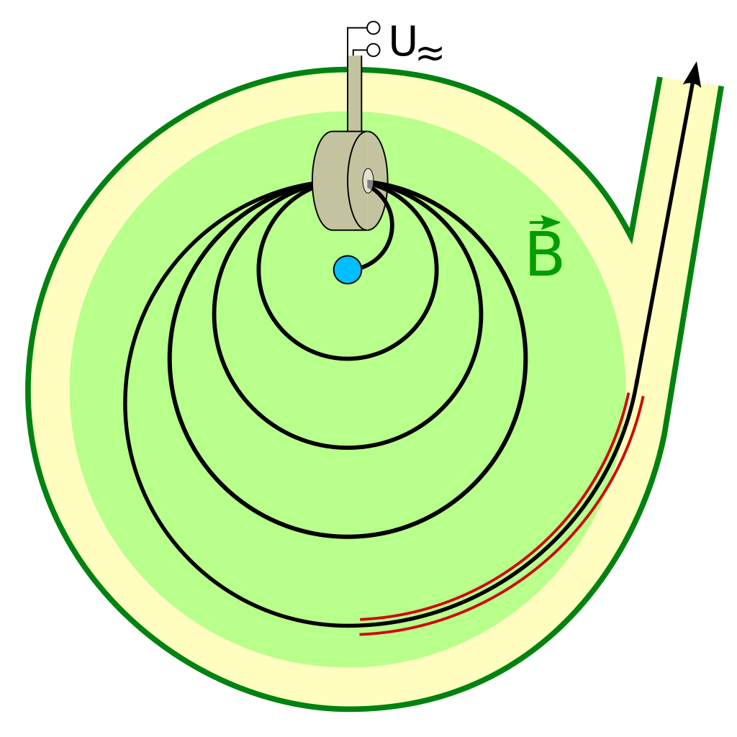
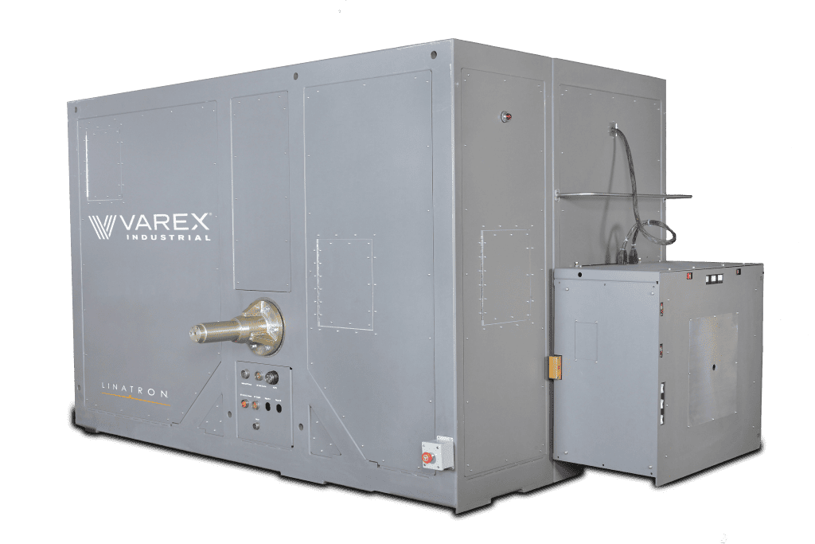
The Microtron and K15 are the two smaller machines that now fall under 420.2D.
Typical “K15” type machine
Typical microtron

Slide 6
The different organizations associated with accelerators cross numerous boundaries
Laboratory Director
S, T & E
Weapons
Operations
LANSCE
DARHT
Safety Basis
ASO
K15
Radiation Protection
Microtron
ASD - Scorpius

Slide 7
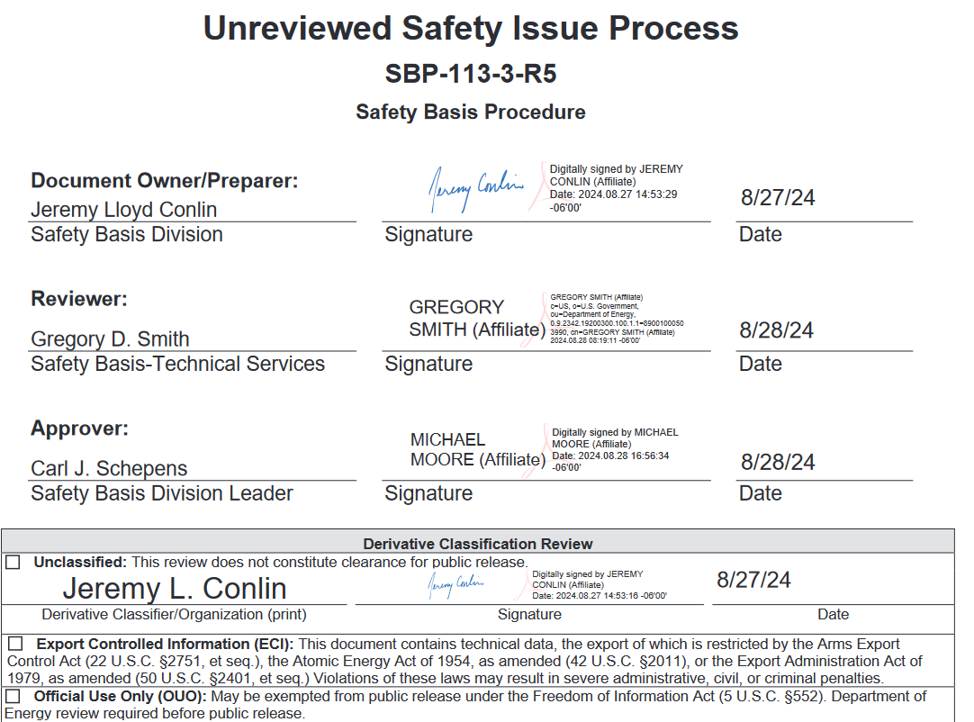
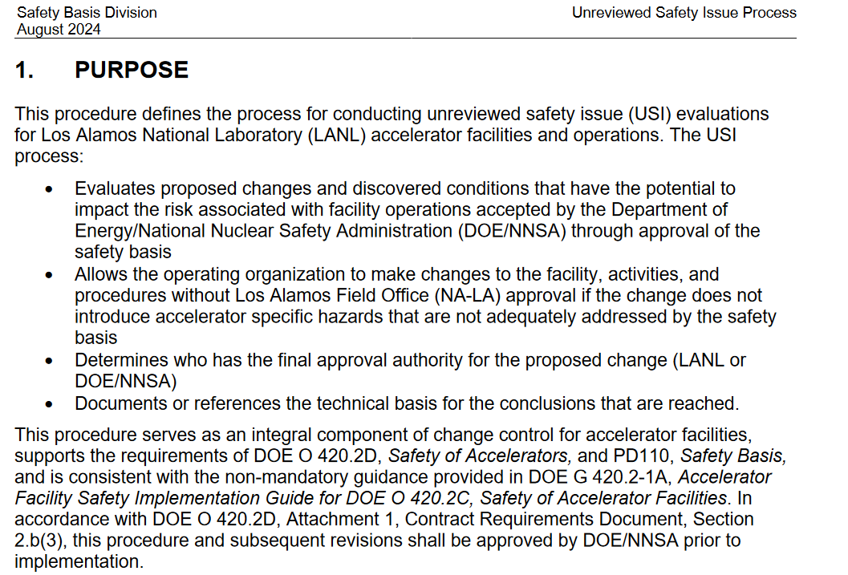
The LANL USI process is institutionally owned and managed (and has been for some time)

Slide 8
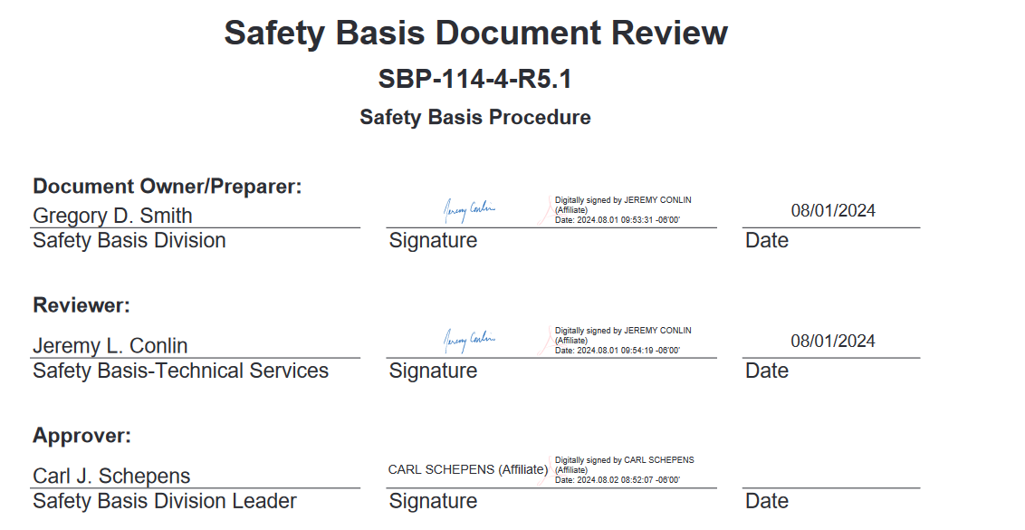
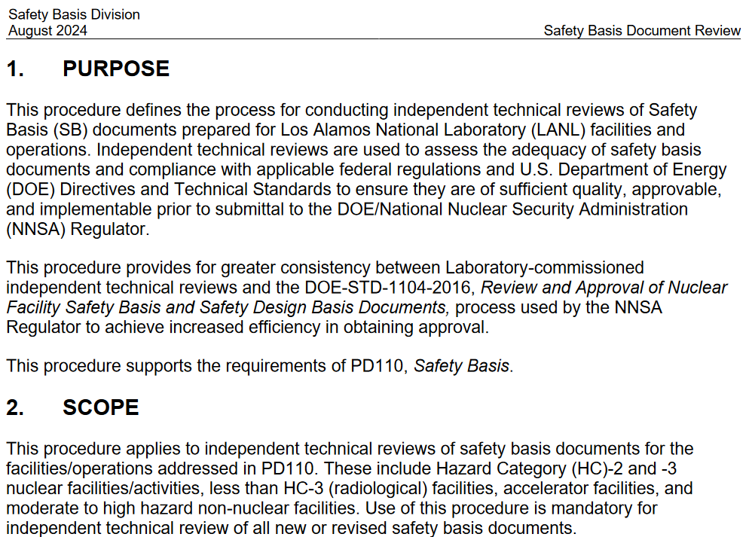
The LANL Safety Basis Division also has a procedure for Safety Basis Document Review

Slide 9
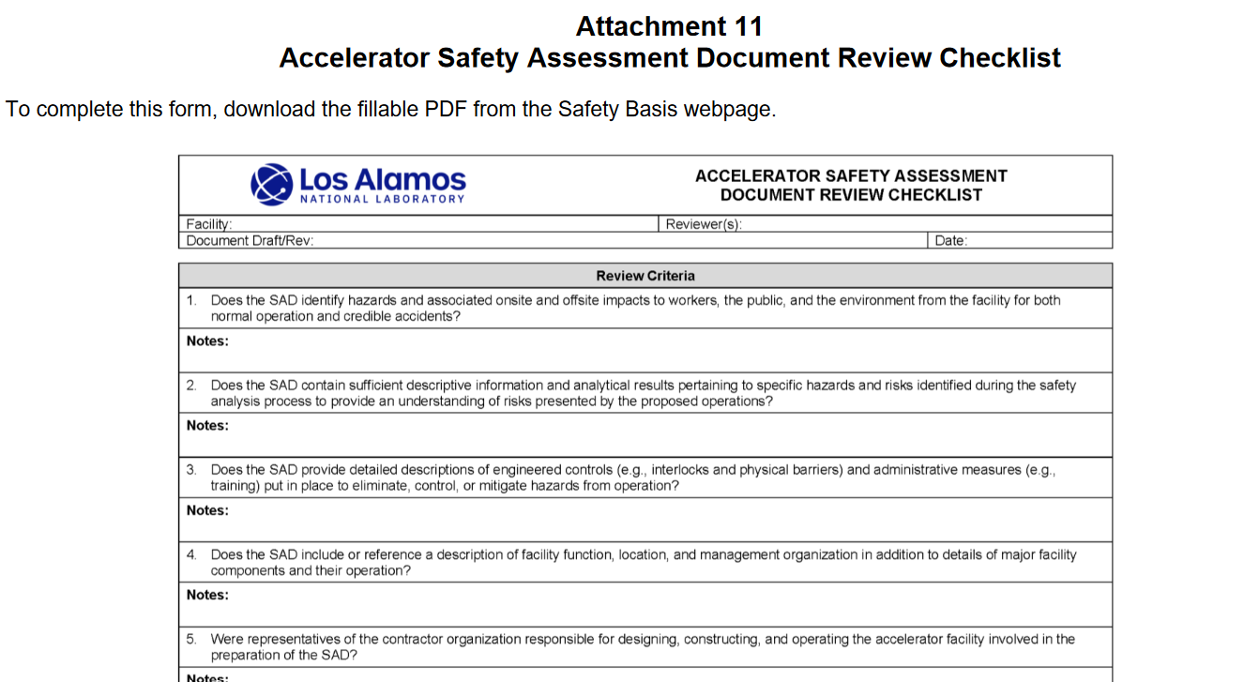
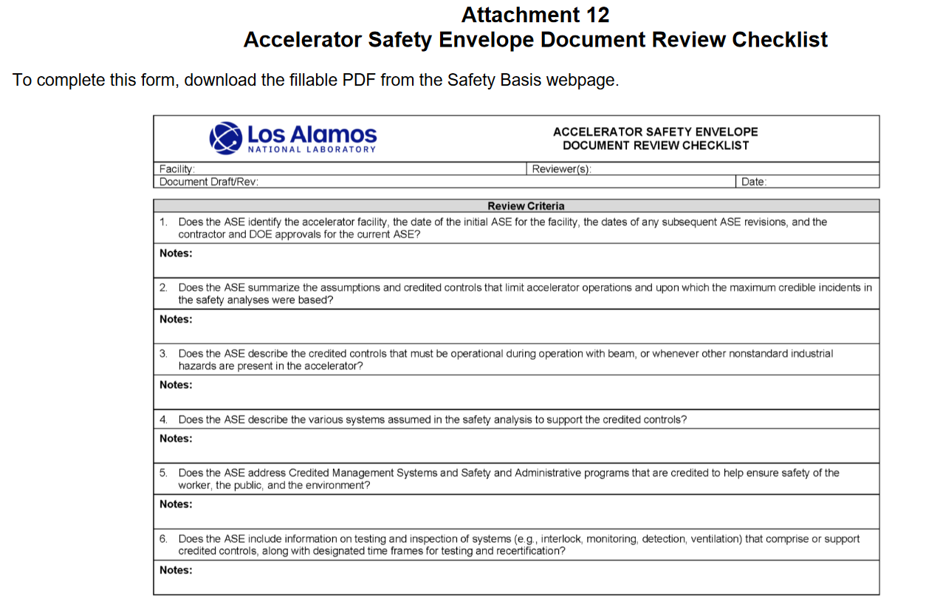
This process is checklist-driven, including checklists for a SAD and ASE

Slide 10
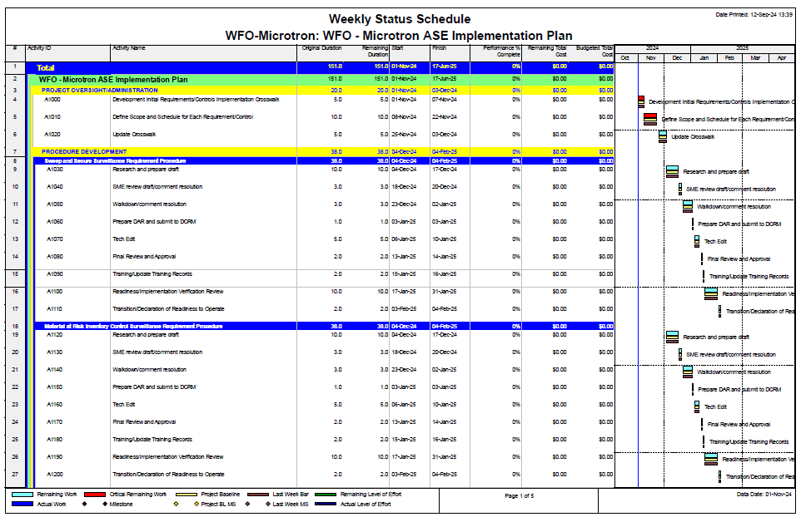
The process is being planned and updated on a weekly basis

Slide 11
Next Steps
Solidifying the Implementation Plan is ongoing right now.
ASE and SAD for both the Microtron and K15 are drafted and under review.
Many documents under the ASO are based on the documentation that was being used under the RGD requirements.
Walk-downs uncovered areas that should be re-assessed as we move from RGD-space to ASO-space. (What are “industry-standards” vs requirements?)
Despite LANL’s institutional experience, we are still working to figure out how to use varied areas of expertise spread throughout different organizations to construct a “new” 420.2D-compliant small facility (that has been there for many years).

