Slide 1
FERMILAB-SLIDES-24-0257-ESH
Hazard Assessment Methodology
Jessica Malo & Maddie Schoell
2024 Accelerator Safety Workshop
October 8-10, 2024

Slide 2
Outline
Non-Accelerator Specific Hazard (NASH) Analysis Methodology
Implementation at Fermilab

Slide 3
NASH Analysis Methodology
During major overhaul of Fermilab SAD during DOE O 420.02D implementation, also incorporated new, standardized hazard assessment methodology for non-accelerator specific hazards (NASH)
Use DOE-HDBK-1163-0020 Integration of Hazard Analyses
Community accepted process for performing risk assessments
Analyzes hazards for three receptors
Facility Worker (the worker actively performing the work)
Co-located Worker (the worker in the vicinity of the work, but not actively participating)
Members of public (due to Fermilab open campus, must involve the public onsite).

Slide 4
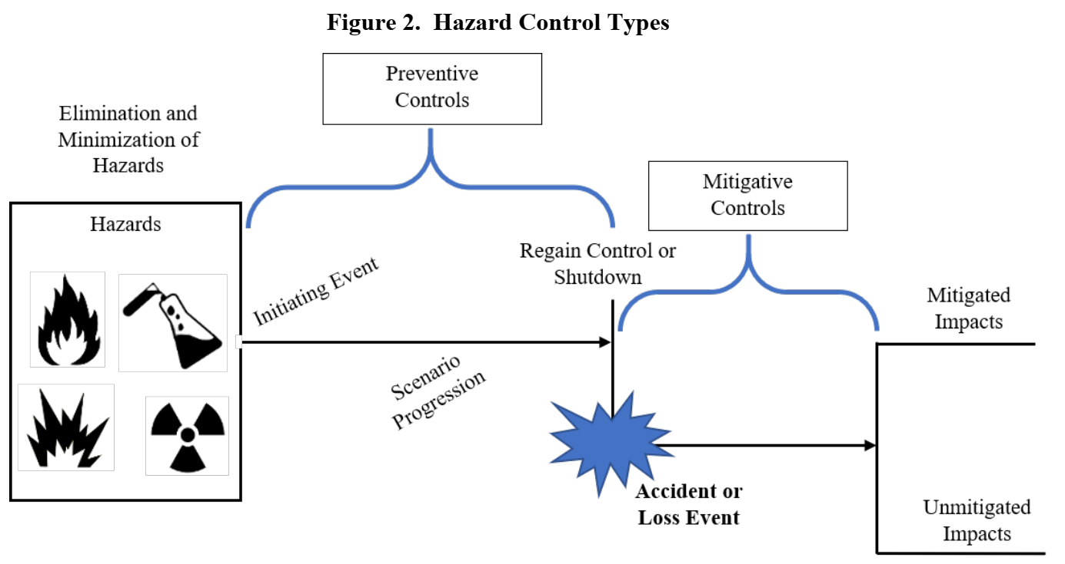
NASH Analysis Methodology
Hazard/Risk identified by facility
Reduce
Event
Likelihood
Reduce
Event
Consequences
Facility Workers
Co-Located Workers
Public
Residual Risk

Slide 5
NASH Analysis Methodology
Hazard | Hazard Description | Baseline Qualitative Risk (without controls) | Preventative (P)/ Mitigative (M) | Residual Qualitative Risk (with controls)
Lead | Hazard: "Potential {worker, co-located worker, or public} exposure to XYZ." | L: A C: M R: II | P-preventive measure #1 M- mitigative measure #1 | L: U C: L R: III
Describe the hazard/hazard event: "Potential exposure to xyz" to worker (or to co-located worker, or to member of public).
What is the baseline qualitative risk?
What is baseline likelihood of exposure event? (Anticipated, Unlikely, Extremely Unlikely, Beyond Extremely Unlikely)
What is baseline consequence of exposure event? (High, Moderate, Low, Negligible)
What preventive and mitigative measures can we use to reduce risks caused by this exposure event?
What is the residual qualitative risk?

Slide 6
NASH Analysis Methodology
DOE-HDBK-1163-2020 provides information on how to determine baseline likelihood and consequence for each hazard type.
We took that information and created easy to use legends for each hazard type.

Slide 7
The Risk Matrix
Move across 1 bin for every “P” control
1 P
baseline
2 M
Move down 1 bin for every “M” control
residual
Excerpts from Appendix C – Non-Accelerator Specific Hazards Risk Matrix Tables
Risk Levels I and II are not acceptable, require controls to be put in place.
Risk Levels III and IV are acceptable.

Slide 8
Implementation at Fermilab
Identify hazards for all accelerator facilities
Develop Standard NASH Risk Matrix Tables
Each accelerator facility reviews Standard NASH Risk Matrix tables
Confirms they follow standard controls – no further action
Confirms they utilize different controls – must perform individual NASH Risk Matrix for that facility for that hazard
Incorporation into the SAD

Slide 9
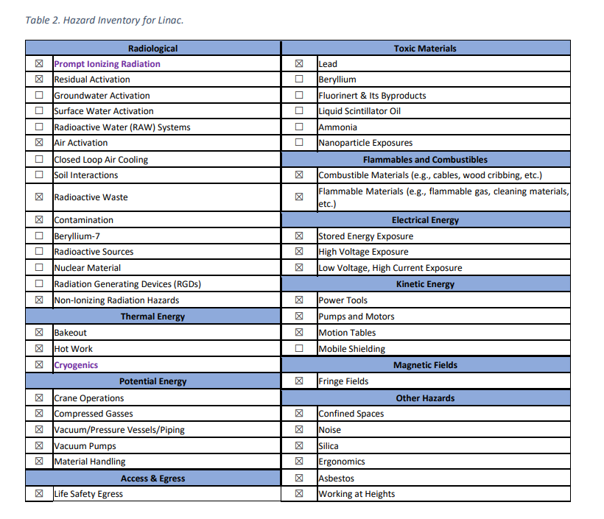
Implementation at Fermilab
Identify hazards for all accelerator facilities
All existing SAD Chapters were reviewed for the identified hazards
A common Hazard Identification Tale developed
Each facility then checked off hazards applicable to them
Ensured all hazards were considered and confirmed present or not present. Nothing “forgotten”.

Slide 10
Implementation at Fermilab
Develop Standard NASH Risk Matrix Tables
Conducted a 3-day workshop with all ESH Subject Matter Experts and representatives for each accelerator facility
Identified which of the NASH hazards were common, and which were more facility-specific
All NASH radiological hazards too unique, individual tables needed
All other hazards use generally the same approach throughout the Lab, worth developing common Risk Matrix Table
Everyone worked together to develop 30 Common NASH Risk Matrix Tables
10 hazard groups from HID, 32 individual hazards, 3 receptors per hazard
Resulted in 30 separate tables, with ~100 hazard/receptor combinations analyzed
Good opportunity for ES&H to glean facility-level experiences and capture them within these common risk tables. Also good for Line Organization to understand ESH Programs in more detail.

Slide 11
Implementation at Fermilab

Slide 12
Implementation at Fermilab
Each accelerator facility reviews Standard NASH Risk Matrix tables
If the hazard is addressed fully by the Common NASH Risk Matrix table, the individual SAD Chapter will refer to the Common NASH Risk Matrix Table
If the hazard is unique or not fully covered by the Common NASH Risk Matrix table, the individual SAD Chapter will evaluate that hazard within its own Risk Matrix Table

Slide 13
Implementation at Fermilab
Incorporation into the SAD
Fermilab has one large, modular SAD
Each accelerator facility, and accelerator or accelerator segment has its own Chapter
NASH Common Risk Matrix table is an Appendix to the SAD
Each SAD Chapter has its own Hazard ID Table
In the body of the SAD, each identified hazard is discussed
Reason for the hazard
Baseline and residual risk
Whether it follows the Common NASH table, or has its own

Slide 14
Questions?

