Slide 1
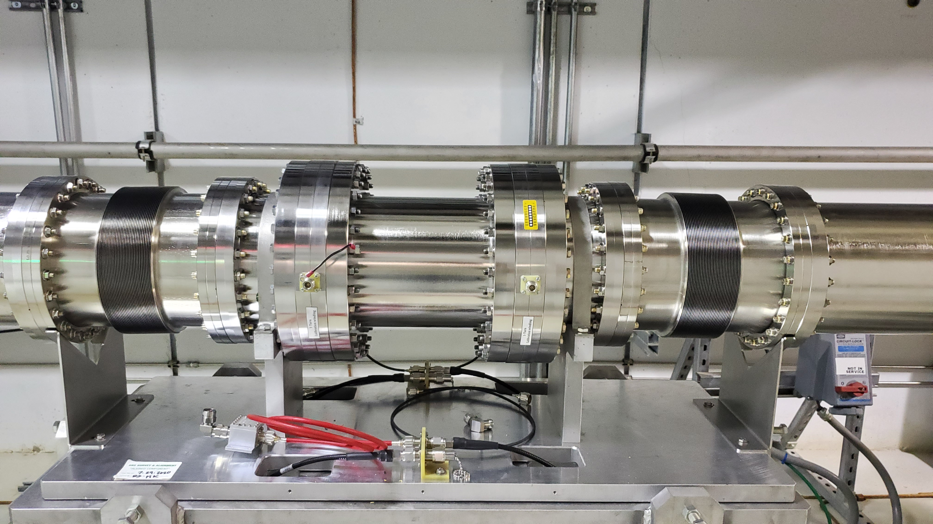
Technical Systems that Support the SAD Beam Power Limiting System
Patrick Bong
ORNL SNS Protection Systems Group

Slide 2
BPLS Team: Special Thanks To:
Trent Allison Osprey DCS
Charlotte Barbier ITER
Miljko Bobrek ORNL
Patrick Bong ORNL
Nick Evans ORNL
Kay Kasemir ORNL
Kelly Mahoney ORNL
Tommy Michaelides ORNL
Yugang Tan ORNL
Karen White ORNL
Dave Willis ORNL
Ashwini Aher Austin Bullman Eric Breeding Steve Crawford Doug Curry Ken Fowkes Tena Graben-Galyon Alan Justice Jeff Killian Tim Lessard Robert Morton | Syd Murray Jacob Platfoot Chuck Roberts Bryan Robertson Melanie Smith Richard Schwartz Steve Sherwood Rob Tennille Andy Webster SNS Operations SNS PPU Project

Slide 3
Beam power delivered to the target must be regulated to keep the beam power under the Accelerator Safety Envelope limit.
Problem: Proton Power Upgrade doubled the facility beam power from 1.4 MW to 2.8 MW
ASE - When beam is directed to the Target, beam power shall not exceed the nominal 2MW limit by more than 10%, averaged over any 1-minute period (56 seconds).
Machine Protection – Beam power shall remain below 2.05 MW averaged over 10 seconds

Slide 4
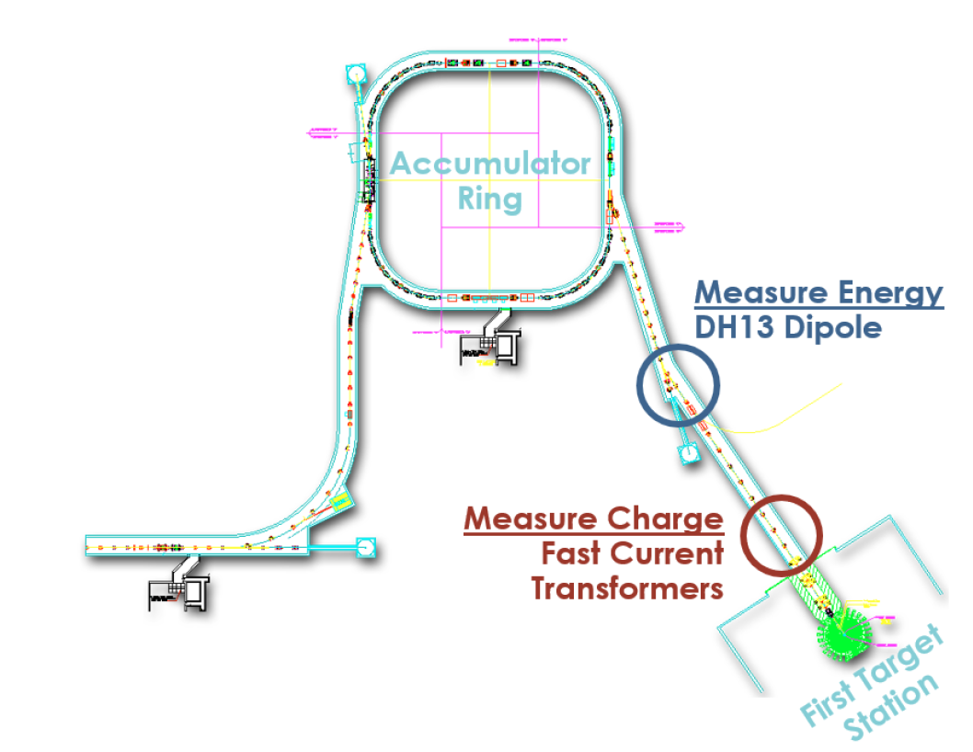
Beam power to the target is regulated by the Beam Power Limiting System.
Notes:
Beam power delivered to the SNS Target is regulated by a Credited Engineered Control and Machine Protection System.
Dipole magnet current is measured and beam energy is calculated.
Beam charge is measured with Fast Current Transformers (FCTs) upstream of the beam target

Slide 5
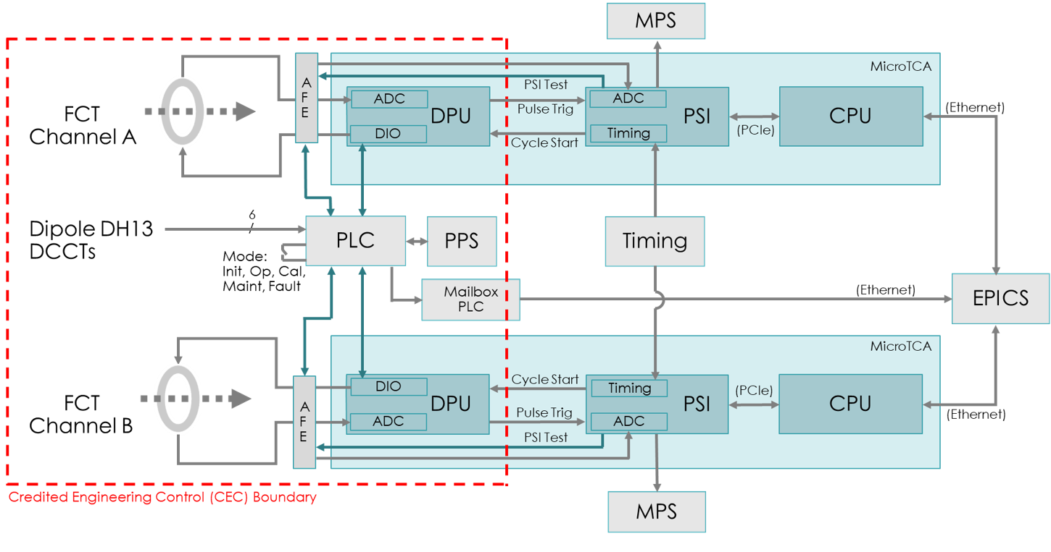
The BPLS is an integrated PPS and MPS solution.
Notes:
The Credited Engineering Control and Machine Protection System live in the same MicroTCA (uTCA) crate.
Both systems are redundant.
The integration allows both systems to analyze the same analog transducer data for beam charge.

Slide 6
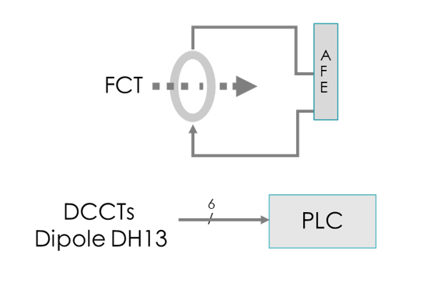
Beam power is calculated from the beam charge and beam energy.
Beam Charge
Beam Energy
Notes:
Beam Charge is measured by a Fast Current Transformer (FCT) which is conditioned in the Analog Front End (AFE).
Current to the DH13 dipole is measured with six Direct Current – Current Transformers (DCCT)
Three oriented in the positive direction, three in the negative direction, for triple redundant voting.
This allows for continued operation with a failed sensor.
The Beam energy is calculated from the dipole current

Slide 7
Fast vs. Slow Calculations
Fast – Beam Charge
Pulse to pulse measurement
Rolling average over 10 seconds (MPS) and 56 seconds (PPS)
Performed in FPGA (Field Programmable Gate Array)
Slow – Beam Power
Calculated from dipole current
Beam charge threshold calculation
Performed in PLC (Programmable Logic Controller)

Slide 8
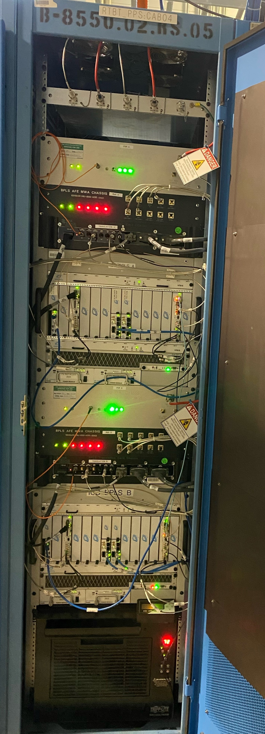
Slow - PLC
Fast - FPGA
Long Haul Cables to FCT
Pulse Voltage Module
Analog Front End
Safety PLC
DCCT Analog
μTCA DPU / PSI
A
HMI
Pulse Voltage Module
Analog Front End
μTCA DPU / PSI
B
Temperature Control
Notes:
The BPLS hardware is housed in two racks. The slow rack contains the hardware to calculate beam energy.
The fast rack measures beam charge.
uTCA stands for Micro Telecommunications Computing Architecture, which is an industry standard for FPGA controls.

Slide 9
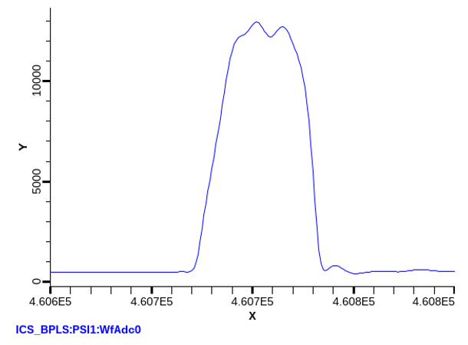
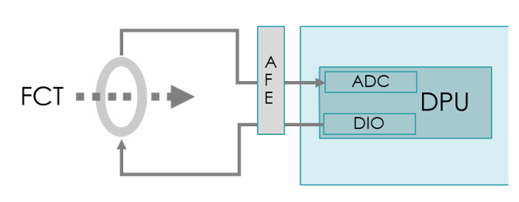
The fast Digital Processing Unit (DPU) integrates the beam pulse to get beam charge. Beam charge is averaged over 56 seconds for the Credited Engineering Control (CEC).

Slide 10
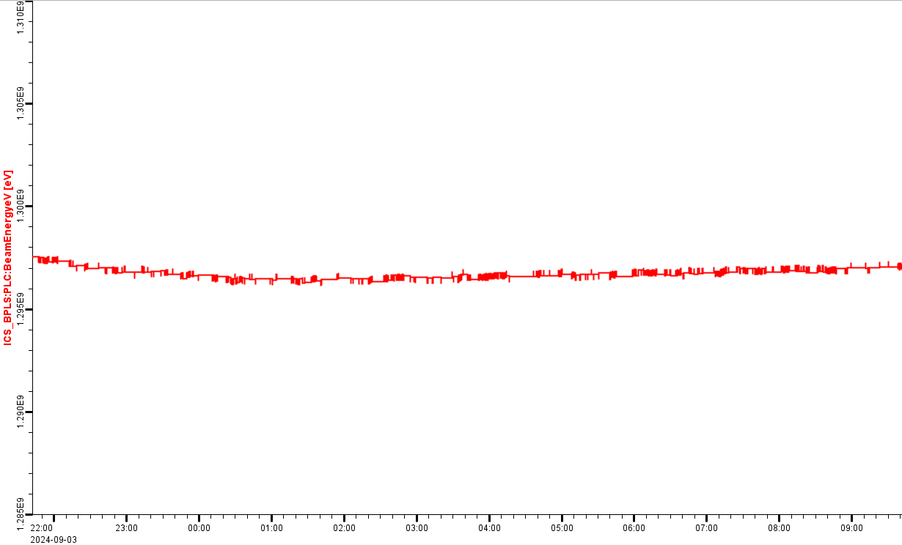
The slow Programmable Logic Controller (PLC) calculates the beam energy and beam charge threshold.
Notes:
Three current transducers are used to measure dipole current. A redundant set in the opposite polarity make the same measurement for the B Chain.
Once the beam is setup the dipole has very little change for the energy match and is stable for long periods of time.
The PLC calculates the beam energy and determines the beam charge that will exceed the beam power threshold.

Slide 11
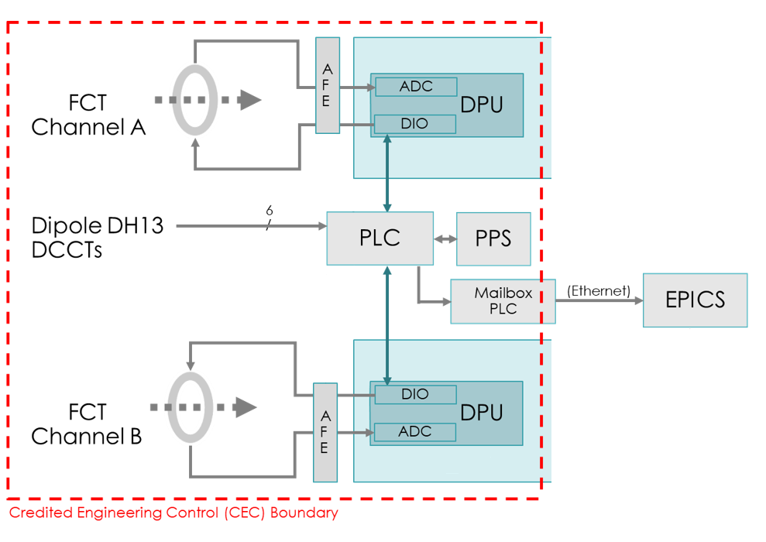
The PLC communicates the beam charge threshold to the DPU. The DPU signals a trip if the threshold is exceeded.
Notes:
The beam charge is averaged over 56 seconds. The additional 4 seconds of propagation time to allow the beam to terminate by the PPS.
System information is sent to EPICS from a Mailbox PLC which acts as a firewall between the isolated PPS network and the Controls System network.

Slide 12
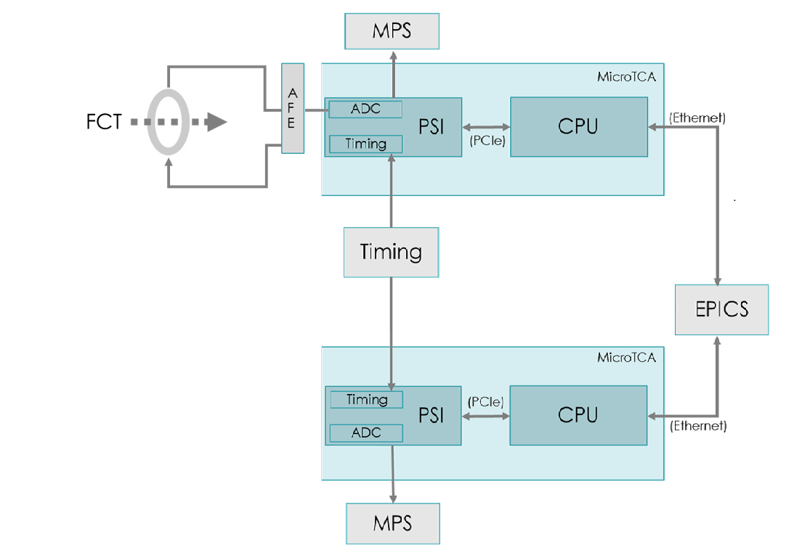
The MPS (Machine Protection System) averages the beam charge over 10 seconds and inhibits the beam if the average exceeds the threshold.
Notes:
MPS function is implemented in the PSI (Protection System Interface)
The ADC (Analog to Digital Converter) receives beam current from the FCT {Fast Current Transformer)
The timing system provides a trigger to capture beam pulses.
Beam charge is averaged over 10 seconds and an MPS fault is triggered if the beam charge threshold is exceeded
EPICS IOC runs in the CPU
The beam charge threshold is set in the CPU and read by the PSI.
PSI supplies data to the EPICS IOC running in the CPU

Slide 13
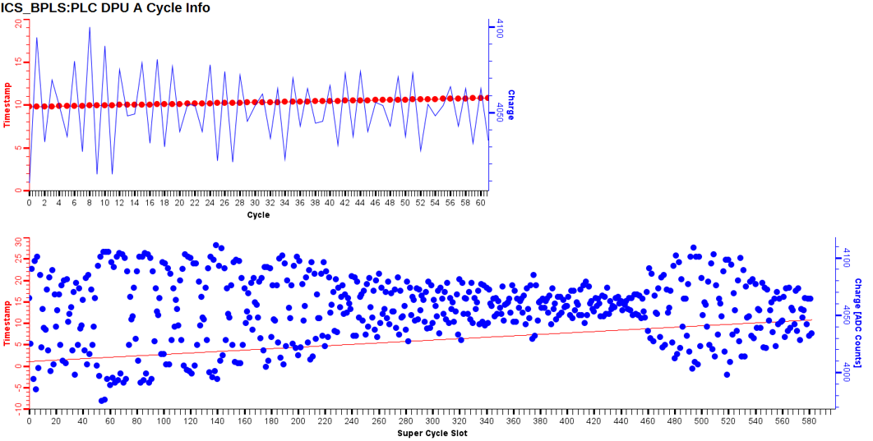
Diagnostics show some variation in pulse-to-pulse charge. The BPLS unit for charge is counts.

Slide 14
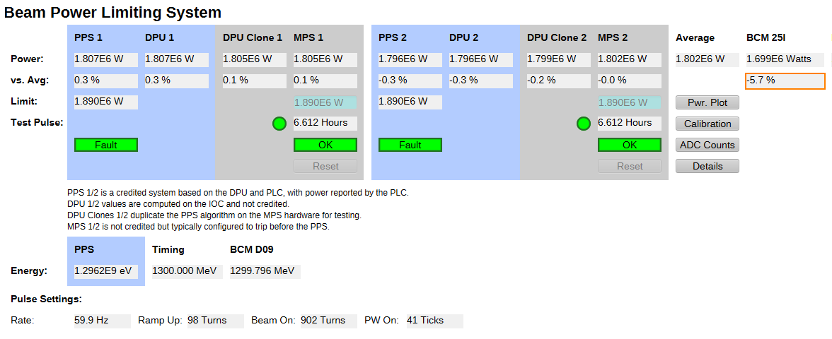
EPICS displays the error between the average beam power and the individual calculations.
Notes:
The credited controls are shaded in blue.
The MPS is in grey, as is the DPU clone that resides on the PSI board.

Slide 15
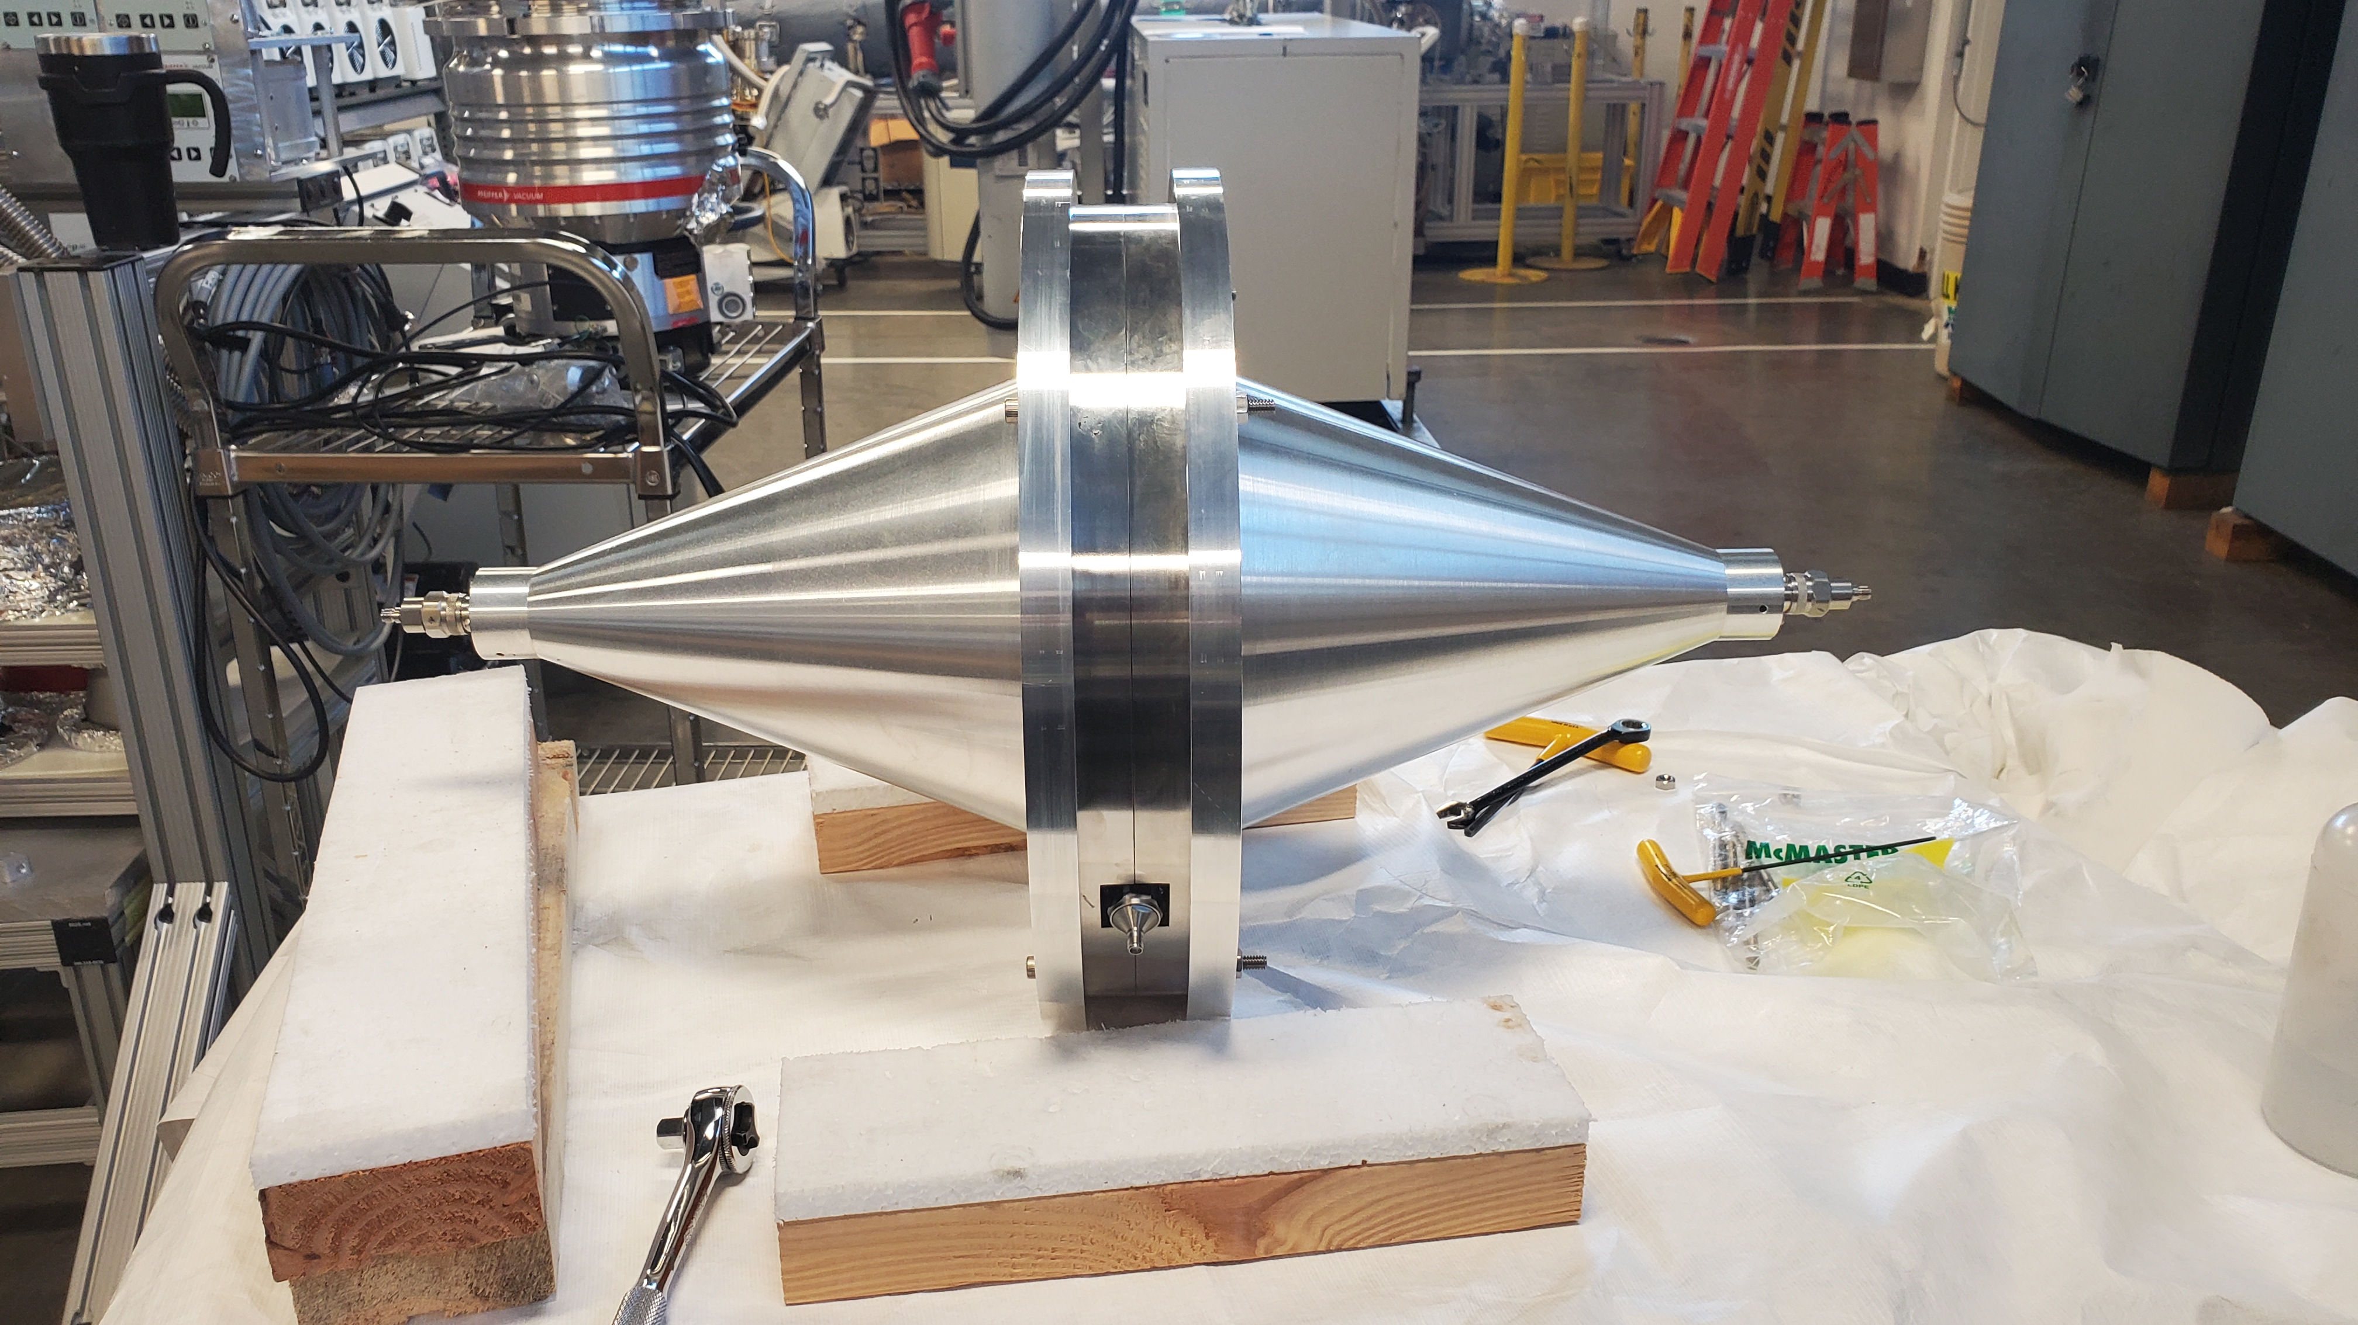
The calibrated components of the BPLS provide a highly accurate measurement of beam power to the target.
DCCT
Direct Current – Current Transformers
As installed (without cover)
FCT
Fast Current Transformer
Shown in calibration chamber
Notes:
CONCLUSION

