Slide 1
Work Planning and Control Elements in Accelerator Maintenance and Operations
Paul Sampson
October 9th , 2024 ASW2024

Slide 2
Outline
Introduction and facilities
Workforce structure
Work planning evolution
Example work plans
Summary

Slide 3
Introduction
Group Leader for the Accelerator Operations Support Group at CAD
Support and maintain scientific facilities
Coordinate all work within the department

Slide 4
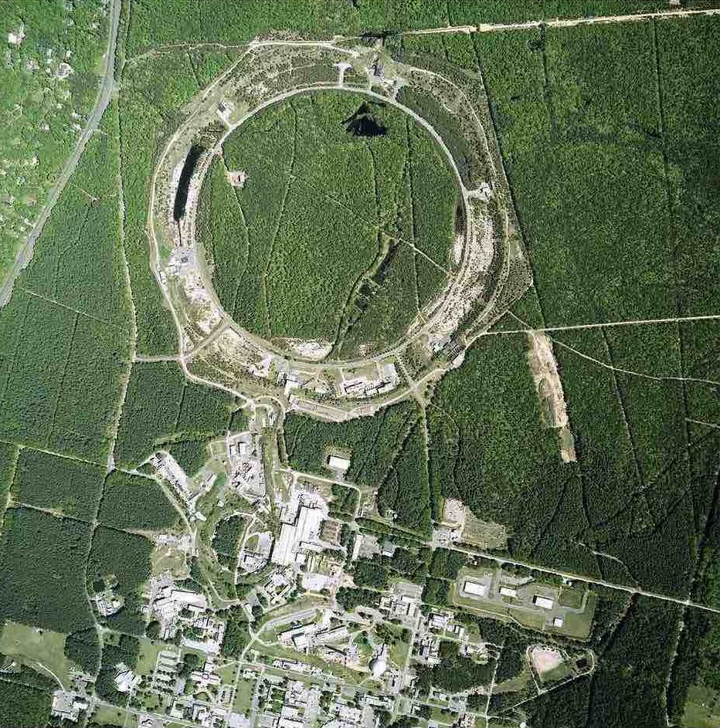
Complex:
Pre-injectors: EBIS, LINAC, Tandem
Synchrotrons: 3GeV Booster, 30GeV AGS
Collider: 300GeV(CM) RHIC
Facilities:
Nasa Space Radiation Lab
Brookhaven Lab Isotope Producer (BLIP)
RHIC Experiments:
STAR and sPHENIX
Notes:
Pioneering Hadron Electron Nuclear Interaction eXperiment

Slide 5
Work force structure
Technical, engineering and scientific staff at CAD all participate in the work planning process
Dedicated trades also at CAD: Electricians, Rigging, Carpentry, Survey, Water Group
Groups outside of CAD: All other trades, HVAC, Wending, Fire Rescue, Police, Janitorial, Site rigging, Painting, Welding, Carpentry, Modernization Project Office (MPO), Grounds, Health Physics, Contractors…

Slide 6
Evolution of a workplan:
Job definition: What do we need?
Scope: What resources will be needed
Assignment: Work Control Coordinators, WCC begins the process of managing the job
Work Types:
Prescribed (Operations Procedure Manual -OPM)
Permitted (Enhanced Work Plan- EWP)
Worker Planned
Outside EWP, MAXIMO (Facilities and Operations –F&O)

Slide 7
Review process and tools:
Once defined, a job must be examined to reveal all necessary reviews are generated, permits acquired, permissions granted, etc.
Job Screening SBMS Tool
CAD Screening Guide tool
At a minimum, a Job Hazard Analysis (JHA) shall be performed.
At CAD, for work 50V or above, an Independent review and electrical briefing is completed by a qualified Independent Electrical Work Reviewer (IEWR).

Slide 8
Approval and Scheduling
Once a workplan has been screened, reviewed and approved with all necessary parallel plans, permits and other materials assembled, the work gets final review and scheduling:
In addition to the work plan at CAD the Job Request System is utilized to complete approval for execution, scheduling, closeout and archiving

Slide 9
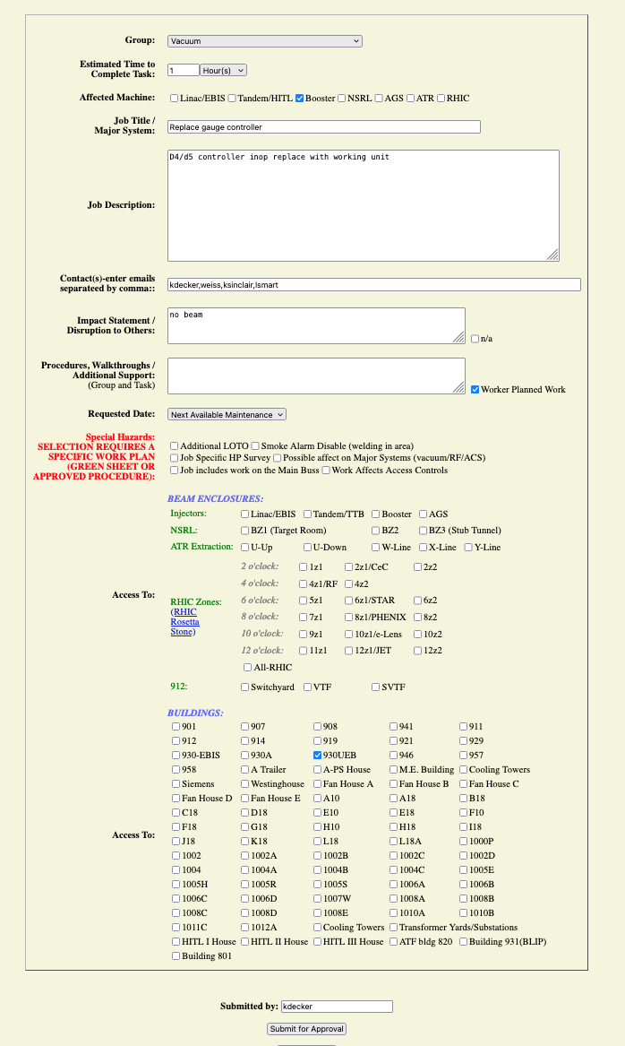
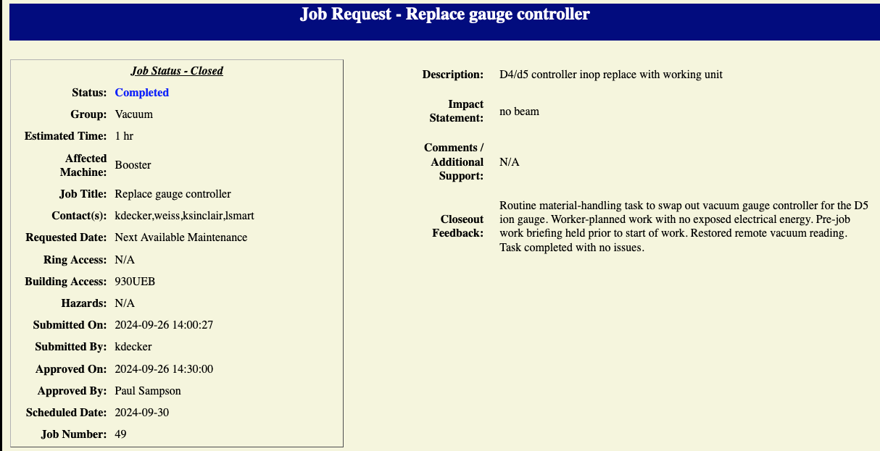
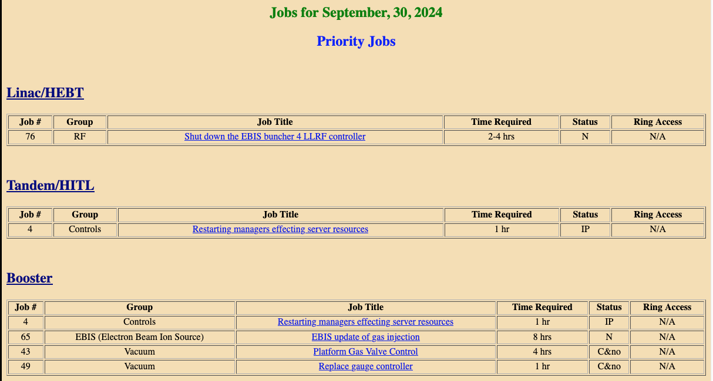
“Simple” Job: Routine controller replacement

Slide 10
Complex job:
This example based on work completed during the latest shutdown. It was to replace a failed feedthrough in a valve-box.
Many groups, disciplines and systems involved.
Power Supply, Cryogenics, Mechanical, Site Welding, Project Management, Lab and department management, Fire Rescue, Access Controls….

Slide 11
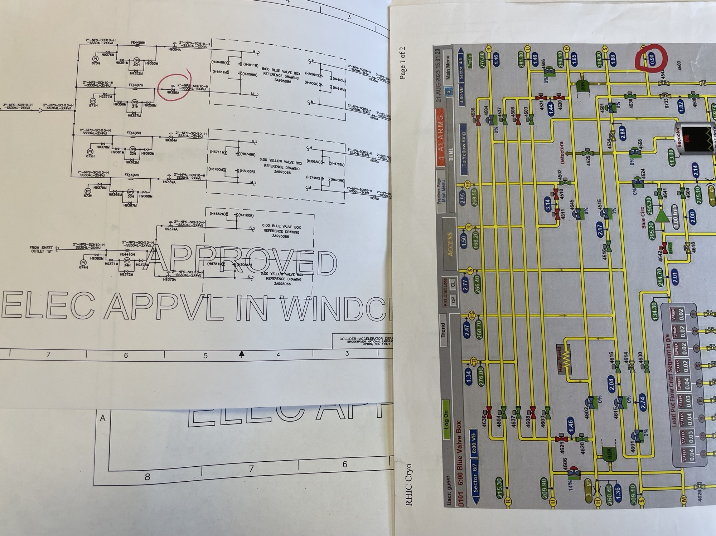
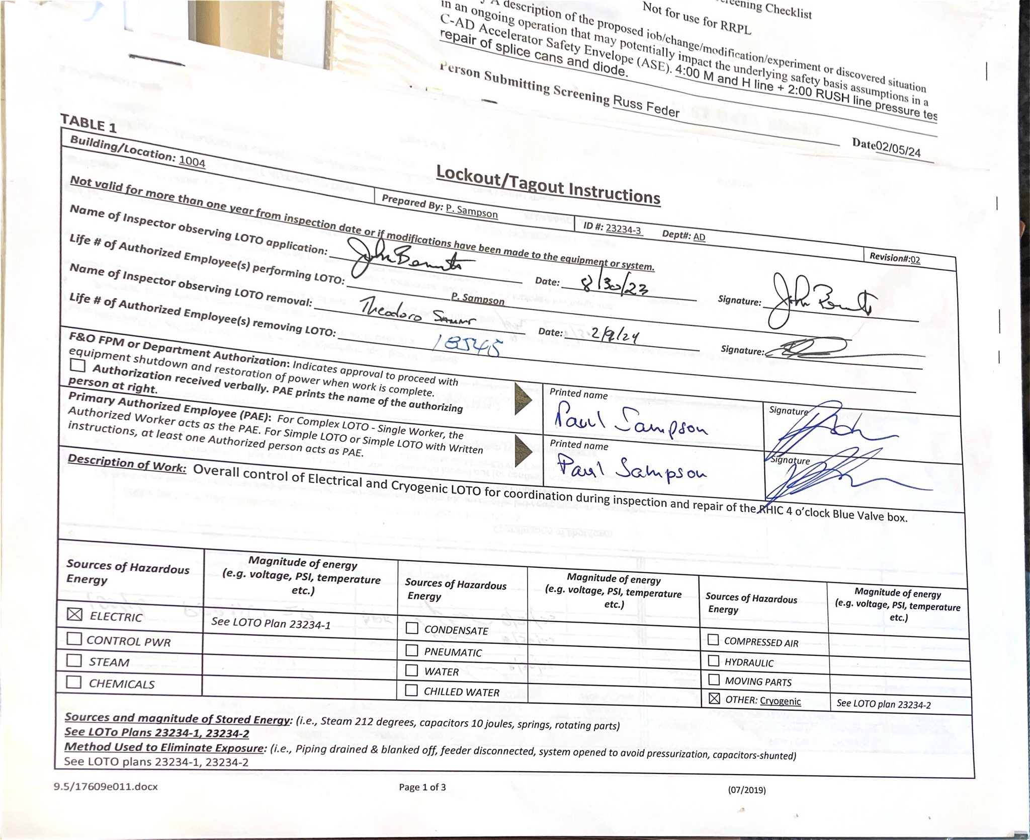
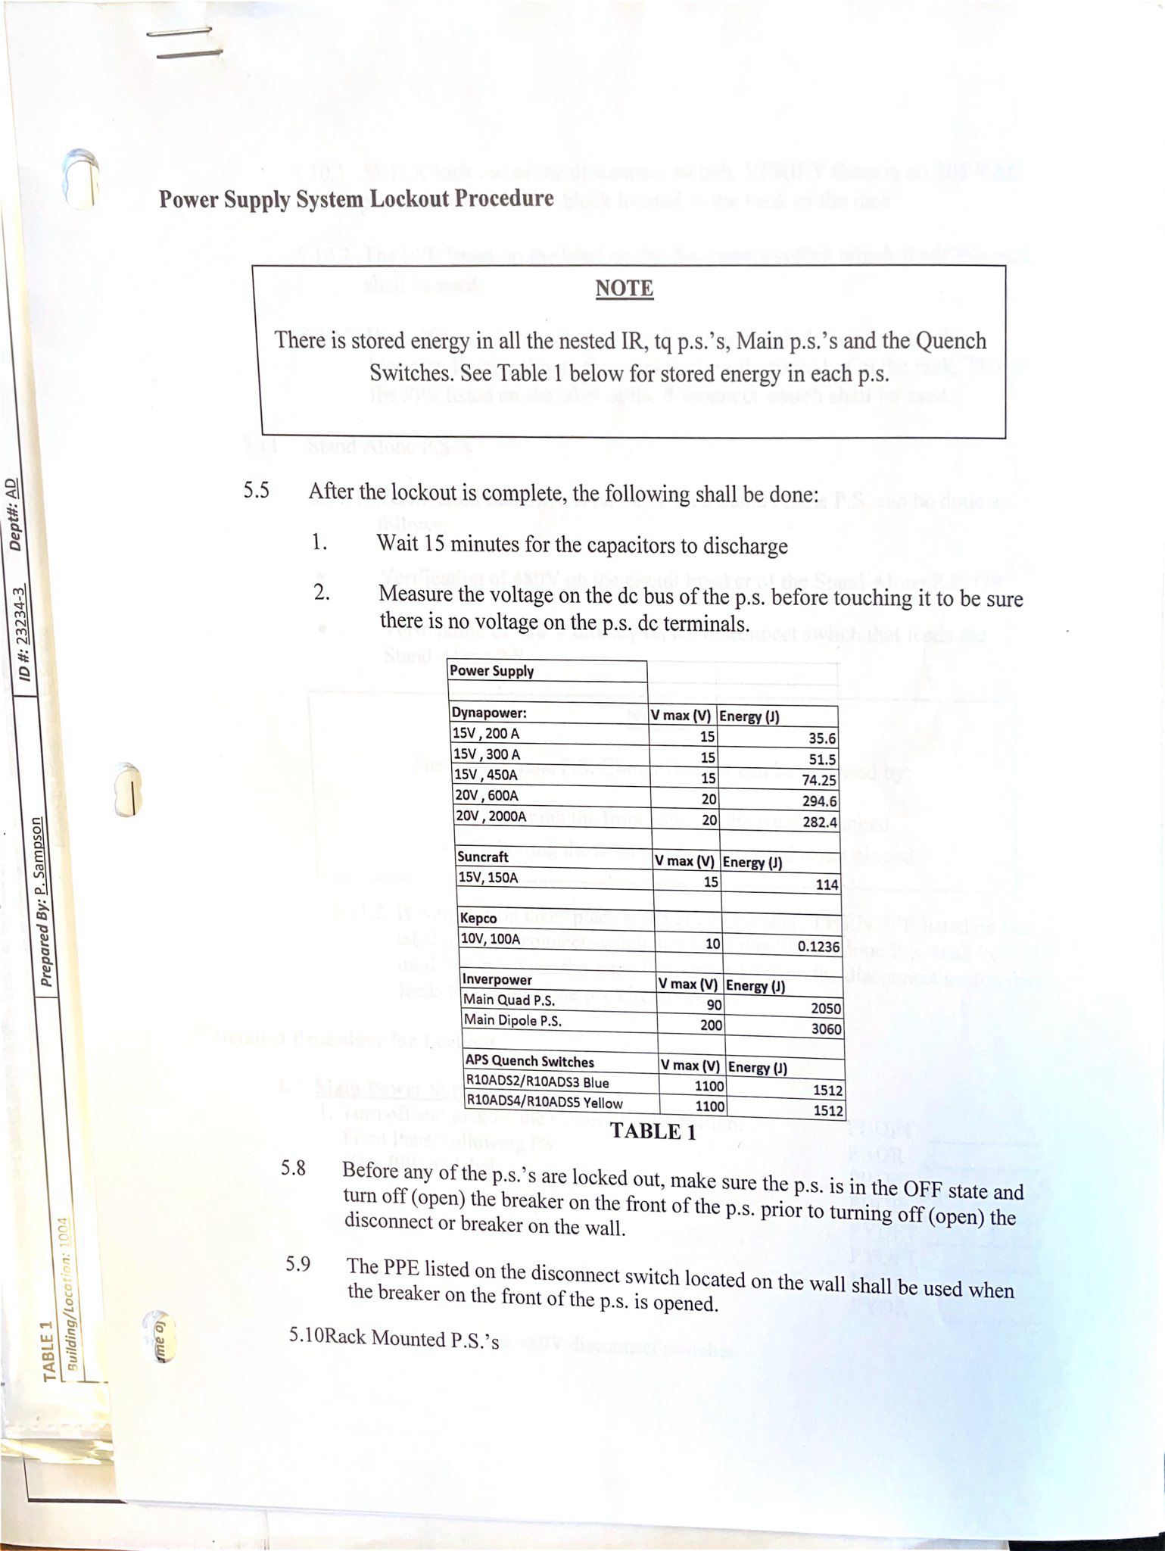
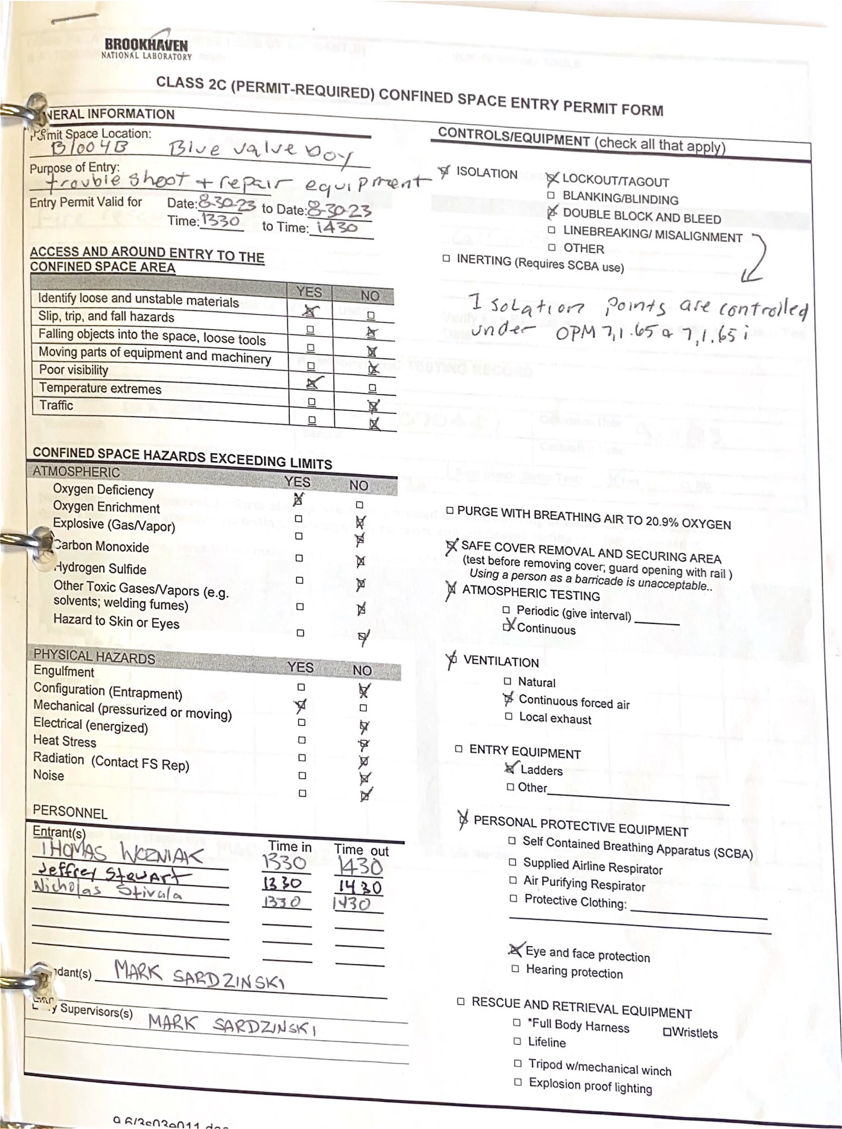
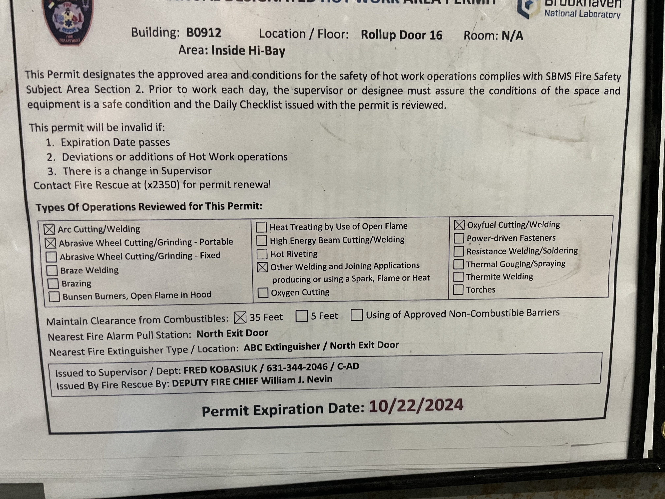
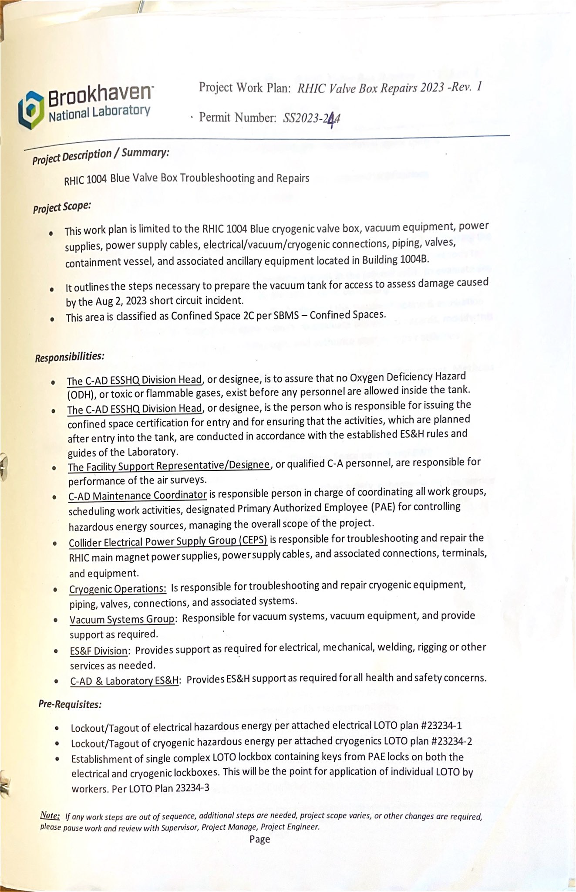
First Planning Steps:
Group meetings to map out plan of action.
Set primary contacts for sub jobs
Begin safety reviews
Define Plans:
Burn permits
Electrical and Mechanical complex LOTO
Confined Space permits
Job execution sequence, schedule
Gather reference material, Associated OPMs, guides

Slide 12
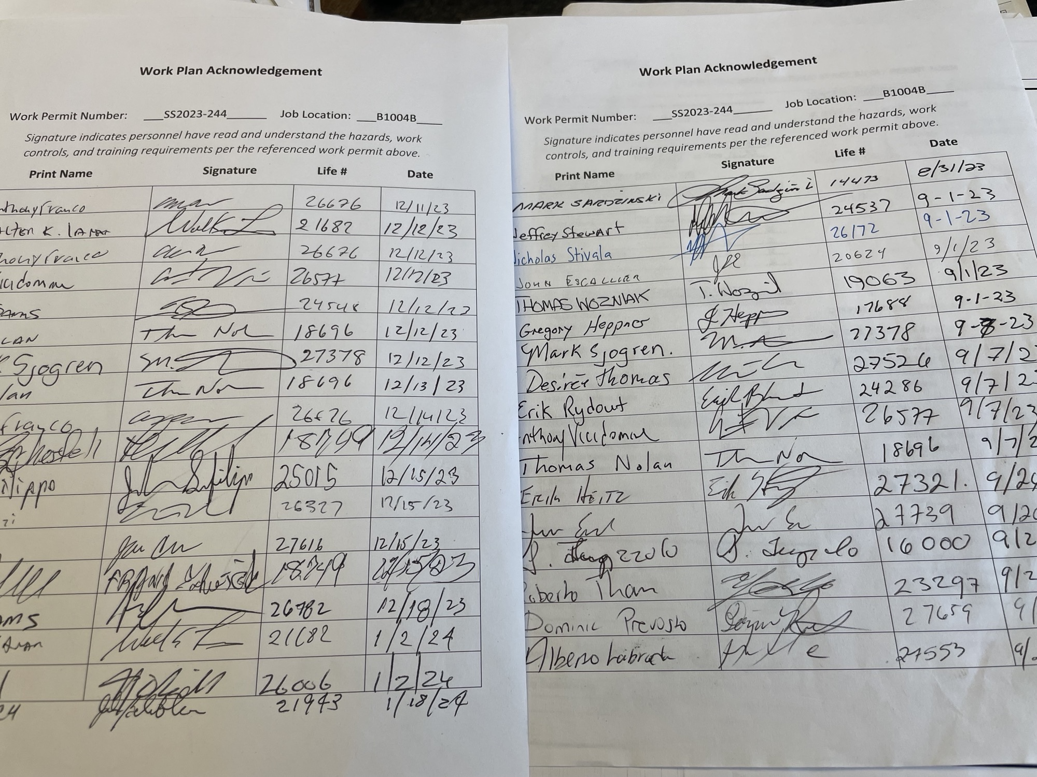
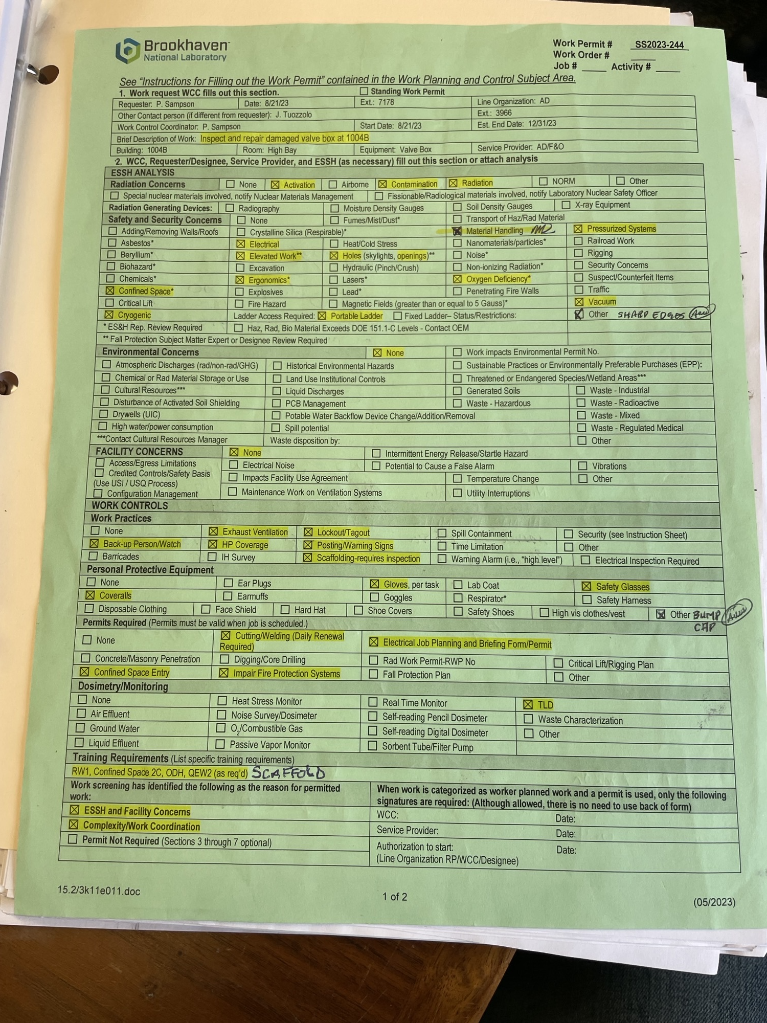
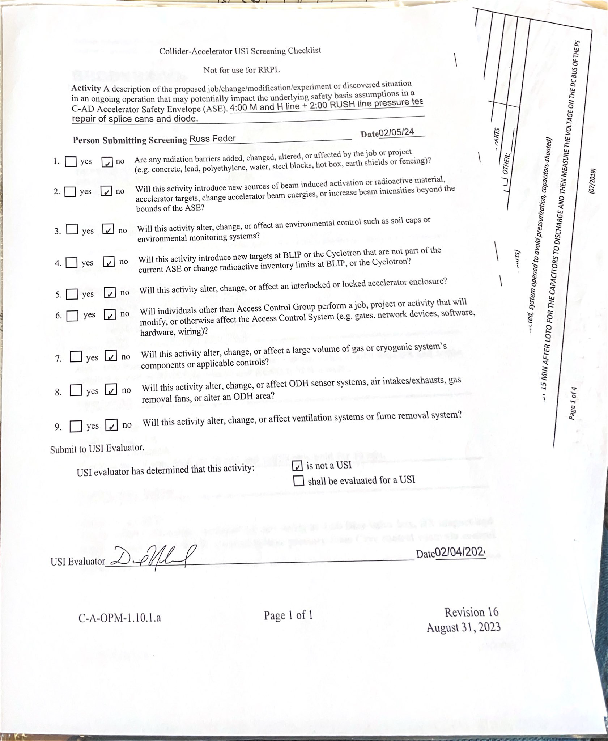
Review
Individual item review: Department and laboratory level
Overall review: Committee of SMEs, Safety, Management
Complete Unreviewed Safety Issue (USI) screen, incorporate findings
Briefings:
Electrical & Mechanical LOTO by Primary Authorized Worker
Overall job briefing
Hazard labeling:
Postings, barrier tape, safety watch

Slide 13
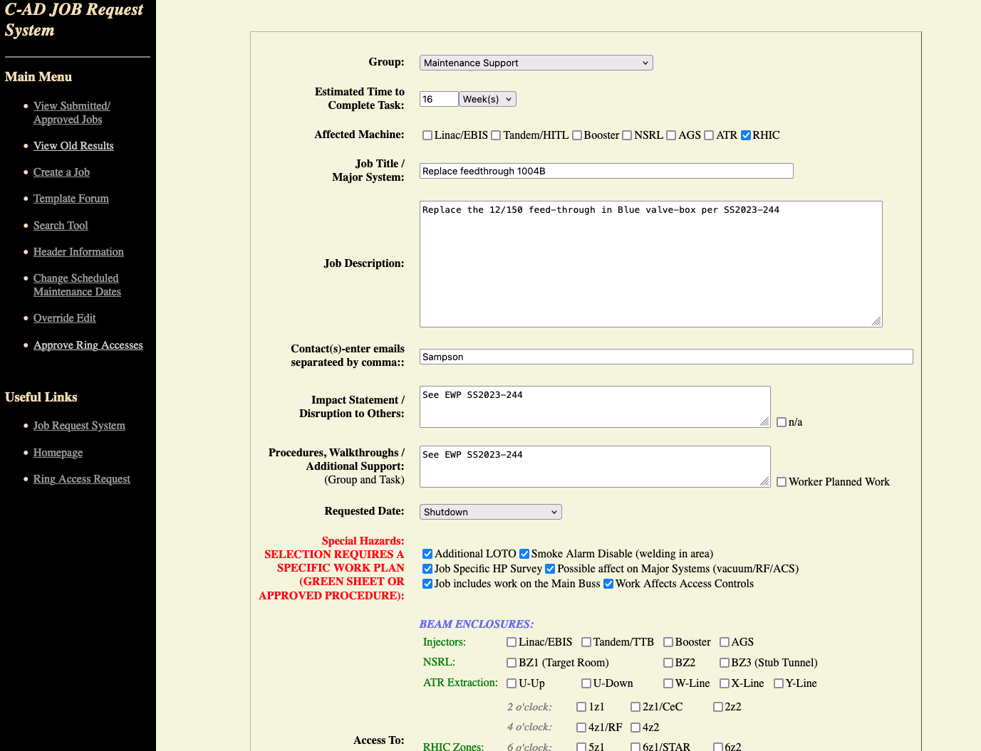
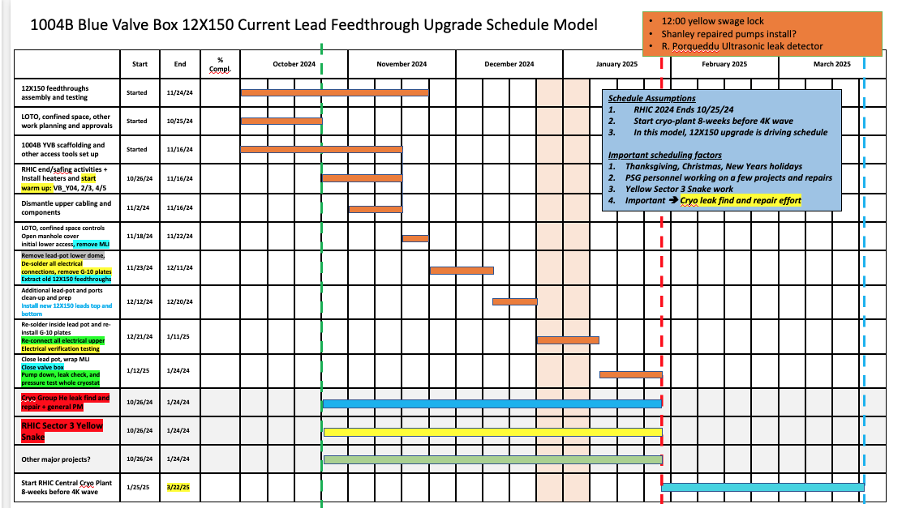
Scheduling and Execution
Submit Job Request, await approval
Line Management approval for job start
Start work!

Slide 14
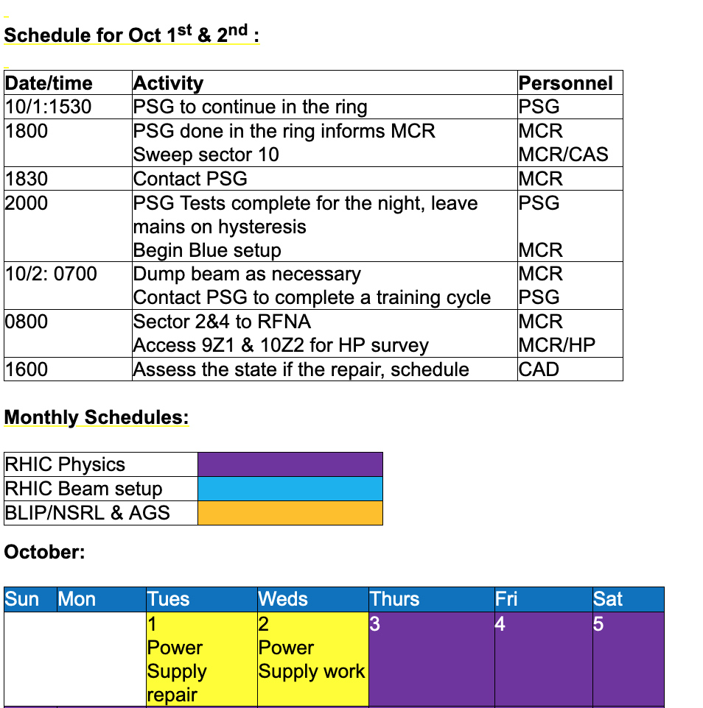
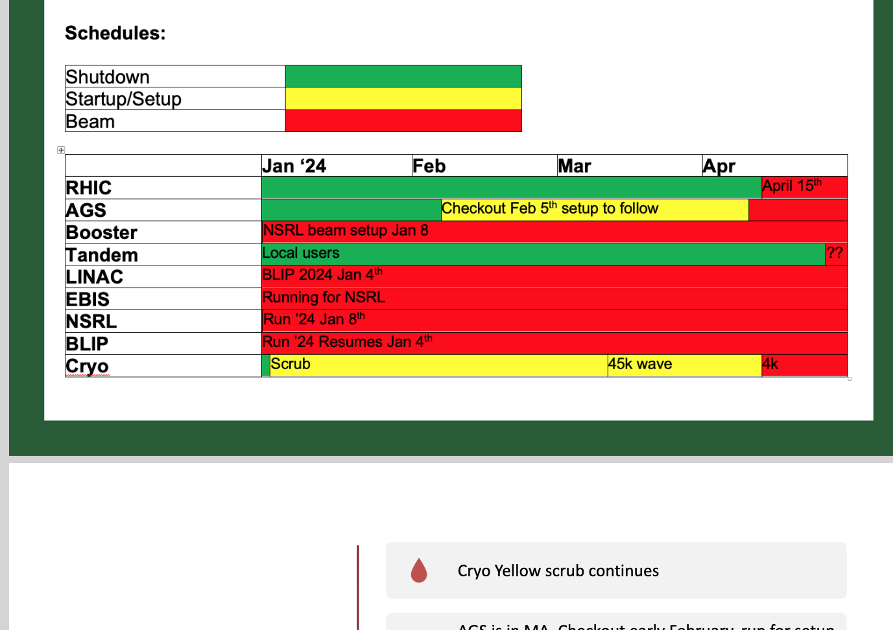
During the work:
Daily Briefings, POD schedule updates.
Weekly Updates at the Supervisor’s and Time meetings

Slide 15
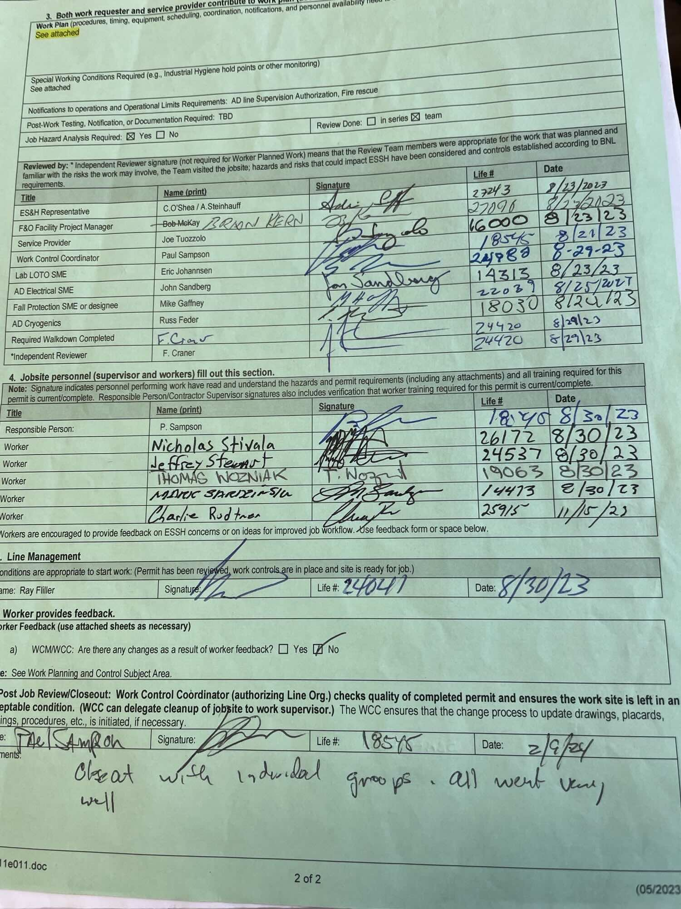
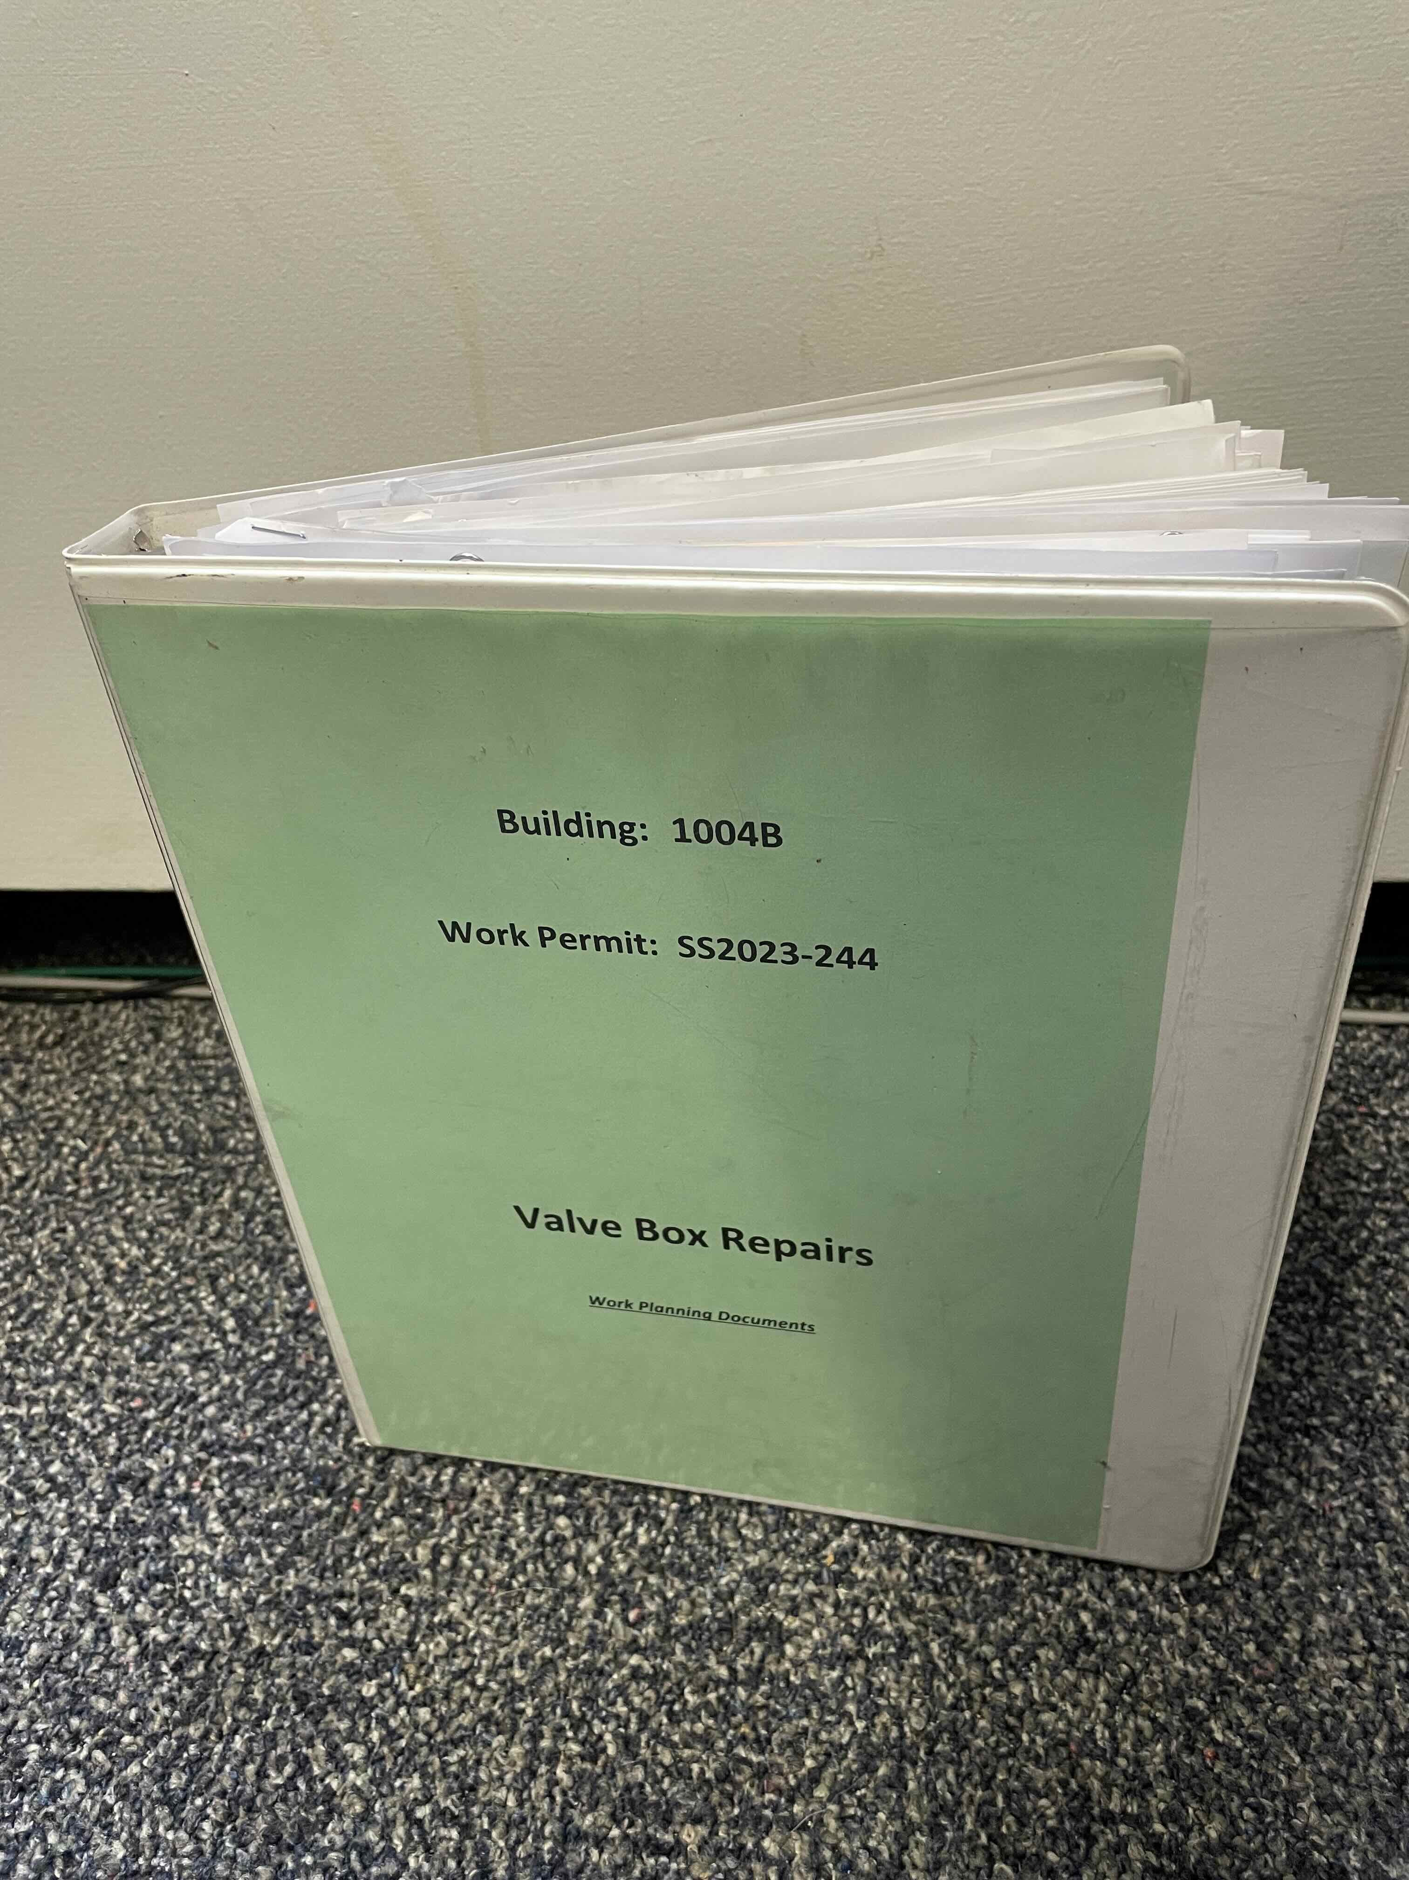
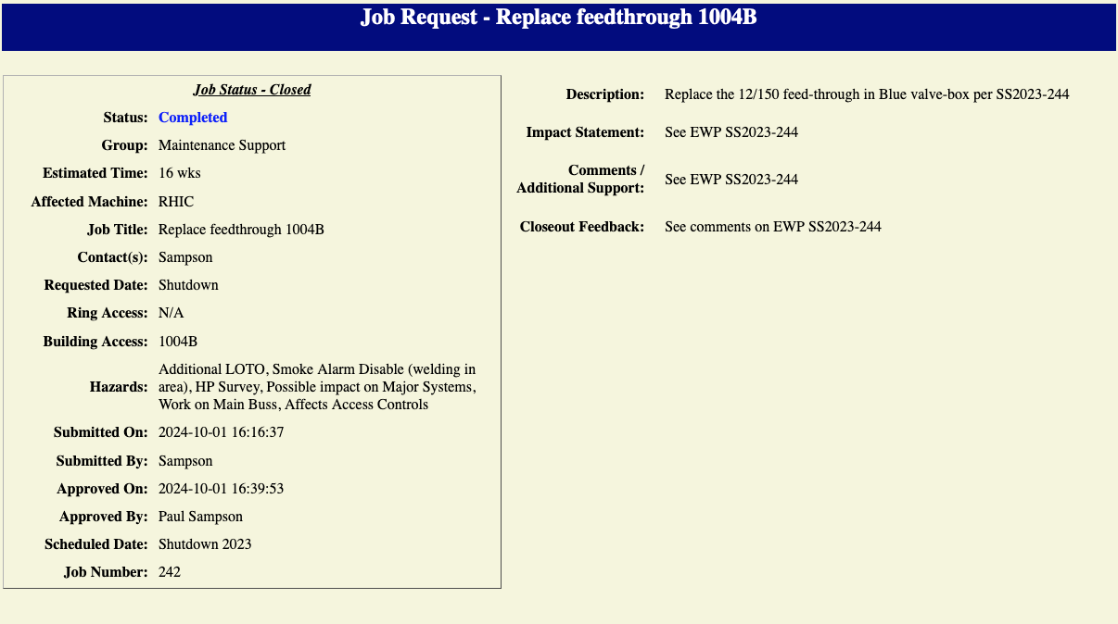
End Game
Final tasks
Testing
Feedback
Closeout
Return to service

Slide 16
Summary:
At CAD, work planning is an integral part of safe and efficient operations
All work, large and small, is planned using standardized architecture
Worker engagement and feedback is encouraged and solicited throughout the process
Tools for work planning continue to be improved and developed to better assist work planners in the process

Slide 17
Thankyou!

