Slide 1
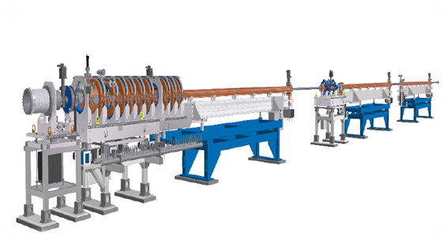
Safety Culture, Work Management, Leadership: Tying it Altogether at the Canadian Light Source!
Accelerator Safety Workshop
October 10, 2024
Tim West, Director of Operations
Grant Cubbon, HSE Manager
Notes:
Good morning.
Today’s safety moment will discuss recent changes to our minimum staff complement at CLS

Slide 2
SAFETY
Every workplace has a safety culture!
a business objective directed at preserving and protecting workers, the public, the environment, and assets against harm…
a business objective directed at preserving and protecting workers, the public, the environment, and assets against harm…
business objective
Safety Culture – Measure of a business objective based on the behavior of workers
Canadian Standards Association (CSA) – N286 “Management Systems”

Slide 3
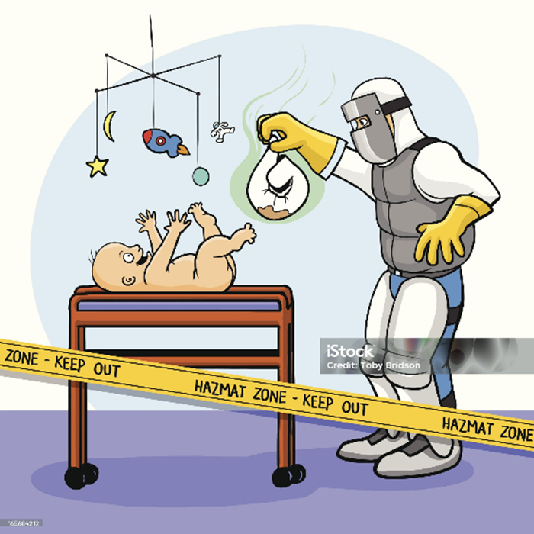
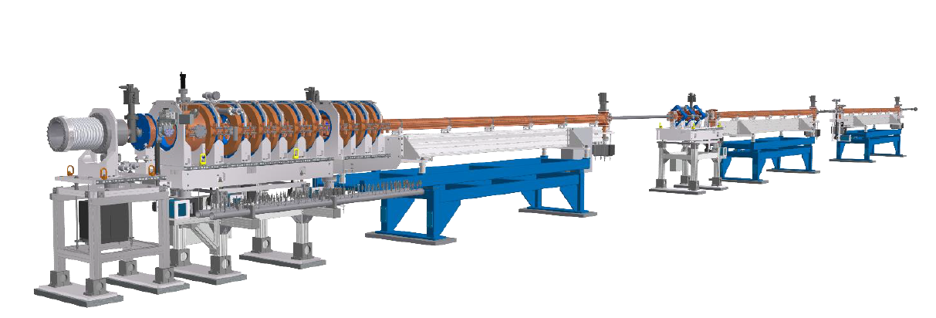
New Linac Announcement Reaction
Safety Manager
Accelerator Physicists
Scientists
Hazard Assessment and Control
Shiny New Toy
Better Beam!

Slide 4
CLS Linac Replacement Project
Why Change the Linac????
Better Beam, Better Reliability!!
Change = Opportunity
What else can we get from the project?
Large project touching many departments
Planning and Preparation
Dismantling
Installation
Commissioning/Testing
Reflection of Workplace Culture
Chance to improve and grow

Slide 5
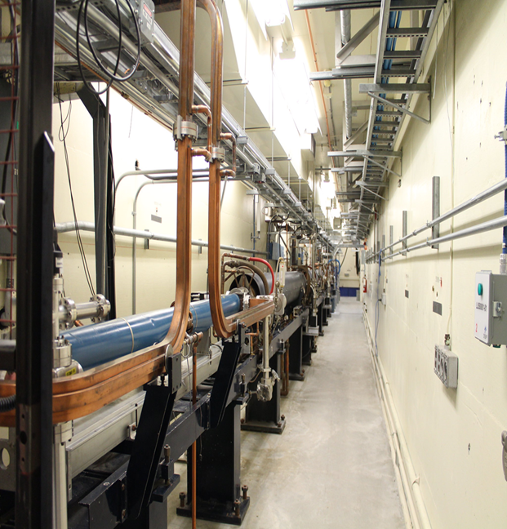
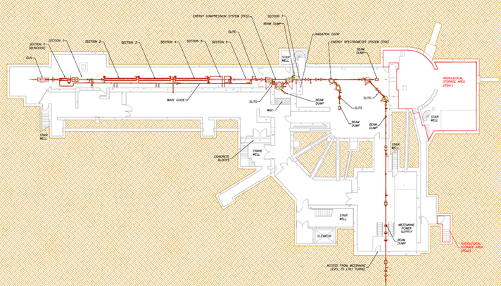
Like For Like Change
250 MeV Linac
Same location
1Hz e⁻ Pulse
RF 2856 3000 Hz
Physically shorter
3 sections from 6 sections
Like for like safety?
Shielding
Lockup
Fire Protection
To Synchroton
LINAC
2 Stories Underground

Slide 6
Technical Values
Parameters | Current LINAC Values | Final Design LINAC Values | Units
Accelerator Particles | electrons | electrons | n/a
Nominal Beam Energy | 250 | 250 | MeV
Minimum Beam Energy in any RF failure mode | 180 | 180 | MeV
Single Bunch Mode Beam charge in 500 MHz Bunch 3 | 0.24 | 1.5 | nC
Single Bunch Mode Bunch Length | 0.003 | 0.003 | ns
Multi Bunch Mode Beam charge per 500 MHz Bunch (adjustable) | 0.08 | 0.08 | nC
Multi Bunch Mode Train Length, 5 to 70 bunches at 500 MHz (2 ns RF buckets) | 1-140 | 10 to 140 | ns
Center energy stability (pulse to pulse) | ≤ 0.1 | ≤0.1 | % (RMS)
Energy Spread | ≤0.3 | ≤0.5 | % (RMS)
Normalized Emittance (1s) (X or Y) | 10 | ≤50 | π m·mrad (1 sigma in X or Y)
Injector Frequency adjustable to | 2856 | 3000.24 ± 0.050 | MHz
Booster Synchrotron RF Frequency | 500.04 ± 0.005 | 500.04 ± 0.005 | MHz
Injector Nominal Repetition rate* | 1 | 1 | Hz
Modulators and Klystrons Repetition Rate | 1 | 1 to 10 | Hz
Pulse to pulse beam position variation (RMS) | 0.2 | 0.2 | mm rms
Pulse to pulse beam angle variation (RMS) | 0.05 | 0.05 | mrad rms

Slide 7
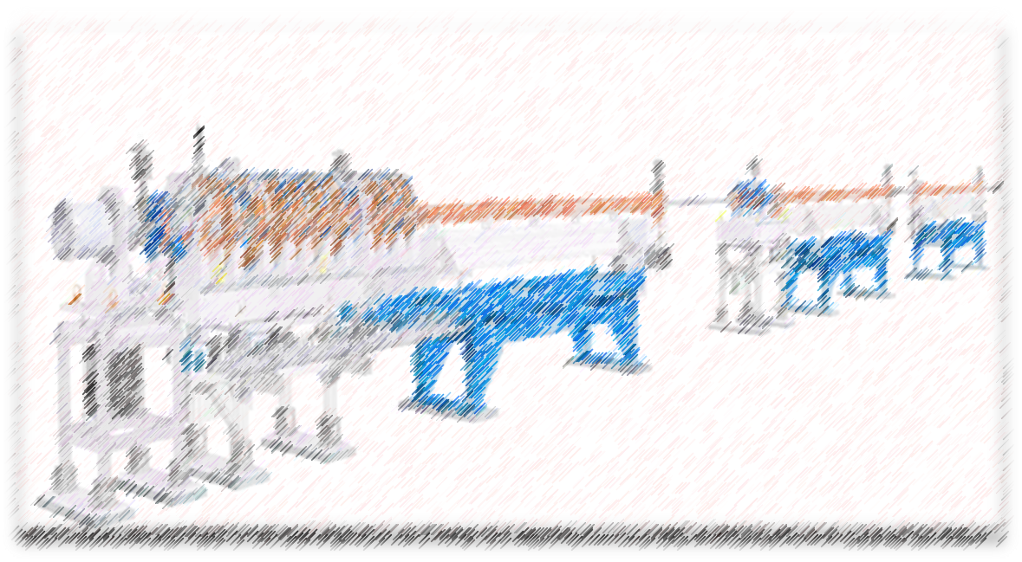
Safety Planning And Preparation
Regulatory
Documentation: “Like for Like Change”
No Licencing concerns!
Worker Safety
Hazardous Building Materials Assessment
Residual radiation surveys
Dismantling Plan
Logistics and storage plans
Daily Tool-Box Meetings

Slide 8
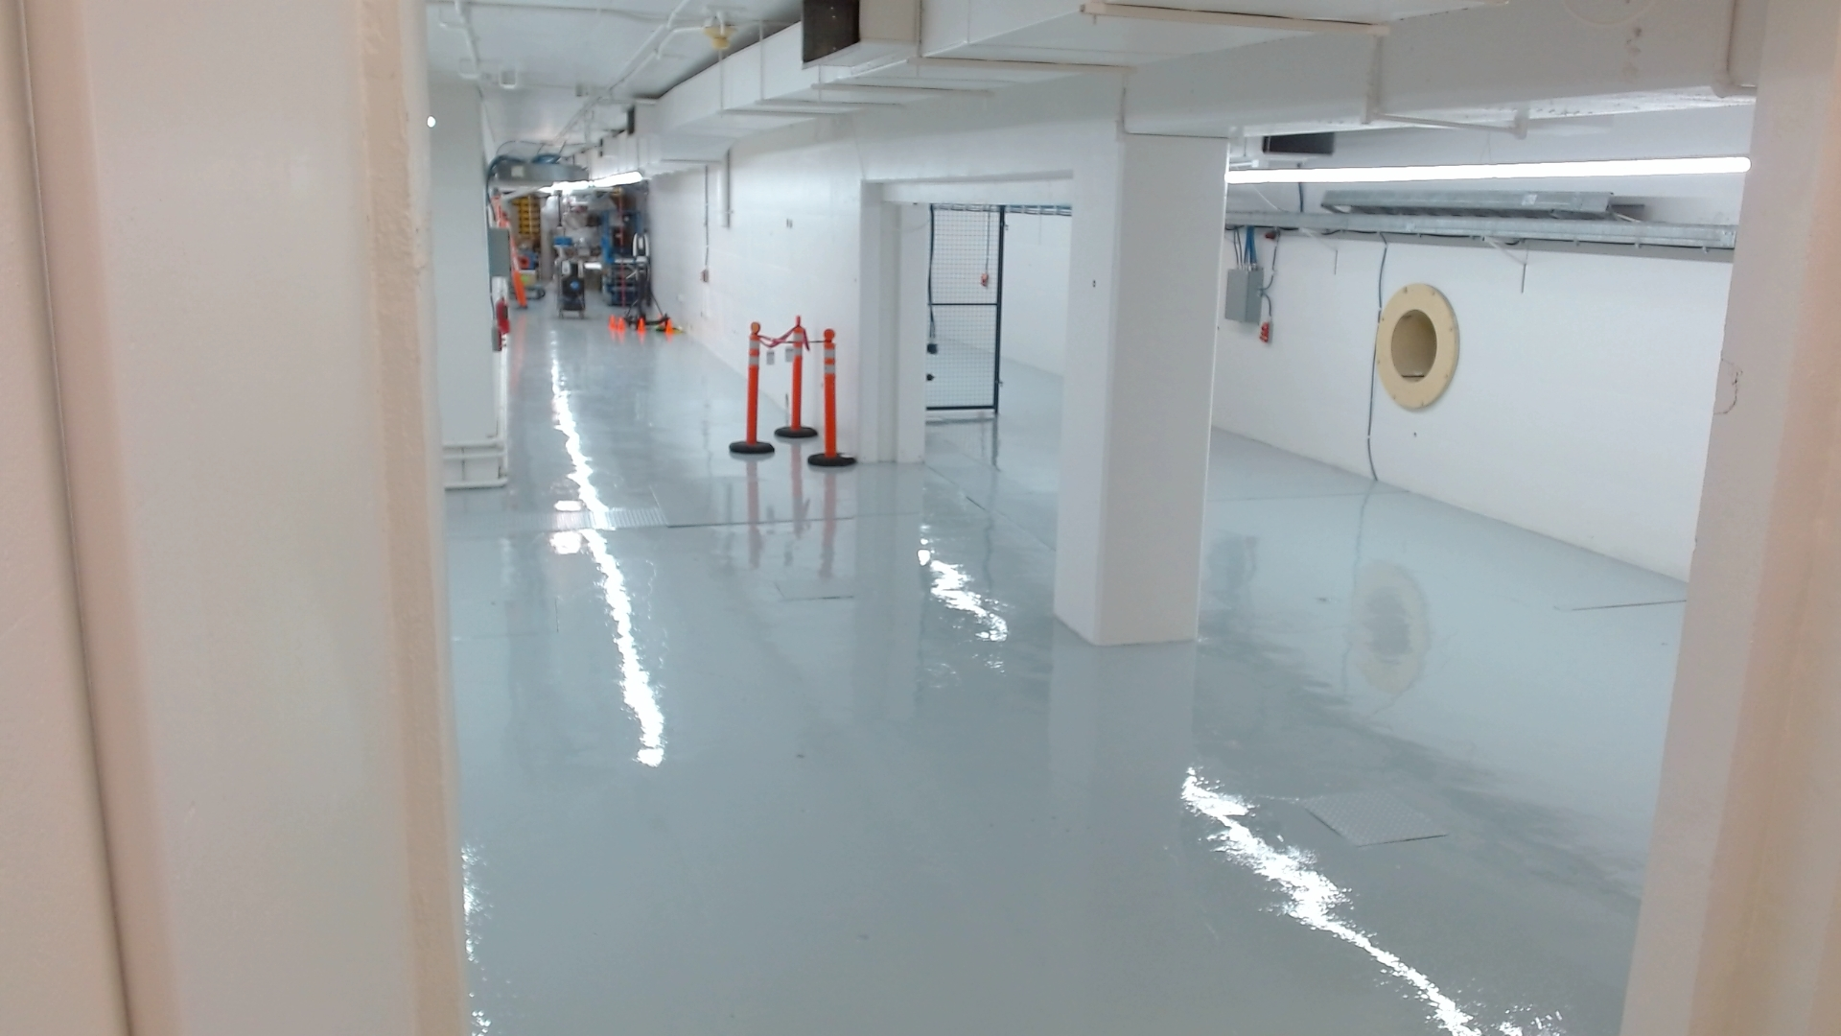
Out with the old linac!
Gone in 3 Days!
2 weeks allotted as contingency
Radiation Surveys kept pace
Logistics kept pace
All due to good preparation!
No injuries
No minor injuries, no near misses
Compliance
Limits on total occupancy in linac area
Hot work permits/requirements
Lockout/Tagout (Control of Hazardous Energy)
Worker PPE Requirements
Linac Hall After!
Notes:
Operator debate:
‘0’ came from a synchrotron where grad student injected beam in morning then went to classes
Other synchrotrons required 2 operators in control room when operating
Senior Operator – learned to operate during commissioning years
‘volunteer’ was any staff member who took training to perform basic operations (enable RF, inject beam, reset simple issue, how to get help)
Smooth operator t-shirt as humor for reward for being volunteer operator
T-shirt was not actually presented
Floor Coordinator
2005 Volunteers at first were science staff who were on-site anyway commissioning their beamline
2011: Casual were student hired to take mostly overnight and weekend shift
2011: 3 full time permanent FC positions added
2016: 4 Permanent FC’s moved to HSE department
D-Shift Safety – HSE staff only

Slide 9
Perfection?
Storage Issues
Several storage non-conformances
All resolved promptly when raised
Reminders in daily meetings
Signs and Barriers
Linac removal resulted in partially uncovered sump - poorly marked
But no big surprises…

Slide 10
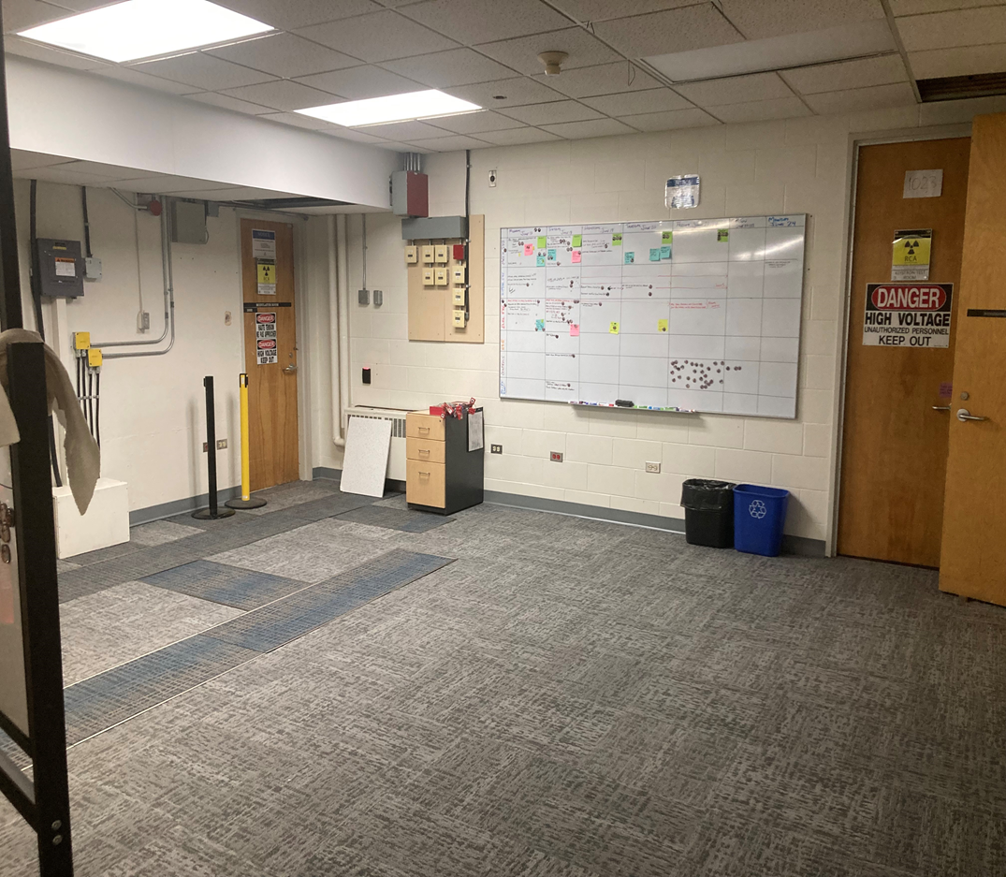
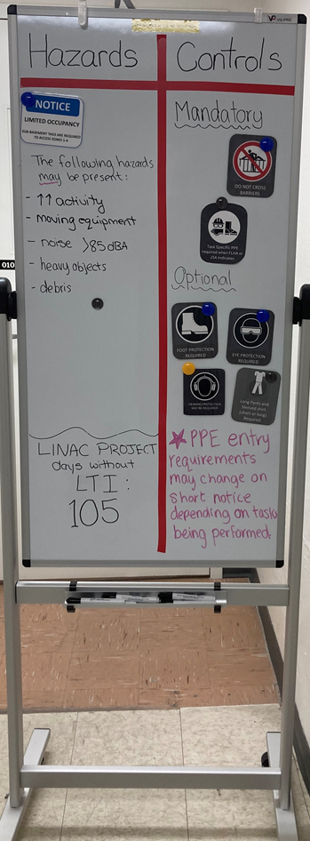
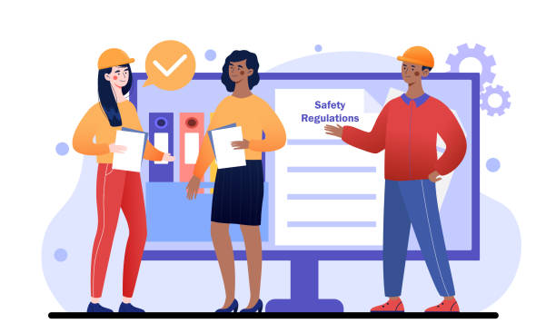
Communication
Communication of work, change, and safety concerns through:
Daily Tool-Box Meetings
8am, 3:15pm leads + Managers
Signs
‘SLACK’ channels
Reporting Systems
Hallway meetings
Reinforced the message!!!
Meeting Room
(Standing Room Only!)

Slide 11
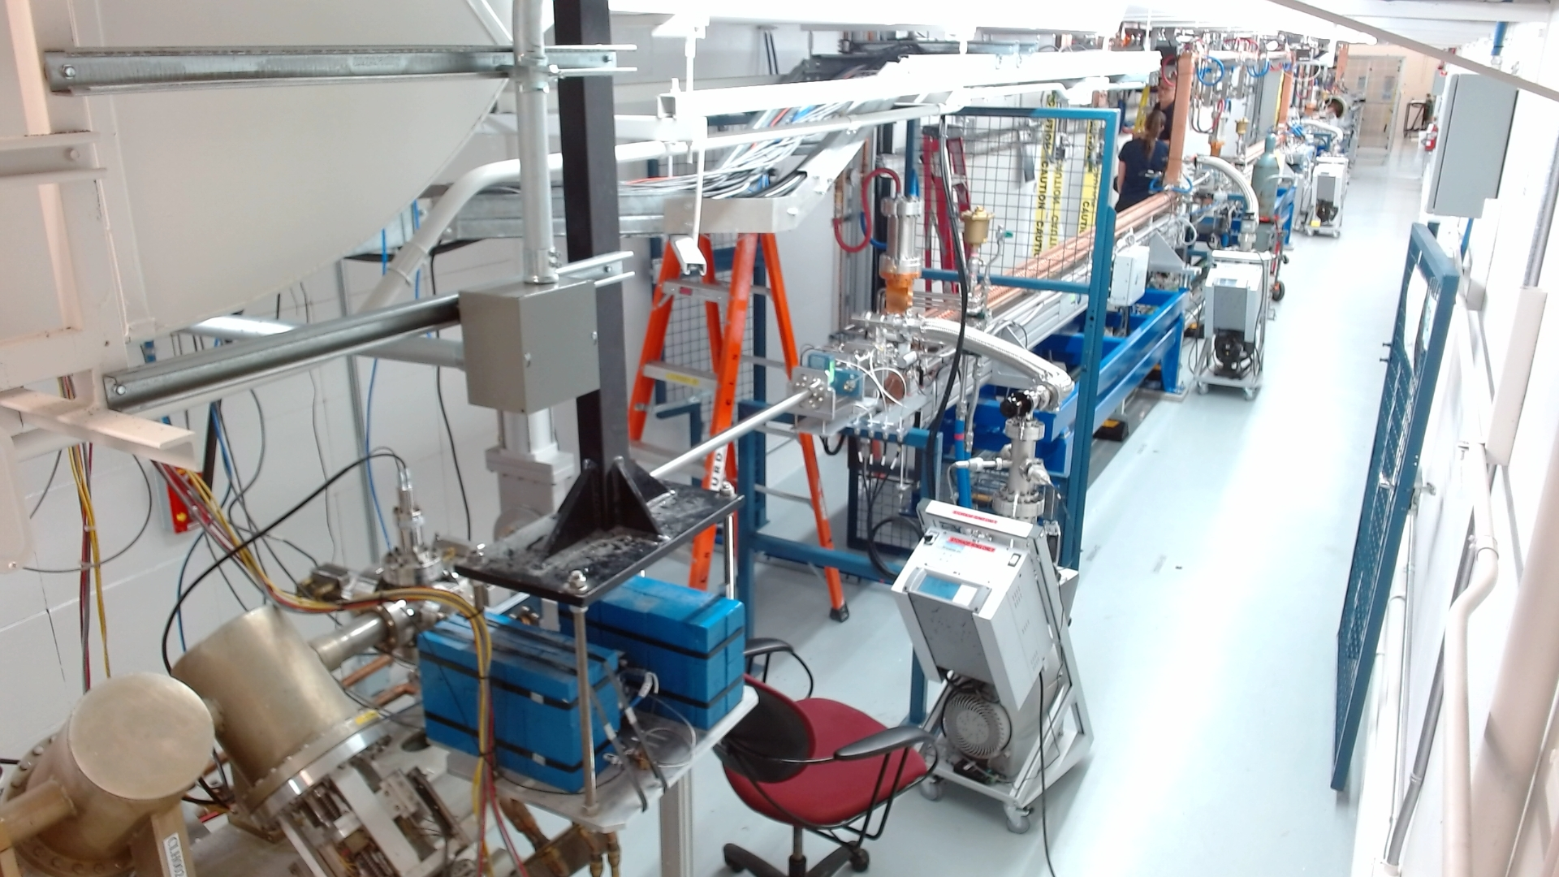
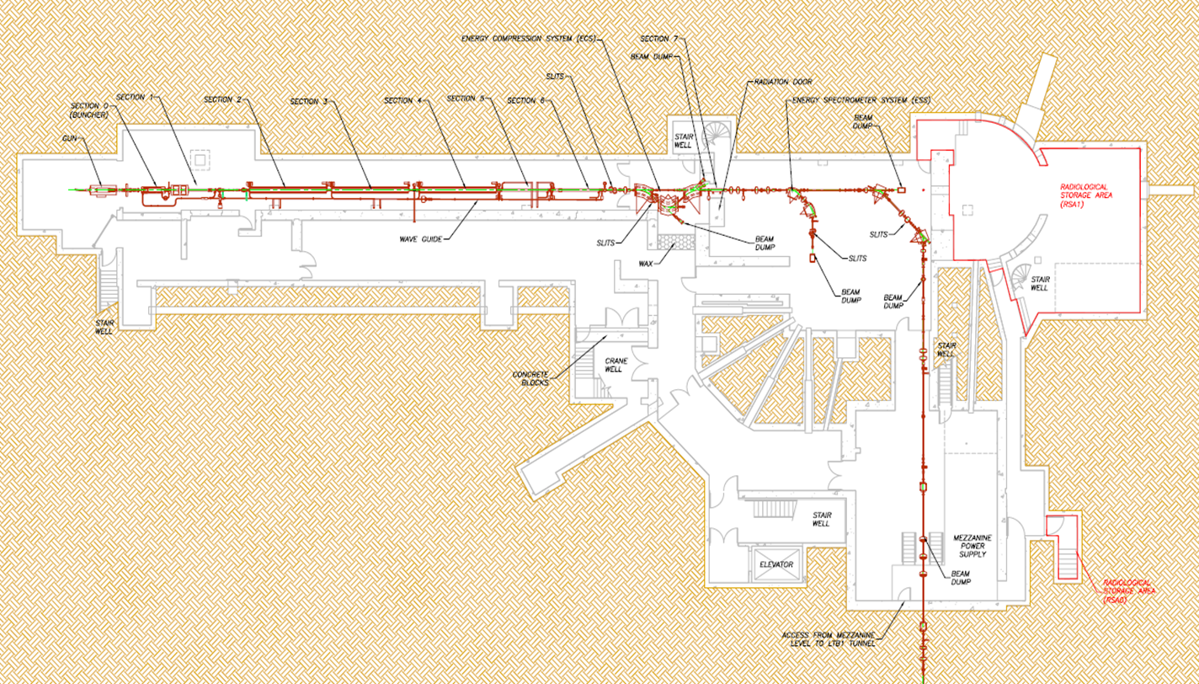
CLS Linac Hall Before/After
LINAC
To Synchroton

Slide 12
Observations
Ongoing safe work practices
105 lost time injury free days
Lesson’s learned for future project success
Individual growth
So what will we get from the project?
Growth, improvement,
AND……
A new Linac!!!

Slide 13
Culture of Safety
HSE Culture Ladder
P. Hudson / Safety Science 45 (2007) 697–722
Notes:
Lead by example – transparency and accountability
Communicate regularly
Ask for improvement ideas
Empower employees
Emphasize the importance of small, incremental improvements
Help share ideas and improvements
Celebrate the results
Encourage participation by keeping the methodology simple
https://ccitracc.com/inspire-a-culture-of-continuous-improvement/
P. Hudson / Safety Science 45 (2007) 697–722
https://safetyculture.com/topics/continuous-improvement-culture/

Slide 14
Leadership Philosophy/Style
Self-Discipline,
Humility,
Perseverance,
Curiosity and
Willingness to Change
In a integrated and intentional manner:
Plan, know, control, and improve your business
Know and grow your people
Management System
Notes:
The management system brings together in a planned and integrated manner the processes necessary to satisfy the requirements that must be met to achieve business success and sustainability.
N286-12 - CSA

Slide 15
Leader Standard Work (LSW)
Gemba Academy - 2024

Slide 16
Leadership Philosophy/Style
Culture of
Safety & Continuous Improvement
Leader Standard Work (LSW)
And…successful execution of the Strategic Plan!
Management System
Notes:
CHATGPT - In summary, the link between a management system and Leader Standard Work is essential for ensuring alignment, effective implementation, continuous improvement, and a feedback loop within an organization. By integrating Leader Standard Work into the management system, organizations can enhance their ability to achieve their strategic objectives, drive operational excellence, and adapt to changing circumstances effectively.
Continuous Improvement: Both a management system and Leader Standard Work are essential for fostering a culture of continuous improvement within an organization. The management system establishes the processes and mechanisms for identifying, analyzing, and addressing areas for improvement systematically. Leader Standard Work complements this by facilitating regular Gemba walks, performance reviews, problem-solving sessions, and other activities aimed at driving continuous improvement at the frontline level. Together, they create a dynamic environment where improvement becomes an inherent part of the organization's DNA.
Feedback Loop: Leader Standard Work provides leaders with opportunities to gather feedback, monitor performance, and assess the effectiveness of the management system. Through activities such as Gemba walks and performance reviews, leaders can identify gaps, bottlenecks, and areas of improvement within the organization's processes and systems. This feedback loop enables leaders to make informed decisions, refine the management system, and drive sustainable improvement over time.

Slide 17
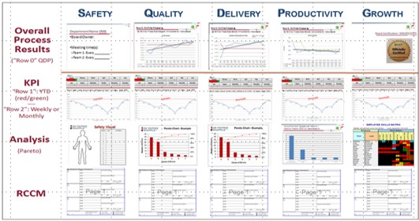
Types of Leader Standard Work
Daily Huddles
Status Exchange (1:1)
Notes:
https://www.linkedin.com/pulse/daily-huddle-meetings-rock-shannon-barrett/
https://www.notta.ai/en/blog/one-on-one-meeting-guide
Gemba Walks (Purposeful walk abouts)
Process Reviews
Team Meetings
Performance Meetings

Slide 18
Safety Domains
Leader Standard Work
Past Harm
Has work been safe in the past?
Status Exchange (1:1)
Sensitivity to Operations
Are workers safe today?
Daily Huddles
Gemba Walk
Anticipation and Preparedness
Will work be safe in the future?
Performance Meeting
Reliability
Visual Management
Are systems/processes reliable?
Process Review
Integration and Learning
Are we responding and improving?
Notes:
Past, Present, Future, Reliability and Learning

Slide 19
Safety Integration into Leader Standard Work
Go see the area and process where an injury occurred
Go see the area and process where a safety concern/issue exists
Go see the area where there a new or upcoming change (process, equipment, etc.)
Go see how a team has worked through a safety problem and made improvements
Go see why a process isn’t happening the way it is supposed to

Slide 20
Has there been a safety issue in the last 24 hours?
What is the work today and are there any safety concerns?
Is there any upcoming work or changes that could pose safety risks?
Is there any work not happening according to plan?
What safety improvements have been made and can be shared?
Integrate and overlap across LSW to ensure visibility, accountability, coaching, etc. on safety
Make it a habit – the normal way of operating / doing work!

Slide 21
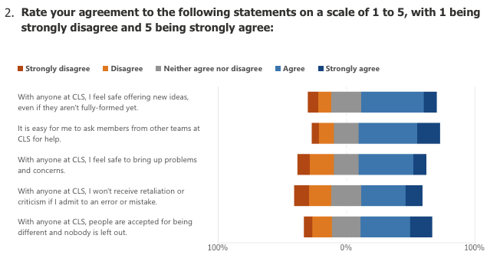
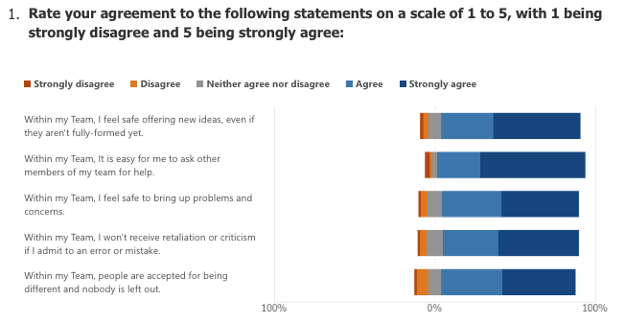
Integrate Safety Data into LSW
Notes:
Also talk about the SRS info, building a IRS system etc.

Slide 22
Implementation Process at Canadian Light Source FY2025 – FY2027
Executive Team buy in and ownership
Leaders Teaching Leaders
Build capacity for leaders to focus on being leaders
No meeting zones, supports, etc.
Partner with University (Usask) to provide fundamental training
Leadership, Operational Excellence (CI), etc.
Internal training sessions to align training to LSW
Coaching of Executive Team
Scale and spread to Managers (then supervisors)
Notes:
Leaders should have their SW with them virtually all the time, whether on a clipboard, printed on a card, in a daily planner etc.
The leader should note completion of the indicated tasks on the standard work form. When they are unable to complete a task in sequence, on time, or at all, they should specifically not it and record why.
Leaders should use the SW document to record daily notes, observations, requests for follow up etc. They serve as a communication vehicle for the leaders supervisor. The leader turns in each day’s document to his/her supervisor who quickly reviews it to pick up any actions requested by the subordinate and note the nature of the subordinate’s response to abnormalities in his/her areas. Often, “turning in” SW means filing it in a visual display. This signals completion of SW for that day and makes the docs readily available in a single location for the supervisor to scan quickly.
As part of the weekly gemba walk, the Director pulls the managers previous weeks SW for a brief review
Barriers:
Capacity
Understanding
Self-Disciple, humility, perseverance, curiosity and willingness (key principles/behaviours)
Remember, they all do LSW to some degree already. Beyond heroes and firefighting to a reliable system based on trust, accountability and safety.

Slide 23
Thank-you!

