Slide 1
Second Target Station at Oak Ridge National Laboratory
Aaron Jacques, Joseph Tipton, Joel Montross, Justin Mach,, Thomas Mcmanamy, Min-Tsung Kao, Yong Joong Lee, Lukas Zavorka, Kristel Ghoos, Lukas Bearden
Presented by:
Daniel Lyngh
Group Leader – Neutron Production Systems, STS
Accelerator Safety Workshop, October 10, 2024

Slide 2
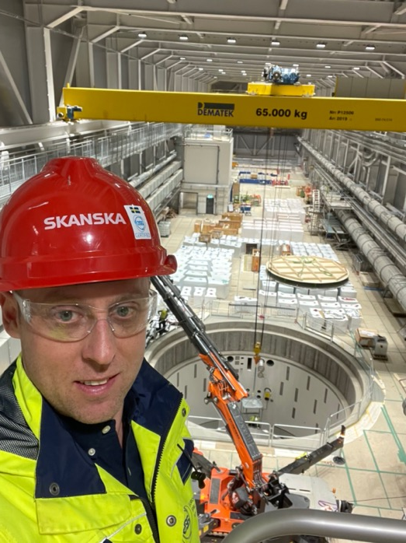
About Me
Group Leader - Neutron Production Systems at ORNL since 2021
Mechanical Engineer with 20 years in mega projects:
Work Package Manager/Senior Engineer – European Spallation Source
Project Manager – Aker Oilfield Services
Mechanical Design Engineer – Rolls Royce/Aker Subsea
Master of Science from University of Lund
PMI Certified PMP

Slide 3
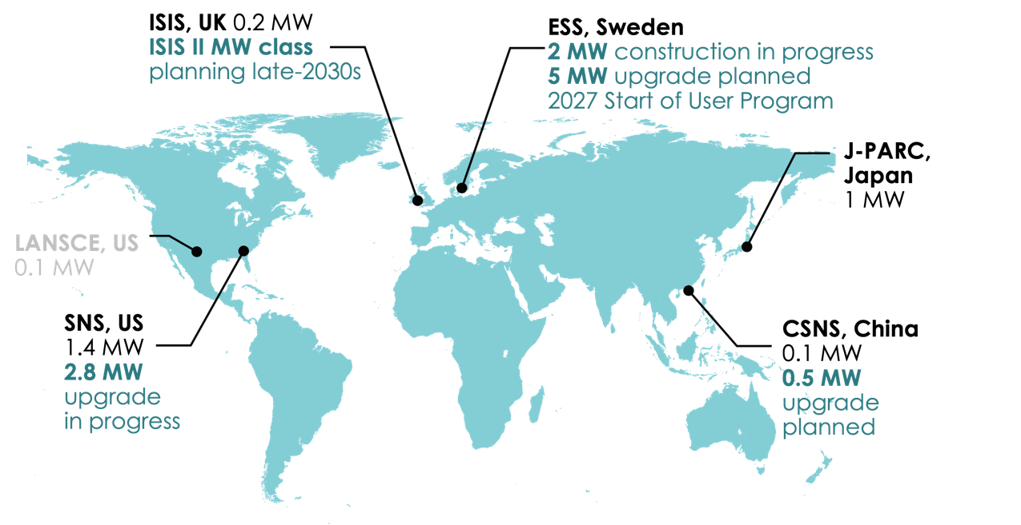
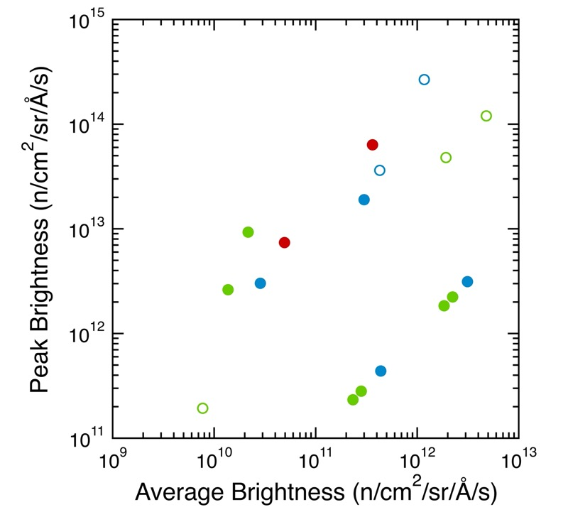
STS will close the neutron capability gap and ensure that the US will remain a global leader in pulsed neutron science
λ = 5 Å
USA
short-pulse
Asia
SNS-STS
ESS (5 MW)
Europe
Planned
Existing
J-PARC
SNS-FTS (2 MW)
ESS (2 MW)
SNS-FTS
ISIS TS2
CSNS
long-pulse
HFIR
ISIS TS1
LUJAN
FRM-II
ILL
NIST
SONATE (est.)
PSI
steady-state
ORPHEE
Other nations are investing in spallation neutron sources

Slide 4
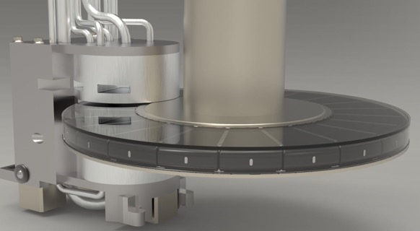
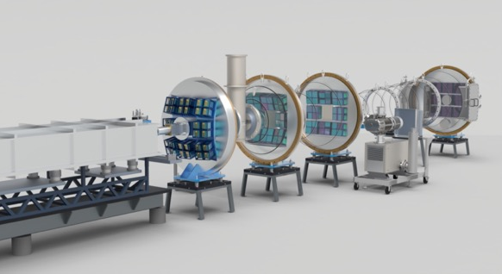
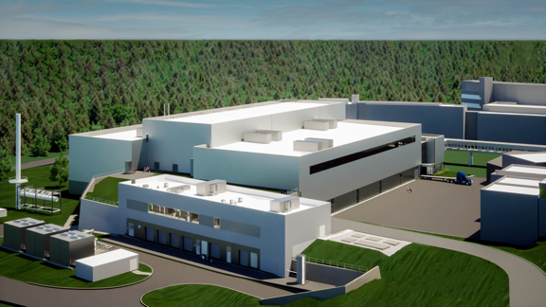
STS scope is well-defined to deliver world-leading capabilities
Accelerator
Target
Instruments
Conventional Facilities
Integrated Controls
Transport protons to STS operating at 15Hz
Independent operation of First Target Station (FTS) and STS
Solid rotating water-cooled tungsten target
2 high brightness, supercritical H₂ moderators
Provide capability for ~20 instrument end stations
8 instruments included in STS scope
~220k sf of new infrastructure
RTST tunnel
Central Services Building
Target & Instrument Building
Control systems and computing infrastructure
DAQ for neutron instruments
Tungsten target
CENTAUR instrument
STS buildings
Notes:
So the Accelerator extracts the beam from the existing High Energy Beam Transport line at SNS and transports the beam to the second target station. It, along with the integrated controls, also provides the capability to operate the FTS or STS independently.
The spallation source is a rotating tungsten disc with high brightness supercritical moderators above and below the Target
There will be 22 beam lines available at the facility, with five beam lines built within the project
Conventional Facilities provides 9 new buildings on the SNS site with 350,000 gross square feet, including three Instrument Halls meant to house the end stations for three different length categories for beam lines – 40 m, 50 m, and 90 m
Integrated Controls provides the control system and computing infrastructure for the entire STS and performs the Data Acquisition for the neutron scattering instruments

Slide 5
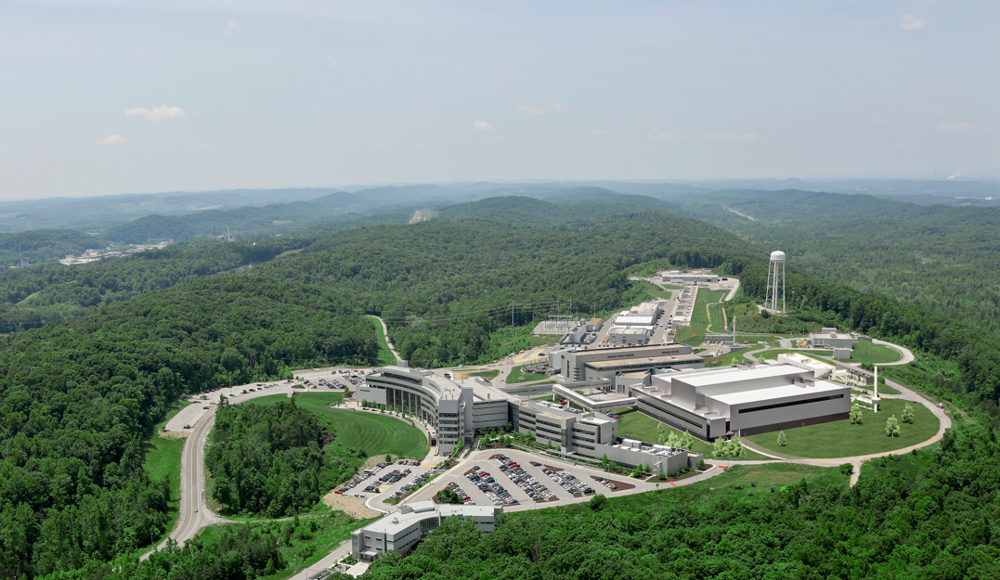
SNS upgrades will accelerate scientific progress and deliver wholly new capabilities
Proton Power Upgrade (PPU) project: Double the power of the existing accelerator structure
First Target Station (FTS) is optimized for thermal neutrons
Increases the brightness of beams of pulsed neutrons
Provides new science capabilities for atomic resolution and fast dynamics
Provides a platform for STS
Second Target Station (STS) project: Build the second target station with initial suite of beam lines
Optimized for cold neutrons
World-leading peak brightness
Provide new science capabilities for measurements across broader ranges of temporal and length scales, real-time, and smaller samples
Complete 2037-2039
Notes:
SNS was planned from its outset to be upgraded to operate at higher power and to share this power with a second target station.
The Proton Power Upgrade, or PPU, project, which is a totally separate project from STS, will double the power of the SNS accelerator.
PPU is well underway and they are already assembling cryomodules and building infrastructure
I should also mention that the First Target Station is optimized for thermal neutrons and with the PPU power increase it will be among the brightest sources of thermal neutrons in the world
The STS Project, which is outlined in yellow on this artists concept of the SNS site, is the subject of this review. STS will be optimized for cold neutrons, in-line with its Mission Need.
In fact, as I will show in a later slide, STS will achieve the highest brightness of cold neutrons in the world, which will provide scientists the capability to make measurements across a broader range of length and time scales and to examine smaller samples

Slide 6
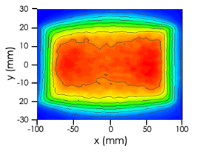
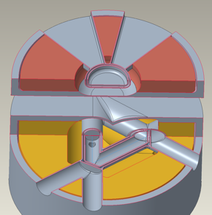
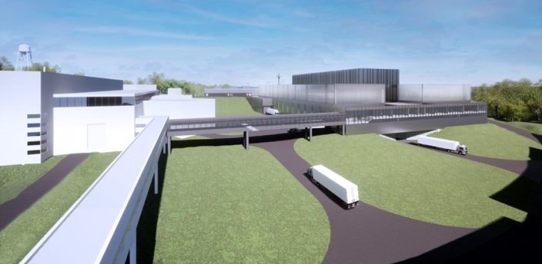
STS combines advanced technologies to deliver new science capabilities needed to understand more complex materials, processes, and devices
Start with the world’s most powerful hadron accelerator – the SNS
Use the accumulator ring to compress the proton pulse
Add optics & transport to produce uniform proton spot size on the target
Add rotating, segmented solid-tungsten target
PPU upgraded SNS
46.7 kJ/proton pulse
60 Hz, 2.8 MW capable
1 msec linac production compressed to < 1 μsec
Spreads heat load over larger volume with longer lifetime
STS proton area = 60 cm²
FTS proton area = 140 cm²
Add low dimensional moderators, tightly-coupled to neutron production zone
Add science-driven, optimized instrument designs
Next generation neutron facility with science capabilities needed for materials innovation: materials discovery & materials in-action.
8 initial STS instruments, latest technologies, integrated controls, scientific software, proposed by and selected with the user community
Two high-brightness, geometrically-optimized moderators (cylinder & tube)

Slide 7
STS will make optimal use of the PPU-upgraded SNS accelerator capability
1 out of 4 proton pulses
15 Hz
700 kW
Accumulator Ring
60 Hz accelerator
46.7 kJ/proton pulse
2.8 MW capable
Ion Source
Linac
Second Target Station (STS)
Short pulses at 15 Hz enables simultaneous measurement across broad wavelength range (Δλ =13.2 Å at 20 m from source)
Complementarity with FTS – uses all available accelerator capability provided by PPU
Flexibility will be provided to operate both FTS and STS at the same time or separately if either is shutdown
First Target Station (FTS)
3 out of 4 proton pulses
45 pulses/sec
2 MW
*animation courtesy of Matt Stone
Notes:
Both the first and second target station make use of the same accelerator infrastructure of the SNS. Negatively ionized hydrogen atoms are accelerated along the linear accelerator up to about 90% of the speed of light. The particles pass through a foil which strips them of their electrons, leaving just a positively charged proton. The protons are injected into a storage ring and further accelerated and bunched together into pulses. These pulses then are sent to the liquid mercury target of the first target station to produce neutrons. The second target station will use the same accelerator, but operate at a rate of 15 Hz. So one in four of the first target stations pulses will be sent to the second target station. To compensate for this loss of neutrons at the first target station, the linear accelerator is currently going through a power upgrade to operate at up to 2 MW peak power compared to the current 1.4 MW.
Both of these target stations can operate independently If the first target station is under a maintenance outage, the second target station can continue to operate.

Slide 8
STS Schedule

Slide 9
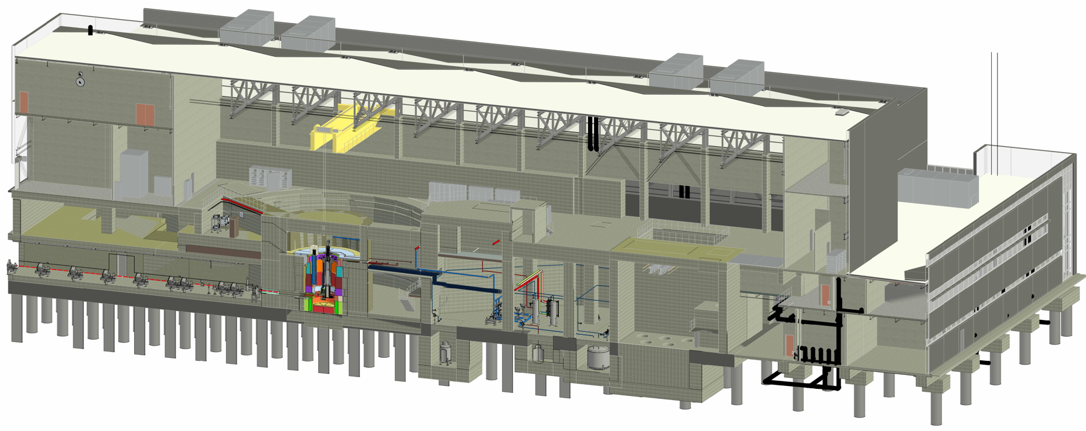
Target Systems visual scope
Cryogenic Moderator System rooms
Target drive room
Service cell
Mock-up test stand
Monolith
Delay tank & gas-liquid separator cavities
Hot process vault

Slide 10
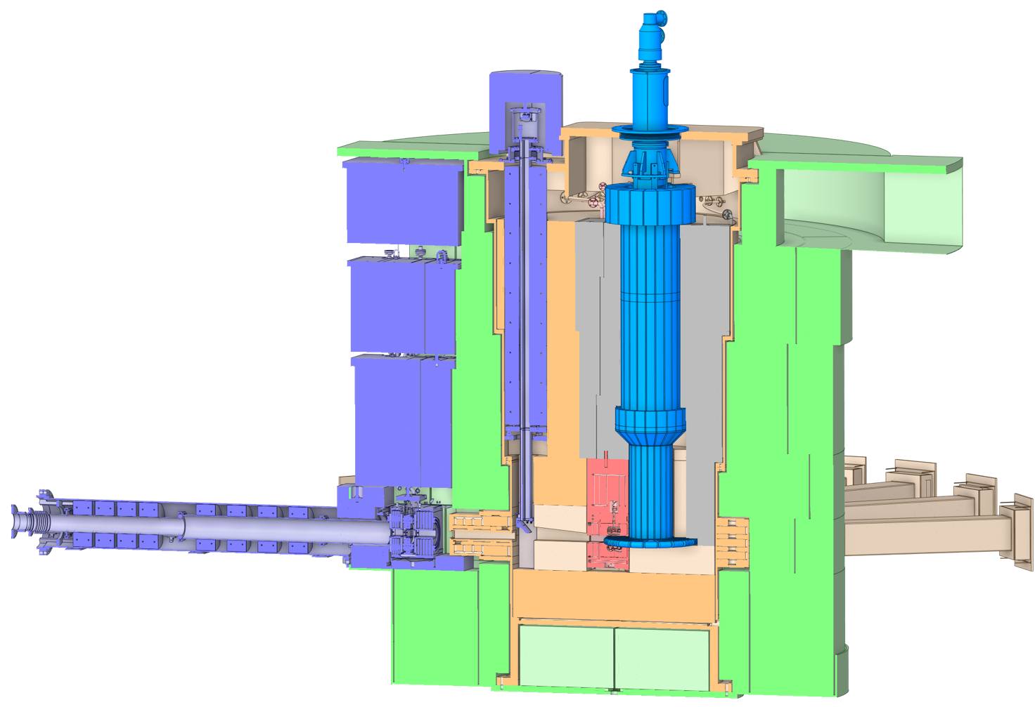
Monolith visual scope
Rotating target drive
Target Viewing Periscope
Core Vessel
Core Vessel Shielding
Rotating target shaft
Bulk Shielding
Moderator Reflector Assembly
Rotating target
Proton beam window

Slide 11
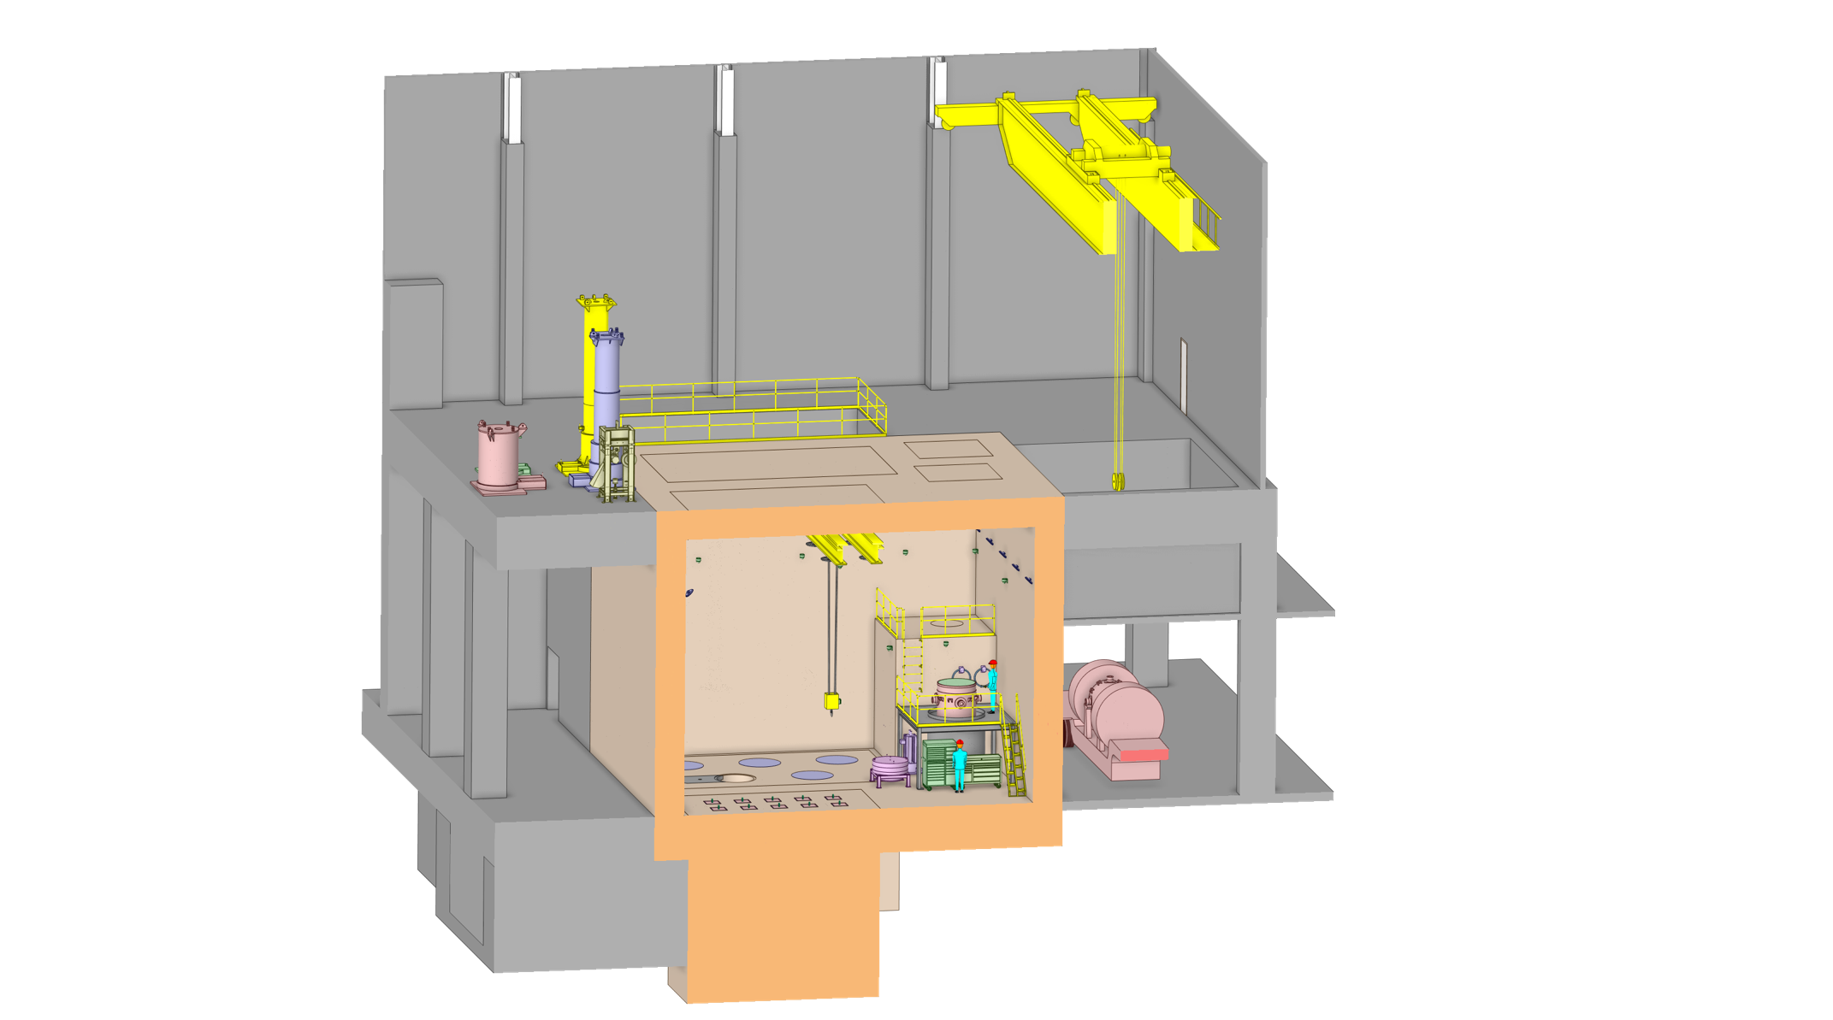
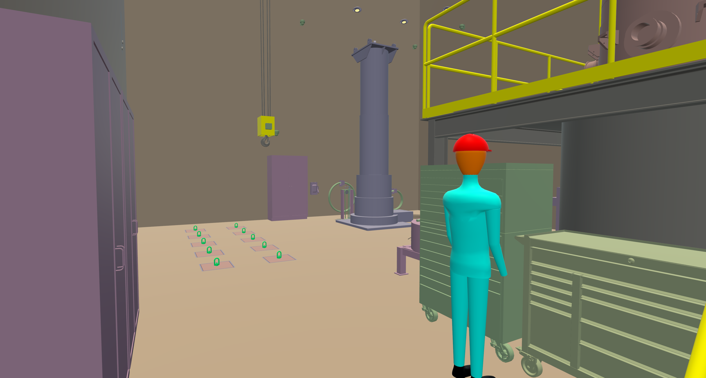
Remote Handling Waste Processing Facility

Slide 12
Second Target Station at ORNL

Slide 13
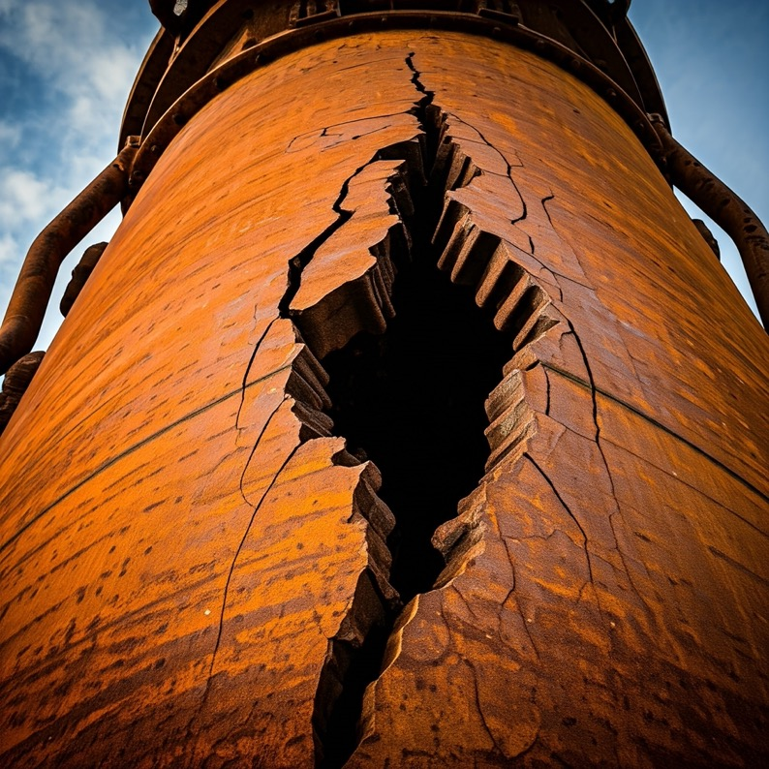
How SAFE can we make a neutron spallation target?

Slide 14
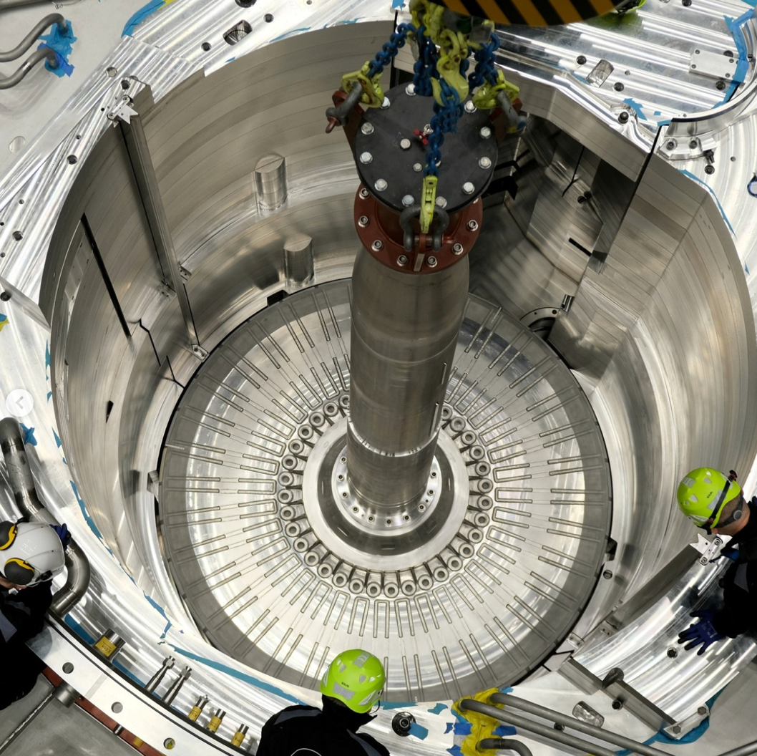
All Targets fail?
Overheating
Water-leaks
Mercury-leaks
Cracks
Fatigue
Cavitation
Notes:
There has historically been many failed targets at the spallation sources. Failed targets generally results in halted operation of the science factories upsetting users as well as sponsors.
ISIS - Tungsten Tantalum Shroud punctured by beam, Tungsten isotopes in the cooling water
PSI - Cracked Target Cannelloni
SNS – Failed targets in many forms, cavitation, fatigue, mercury leaks.
Additionally they are generally difficult & Expensive to build
For example the ESS target which consists of 36 cassettes of tungsten bricks inserted to a large heavy chassis cooled by ambient Helium.
So what can we do to
So the challenge we took on was to create a new type of design.

Slide 15
How do we make a safe target
Historical failure modes/drivers:
Containment of the spallation material
Tungsten Escape
Mercury Leaks
Water leaks
Overheating Tungsten could be caused by:
Loss of cooling + continued beam
Stop of rotation + continued beam
Overheated Tungsten could cause:
Tungsten Steam Reaction releasing radioisotopes
Melting Hydrogen Moderator i.e. potential explosion
Robustness –never break
Easy to repair
Cheap – simple to manufacture, low grade materials
Safe – Avoid Mercury, uranium, hydrogen lead low temperatures, add heavy shielding
Blocked coolant flow
Stopped rotation, local overheat

Slide 16
It shall never break!
Notes:
We need it robust!

Slide 17
It shall be quick and easy to repair!
Notes:
Quick to access (short decay time)
easy to handle!

Slide 18
It shall be cheap!
Notes:
Cheap materials
Simple manufacturing

Slide 19
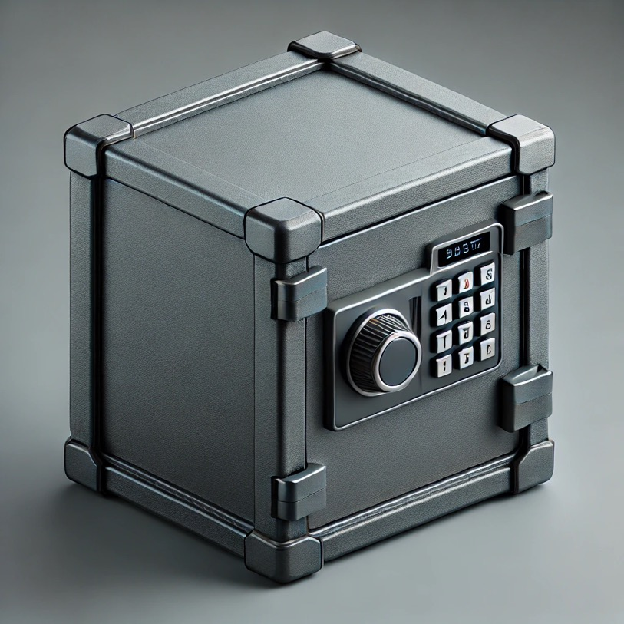
It must be safe!
Notes:
Avoid materials that can form dangerous radioisotopes
Stick with materials that have a straightforward waster process
Generally bad stuff happens at high temperatures so avoid that

Slide 20
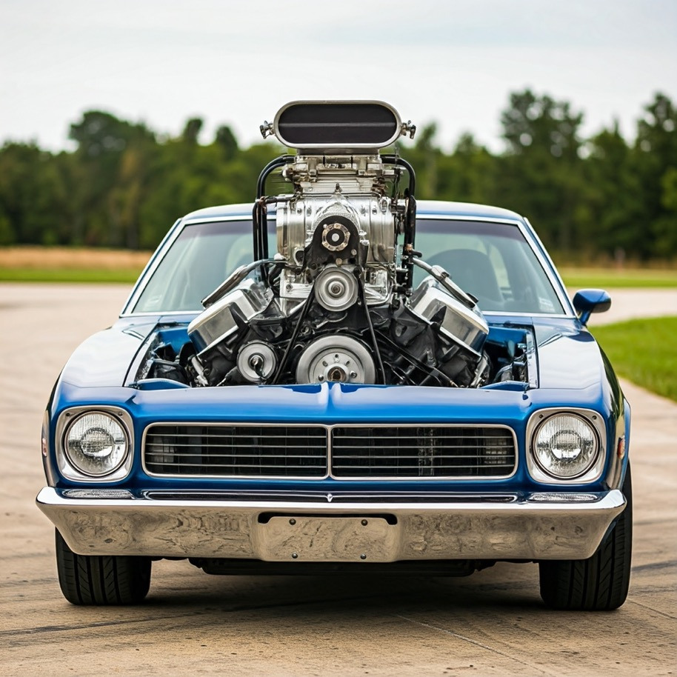
And it shall be 10x better than any before!
Notes:
Bigger faster smarter better

Slide 21
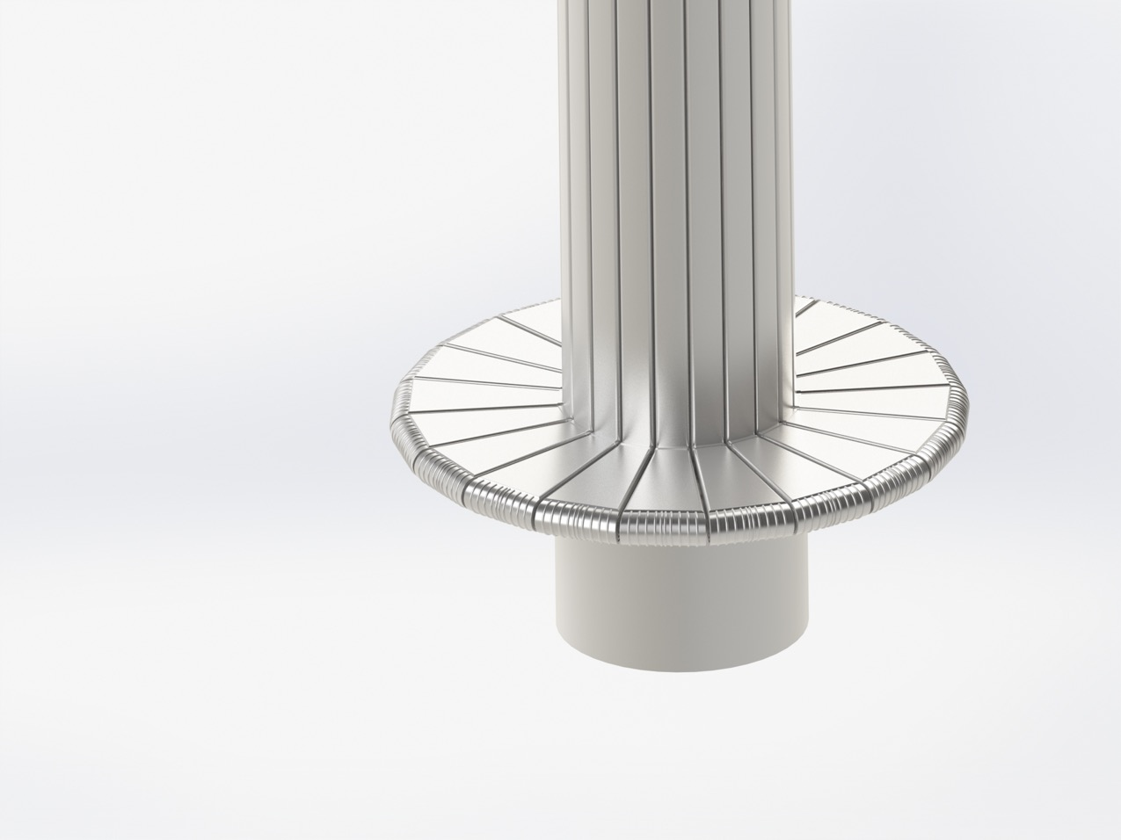
Step 1
Modularize it!

Slide 22
Step 2
Make it robust!
Minimize moving parts
Remove fragile features
Reduce welding and connection points

Slide 23
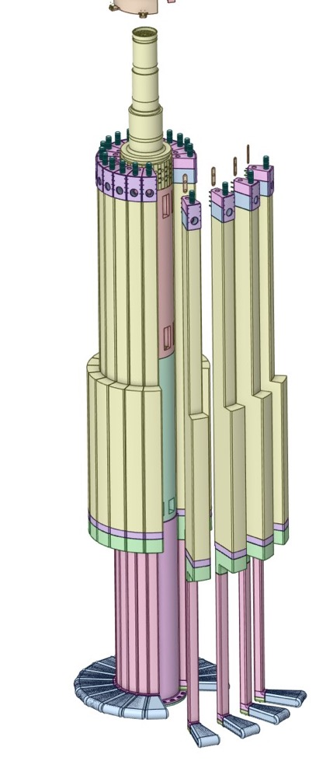
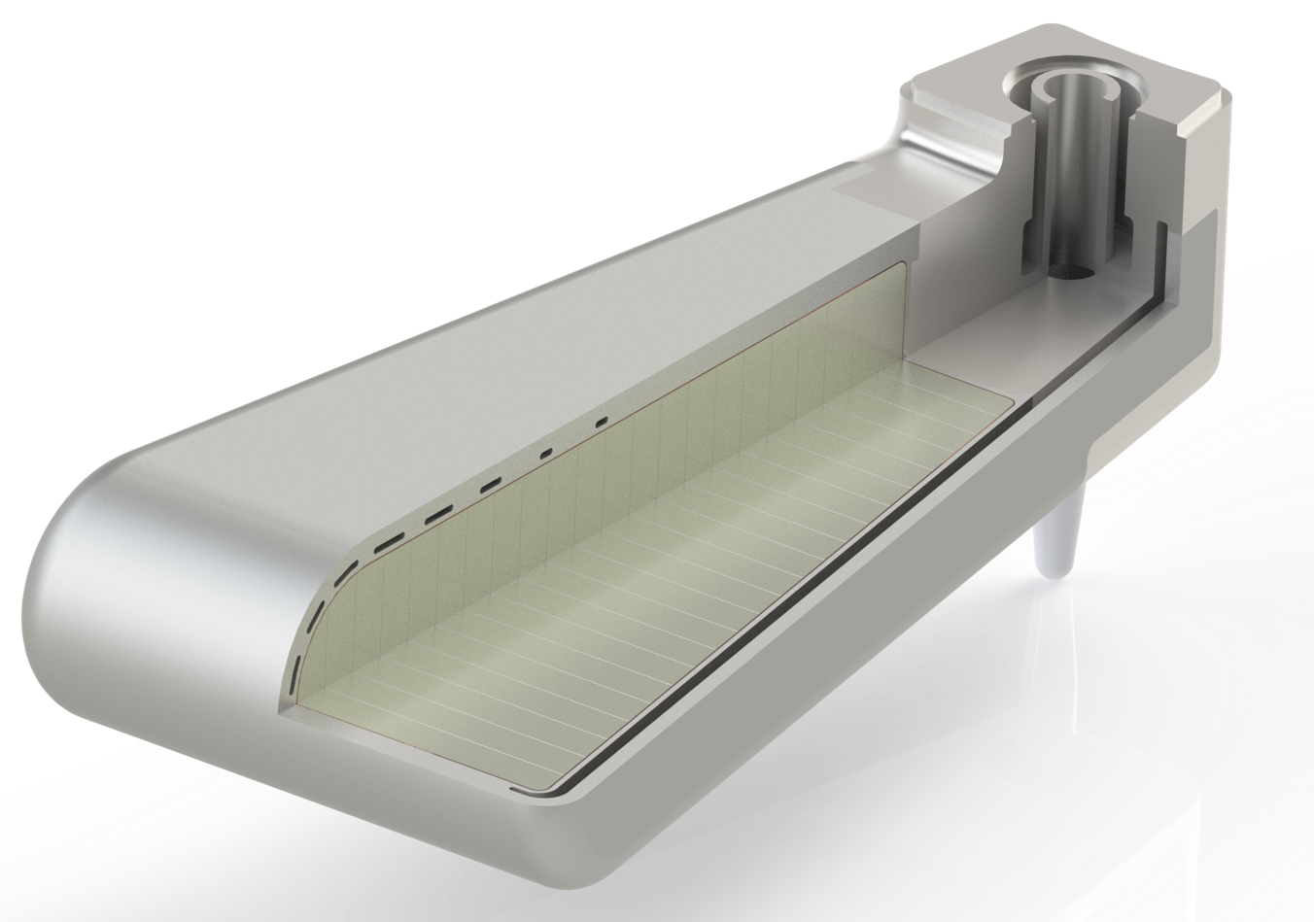
Voila! The STS Target!

Slide 24
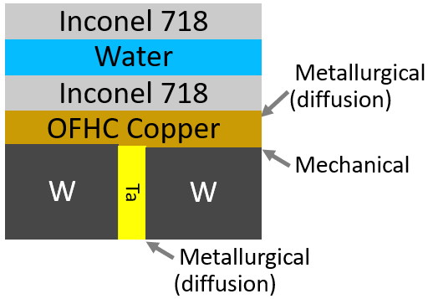
Cross flow design is (relatively) easy to fabricate
INC718 Forged Shroud
(water passages EDM after HIP)
Copper shell 2x
W -Ta VHP
Spallation Package
316L SST Block
& 316L Spacers,
TIG welded to
HIP Package.
INC718 Inner Shroud
INC718 water cover 2x

Slide 25
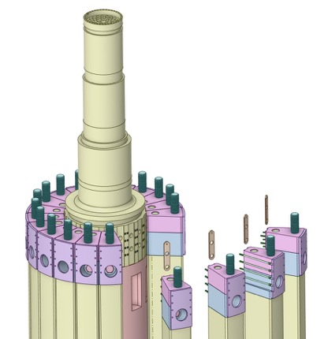
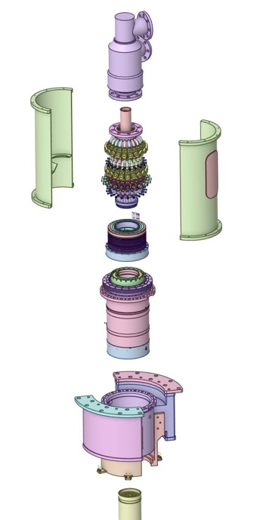
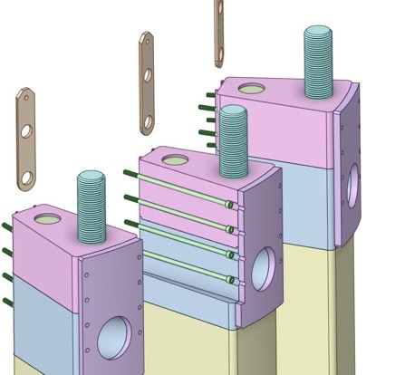
Exploded View

Slide 26
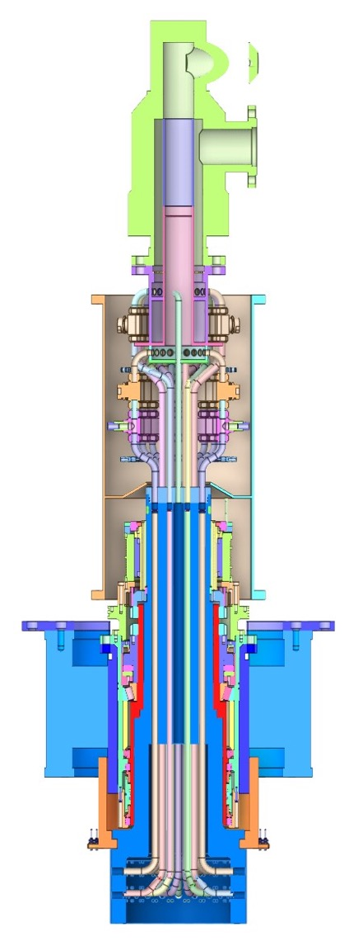
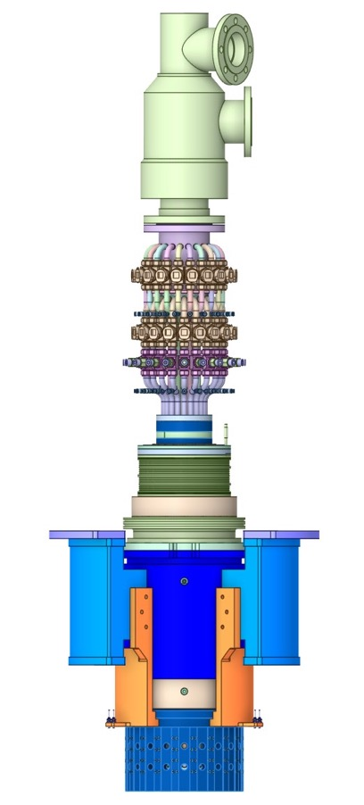
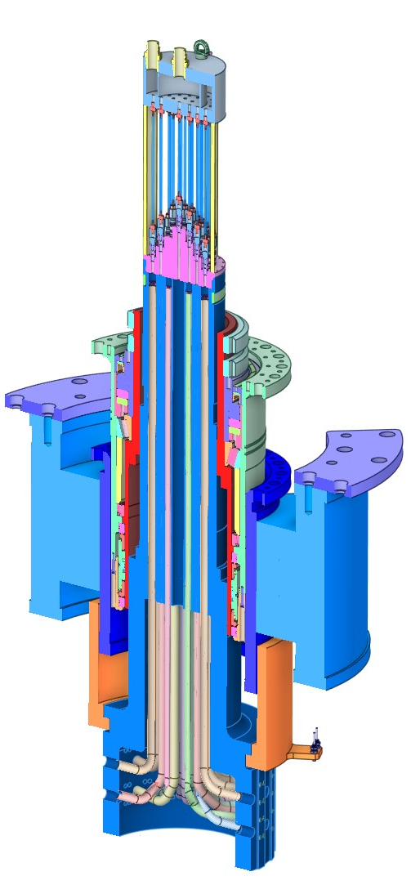
Details on the Drive and Water Manifold
Water rotary union
Valve Assembly
Motor Assembly
Bearing Assembly
Crown

Slide 27
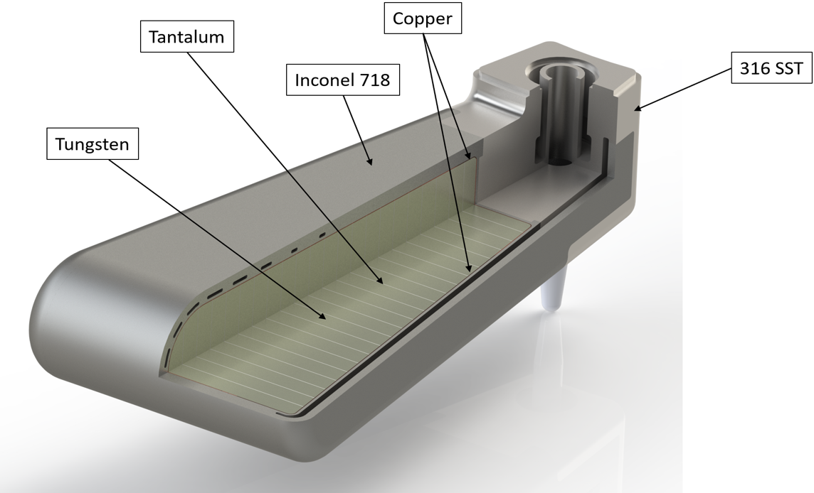
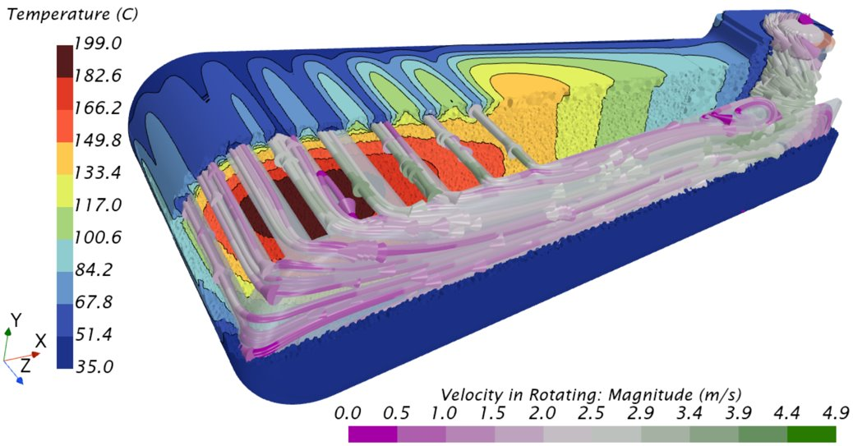
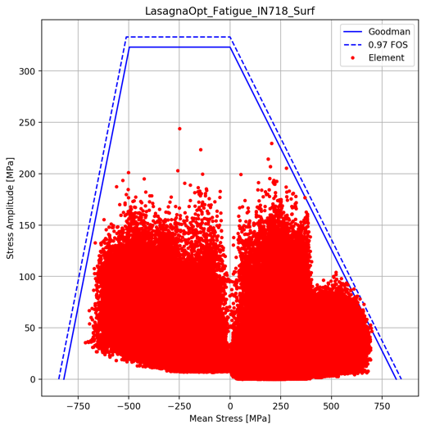
The STS design utilizes an edge cooled target design
Water channels
Water flow
Notes:
Robust – Solid materials, HIPed together forming intermetallic bonds around the spallation material
Easily Cooled – Cooling system is force flow water
Modular – Quick replacement (2 weeks shutdown)

Slide 28
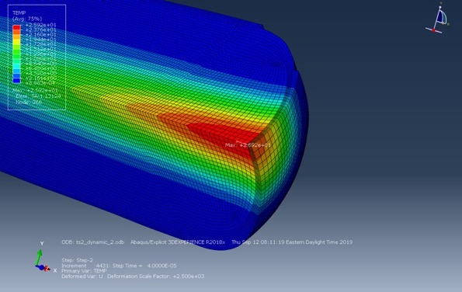
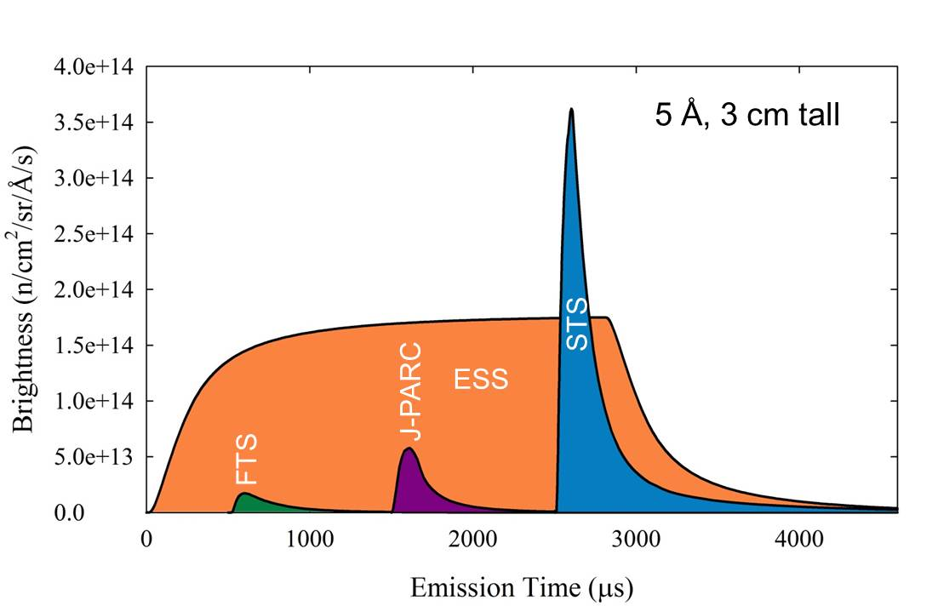
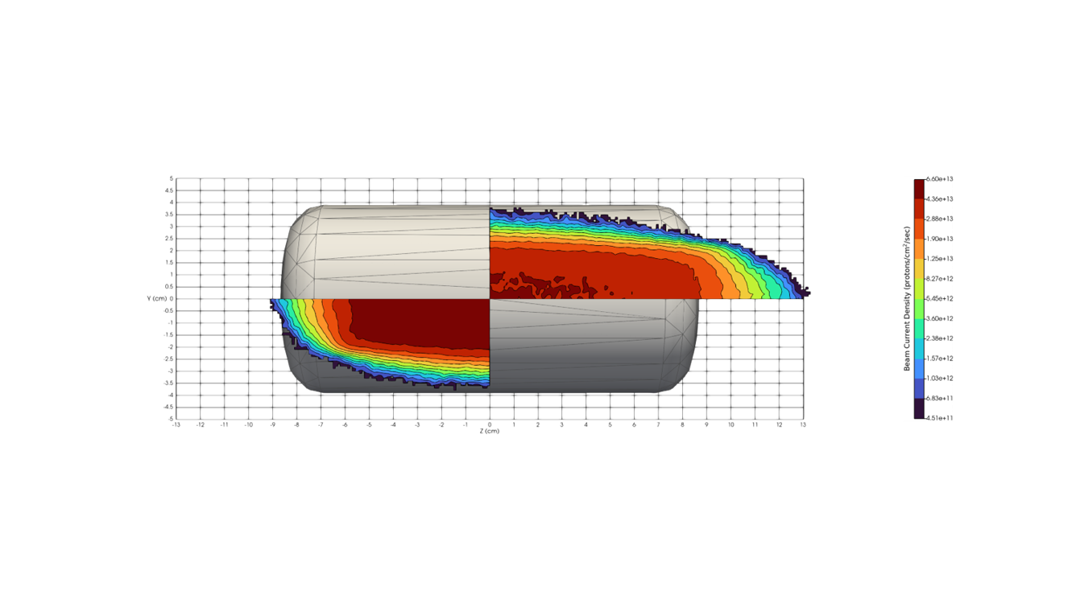
STS target vs other sources
Parameter | LANSCE MkIII | ISIS TS1 | ISIS TS2 MkII | CSNS | STS
Power (kW) | 80 | 160 | 32 | 100 | 700
Energy (GeV)/proton | 0.8 | 0.8 | 0.8 | 1.6 | 1.3
Frequency, f (Hz) | 20 | 50 | 10 | 25 | 15
Pusle Duration (ns) | 125 | 500 | 500 | 400 | 700
Average current (µA) | 100 | 200 | 40 | 63 | 538
Protons/pulse, N_{p} (10¹⁴) | 0.312 | 0.250 | 0.250 | 0.156 | 2.241
Energy/Pulse (kJ/pulse) | 4.0 | 3.2 | 3.2 | 4.0 | 46.7
Gaussian horizontal, σ_{x} (mm) | 15.0 | 17.9 | 6.0 | 30.0 | 58.8
Super Gaussian, n_{x} | 2.0 | 2.0 | 2.0 | 2.0 | 6.0
Gaussian vertical, σ_{y} (mm) | 15.0 | 17.9 | 6.0 | 10.0 | 20.9
Super Gaussian, n_{y} | 2.0 | 2.0 | 2.0 | 2.0 | 5.1
Peak protons/m²/pulse, I₀ (10¹⁶) | 2.2 | 1.2 | 11.0 | 0.8 | 4.2
Peak Energy Flux (kJ/m2/s) | 28.3 | 4.0 | 35.4 | 3.3 | 9.5
35
TS2
*Illustration courtesy of Wouter de Wet

Slide 29
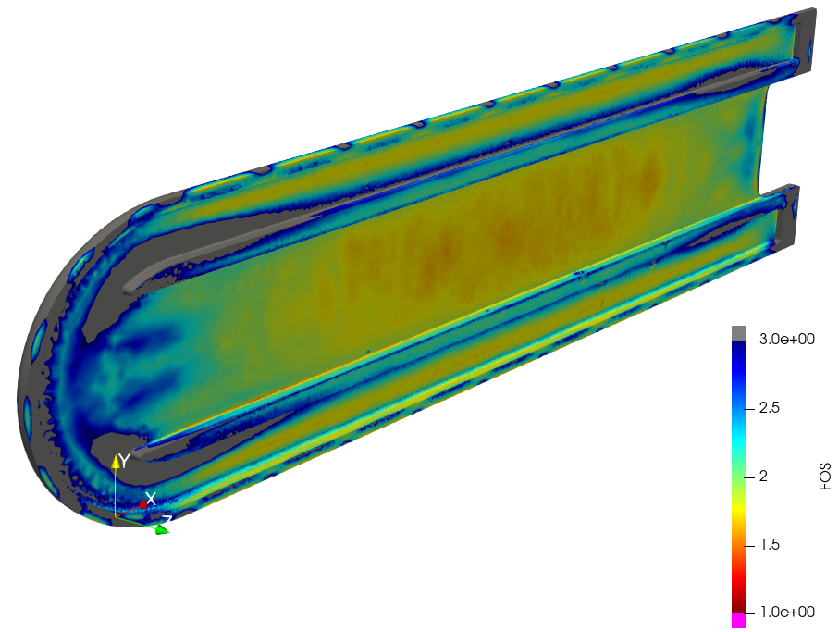
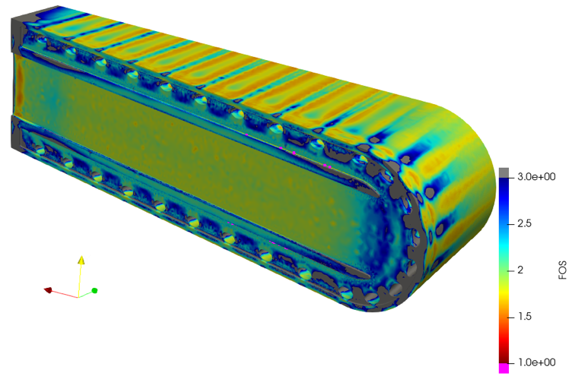
HIP bonding and edge cooling produces an acceptable fatigue life for tungsten and Inconel

Slide 30
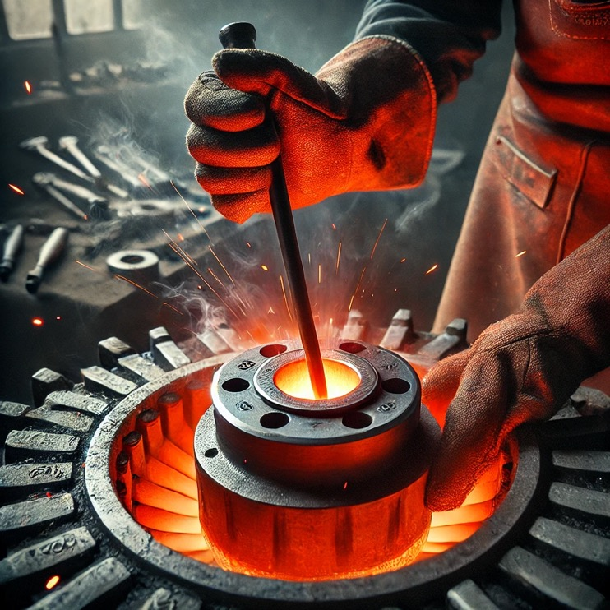
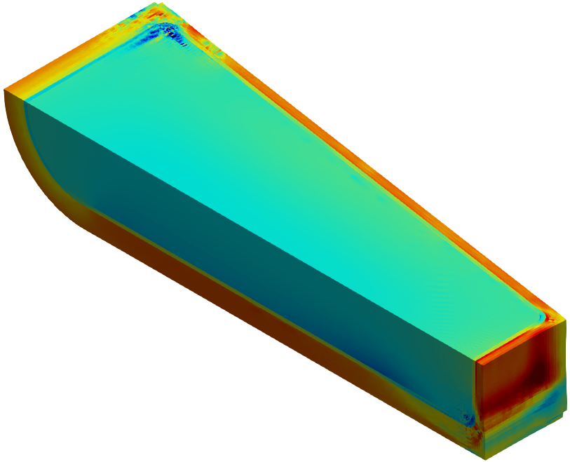
HIP fabrication method imparts a high level of compressive residual stress to further improve fatigue performance of tungsten
Hydrostatic stress
[Pa, ±400 MPa]
Inconel CTE ~ 3X tungsten CTE
¼ symmetry (solid tungsten block used for spallation material)

Slide 31
Segment Drive Valve Assembly
Can isolate individual segments
Can empty individual segments of water
Leak/pressure test individual segments
Allows cooling other segments during troubleshooting
1
2

Slide 32
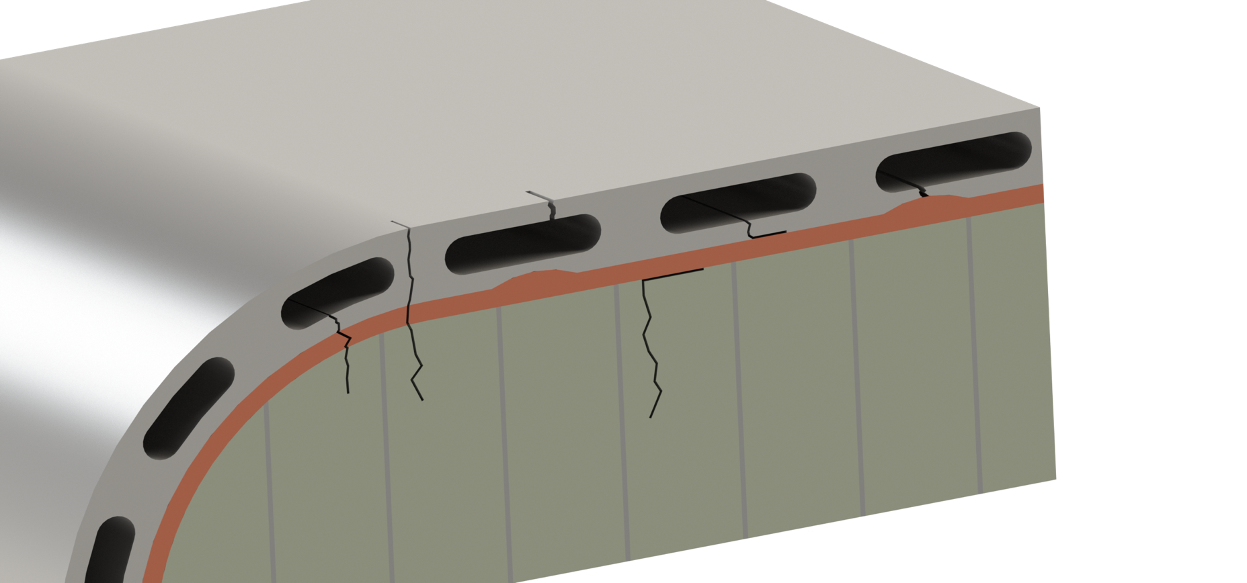
Identified Failure Modes
3
5
1
6
4
2
Notes:
The final mechanical robustness of the target block comes down to a thoughtful combination of material characteristics and manufacturing process.
In addition to traditional manufacturing failures such as welding issues, poor material qualities etc that can to a large degree be avoided by thurough inspection.
We have identified 6 potential mechanical failures of different character with different likelihood and consequence.
Most probable is no4, Tungsten is highly brittle, and cracks in the tungsten plates would not surprise us. However, we consider our design failure compliant here. The compliant interstitial layer is expected (proven to arrest such cracks in the weaker bond between the copper and tungsten).
3 and 6 are potential consequences of unexpected copper swelling, these are consider less probable.
1 and 3 are our worst cases and what we have decided to avoid. 3 would result in a water leak into our core vessel which would have limited consequences and be mitigated by leak sourcing and replacing the effected segment.
1 ihas the consequence of tungsten coming into contact with water. But we believe our analysis and manufacturing design to have made it highly unlikely to see this failure mode.

Slide 33
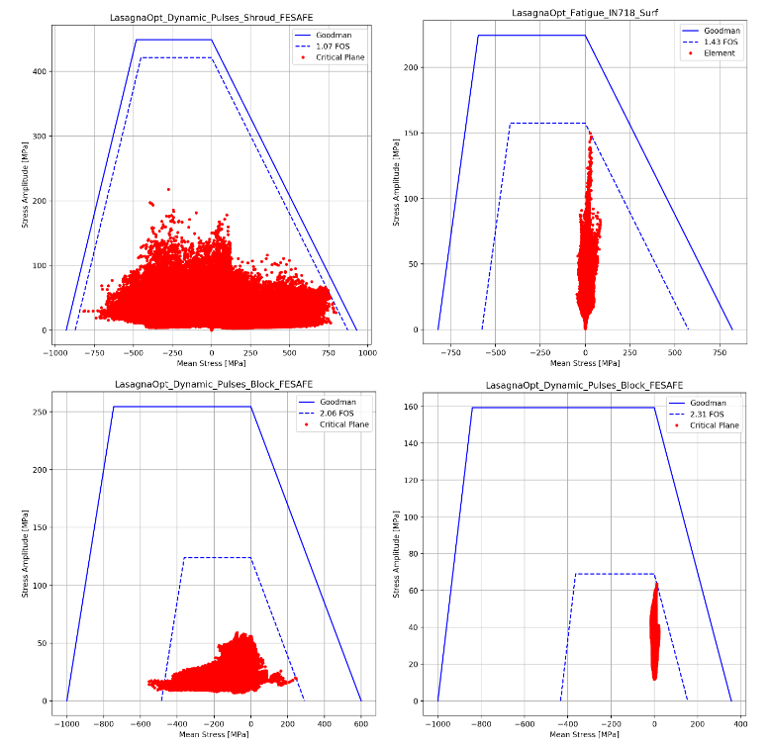
The STS design manages failures that occur from dynamic pulses – Water Leaks
3
1

Slide 34
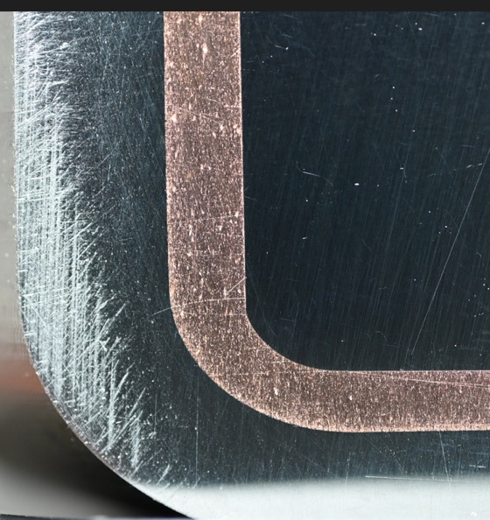
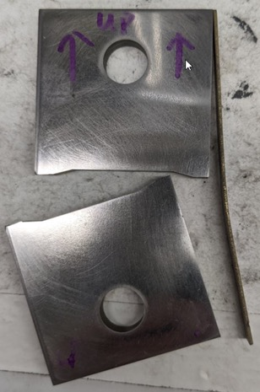
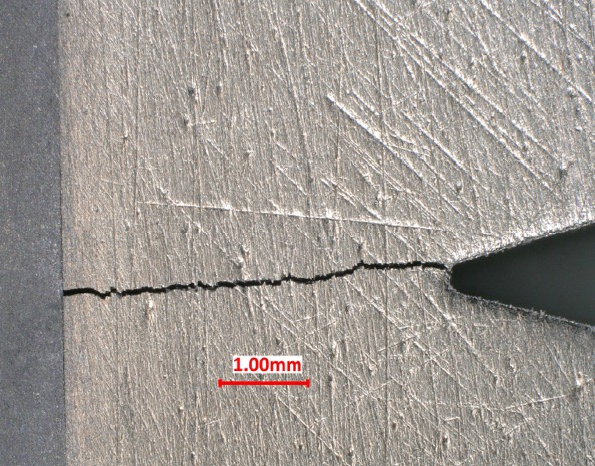
The STS design manages failures that occur from dynamic pulses – Crack Arresting
4
Ta
W

Slide 35
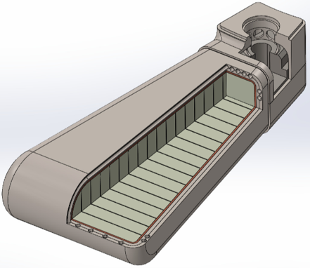
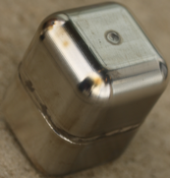
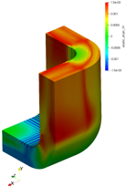
Mfg. R&D input to design → aiding preparation for CD-3 approval
*estimated R&D completion dates – range → uncertainty **may require auxiliary HPC to complete |  | R&D Requirements
 |  | Measure material interfaces’ properties vs. bonding pressure | Predict material interfaces’ bonding pressure | Develop HIP / confirm residual stress prediction is conservative | Fabrication review & approval | Confirm (observe) material interface bonding | Confirm (measure) as-manufactured Inconel properties
Design Deliverables | Analysis confirms material interfaces pass requirements | VHP coupon samples (Q3-Q4 FY24)* | Full-scale HIP simulation** (Q3 FY24 – Q3 FY25)
 | Analysis confirms Inconel FOS > 1 |  |  | Small-scale prototypes & simulation (Q3 FY24 – Q3 FY25)
 | Verify design & analysis |  |  |  | Full-scale fabrication (Q1-Q2 FY25) | Full-scale destructive examination (Q2-Q3 FY25) | Full-scale material testing (Q3-Q4 FY25)
in progress
not started
Production

Slide 36
Target & Moderator and Reflector Assembly

Slide 37
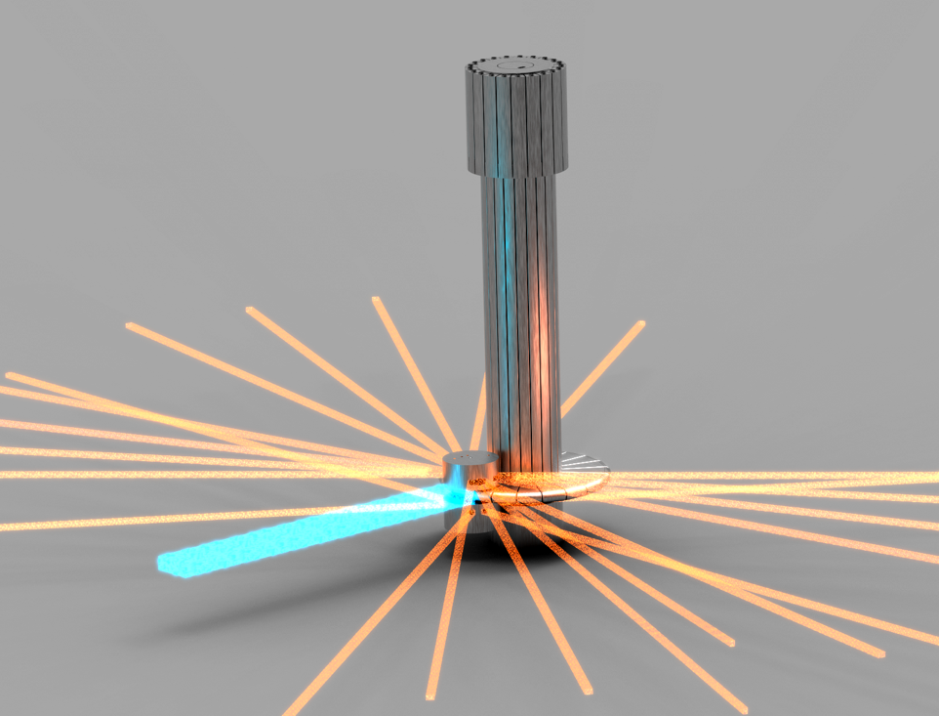
STS Neutron Production

Slide 38
