Slide 1
NNSA/NNSS Enhanced Capability Subcritical Experiments
James R Jones – NNSA, NFO Radiation Protection and Accelerator Safety SME

Slide 2
Outline
Machine Overview
Overview of our Safety Basis Philosophy
Regulatory Approach for Accelerator Operation
  Crosswalk demonstrating equivalency
Technical Safety Requirements Implications of Incorporation of the Accelerator Control

Slide 3
Scorpius (Advanced Sources and Detectors) Overview
Scorpius – 22MeV induction accelerator
  Integrated Test Stand (ITS)
Z-pinch Experimental Underground System (ZEUS)
  Dense Plasma Focus (DPF)
Notes:
These projects are designed at LANL initially by David Funk (this is his presentation)
He has since “retired” to NNSS to oversee the implementation of these projects

Slide 4
Scorpius (Advanced Sources and Detectors) Overview
Notes:
These are some of the radiation machines we have at the site; almost all are used for stockpile or defense missions.
More on this later

Slide 5

Scorpius (Advanced Sources and Detectors) Overview
Notes:
Induction accelerator but with solid state pulsers. Originally, I thought the main benefit of using SS over marx banks was the ability to hot-swap bad units reducing down time.
It’s actually for fine control over the pulses and timing.

Slide 6
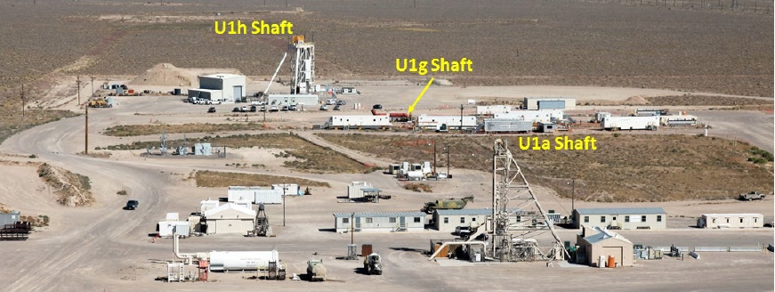
Scorpius Will be Installed at the Nevada National Security Site: a Haz Cat 2 Nuclear Facility
290m
U1a Complex Enhancements Project (UCEP)
Notes:
It’s being installed 950’ underground

Slide 7
Overview of Safety Basis Philosophy: Highlights
Utilize one safety analysis for the entire U1a Complex Facility operations (accelerator and sub-critical experiments)
  Inclusion of Accelerator Operations into the Documented Safety Analysis (DSA)
Utilize existing analysis from Dual-Axis Radiographic Hydrodynamic Test Facility at LANL and current operations
Integrate and align with design progression for the Civil Construction (UCEP) – two subprojects
  Subproject 010 (non-nuclear), facility preparation and life safety (complete)
  Subproject 020, balance of required systems, including nuclear operations controls

Slide 8
Regulatory Approach for Accelerator Operation Involves Incorporation of the Accelerator Control Set within the DSA
Two competing regulatory frameworks exist for accelerator operations within the U1a Complex Hazard Category 2 Nuclear Facility
  10CFR830 Subpart B/DOE-STD-3009-2014
  DOE Order 420.2C (replaced by 420.2D on 9/9/2022)
Incorporation of the accelerator within the DSA as allowed through equivalency within 420.2C
  Crosswalk demonstrating equivalency
Safety Basis Strategy demonstrates equivalent protection for accelerator operations under 10CFR830
  Allowed under DOE O 420.2C (also O 420.2D)
  Submitted to NNSA – Approved by NA-50
  Approved by the Cognizant Secretarial Officer on 4/7/2020

Slide 9
420.2C (2D) Order Requirements vs Equivalent Criteria
DOE O 420.2C Requirement (In 420.2D) | Proposed Equivalent Approach
4.a. (4.a.) DOE organizations are required to have oversight, consistent with current DOE oversight policy, over contractors who design, build and operate accelerators. This includes oversight of any modifications to facility, its equipment or program elements that have potential to significantly impact risk, complexity, visibility, safety and security of operating or maintaining accelerator facility. | Existing NNSA/NFO processes are compliant with DOE O 226.1B, Implementation of DOE Oversight Policy, and ensure adequate oversight capabilities exist in all required areas.
4.b.(1) Accelerator Safety Envelope (ASE): 4.c.(2): 420.2D - DOE approved Accelerator Safety Envelope (ASE) a. Defines physical and administrative bounding conditions and controls for safe operations based on analysis documented in SAD. b. Requires DOE approval; may be submitted as a separate document from SAD. c. Activities expected to exceed bounding conditions of ASE require DOE approval. Any activity violating the ASE must be terminated immediately and be put in a safe and stable configuration. | Technical Safety Requirements (TSR) (Compliant with DOE G 423.1-1B) Addresses all key elements of ASE. Defines limits, controls, and related actions that establish specific parameters and requisite actions for safe operations based on analysis documented in DSA. Includes use and application provisions that define operability requirements/violations and actions necessary to achieve safe and stable configuration. USQ process ensures changes are approved at the appropriate level.

Slide 10
420.2C (2D) Order Requirements vs Equivalent Criteria
DOE O 420.2C Requirement (In 420.2D) | Proposed Equivalent Approach
4.b.(2) 4.c.(1): Safety Assessment Document (SAD). a. Identifies hazards and associated onsite and offsite impacts to workers, public, and environment from facility for both normal operations and credible accidents. b. Contains sufficient descriptive information and analytical results pertaining to specific hazards and risks identified during safety analysis process to provide an understanding of risks presented by the proposed operations. c. Provide detailed descriptions of engineered controls (e.g., interlocks and physical barriers) and administrative measures (e.g., training) taken to eliminate, control, or mitigate hazards from operation. d. Include or reference a description of facility function, location, and management organization in addition to details of major facility components and their operation. | Documented Safety Analysis (DSA) (Compliant with DOE-STD-3009-2014) Addresses all key elements of SAD. Describes facility, work scope, and safety structures, systems and components. Identifies natural and man-made hazards associated with the facility. Evaluates normal, abnormal, and accident conditions, identification of energy sources or processes that might contribute to the generation or uncontrolled release of radioactive and other hazardous materials. Derives hazard controls necessary to ensure adequate protection of workers, the public, and the environment, demonstrates adequacy of controls to eliminate, limit, or mitigate identified hazards, and defines the processes for maintaining the controls current. Defines management organization and characteristics of safety management programs necessary to ensure safe operation of the facility.

Slide 11
420.2C (2D) Order Requirements vs Equivalent Criteria
DOE O 420.2C Requirement (In 420.D) | Proposed Equivalent Approach
4.b.(3) 4.c.(2) Clearly defined roles and responsibilities for accelerator activities including those for training and procedures. | Consistent with DOE G 423.1-1B (Section 2.3.1 of Appendix A) NNSA/NFO will comply with the requirement.
4.b.(4) Unreviewed Safety Issue (USI) Process. 4.c.(3): DOE approved Unreviewed Safety Issue (USI) Process Supports configuration management efforts that help ensure facility and supporting safety documentation are maintained current and periodically updated. | Unreviewed Safety Question (USQ) Process. Addresses all key elements of USI Process. Existing NNSA/NFO-approved process ensures configuration management/safety basis integrity by reviewing potential USQs, reporting USQs to NFO, and obtaining approval from NFO prior to taking any action that involves a positive USQ Determination.

Slide 12
420.2C (2D) Order Requirements vs Equivalent Criteria
DOE O 420.2C Requirement | Proposed Equivalent Approach
4.b.(5) Accelerator Readiness Review (ARR) 4.c.(3): DOE Approved Accelerator Readiness Review (ARR) Ensures facilities are adequately prepared for safe commissioning/operations. Performed before DOE approval for commissioning/routine operation. Contractor must demonstrate: a. Contractor Assurance System that maintains an internal assessment process. b. Configuration Management Program that is related to accelerator safety. c. Credited controls and administrative processes related to accelerator safety (e.g. training, procedures, etc.). | Readiness Assessment (RA) (Compliant with DOE O 425.1D – Contractor and Federal RA) Addresses all key elements of ARR. Provides independent verification of readiness prior to start of commissioning/operations. Core requirements verify readiness of personnel, procedures, programs, and equipment.

Slide 13
420.2C (2D) Order Requirements vs Equivalent Criteria
DOE O 420.2C Requirement (In 420.2D) | Proposed Equivalent Approach
4.b.(6) 4.b.(3) Current listing/inventory of accelerators under this Order and exemptions or equivalencies granted in accordance with paragraph 3.c.(2) and 3.c.(3) ((4.b.(1) and 4.b.(2)) of this Order. | NNSA/NFO will comply with the requirement.
4.c. 5.b.(5) DOE organizations must ensure accelerator facilities or modules that implement and operate to alternate safety standards, requirements or DOE Directives adequately address hazards in accordance with paragraph 3.c.(3) (3.c. and/or 4.d.) of this Order. | NNSA/NFO will ensure alternative safety standards, requirements or DOE Directives adequately address hazards in accordance with paragraph 3.c.(3) of the Order.
4.d. 4.d. DOE organizations must ensure the Contractor Assurance System includes processes for the review of contractor accelerator safety program elements as specified in the CRD. | Existing Contractor Assurance System will be modified to include processes for the review of contractor accelerator safety program elements as defined in the safety basis documentation.

Slide 14
Scorpius Will Implement Safety Controls as Technical Safety Requirements within the DSA
Anticipated Safety-Significant Controls for Accelerator Operation:
  Beam Stop (Limiting Conditions for Operation)
  Labyrinth Shielding Structure (Design Feature)
  Safety Interlock System (Limiting Conditions for Operation)
  Zero Room Plug Shielding (Design Feature)
  Key Access Controls - Specific Admin Control
  Linear Accelerator Pulse Limit - Specific Admin Control
  Sweep and Secure - Specific Admin Control
Safety-Significant Controls will be carried forward into the TSRs
Control set is comparable to the SAD/ASE for DARHT, which provided a benchmark
Mode definitions and applicability are based upon System Concepts approach
USQ applicability will be addressed through categorical exclusions
  Non-safety related equipment
  No potential for interim hazards or configurations

Slide 15
Scorpius Will Implement Safety Controls as Technical Safety Requirements within the DSA
Integrated Test Stand ITS

Slide 16
Key to this is the development of an Integrated Test Stand to demonstrate operational performance of the Scorpius Injector
Goal 1: Commission the Injector (opportunity to demonstrate software control and interface with the Safety Interlock System) and demonstrate TRL-7
Goal 2: Verify beam performance (e.g., emittance,)
Goal 3: Training of the operations team and dress rehearsal for operations in PULSE (main reason for ITS at A-1)
Work at ITS will include those activities required to meet the goals above. Additional work has been considered and captured, but its execution will depend on the state of PULSE Construction. Once the main goals are met, we need to expedite assembly at PULSE in support of mission need
Notes:
ITS is not inside a Nuclear Facility so we have to comply with 420.2D, which means we limit it to less than 10MeV. The contractor chooses to limit instead of create SAD/ASE for a confirmation run.

Slide 17
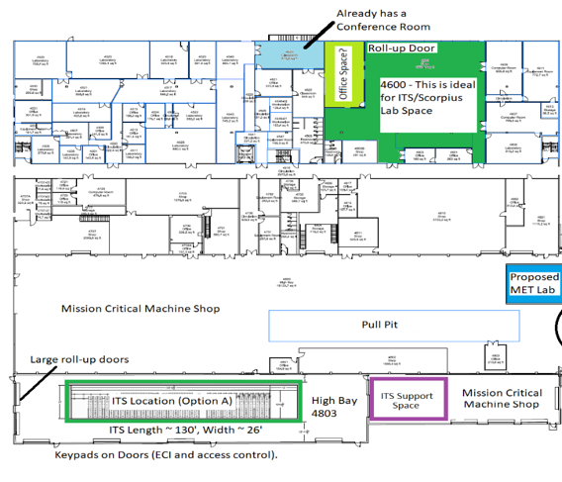
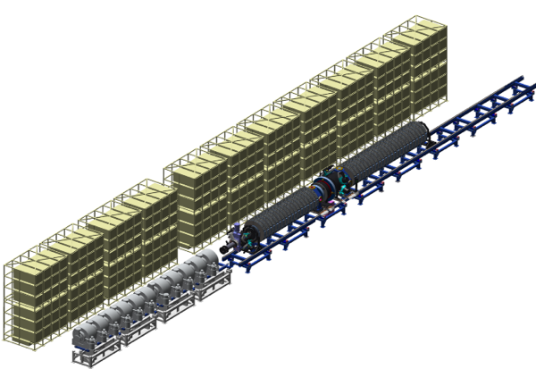
The ASD Project is developing an Integrated Test Stand to demonstrate operational performance of the Scorpius Injector
Workshops have been executed and plans developed for using the Integrated Test Stand in North Las Vegas
The Integrated Test Stand (ITS) in NLV will support testing, transition to ops, and turnover of Scorpius to NNSS

Slide 18
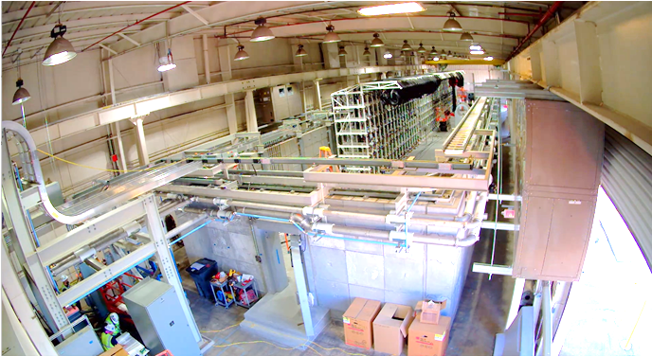
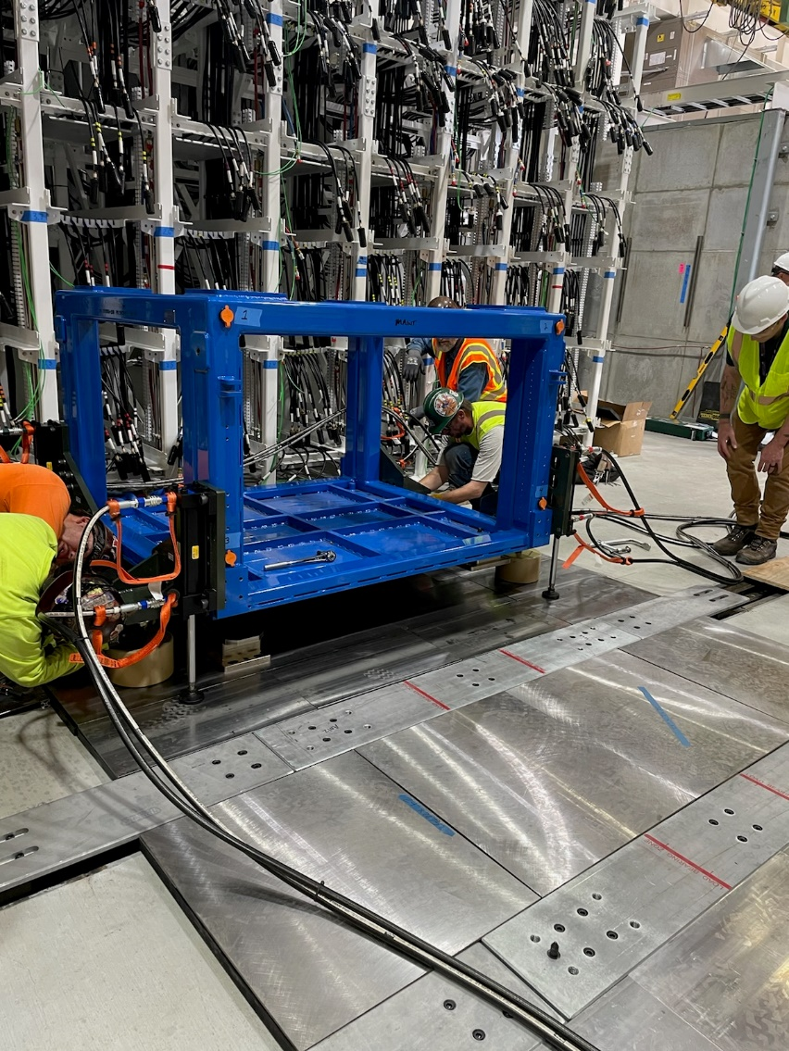
ITS Infrastructure Install is ongoing, with the first injector modules expected to be installed by the end of October
Inside A-1 – overlooking shield wall into test bay
Dry Run of module movements from storage to rail

Slide 19
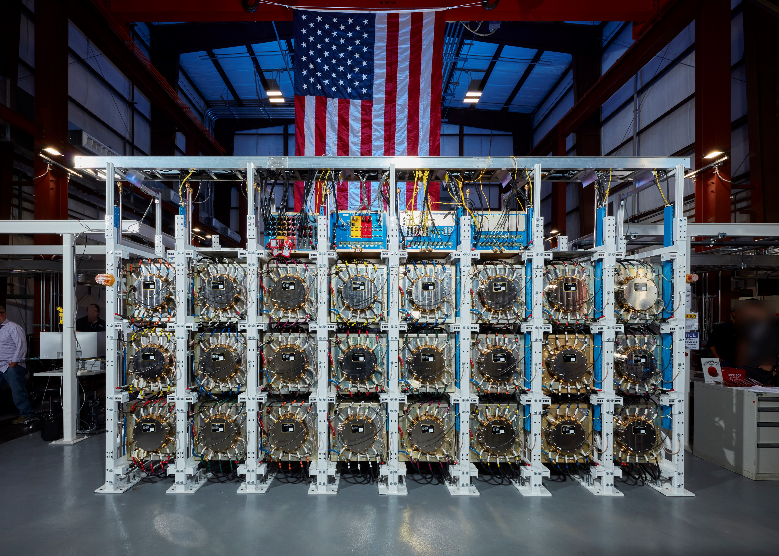
ITS Infrastructure Install is ongoing, with the first injector modules expected to be installed by the end of October

Slide 20
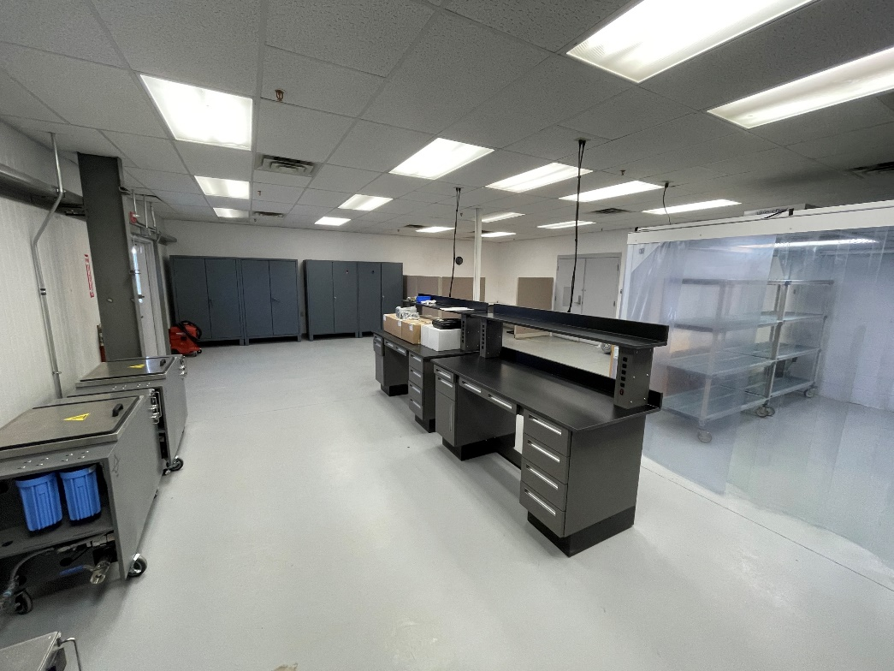
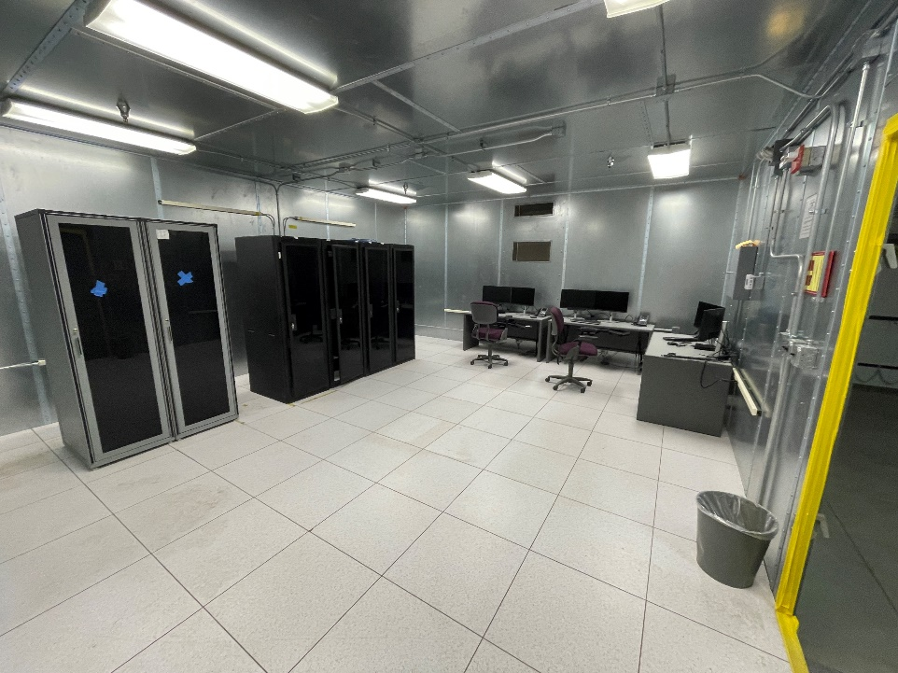
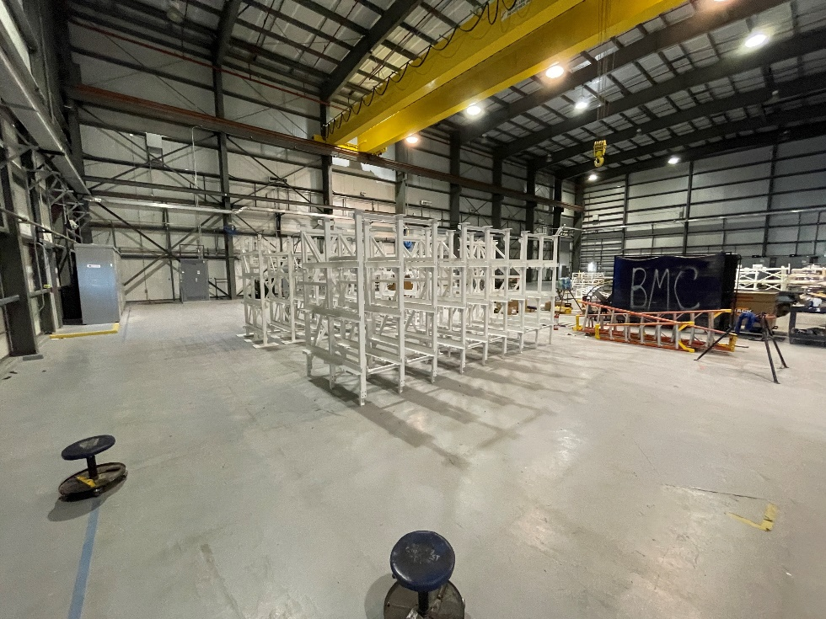
The ECSE Support Laboratory at 6-922 is also in the process Install of installing needed equipment
Control Room
Vacuum Lab
LRU Racks getting prepped for install

Slide 21
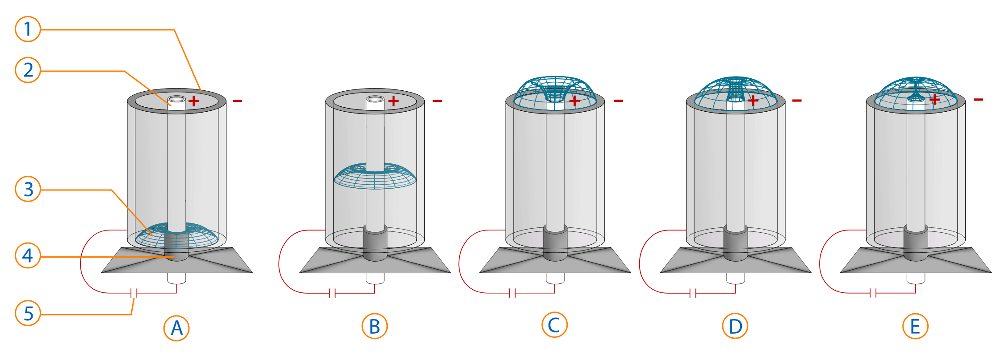
What is a Dense Plasma Focus?
Dense Plasma Focus
A DPF is a pulsed power technology that charges a bank of capacitors (A) and discharges that energy through a sub-atmospheric gas (B). The anode/cathode configuration allows magnetic forces to first axial motivate (B), the radially compress the gas (C&D). The type of ionizing radiation that is produced is based on the gas composition (E).
There are (4) MegaAmp-Class DPFs in the United States currently operating (NNSS x2, LLNL and VERUS)
There are many other small DPFs operating in the country
Image credit: Wikimedia Commons

Slide 22
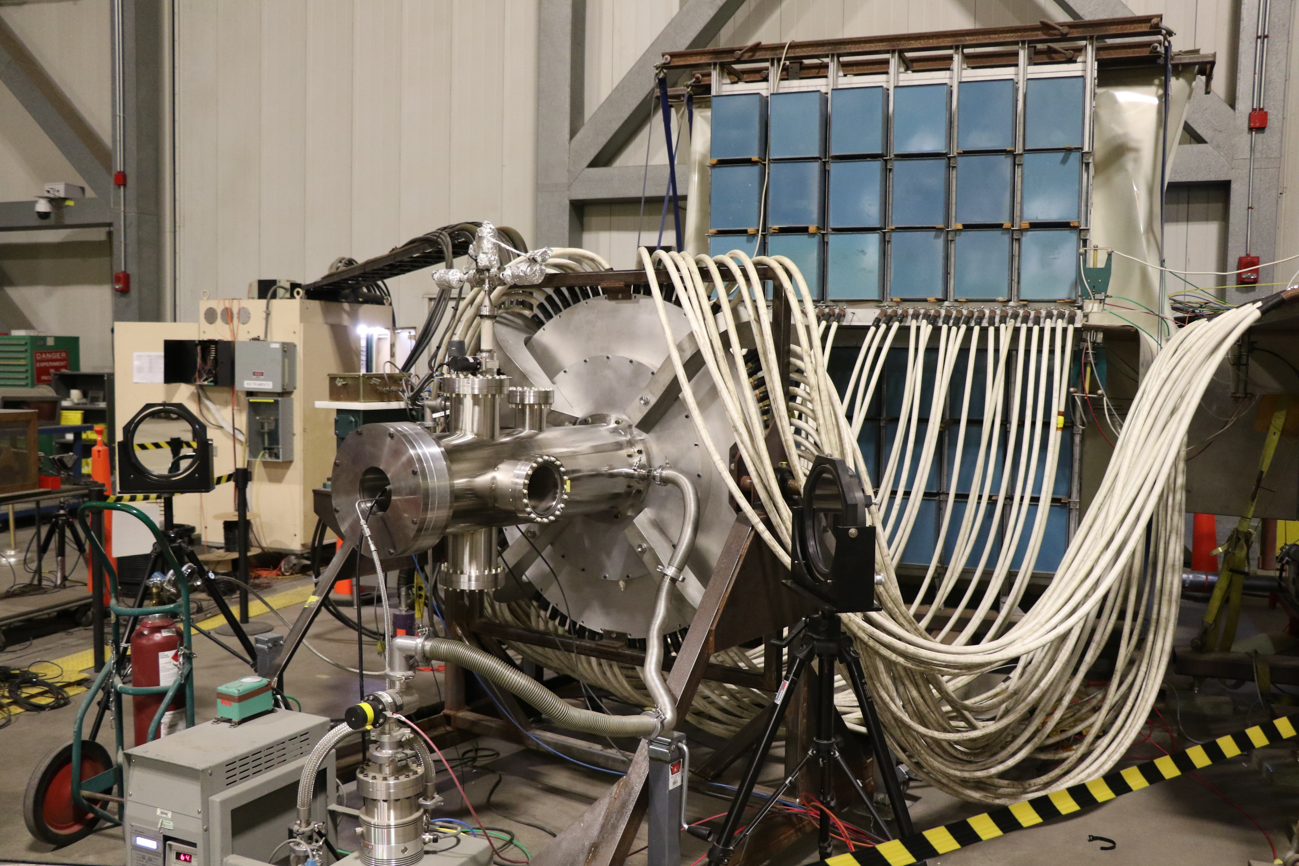
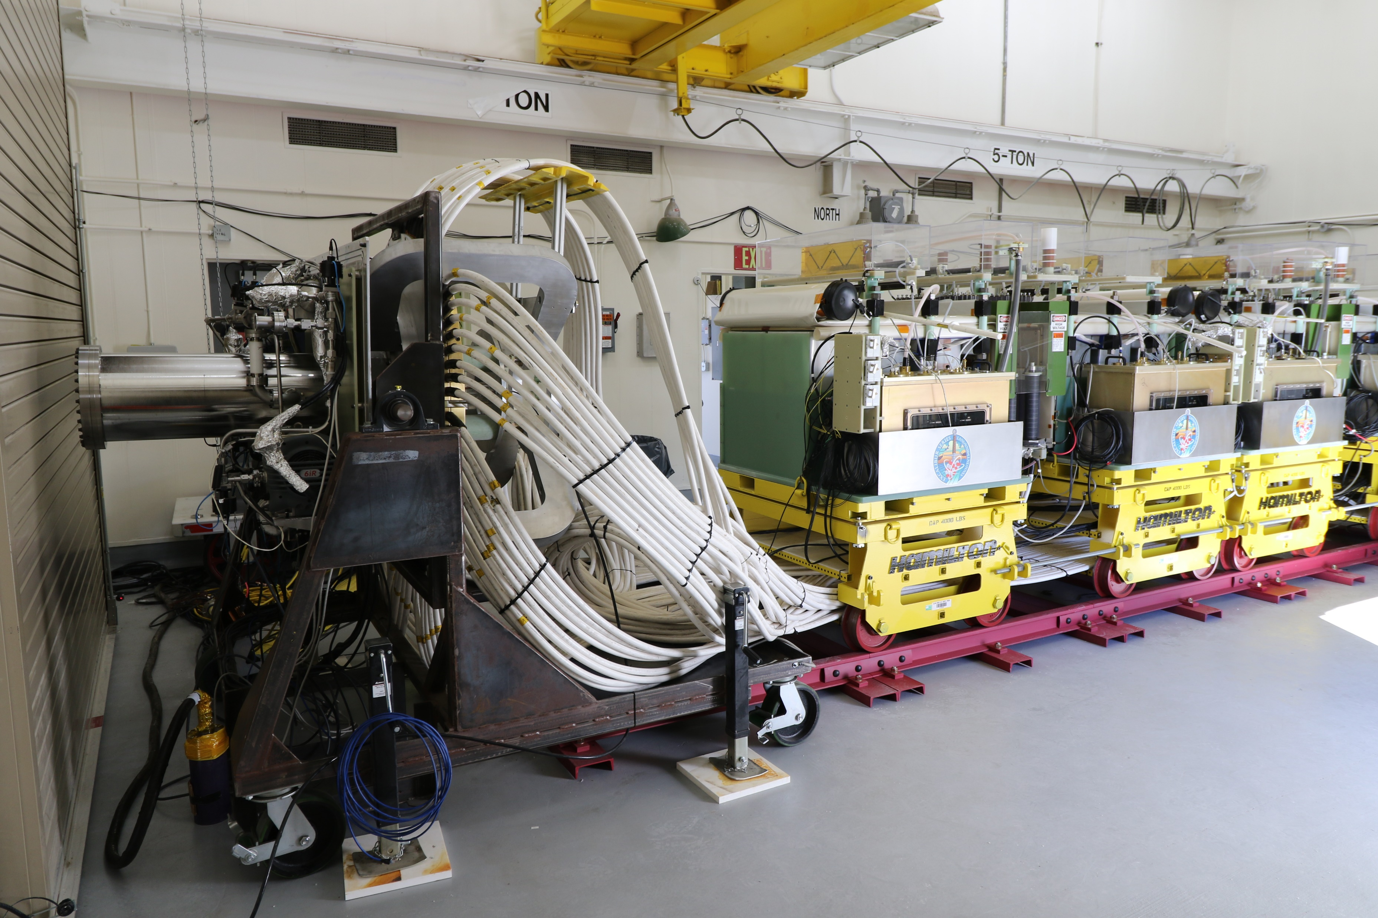
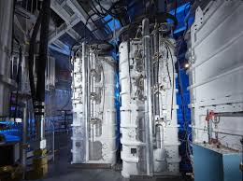
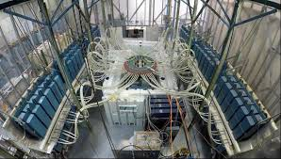
DPFs Around the Country
Gemini (DD, NNSS)
ZEUS (DT, NNSS)
VERUS (DD, VERUS/DOD)
MJLONIR (DD, LLNL)
Notes:
If table-top neutron generator is like a N-lantern then DPF is like a N-flash bulb

