Slide 2
How to use the facility's resources and create a greenfield facility that will be sustainable and recyclable.
DOE Accelerator Safety Workshop (ASW) BNL
PRESENTED BY Mattias Eriksson, ESS, Material and inspiration provided by Erica Lindström Environment & OHS Engineer
2024-10-09

Slide 3
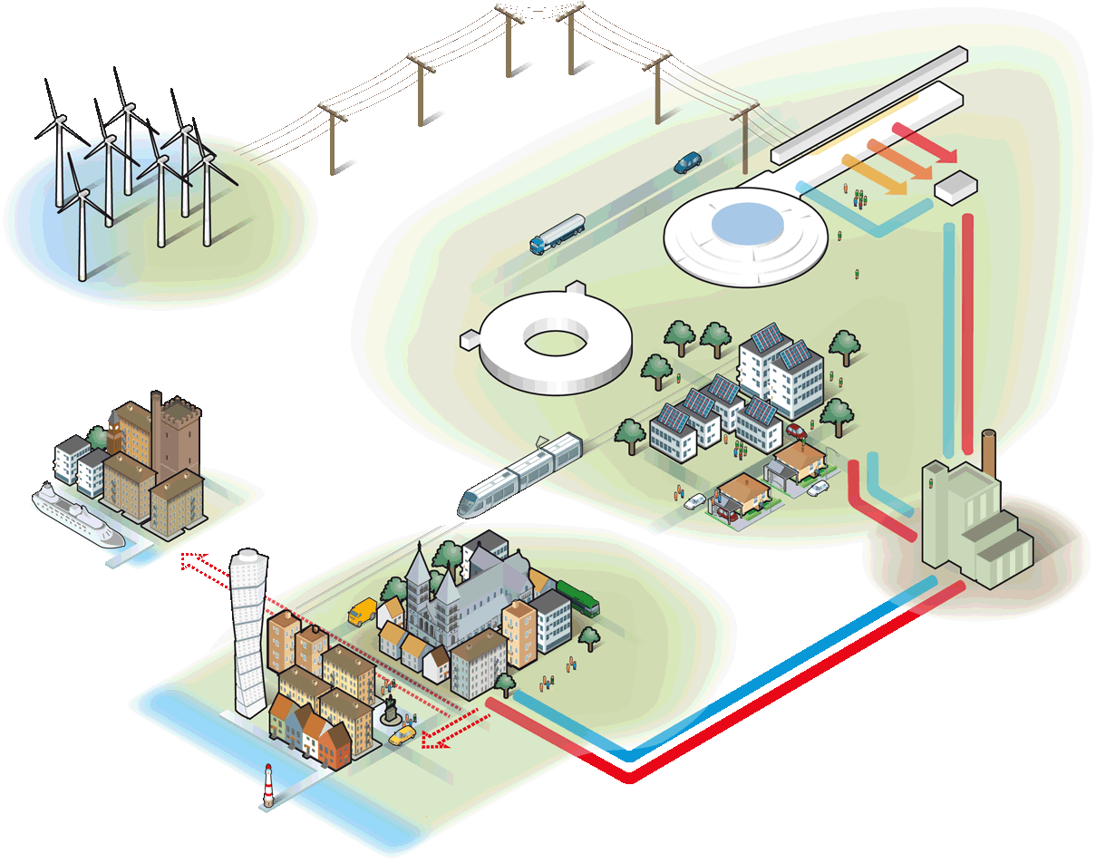
Energy solutions at ESS
2. Renewable – all energy is derived from renewable sources
1. Responsible – the facility uses as little energy as possible
3. Recyclable – as much surplus heat as possible is recycled
Notes:
ESS is committed to an energy concept that consists of three parts:
Responsible – requires that the facility use as little energy as possible.
Renewable – requires that all energy must derive from renewable sources.
Recyclable – requires that as much surplus heat as possible is recycled.
I’m working with the responsible and renewable parts local companies like Alfalaval provides heat exchangers for the ectogrid Kraftringen provides heating to ESS when needed and receives exesive heat from ESS
E.ON works with providing the electrical distribution at ESS site
Stena provides the recycling service at ESS, the recyceling service is almost payed by the recycled the material!
The amount of electricity required for the operation of ESS corresponds to the annual output from 30-40 wind turbines (around 270 GWh/year). This is about as much as the annual consumption of 40 000 apartments or of a small Swedish municipality.
When ESS is fully commissioned, the power consumption in Lund will rise by 20-30%.

Slide 4
E.ON ectogridTM
Illustrative
District heating
High temp
Medium temp
Medium/low temp
Low temp
Full flexibility and redundancy

Slide 5
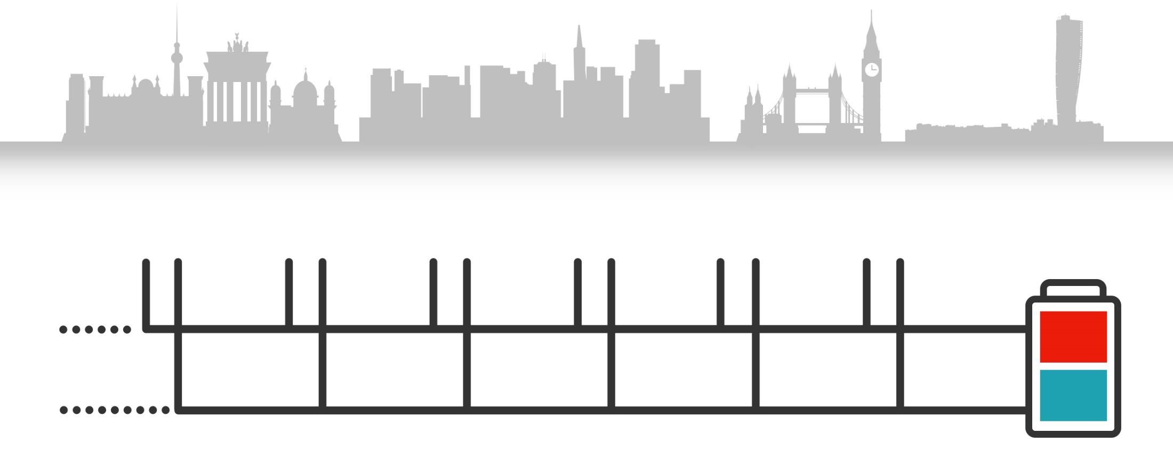
The most energy efficient heating and cooling solution
Cheaper to build - one grid serves 2 utilitites
Cheaper to operate
How ectogrid™ works
Buildings connected to the same system provide each other with heating and cooling.
~15-40 ^{O}C
~5-30 ^{O}C
Notes:
-The process of cooling a building also means removal of heat and vice versa for heating. Traditionally, cities have been designed with separate infrastructures for heating and cooling, resulting in that this excess energy is being lost. By taking an integrated approach, excess energy from both heating and cooling can be shared between buildings, reducing the need of supplied energy.

Slide 6
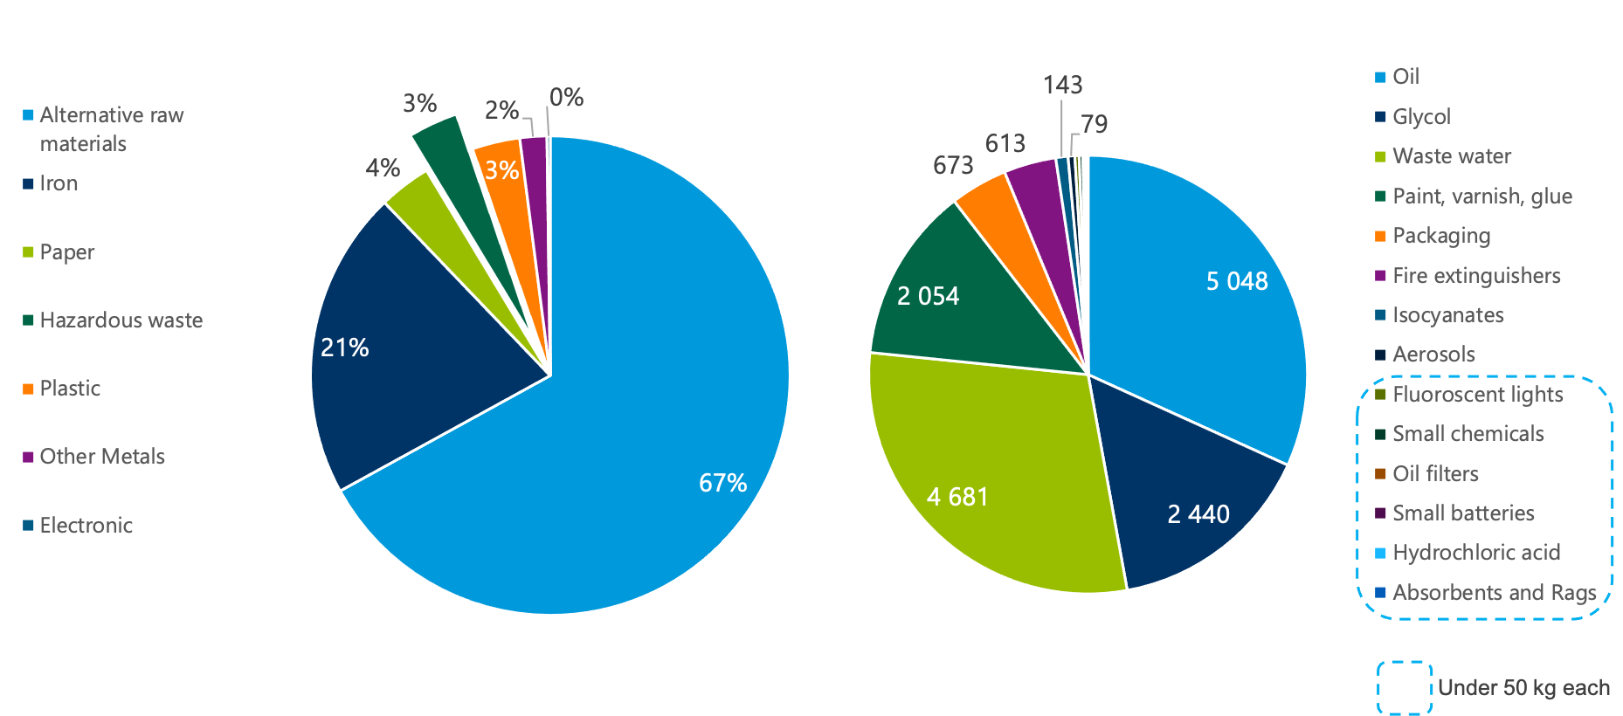
Actual hazardous waste at ESS 2023
Hazardous waste [kg]
Notes:
Disposal: Transportation of Hazardous Waste needs to be registered to the Swedish Environmental Protection Agency
Total amount of Hazardous waste the last 12 months: 15884 kg 35018 lbs
One issue we still have to solve…
Where to store our radioactive waste!? Initial storage is handled at the facility but the longterm?? Swedish government has given the Swedish radiological institute the assignment to figure this out 2023 but the report is not done.

Slide 7
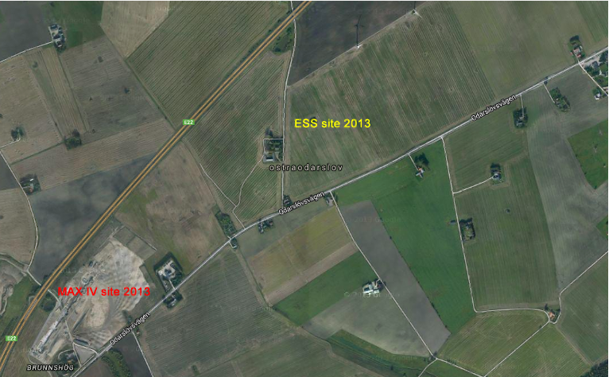
What we started with
Monoculture farmland
Notes:
Totalt 74 hectars 182 acers
2/3 of this surface is green areas
1/3 of the area is buildings and paved areas

Slide 8
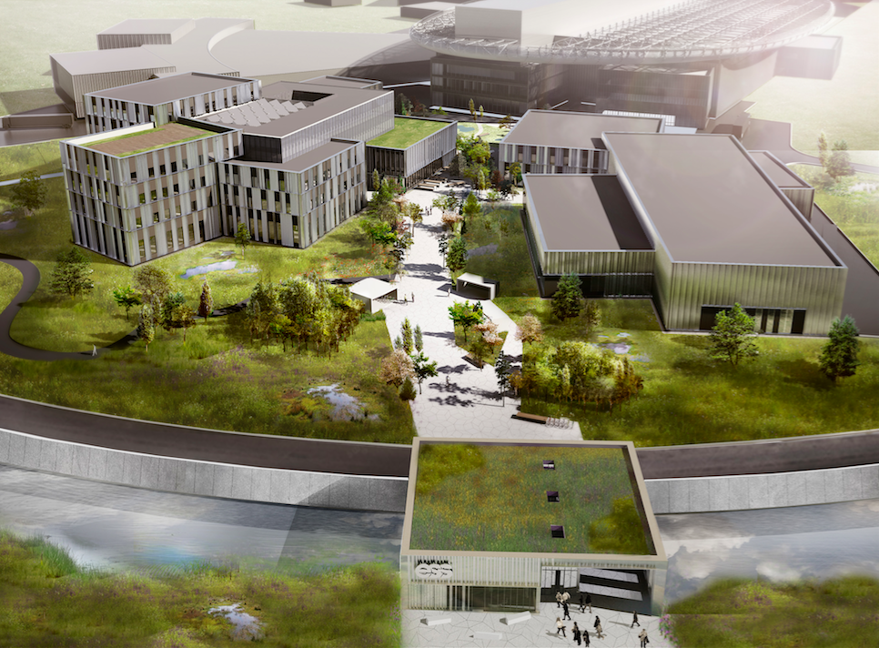
What was the plan!
Notes:
Main offices, auditoriums, canteen (B01), BREEAM certified (Environmental performance certification system Sustainable Building Certification
Mechanical workshops/labs (B02)
Entrance building (F04)

Slide 9
2024
Notes:
ESS is a greenfield project and the design had to be adapted to the unique needs of a large-scale next-generation research facility, while maintaining an emphasis on inspiring aesthetics and environmental sustainability.
-operational time is 40 years on paper
-envoirmental aspects like noise pollution and water pollution is constantly monitored

Slide 10
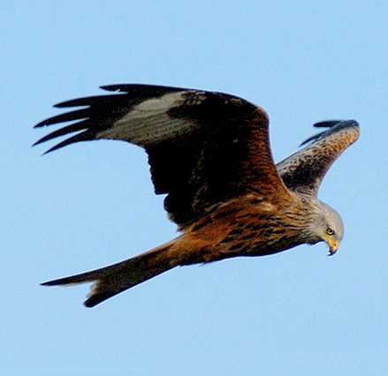
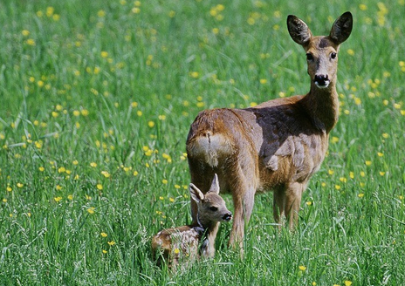
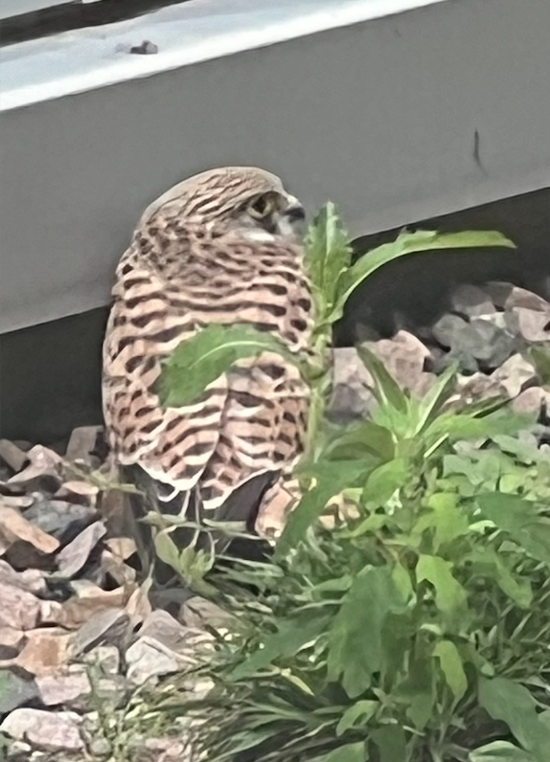
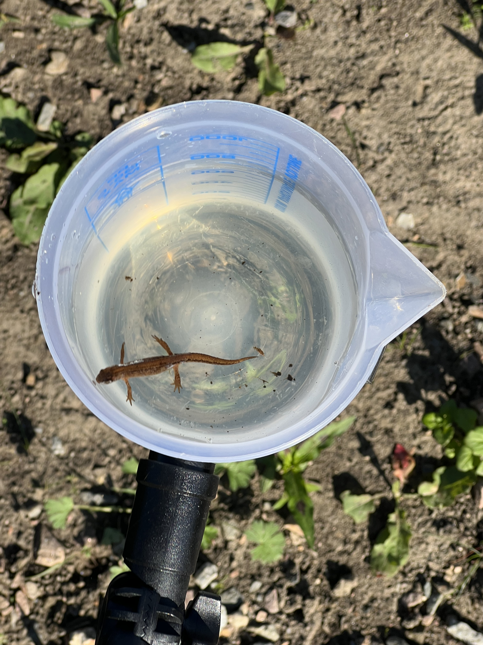
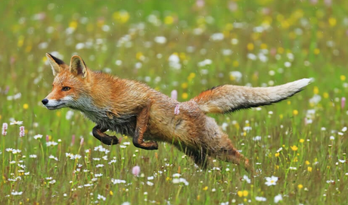
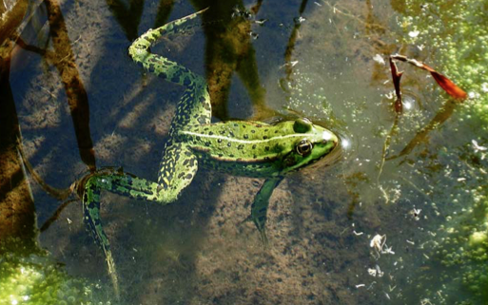
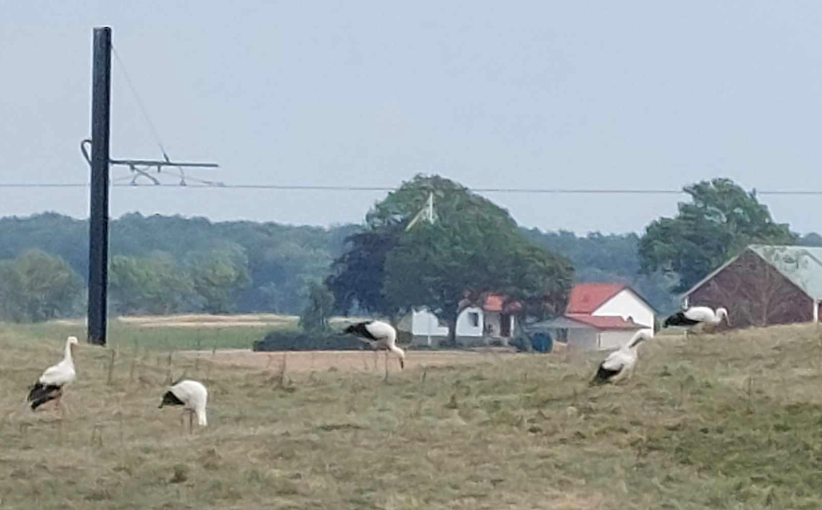
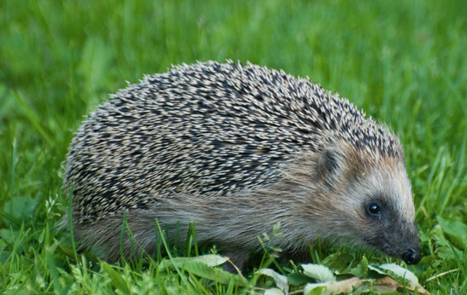
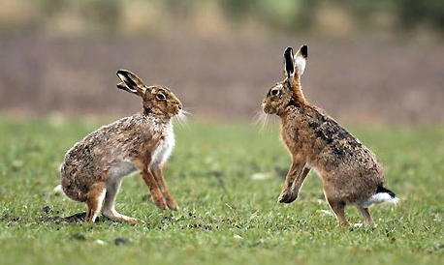
Diversity of species at ESS

Slide 11
Thank you! Questions?

