Slide 1
Configuration Management
Presented at the DOE Accelerator Safety Workshop – October 10, 2024
Michael Dayton
Oak Ridge National Laboratory

Slide 2
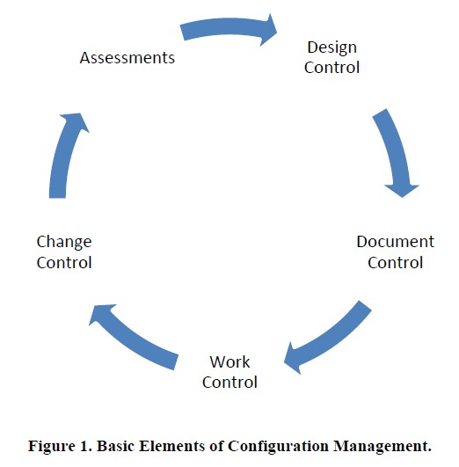
Why discuss Configuration Management at a Safety Workshop?
Because Configuration Management (CM) forms the foundation for everything we do…
The five elements of CM impact all aspects of accelerator and facility operation (and hence Safety):
Design Change
Document Control
Work Control
Change Control
Assessments

Slide 3
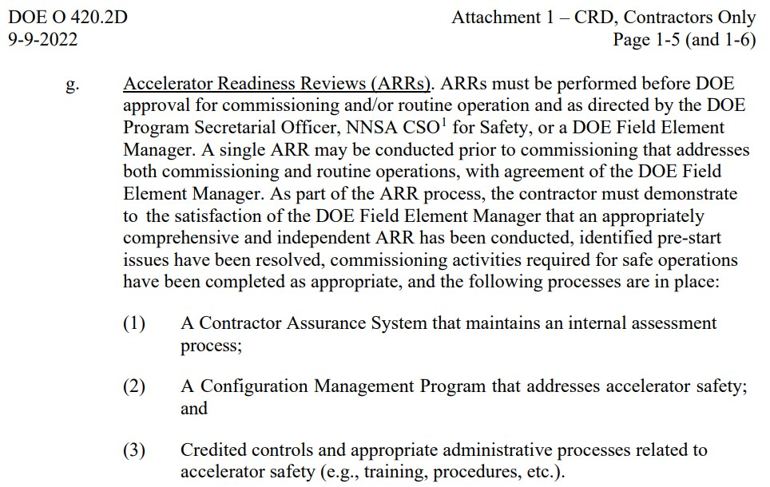
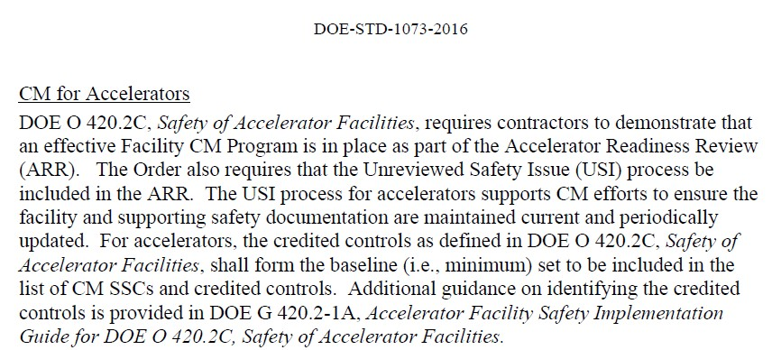
What are DOE’s CM expectations?
Configuration Management requirements for accelerators can be traced from 420.2d to DOE-STD-1073, Configuration Management:
DOE-STD-1073
420.2D

Slide 4
Graded Approach
Given limited resources, a Graded Approach must be applied based on the amount of risk assumed if things don’t go well…
From DOE-STD-1073
“The goal is to apply the highest level of resources to the most important equipment…”

Slide 5
How to define important equipment?
Configuration Management (CM) is recognized at SNS as the critical foundation to most everything we do.
Efforts have been underway for years to refine and streamline the underlying processes that enable strong configuration management:
Design Change
Document Control
Work Control
Change Control
Assessments
Our processes have been crafted to define levels of
review and approval (thru a Graded Approach) for most
of the facility – not only CECs
Recent safety incidents and ORPS reportable events
involved “routine” activities on conventional and non-
safety critical systems
Our objective is to make it easier for employees to do the right thing when it
comes to maintaining the configuration of the whole facility – not just CECs.

Slide 6
Safety Incidents Borne out of CM Issues
Work Control Closeout
Zero Energy Check
Workers performing a minor equipment upgrade in an HVAC system electrical cabinet found that the cabinet configuration did not match the work instructions
Work was stopped and the instructions/drawings were redlined and approved to safely proceed but this updated documentation was not archived
During a subsequent maintenance outage, an additional cabinet was modified, and a new crew of workers did not recognize the out-of- configuration situation and proceeded to install the update. One worker received a shock during the install.
Lack of configuration management during work package closeout directly contributed to the incident.
Workers relocating breakers in an existing electrical cabinet performed LTV (LOTO) prior to performing the work. A zero-energy check was completed per the work instructions.
Not documented on the drawings or work instructions was an additional breaker/circuit in the cabinet that was still energized.
Workers proceeded and encountered arcing when trying to relocate the energized breaker.
Lack of configuration management relative to drawing updates resulted in a live circuit that was not documented on the cabinet drawings.

Slide 7
CM is the Gift That Keeps on Giving
Fundamentally, appropriate CM ensures that the configuration of the facility is properly documented
Adequate control of facility configuration provides several benefits:
Facility modifications and upgrades benefit from good documentation when the “baseline” configuration is known – better efficiency in the design process
Change implementation is improved as “field changes” are mitigated when everything “fits right the first time” – rework and modifications are minimized
Work control and maintenance is more efficient when the field matches the work instructions and replacement parts are the correct part number

Slide 8
Final Thoughts
Configuration Management is hard. It is resource intensive. It adds inertia to processes and workflows.
Configuration Management is also vital to the safe and efficient operation of facilities.
Finding the right balance is the challenge…

