Slide 1
LWFA safety measures @ ATF, BNL
Naveen Pathak
Stony Brook University
DOE Accelerator Safety Workshop, BNL, NY

Slide 2
LWFA experiment collaborators
Stony Brook University
V. N. Litvinenko (PI), N. Vafaei-Najafabadi (PI), R. Samulyak,
I. Petrushina, A. Jain, A. Gaikwad, A. Cheng, P. Kumar
Brookhaven National Laboratory
I. Pogorelsky (PI), M. Fedurin, M. Polyanskiy, M. Babzien, W. Li,
Accelerator Test Facility (ATF)
K. Kusche, M. Palmer
University of Texas at Austin
M. Downer (PI), R. Zgadzaj, Y. Cao, B. Dinh. J. Welch, G. Tiwari
University of California Los Angeles
C. Joshi (PI), A. Farrell, M. Sinclair, C. Zhang, Y. Wu. K. Miller

Slide 3
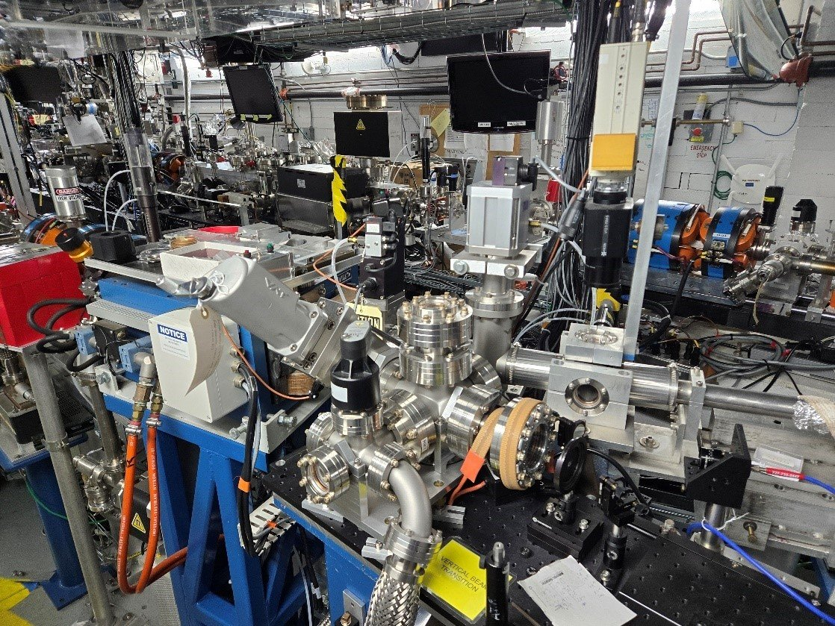
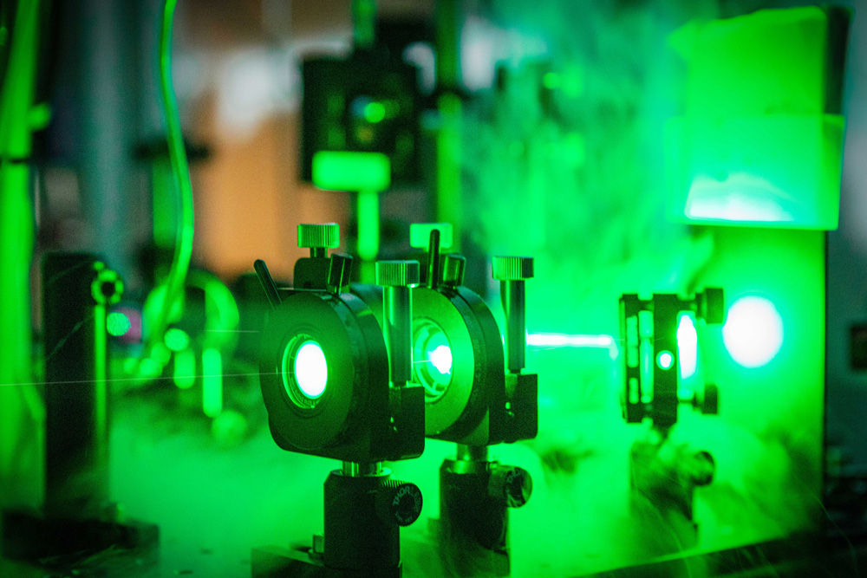
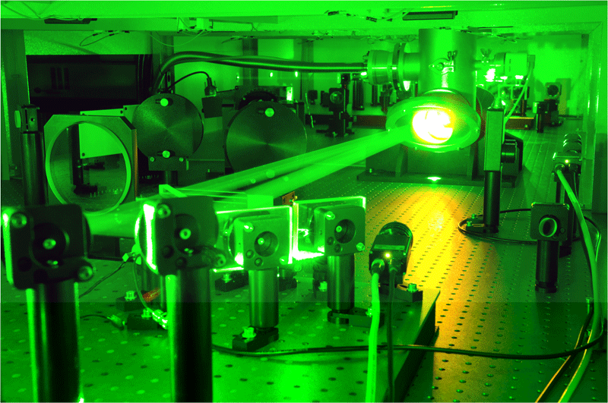
Accelerator Test Facility (ATF) : a unique experimental platform
Facility integrated with
An electron accelerator
High Power CO2 laser
High Power Ti:Sapphire laser
(50-70 MeV, 500 pC)
(2 ps, 5 TW, λ = 10 μm)
(80 fs, 0.4 TW, λ = 0.8 μm)
Linear accelerator
Main laser pulse
Auxiliary laser pulse
ATF provides an unprecedented combination of scientific tools for exploring the interaction of low-density plasma with intense laser pulses, which is in high interest of laser based plasma acceleration.

Slide 4
Why ATF CO2 laser pulse for LWFA ?
Blowout regime @ plasma density of 3e¹⁵ cm⁻³
Plasma wave
Laser pulse
(1 ps, 2 TW)
Plasma wave is excited due to the ponderomotive force (PF) of a laser pulse.
PF depends on a0.
a0 = 8.55e⁻¹⁰ x λ (μm) x √
I (W cm⁻²)
Ti: Sapphire based laser pulse: λ = 0.8 μm
CO2 laser pulse: λ = 10.0 μm
Large ponderomotive force (a0) without using large energy.
Lower plasma density : instability free propagation of laser pulse in plasma !
: larger dephasing length, and therefore, high energy gain !

Slide 5
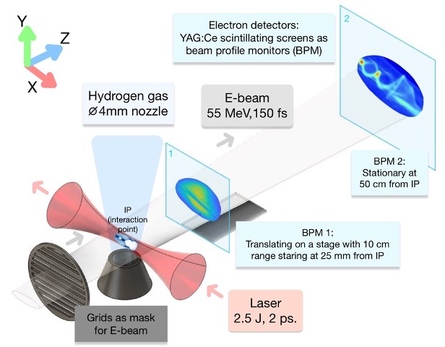
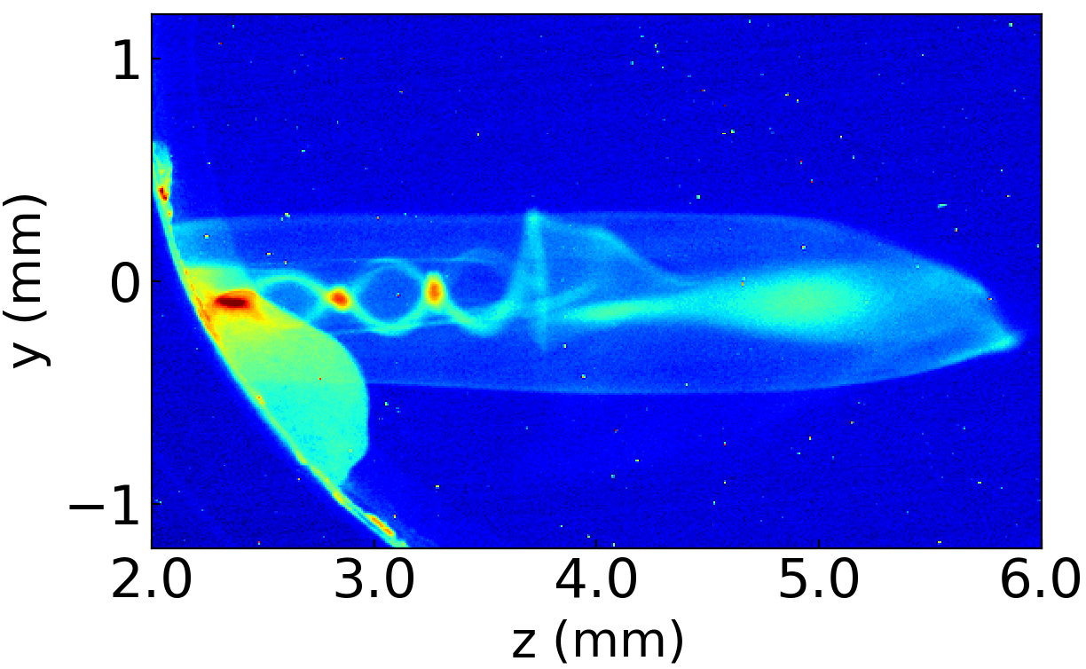
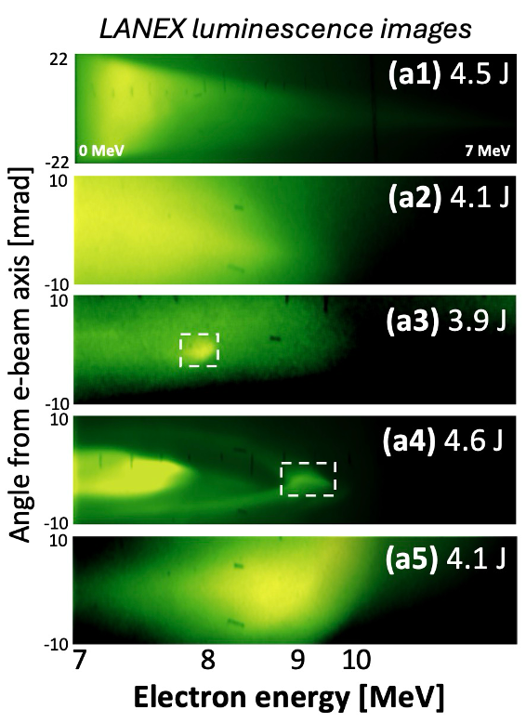
LWFA Experiments @ ATF : Concerned with the generation of high energetic particles and radiations.
Schematic of typical experimental set up
First time clear observation of wakefield in experiment
Accelerated charge approaching 1 nC
Probing wakefield
Probing wakefield
Experiment
Simulation
Understanding the wake structure for external injection.
Proper safety regulations are implemented and followed in order to ensure the safe and smooth operation of the facility.

Slide 6
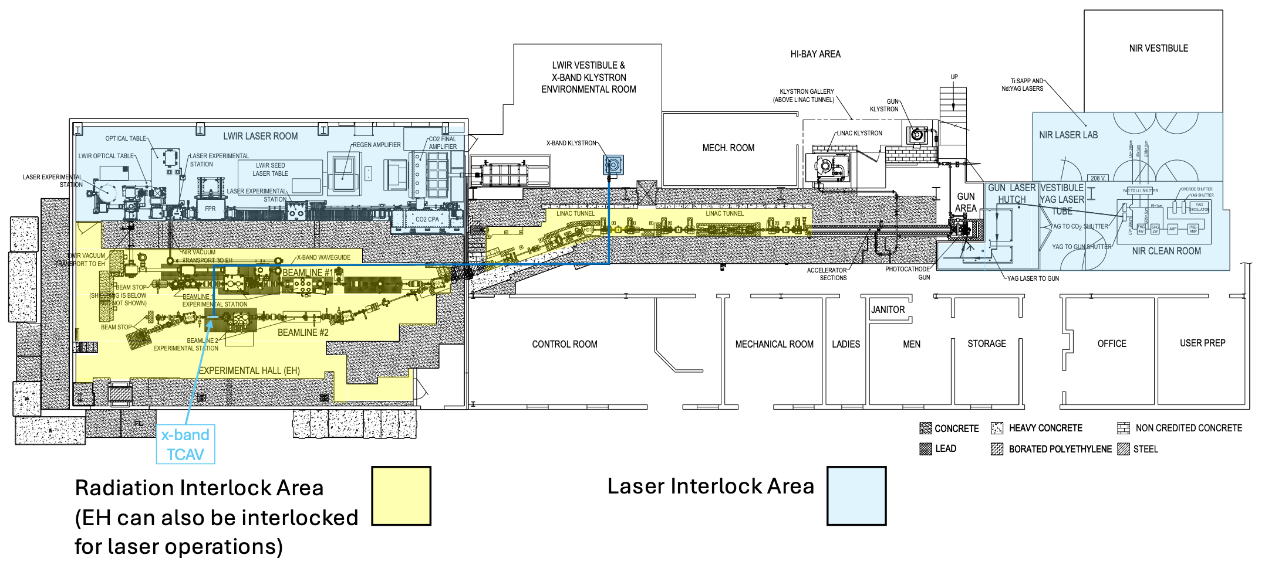
ATF Safety Approach for Novel Acceleration Techniques - I

Slide 7
ATF Safety Approach for Novel Acceleration Techniques - II

Slide 8
Thank you for kind attention.

