Slide 1
Sustainability Research
Thomas Roser, Sr. Scientist Emeritus, BNL
Chair of ICFA Panel on Sustainable Accelerators and Colliders
Accelerator Safety Workshop, Oct. 10, 2024

Slide 2
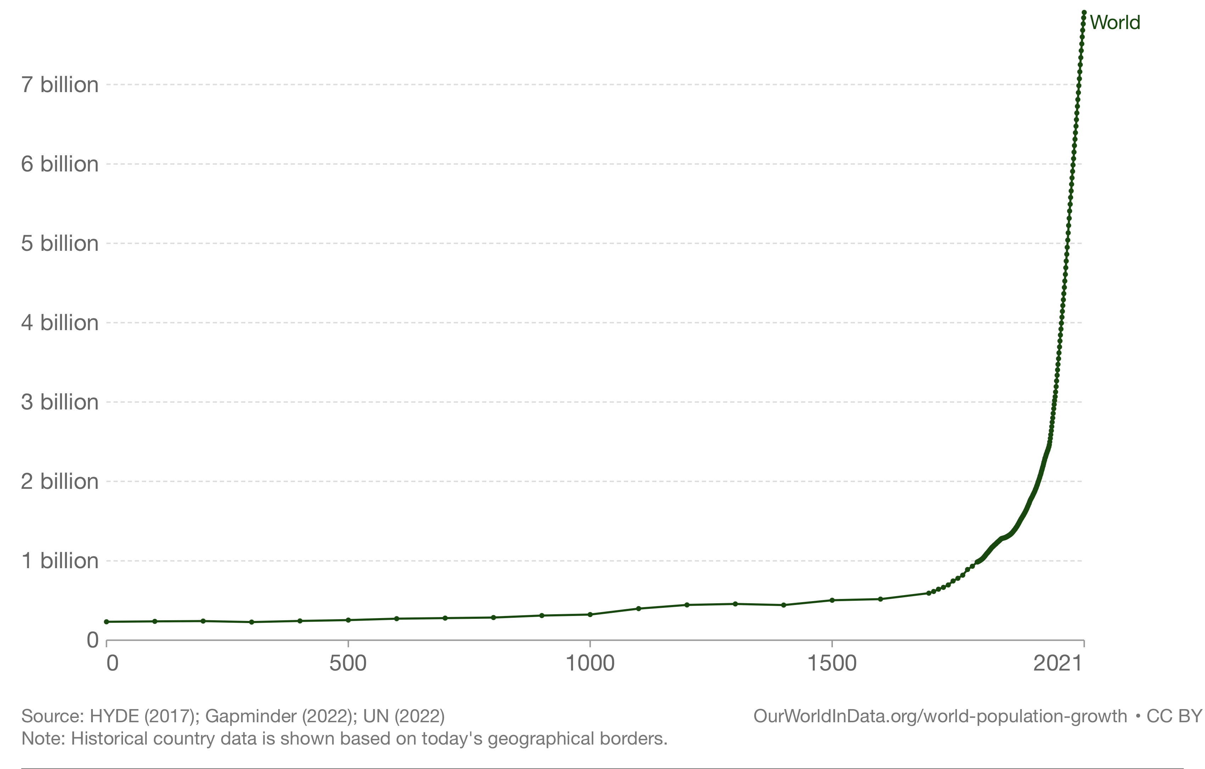
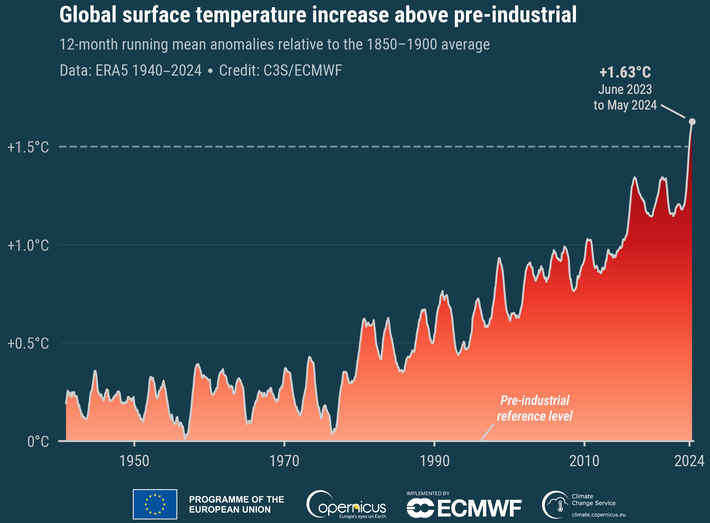
Thoughts on sustainability
World Population, 0 - 2023
The safety of human life on earth as we know it is endangered by the unsustainable exploitation of many natural resources.
Maybe most importantly, over the last 250 years the availability of essentially unlimited amounts of fossil fuel energy has resulted in rapid population growth and unsustainable use of many natural resources.
The most urgent issue but certainly not the only one: CO2 from burning fossil fuels accumulates in the atmosphere and heats the planet. CO2 in the atmosphere is the primary determinant of the earth’s average surface temperature.
The future accelerator projects will overlap in time with increasingly more extreme weather events around the world and urgent demands to cut CO2 emissions.

Slide 3
How to reduce CO2 emissions – the importance of reduced energy consumption
Human-caused CO2 emissions are mainly the product of three factors:
  Number of people x
  Energy consumption per person x
  CO2 emission per energy produced.
Present actions have no noticeable effect! Actions on each of the three factors are urgently needed:
  (1) World population:
  Growth is slowing mainly due to reduced poverty and increased equality for women.
  (2) Reduce energy consumption per person by increasing energy efficiency for all activities (cultural change and technological innovation): Increasing energy efficiency is very feasible and can be implemented quickly. Interesting approach: “2000W Society” in Switzerland: Numerical goal for primary power consumption of 2.0kW per person (Now: US: 9.0kW, Europe: 4.4kW, China: 3.6kW, India: 0.8kW, World: 2.4kW, required food for humans (subsistence): ~ 100W)
  (3) Switch to carbon-neutral energy sources on a large scale (technological innovation): No detectable reduction of annual growth of atmospheric CO2 concentration even after massive investments. Note that the low-density energy sources (solar and wind) require much more hardware, resources and energy investment per energy produced than the high-density energy sources (fossil fuel, nuclear).
  Today, only nuclear energy has the demonstrated scalability to completely replace fossil fuels.

Slide 4
What can the Accelerator Community do?
Sustainability regarding CO2 emissions mainly consists of both reducing total energy consumption and transition to carbon-neutral energy sources. Such an approach needs to be applied to all accelerator projects and facilities.
We need to focus on the development of energy efficient accelerator technologies with the same priority as achieving higher performance. Every new facility should prioritize low energy consumption, even if it means that the project is delayed to do the necessary R&D.
Like the 2000W Society idea, a numerical goal or budget for the energy consumption of accelerator-based user facilities could be a useful concept. For example, a goal for the maximum power consumption per user could be defined (5 – 10 kW per user?). (LHC: 10000 users, 120 MW, 12 kW/user; NSLS II (light source): 2000 users, 6 MW, 3 kW/user ; RHIC: 1000 users, 25 MW, 25 kW/user)

Slide 5
Areas of R&D to reduce energy consumption
Accelerator facilities need to produce high energy conditions. This means that energy efficiency often requires some form of recovery of the lost energy.
  More efficient power converters to DC and RF (incremental)
  Pulsed systems with energy recovery
  More efficient He refrigerators (presently 3 – 4 times worse than Carnot efficiency!)
  Recovery of process heat using heat pump technology
  Use of energy efficient components (Superconducting technology, permanent magnets, HTS, …)
  Compact accelerators using fewer resources for construction (Muon collider, Wakefield Accelerators (?), …)
  Energy efficient accelerator concepts (Storage rings, Energy Recovery Accelerators, …)

Slide 6
What can the Accelerator Community do? Carbon-neutral energy
Accelerator driven sub-critical reactors: Nuclear power is the only carbon-neutral energy source that has been proven to be scalable. The main obstacle is the treatment of the radioactive “waste”. Accelerator driven sub-critical reactors (Accelerator Driven Systems ) can transmute this waste and also generate energy. The accelerator must be highly reliable and very energy efficient. The accelerator community can do this!
Heavy ion inertial fusion: The inertial fusion experiments at NIF have demonstrated the concept: more energy was released than the energy of the laser beams used to compress the fuel pellet. However, the energy efficiency of producing the laser beams is very low. Heavy ion beams used compress the pellets can be produced with much higher energy efficiency. Fusion energy might well not be ready for many decades, but R&D of possible approaches need to be done now.

Slide 7
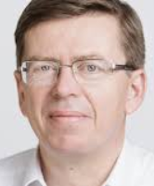
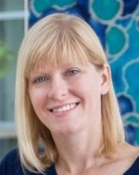
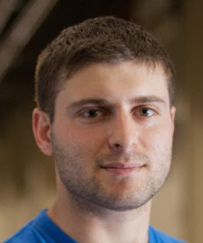

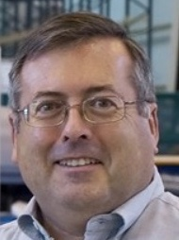
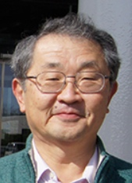

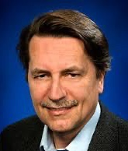
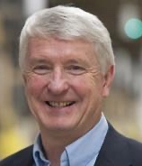
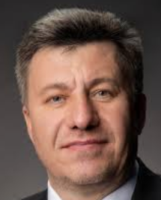
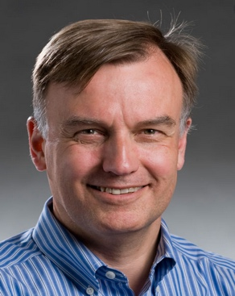

Snowmass 2021 Accelerator Frontier Collider Implementation Task Force
The Collider Implementation Task Force (ITF) was charged with the evaluation and fair and impartial comparison of future collider proposals, including R&D needs, schedule, cost (using the same accounting rules), and environmental impact and sustainability.
The full report is published in Journal of Instrumentation (TR et al, 2023 JINST 18 P05018).
Reinhard Brinkmann
(DESY)
Sarah Cousineau (ORNL)
Dmitri Denisov
(BNL)
Spencer Gessner (SLAC)
Steve Gourlay
(LBNL)
Philippe Lebrun (CERN)
Philippe Lebrun (CERN)
Meenakshi Narain (Brown U., deceased)
Katsunobu Oide (KEK)
Katsunobu Oide (KEK)
Tor Raubenheimer
(SLAC)
Thomas Roser (BNL, Chair)
John Seeman
(SLAC)
Vladimir Shiltsev (FNAL)
Jim Strait
(FNAL)
Marlene Turner
(LBNL)
LianTao Wang
(U. Chicago)

Slide 8
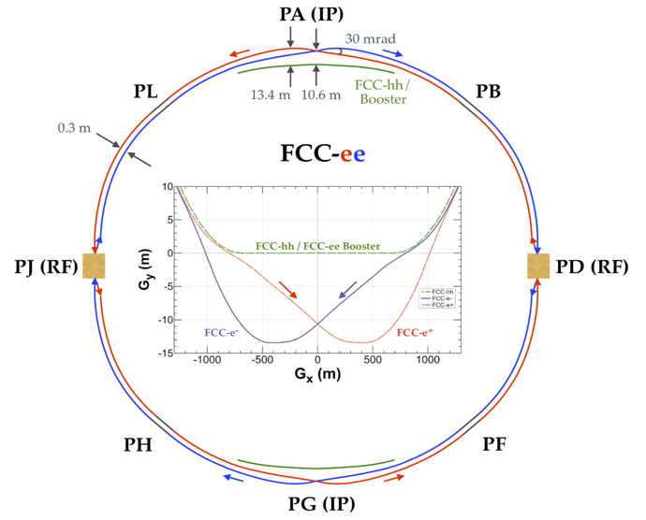
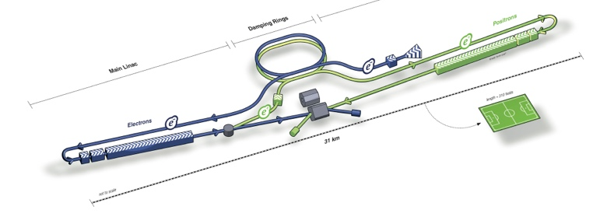
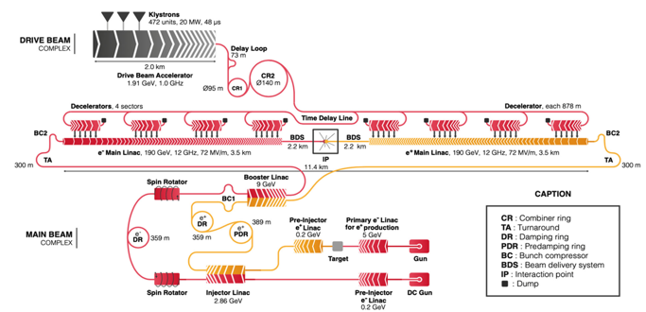

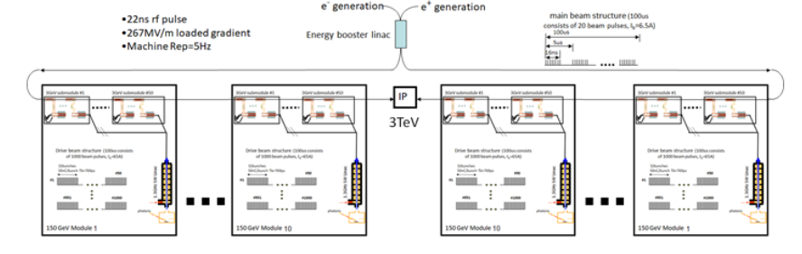
Future collider proposals: 0.125 – 500 TeV; e+e-, hh, eh, μμ, γγ, …
Storage ring colliders
Linear colliders
ERL colliders
Muon collider
Wakefield colliders
FCC-ee 0.24 TeV
FCC-hh 100 TeV
FCC-eh 3.5 TeV
CEPC 0.24 TeV
SPPC 125 TeV
SPPC-CEPC 5.5 TeV
Collider-in-the-sea 500 TeV
ILC 0.25 TeV
CLIC 0.24 TeV
CCC 0.25 TeV
CERC 0.24 TeV
ReLiC 0.24 TeV
ERLC 0.24 TeV
MC 10 TeV
10 km
PWFA 15 TeV
LWFA 15 TeV
SWFA 3 TeV

Slide 9
Higgs factory summary from Snowmass Implementation Task Force

Slide 10
ICFA Panel on Sustainable Accelerators and Colliders
Panel members:
  Europe: Mike Seidel (PSI, Switzerland), Jerome Schwindling (CEA/IRFU, France), Ruggero Ricci (LNF, Italy), Peter McIntosh (STFC, UK), Roberto Losito (CERN, Switzerland), Maxim Titov (CEA), Denise Völker (DESY)
  Asia: Takayuki Saeki (KEK, Japan), Yuhui Li (IHEP, China), Hiroki Okuno (Riken, Japan), Jui-Che Huang (NSRRC, Taiwan), Eugene Levichev (BINP, Russia)
  America: John Byrd (ANL, USA), Soren Prestemon (LBNL, USA), Thomas Roser (BNL, USA), Andrew Hutton (JLAB, USA), Robert Laxdal (TRIUMF, Canada), Mary Convery (FNAL, USA), Emilio Nanni (SLAC, USA)
Mandate:
  Assess and promote developments on energy efficient and sustainable accelerator concepts, technologies, and strategies for operation
  Assess and promote the use of accelerators for the development of Carbon-neutral energy sources.
  Formulate recommendations on R&D and support ICFA with networking across the laboratories and with communications.

Slide 11
Recent Activities of ICFA Sustainability Panel
Members of the panel biannually prepare and update summary slides of the energy efficiency efforts and plans at their labs. These summaries are very helpful to exchange information between labs and might foster a friendly competition of who can do the most.
  Many laboratories are expanding their use of Carbon-neutral energy sources. Whereas this is a highly welcome development it does not replace or obviate the need for increased energy efficiency and reduced energy consumption.
Participate in the workshop series on Energy for Sustainable Science at Research Infrastructures (ESSRI), the premier European WS on energy efficiency at accelerator laboratories. Longer term, this workshop could either be expanded to be held more internationally or similar workshop series could be established outside Europe.

Slide 12
Lifecycle analyses
All future accelerator proposals need to be analyzed for total lifecycle energy consumption (energy footprint) and CO2 emissions (carbon footprint). Such analyses should play an important role in selecting the next project.
Some large collider proposals (FCC, ILC, CLIC, CCC) have already prepared such lifecycle analyses. They cover or should cover construction of infrastructure, accelerators, and detectors, operation and appropriate decommissioning. (Recent reports: Life Cycle Assessment for CLIC and ILC, July 2023; M. Breidenbach et al., PRX Energy 2, 047001; also, RUEDI, Daresbury)
The lifecycle analyses of energy and carbon footprint should use the same main parameters such as total operating time of the facility, CO2 emission and energy consumed per ton of concrete, steel, and aluminum used, CO2 emission per GWh used, level of decommissioning required, …

Slide 13
Additional efforts of our community to reduce green house gas emissions
A large part of the carbon footprint of our community comes from attending meetings and conferences. We should increase the number of remote and hybrid meetings.
  One possibility is to limit in-person attendance to participants that can reach the site without needing a plane ride and offer equivalent participation for remote attendees from overseas. It will require a concerted effort to develop tools and organizations that can make such hybrid meetings successful.
The use of potent green house gases in our facilities, such as the HV insulation gas SF6 and detector gases, needs to be minimized and leaks eliminated.

Slide 14
Summary (ICFA Sustainability Strategy)
The worldwide “Climate Emergency” requires everybody to take urgent action, including the accelerator community.
Future accelerator projects will need to minimize resource use, especially energy consumption and CO2 emissions throughout their lifecycle from construction, operation, to decommissioning. Comparative lifecycle analyses of total energy and carbon footprint should be completed for all future accelerator projects and used as an important part of the selection process.
R&D of increased efficiency and new more efficient concepts to reduce energy consumption and CO2 emissions should be prioritized at least as high as performance and cost reduction R&D.
Efforts and plans to improve energy efficiency and reduce energy consumption of accelerator facilities should be communicated and exchanged between facilities. The ICFA Sustainability Panel is facilitating this between HEP labs and could be expanded to all major accelerator facilities.

