Slide 1
Machine Protection
Michael Costanzo
October 7th 2024

Slide 2
Machine Protection
Michael Costanzo
October 7th 2024

Slide 3
Overview
What is machine protection?
Hazard sources
Human Operators
Protection Approaches
Relation to ML / AI

Slide 4
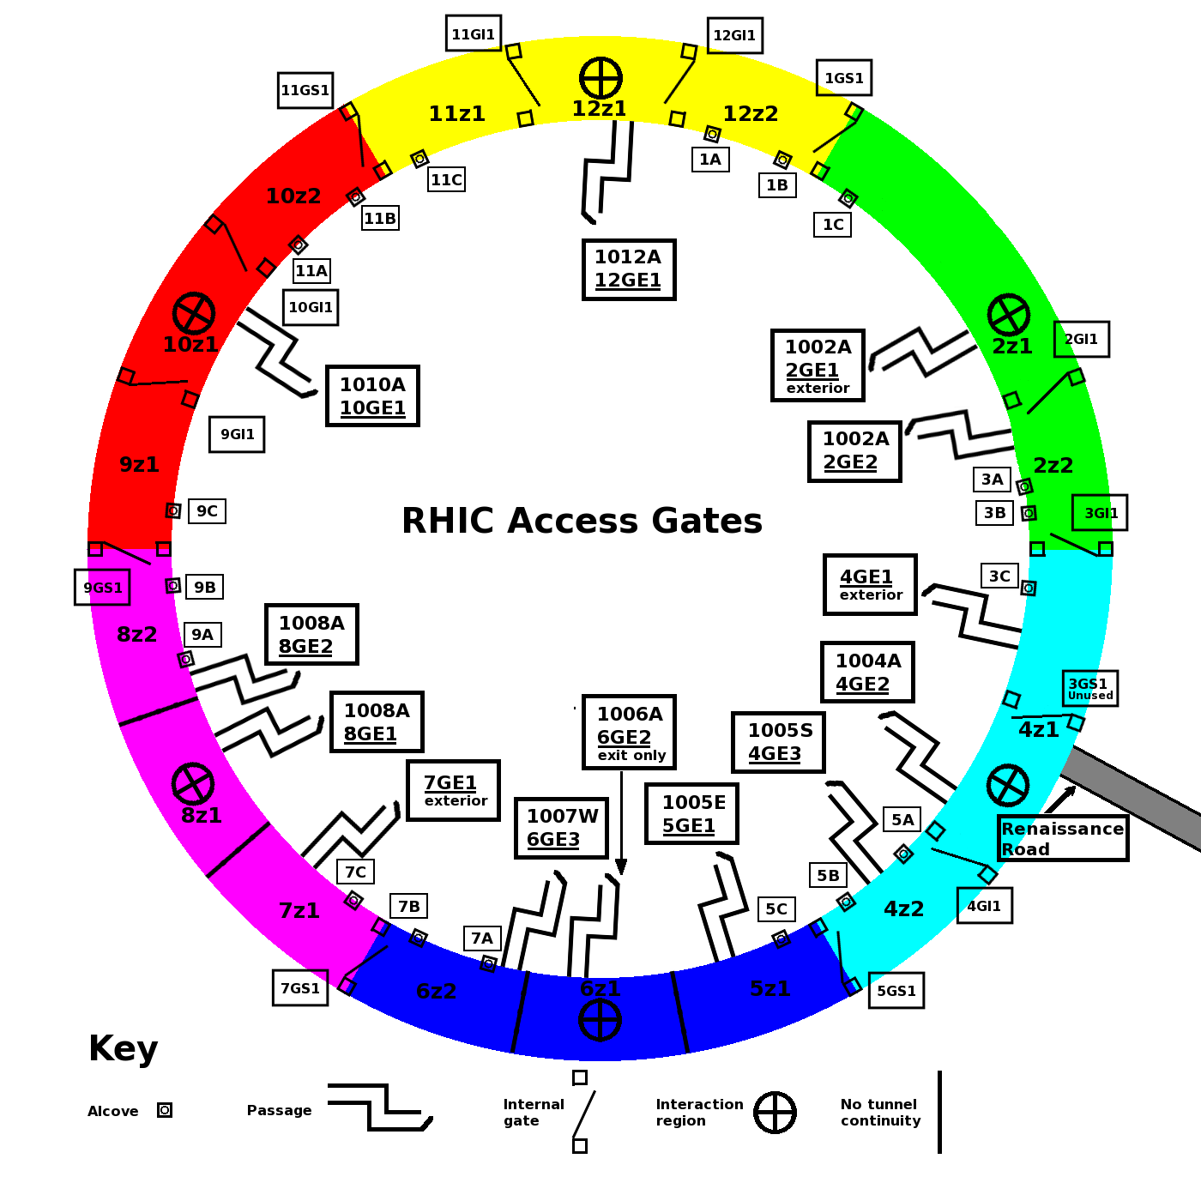
What Machine Protection Isn’t
It is not personnel protection
Personnel protection is a credited control system, distinct from machine protection
At RHIC this is the Particle Accelerator Safety System (PASS)
The primary role of PASS is to control and manage human access to beam areas
A mutex between beam and humans

Slide 5
What Machine Protection Is
System(s) to prevent damage to machine components that:
Are expensive
Cause down time
Take a long time to repair
Could have programmatic impacts

Slide 6
Protection From What?
The general themes are stored energy and energy density
Energy of a particle beam
Highly focused beam incident on a surface
Current in superconducting systems
Protect the machine from itself

Slide 7
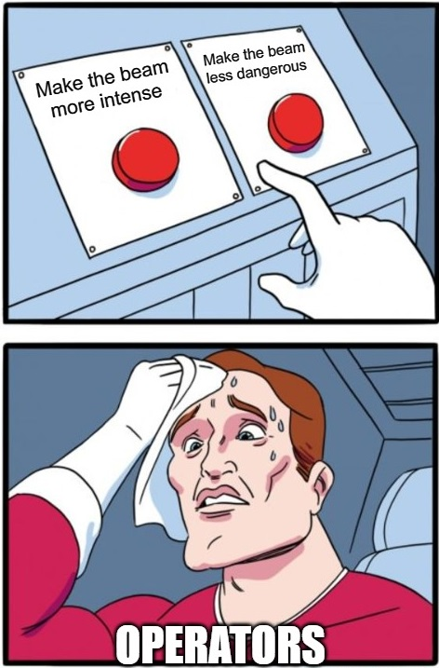
Human Operators
Operators and specialists issue control inputs
There’s an enormous parameter space
Sequencing for many operations is crucial
Contexts are often changing:
Different beams
Different modes
Non-continuous measurements
A waterfall of statuses, readbacks, and alarms

Slide 8
Timescale
Machine configuration can evolve rapidly and unexpectedly
Beams travel on the order of c
Time budget to prevent damage often in microseconds
A significant amount of alarms occur after the fact
No room for humans in the loop
CONDITION
DETECTION
LOGIC &
PROPAGATION
MITIGATION
RESPONSE
Total Response Budget

Slide 9
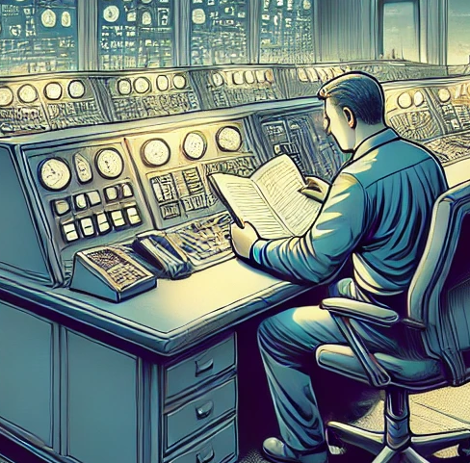
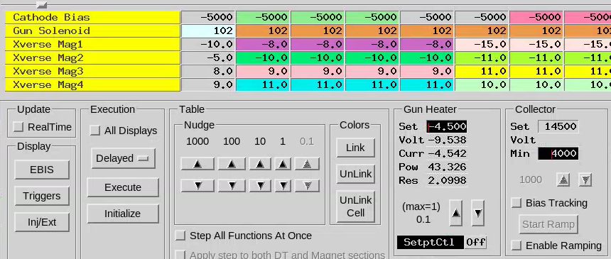
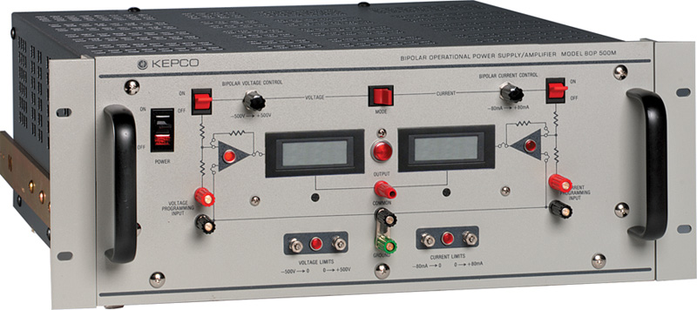
A Layered View
Elevated privileges
Required to change limits
Administrative Control
Application Level
Device Limits
Hardware

Slide 10
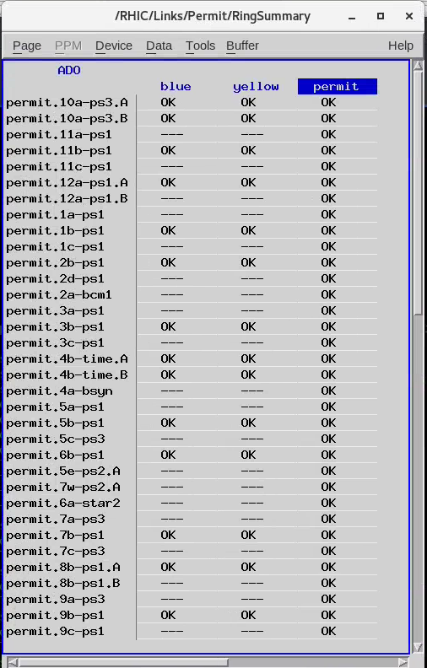
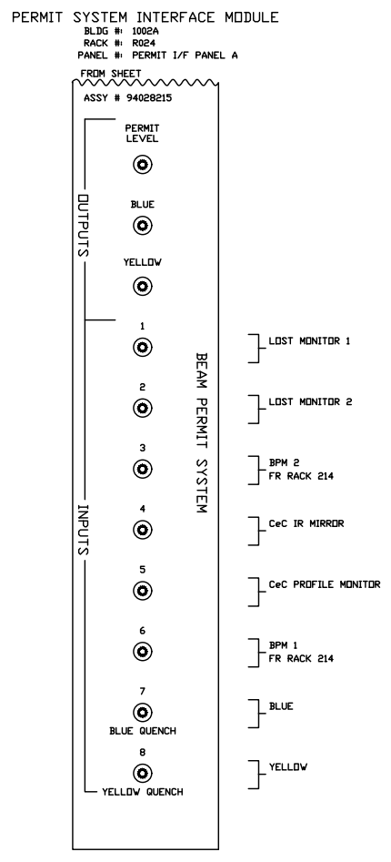
Beam Permit System
Key Inputs:
BPMs
Loss Monitors
Quench Detection
Mitigation
Abort Kickers
Beamstops
Altering permit configuration requires elevated privileges

Slide 11
MPS, Largely Independent of Operators
Operators need not intervene for MPS to take action
Beam Permit is an operating constraint
Within the ‘permit envelope’, operators exercise their discretion
Altering the Permit system is under administrative control

Slide 12
AI / ML as an operating agent
Does not bypass the protection layers
Must stay within the ‘Permit envelope’, just like human operators
No privilege to alter Permit configuration
Functionally comparable to existing feedback systems

Slide 13
AI / ML as a Detection Source
Possible early warning / preventative agent
Potentially able to synthesize large, heterogeneous data streams
May find subtle correlations and precursors
Need training data
Beam aborts are sparse (relative to the volume of data)

Slide 14
Summary
Machine Protection is fundamental to operational accelerators
Machine Protection is intentionally autonomous
Operators work within the MPS ‘envelope’
AI/ML agents must also work within the MPS ‘envelope’
AI/ML also offers the prospect of enhanced protection

Slide 15
Questions?
Comments?

