Slide 1

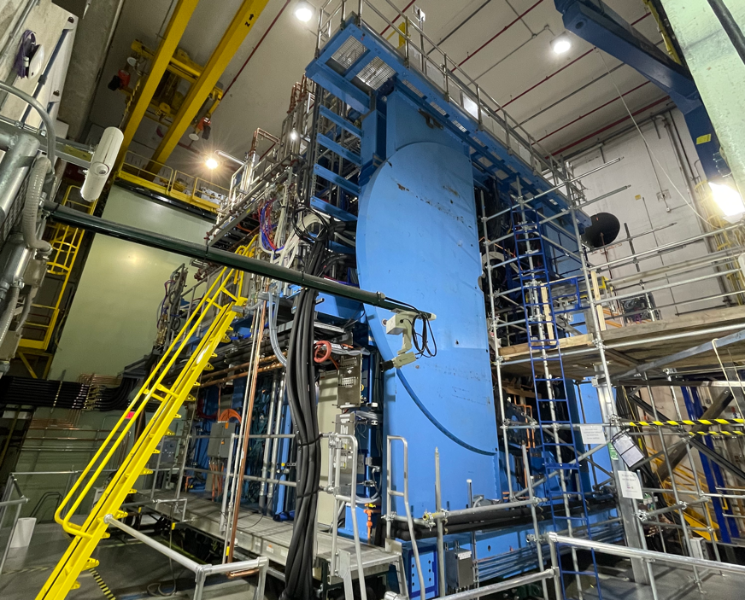



Introduction of sPHENIX & INTT
RIKEN/RBRC
Itaru Nakagawa

Slide 2
Basics of Particle Interaction
RIKEN/RBRC
Itaru Nakagawa

Slide 3
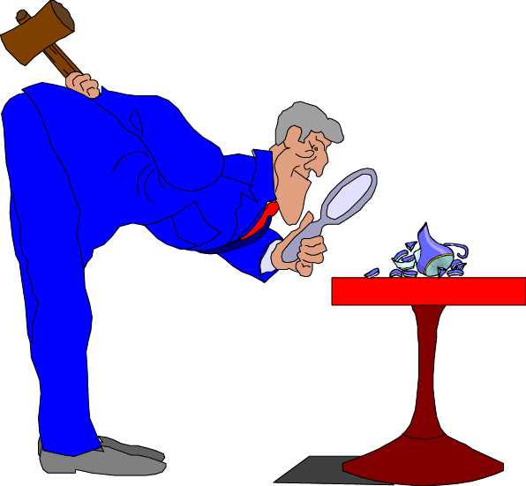
Accelerator
Detector
QGP
Notes:
What is this object made of?

Slide 4
sPHENIX detector
  General concept of the modern particle collider
    Particle flow algorithm
    The technologies
      Calorimeter: sampling (SciFi, Sandwiched, Cherenkov light detection) and homogeneous (CMS ECal made of Lead Tungstate scintillating crystal). The PMT, SiPM
      Tracker: TPC, wire chamber, silicon, etc
      Magnet: charged particle curvature by Solenoid, etc
    What is difference between Electromagnetic and Hadronic calorimeters (interaction length and radiation length)?
    The particle identification (dE/dx of TPC, TOF, AC-LGAD, etc)
  Each subsystem of sPHENIX
    Geometry, technology, specification and performance, and the role of each subsystem
  Review of the sPHENIX construction
  Some physics projections
INTT
  Introduction to silicon detector, the technology
  The detail specifications of INTT
  Role of INTT in more detail
    The (out-time) pile-up suppression
      What is pile-up?
    How the single-bunch-crossing relevant to tracking (which is important to spin program, but why?)
  The story of INTT (from scratch to ladder production to detector installation to data taking)
    Some achievements of INTT (may have some overlaps with the INTT review talk, but should be fine)

Slide 5
Basics
~particle interactions in matter~

Slide 6
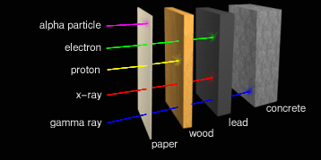
P Ra

Slide 7
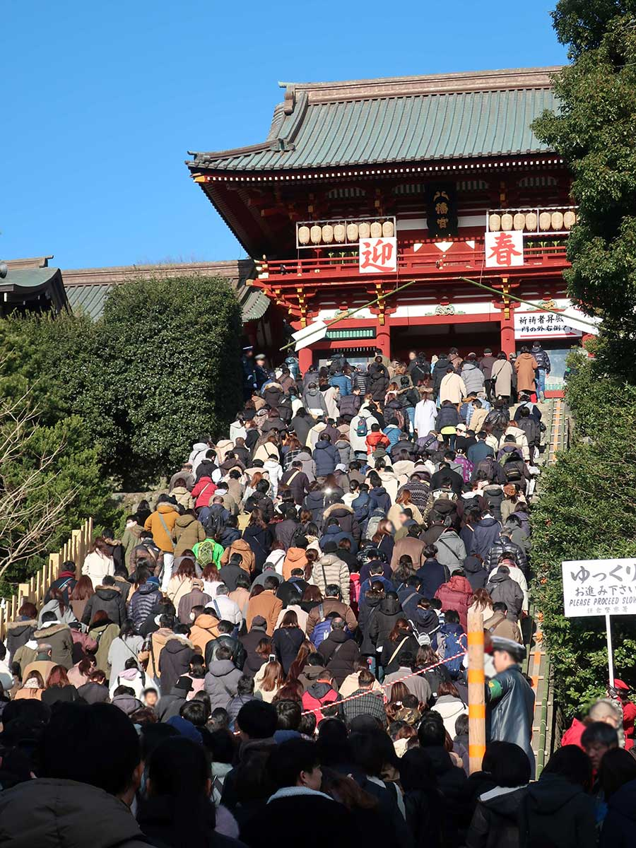

Slide 8


I am exhausted !
You’ve lost energy by interacting with people …

Slide 9
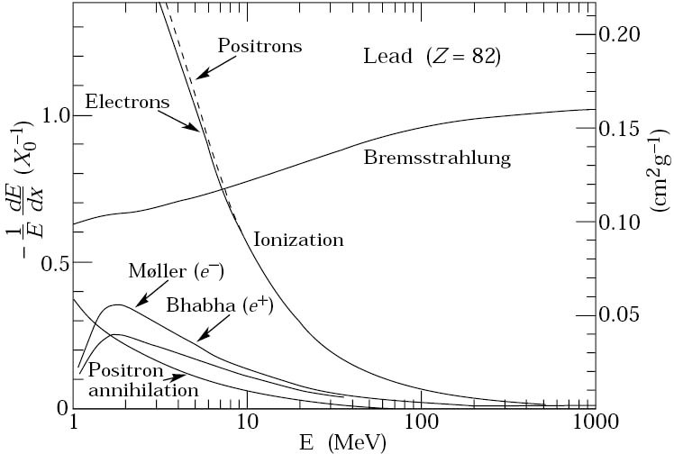
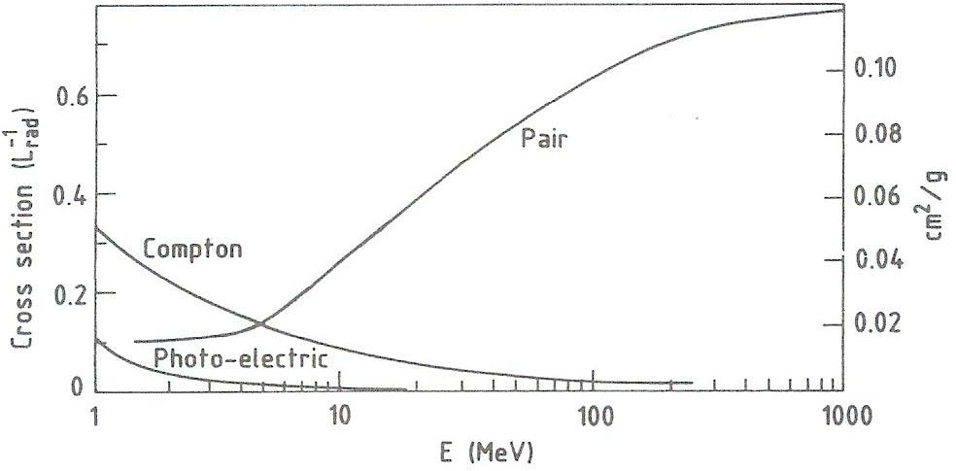
Interaction of particles with matter
Overview of interaction processes
Lead (Z=82)
Particles created in the collision of high- energy particle beams experience electromagnetic and/or nuclear interactions in the detector material they pass through
Understanding these processes are vital for the design of any detector system!
Main processes for charged particles:
  Ionization
  Cherenkov radiation
  Bremsstrahlung
C. Fabjan, 1987
Lead (Z=82)
Main processes for photons:
Photoelectric effect
Compton scattering
Pair production
C. Fabjan, 1987
NEPPSRIII
Depending on mass, momentum, species…
Craigville, Cape Cod, 08/23/2004
Bernd Surrow

Slide 10
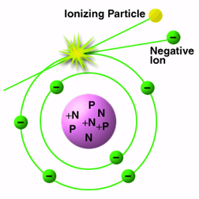
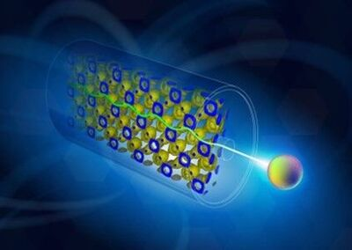
Ionization Energy Loss

Slide 11
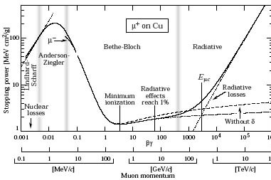






Bethe-Bloch Formula
Ionization
  Bethe-Bloch equation: Mean energy (or stopping power)
PDG, 2004
loss
-dE/dx in units of:
(MeV/cm)/(g/cm³)=(MeV cm²/g)
-dE/x for charged particles: M » m_{e}
Minimum at approx.:
(-dE/dx of relativistic particles: Close to minimum-ionizing particle (MIP)
with:
Note:
Density (δ) and shell (C) corrections at high and low energies, respectively
-dE/dx for electrons modified due to the kinematics, spin and identity of the incident electron with the medium electrons
NEPPSRIII
Bernd Surrow
Craigville, Cape Cod, 08/23/2004

Slide 12
Bethe-Block Formula
https://pdg.lbl.gov/2006/reviews/passagerpp.pdf

Slide 13
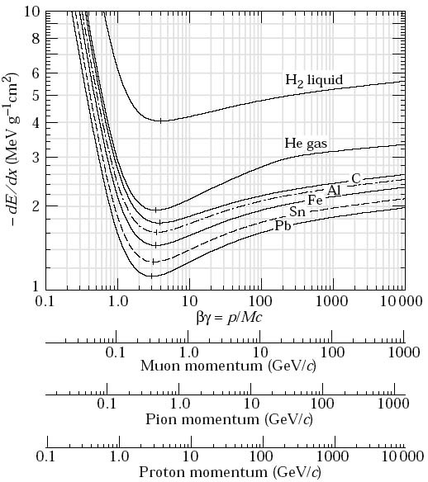
dE/dx for Various Elements
Ionization
Medium dependence
  Weak dependence on the medium, since Z/A ≈ 0.5:
Material | Z | A | Z/A | dE/dx min (MeVcm²/g) | Density (g/cm³)
H₂ (liquid) | 1 | 1.008 | 0.992 | 4.034 | 0.0708
He | 2 | 4.002 | 0.500 | 1.937 | 0.125
C | 6 | 12.01 | 0.500 | 1.745 | 2.27
Al | 13 | 26.98 | 0.482 | 1.615 | 2.70
Cu | 29 | 63.55 | 0.456 | 1.403 | 8.96
Pb | 82 | 207.2 | 0.396 | 1.123 | 11.4
W | 74 | 183.8 | 0.403 | 1.145 | 19.3
U | 92 | 238.0 | 0.387 | 1.082 | 19.0
Scint. |  |  | 0.538 | 1.936 | 1.03
BGO |  |  | 0.421 | 1.251 | 7.10
CsI |  |  | 0.416 | 1.243 | 4.53
NaI |  |  | 0.427 | 1.305 | 3.67
PDG, 2004
Scintillator: dE/dx|_{min} ≈ 2MeV/cm
Tungsten: dE/dx|_{min} ≈ 22MeV/cm
NEPPSRIII
Bernd Su
Craigville, Cape Cod, 08/23/2004

Slide 14


What do you drop?
https://www.photo-ac.com/main/search?q=この先急カーブ&srt=dlrank

Slide 15
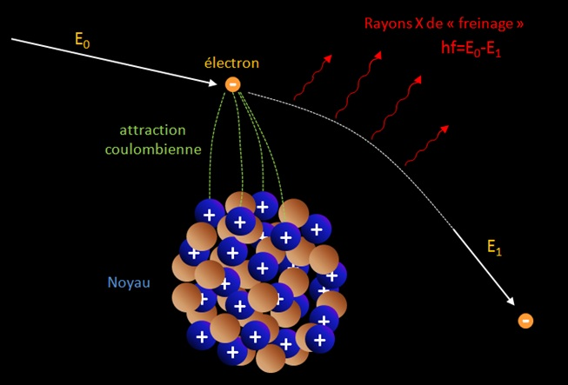
Radiative Energy Loss
Attractive Force by Coulomb Field
Nucleus
https://www.cloudylabs.fr/wp/les-processus-de-pertes-denergie-des-particules/

Slide 16
Bremsstrahlung : electromagnetic radiative energy loss
A decelerated or accelerated charged particle radiates photons. The mean radiative energy loss is given by :
fine structure constant = 1/137
medium atomic number
incoming particle energy
_{dE} rad
dx
MeV g/ cm²
m
2
−
(
)=
0.3071
α 2 2 e
E 183
Z z ( )
ln( )
A (g) ^{π}
m m_{e}
_{Z}1/ 3
incoming particle mass
incoming particle charge state
The mean radiative energy loss of a particle of charge z and mass m is a function of the mean radiative energy loss of an electron :
2
_{dE} rad _{dE}rad
dx
Electrons are much more sensitive to this effect.
m
dx
( z ,m)=( ^{e} ) z²
(e⁻)
m
http://lpsc.in2p3.fr/collot

Slide 17
Radiation Length X₀
induced by atomic electrons :
classical radius of electron : r _{e}=α / m_{e}
rad
₋dE ₍
Z ( Z +1) A
2
₍ 183 ₎
e⁻)=4 α N _{A}
r E ln
dx
e
Z
1/ 3
which can be rewritten as :
rad
₋dE ₍ −₎₌ E
where X is the medium radiation length
e
0
dx X
0
then over a path x in the medium, the mean radiated energy of an electron reads :
E^{rad} (e⁻)=E (1−e^{−x / X 0})
where x is expressed in cm or g/cm²
and :
2
716.4 A ( g )
X ( g / cm )=
0
Z ( Z +1) ln ( ²⁸⁷ )
_{Z}1/2
http://lpsc.in2p3.fr/collot

Slide 18

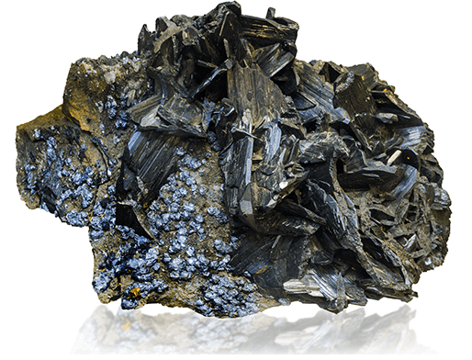
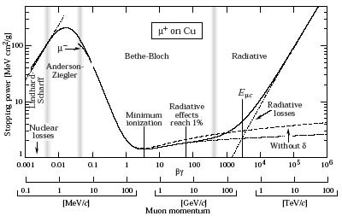
Radiation Length X₀ for Various Elements
Bremsstrahlung
  Material dependence in radiation length X₀
  Critical energy:
2
716.4 A ( g )
X ( g / cm )=
0
Z ( Z +1) ln ( ²⁸⁷ )
Material | Z | A | Z/A | X₀ (cm) | Density (g/cm³)
H₂ (liquid) | 1 | 1.008 | 0.992 | 866 | 0.0708
He | 2 | 4.002 | 0.500 | 756 | 0.125
C | 6 | 12.01 | 0.500 | 18.8 | 2.27
Al | 13 | 26.98 | 0.482 | 8.9 | 2.70
Cu | 29 | 63.55 | 0.456 | 1.43 | 8.96
Pb | 82 | 207.2 | 0.396 | 0.56 | 11.4
W | 74 | 183.8 | 0.403 | 0.35 | 19.3
U | 92 | 238.0 | 0.387 | 0.32 | 19.0
Scint. |  |  | 0.538 | 42.4 | 1.03
BGO |  |  | 0.421 | 1.12 | 7.10
CsI |  |  | 0.416 | 1.85 | 4.53
NaI |  |  | 0.427 | 2.59 | 3.67
_{Z}1/2

Slide 19

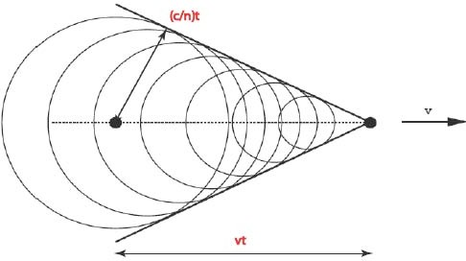



Cherenkov Radiation
Cherenkov radiation
  Definition: Cherenkov radiation arises when a charged particle in a material moves faster than the speed of light in that same medium:
Condition for Cherenkov radiation to occur:
Energy emitted per unit path length:
Example: Lead-glass (Passive absorber material = Active detector
material) calorimeter (Type SF5):
Density: ρ = 4.08g/cm
Radiation length: X₀ = 2.54cm
● Index of refraction: n = 1.67
NEPPSRIII
Bernd Surrow
Craigville, Cape Cod, 08/23/2004

Slide 20
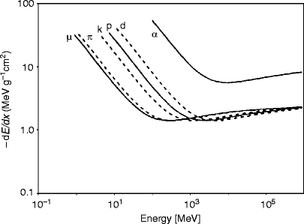
Stopping Power of Minimum Ionazation Particle
MIP
https://link.springer.com/referenceworkentry/10.1007/978-1-4419-0720-2_8/figures/3_8
https://pdg.lbl.gov/2006/reviews/passagerpp.pdf

Slide 21

Stopping Power of Minimum Ionazation Particle
MIP
https://www.researchgate.net/figure/Average-energy-loss-of-muons-in-iron_fig2_4154863

Slide 22
Photon induced Electrons

Slide 23
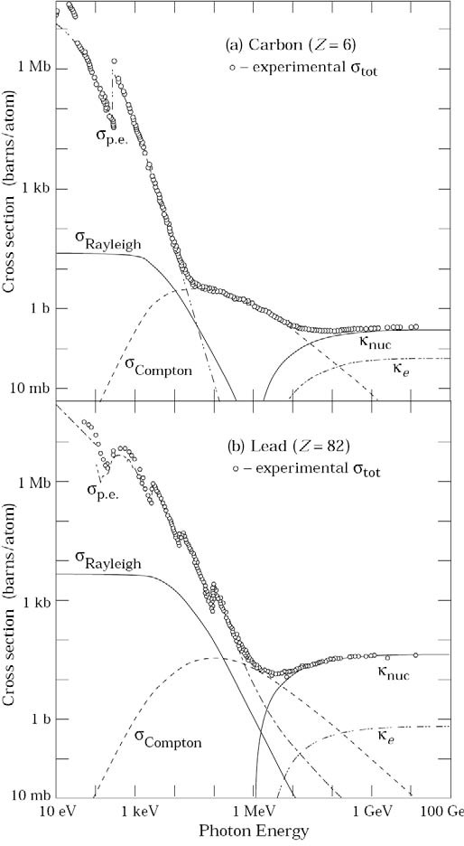




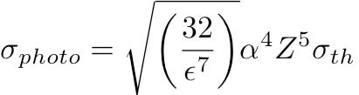





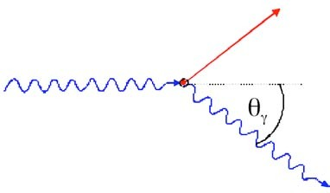







Interaction of photon with matter
Interactions of photons with matter
  Photoelectric effect
For Eη « m_{e}c² and the fact that for Eη above the K shell, almost only K electrons are involved one finds:
Compton scattering
Assume electrons as quasi-free and Eη » m_{e}c²
:
(Klein-Nishina)
Atomic Compton cross-section:
PDG, 2004

Slide 24
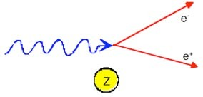


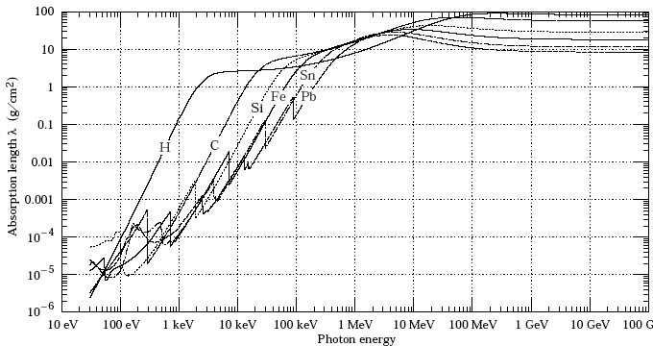


Interaction of photon with matter
Interactions of photons with matter
  Pair production
Absorption coefficient
Total probability for η inter- action in matter:
X₀ (Pb) = 6.4 g/cm²
Probability per unit length or total absorption coefficient (Inverse of absorption length λ of η):
PDG, 2004

Slide 25

Transverse Size
…
Eventually original energy is absorbed in the matter
Thickness

Slide 26

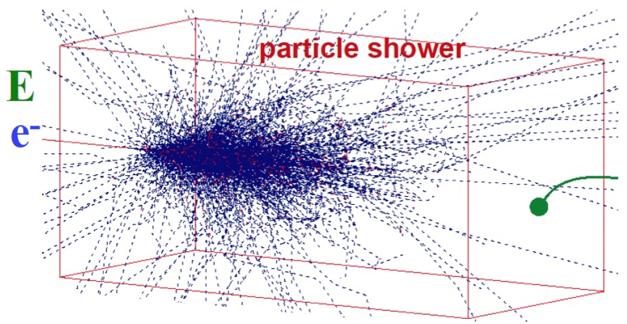
Electro-Magnetic Shower
https://www.physi.uni-heidelberg.de/~sma/teaching/GraduateDays2017/sma_Detectors_4_Calorimeters.pdf
Ends up with multiple particles and the primary particle may stop in the material

Slide 27
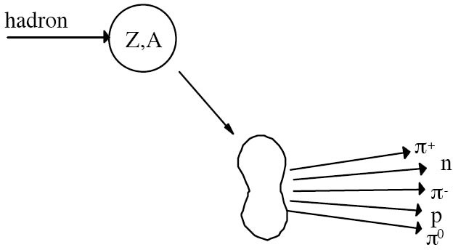

Nuclear Interaction
Nuclear interactions
  The interaction of energetic hadrons (charged or neutral) is determined by various nuclear processes:
Multiplicity ∝ ln(E) P_{t} < 1 GeV/c
Excitation and finally breakup of nucleus: nuclear fragments and production of secondary particles
For high energies (> 1GeV) the cross-sections depend only little on the energy and on the type of the incident particle (p, π, K, …)
Define in analogy to X₀ a hadronic interaction length λ_{I}:

Slide 28
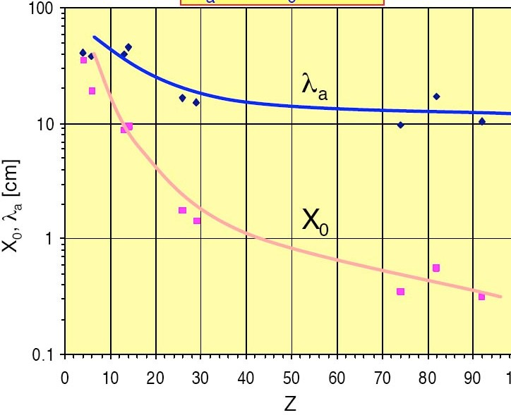
Nuclear Interaction Length in Various Elements
Comparison of nuclear interaction length (in cm) and radiation length (in cm)
Material | Z | A | Z/A | X₀ (cm) | λ_{I} (cm) | Density (g/cm³)
H₂ (liquid) | 1 | 1.008 | 0.992 | 866 | 718 | 0.0708
He | 2 | 4.002 | 0.500 | 756 | 520 | 0.125
C | 6 | 12.01 | 0.500 | 18.8 | 38.1 | 2.27
Al | 13 | 26.98 | 0.482 | 8.9 | 39.4 | 2.70
Cu | 29 | 63.55 | 0.456 | 1.43 | 15.1 | 8.96
Pb | 82 | 207.2 | 0.396 | 0.56 | 17.1 | 11.4
W | 74 | 183.8 | 0.403 | 0.35 | 9.58 | 19.3
U | 92 | 238.0 | 0.387 | 0.32 | 10.5 | 19.0
Scint. |  |  | 0.538 | 42.4 | 81.5 | 1.03
BGO |  |  | 0.421 | 1.12 | 22.1 | 7.10
CsI |  |  | 0.416 | 1.85 | 36.9 | 4.53
NaI |  |  | 0.427 | 2.59 | 41.1 | 3.67
X₀, λ₀ [cm]
λ_{I}
X₀
Z

Slide 29
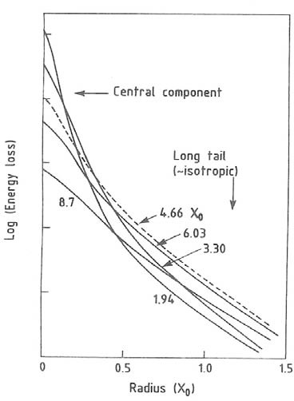
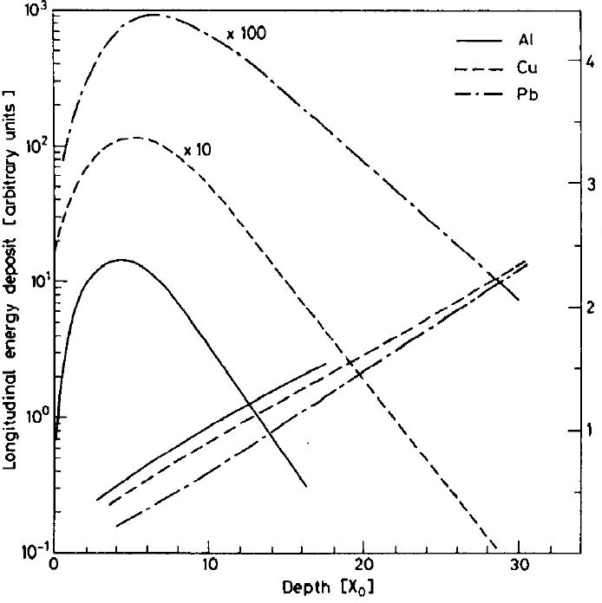
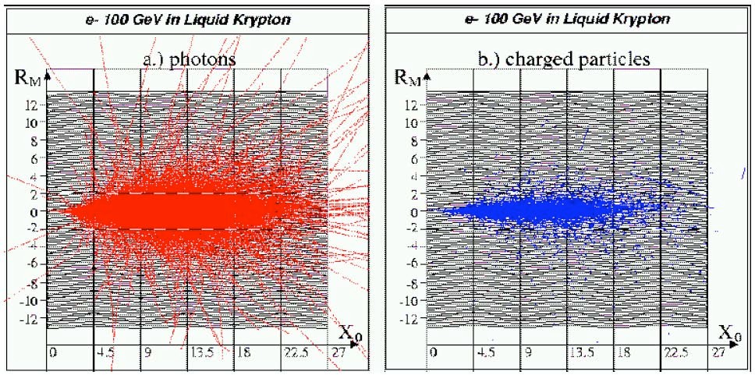
EM vs Hadron showers
Shower profile
6GeV electrons in different materials:
C. Fabjan, 1987
MC simulation:
C. Fabjan, 1987
D. Wegener, 2001

Slide 30
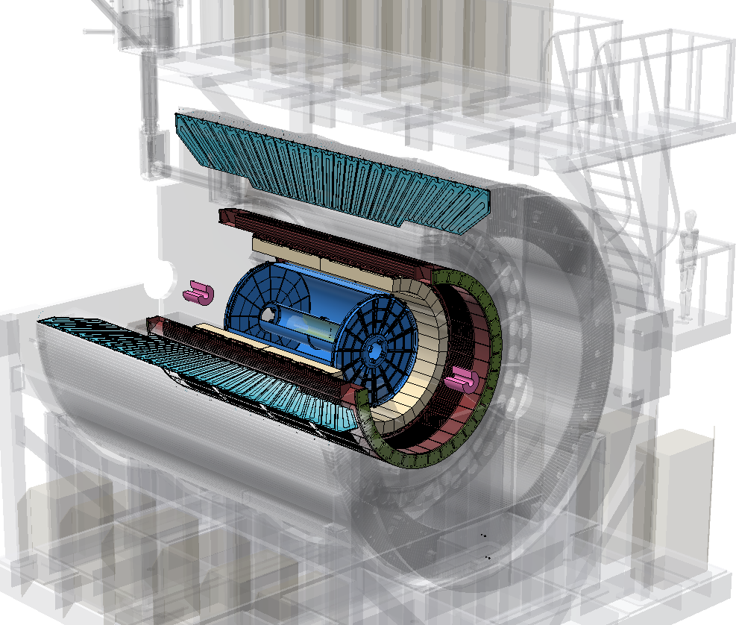
sPHENIX Detectors
Tracking
Calorimetry
Time Projection Chamber (TPC)
(TPOT not shown)
Intermediate Tracker (INTT)
MicroVertex Detector (MVTX)
Hadronic Calorimeters
Outer
Inner
Electromagnetic Calorimeter
Trigger/event characterization:
Minimum Bias Detector (MBD)
Event Plane (sEPD) (not shown)

Slide 31
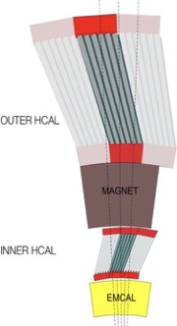
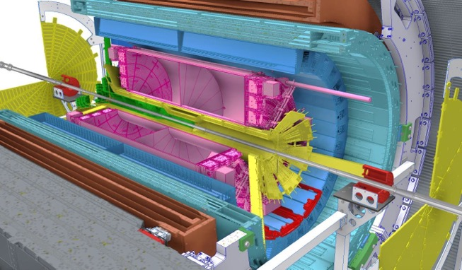




















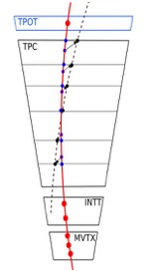





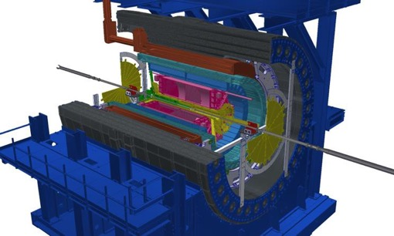




sPHENIX Detector
Calorimeter system
◙ 1.4T Solenoid from BaBar
◙ Hermetic coverage:
|η|<1.1, 2π in φ
◙ Large-acceptance EM+H calorimeters: brings first full jet reconstruction & b-jet tagging at RHIC!!
◙ High data rates: 15 kHz for
all subdetectors
◙ Precise tracking with tracking system in stream readout
sEPD
TPC
iHCal
oHCal
EMCal
MVTX
MBD
iHCal
MAGNET
INTT
oHCal
oHCal
TPOT
Tracking
system
2023 : Commissioning Au+Au
2024 : p+p, Au+Au
2025 : Au+Au … p+A?
$\sqrt{s}=$200GeV

Slide 32
Modern Experimental Detector Layout

