Slide 1
SigProc improvement with multi-plane protection (MP)
Wenqiang Gu, Xuyang Ning

Slide 2
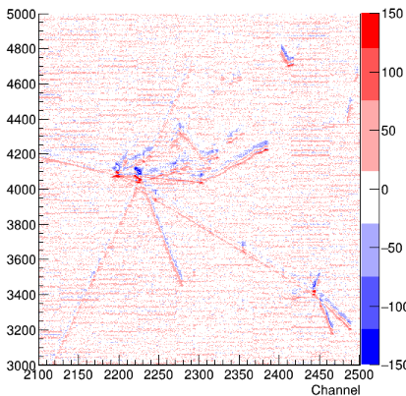
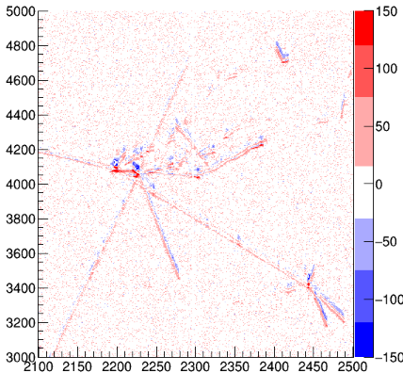
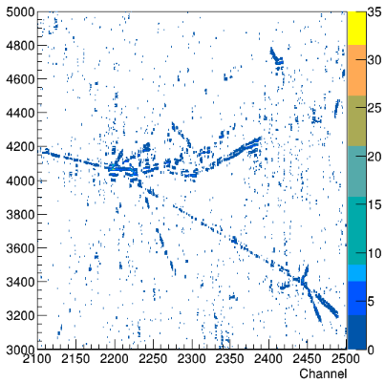
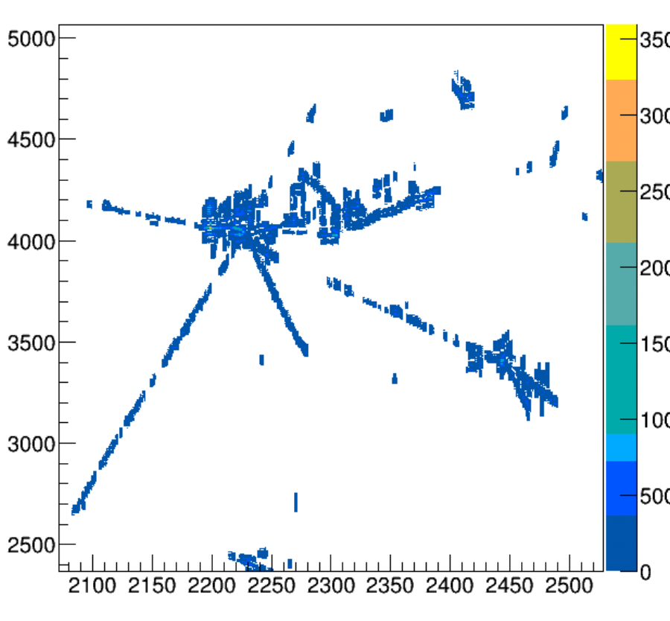
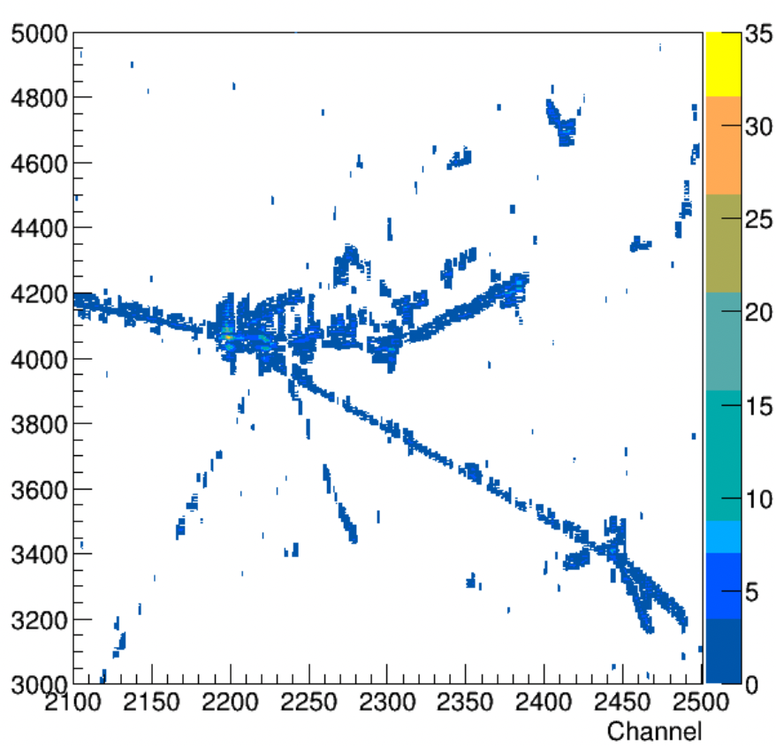
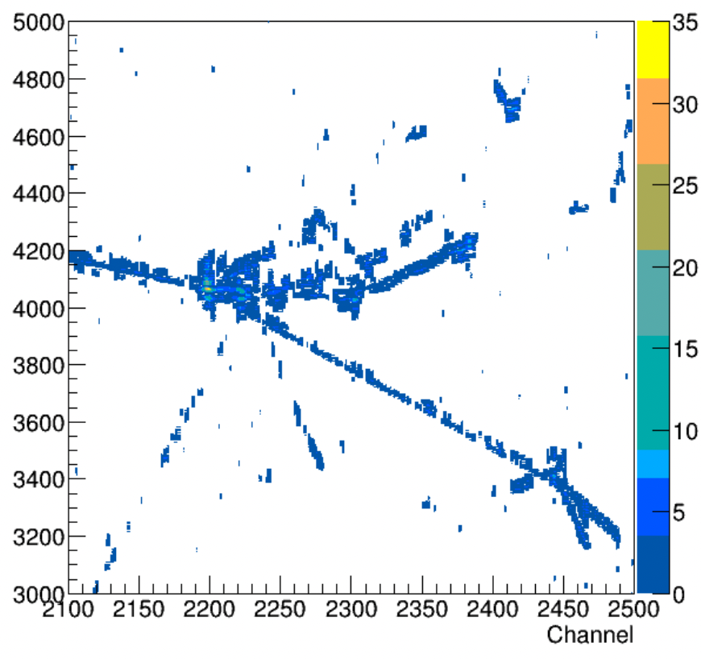
/exp/dune/data/users/wenqiang/larsuite/v09_91_03d00/test/np04hd_raw_run027380_0014_dataflow3_datawriter_0_20240622T102808_reco_stage1.root –nskip 14
Run 27380 Event 2019
APA 1 - W plane
Wiener filter: a= 0.06 MHz
Wiener filter: a= 0.12 MHz
No improvement from MP?
Raw waveform
Denoised
(CNR by Barnali et al.)
Deconvolution with new field response
(low thres. ROI: 2.5 r.m.s)
[x] Multi-plane ROI protection
[?] DNN ROI
v09_91_03d00
Improved
[x] wiener filters
[x] low-freq. filters
[?] ROI thresholds
Improvements in other planes?
Need further validation/calibration of field response
Notes:
$ source /cvmfs/dune.opensciencegrid.org/products/dune/setup_dune.sh;
$ setup dunesw v09_91_03d00 -q e26:prof
$ export WIRECELL_PATH=/exp/dune/data/users/wenqiang/larsuite/v09_91_03d00/test/wire-cell-cfg:$WIRECELL_PATH
$ export LD_LIBRARY_PATH=/exp/dune/data/users/wenqiang/larsuite/wire-cell-toolkit/install/lib64/:$LD_LIBRARY_PATH
// sp.jsonnet
plane2layer: if anode.data.ident==0 then [0,2,1] else [0,1,2],
Wiener_tight_filters: if anode.data.ident==0
then ["Wiener_tight_U_APA1", "Wiener_tight_W_APA1", "Wiener_tight_V_APA1"] // ind, ind, col
else ["Wiener_tight_U", "Wiener_tight_V", "Wiener_tight_W"],

Slide 3
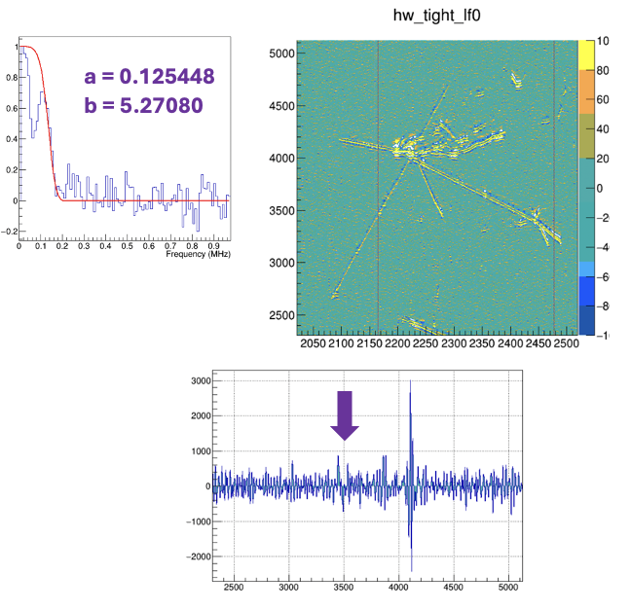
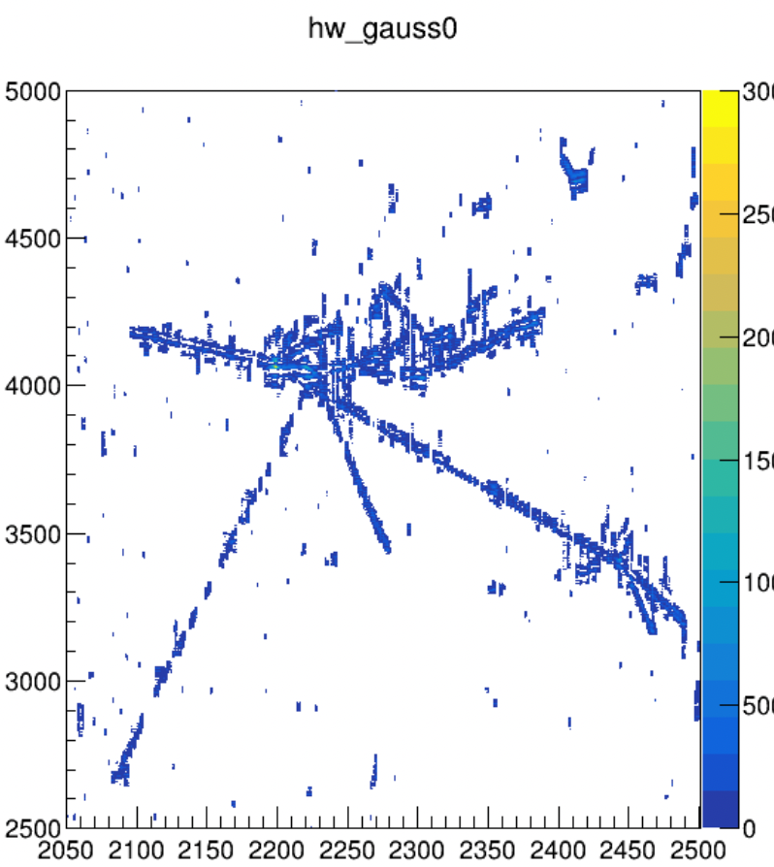
Issues for using MP2ROI & MP3ROI
Restore ROIs in CleanUpROIs?
plane -> layer for RayGrid::coordinate_t
reduce m_mp_th1 // 1000, m_mpth2 // 500\
500, 250?
Maybe not important,
connectivity can still help

Slide 4
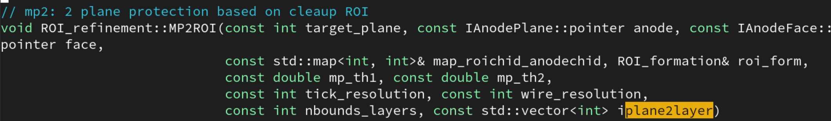
plane vs layer in MP2ROI() & MP3ROI()
iplane2layer== {0,1,2} // default
== {0,2,1} // APA1

Slide 5
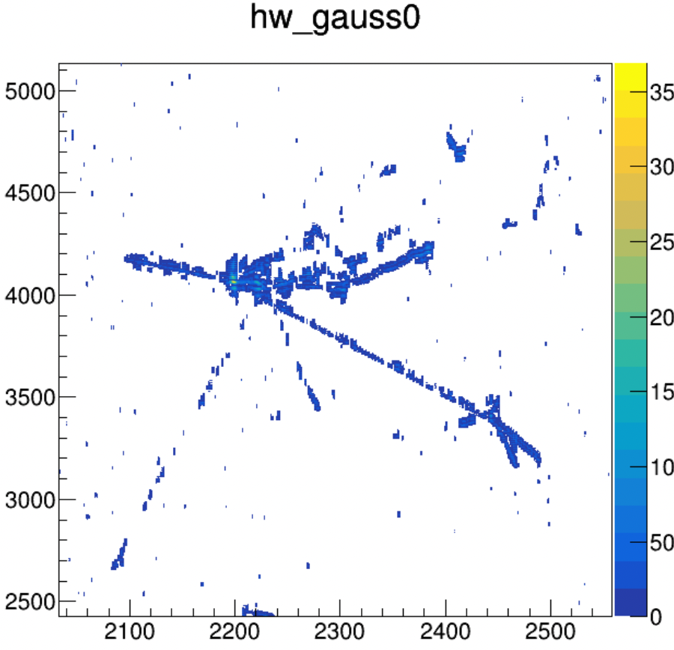
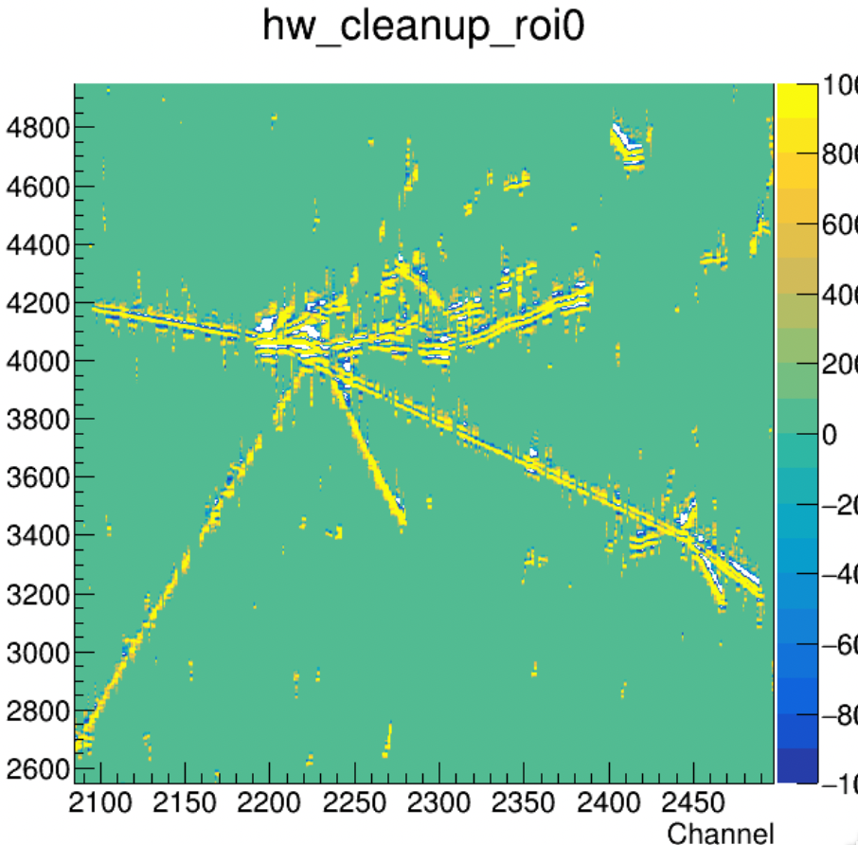
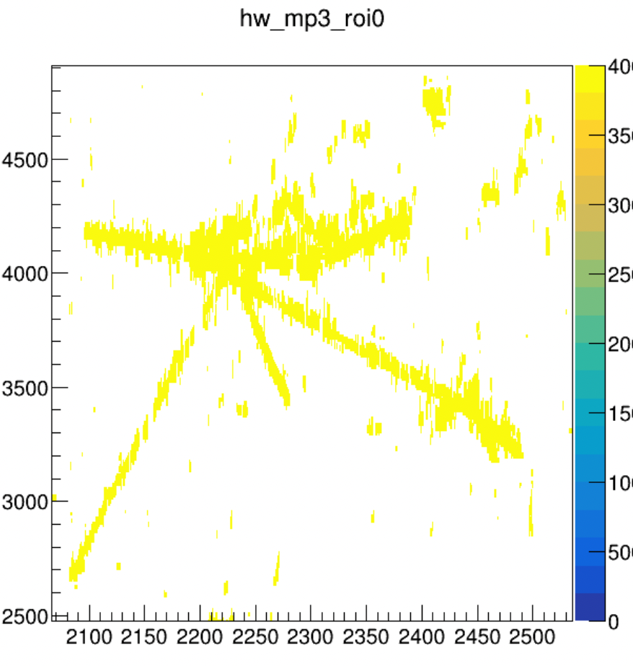
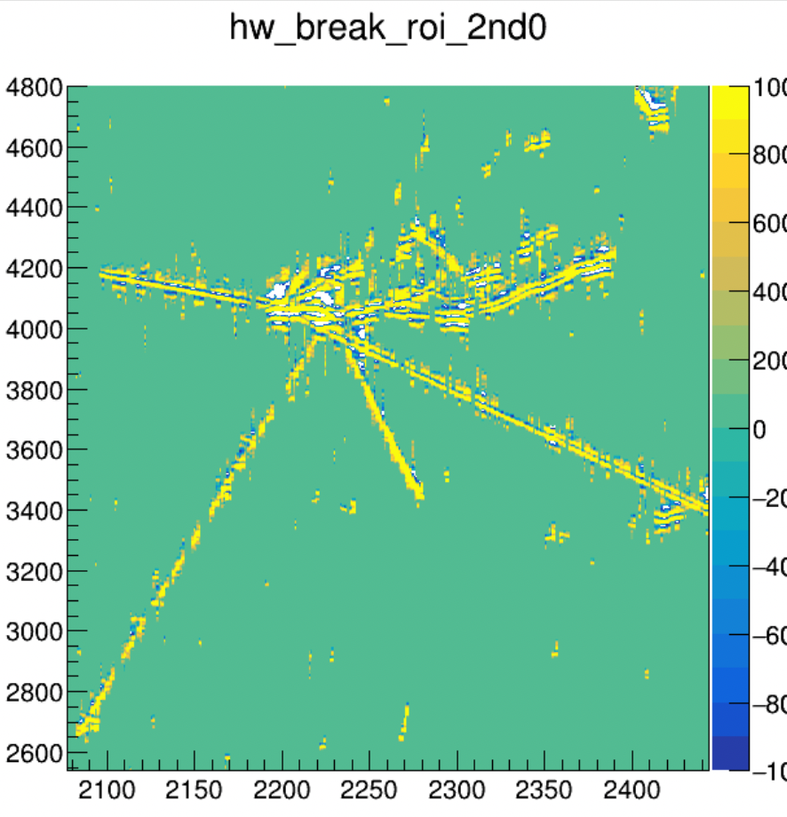
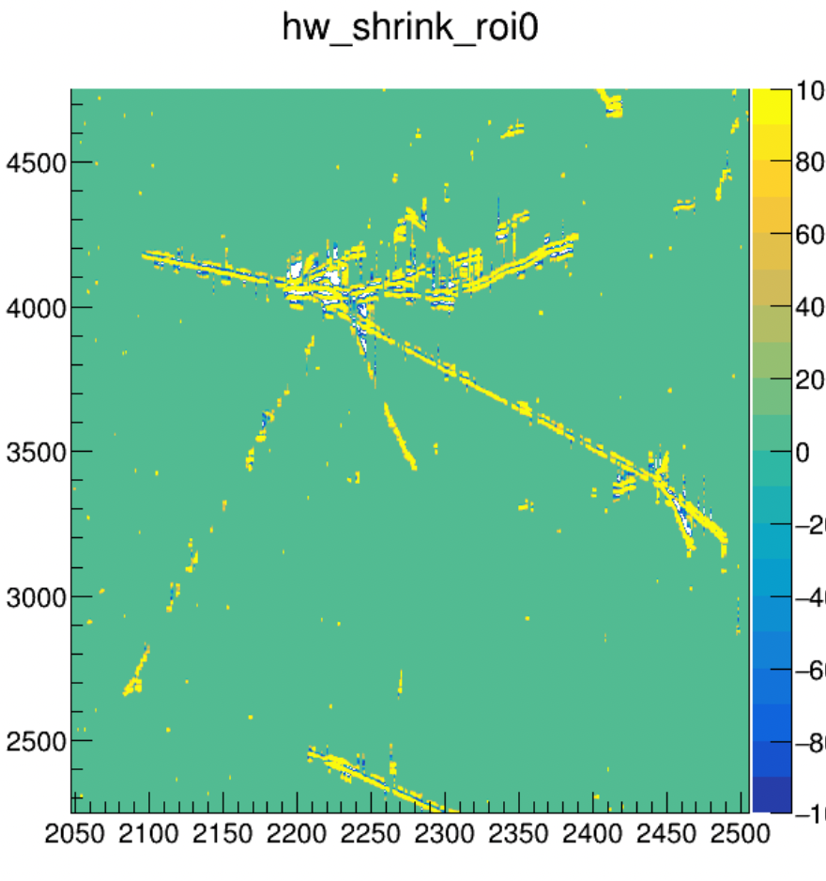
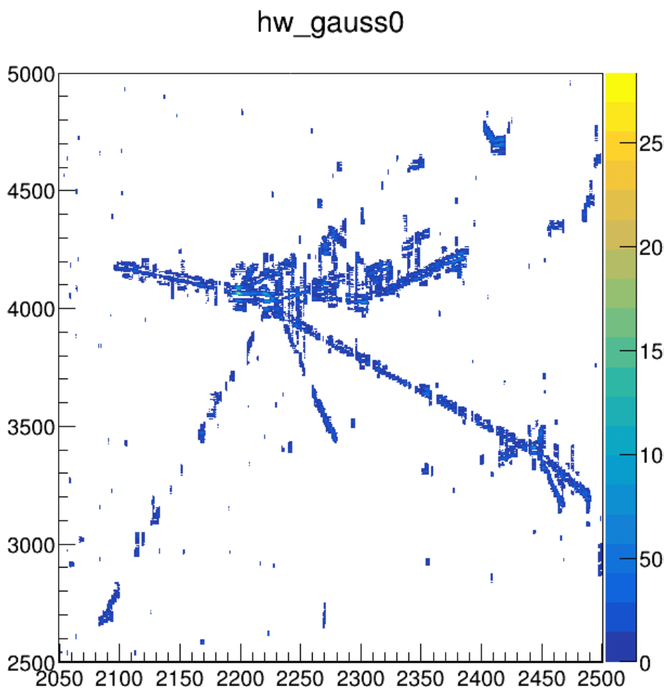
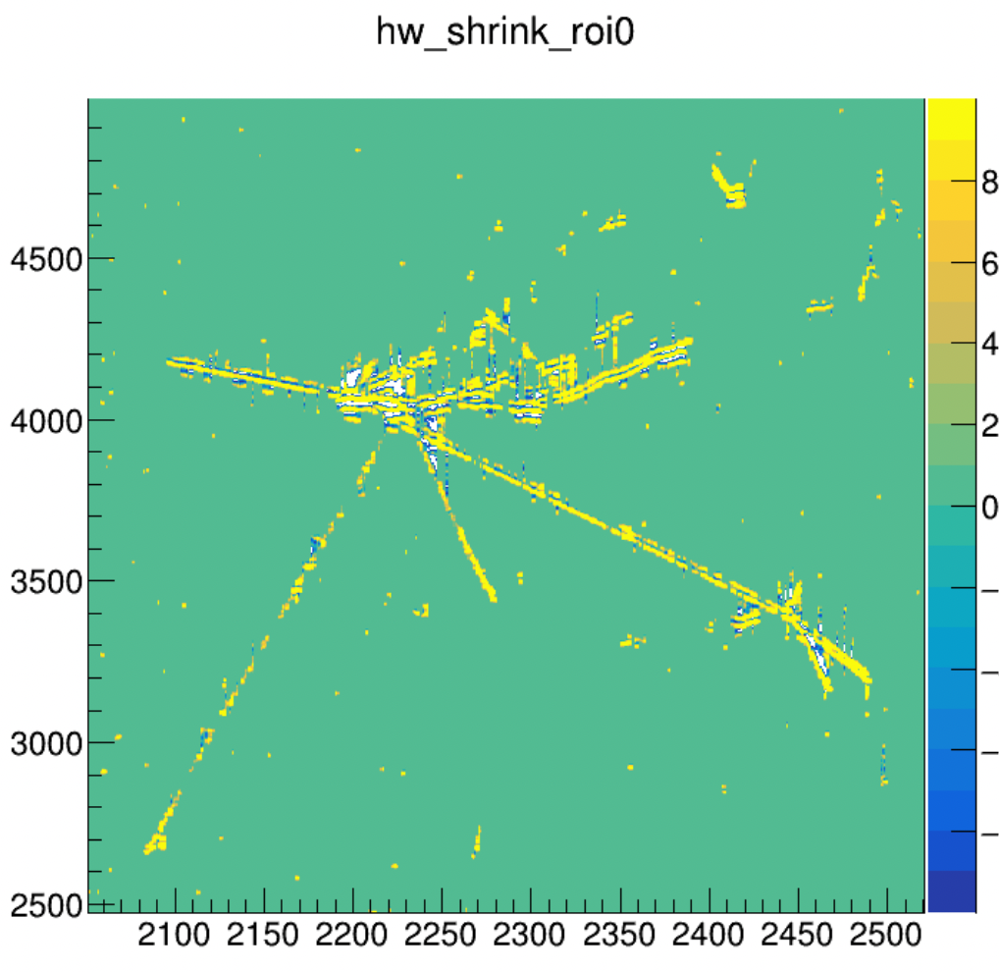
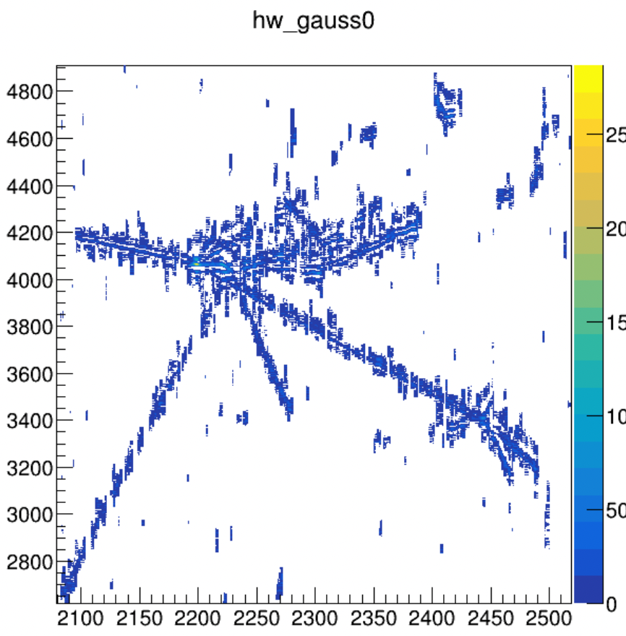
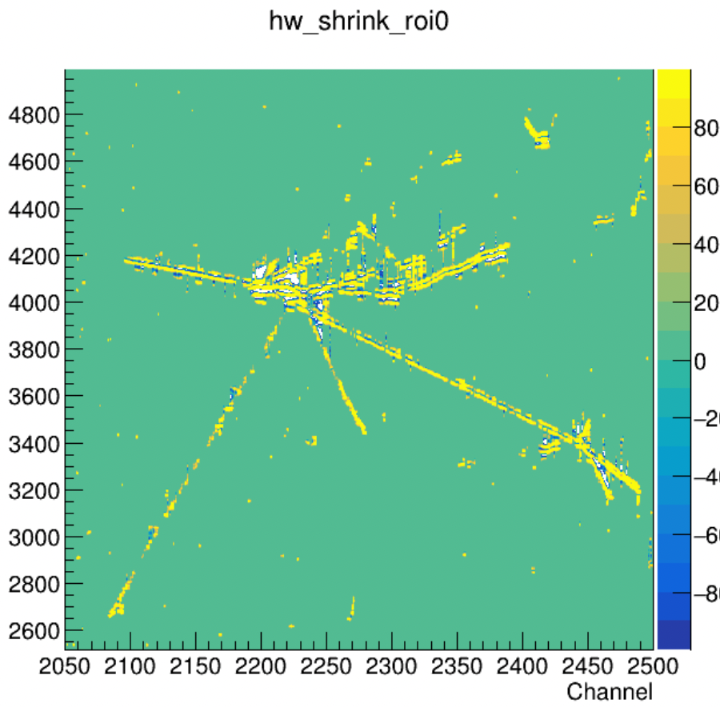
CleanUpROIs -> MP ROI -> BreakROI -> ShrinkROI
w/o MP ROI
ShrinkROIs()
+ CheckROIs()
+ CleanUpROIs()
not too bad
Wiener filter:
a = 0.12MHz
r_th_factor: 3.0 // default
CleanUpROI right after ShrinkROI diminishes some ROIs
ShrinkROIs()
+ CheckROIs()
ShrinkROIs()
w/o ShrinkROI
Notes:
tight, loose, cleanup, MP2/MP3, break (1&2), shrink, extend

Slide 6
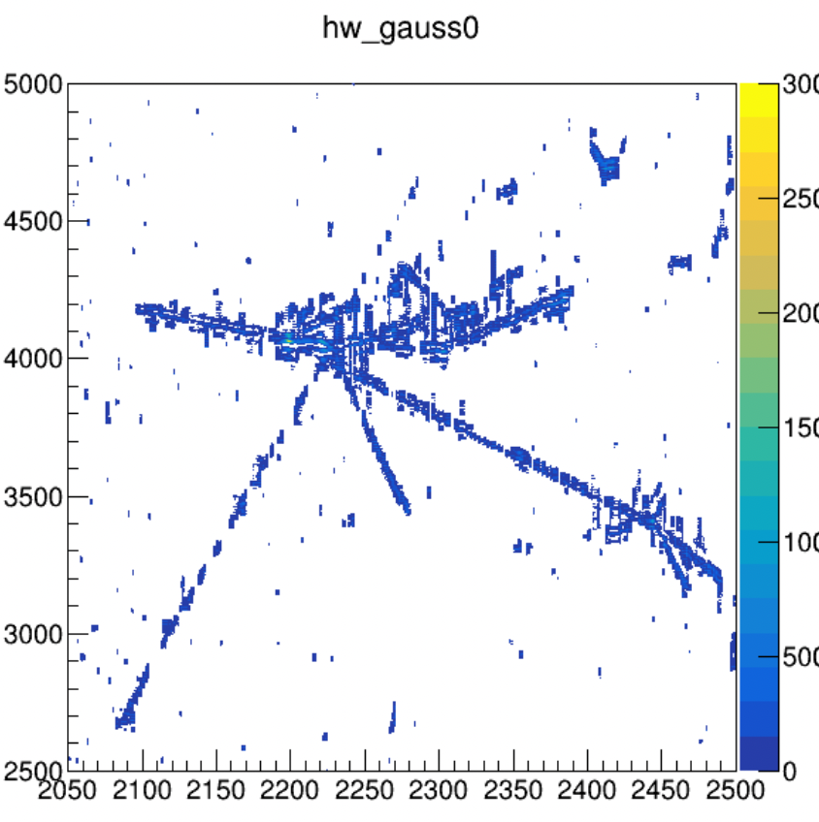
Wiener filter: a= 0.06 MHz
tight: lf, wiener
loose: lf, wiener
ROI refinement: r_th_factor: 3.0 -> 2.5
cleanup
MP2/MP3: plane->layer, mp_th1, mp_th2?
break (1&2): thr?
shrink: thr?
cleanupCol/Ind: thr
extend:
r_th_factor: 3.0 // default
r_th_factor: 2.5
mp_th1/2 *= 50%

Slide 7
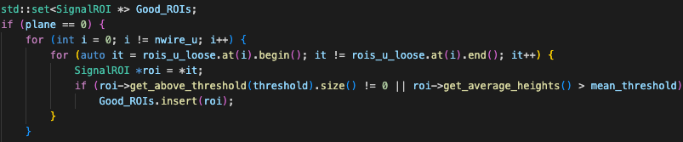
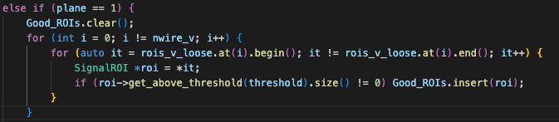
A bug in CleanUpInductionROIs ?

