Slide 1
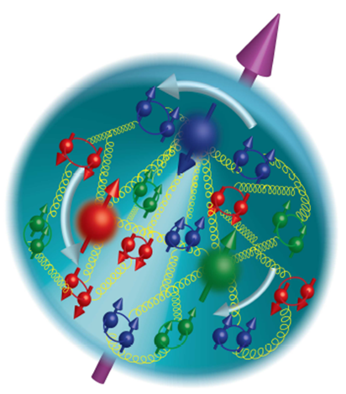
Accessing Gluon Polarization with
Di-jets: Present and Future
Brian Page
Brookhaven National Laboratory

Slide 2
Outline
Introduction: Current knowledge of proton spin and inclusive results from RHIC
Present: Current di-jet results from STAR
Near Future: Upcoming di-jet measurements at STAR
Farther Future: Prospects for di-jet measurements at an EIC

Slide 3
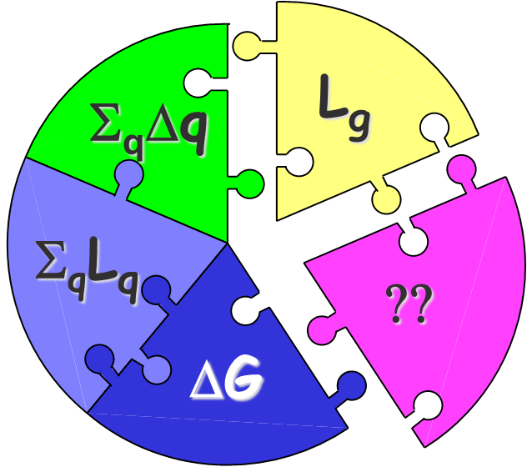
Piecing Together the Proton Spin
Simple picture of proton composed of three valence quarks superseded by complex interaction of quarks, antiquarks, and gluons
The proton’s spin must arise from combination of intrinsic and orbital angular momenta of these components
This talk will deal with the intrinsic gluon contribution, ∆G
Helicity Distributions: Δq, Δg

Slide 4
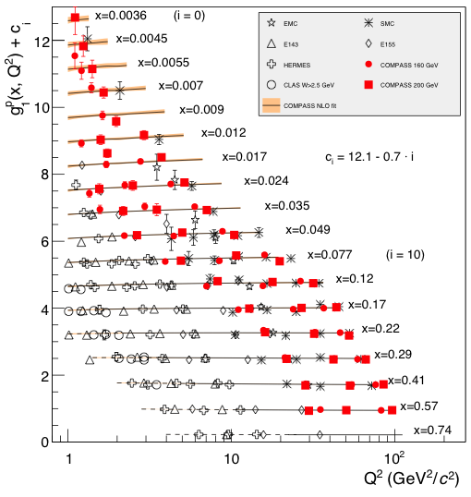
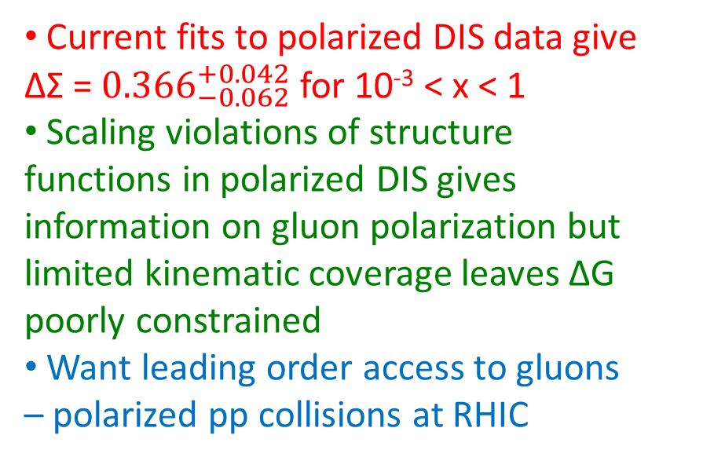
Intrinsic Gluon Contribution: ∆G
Current fits to polarized DIS data give ∆Σ = ${0.366}_{−0.062}^{+0.042}$ for 10⁻³ < x < 1
Scaling violations of structure functions in polarized DIS gives information on gluon polarization but limited kinematic coverage leaves ΔG poorly constrained
Want leading order access to gluons – polarized pp collisions at RHIC
Kinematic reach of polarized DIS measurements

Slide 5





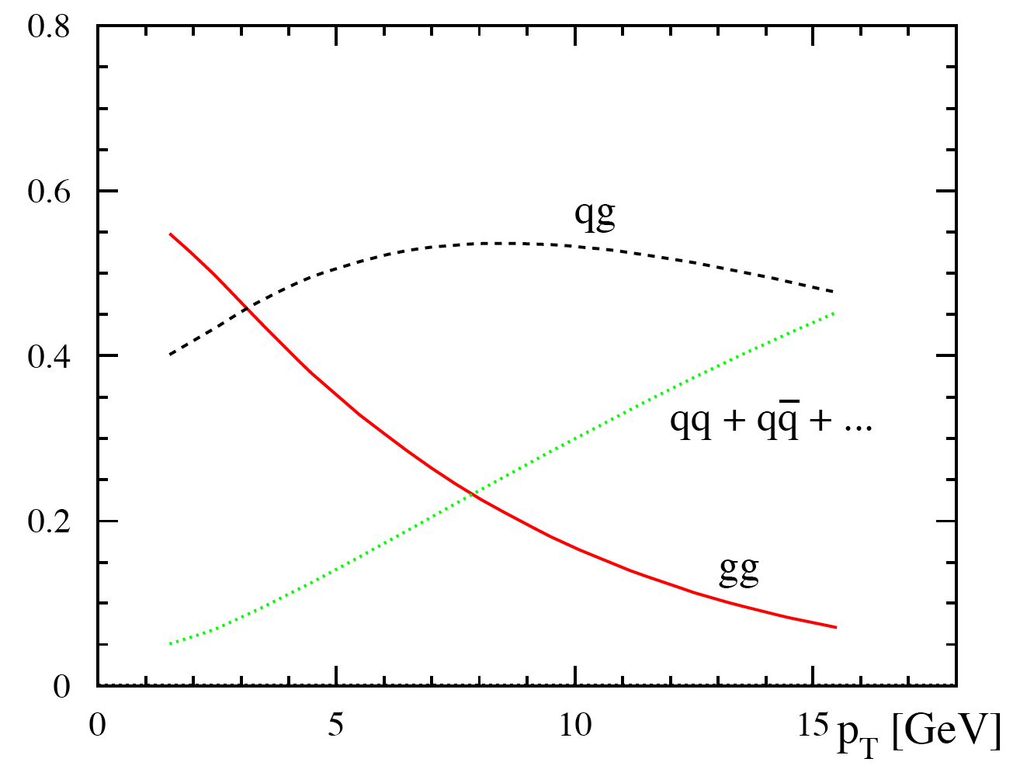
Accessing ∆G at RHIC: A_{LL}
Parton Level Asymmetry
Partonic fractions in jet production at 200 GeV
For most RHIC kinematics, gg and qg dominate, making A_{LL} for jets and hadrons sensitive to gluon polarization.
10
20
30 p_{T}(GeV)

Slide 6

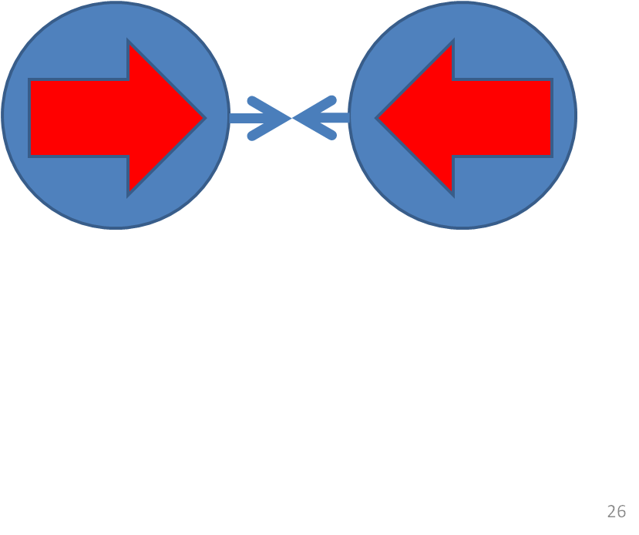
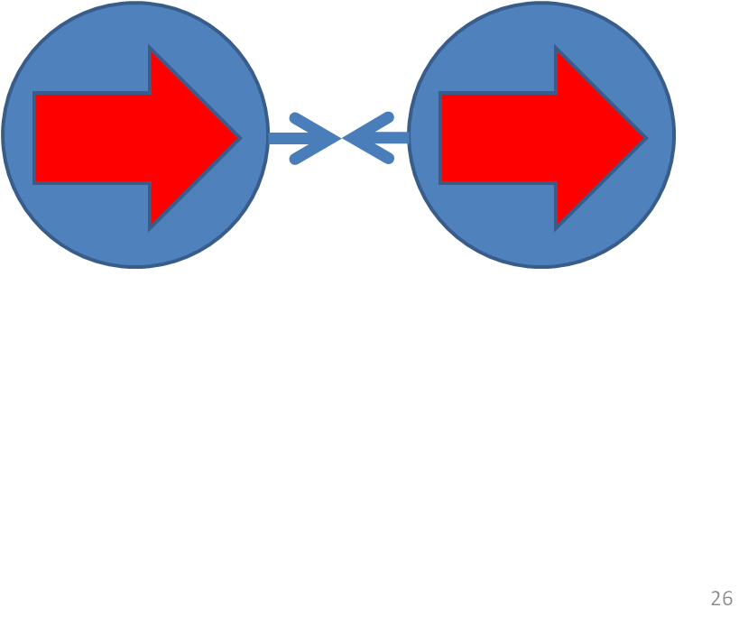
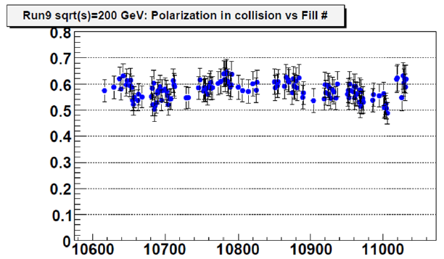
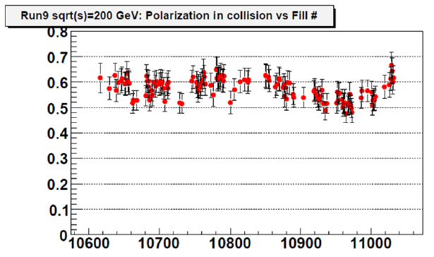
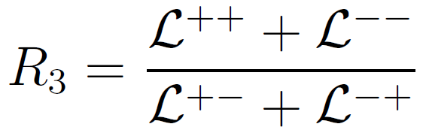
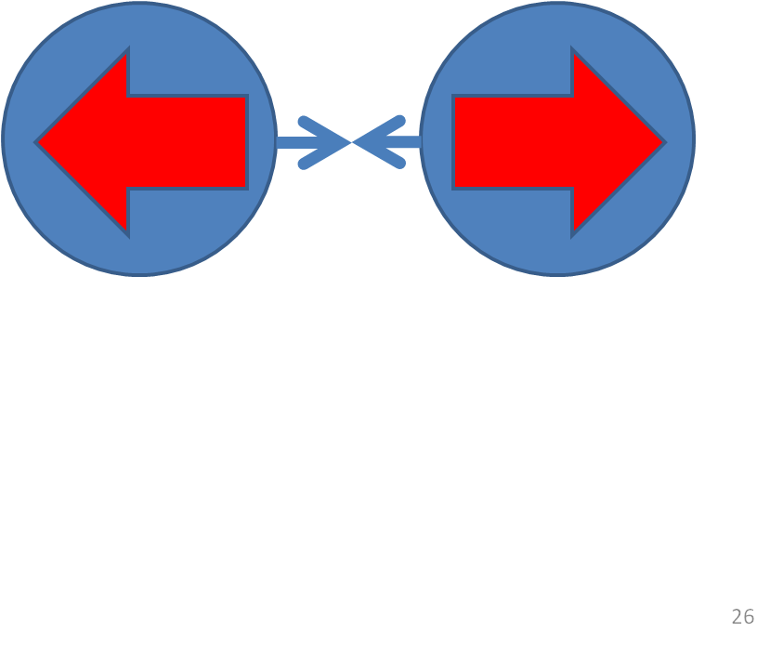
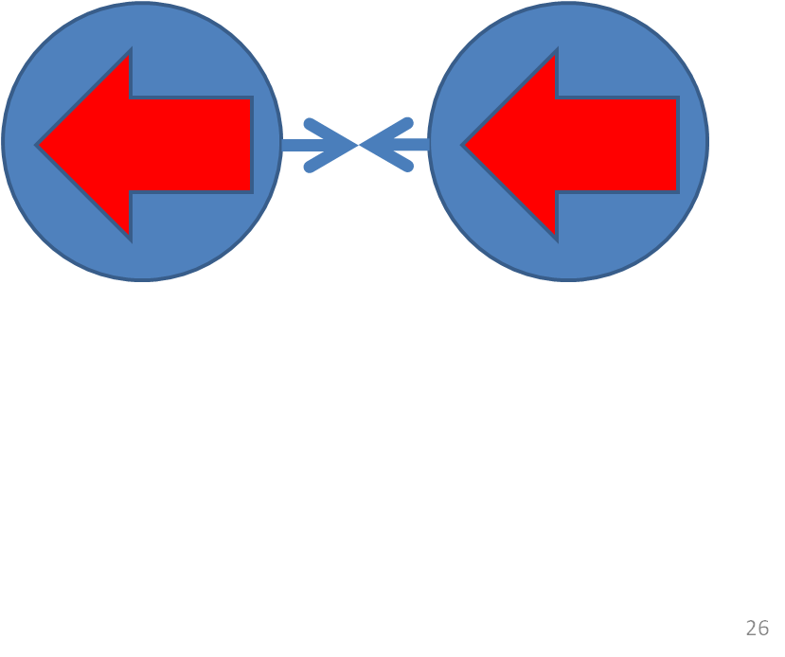
A_{LL}: What Do We Measure?

Slide 7
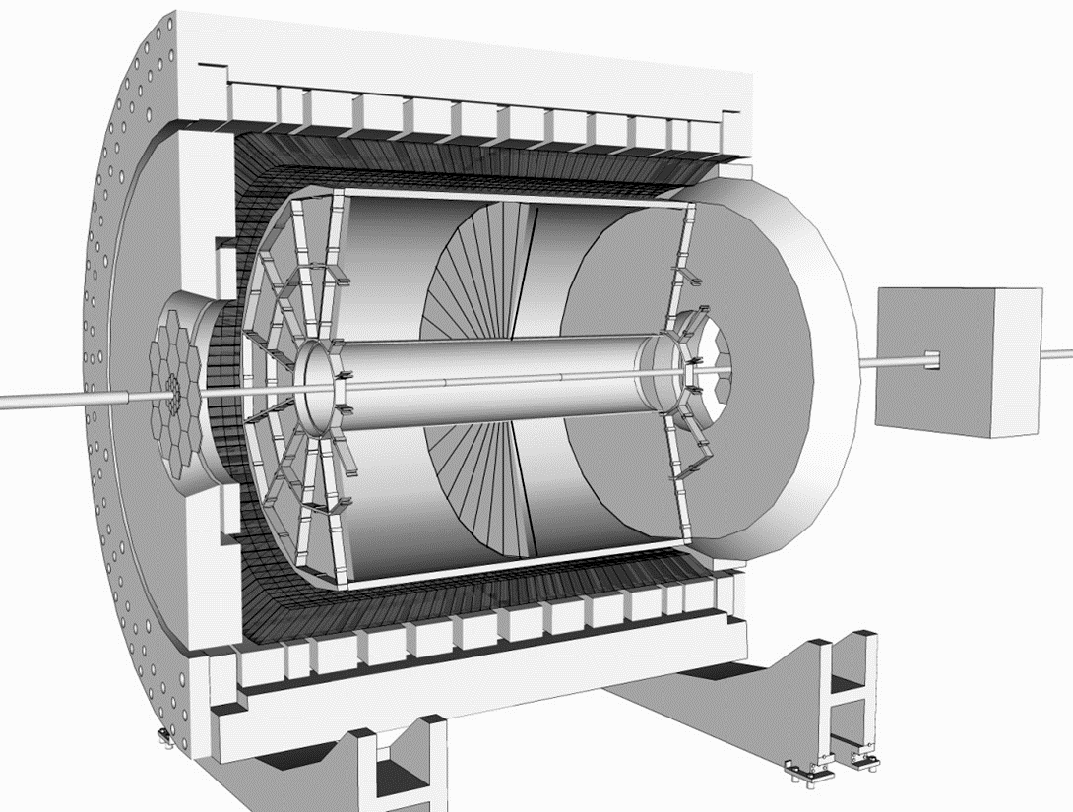
STAR Detector
Time Projection Chamber (TPC)
Charged Particle Tracking |η|<1.3
η = 0
Endcap Electromagnetic Calorimeter:
1<η<2
η = 1
Barrel Electromagnetic Calorimeter (BEMC):
|η|<1

Slide 8
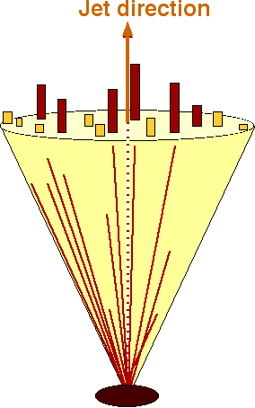
Jet Reconstruction
Jet Levels
MC Jets
Anti-K_{T} Algorithm:
Radius = 0.6
Less sensitive to underlying event and pile-up effects
Implemented using FastJet
Used in both data and simulation
Detector
GEANT
Particle
Three Simulation Jet Levels:
Parton – Jets produced from hard scattered partons as well as ISR and FSR
Particle – Jets produced from stable particles arising from fragmenting partons including beam remnants
Detector – Jets produced from simulated detector response to final state particles
PYTHIA
Parton

Slide 9
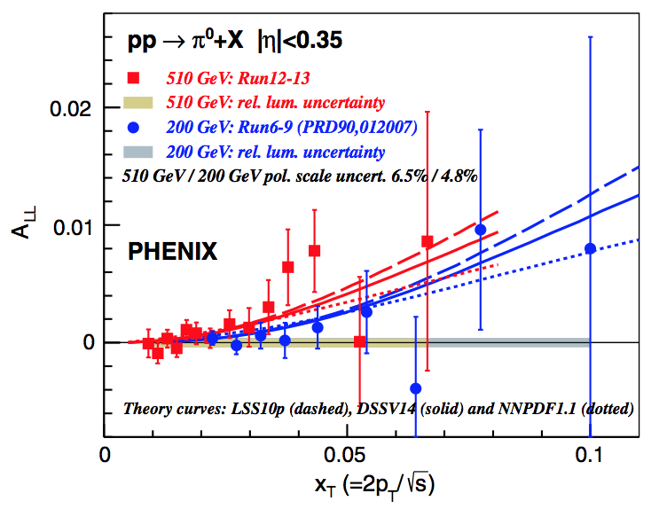
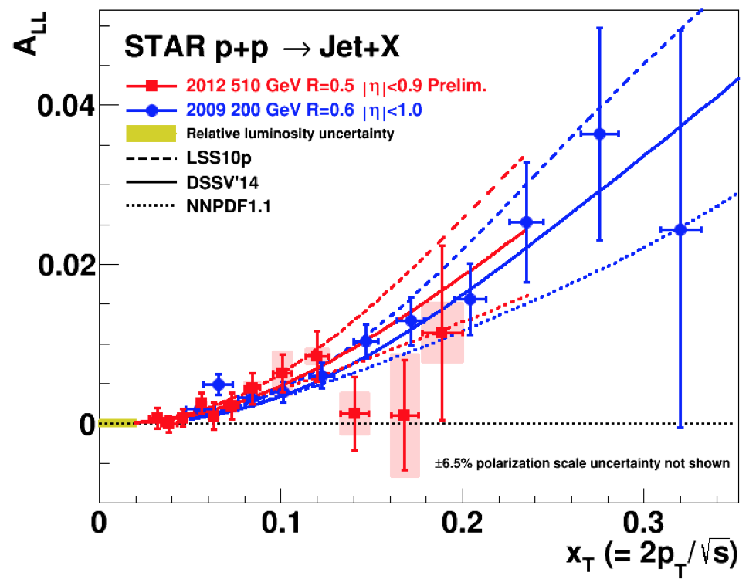
Inclusive Jet and π⁰ A_{LL}
2009 STAR 200 GeV inclusive jet results have factor of 3 to 4 better statistical precision than previous results
Results divided into two pseudorapidity ranges which emphasize different partonic kinematics
Results sit consistently above the 2008 DSSV curve (but within uncertainties) which was consistent with zero gluon polarization
STAR and PHENIX measure A_{LL} using predominately inclusive jet and π⁰ final states, respectively
Results at both 200 and 500 GeV are consistent between the two experiments

Slide 10
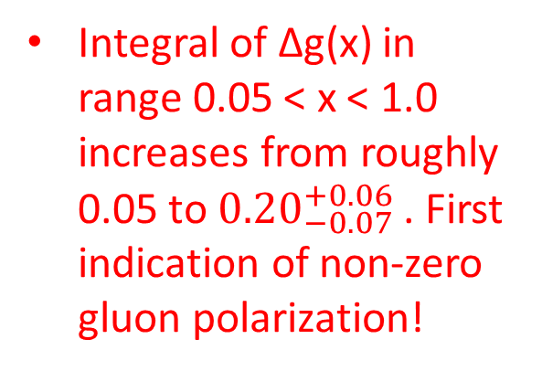
New DSSV Results
Phys. Rev. Lett. 113, 012001 (2014)
Integral of ∆g(x) in range 0.05 < x < 1.0 increases from roughly 0.05 to ${0.20}_{−0.07}^{+0.06}$ . First indication of non-zero gluon polarization!
Uncertainty shrinks substantially from DSSV* to new DSSV fit
Uncertainty on integral over low x region is still sizable (only √s = 200 GeV RHIC data)

Slide 11
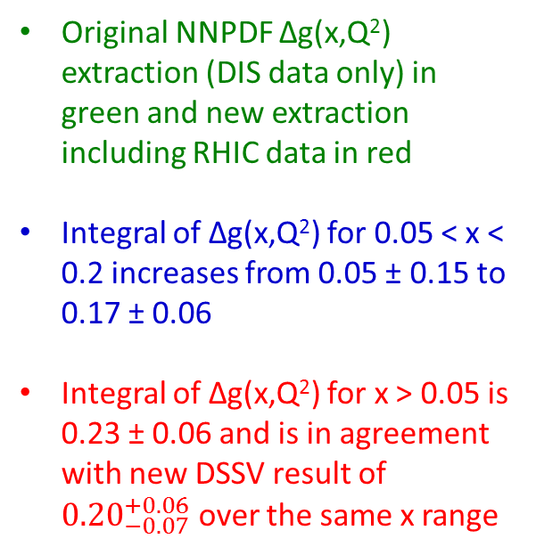
New NNPDF Results
Nucl. Phys. B 887, 276 (2014)
Original NNPDF ∆g(x,Q²) extraction (DIS data only) in green and new extraction including RHIC data in red
Integral of ∆g(x,Q²) for 0.05 < x < 0.2 increases from 0.05 ± 0.15 to 0.17 ± 0.06
Integral of ∆g(x,Q²) for x > 0.05 is 0.23 ± 0.06 and is in agreement with new DSSV result of ${0.20}_{−0.07}^{+0.06}$ over the same x range

Slide 12
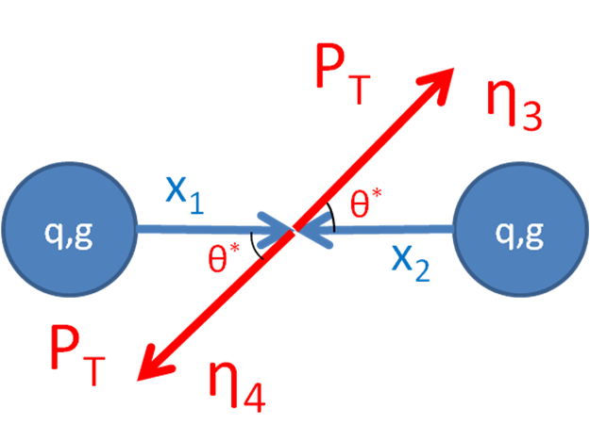
Beyond Inclusive: Di-jet Measurements
Coincidence measurements capture more information about the partonic hard-scattering and provide a more direct link to the initial kinematics than inclusive probes
Leading order expressions show how different jet configurations are sensitive to different kinematic values

Slide 13
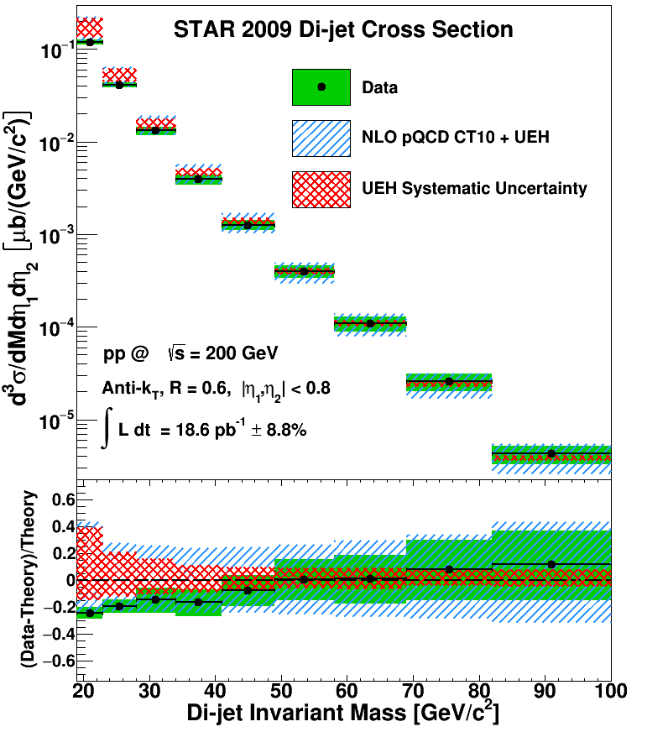
Di-jet Cross Section
arXiv:1610.06616
Unpolarized di-jet cross section was extracted and compared to NLO pQCD theoretical prediction
Theoretical prediction was corrected for underlying event and hadronization (UEH) effects; the systematic on this correction is shown as the red band
Blue band is the quadrature sum of the UEH systematic and uncertainty on the theoretical prediction due to PDF uncertainty and scale variation
Data uncertainty smaller than theoretical uncertainty for all bins meaning these data should be able to help constrain unpolarized PDFs

Slide 14
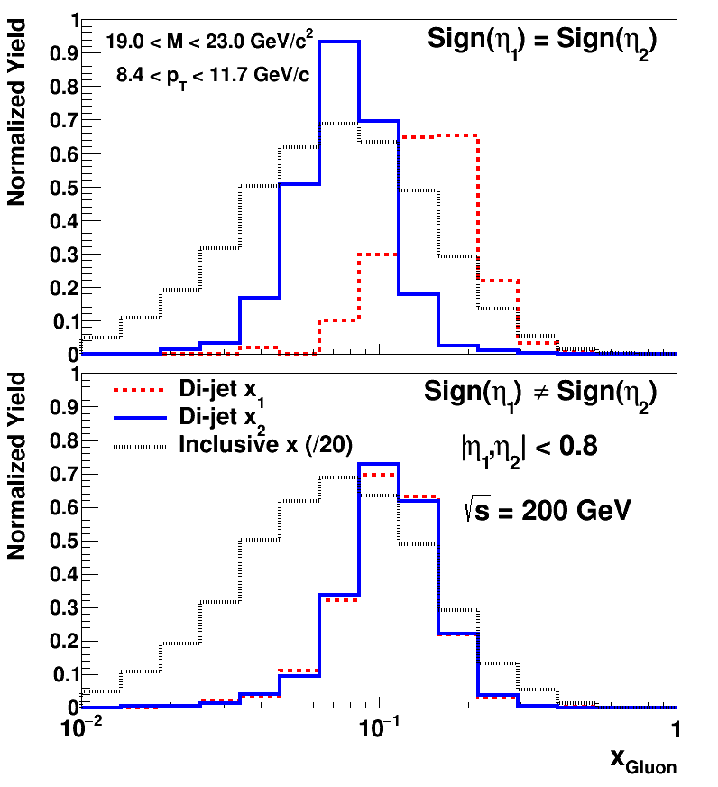
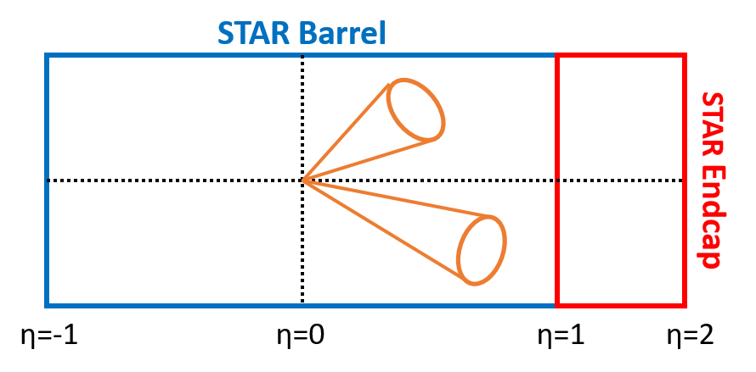
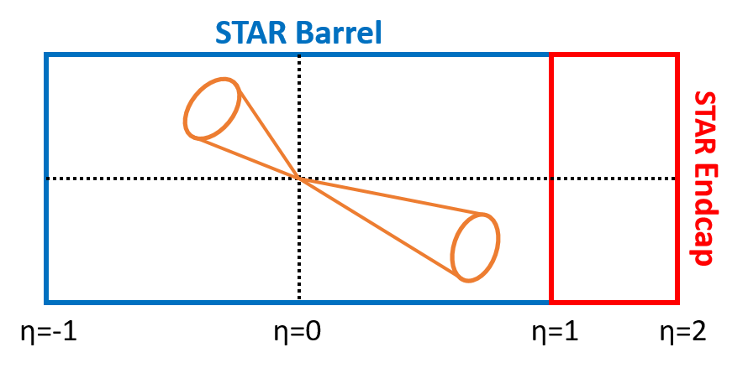
Mid-Rapidity Di-jet Kinematics
Inclusive jets integrate over a large range of gluon momentum fraction in a given p_{T} bin
Advantage of the di-jet final state comes from the better achievable resolution in gluon momentum fraction
Can also see that same sign topology selects more asymmetric collisions
Different di-jet mass bins select different gluon momentum fractions
arXiv:1602.03922
arXiv:1610.06616

Slide 15
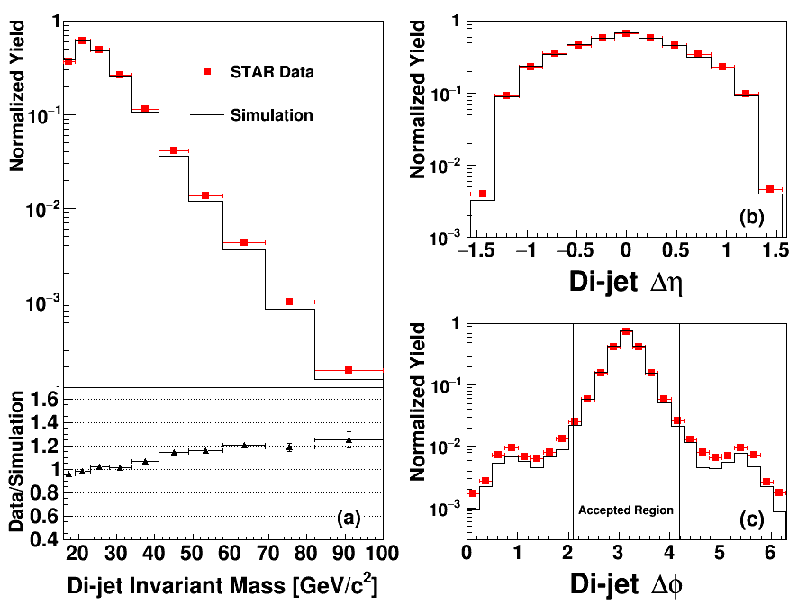
Simulation Sample
arXiv:1610.06616
Simulation sample needed to unfold and correct raw data yields and evaluate systematic errors
Events generated using PYTHIA and run through a detector response package based on GEANT
Simulated events embedded into zero-bias data events to better track run conditions
Simulated distributions match data quite well

Slide 16
Systematics
A number of systematic uncertainties on both the di-jet mass and asymmetry were evaluated:
  Mass Shift: ~0.3 – 0.7 GeV
  Jet Energy Scale: ~0.4 – 1.4 GeV
  PYTHIA->NLO: ~0.2 – 3.0 GeV
  Trigger and Reconstruction Bias: ~0.0003 – 0.0032
  Residual Transverse Polarization: ~0.00028 – 0.00251

Slide 17
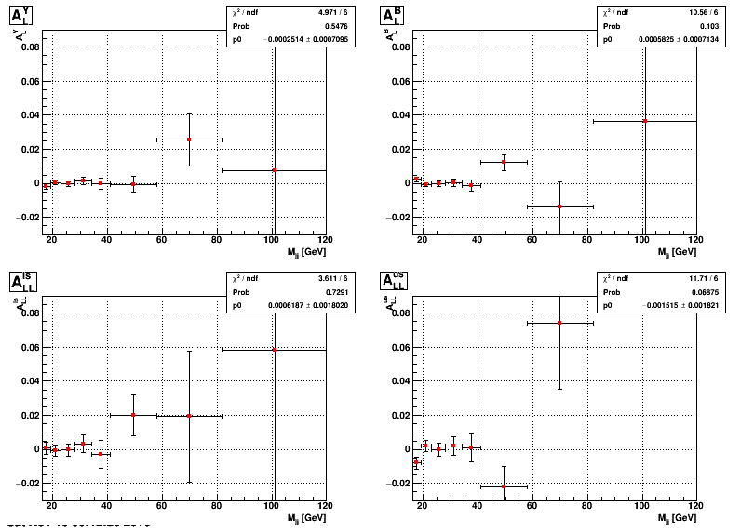
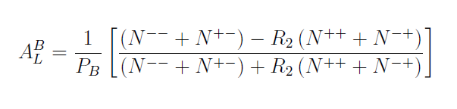




False Asymmetries

Slide 18
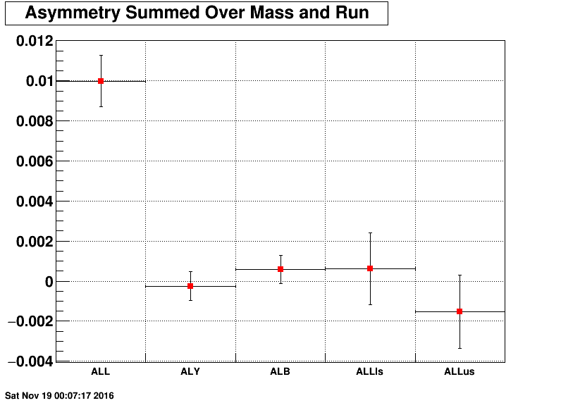
Asymmetry Summary
Asymmetries Summed Over Mass and Run
Signal Asymmetry
False Asymmetries
Can gain much more power by looking differentially in mass and topology

Slide 19
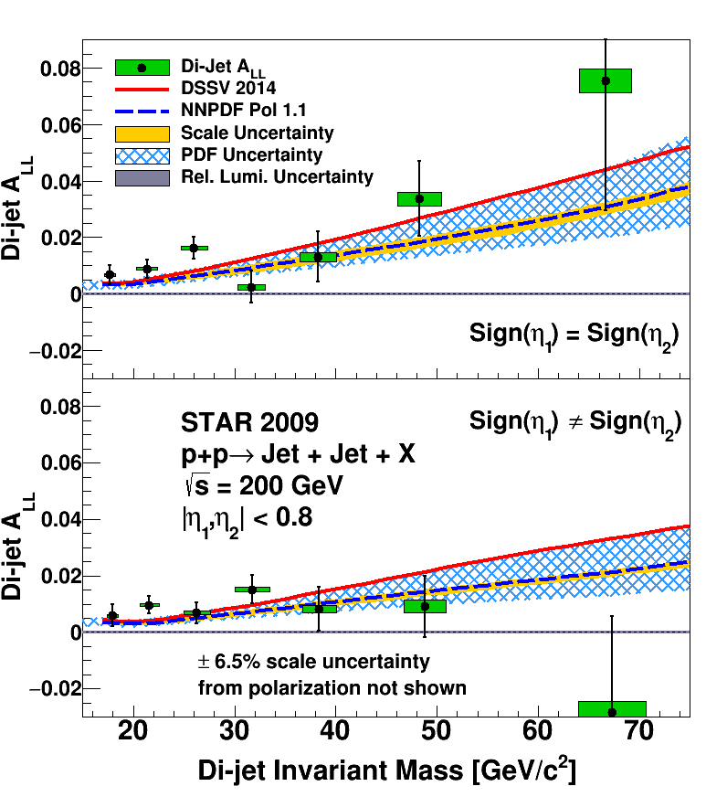
Mid-Rapidity Di-jet A_{LL}
arXiv:1610.06616
Mid-rapidity di-jet A_{LL} presented for two topologies as a function of di-jet invariant mass corrected to parton level
Data compared to expectations from DSSV14 and NNPDFpol1.1 polarized PDFs, both of which contain 2009 inclusive jet resuts
Systematic bands from PDF and scale uncertainties shown for NNPDFpol1.1 curve

Slide 20
Pushing to Lower X: Higher Energy
RHIC has placed strong constraints on ∆G in the range x > 0.05 but lower x regions are relatively unexplored
There are two knobs to turn which can provide access to lower x: higher energies and forward rapidities
Can see that moving to higher center of mass energies will push down to lower x values

Slide 21
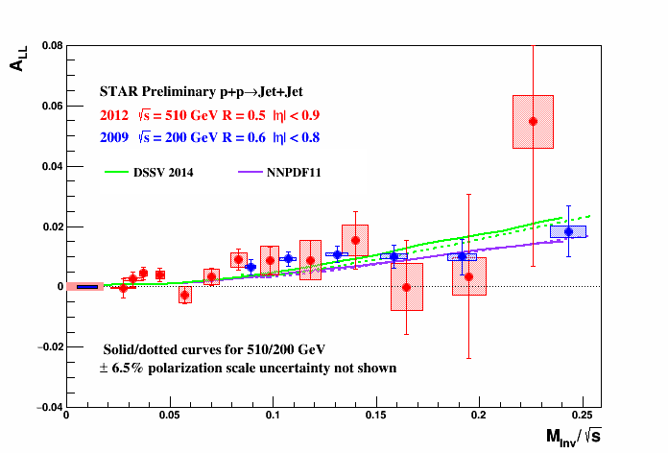
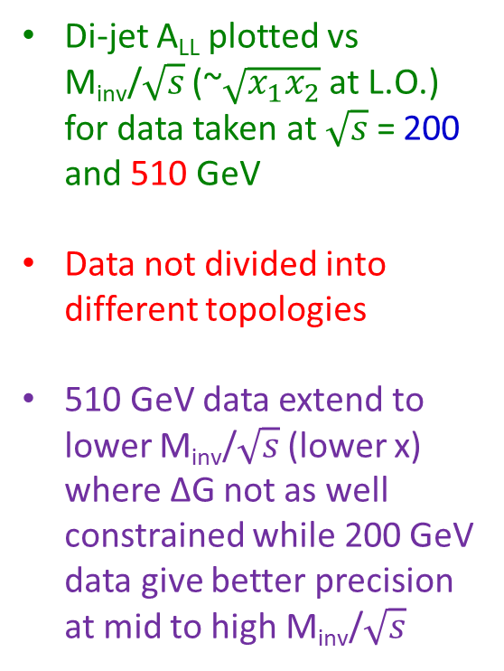
√s = 200 Vs 500 GeV Di-jet A_{LL}
arXiv:1602.03922
Di-jet A_{LL} plotted vs M_{inv}/$\sqrt{s}$ (~$\sqrt{x_{1}x_{2}}$ at L.O.) for data taken at $\sqrt{s}$ = 200 and 510 GeV
Data not divided into different topologies
510 GeV data extend to lower M_{inv}/$\sqrt{s}$ (lower x) where ∆G not as well constrained while 200 GeV data give better precision at mid to high M_{inv}/$\sqrt{s}$

Slide 22
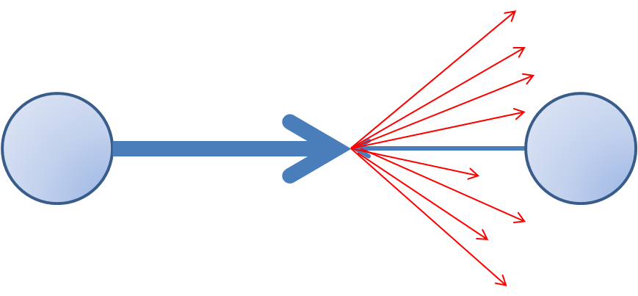
Pushing to Lower X: Forward Rapidity
The second way to push to lower x is to look at jets which go to forward rapidities
More forward jets are indicative of more asymmetric collisions which will contain lower x partons

Slide 23
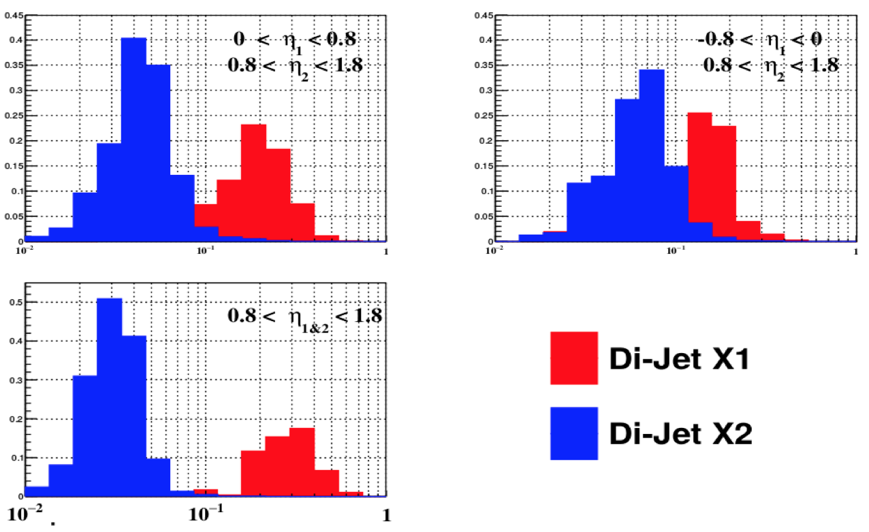
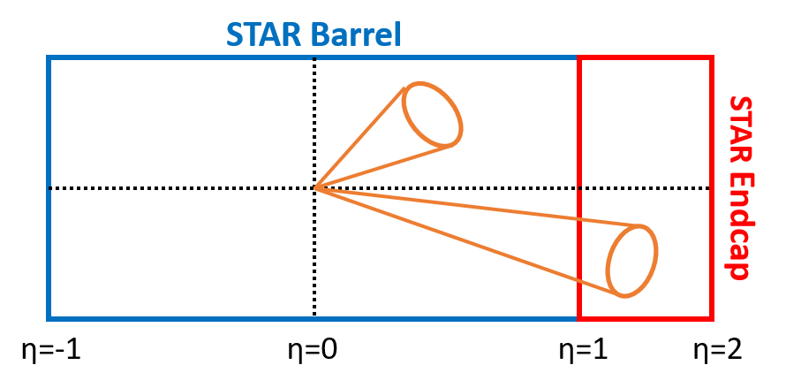
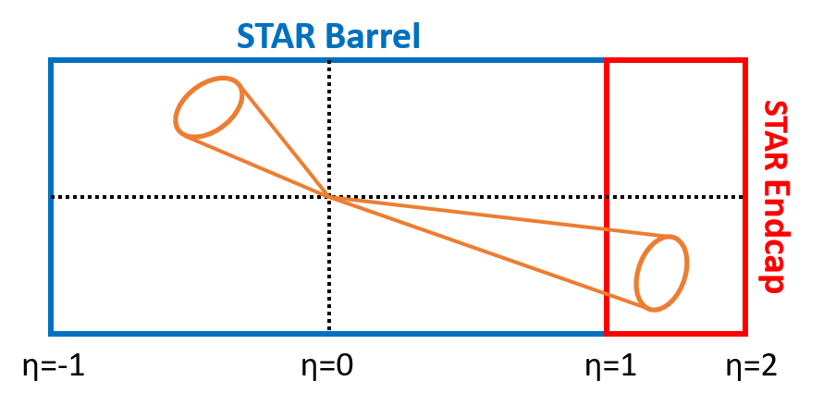
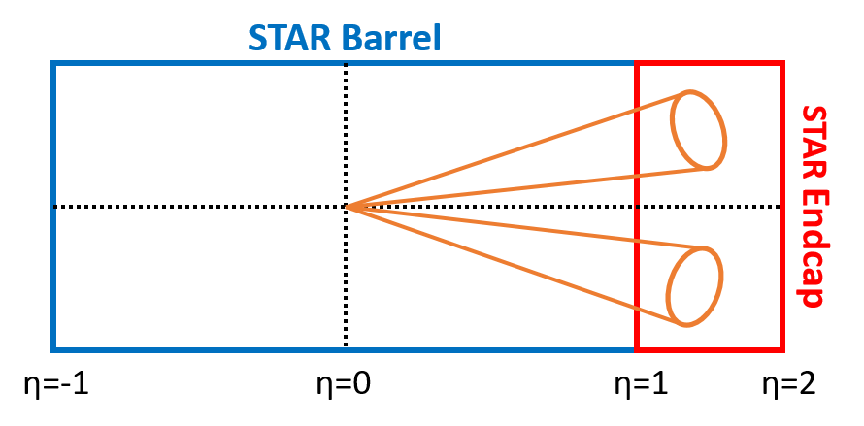
Forward Di-jet Topologies
Adding the Endcap opens up several new di-jet topologies
Forward jets probe lower values of gluon momentum fraction while selecting more asymmetric collisions

Slide 24
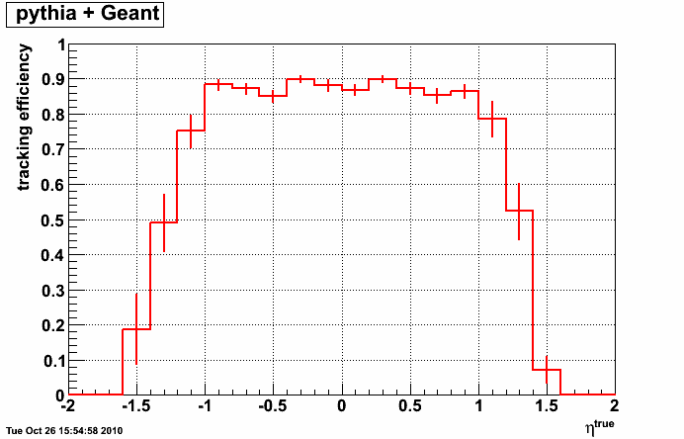
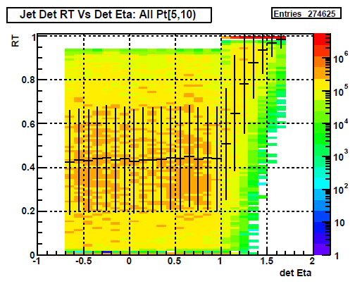
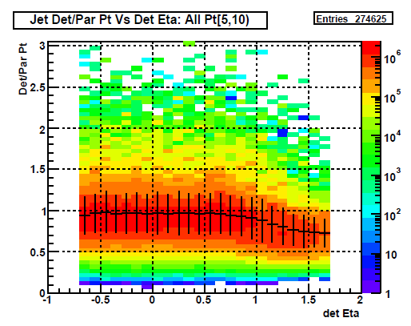
Challenges at Forward Rapidity
Endcap Region
Jet p_{T} [5,10) GeV
TPC efficiency decreases in forward region
Fewer tracks means reconstructed jets will have lower p_{T} on average
Will also have significant neutral energy bias and reconstruction efficiency effects
Above effects are p_{T}, eta, and trigger dependent -> Much to disentangle!
Notes:
Place shading in endcap region

Slide 25
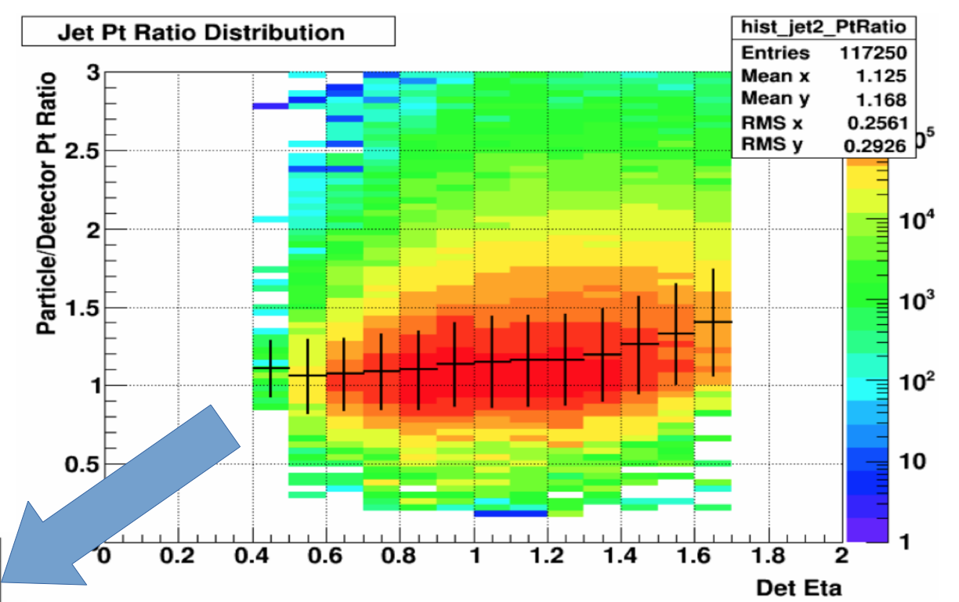
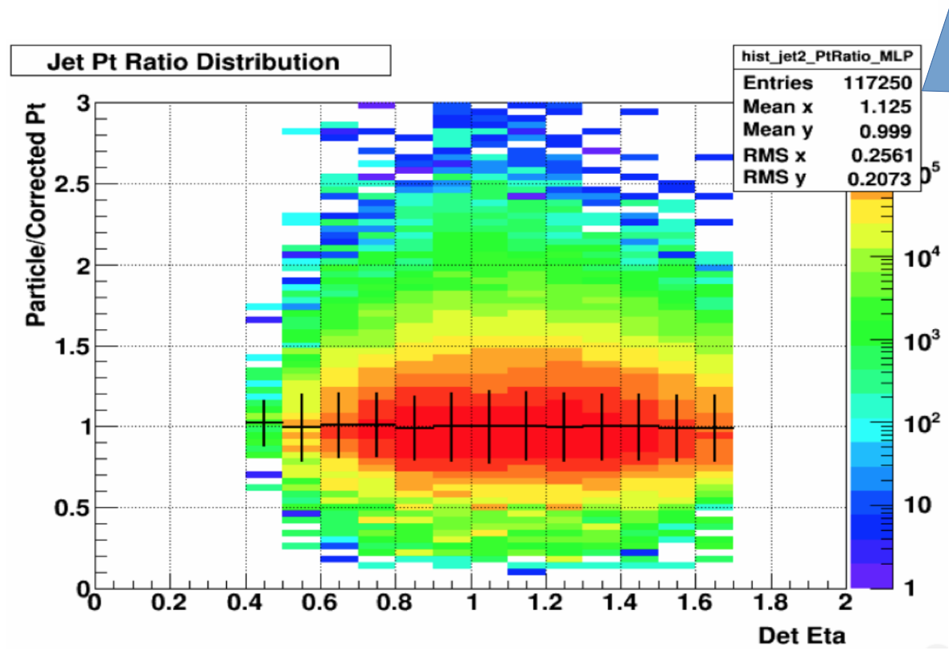
Machine Learning Corrections
Use a multivariate regression technique to correct jet p_{T} to particle level event-by-event
Supervised machine learning method can simultaneously handle p_{T}, jet position and neutral fraction dependencies
Machine learning technique: Multilayer perceptron (TMVA)
Input Variables: detector level p_{T}, detector eta, neutral fraction
Target: particle level p_{T}

Slide 26
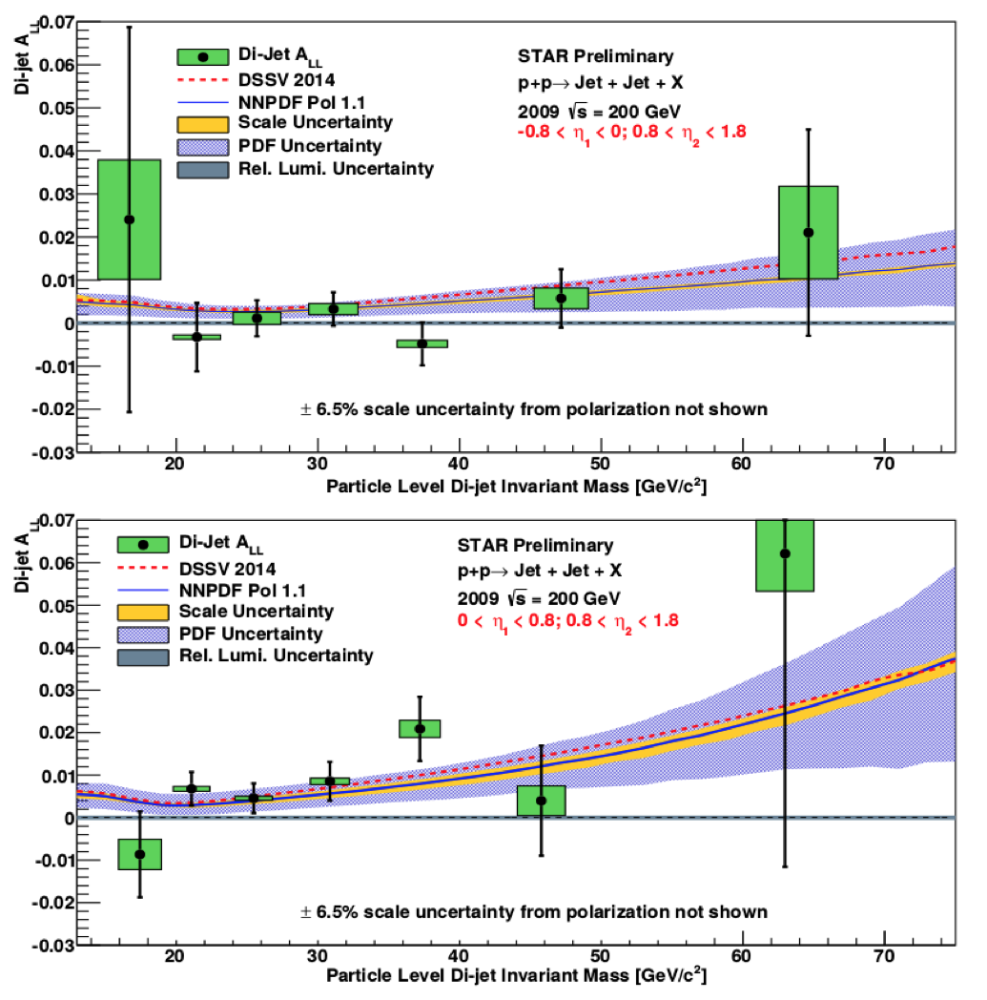
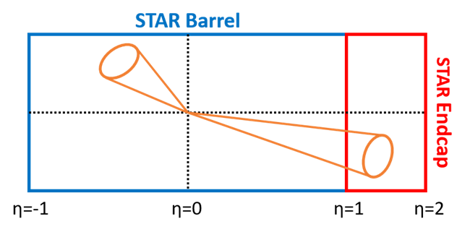
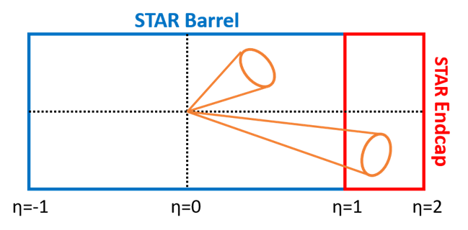
Forward Di-jet A_{LL}
Di-jet A_{LL} shown for two Barrel-Endcap topologies
These forward di-jets should access gluons with lower momentum fraction
Results again compared to DSSV14 and NNPDFpol1.1 expectations

Slide 27
Forward Di-jet A_{LL}
Di-jet events with both jets in the Endcap probe the lowest gluon momentum fractions
The cross section drops for forward jets making this measurement statistically challenging

Slide 28
Future Analysis Improvements
Now have two data-driven methods for exploring and characterizing underlying event effects which will allow this contribution to be subtracted from jets
Improvements to jet p_{T} / di-jet mass systematic determination based on evaluation of PYTHIA tune variations
Improvements to trigger and reconstruction bias correction / systematic by using NNPDF replicas as opposed to different polarized PDF sets

Slide 29
Where to from Here?
Inclusive jet and π⁰ data from RHIC have placed meaningful constraints on ∆G for x > 0.05
Future results at √s = 500 GeV and forward rapidity will extend constraints to somewhat lower x and di-jet measurements will provide better constraints on the shape of ∆G
Despite this, RHIC data will not be able to completely constrain the full integral of ∆G
What is needed to pin down the gluon contribution to the proton spin?

Slide 30
EIC: Polarized ep Collider
Hera
JLab, Compass & HERMES
RHIC
DIS: Kinematic precision
Colliders: Large kinematic coverage
EIC!
Polarization: Spin observables

Slide 31
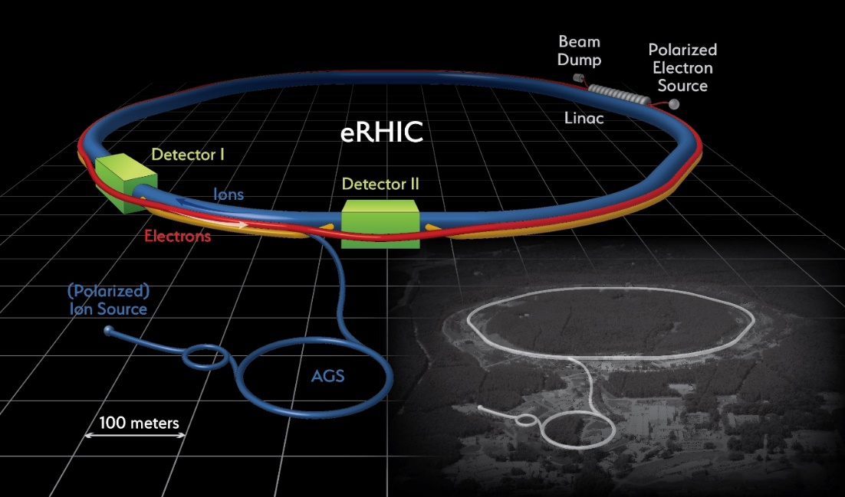
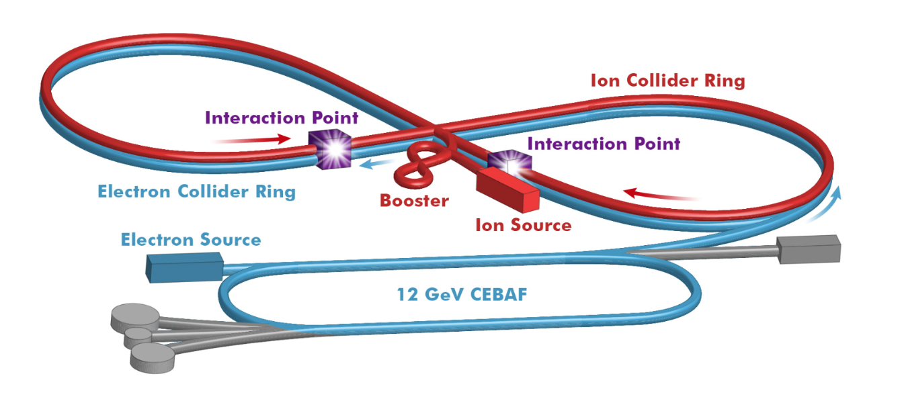
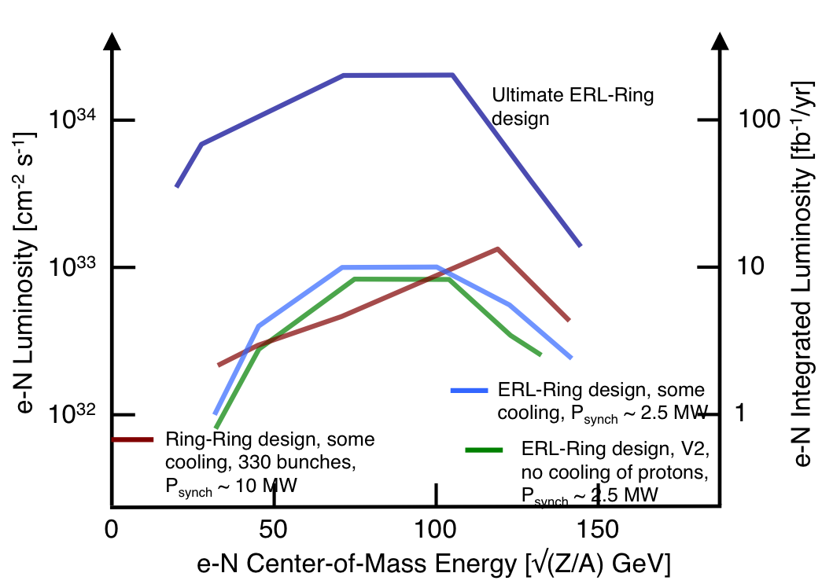
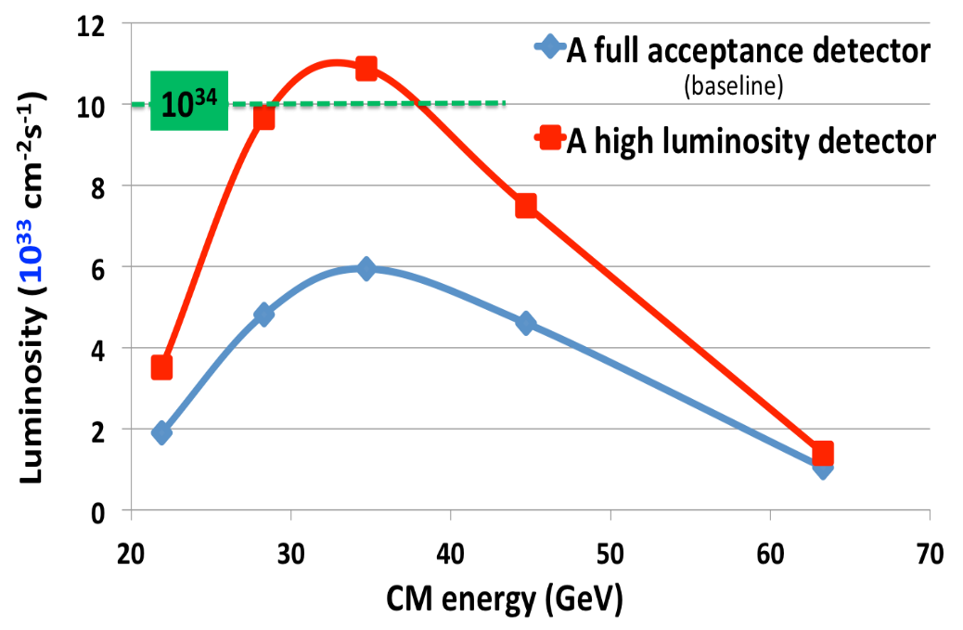
EIC: eRHIC or JLEIC

Slide 32
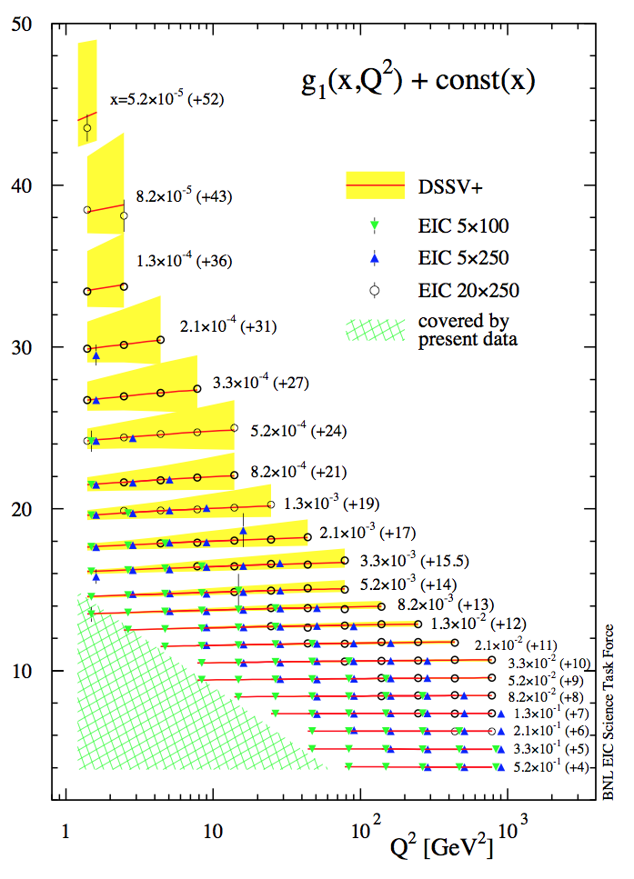
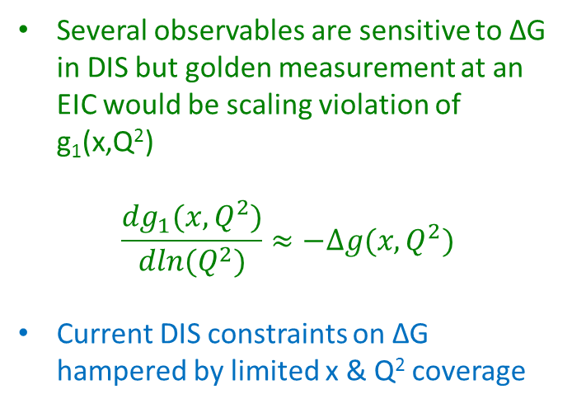
EIC: Accessing ∆G Via g₁
arXiv:1206.6014
Several observables are sensitive to ∆G in DIS but golden measurement at an EIC would be scaling violation of g₁(x,Q²)
$$\frac{dg_{1}(x,Q^{2})}{dln(Q^{2})}≈−∆g(x,Q^{2})$$
Current DIS constraints on ∆G hampered by limited x & Q² coverage
EIC would greatly expand kinematic reach and precision of g₁(x,Q²) measurements!

Slide 33
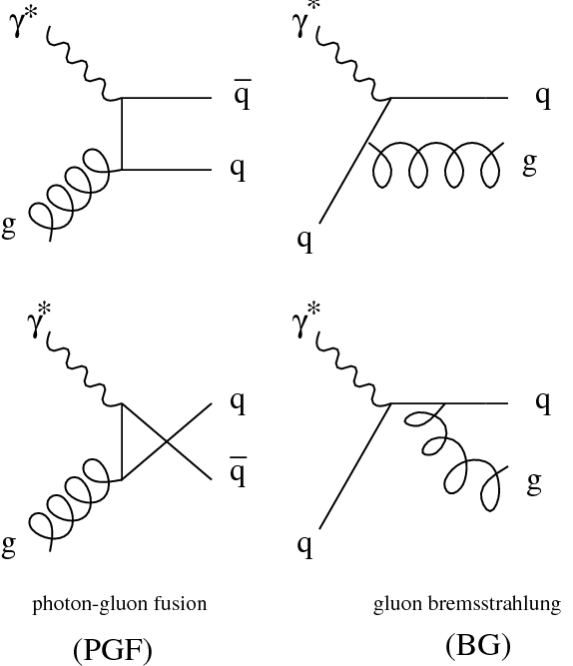
Gluon Polarization with Di-jets
Gluons can be also be probed in DIS via the higher-order photon gluon fusion process
Also have the QCD – Compton process which probes quarks at the same order
Both processes produce 2 angularly separated hard partons -> Di-jet
At lower Q2, resolved processes in which the photon assumes a hadronic structure begin to dominate
Asymmetry is a convolution of polarized PDF from the proton and polarized photon structure – which is completely unconstrained
Would like to suppress the resolved component
Photon-Gluon Fusion
Resolved
Di-Jet
QCD – Compton

Slide 34


X_{γ}: Reconstructed Vs True
1
1
Will use virtual photon momentum fraction to discriminate between resolved and direct processes
See good agreement between reconstructed and true X_{γ} for all Q² ranges
Di-jets found in Breit frame and required one jet with p_{T} ≥ 5 GeV and the other with p_{T} ≥ 4 GeV
Reco
Reco
Q² = 10 - 100
Q² = 1 - 10
10⁻²
True
1
10⁻²
True
1
1
1
Reco
Reco
Q² = 0.1 – 1.0
Q² = 0.01 – 0.1
10⁻²
True
1
10⁻²
True
1
X_{γ} $= \frac{1}{2E_{e}y} \left(p_{T1}e^{−η_{1}}+p_{T2}e^{−η_{2}}\right)$

Slide 35

Direct Vs Resolved Processes
Plot reconstructed X_{γ} for direct and resolved processes
Direct processes should concentrate toward 1 while resolved processes are at lower values
Direct processes dominate at higher Q² while resolved are more prevalent at low Q²
Cut of X_{γ} > 0.7 enhances the direct fraction at all Q²
Q² = 1 - 10
Q² = 10 - 100
Q² = 0.1 – 1.0
Q² = 0.01 – 0.1
Accepted Region

Slide 36

Di-jet Invariant Mass
Di-jet Mass: Q² = 10-100
Di-jet Mass: Q² = 10-100
x_{γ} > 0.7
See that the cut on X_{γ} significantly reduces the resolved contribution while maintaining the direct events
Separation between resolved and direct is most prominent at high Q² and low di-jet invariant mass
All
Q² = 1 - 10
Q² = 10 - 100
Q² = 0.1 – 1.0
Q² = 0.01 – 1.0

Slide 37






Proton Partonic Kinematics
Parton Momentum Fraction: Photon Gluon Fusion
To measure ∆G, need to probe the parton coming from the proton
Momentum fraction of the parton from proton is well reconstructed
X_{P} is related to Bjorken-x and Q² at leading order
Q² and Bjorken-x are also related via the collision energy and inelasticity
Accessible X_{P} range basically determined by beam energies
Lowest XP we can probe is about 0.005
1
1
$$X_{P}= x_{B}\left(1+ \frac{M^{2}}{Q^{2}}\right)$$
Reco
Reco
10⁻²
True
1
10⁻²
True
1
$$Q^{2}=syx_{B}$$
1
1
$$X_{P}= x_{B}+ \frac{M^{2}}{sy}$$
Reco
Reco
10⁻²
True
1
10⁻²
True
1
X_{P} $= \frac{1}{2E_{P}} \left(p_{T1}e^{−η_{1}}+p_{T2}e^{−η_{2}}\right)$
≈ $\frac{100}{(20000 x 0.95)}$ ≈ 0.005

Slide 38







X_{P} For Different Q²
Q² = 10-100
Q² = 1-10
$$\int{L=0.25 {fb}^{−1}}$$
$$\int{L=0.01 {fb}^{−1}}$$
Q² and x range covered by di-jet asymmetry measurements
Experimentally possible to extend these measurements to Q² < 1
X_{P}
X_{P}
At lower Q², contribution from resolved process increases while QCD Compton contribution decreases
For a given di-jet mass range, same X_{P} can be probed over large range of Q²
Can test evolution of ∆G
Q² = 0.01-0.1
$$\int{L=0.002 {fb}^{−1}}$$
X_{P}

Slide 39
Summary
Early fixed target data showed that the proton’s spin cannot be carried by quark helicity alone but could not constrain the gluon contribution
Jet and Pion inclusive asymmetries from polarized pp collisions at RHIC have placed strong constraints on ∆G for Bjorken-x > 0.05
Di-jet correlation measurements give better partonic momentum fraction resolution, thus providing better constraints on the shape ∆g(x)
Future measurements as higher energies and more forward rapidities will push to lower momentum fractions where current constraints are poor
A high energy/luminosity polarized ep collider will have the kinematic reach and precision to pin down the gluon polarization via scaling violations of the g₁ structure function
NLO access to ∆G will be possible via the photon-gluon fusion process and will provide a systematic check on the g₁ results while allowing the study of the evolution of ∆G over a wide Q² range

Slide 40
Backup

Slide 41


RHIC: First Polarized pp Collider

Slide 42

RHIC: First Polarized pp Collider
Time Projection Chamber (TPC)
Charged Particle Tracking |η|<1.3
η = 0
Endcap Electromagnetic Calorimeter:
1<η<2
η = 1
Barrel Electromagnetic Calorimeter (BEMC):
|η|<1

Slide 43

Mass Shift
Closed = Particle Level, Open = Parton Level Shift
Shift
Correct di-jet mass back to parton level via a shift which is the average difference between mass at detector and parton levels
Calculate shift assuming several track-finding inefficiencies: 0%, 4%, and 7%
Nominal shift found using 0% points while 4%, and 7% values used to calculate systematic and check for linearity

Slide 44

Trigger and Reconstruction Bias

Slide 45
Trigger and Reconstruction Bias
Trigger used to select events biases the underlying sub-process fractions which can alter measured asymmetry
Correct for this by calculating the difference in A_{LL} between parton and detector-level di-jets for 3 polarized PDFs which ‘bracket’ our measured asymmetry
Average of highest and lowest ∆A_{LL} taken as correction while half the difference used as a systematic
Red = DSSV, Blue = DSSV2009a, Green = LSS2010Pos
∆A_{LL}

Slide 46

eRHIC
JLEIC
arXiv:1409.1633
arXiv:1504.07961
Both machine designs built on existing machines
Linac - Ring
Ring- Ring
reuse Cebaf as full energy lepton injector
electron: 3-10 GeV
protons: 20-100 GeV
ions: 8-40 GeV/u for Pb
polarised ions: p, d, 3He, possibly Li
Polarisation for both beams: > 70%
full √s range available from beginning
→ staging in luminosity
Luminosity 10³³ to 10³⁴ cm⁻²s⁻¹
→ staging center-of-mass energy
Both machines utilize crossing angles
10 mrad 50 mrad
→ need for Crab cavities
Bunch frequency: 9.4 MHz
Bunch frequency: 476 MHz
159 MHz@√s=63GeV
Both designs take great care to have maximal to full acceptance for scattered protons from diffractive reactions, breakup neutrons and spectator tagging
2 interaction regions

Slide 47
Importance of Systematic Control
The excellent statistical precision achievable with an EIC means control of systematics will be critical
Above plot shows how the constraint on ∆G is affected by systematic uncertainty
Notes:
Plots from EIC white paper arXiv:1212.1701

Slide 48

Di-jet Invariant Mass
See that the cut on X_{γ} significantly reduces the resolved contribution while maintaining the direct events
Separation between resolved and direct is most prominent at high Q² and low di-jet invariant mass
Q² = 10 - 100
Q² = 1 - 10
Q² = 0.1 – 1.0
Q² = 0.01 – 1.0

Slide 49
X_{P} Vs Mass
Q² = 10 – 100 GeV/c²
X_{P}
X_{P}
As shown on the previous slide, accessible X_{P} range is determined largely by beam energy
Different di-jet mass ranges select different process fractions with lower masses containing less resolved contribution
Selection of high mass events also cut out low X_{P} contribution
Resolved
QCDC
Mass
Mass
X_{P}
PGF
Mass
X_{P}

Slide 50
EIC: Solving the Spin Puzzle
arXiv:1409.1633
1/2 -
Gluon
-
Quarks
=
orbital angular
momentum
Above plot shows the running integral of ∆g(x,Q²) from x_{min} to 1 as a function of x_{min}
Large reduction in uncertainty on ∆G from EIC can be seen
EIC will also reduce the uncertainty on the quark contribution to the proton spin
No assumptions about hyperon beta decay in EIC uncertainty
Constraints on gluon and quark contributions will provide information on the orbital angular momentum component of proton spin

Slide 51

Next Up – Jets in the Endcap
Can access lower partonic momenta by looking at final states in forward regions
Forward final states arise from asymmetric partonic collisions
Jet Configuration | Minimum X
Symmetric Barrel | 0.17 – 0.06
East-Barrel Endcap | 0.10 – 0.05
Endcap Endcap | 0.01
Notes:
Animate to show mid-rapidity case moving into forward rapidity case

