Slide 1
Electronics and DAQ WG – 8/29/2024
Agenda
Announcements
VTRX+ / DC-DC converter updates - Fernando Barbosa
Radiation Testing Results – Tim Camarda
Announcements:
Off Project Review Last week (8/22 – 8/23)
DAC R&D meeting (8/28-8/29)
Software Computing Review coming up (9/26-9/27)
preTDR drafting
preTDR version 0 (sept 29th)
Internal review process (October)
preTDR version 1(December 1st)
CD-3B Directors Review 10/22-10/24
CD-3B DOE review in January
December Streaming Workshop in Japan

Slide 2
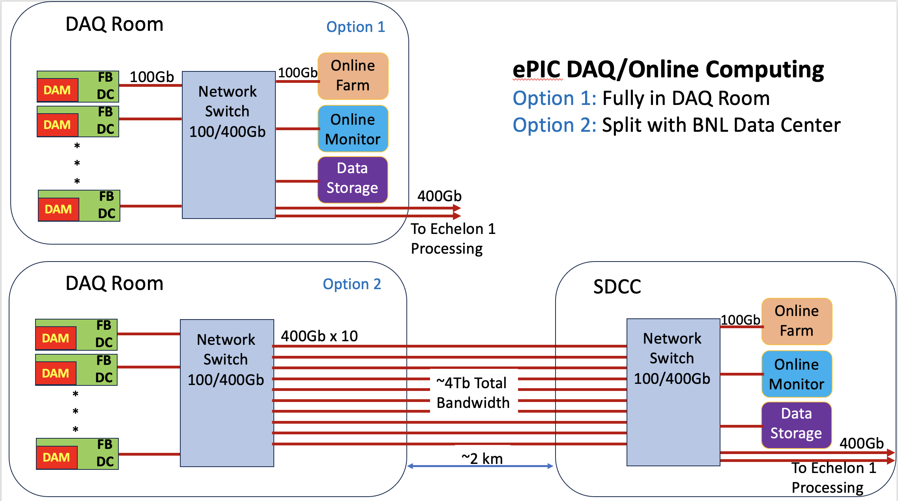
Echelon 0 Computing Options
(with Option 2 we need off-project support for enough direct fiber between IP-6 and SDCC)
Off project review →
cost / benefit analysis needed….

Slide 3
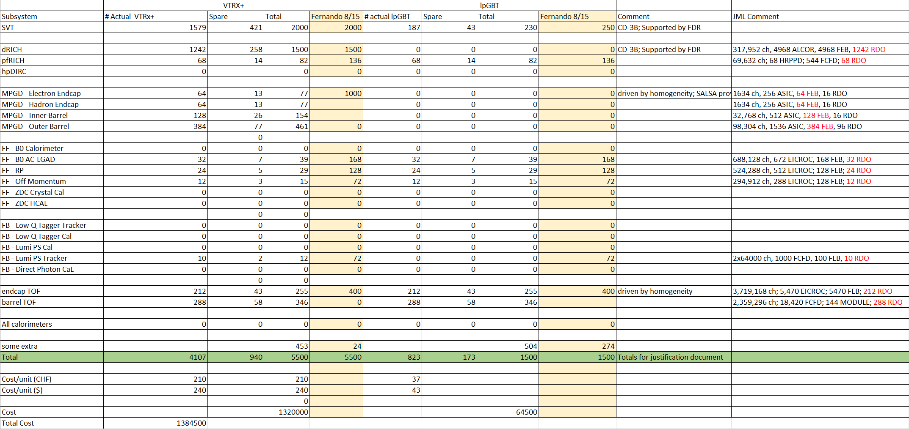
VTRX+ / lpGBT requests for CD-3B

