Slide 1
^{RCS Compton Update}
Dave Gaskell
Jefferson Lab
September 19, 2024

Slide 2
RCS Compton Rates
1-2 Hz
N_{γ} = <P>/(f_{laser} E_{laser})
RCS Compton will use low duty cycle, higher peak power laser (similar to HERMES LPOL)
→ Example system from RPMC lasers: Pulse energy = 30 mJ @ 2 Hz (<P>=60 mW) → 8.0E16 photons/pulse
For 15 ns pulses, backscattered photon rate is 240 kHz, “ideal” measurement times on the order of a few seconds

Slide 3
Transverse Analyzing Power and Measurement
In contrast to longitudinal measurement, measurement of transverse polarization requires sensitivity to spatial dependence of asymmetry
φ=0
SPEAR @ SLAC

Slide 4
Simple rate, measurement time estimates
Average analyzing power:
→ Average value of asymmetry over acceptance
Energy-weighted:
→ Energy deposited in detector for each helicity state
Differential:
→ Measurement of asymmetry bin-by-bin vs. energy, etc.
Assuming 80% polarization, <P_{laser}>= 6mW, 300 μm beam spot size…, → time for 1% measurement
E_{beam} | A_{avg} | T_{avg} | A_{energy} | T_{energy} | A_{diff} | T_{diff}
5 | 4.51% | 243 s | 5.78% | 148 s | 5.48% | 164 s
10 | 7.79% | 92 s | 10.15% | 54 s | 9.56% | 61 s
18 | 11.29% | 51 s | 14.91% | 29 s | 13.96% | 33 s

Slide 5
Toy Monte Carlo
Used toy Monte Carlo to look at asymmetries, energy/per bunch etc.
Generated events for 240 bunches (i.e., 2 minutes of running)
  For each bunch/crossing, generated number of backscattered photons based on simple luminosity estimates
  Assumed luminosity 10x smaller than previous slide → 6 mW average laser power
  12,000-15,800 backscattered photons/bunch crossing
Assumed detector 25 m away from laser-beam collision point
  No realistic simulation of detector – just a point in space to look at distributions
Event generator ignores hourglass effect, assumes all events generated at (0,0) → does incorporated finite beam sizes, but only at that point

Slide 6
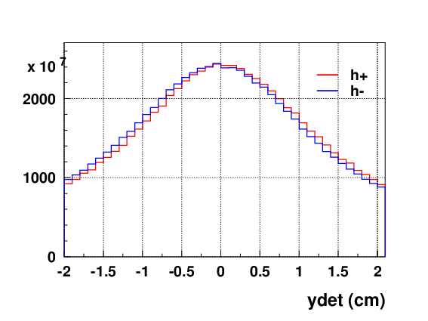
Detector Distributions
LEP polarimeter measured difference in vertical position for h+ and h- induce by transverse analyzing power
At 5 GeV, average position difference for h+ and h- is
Y_{h+} - Y_{h-} = 0.49 mm
At 18 GeV, difference is similar magnitude:
Y_{h+} - Y_{h-} = 0.38 mm
While measurable, this quantity extremely sensitive to knowledge of absolute detector position and laser-beam collision point
5 GeV

Slide 7
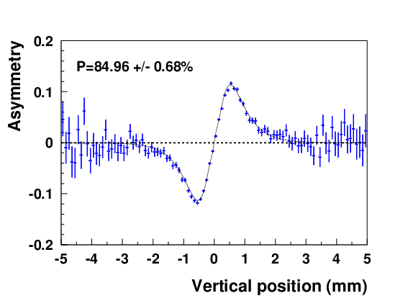
Differential Asymmetry measurement
Differential measurement of asymmetry vs. position at detector allows us to incorporate offsets in the fit
Example using Toy MC for counting-mode asymmetry vs. y assuming 0.1 mm segmentation
(240 bunches)
→ Requires detector operated in integrating mode (~10,000 photons/bunch) with signal proportional to number of photons in each channel

Slide 8
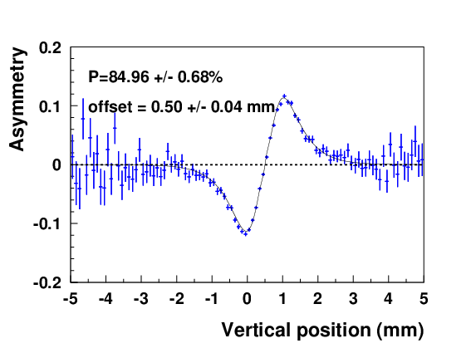
Differential Asymmetry measurement
Differential measurement of asymmetry vs. position at detector allows us to incorporate offsets in the fit
Example using Toy MC for counting-mode asymmetry vs. y assuming 0.1 mm segmentation
(240 bunches)
→ Requires detector operating in integrating mode (~10,000 photons/bunch) with signal proportional to number of photons in each channel

Slide 9
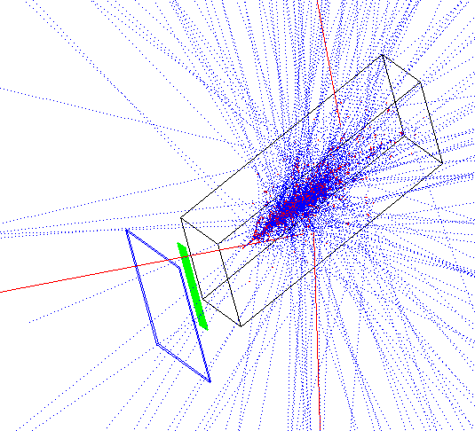
GEANT3 Simulations
Originally assumed a Cherenkov-style detector with number of photoelectrons proportional to number of particles incident on detector
Not easy to build such a detector with needed granularity
Switched to diamond detector – record total energy deposited in each strip for a single laser strip
Detector components:
1 mm W converter
500 strip diamond detector, 1 x 5 cm
W/ScFI calorimeter (not really relevant here)
Simulation = 100,000 backscattered photons
Assuming 10,000 photons/laser pulse = 10 laser pulses

Slide 10
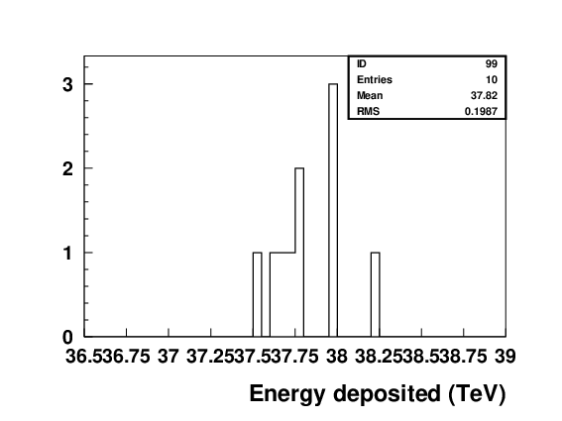
Energy deposited in Photon Detector
18 GeV
Assuming ~10,000 backscattered photons per laser pulse, large amount of energy deposited in photon calorimeter
37 TeV!
Calorimeter response not crucial for RCS polarimeter, but would like to be able to measure absence of a longitudinal asymmetry
Energy per laser pulse

Slide 11
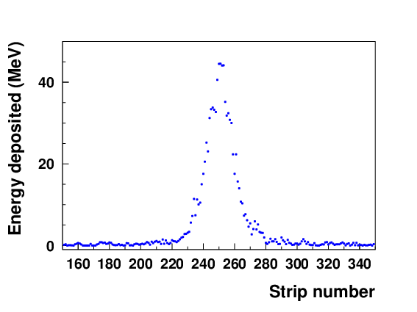
Energy Deposited in Diamond Strips
18 GeV
Diamond detectors assumed to be ~0.5 mm, much higher segmentation
More modest amount of energy deposited in each strip for a single laser pulse
Even though time response not crucial for this application, could use FLAT-32 ASIC here as well
→ Can choose analog pulse as opposed to discriminated signal (ESR Compton use)

Slide 12
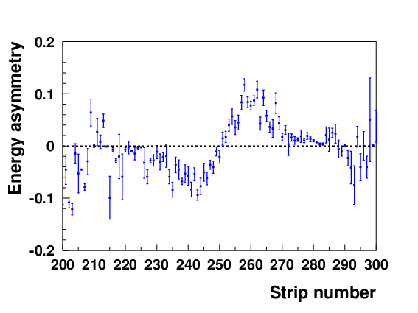
Energy Asymmetry
Transverse polarization will be extracted using asymmetry in energy deposited in each strip
18 GeV
Since diamond planes are thin, energy deposited roughly the same for all photons
→ Resulting asymmetry similar to that from Cherenkov-type detector
Note: only 10,000 backscattered photons (simulation operator error)

Slide 13
RCS to-do list
Get realistic beam parameters for RCS laser IP
Add 5 GeV, 10 GeV
Perform robust estimates of measurement times using this technique
Add another plane for measurement of in-plane polarization
Check sensitivity to residual longitudinal polarization

