Slide 1
Update on Prototyping & Stave Structure Analysis
11/09/24

Slide 2
Quarter Length Stave
Stave jig parts (including K9 foam block)
Start with 2 (quarter stave)
We have all the material we need for a first prototype
Working on Kapton C channel
Currently have a couple of prototype Carbon Fibre I beams but we may try making one more
We have hand cut carbon fibre skins (2 ply 0/90) but plan to make production intent on drag knife

Slide 3
Quarter Length Stave

Slide 4
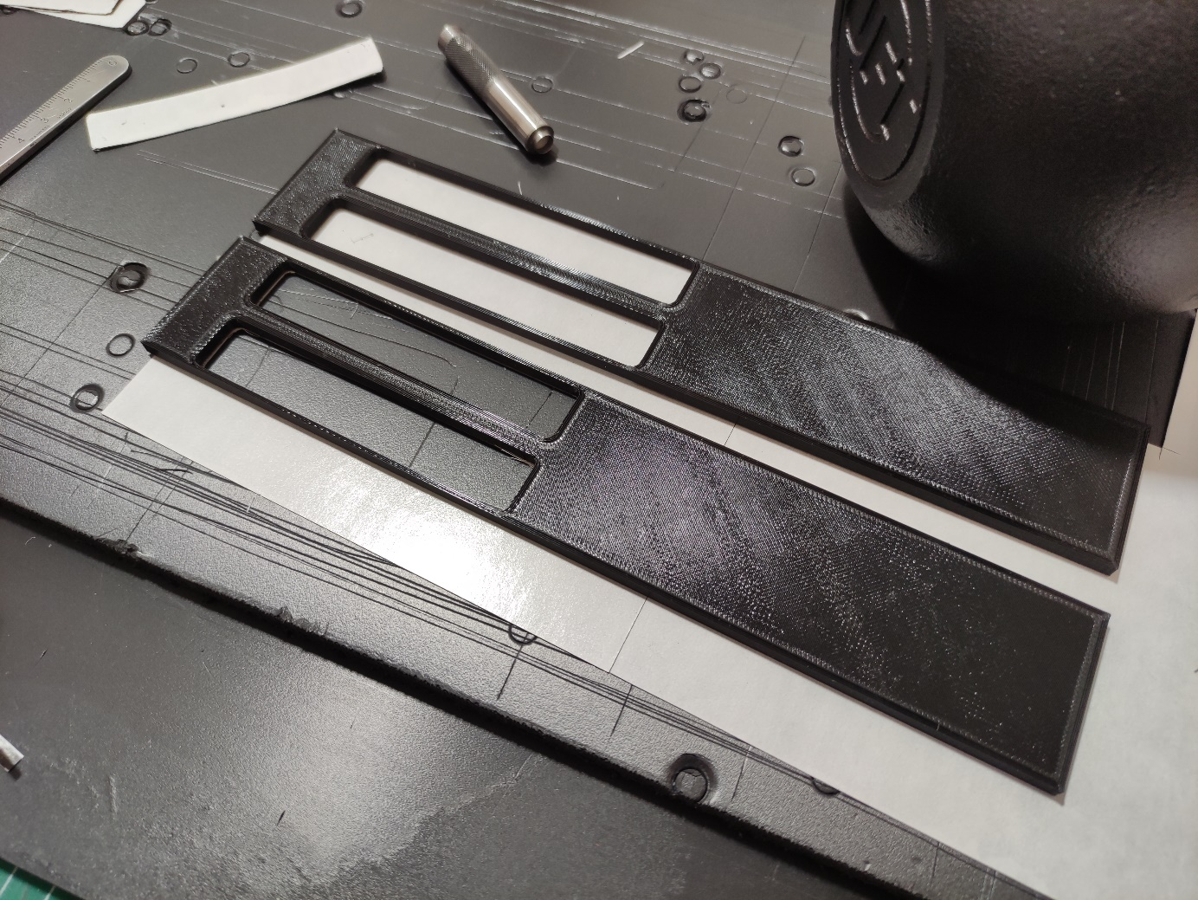
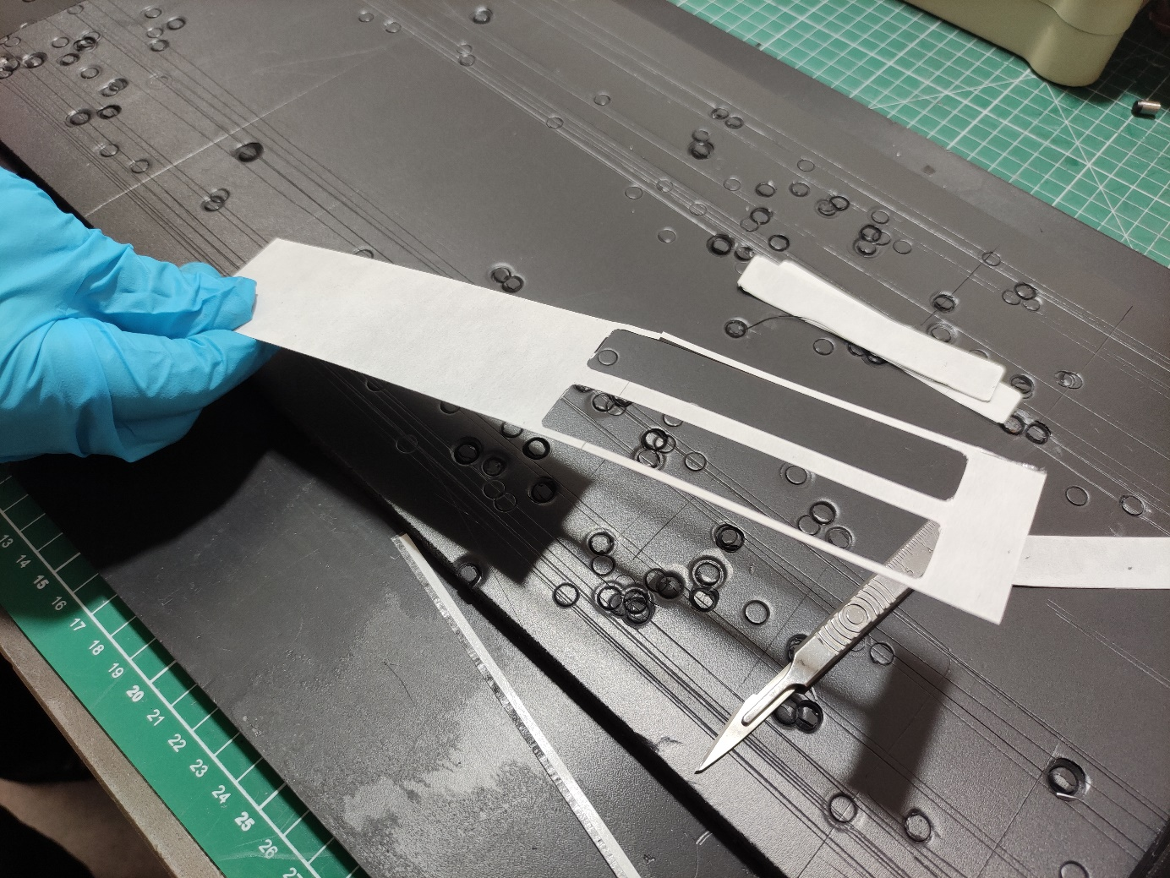
Quarter Length Stave
3D printed stencils and resulting parts(hoping to also get drag knife versions ASAP)

Slide 5
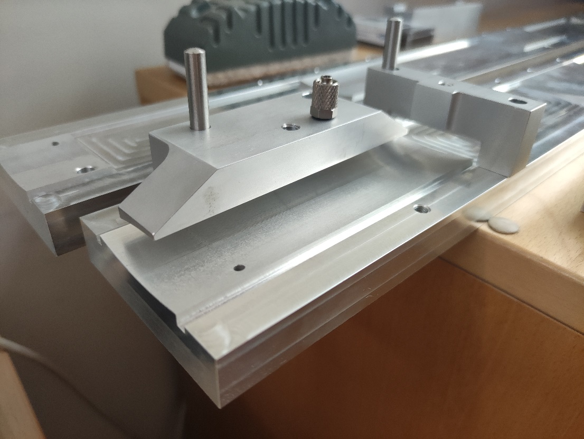
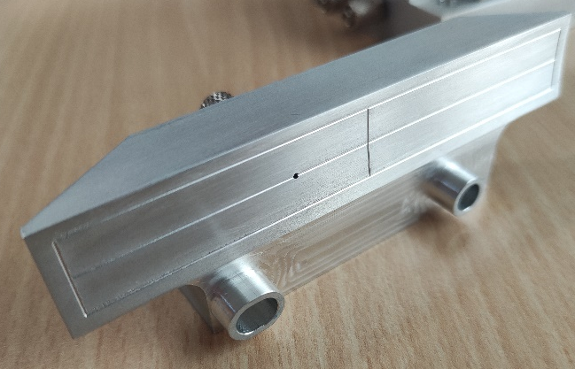
Module Assembly Tooling
Gap under vacuum tool looks consistent (this sets glue thickness) should be approx. 100 microns
L4 Module Installation Tooling

Slide 6
Comparison of Flat vs. Curved stave structure
07/08/2024

Slide 7
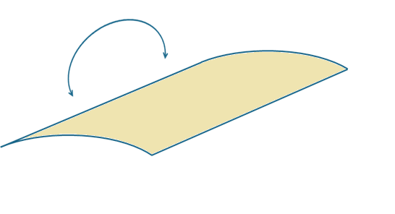
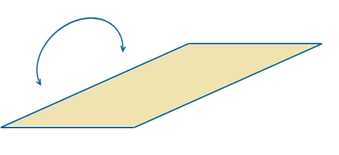
Introduction
Why do we curve our sensors?
Local Stiffness argument has been presented previously
Reduced deformation under internal pressure
Higher internal mode of Sensor
What about Global Stiffness?
Curved sensors may also improve global stiffness
Left object has higher moment of inertia should be harder to bend along the long axis
Flat Sensor will have centre of area slightly further from neutral axis so hard to predict the difference

Slide 8
Comparison Geometry
For fair comparison try to match radiation length
Only components which differ are the I and C channel thicknesses
Internal volume should be equal to or higher than the curved concept we have been using so far (we don’t want to increase flow velocity)
Curved Assembly
8mm thick in centre
4mm thick at tip
Flow Area – 131 mm²
Mass - 249.4g
Flat Assembly
6.65 mm constant thickness
Flow Area – 137 mm²
Mass - 256.6 g

Slide 9
Mode Comparison – First & Second Mode
Curved Assembly
91.581 Hz
236.44 Hz
Flat Assembly
84.57 Hz
242.33 Hz

Slide 10
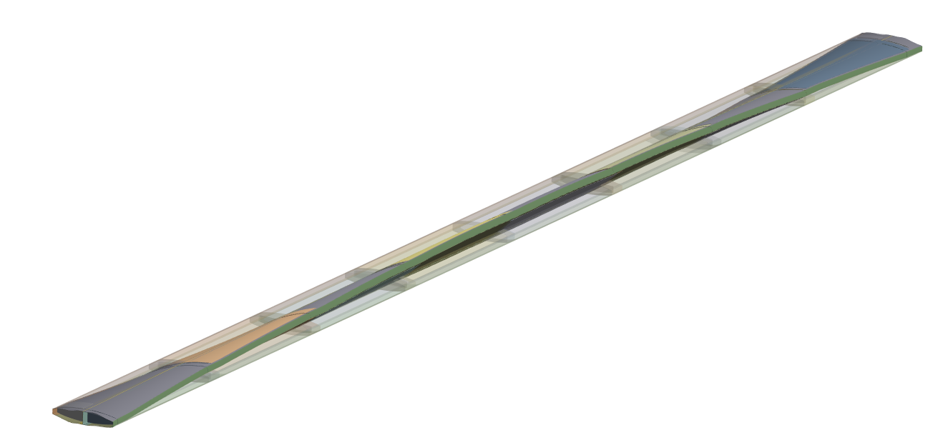
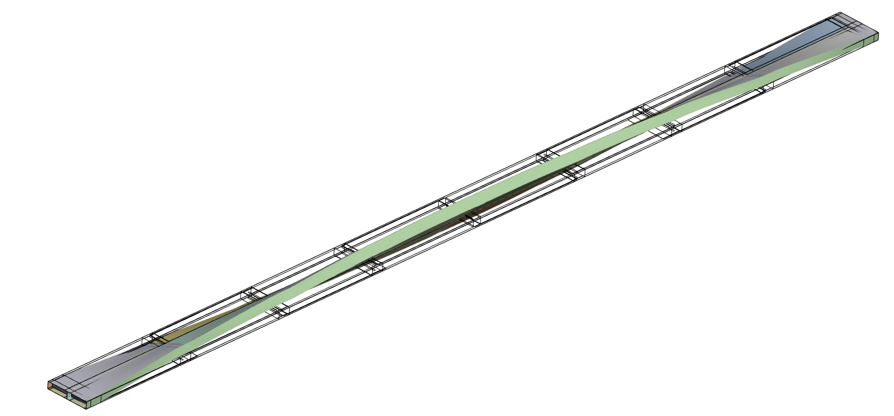
Mode Comparison – Third & Fourth Mode
Curved Assembly
274.44 Hz
379.29 Hz
Flat Assembly
254.23 Hz
338.36 Hz

Slide 11
Sensor Internal Mode Frequencies
In previous sensor mode studies used a best-case constraint for maximising internal mode
Fixed around outer edge,
Equivalent to infinite stiffness structure
Mode frequency will be lower with less stiff boundary
Internal modes in the 1-3 kHz range

Slide 12
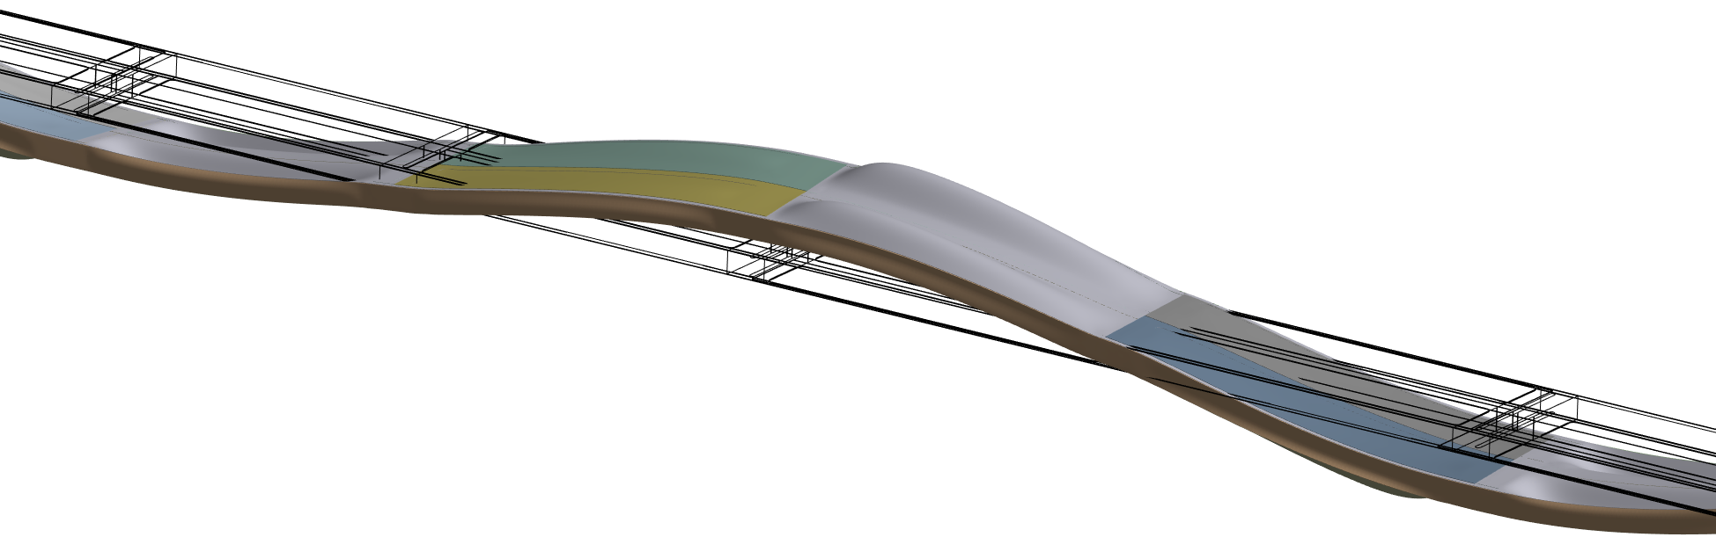
Sensor internal mode frequencies
745 Hz – Carbon Skins show local deformation
No modes involving substantial deformation of the LAS under 2 kHz

