Slide 1
Prototype status
First quarterstave

Slide 2
Introduction
We co-cured the first quarterstave prototype
  Using first set of mould tools (parts for full size stave will be produced once we absorb lesson from quarter stave
  Using 2 layers (90/0) of K13C2U/EX1515 (cut by hand)
  Using Kapton C-channel for side close-outs
  Rapid prototyped end pieces
Despite a glitch (vacuum failure resulted in abort of first cure cycle during up-ramp at about 110°C) the result is very satisfying
  Visually good compaction and bonding
  K9 foam cross ribs withstood pressure well – no visible crushing and feel solid
  Removal of mould parts was fiddly, but worked in the end
    Issue was glue that crept between the mould parts
  End pieces are crushed, but this is not a concern

Slide 3
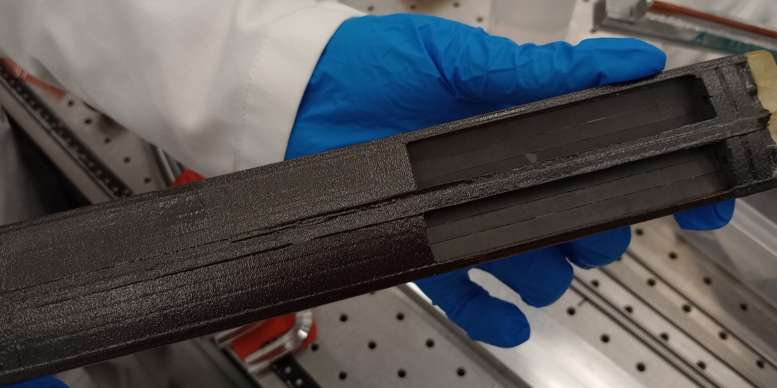
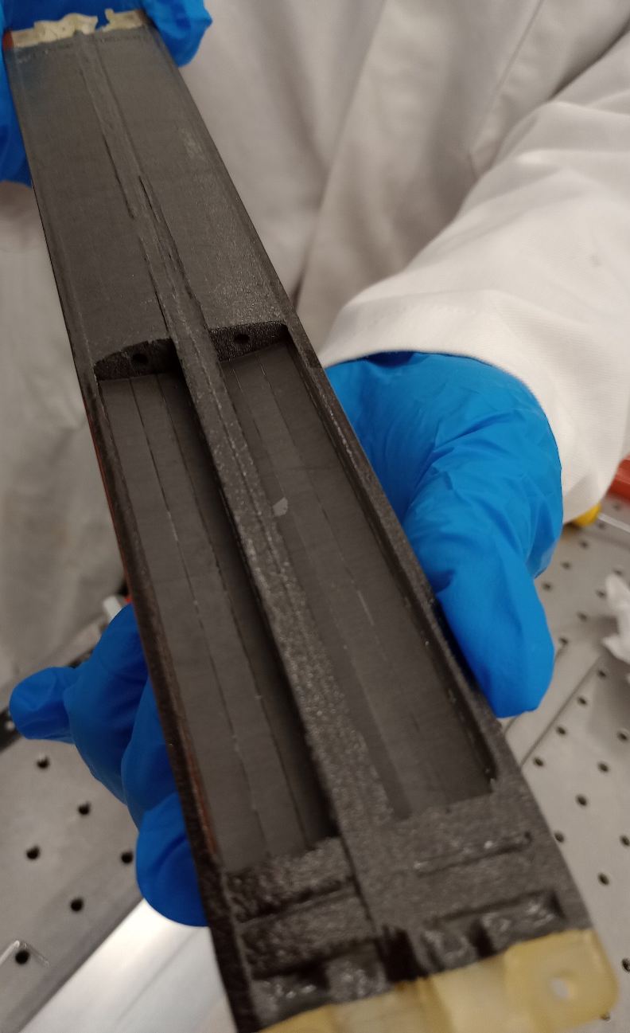
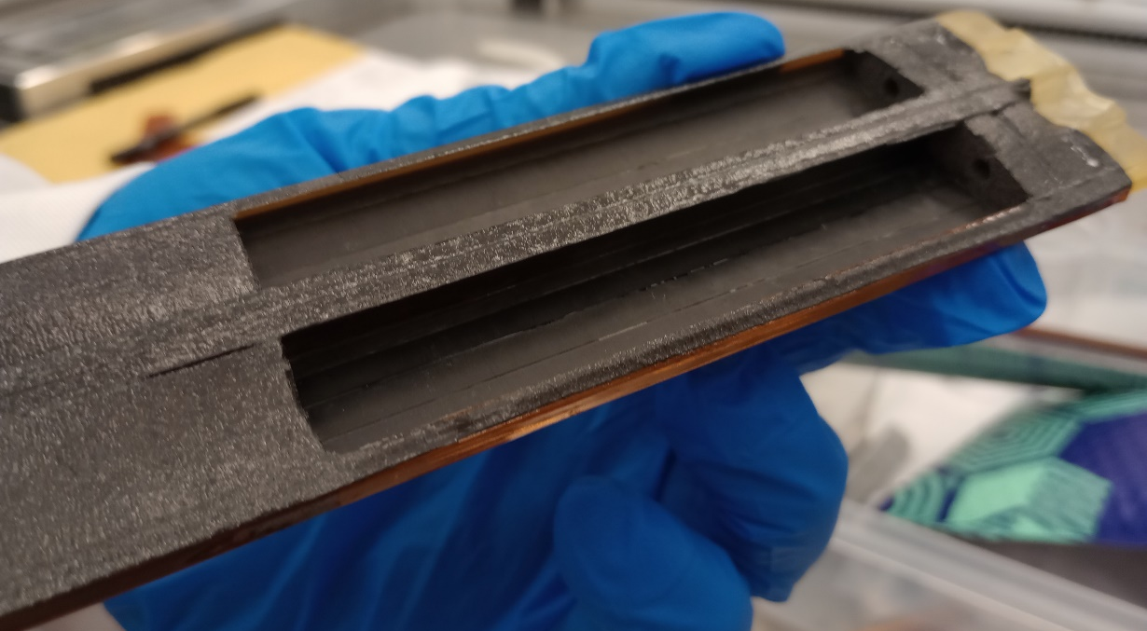
Pictures

Slide 4
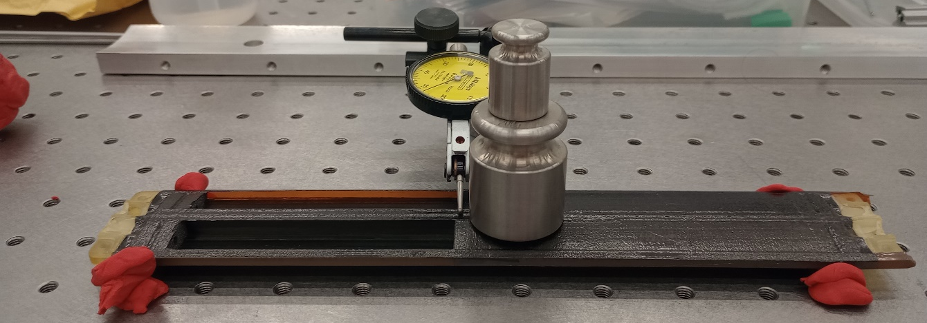
Quantitative results
Mass estimate
3pt bend test
Measured: 8.95 g

Slide 5
Next steps
Cure another quarterstave
  Still working on the cutting with the automated knife cutter
  Improved trimming of I-beams
  Next cure with rubber sheets
  Use more robust end pieces (so that we can give fixed end constraints)
    Either solid plastic or aluminium
More quarterstave tests
  Still waiting for vacuum chuck for extraction of mechanical dummy sensors
  Hence will close one quarterstave with Kapton to start flow tests
    For example add dummy ancASIC study temperature with air flow
In parallel
  Update drawings for remaining mould parts for full stave & manufacture
    This will include features to facilitate removal of mould parts after cure
Then cure a full size L4 stave

