Slide 1
Integration, Installation and Infrastructure (Triple I Group)
TIC Update
Roland Wimmer

Slide 2
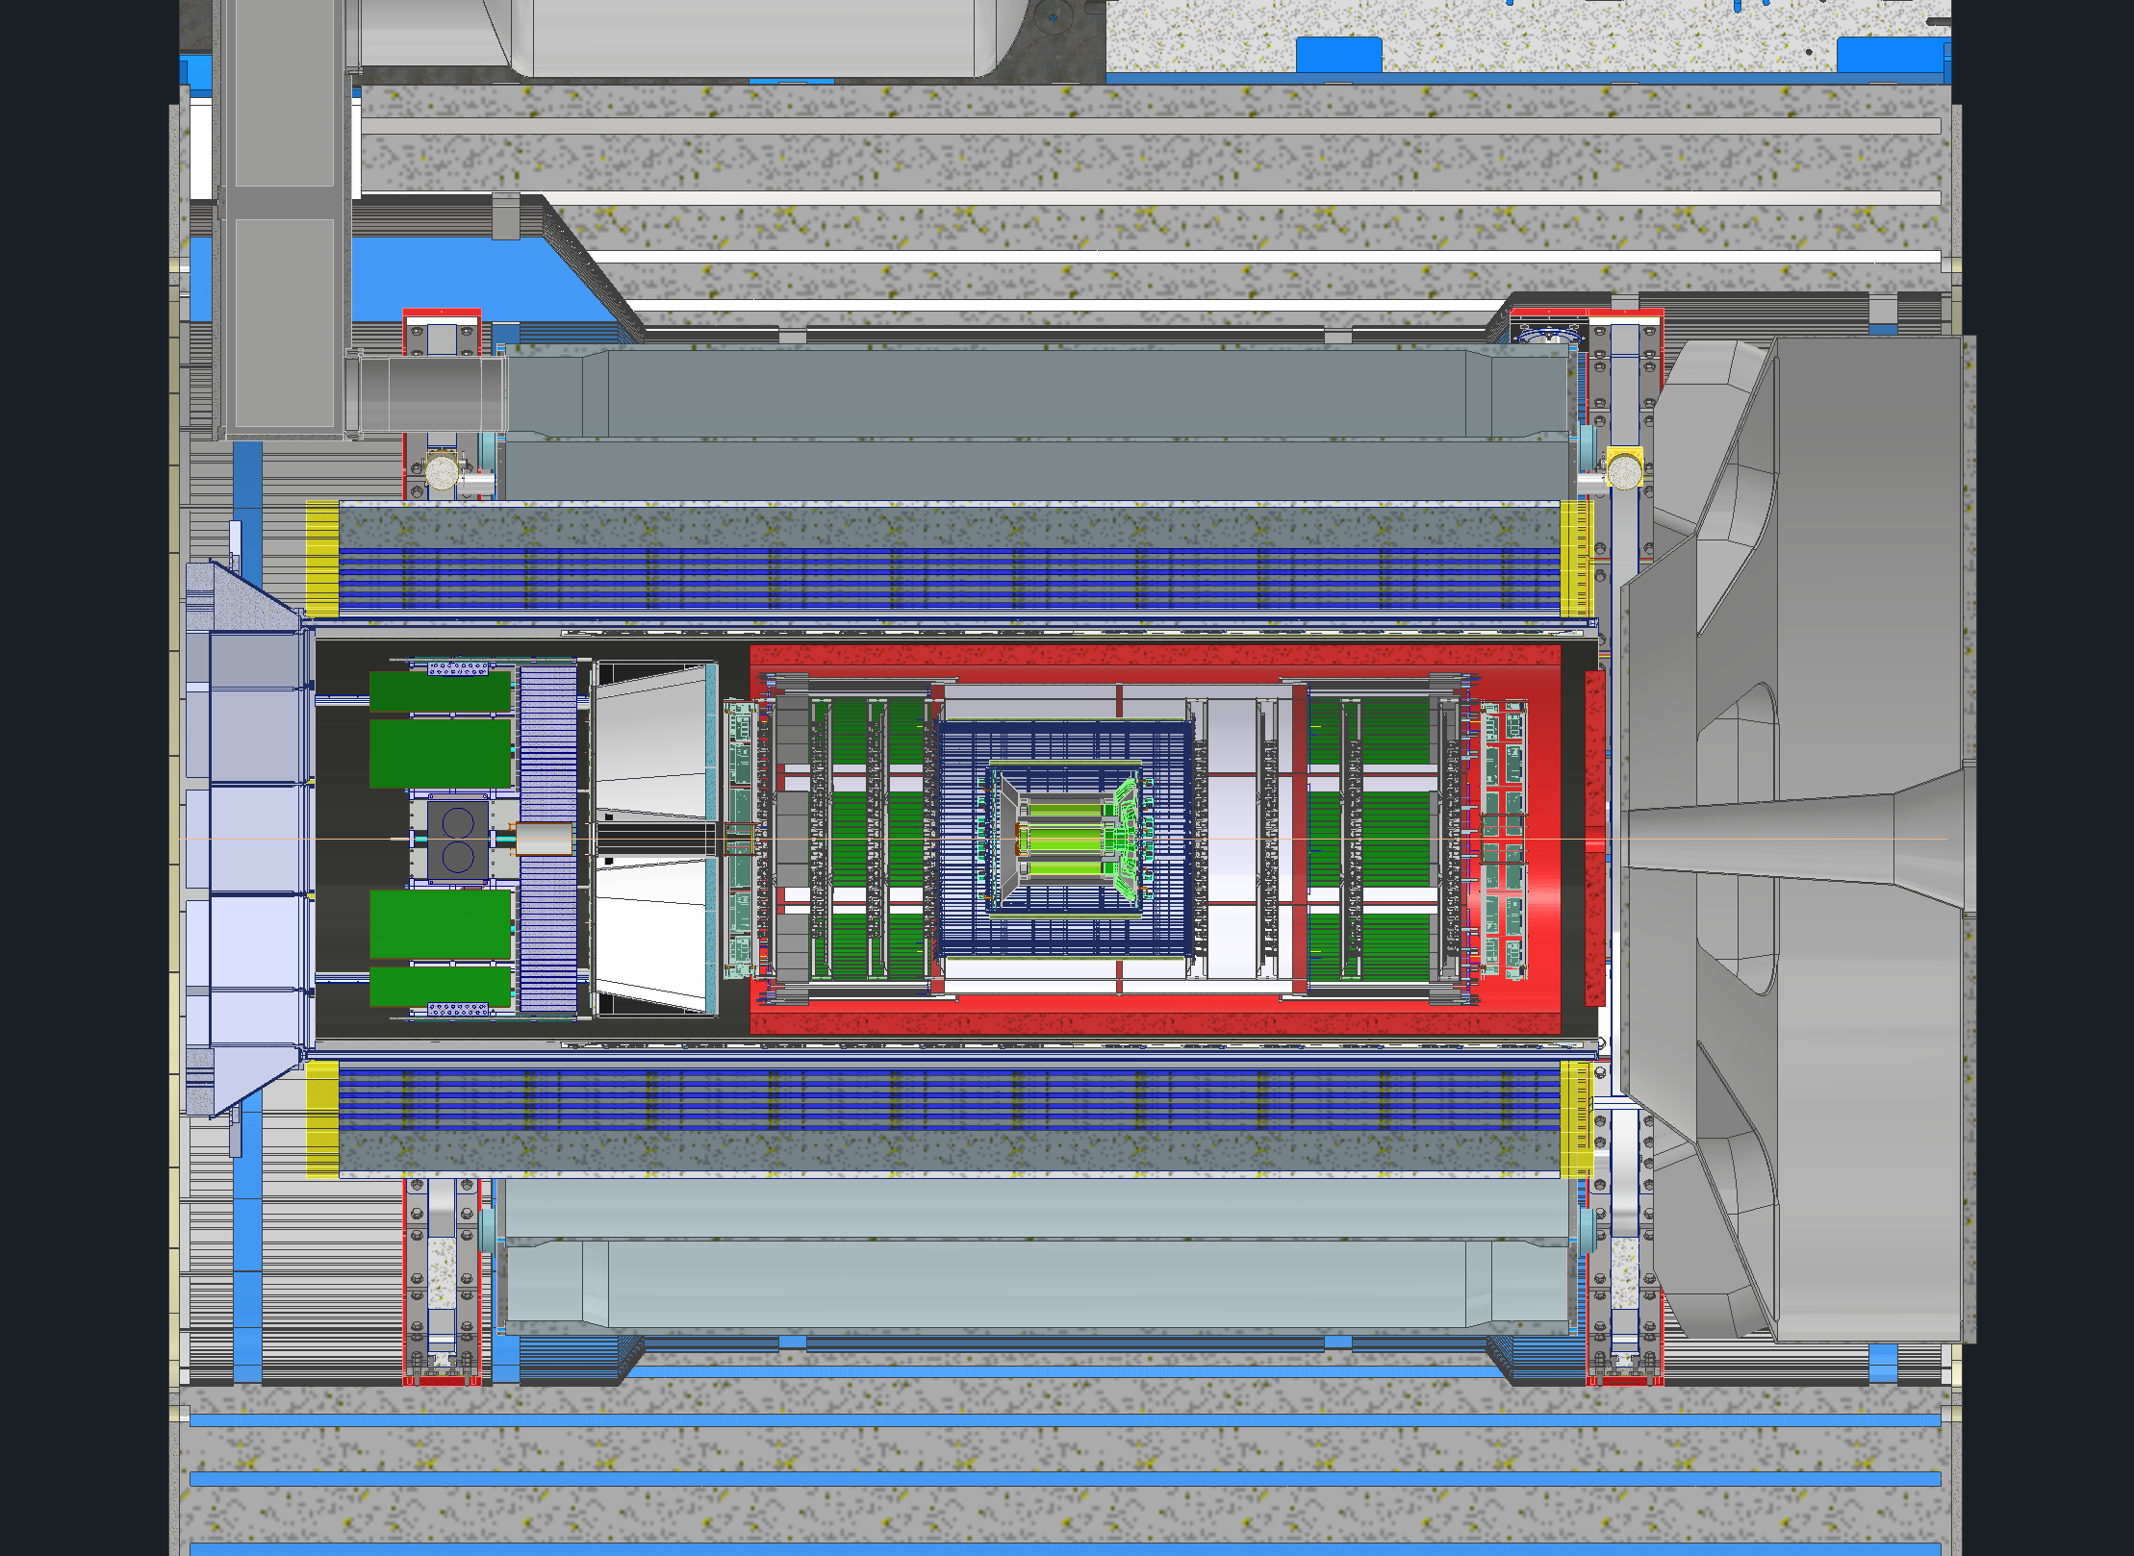
Detector Model Updates
Inner Tracker Model Updates
Services
VTRX+
Cable Trays
AC-LGAD
Flux Return
New Simulations
RCS
Barrel EMCAL
Subgroup Meetings

Slide 3
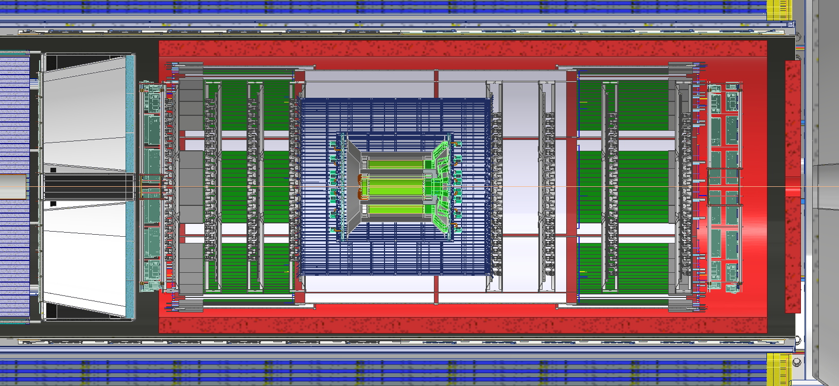
Inner Tracker Updates
Have models for everything except for AC-LGAD
Recently Got models for SVT
Bunch of interferences, will work with them to fix

Slide 4
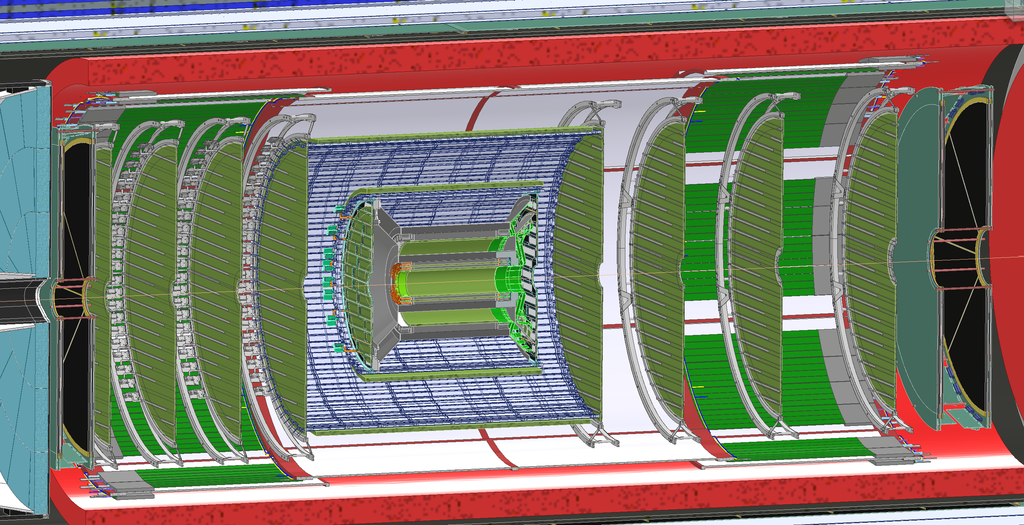

Slide 5
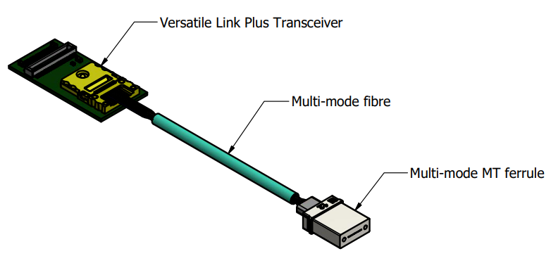
Services – VTRX+
Recently switch all applicable detectors over from RDOs to VTRX+ modules
Modules will be placed on each detector
The modules can only push the signal up to 2m in length so there needs to be a fiber patch to convert to MTP fiber
Each module gets 1 fiber patch, locations will vary from detector to detector
Total VTRX+ modules needed listed below
FEB or RDO
VTRX+
Sub-Detector | Qty
SVT | 1579
MPGD EE | 64
MPGD HE | 64
MPGD IB | 128
MPGD uRwell | 384
TOF Disk | 212
TOF Barrel | 288
dRICH | 1242
pfRICH | 68
Fiber Patch / Feedthrough / Disconnect Panels
Fiber Patch Panel

Slide 6
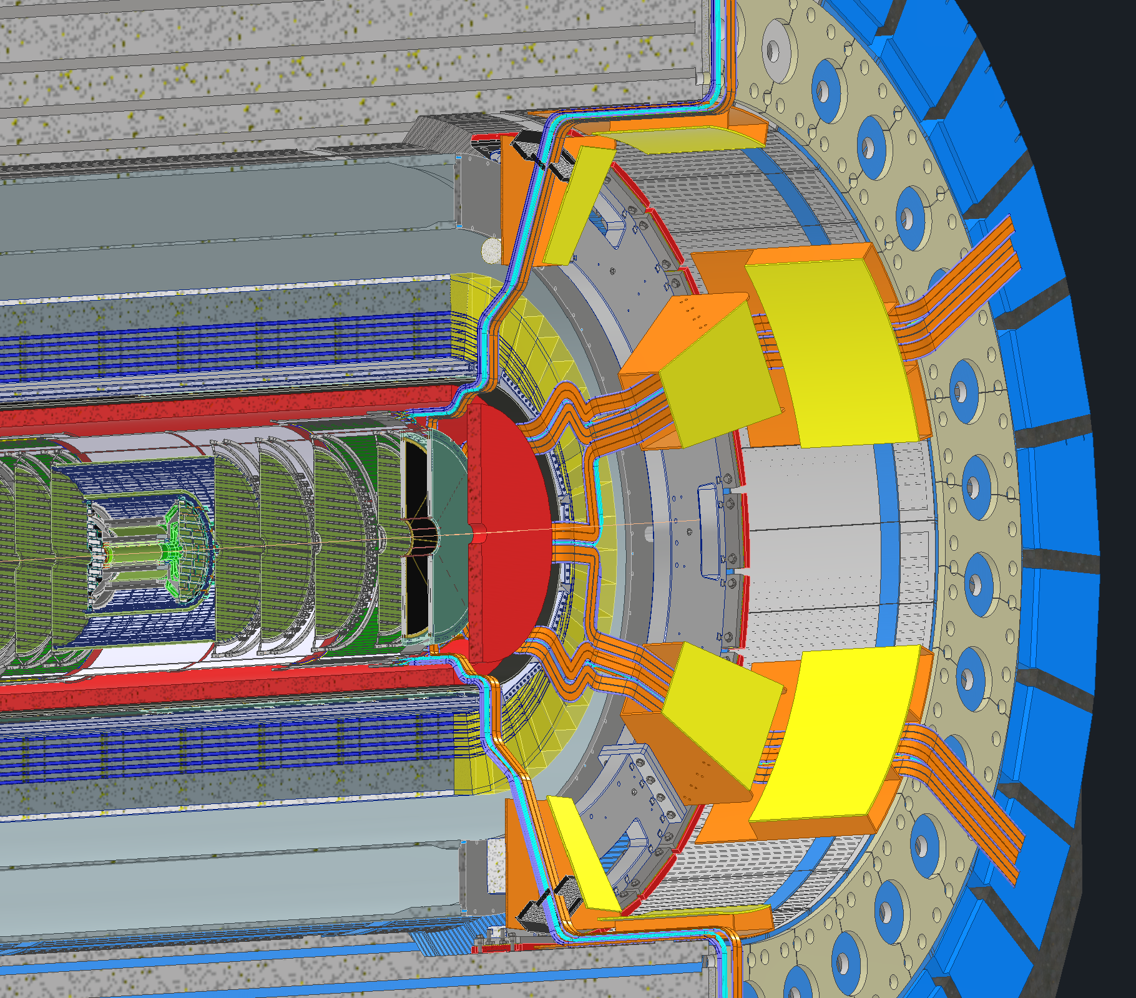
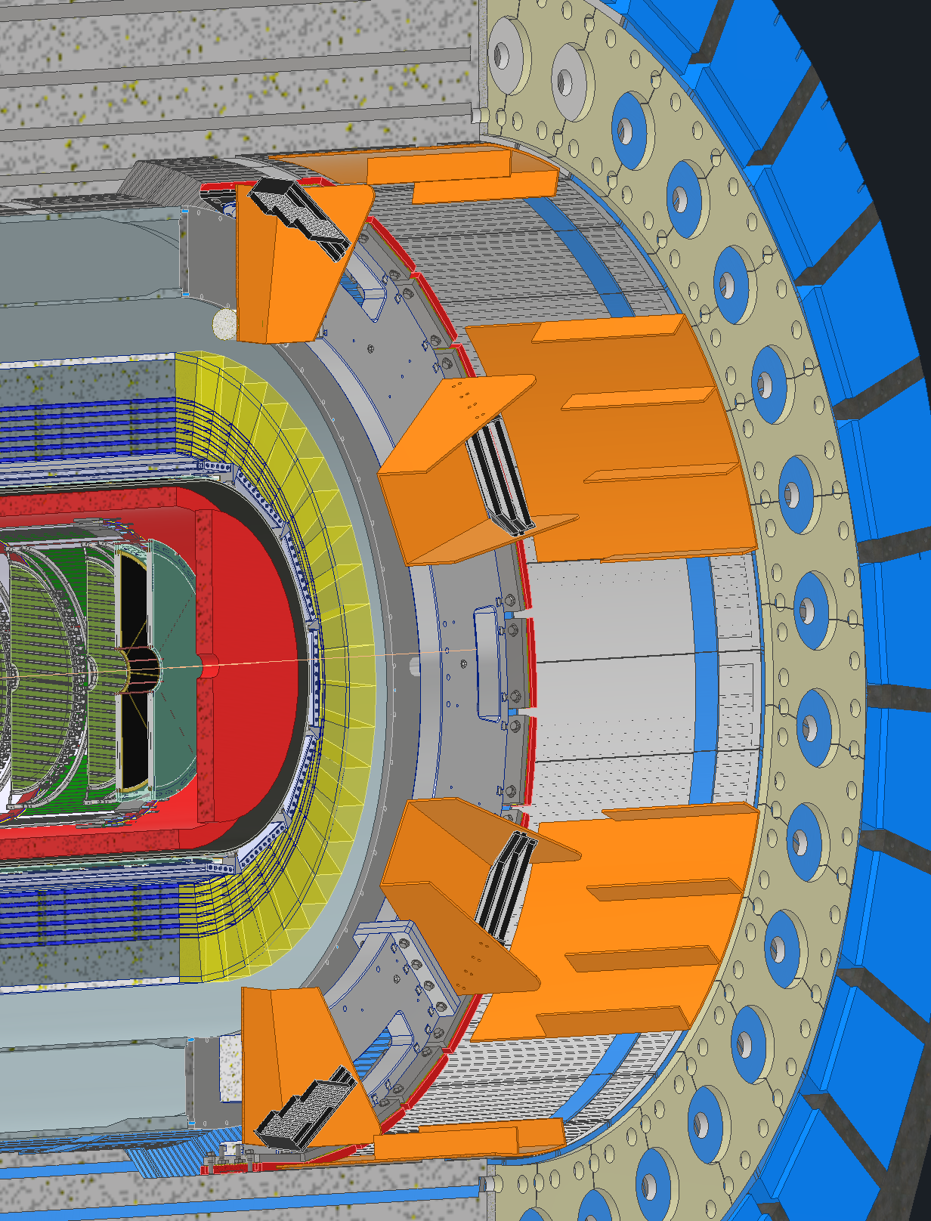
Services – dRICH Cable Trays

Slide 7
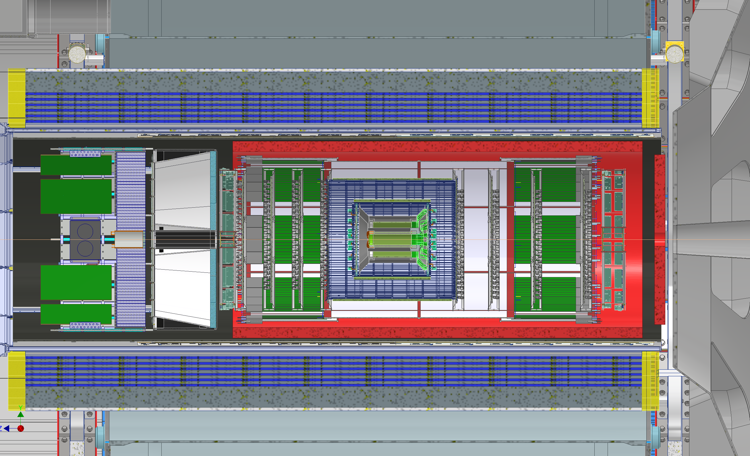
Services – AC-LGAD

Slide 8
Flux Return Steel

Slide 9
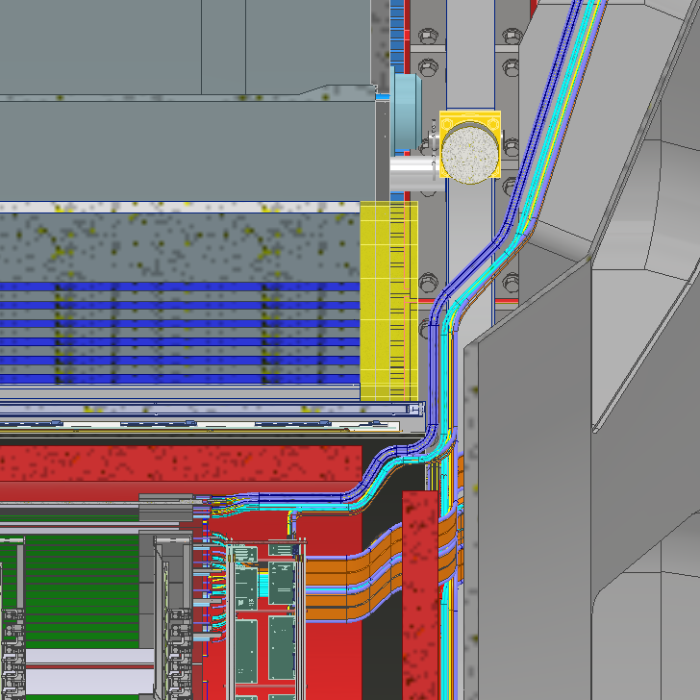
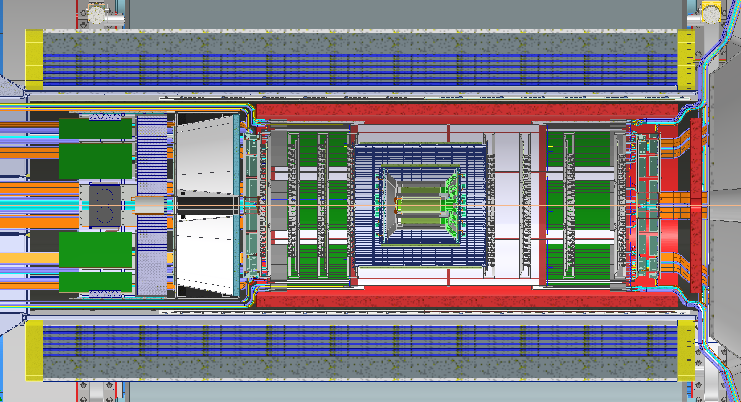
Barrel Emcal

Slide 10
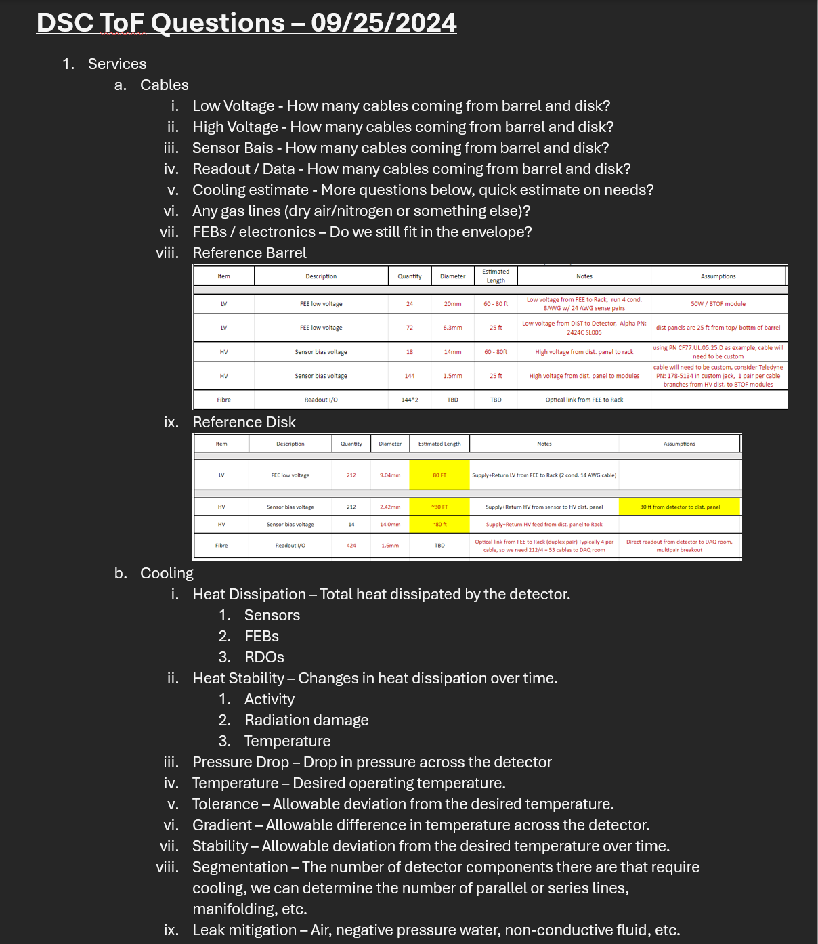
Subgroup Meetings

Slide 11
Backup Slides

