Slide 1
Updates: ProtoDUNE & Others
Wenqiang Gu

Slide 2
ProtoDUNE HD
Beam data taking has been extended to September 18
To collect more +/- 1GeV/c pion data
The proposed beam-dump mode for BSM search has been “rejected”, and will be discussed in the future
Requests for post-beam operation is under discussion
~ 1 month before LAr removal from NP04 cryostat
Short test of beam-dump mode: Here
Cosmic data, CRT configurations, data management, etc.

Slide 3
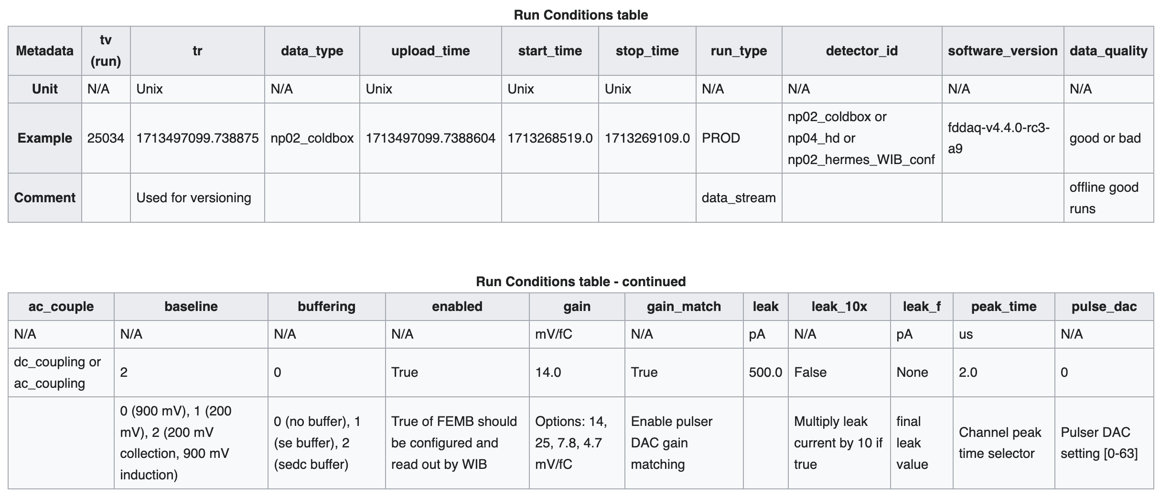
Run condition DB
The run condition DB is now available for ProtoDUNE: Here
Should we integrate it in the larwirecell::ChannelNoiseDB for ”mis-configured” channels, e.g., nominal gain 14mV/fC, while recent data has 7.8mV/fC
Perhaps not urgent as the production team can prepare two different FHiCL files

Slide 4
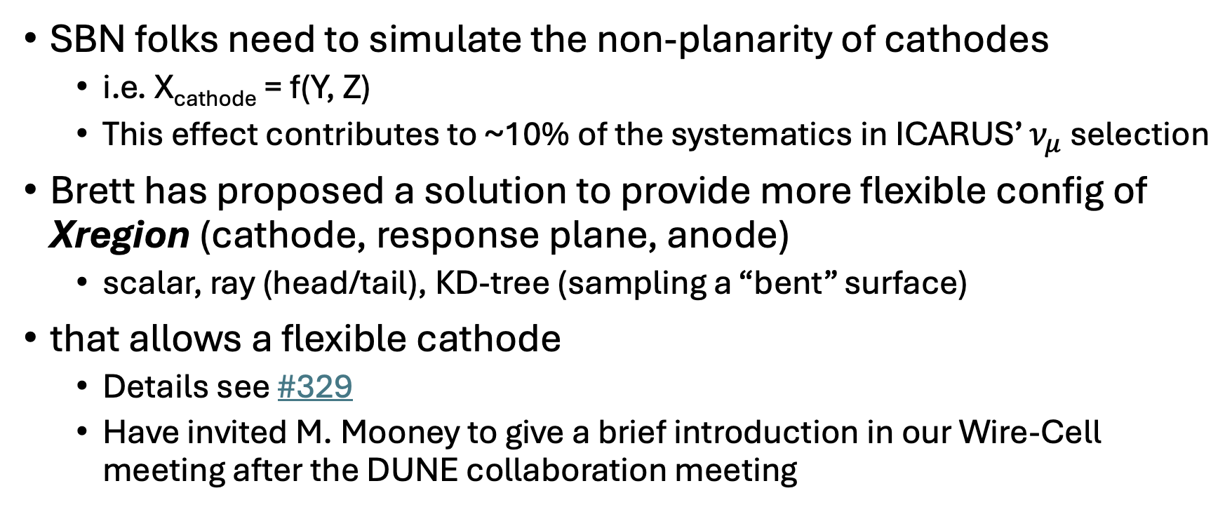
Cathode non-planarity
SBN folks need to simulate the non-planarity of cathodes
i.e. X_{cathode} = f(Y, Z)
This effect contributes to ~10% of the systematics in ICARUS’ $ν_{μ}$ selection
Brett has proposed a solution to provide more flexible config of Xregion (cathode, response plane, anode)
scalar, ray (head/tail), KD-tree (sampling a “bent” surface)
that allows a flexible cathode
Details see #329
Have invited M. Mooney to give a brief introduction in our Wire-Cell meeting after the DUNE collaboration meeting

