Slide 1
PDHD SigProc Update
Xuyang Ning, Wenqiang Gu

Slide 2
Recap: SigProc tuning for ProtoDUNE HD
Adjusted induction sigproc chain for APA1 W
LF filter, wiener filter
PR #325
Fixed bug in APA1’s multi-plane protection
PR #335
Today, we’d like to get some sense of the performance by checking a 1GeV/c beam trigger (run 28548 event 439442, 7.8mV/fC)

Slide 3
Run 28548 Event 439442 (7.8mV/fC)
Understand the difference for
wiener a = 0.06, wiener a= 0.12
w/o MP, w/ MP
Set #1: a=0.06, w/o MP
Set #2: a=0.12, w/o MP
Set #3: a=0.12, w/ MP

Slide 4
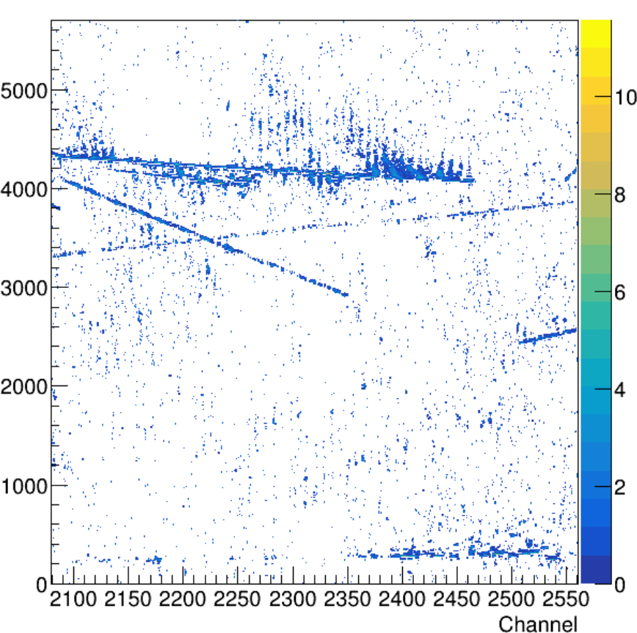
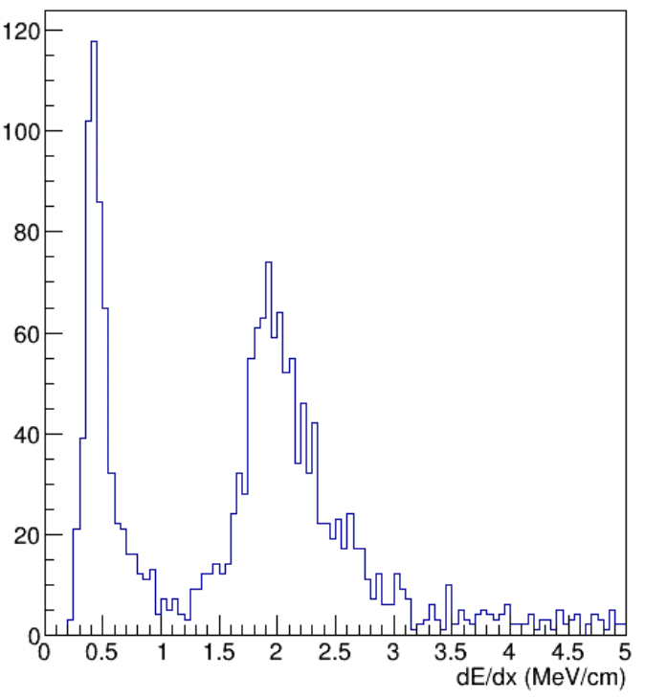
Set #0: dunereco v09_91_03d00
In this version, W plane was not treated as induction
Tight ROI threshold reduced from 3 rms to 2.5rms

Slide 5
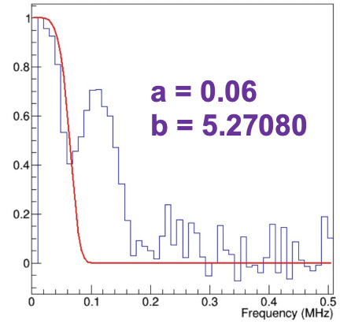
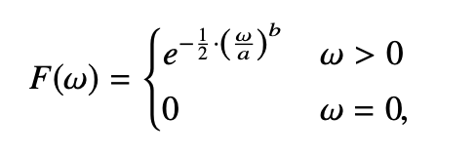
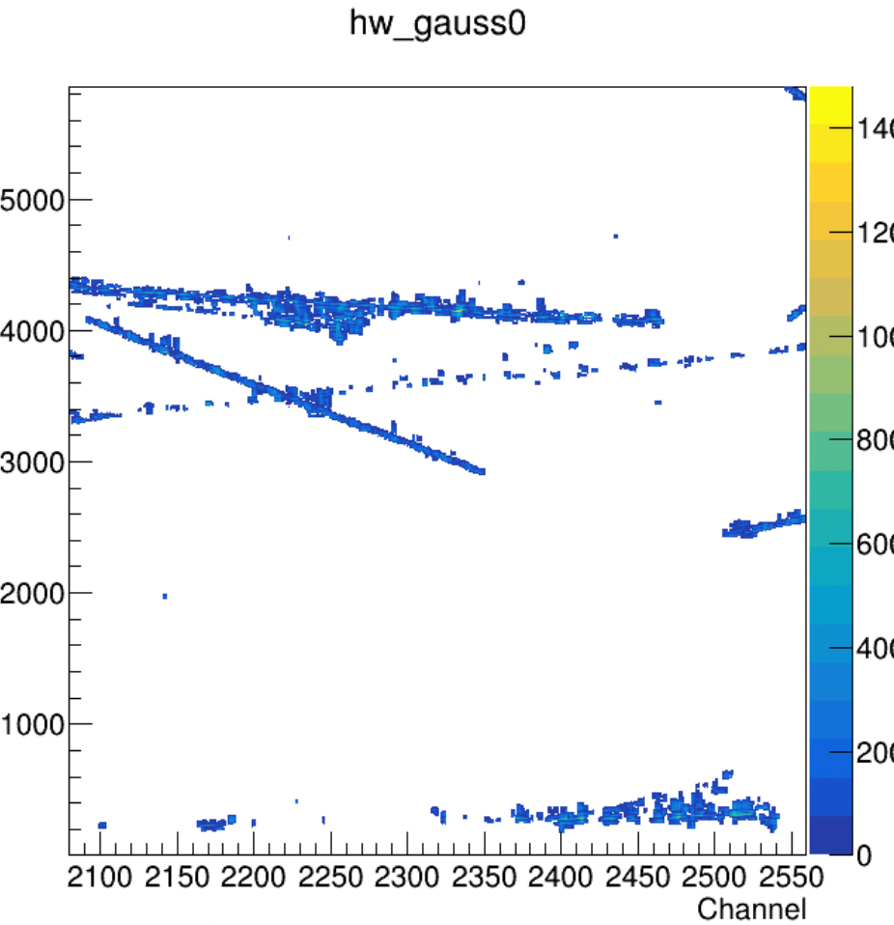
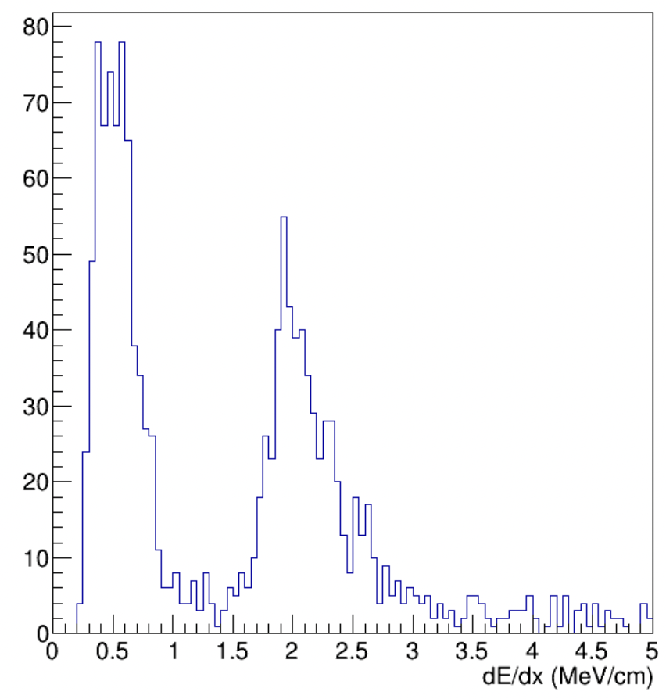
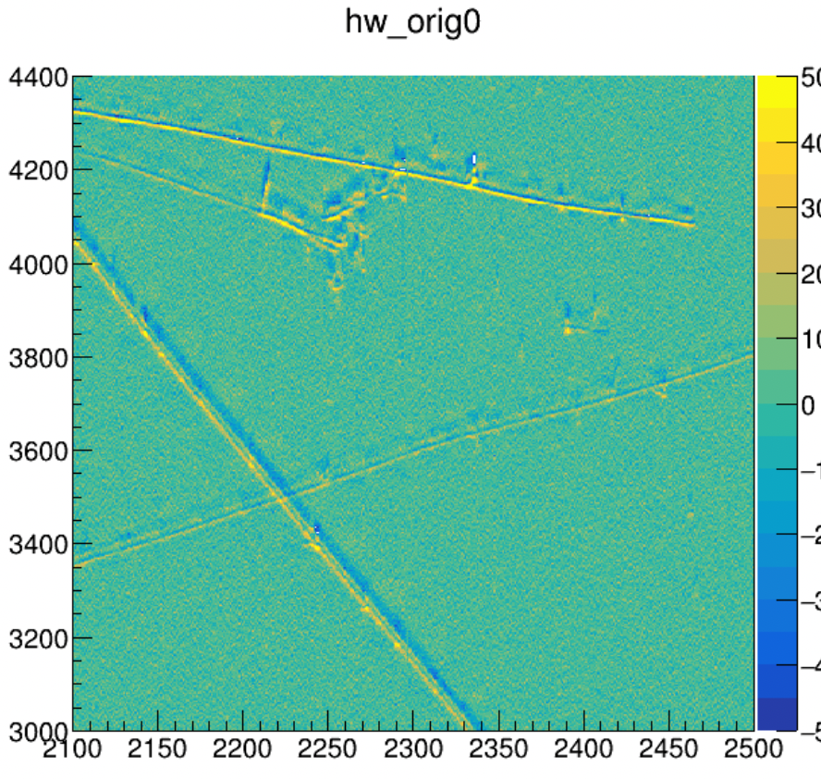
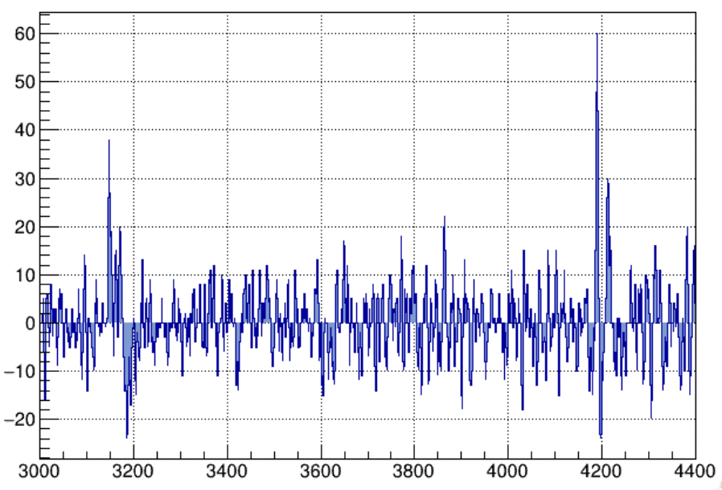
Set #1: Wiener filter a=0.06, w/o MP
Wiener filter a=0.06 seems to have better S/N in the 7GeV beam event that we checked
Raw Waveform
Ch# 2300

Slide 6
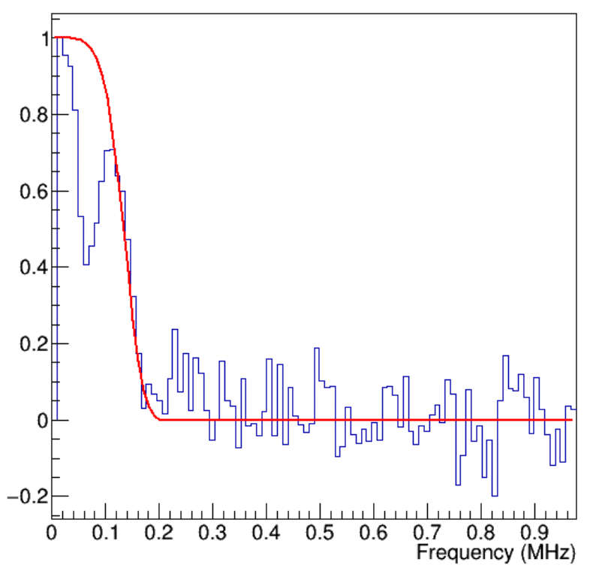
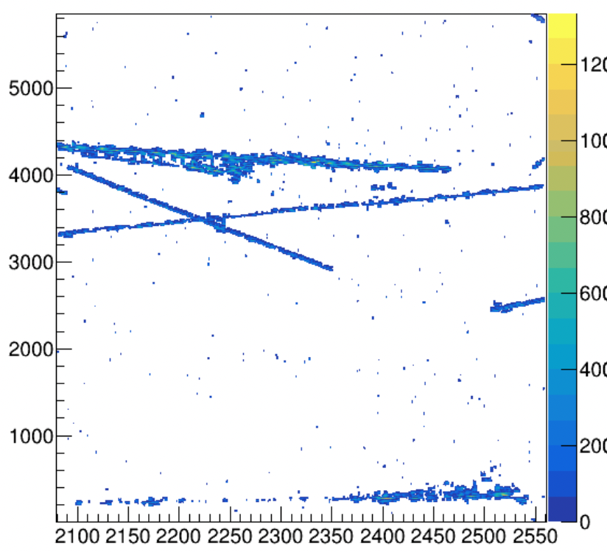
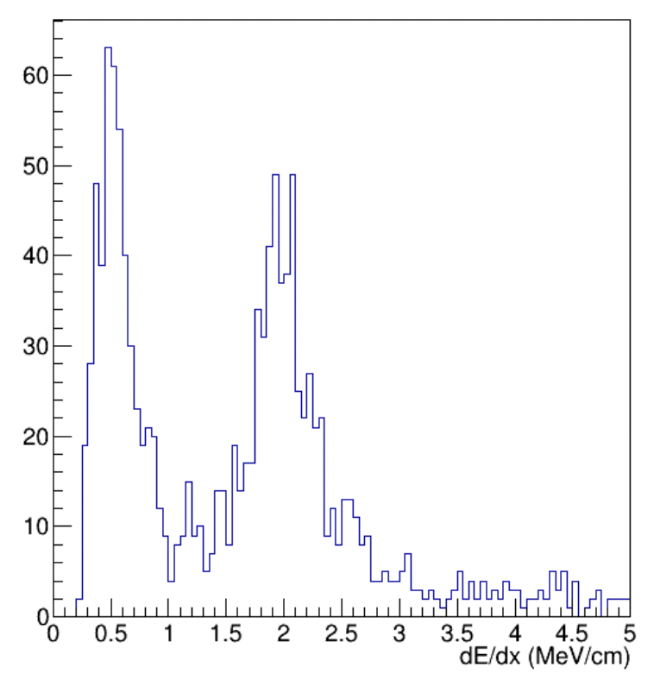
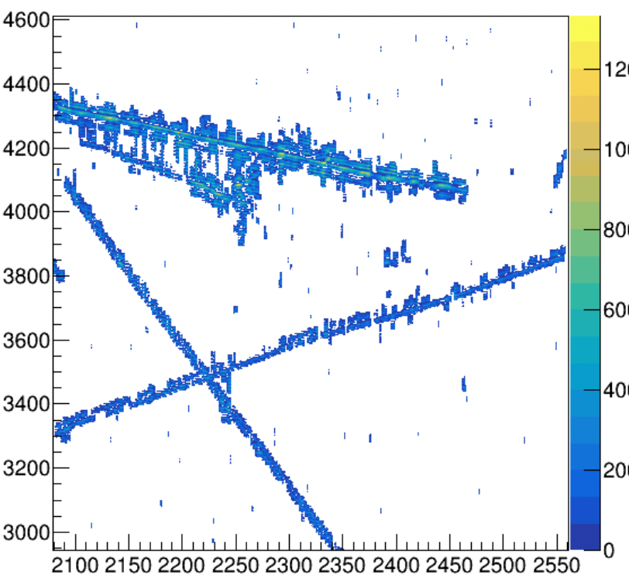
Set #2: a=0.12, w/o MP
a = 0.125448
b = 5.27080
It appears that a=0.12 works better than a=0.06 for this event (run 28548 event 439442)

Slide 7
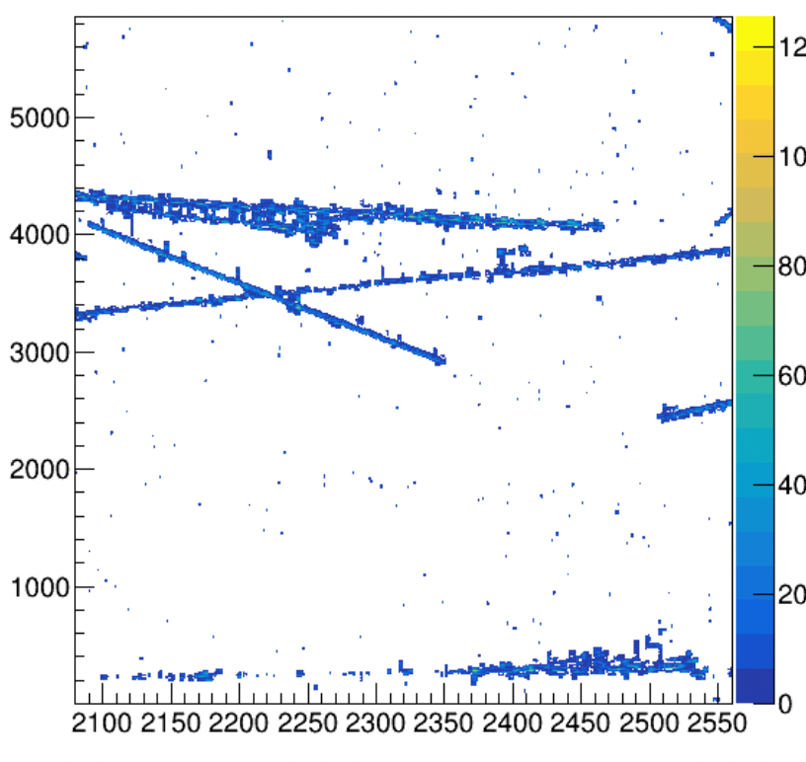
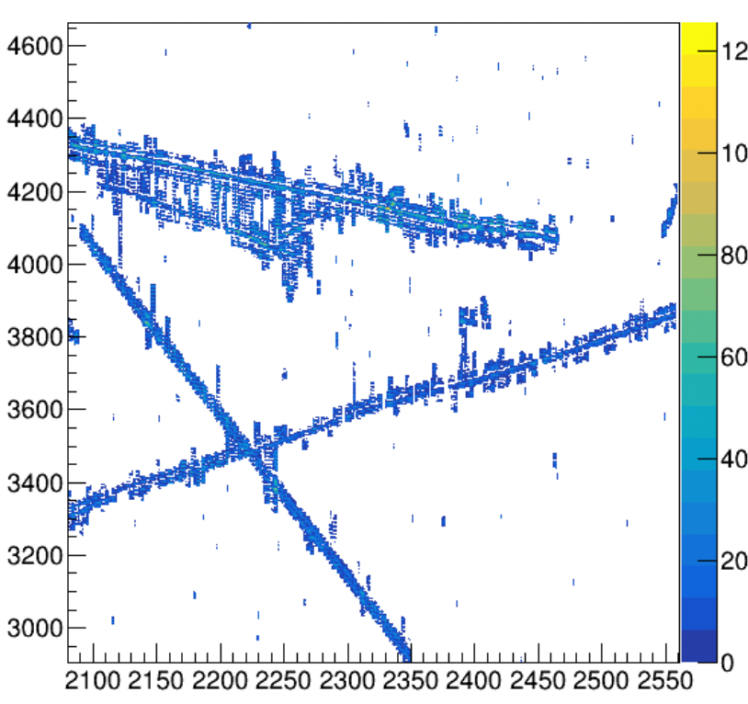
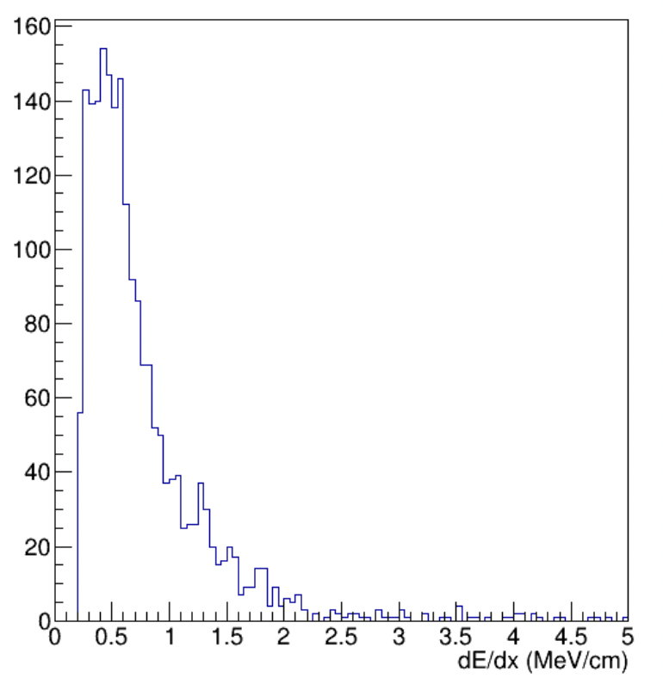
Set #3: a=0.12, w/ MP
½ mp_th1, ½ mp_th2 does not improve the result
w/ MP, the ProtoDUNE reco/calorimetry result becomes worse
See detailed comparison in the next slide

Slide 8
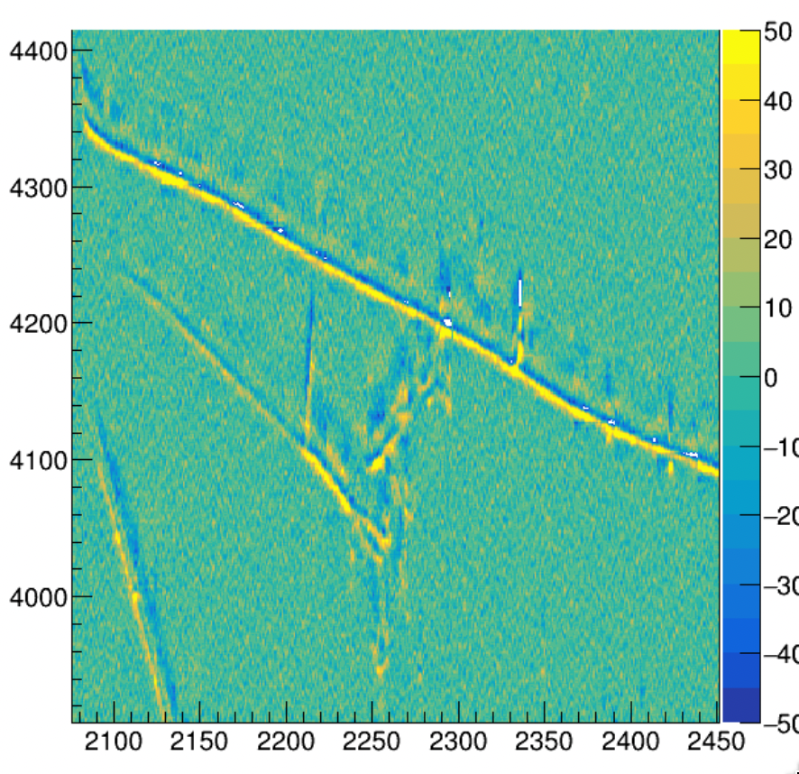
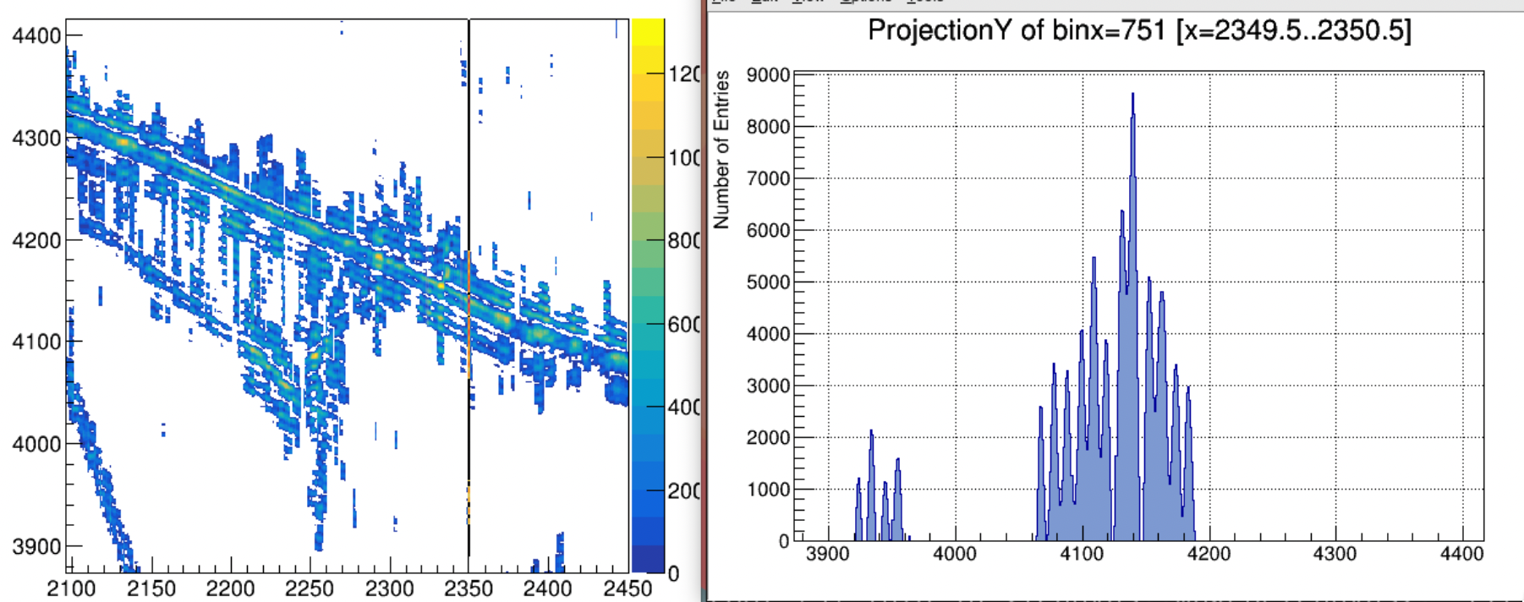
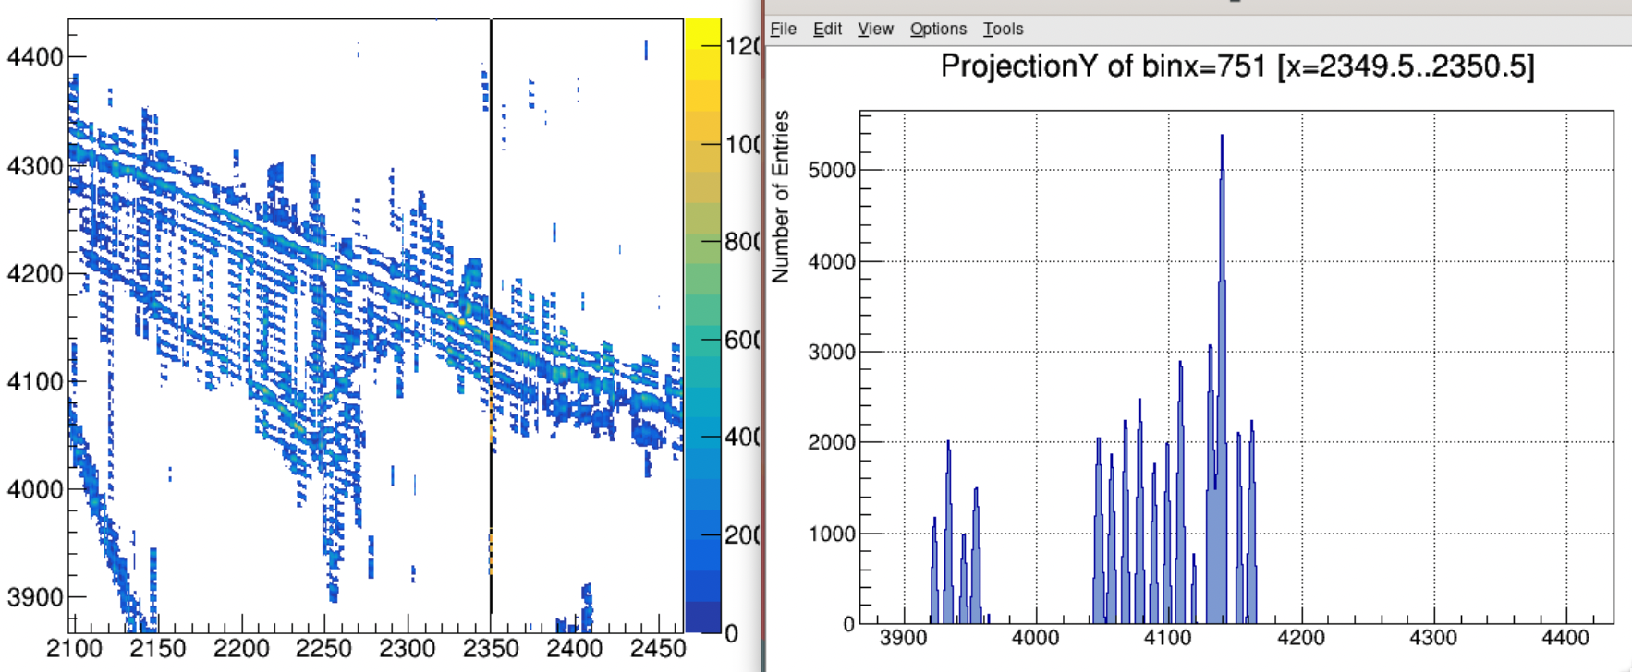
Set #2 vs. #3: w/o MP vs w/ MP
w/o MP
w/ MP
Raw Waveform
w/ MP, ROIs seem to be less scattered, although either looks good
Not sure how the ProtoDUNE reco chain works better w/o MP
Weird “colinear” ROIs (next slide)

Slide 9
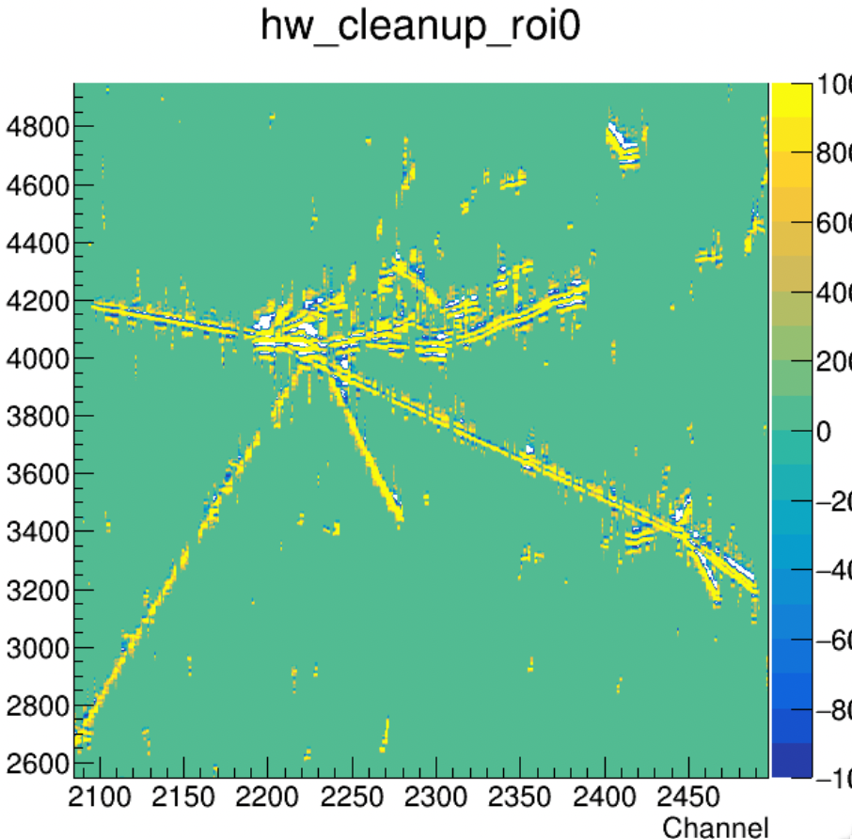
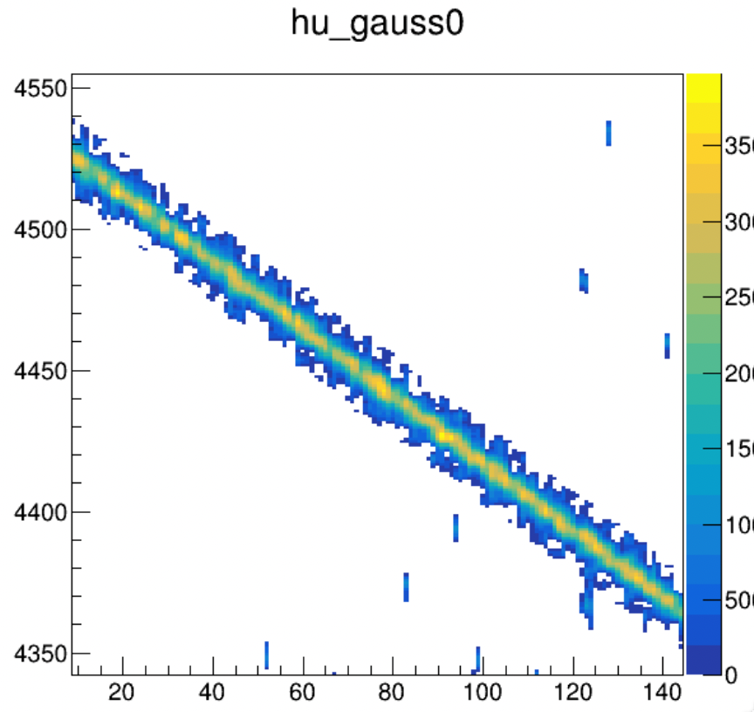
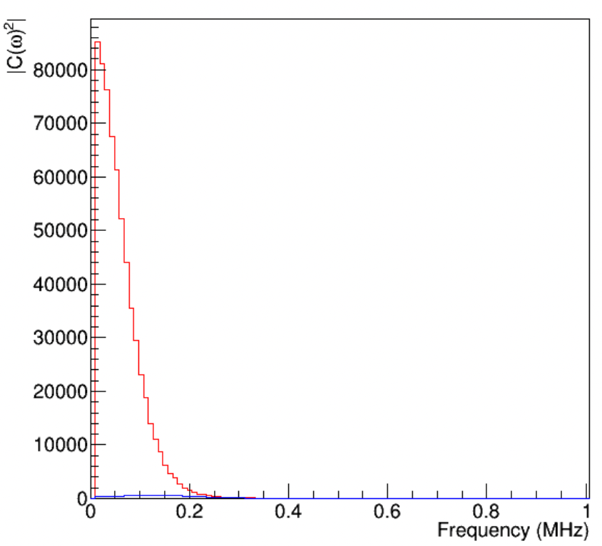
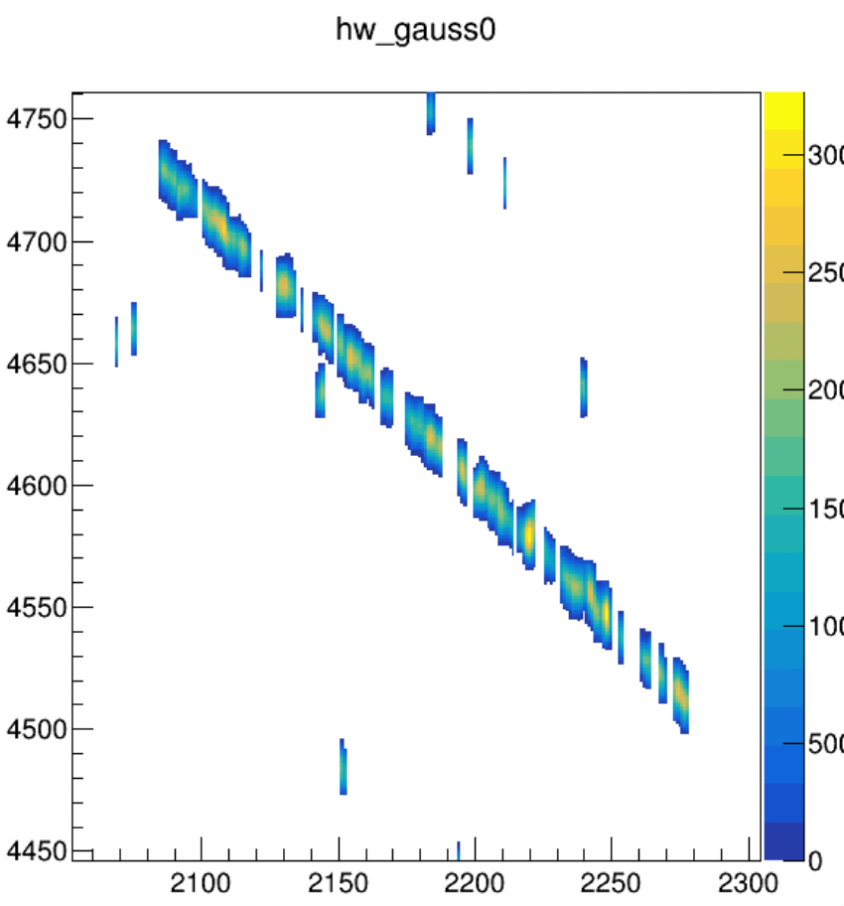
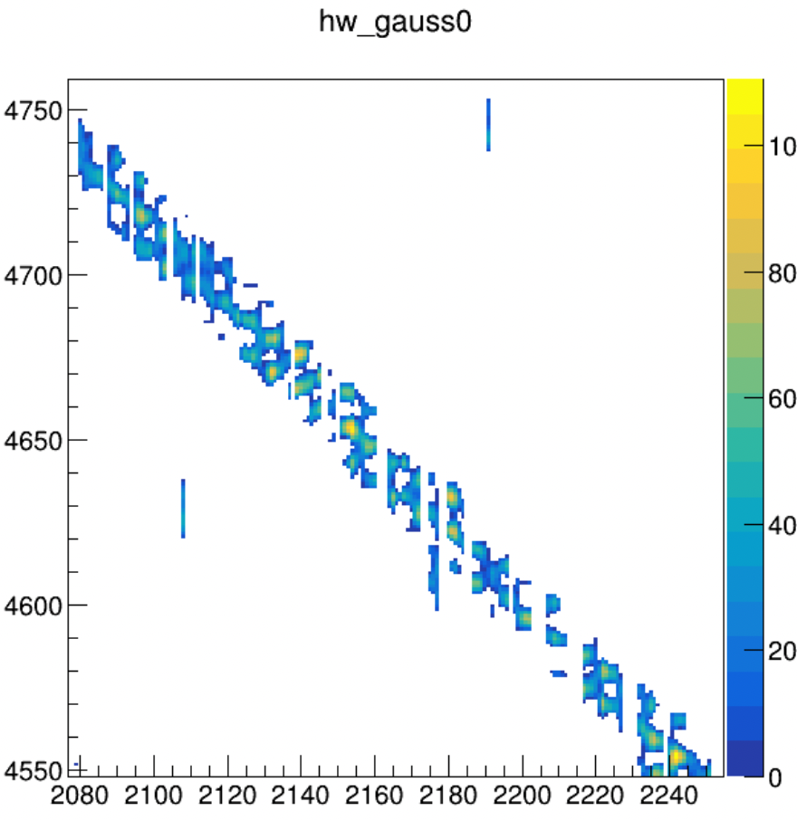
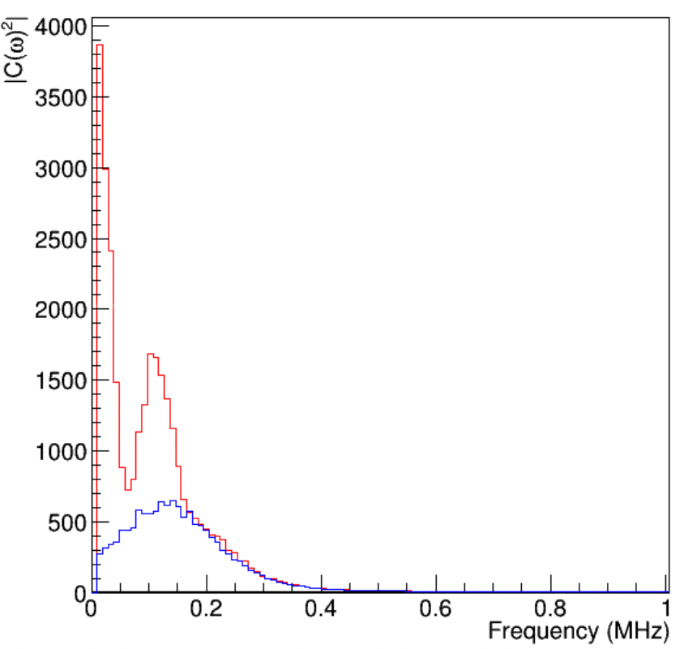
Simulation (beam direction MIP)
APA1 W vs APA1 U
Data (run 28548 event 439442)
w/o MP
Power spectral density
Dispersed signal processing result implies an imperfect deconvolution kernel and unresolved underlaying noise
Power spectral density
Confirmed with simulation that the dispersed sigproc is related to low S/N
The ”colinear” feature should be the issue in FR
Need a calibration!
Gaus
a= 0.06
Gaus
a= 0.12
low S/N ~1:1
Notes:
beam_dir = [-0.178177, -0.196387, 0.959408];
beam_center = [-27.173, 421.445, 0];

