Slide 1
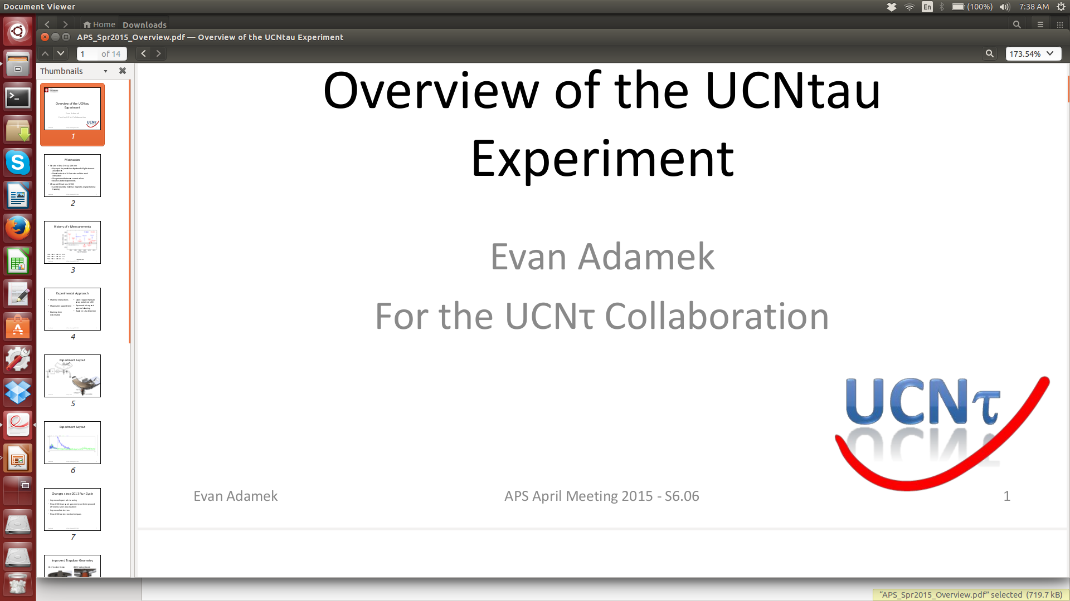
An Improved Ultracold Neutron Bottle for Measuring the Neutron Lifetime
Evan Adamek
UCNτ Collaboration
Indiana University
Brookhaven National Laboratory
10 November 2016

Slide 2
Overview of Full Talk (List of OV slides)
Motivation (3)
Still needs work on slides 4, 6, 7
Experiment Overview (11)
Needs work on slide 14
Analysis summary (21)
Recent improvements and results (34)
Extra slides (40)

Slide 3
Overview of Motivation/Background
Definition of beta decay
Motivation
BBN
Vud
Definition of UCN
Interactions of UCN
State of the field
Beam vs Bottle
Tau history

Slide 4
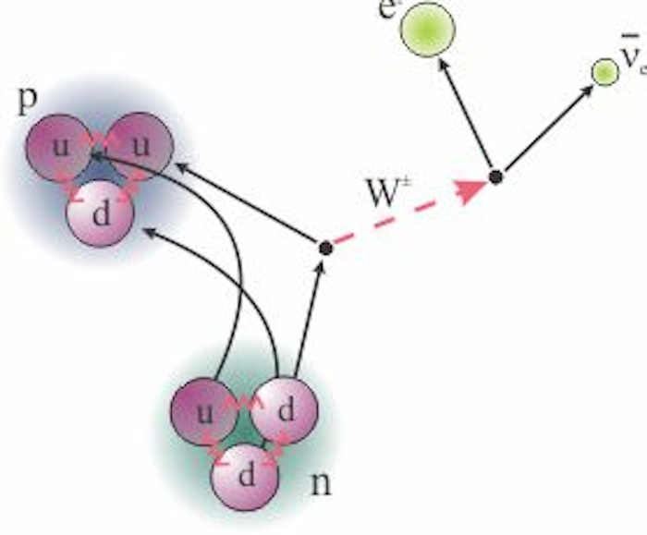
Neutron Beta Decay
n → e⁻ + p + n_{e}
τ_{n} ≈ 881 s
Notes:
Q factor of 782 keV
True for bound or free

Slide 5
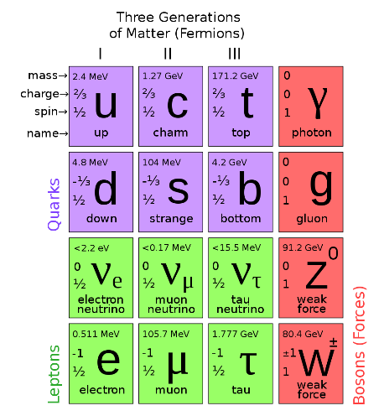
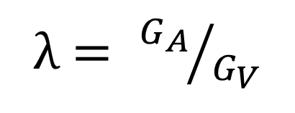
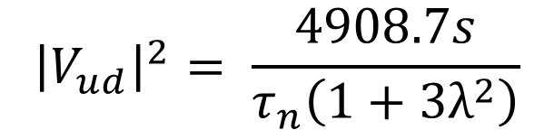
The Neutron and the Standard Model
$${\left|V_{ud}\right|}^{2}= \frac{4908.7s}{τ_{n}\left(1+3λ^{2}\right)}$$
λ$= {G_{A}}/{G_{V}}$
Notes:
Vus – kaon, hyperon, tau decays (.2253 (14), ,2250 (27) and .2202 (15)
Vud (nuclear) -.97425 (8)exp, (10)nucl dep, and (18)RC => Vus =.2255 (10)
Vud (neutron) - .9774 (5)tau and (16)A and (2)RC => Vus=.2114

Slide 6
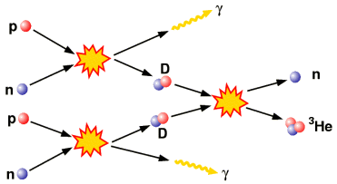
Big Bang Nucleosynthesis
Universal He fraction depends on τ_{n}
Notes:
Prior to ~1second there was a high temperateure radiation dominated plasma of e⁺, e⁻, neutrinos (10⁹ photons/baryon) – rapidly expanding).. Weak interactions maintain neutrons/protons ~1. Hot (>>10^10 K) rapidly expanding plama. Nucleons outnumbred a billion to one – essentially no nuclei.
~ 1 second. Temperatur (~10^10 K) e of order or smaller than n-p mass difference. Weak interaction rates become slower than the expansion rates.
~ 3 seconds – conversion reactions become slow compared to the age of the universe kT~ 0.7 MeV – n_{n}:n_{p}=1:6
Freezeout
significant nucleosynthesis does not happen until universe cools sufficiently (~0.1 MeV, 2 minutes hen number of photons/baryon falls to <1)) that photons do not immediately cause photo disintegration of any deuterium that forms. By this time neutrons have continued to decay and n:p = 1:7 .
From 2-5minutes most neutrons are captured into ⁴He . Not much beyond this because of lack of stable nuclei as mass 5,8.
Yp=rho (4he)/rho(baryon) ~= .25 → neutron lifetime is the most important parameter determining this)

Slide 7
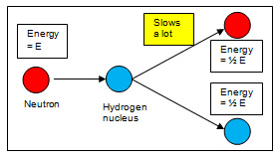
Ultracold Neutrons
LHe, SD₂ moderate spallation neutron energies
E_{UCN} ≤ ~300neV
A. Saunders et al., Rev. Sci. Inst. 84, 013304 (2013)
Notes:
Robbie source ucn talk

Slide 8
UCN Interactions
Notes:
Order of magnitude for each interaction
Tie polarizability to magnetic interaction

Slide 9

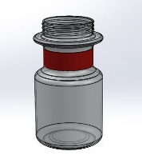
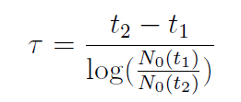

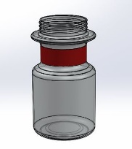
Beam vs Bottle Techniques
Cold Neutron Beam
Number Observed
Ultracold Neutron (UCN)
Bottle
Fill
Store
Count
Time
Notes:
All bottle measurement so far have had to extrapolate to zero losses
Systematics from Nico, slide 40
Geoff Greene has said – beam measurements look difficult and they are, whereas UCN measurements look simple, but they are not. I hope to convince you that our approach is relatively almost as simple as the cartoon above illustrates, at least as compared to beam measurements which are indeed an experimental tour de force…which over decades have squeezed out incredible precision.
So, if you want to make a measurement of the neutron lifetime at the 1s level or better, what technique is currently state of the art?
Uncertainties in beam measurments….

Slide 10
Most precise Beam: τ _{n} = 887.1 ± 2.2 s
Most precise Bottle: τ _{n} = 878.5 ± 0.8 s
Notes:
Wonderful review by Wiedfeldt and greene rev mod physics volume 83, 2011
Rutherford suggested exisitence neutron ~ 1920 (atomic number differs from atomic mass and positivley charged protons alone would not be bound by EM force only)
Chadwick discovered neutron in 1932 (1.005 -1.008 amu – close to present value of 1.0087 amu
First accurate mass Chadwick, goldhaber in 1934 – after more accurate measurement in 1935 these authors suggest neutron could decay into a proton, electron, and neutrino
Oak ridge graphite reactor operated ~ 1 year after first reaction at CP-1 Stagg field Chicgo – in 1940’s first observation of decay of free decay of neutron observed by Snell and company - and so the entreprise of neutron lifetime measurement was launced.
There is significant disagreement between measurements made with cold neutron beams and bottled ultra cold neutrons
The UCNτ Collaboration is using a magneto-gravitational trap to make a measurement of the lifetime that eliminates major systematic uncertainties in previous bottle measurements

Slide 11
Outline for UCNtau definition
Overall picture, describe parts
Array/trap volume
V detector
Monitor detectors
Cleaners
Run plan (Fill hold dump)
Systematics to keep track of

Slide 12
The UCNtau Experiment
Notes:
Give rough overview, talk about parts of experiment

Slide 13
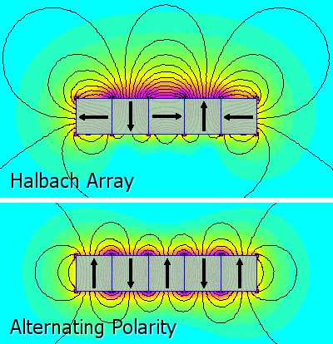
Magneto-gravitational trap
670L Halbach array bounds UCN from below
Gravity bounds UCN (E<50neV) from above
Open top allows in-situ detection
Large volume, minimal surface interaction
Asymmetry → phase space mixing
Holding field prevents depolarization
Notes:
Picture of halbach magnets
Explain systematic – spinflips and holding field coils

Slide 14
Vanadium detector
V dagger
b Scintillator
⁵¹V + n → ⁵²V
⁵²V → ⁵²Cr* + e⁻ + n_{e}
⁵²Cr* → ⁵²Cr + g(1434keV)
Coincident g and b captured by detector stack
t_{V} = 324s
NaI Detectors
Notes:
Write down nuclear rxn and energy
Continuous beta energy up to certain value
1.4 mev cr decay gamma (full energy)

Slide 15
ZnS Detectors
Developed new detectors to replace ¹⁰B monitors
n + ¹⁰B → ⁷Li + a
High eff, low bg
No leak systematics
Z. Wang et al., Nucl. Inst. Meth. A. 798 (2015) 30-35
Notes:
BG < 0.1 Hz
Eff = 95%

Slide 16
Marginally Trapped UCN

Slide 17
Marginally Trapped UCN

Slide 18
UCNtau
Cartoon of fill and empty with our setup
Notes:
Use this to talk about vanadium detector

Slide 19
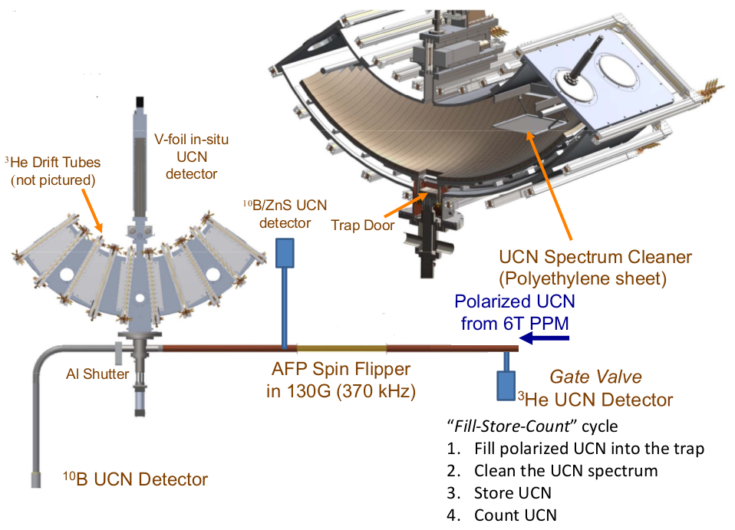
UCNτ Overview:
(In situ V detector)
Notes:
Get rid of 10b detector
Describe how the run process proceeds

Slide 20
Outline for analysis slides
Coincidence settings
Run selection/vetting
Data layout
Background subtraction
Tau fit parameters

Slide 21
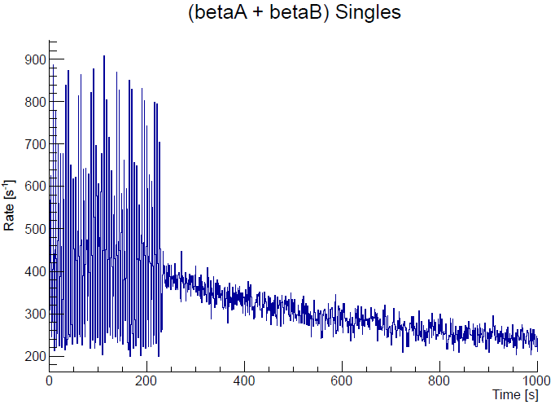
Beam On
Beam Off
Cut Criteria:
21
Notes:
Currently, we are optimizing the detector performance to increases the S/N ratio, without sacrificing the signal rate.
With the V detector working, we can perform meaningful studies on the
time-dep. BG
N₀ Normalization
The evolution of the UCN energy spectrum, by placing V at different height at the end of different storage time.
21

Slide 22
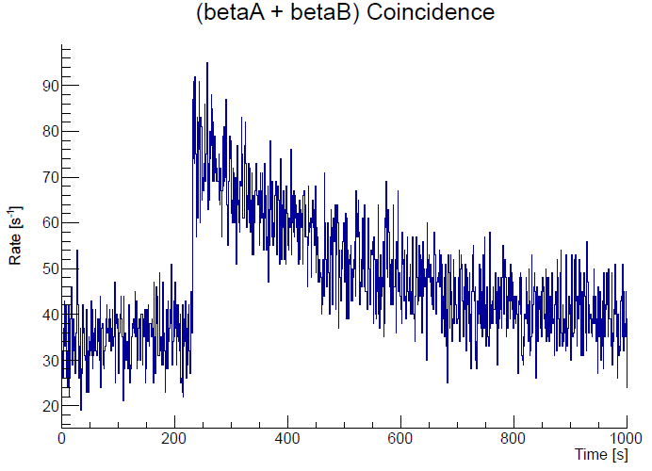
Beam On
Beam Off
S/N= 2.28
ε_{β}=0.8
ε_{γ}=0.3
Cut Criteria:
beta event is not coincident with a beta event in the other detector
beta event pulse-height cut
beta event is coincident with an NaI event
22
Notes:
Currently, we are optimizing the detector performance to increases the S/N ratio, without sacrificing the signal rate.
With the V detector working, we can perform meaningful studies on the
time-dep. BG
N₀ Normalization
The evolution of the UCN energy spectrum, by placing V at different height at the end of different storage time.
22

Slide 23
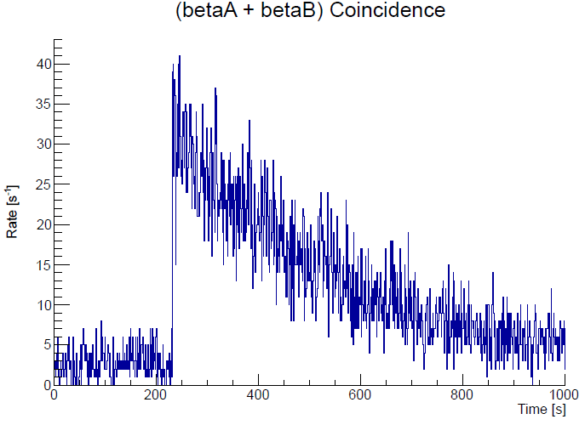
Beam On
Beam Off
S/N= 2.28
ε_{β}=0.8
ε_{γ}=0.3
Cut Criteria:
beta event is not coincident with a beta event in the other detector
beta event pulse-height cut
beta event is coincident with an NaI event
NaI event pulse-height cut
S/N= 10
ε_{β}=0.8
ε_{γ}=0.21
23
Notes:
Currently, we are optimizing the detector performance to increases the S/N ratio, without sacrificing the signal rate.
With the V detector working, we can perform meaningful studies on the
time-dep. BG
N₀ Normalization
The evolution of the UCN energy spectrum, by placing V at different height at the end of different storage time.
23

Slide 24
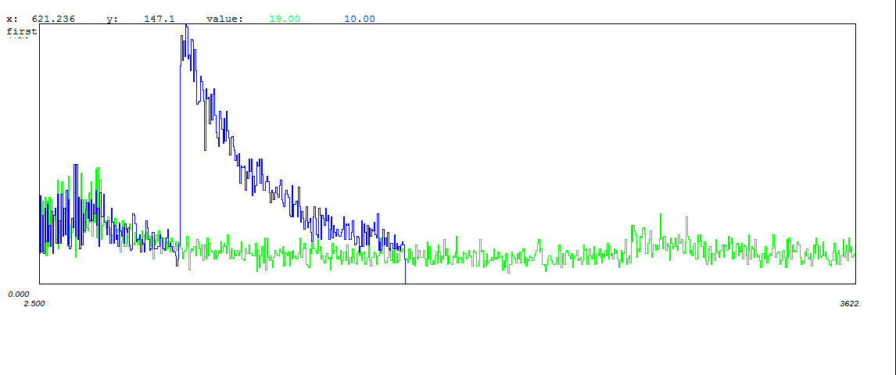
2014-2015 Lifetime Data
Notes:
Add in description of Fill, Store, Count

Slide 25
2014-2015 Lifetime Data
Fill
Clean
Count
Fill
Clean
Store (Long)
Count

Slide 26
2014-2015 Lifetime Data
0s Storage Signal
Background
2000s Storage Signal
Fill
Clean
Count
Fill
Clean
Store (Long)
Count
Notes:
Highlight short background available to short storage run

Slide 27
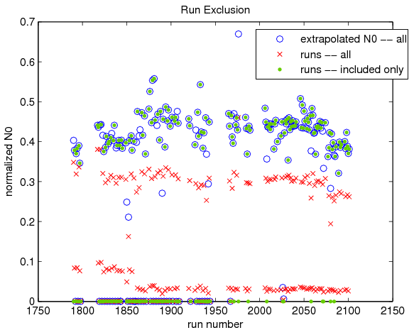
Run Exclusions
Total # of runs: 210
Adjacent NaI channel mixed (16 runs)
Beam drops (10 runs)
Beam reduction (5 runs)
Low normalized N0 (5 runs)
27
Notes:
Description of run vetting process, more details than just this plot

Slide 28
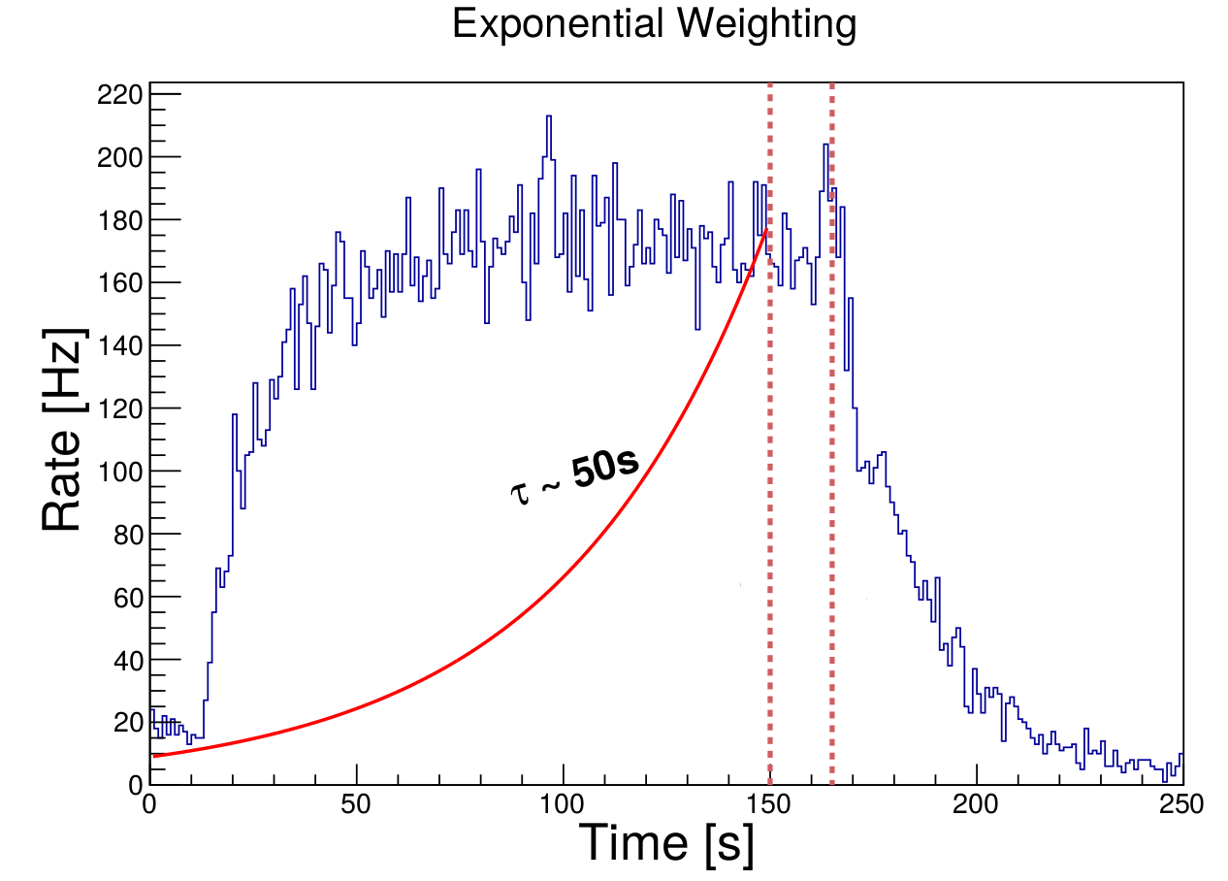
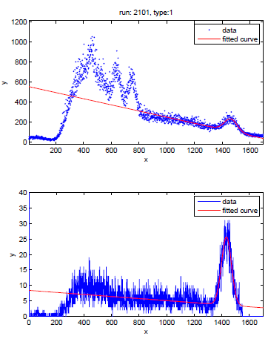
Coincidence Options
Normalization Options
Coincidence Time Window
No coincidence (Singles)
1000ns
200ns
NaI photopeak cut (1434 keV)
(10,1550)
(600, 1550)
(1000,1550)
(1300,1550)
Background Subtraction
Direct Subtraction (Triplet runs)
Independent Fitting
Trace Sums
Sandwich (individual short runs by adjacent long runs)
Gate valve detector vs. standpipe detector
Integrated counts vs. exponential weighting
Before
coincidence
Eγ (keV)
After coincidence
Eγ (keV)

Slide 29
Systematic Effects
(τ_{storage})⁻¹ = (τ_{n}) ⁻¹ + (τ_{loss}) ⁻¹
Notes:
Double check when these values were measured and how we have changed them since then

Slide 30
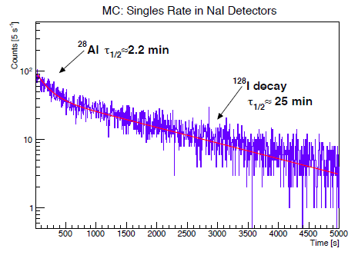
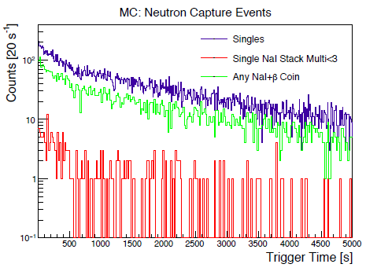
Sources of Background
Cosmic events
Most eliminated through E cuts
Remainder provides constant background, easily fit
Beam induced background (mostly n activation)
Prompt gammas and fast neutrons
Decays from absorption on ²⁸Al, ¹²⁸I, etc.
High energy UCN absorption on vanadium dagger
Non-constant background fit to ⁵²V exponential decay
Plots by R. Pattie
Notes:
Main source of contamination comes from ¹²⁸I (with a half life of 25 mins) and ²⁸Al (2.2 min); we don’t plan to take more data using V foil, however, we can study this neutron-activated background using Monte-Carlo simulations.
The shorter lifetime with larger window is consistent with the contamination of activated Al decay.
The level of contamination is on the level of 10%.
The concern is that the high rate of ¹²⁸I , and its linearly increase rate in E, might introduce a significant level of contamination for the photopeak, biasing the measured lifetime towards a larger value.

Slide 31
Simulated Background – Geant4
Images Courtesy of R.W. Pattie
Notes:
“Geant 4 sim”
Add Robbie’s name
These are for pre

Slide 32
Extracting background from signal
Fit to linear combination of V, Al, I, Pb, and measured BG
Only V and measured BG components nonzero

Slide 33
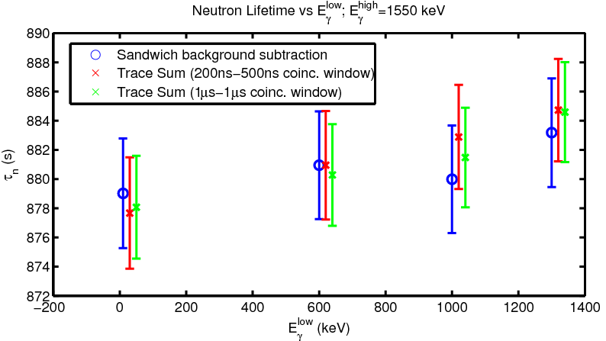
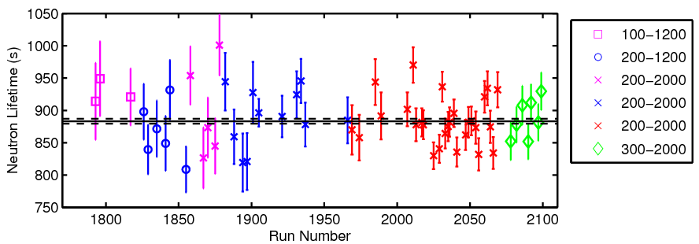
Clean(s)-store(s)
33

Slide 34
Outline for recent results and conclusion
New parts
Large cleaner & cleaning studies
New V detector using ZnS
Analysis results from unblinded component of data

Slide 35
New Dagger Detector

Slide 36
Notes:
Both (1) and (2) effects present
Cleaning studies -> Can correct for quasi bound neutrons
Dagger cleaning eliminates entirely

Slide 37
Unblinded Preliminary Results
Notes:
Discussion of stat reach: 4 days continuous for 1s measurement

Slide 38
Conclusion
Neutron lifetime key to insights into BBN, V-A weak interaction
UCNτ provides new approach to bottling lifetime measurement
Analysis allows for reduction of systematic effects:
Backgrounds are time independent, fully subtractable
Quasi-bound UCN can be completely cleaned
Blinded result: τ_{n}= 878 ± 2.6 ± 0.6 s
Unblinding should give statistical error < 1s

Slide 39
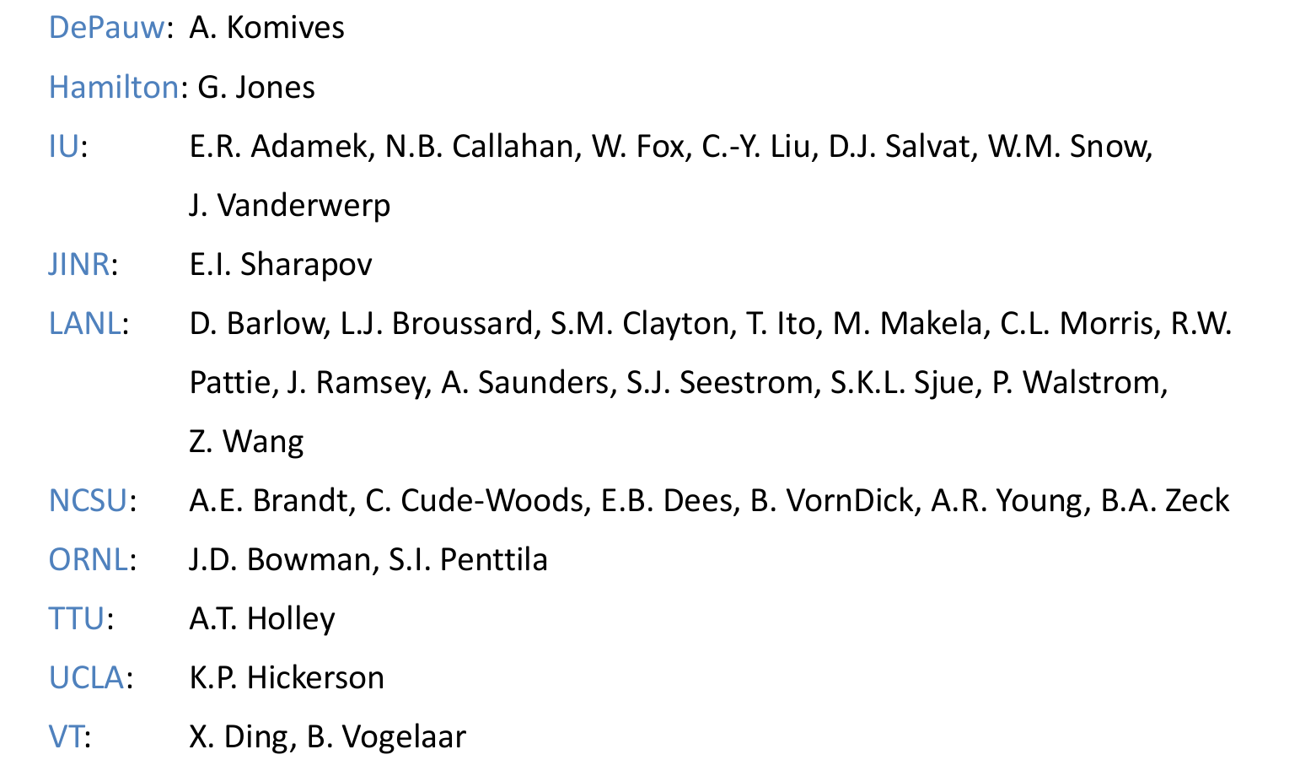
UCNτ Collaboration

Slide 40
Extras
Numerical results from fits:

Slide 41
Phase Space evolution is evident in data that used dagger cleaning
Blue data points are short holding time, Red are long holding time (shifted and scaled)
No Dagger Cleaning
Dagger Cleaning
Data using dagger cleaning showed no counts in peak 1! Cleaning complete

Slide 42
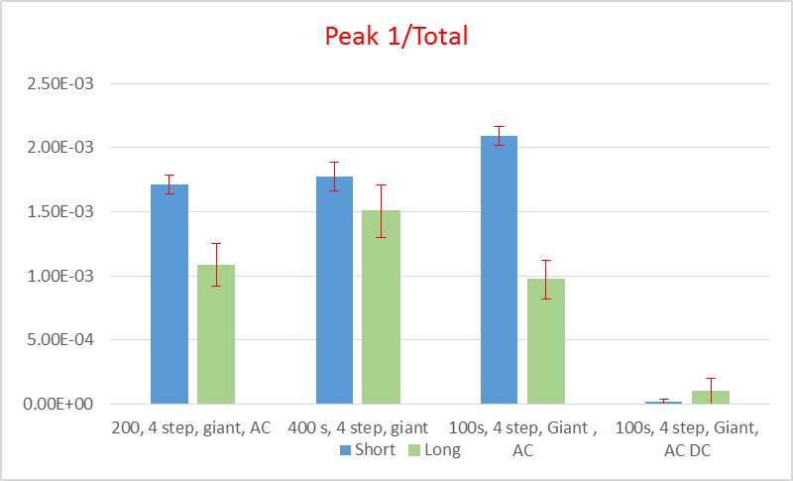
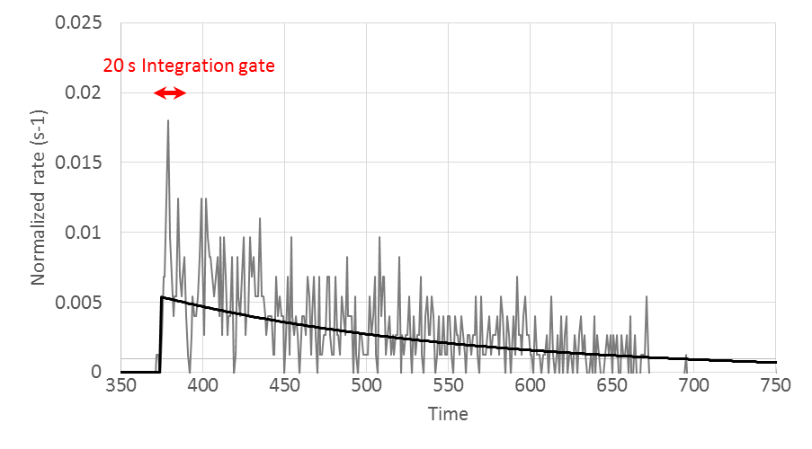
We are able to correct for quasi-trapped neutrons
Fraction of Counts in Peak 1
Unloading curve for dagger in P1 position
Fraction of counts in Peak 1 may be different for short and long runs – lifetime for Peak 1 can be shorter than for the total unloading if cleaning is inadequate
When deep dagger cleaning is used there are no counts in Peak 1 - phase space evolution can be seen in the shape of the unloading curves and variation of lifetime extracted from peaks 2,3, and 4
Unloading curve was used to estimate how many counts from Peak 1 remain in Peak 2,3,4 region – This is used to make a correction for cleaning efficiency
For data without dagger cleaning corrections are 3-9 sec, 10-40% uncertainty
No correction for cleaning is needed in deep dagger cleaning!

Slide 43
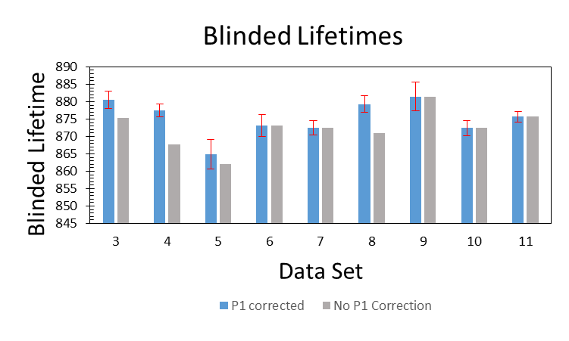
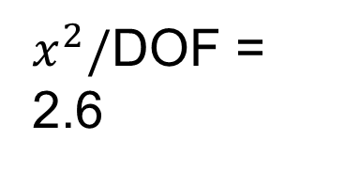
A number of blinded data were obtained Thanksgiving through February to study cleaning effectiveness
Data Set |  | Conditions | Run Pairs | Statistical Uncertainty (sec)
1 | Feb | 200, 1 step, giant, AC up | 17
2 | Jan Set 3 | 200, 1 step, AC, DC | 9
3 | Feb | 200, 4 step, giant, AC | 26 | 2.5
4 | Tday | 300, 4step, DC370, AC | 83 | 1.9
5 | Feb | 400 s, 4 step, giant, ?AC? | 14 | 4.1
6 | Jan Set 3 | 100s, 1 step, AC DC (200,1430) | 24 | 3.1
7 | Jan Set 3 | 100s, 1 step, AC, DC (10,1430) | 38 | 2.1
8 | Feb | 100s, 4 step, Giant , AC (20,1440) | 29 | 2.3
9 | Feb | 100s, 4 step, Giant, AC DC (20,1440) | 13 | 4.1
10 | Dec | 100s, 1 step, DC (10, 1430),AC | 35 | 2.2
11 | Jan set 1 | 100s, 1 step, AC, DC (10,1430) | 74 | 1.5
Overall Statistical Uncertainty 0.8 sec
Blinded lifetimes for different conditions vary somewhat more than statistics (analysis of green shaded run-sets)
$x^{2}/$DOF = 2.6

