Slide 1
Collider-Accelerator Department
Overview
Wolfram Fischer
Deputy Associate Laboratory Director for Accelerators, Nuclear and Particle Physics
Collider-Accelerator Department Chair
19 September 2024
Notes:
15 min => 15 slides max

Slide 2
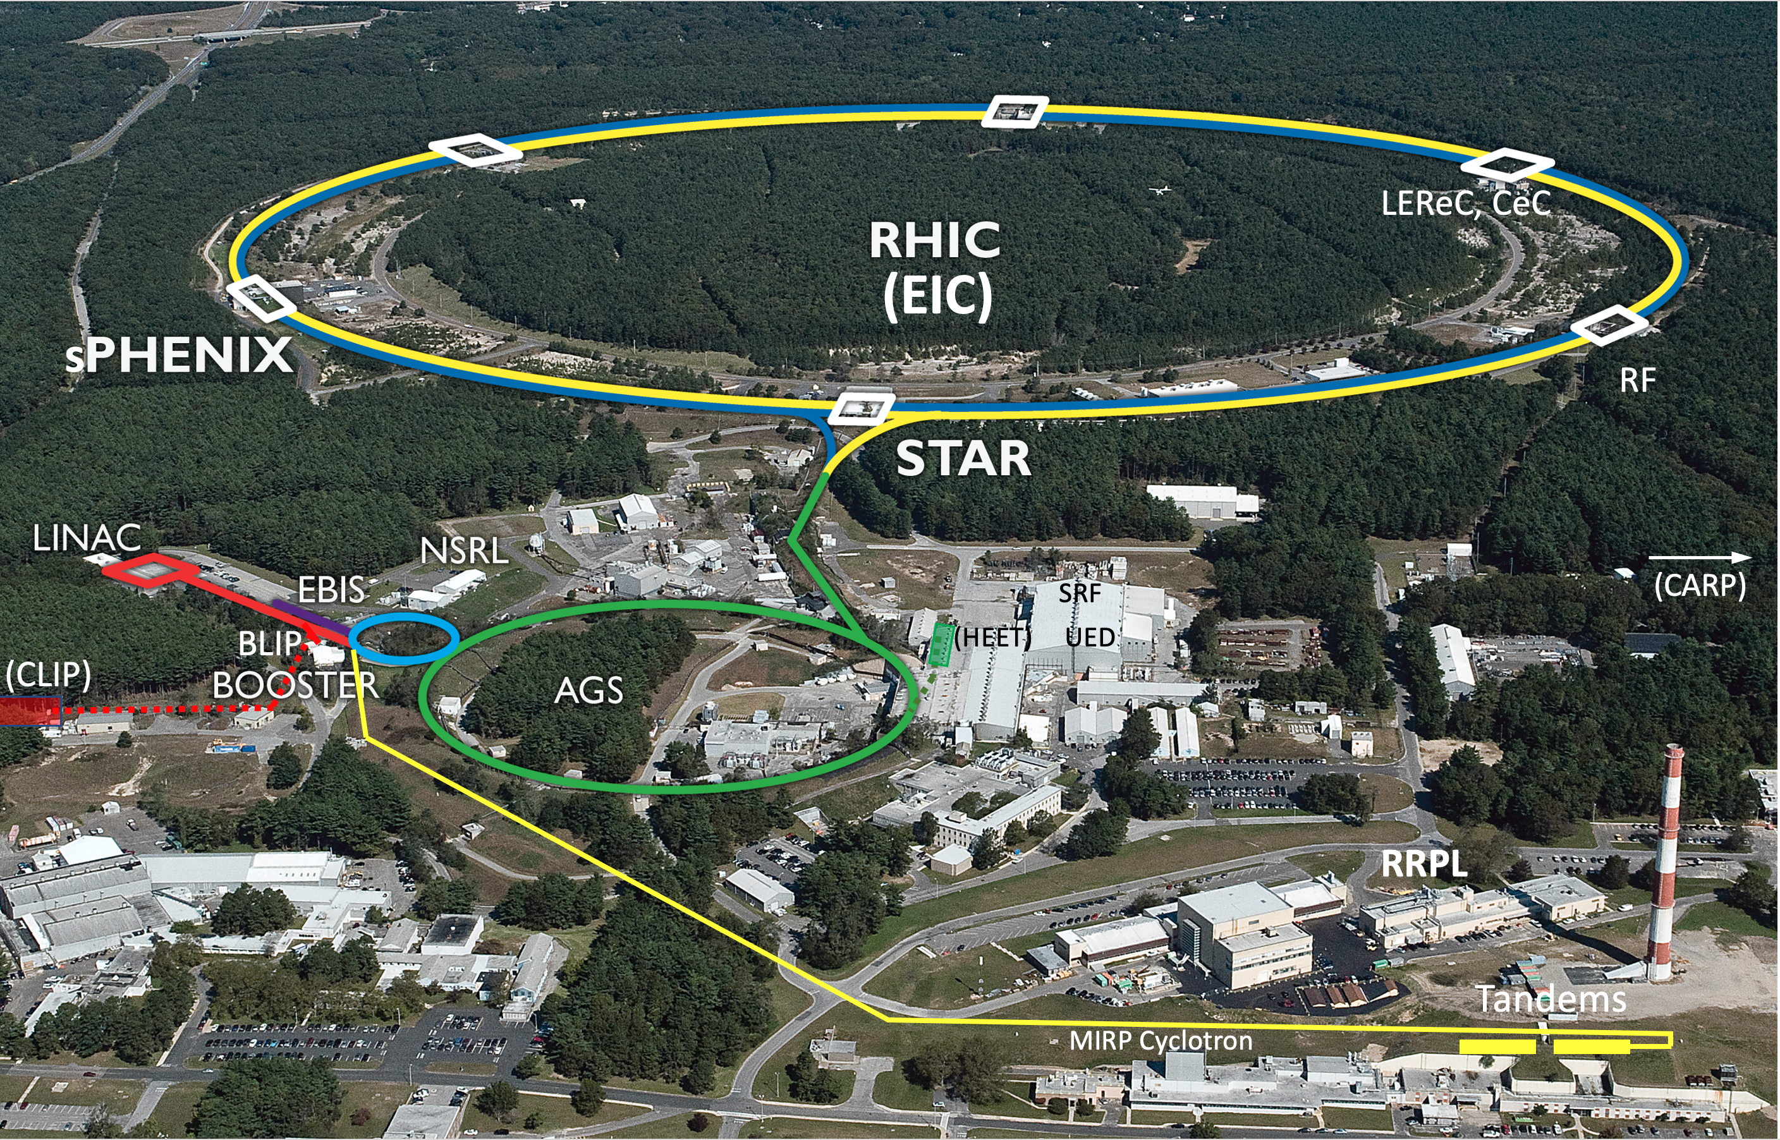
Collider-Accelerator Department facilities
Uniquely flexible and
only hadron collider in
US for exploration of
QCD phase diagram
and proton spin
Injectors also used for
application programs:
- Linac/BLIP for
isotope production
- Booster/NSRL for
space radiation studies
- Tandem for
industrial/academic users
R&D for future facilities
and application
- sources
- polarized beams
- beam cooling

Slide 3
Collider-Accelerator Department
Relativistic Heavy Ion Collider (RHIC)
  Completing the science mission in 2025
  Transition to EIC (staff and facilities)
Application programs
  Brookhaven Linac Isotope Producer (BLIP) – isotope production
  NASA Space Radiation Laboratory (NSRL) – biology and electronics testing
  Tandems – industrial and scientific users
Research and Development
  particle beam sources
  polarized beams: generation, acceleration, storage, polarization measurement
  beam cooling

Slide 4
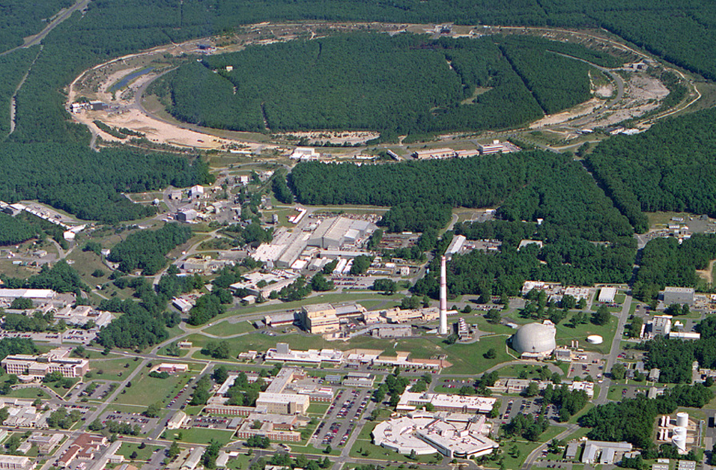
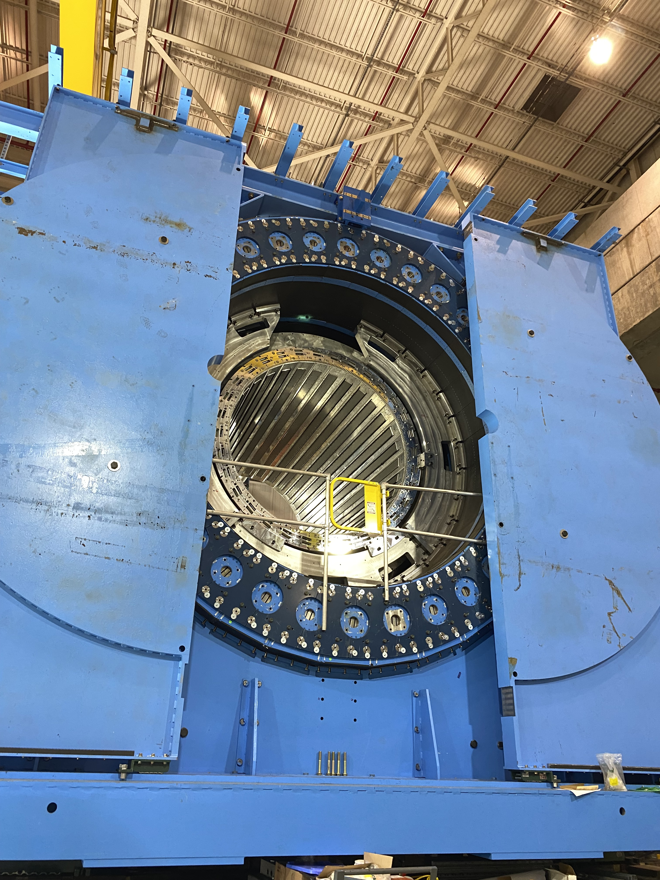
Relativistic Heavy Ion Collider at Brookhaven Natl Lab
Polarized Jet Target
(PHOBOS)
Electron lenses
RHIC g EIC
(BRAHMS)
Electron cooling
(s)PHENIX
RF
STAR
LINAC
NSRL
EBIS
Booster
BLIP
Operation : 2000 – 2025 (planned)
Circumference : 3.8 km
Max dipole field : 3.5 T
Energy : 255 GeV polarized p
: 100 GeV/nucleon Au
Species : ph to U (incl. asymmetric)
Experiments : BRAHMS, PHOBOS (complete)
STAR, PHENIXgsPHENIX
AGS
New sPHENIX detector
for operation 2023-2025
(uses former BaBar magnet)
TPL
Tandems

Slide 5
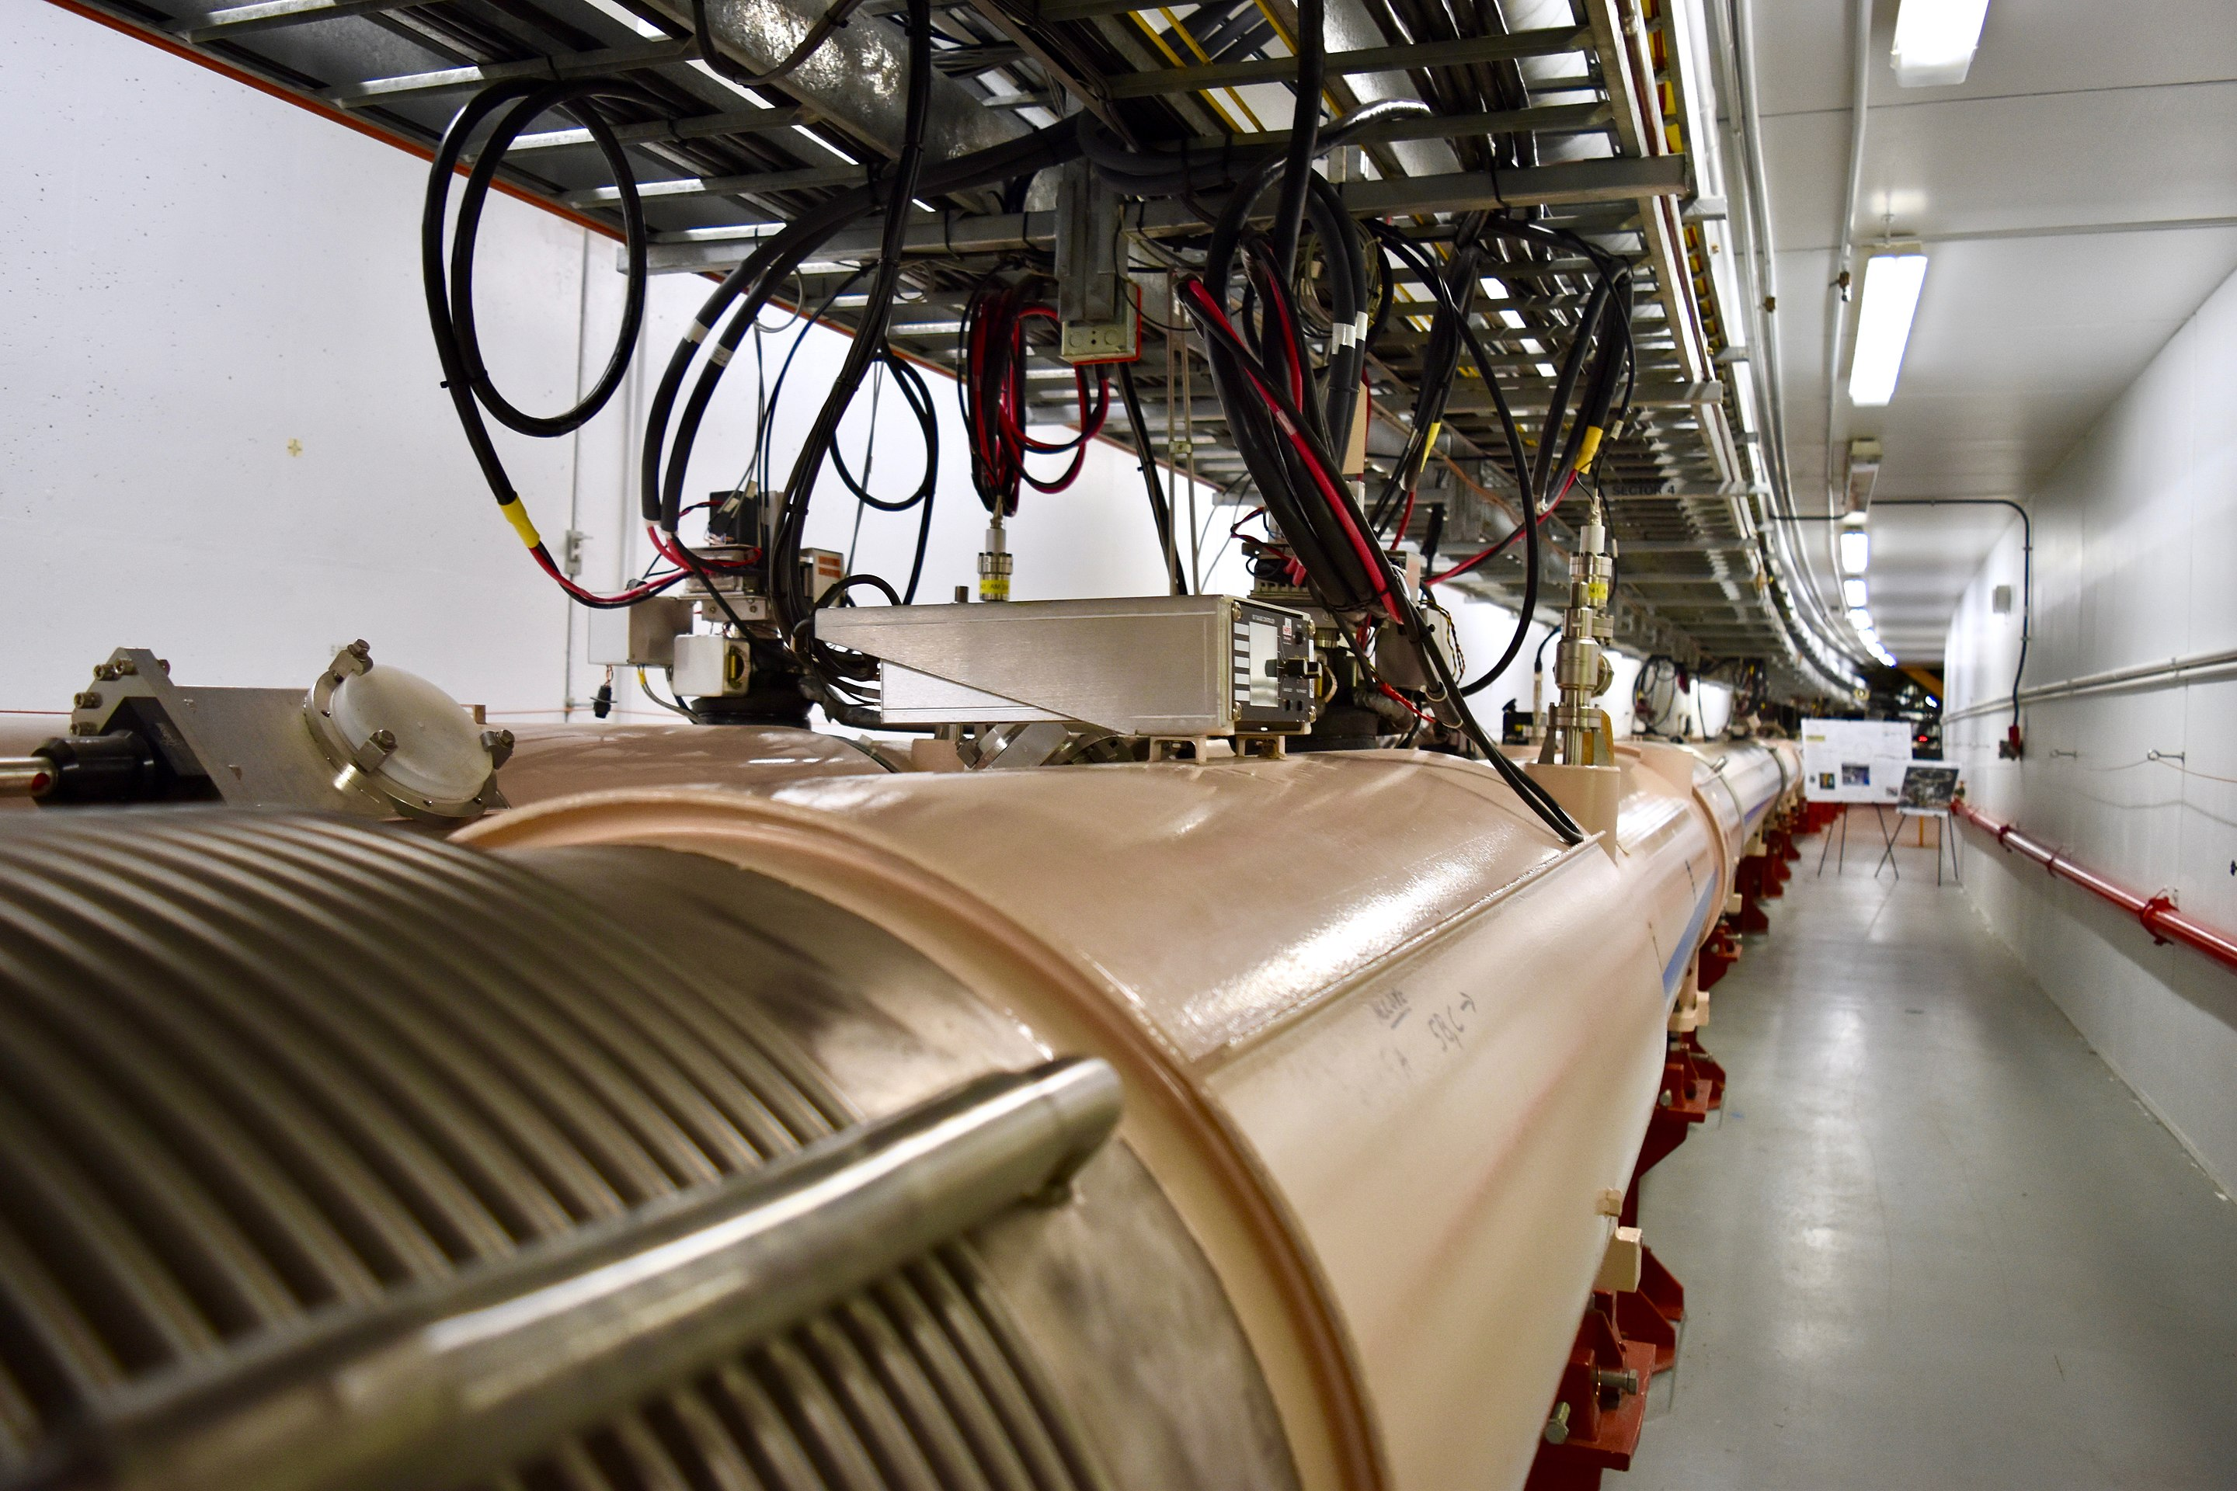
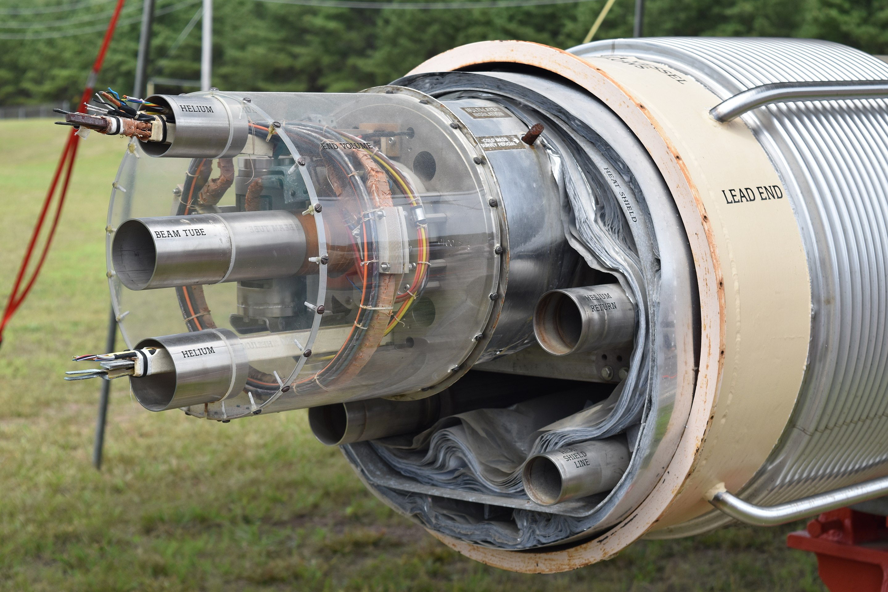
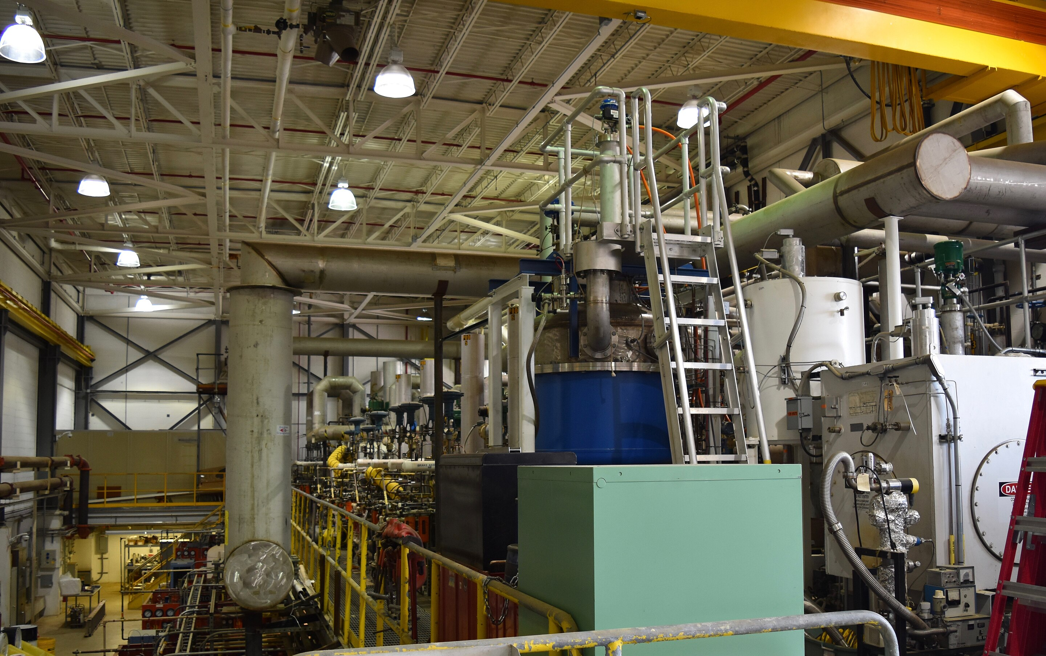
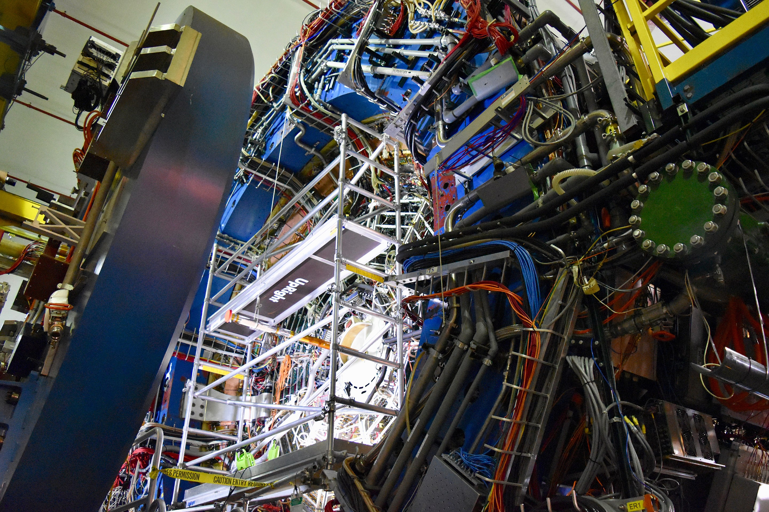
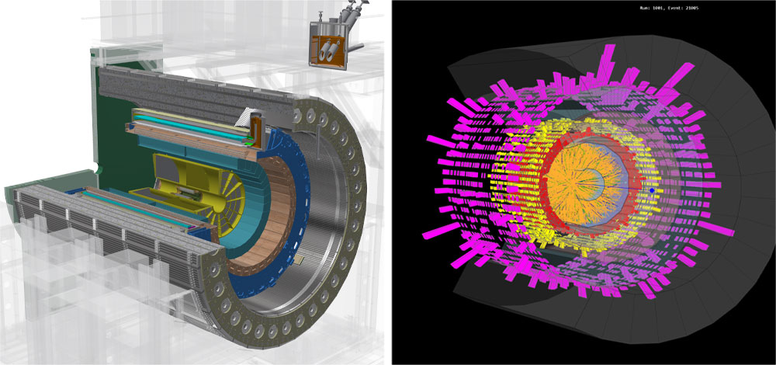
Relativistic Heavy Ion Collider
RHIC tunnel (3.8 km)
Cryo plant for liquid helium
RHIC dipole magnet
STAR detector
sPHENIX detector

Slide 6
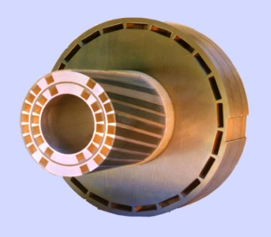
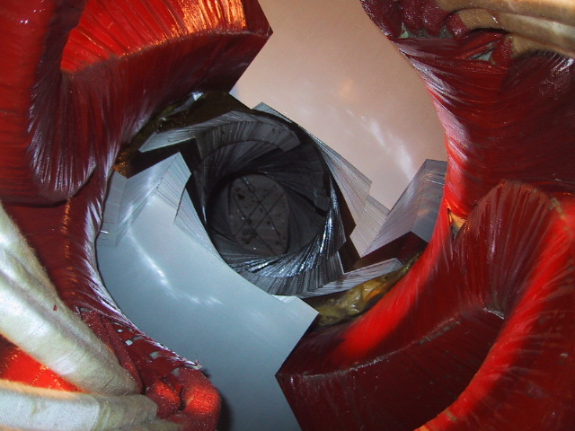
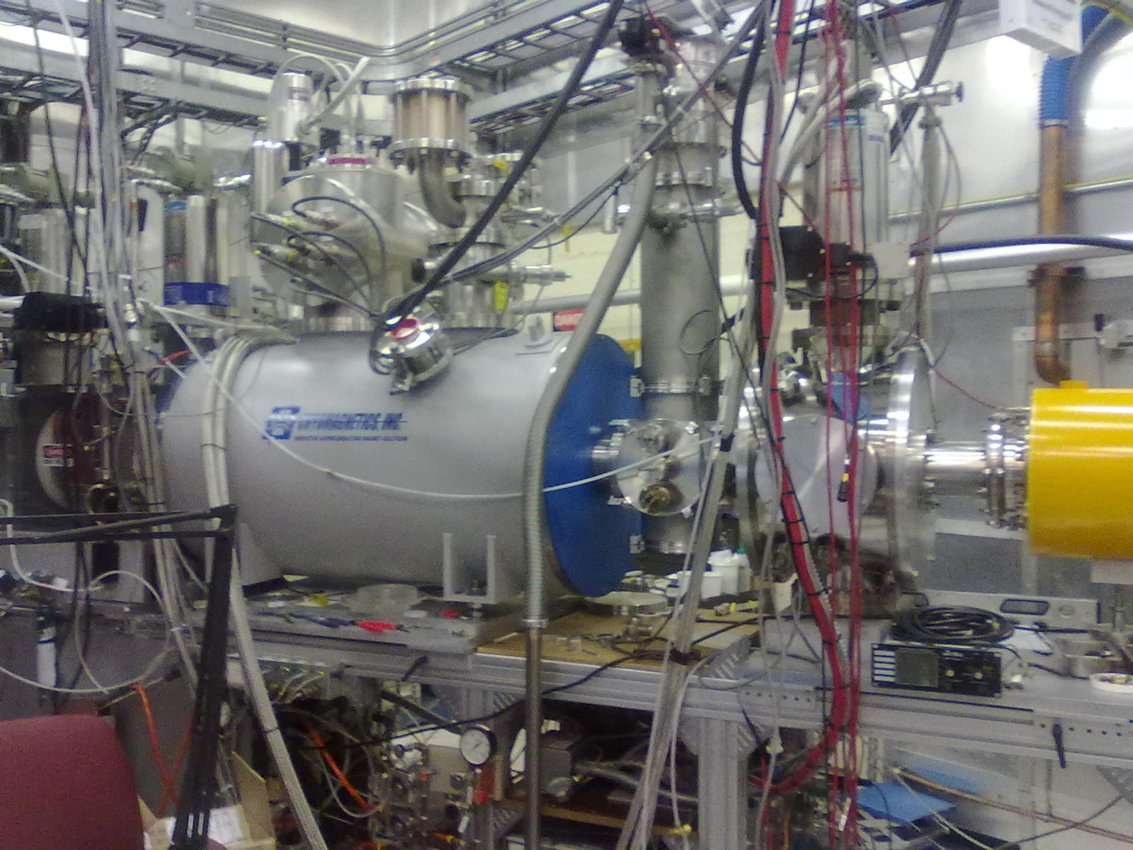
RHIC – First and only polarized hadron collider p↑+p↑
Absolute Polarimeter (H↑ jet)
pC Polarimeters
Spin flipper
Siberian Snakes
Siberian Snakes
PHENIX
STAR
Spin Rotators
(longitudinal polarization)
Spin Rotators (long. pol.)
LINAC
5.9% Helical Partial
Siberian Snake
BOOSTER
Pol. H⁻ Source
AGS
Int. Polarimeter
pC Polarimeter
10-25% Helical Partial Siberian Snake
200 MeV Polarimeter
 | L_{peak} [10³⁰ cm⁻²s⁻¹ ] | L_{avg} [10³⁰ cm⁻²s⁻¹ ] | P_{avg} [%]
100 GeV (2015) | 115 | 63 | 55
255 GeV (2013) | 248 | 160 | 56
Notes:
ADD EBIS he

Slide 7
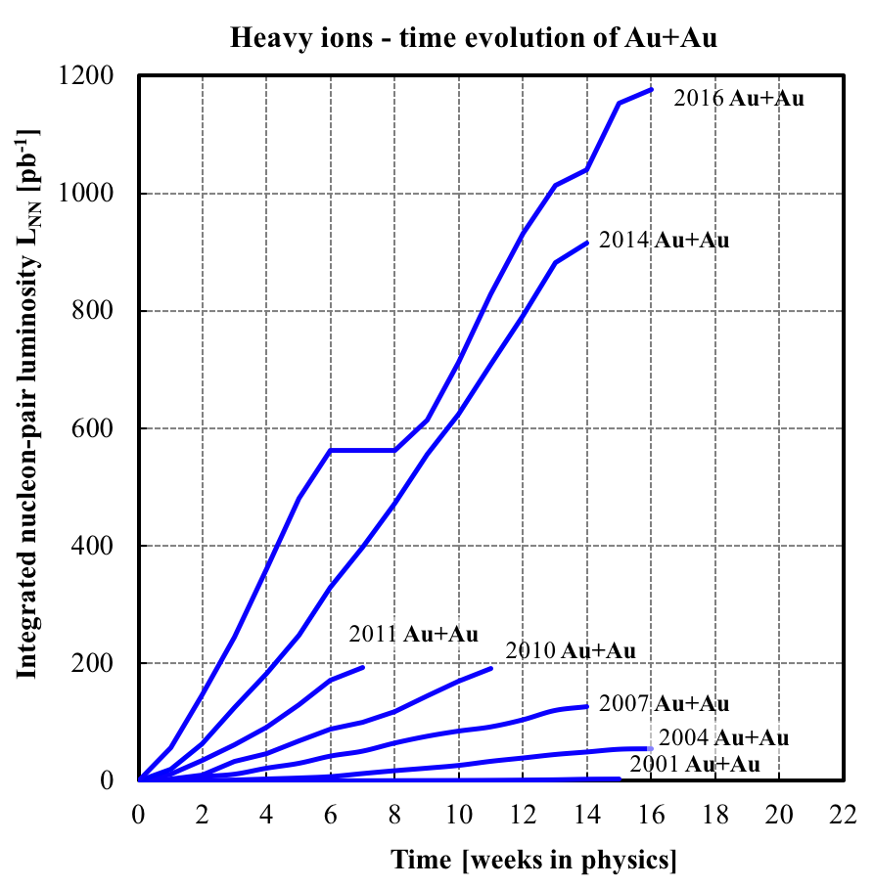
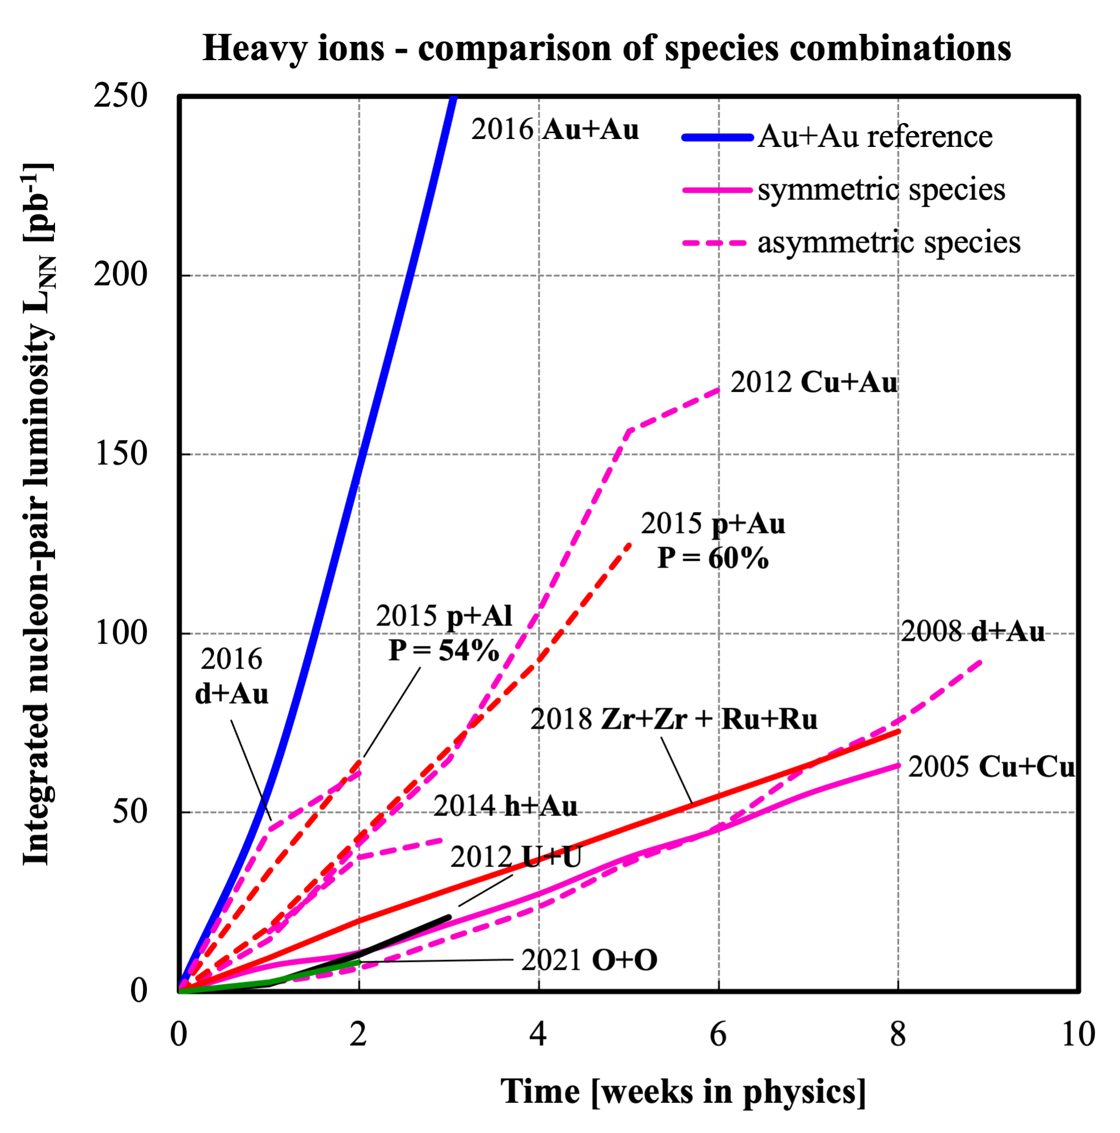
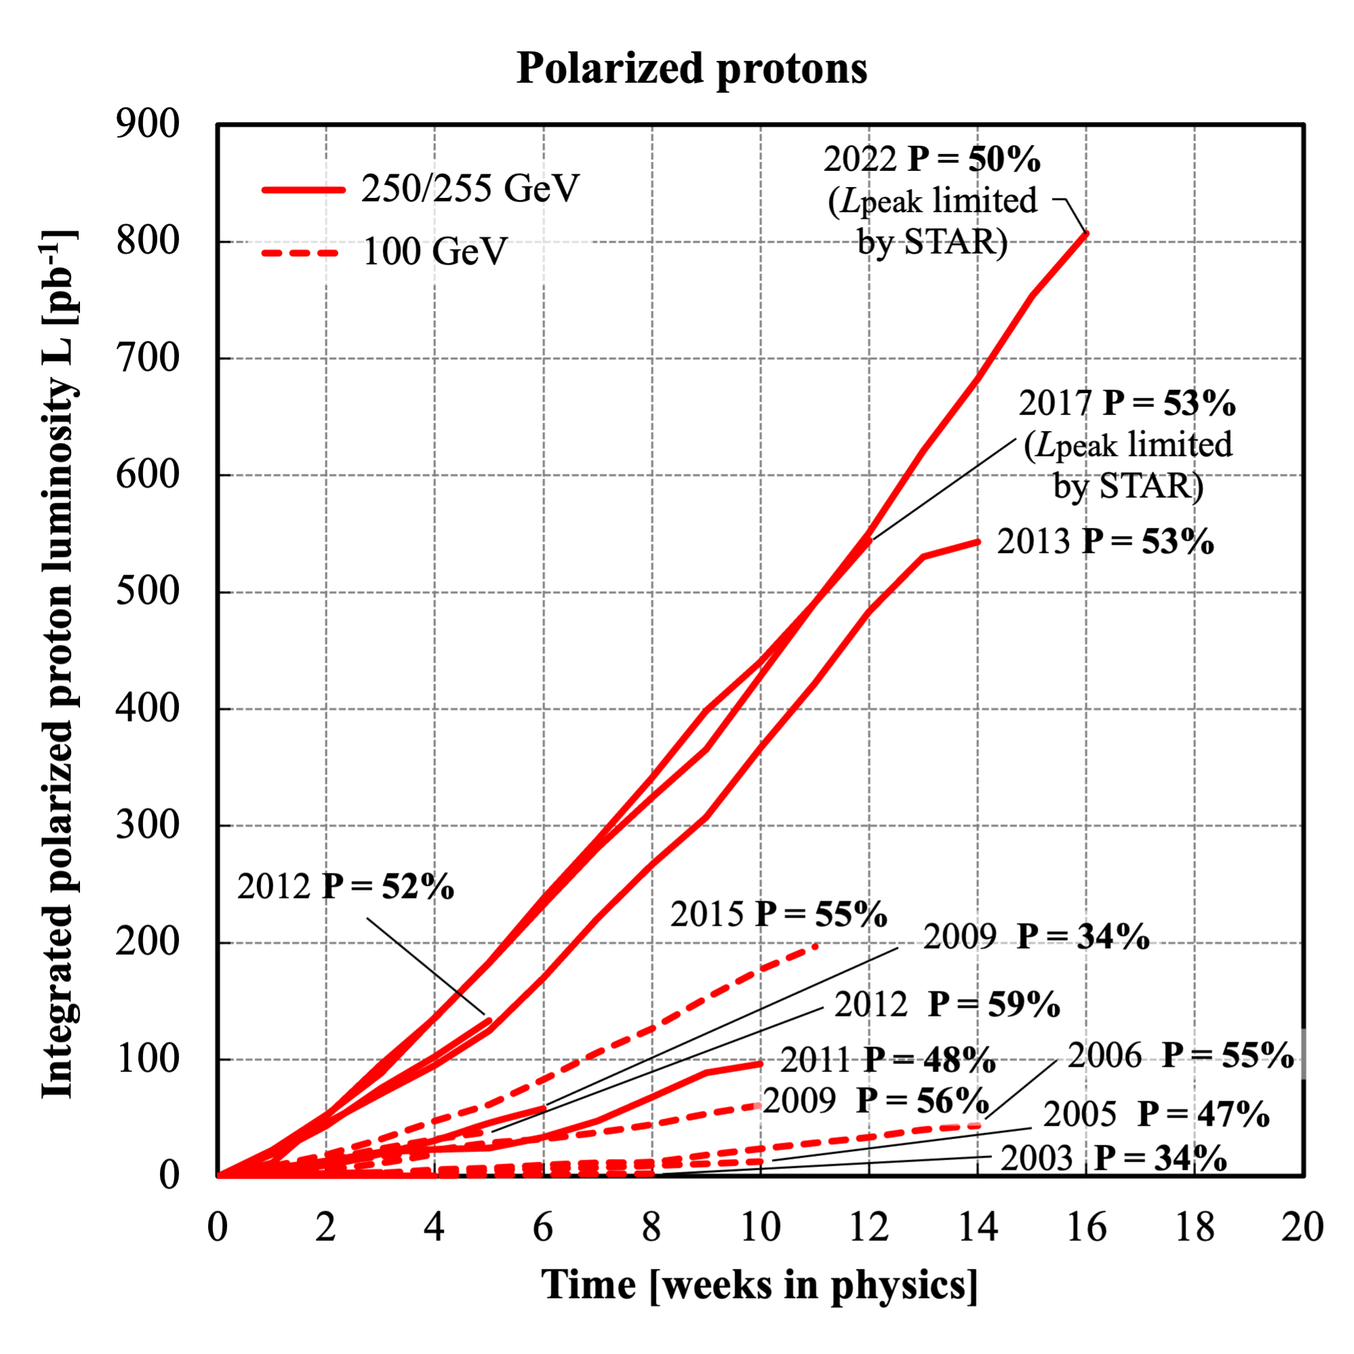
RHIC collider performance - luminosity
Au+Au average store luminosity reached 44x design value

Slide 8
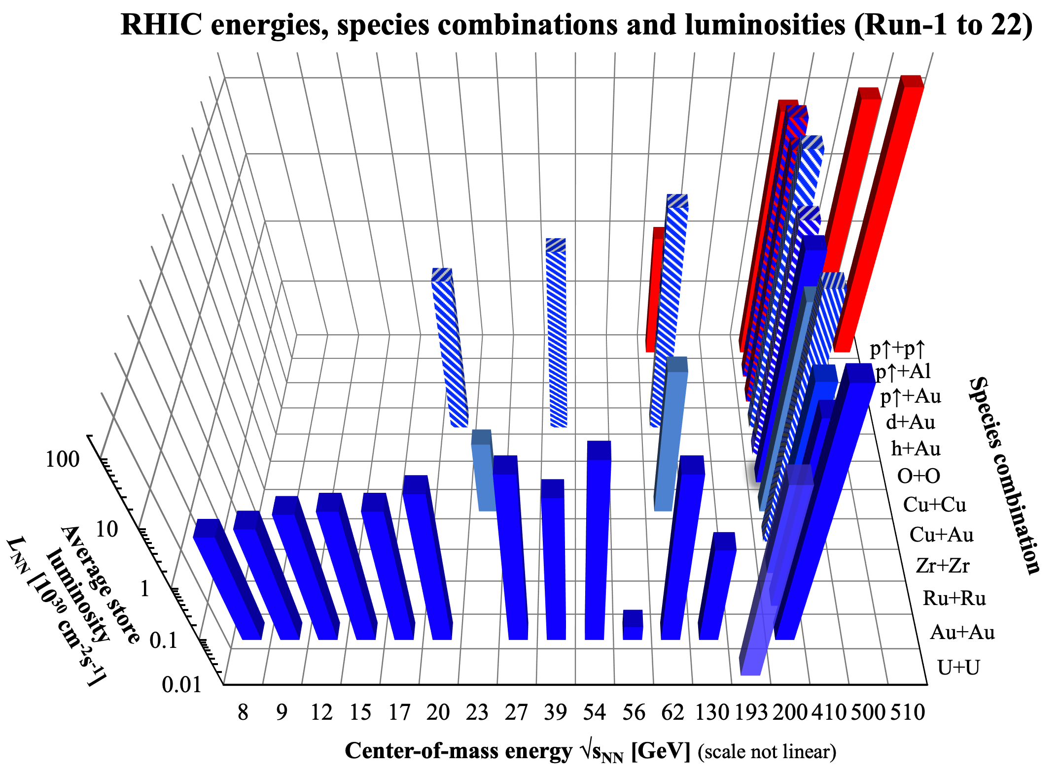
RHIC collider performance - flexibility
nominal injection energy

Slide 9
RHIC – completing the science mission
Run-24: p↑+p↑, Au+Au 27 cryo-weeks total, to 21 Oct 2024
Run-24: Au+Au 24-28 cryo-week total, to 30 Sep 2024
Additional requests for running time:
5 wks p↑+Au, 3 wks STAR fixed target, 2 wks EIC APEX
RHIC program conclusion planned for 30 Sep 2025

Slide 10
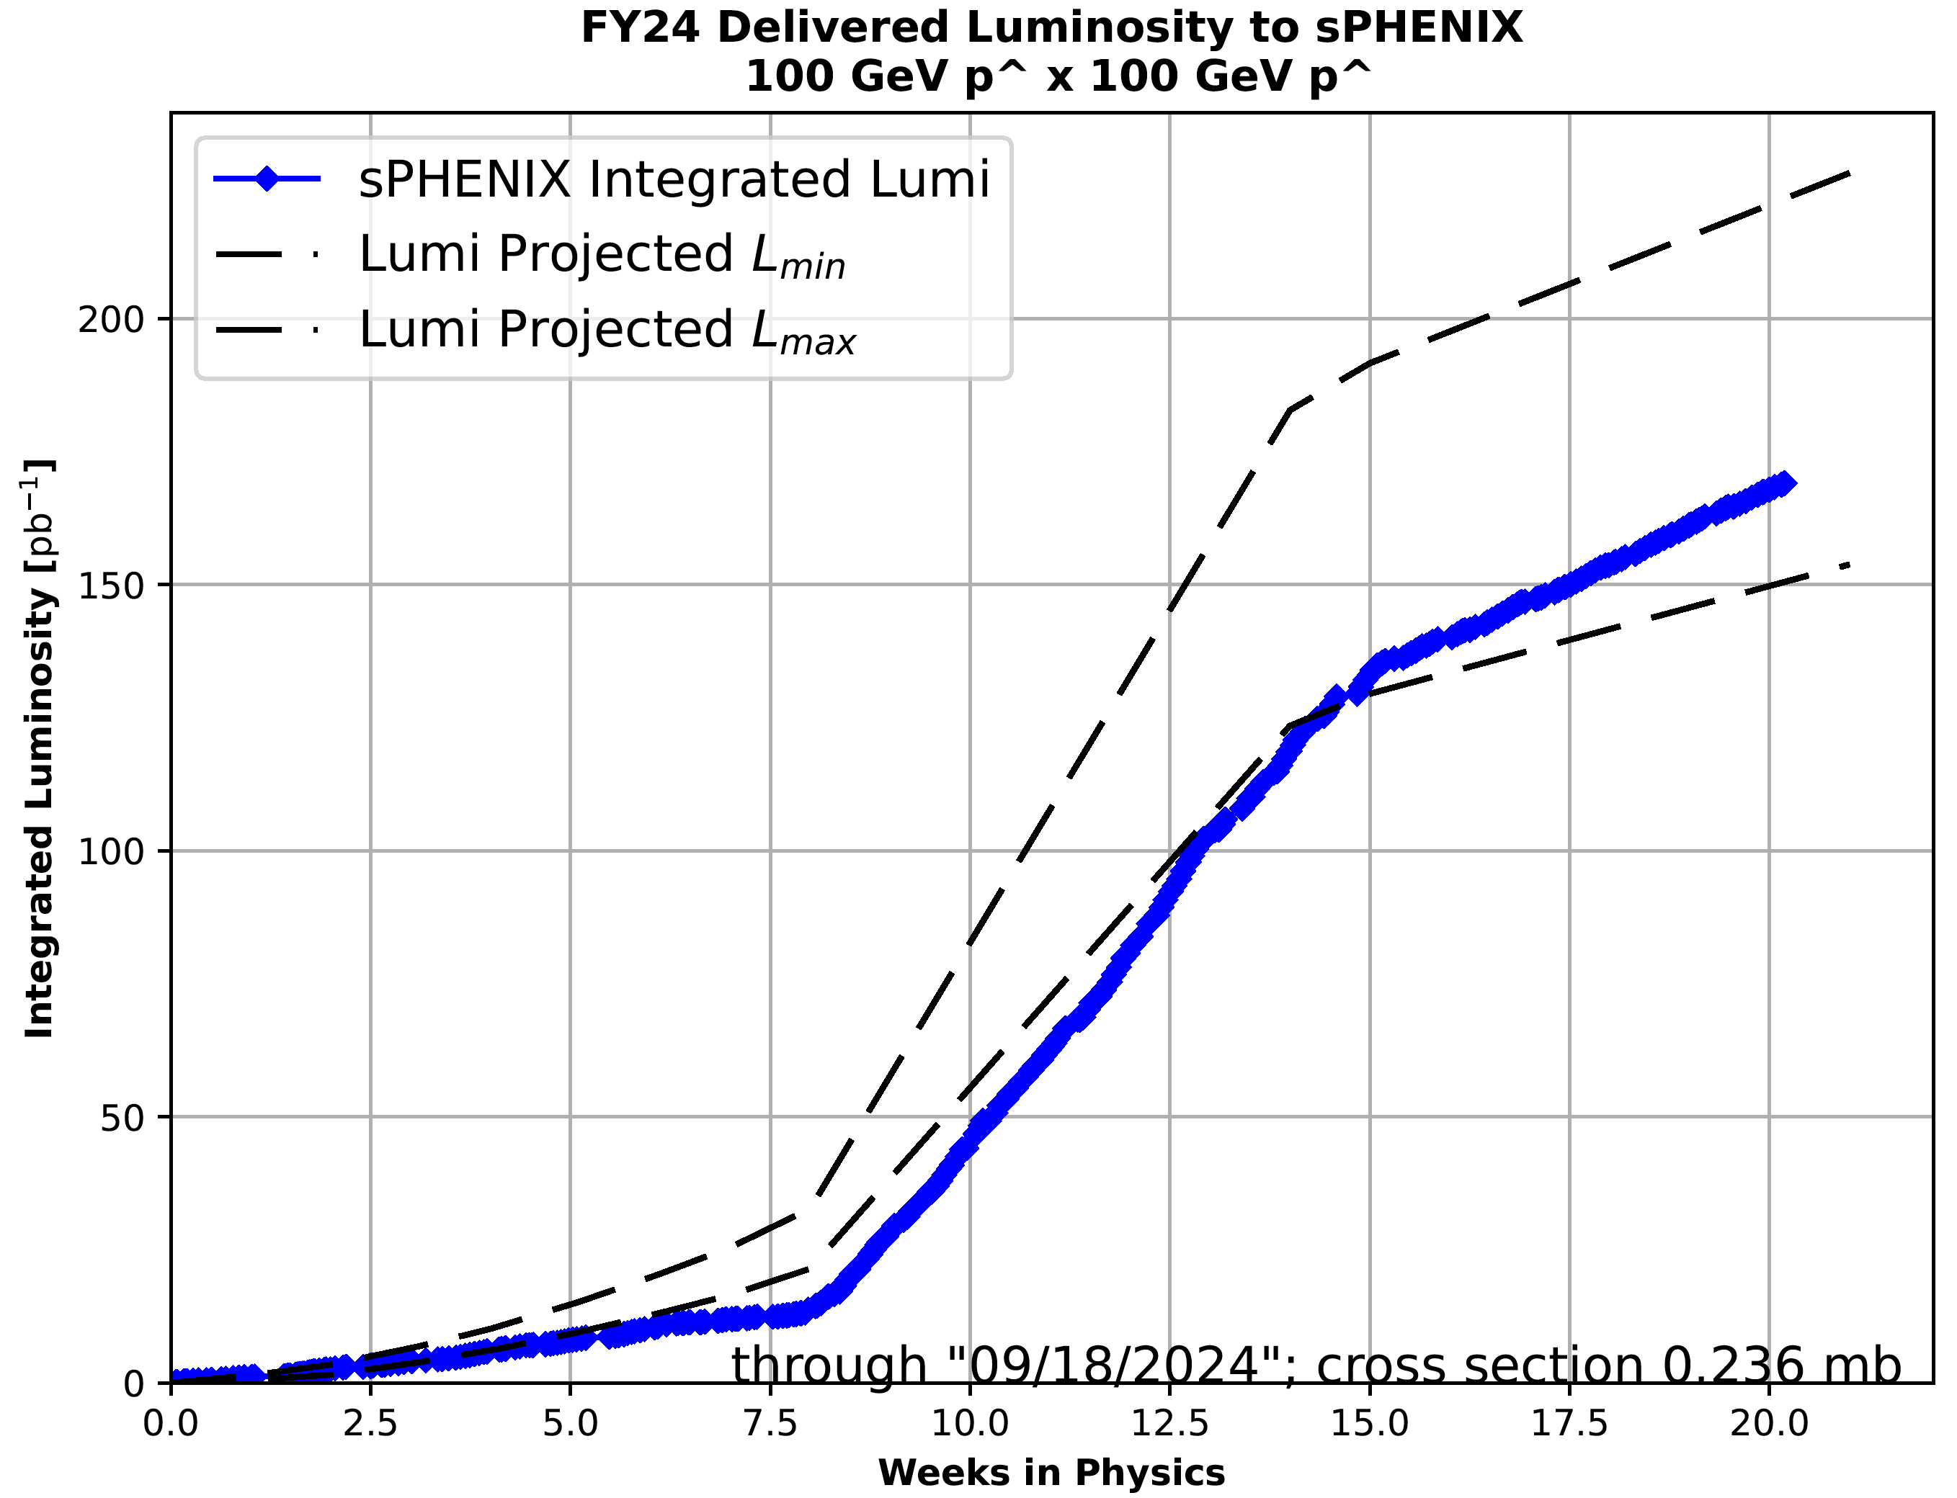
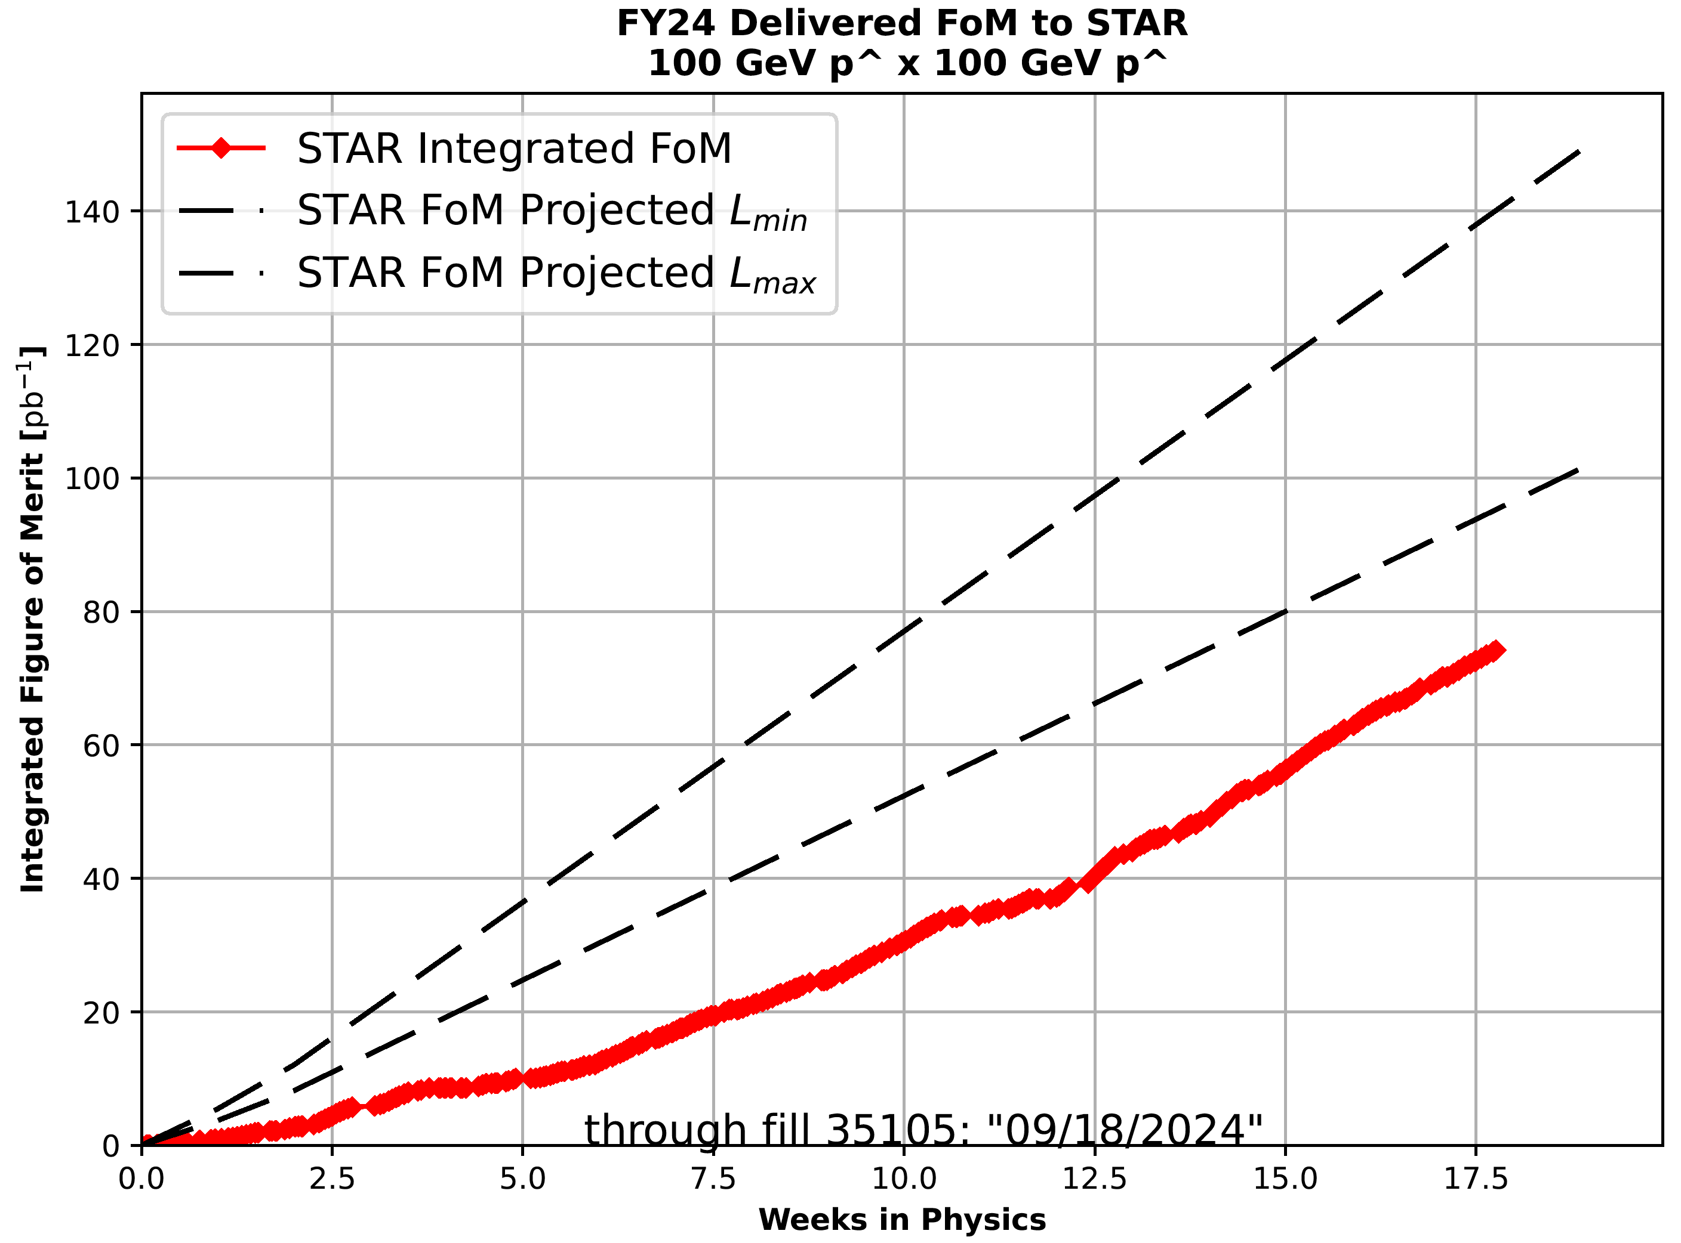
RHIC Run Overview
Run-24 Coordinator: Kiel Hock
Delivered luminosity to sPHENIX and Figure of Merit (FOM) to STAR

Slide 11
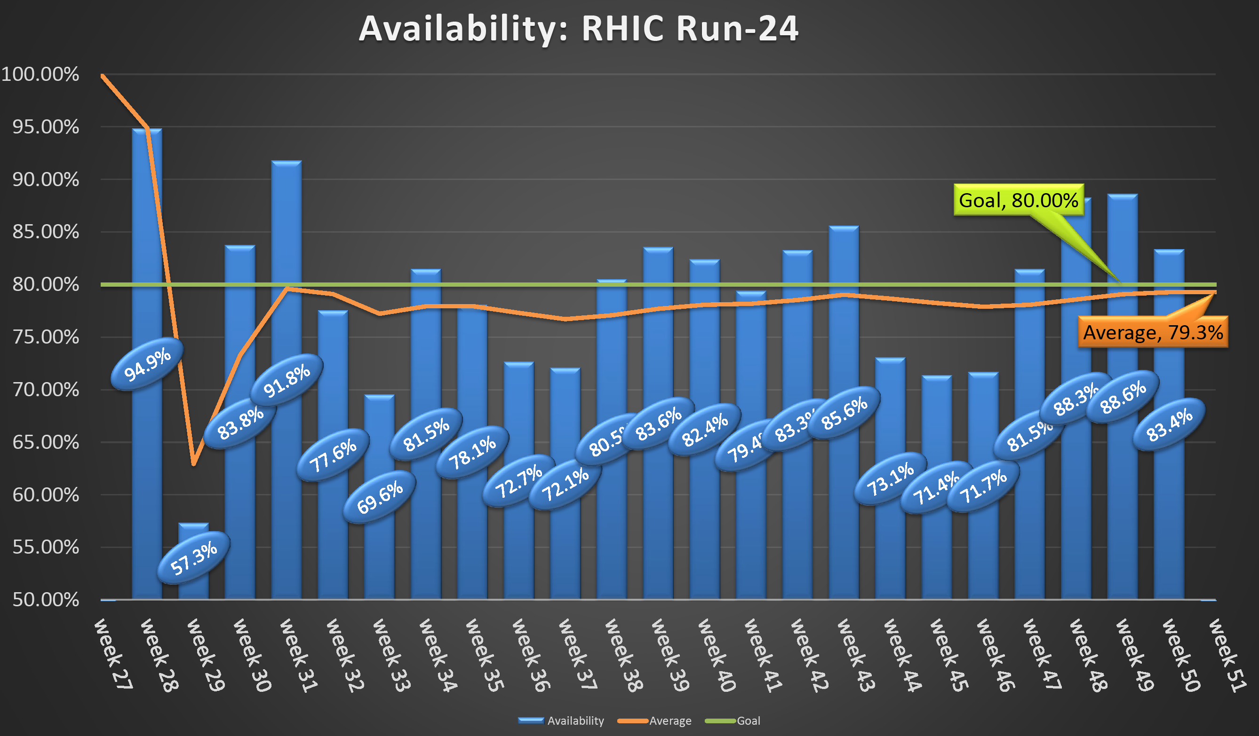
RHIC Availability
Run-24 Coordinator: Kiel Hock
RHIC availability has steadily improved
Time in Physics/day has also improved
Approaching the goal of 80% availability despite very poor availability earlier in the run

Slide 12
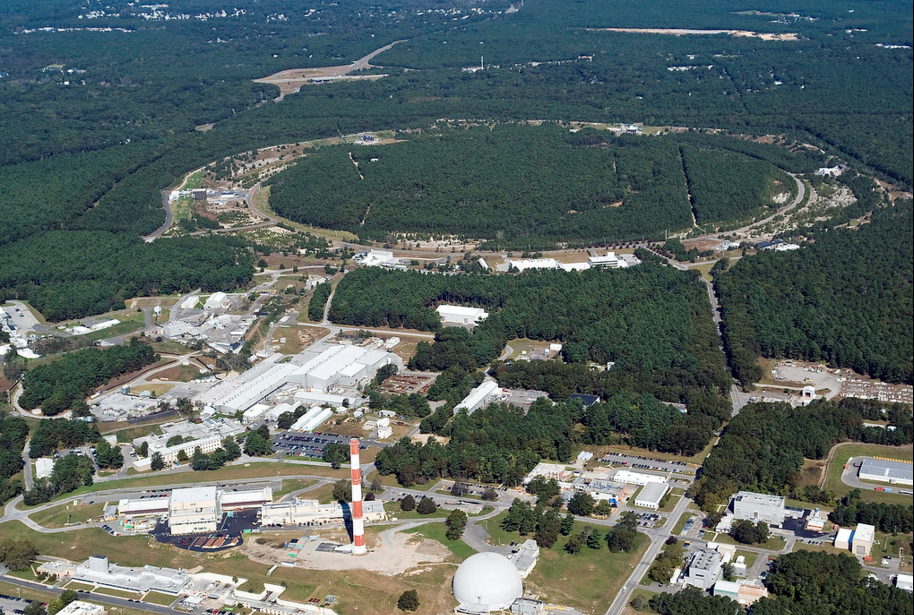
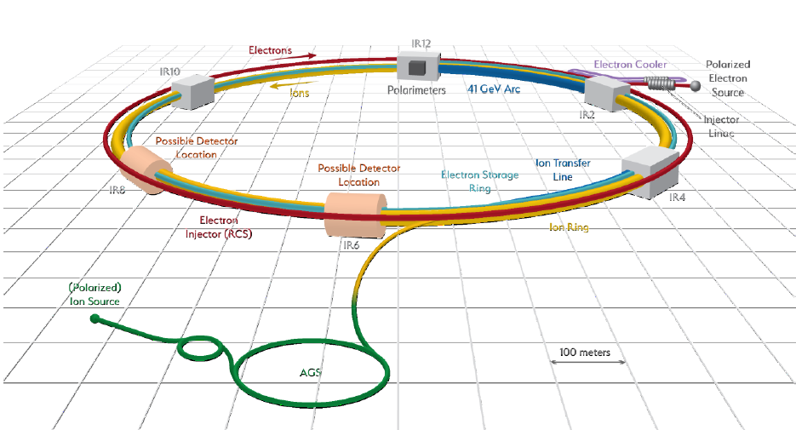
Electron-Ion Collider
BNL-JLab partnership with national and international contribution
sited at BNL - uses RHIC hadron complex
CD-1 June 2021 (Conceptual Design complete, cost range),
Early Science 2032 (planned)
Hadron storage Ring (RHIC Rings) 40-275 GeV (existing)
  1160 bunches, 1A beam current (3x RHIC)
  small vertical beam emittance 1.5 nm
  strong cooling (coherent electron cooling)
Electron storage ring 5–18 GeV (new)
  many bunches, large beam current, 2.5 A ➔ 9 MW S.R. power
  SC RF cavities
  Full energy swap-out injection of polarized bunches
Electron rapid cycling synchrotron 3–18 (new)
  1-2 Hz
  Spin transparent due to high periodicity
High luminosity interaction region(s) (new)
  L = 10³⁴ cm⁻²s⁻¹
  Superconducting magnets
  25 mrad full crossing angle with crab cavities
  Spin rotators (longitudinal spin)
  Forward hadron instrumentation
RHIC
EIC

Slide 13
Synergistic application programs
Funding from FY 2026 onwards
keeps injector complex in ready state
– also allows for continuation of synergistic
application programs
Isotope production – DOE IRP
DOE mission essential function
  uses 200 MeV H⁻ Linac + BLIP
Space radiation testing – NASA (biology) + DoD/others (electronics)
  uses LION/EBIS/Booster + NASA Space Radiation Laboratory (NSRL)

Slide 14
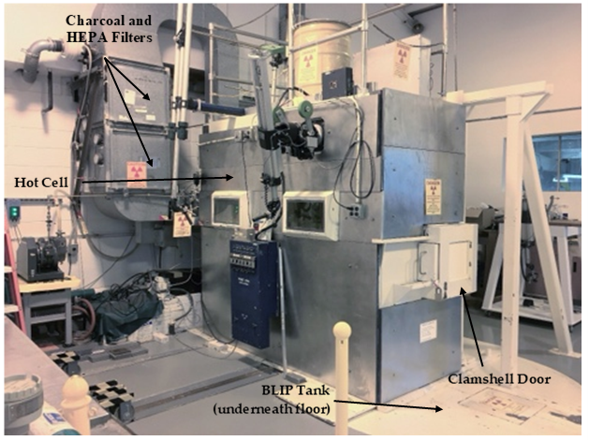
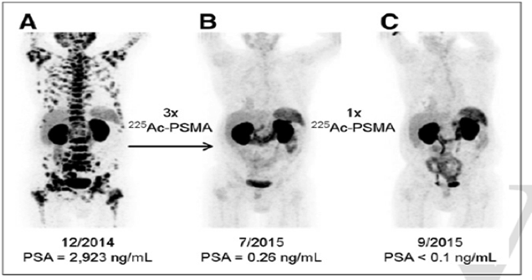
Application 1: Isotope production at
BLIP (Brookhaven Linac Isotope Producer)
Uses 200 MeV H– Linac when
not used for RHIC/EIC
(~99% of all protons accelerated for BLIP)
Target irradiation with 66 – 200 MeV, 165 μA pulse current
  Ac-225: Alpha emitter for treatment of metastatic prostate cancer

Slide 15

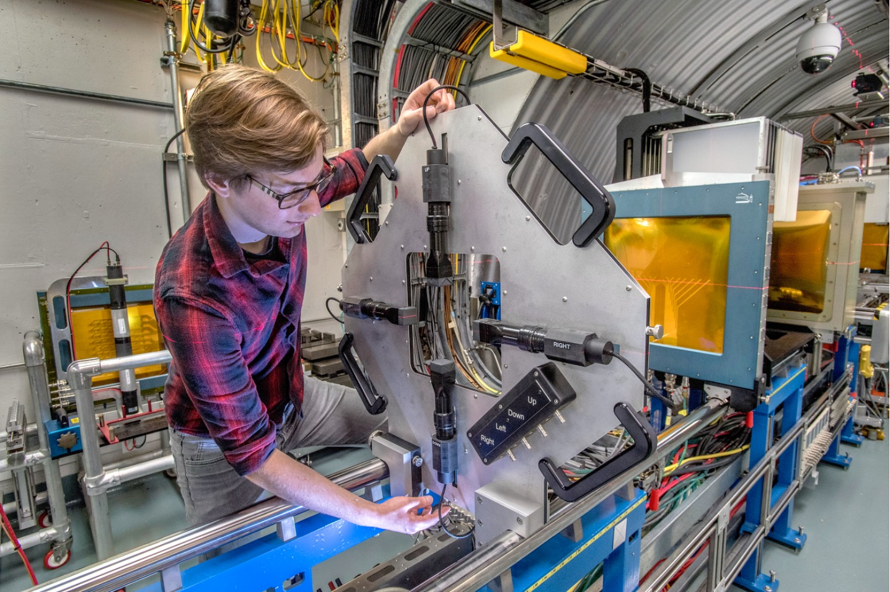
Application 2: space radiation studies at NSRL (NASA Space Radiation Laboratory)
Started in 2003, simulates galactic radiation for human space flight
  Heavy ion beams from AGS Booster
  Electron Beam Ion Source (EBIS) provides all necessary ion beams
  New laser ion source for EBIS allows for rapid species switching to simulate energy and species spectrum of deep space radiation field
Additional uses of NSRL
  Radiation effects studies (rapidly growing demand for satellite electronics testing)
  Agreement with NASA in place for non-NASA users (“non-designated user facility”)

Slide 16
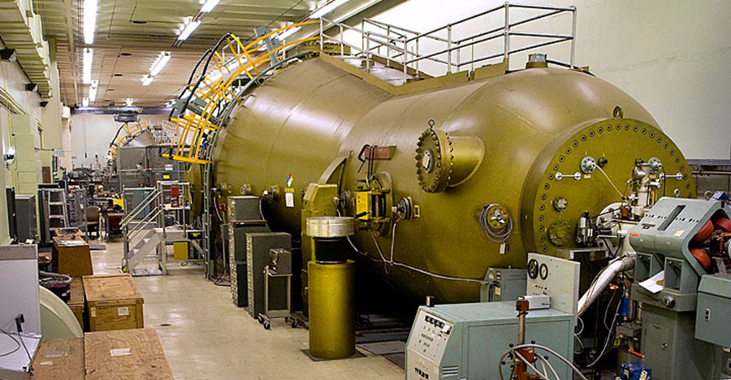
Application 3: Tandem Van de Graaff accelerators (2 machines)
Completed in 1970
Used as RHIC pre-injector
until 2011 (now EBIS)
2 electrostatic accelerators
32 MV (= 2x16 MV) voltage
>40 ion species p to Au
Used for:
Radiation Effects testing and Calibration
Sigle Event Upset Test facility
Ion irradiation/implantation
Radiobiology Research Facility

Slide 17
Accelerator R&D at C-AD
Focus in 3 areas:
Particle beam sources
  High-intensity H– sources
  Polarized proton source (OPPIS)
  Laser Ion Source (LION)
  Electron Beam Ion Source (EBIS)
  Polarized He-3 source
  High-intensity high-brightness electron sources
  Polarized electron sources
Polarized beam development
  Polarization increase in AGS (presently: skew quad system)
  Polarized He-3 acceleration
  Polarimetry development for polarized p and h (Frank Rathmann)
Beam cooling
  Stochastic cooling for heavy ions in RHIC – operational
  Low Energy RHIC electron Cooling (LEReC) -- operational
  Coherent electron Cooling (CeC) – experiment
  EIC ring pre-cooler design (LEReC technology) – design
  EIC ring cooler – design
Notes:
Add pics

Slide 18
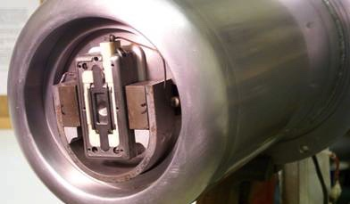
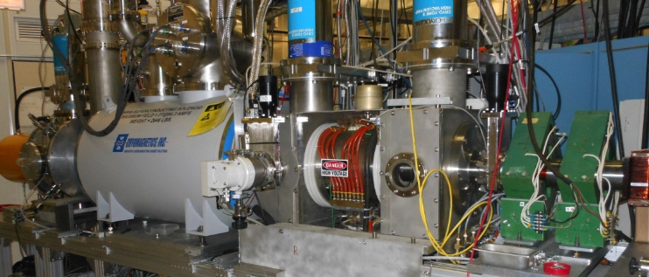
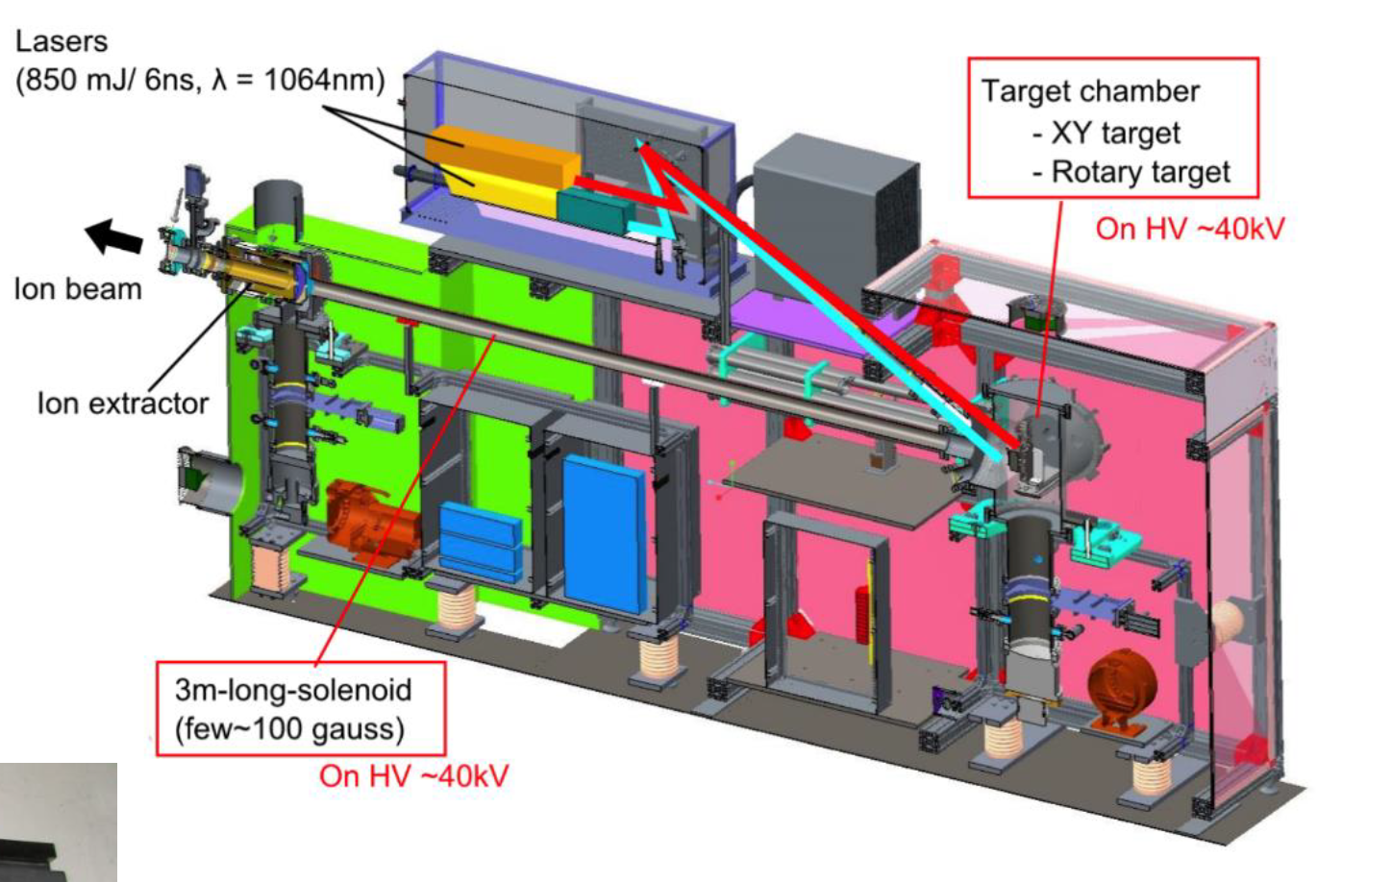
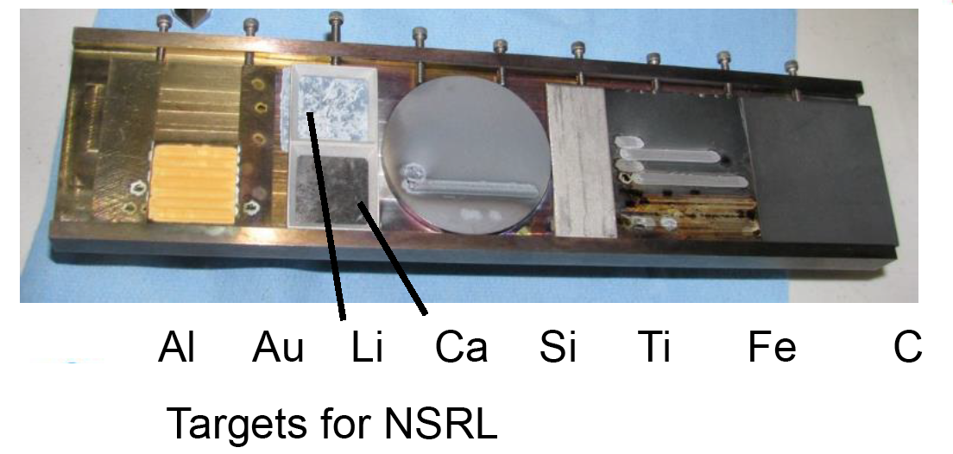
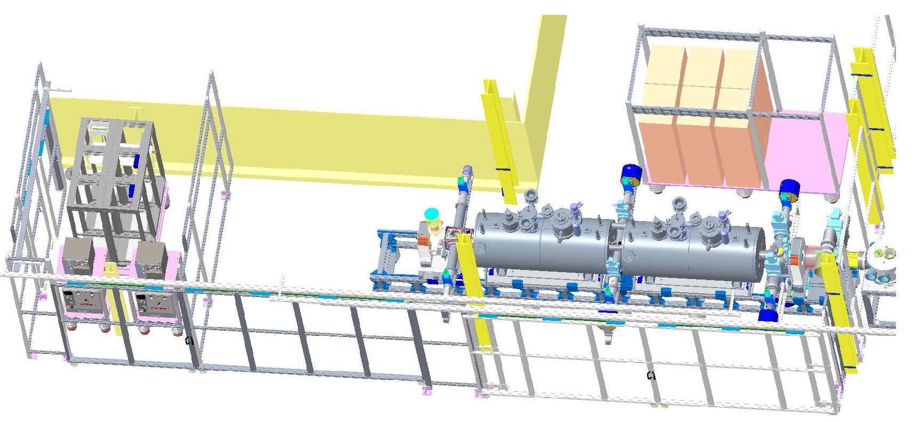
Ion Sources at BNL C-AD
Magnetron
BNL Magnetron H– source
  Hydrogen plasma interacts with Cs-Mo surface
  Highest H– peak current (100 mA)
BNL Optically Pumped Polarized Ion Source (OPPIS)
  Polarized electrons from optically pumped Rubidium are used to generate polarized H⁻ ions
  Highest intensity (1 mA) polarized (83%) H– source
BNL Laser Ion Source (LION)
  First operationally used ion source, couples to EBIS
  Unparalleled flexibility in selecting species
BNL Electron Beam Ion Source (EBIS)
  Intense electron beam in solenoid field stepwise ionizes heavy ions (Au³²⁺ after about 40 ms)
  Highest intensity EBIS, polarized ³He
OPPIS
LION
EBIS

Slide 19
High intensity electron sources
Active photocathode development
  Bi-alkali antimonide cathodes with QE up to 9%
DC photo-electron gun for LEReC
  Built by Cornell and installed at RHIC IR2
  400 kV operation
  30 mA CW current demonstrated, plan for higher
SRF photo-electron gun for CeC
  High brightness: 1.56 MeV, 0.5 nC and 0.3 um
  High bunch charge: up to 10 nC
  CW operation at 80 kHz with little QE drop
  High current operation limited by FPC

Slide 20
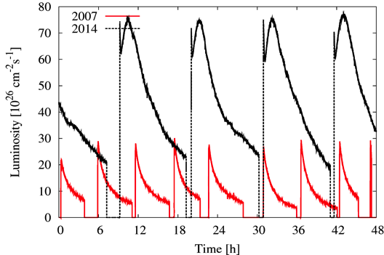
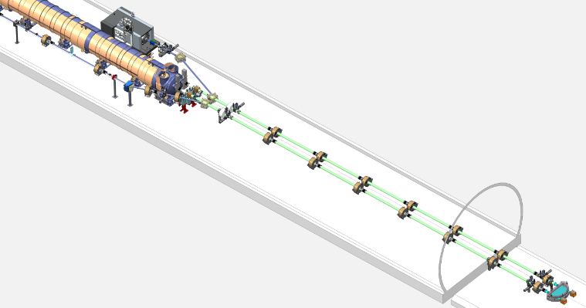
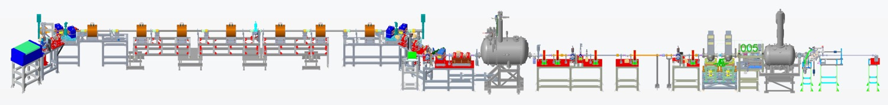
R&D – Beam cooling at RHIC
First high energy, bunched beam stochastic cooling gives record heavy ion collision rates
(10 GHz microwave technology)
First bunched beam electron
cooling for luminosity upgrade
of “low” energy heavy ion collisions
Experimental investigation of
Coherent electron Cooling,
(stochastic cooling with a 30 THz bandwidth)
Kicker
Modulator
Plasma Cascade Amplifier

Slide 21
RHIC – First and only polarized hadron collider p↑+p↑
Absolute Polarimeter (H↑ jet)
pC Polarimeters
Spin flipper
Siberian Snakes
Siberian Snakes
PHENIX
STAR
Spin Rotators
(longitudinal polarization)
Spin Rotators (long. pol.)
LINAC
5.9% Helical Partial
Siberian Snake
BOOSTER
Pol. H⁻ Source
AGS
Int. Polarimeter
pC Polarimeter
10-25% Helical Partial Siberian Snake
200 MeV Polarimeter
 | L_{peak} [10³⁰ cm⁻²s⁻¹ ] | L_{avg} [10³⁰ cm⁻²s⁻¹ ] | P_{avg} [%]
100 GeV (2015) | 115 | 63 | 55
255 GeV (2013) | 248 | 160 | 56
Notes:
ADD EBIS he

Slide 22
Collider-Accelerator Department facilities
Uniquely flexible and
only hadron collider in
US for exploration of
QCD phase diagram
and proton spin
Injectors also used for
application programs:
- Linac/BLIP for
isotope production
- Booster/NSRL for
space radiation studies
- Tandem for
industrial/academic users
R&D for future facilities
and application
- sources
- polarized beams
- beam cooling

