Slide 1
Scintillator Tile Aging Studies for the Electron Ion Collider (Update)
Jerad Johanningmeier
Advisor: Dr. Megan Connors
9/6/2024

Slide 2
Objectives
How does aging affect the performance of the scintillator tiles?
Tile Testing:
Monitor the performance of scintillator tiles over time and ensure that they will maintain consistent performance for their reuse in ePIC.
Tile Baking:
By baking tiles we can accelerate their aging, allowing us to measure how they will perform in the future.

Slide 3
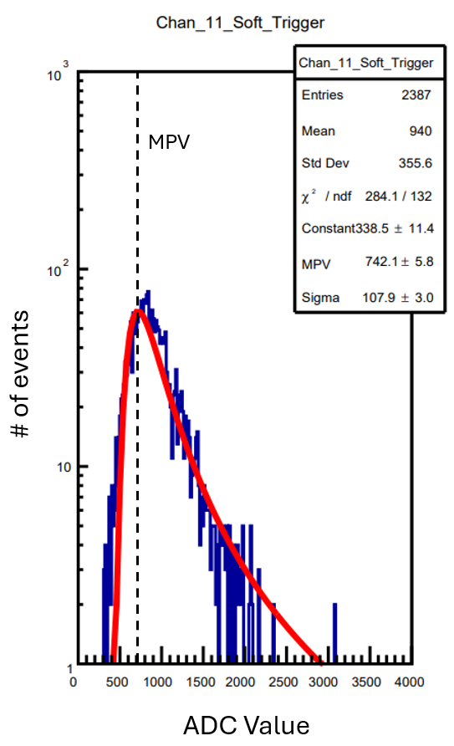
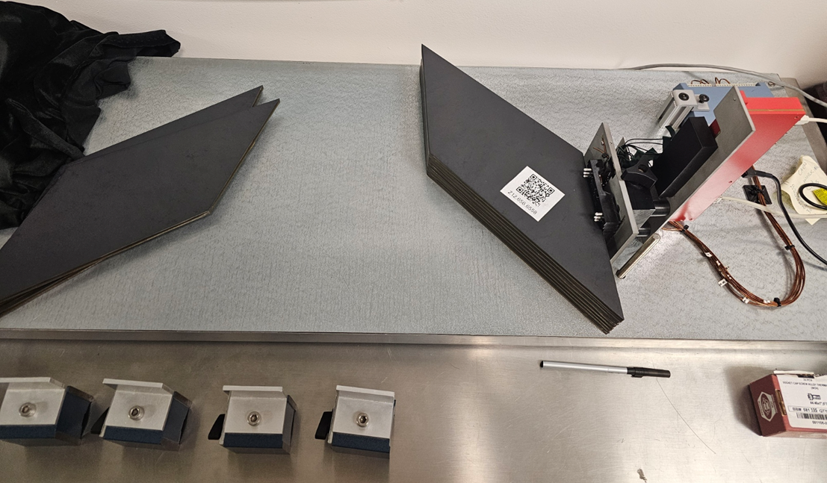
Recap
Tile Testing:
10 Tiles are attached to SiPMs on a test bench and data is collected via ROOT program. (Top and bottom tiles are reference tiles)
The performance of the tiles is determined by a Performance Ratio (PR).
MPV is the peak of a Landau distribution fitted to a histogram of events vs. ADC.

Slide 4
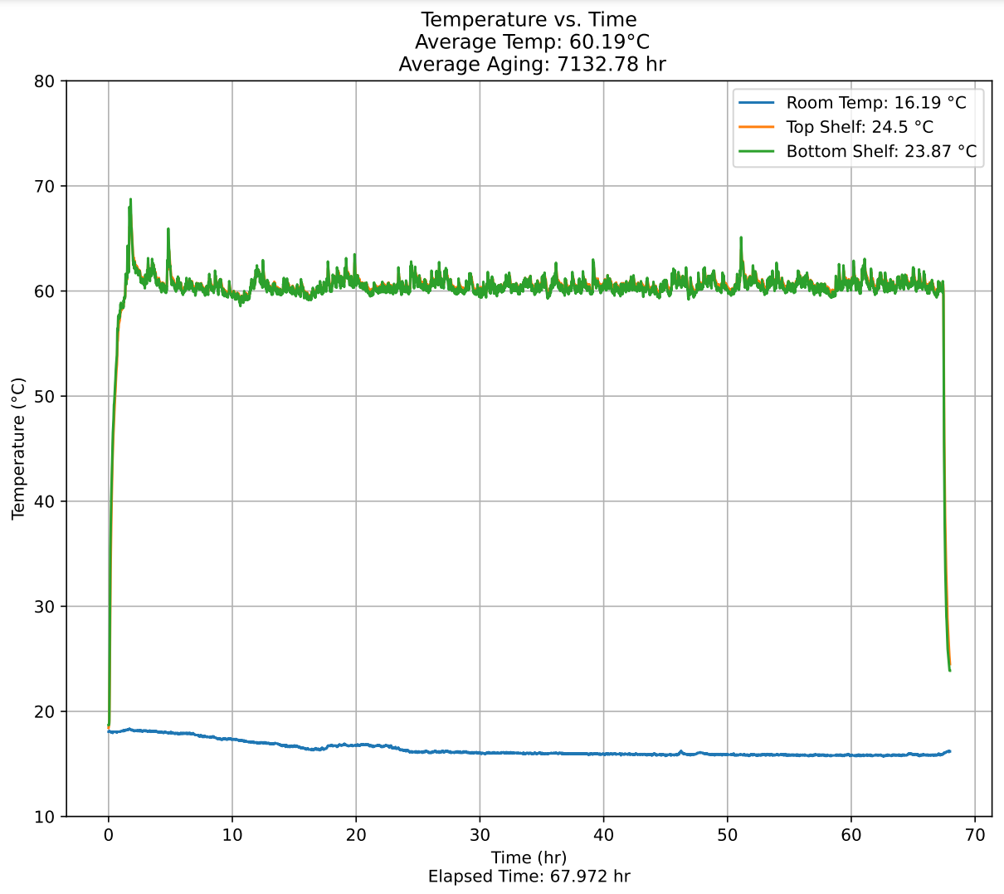
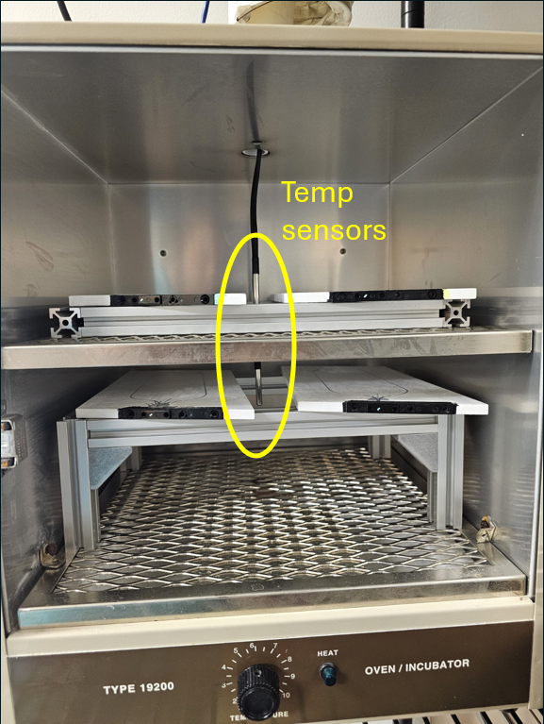
Recap
Tile Baking:
Current procedure has tiles baked 4 at a time, at a target temperature of 60°C with testing breaks every 72 hours.
3x DS18B20 temperature sensors for the temperature of each shelf in the oven as well as the room. (data recorded by an Arduino and read by python script)
The accelerated age is derived from the $Arrhehius Reaction Rate$ Eq.
J. Abdallah, et al., The production and qualification of scintillator tiles for the ATLAS hadronic calorimeter, ATLAS note ATL-TILECAL-PUB-2007-010, (2007)

Slide 5
$Arrhehius Reaction Rate: \frac{dA}{dt}=Ak_{0}e^{E/RT}$ [1]
Where A is the concentration of the scintillation dopants, $k_{0}$ is the reaction constant, E is the activation energy, R is the gas constant and T is temperature.
By taking a ratio of the reaction rate in the oven to the reaction rate at room temp we obtain a factor that can be used to scale the elapsed time to the proper accelerated age.
$$Average aging=\frac{e^{\frac{−E}{RT_{oven}}}}{e^{\frac{−E}{RT_{room}}}}∙∆t$$
My python script uses a constant room temperature of 20°C and the $∆t$ is the time between measurements. Aging is calculated for each sensor in the oven and then averaged to obtain the average aging for all 4 tiles being baked. These average age values for each measurement are then summed over the course of the bake.

Slide 6
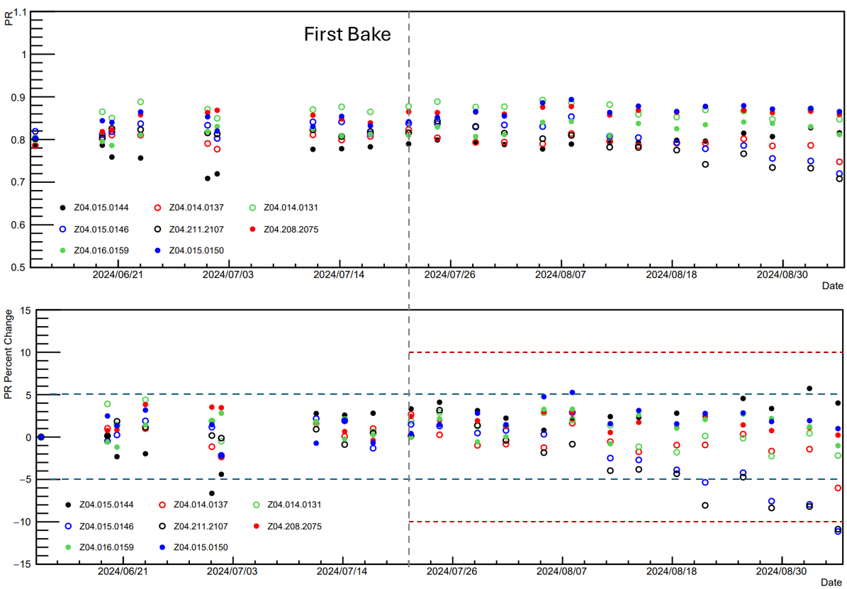
Current Results
*open circles are baked tiles*
Total aging: 96516.33 hr
(11.02 years)
Bottom shelf tiles have shown change beyond -10% (Closest to the heating element in the oven)
Top shelf tiles are trending beyond a -5% change as of the latest test (9/5/24)
Despite similar temps on each shelf, the bottom shelf tiles seem to be degrading faster
Notes:
Previous data point was at 10.2 years

Slide 7
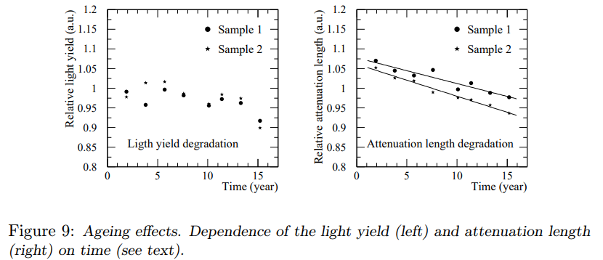
ATLAS Baking Study
Two samples were kept at a temperature of 70°C for 25 days with intermittent breaks for measurements (approx. 16 years of aging)
This study concluded the total deterioration caused by natural aging should not exceed10% after 10 years of operation
J. Abdallah, et al., The production and qualification of scintillator tiles for the ATLAS hadronic calorimeter, ATLAS note ATL-TILECAL-PUB-2007-010, (2007)

Slide 8
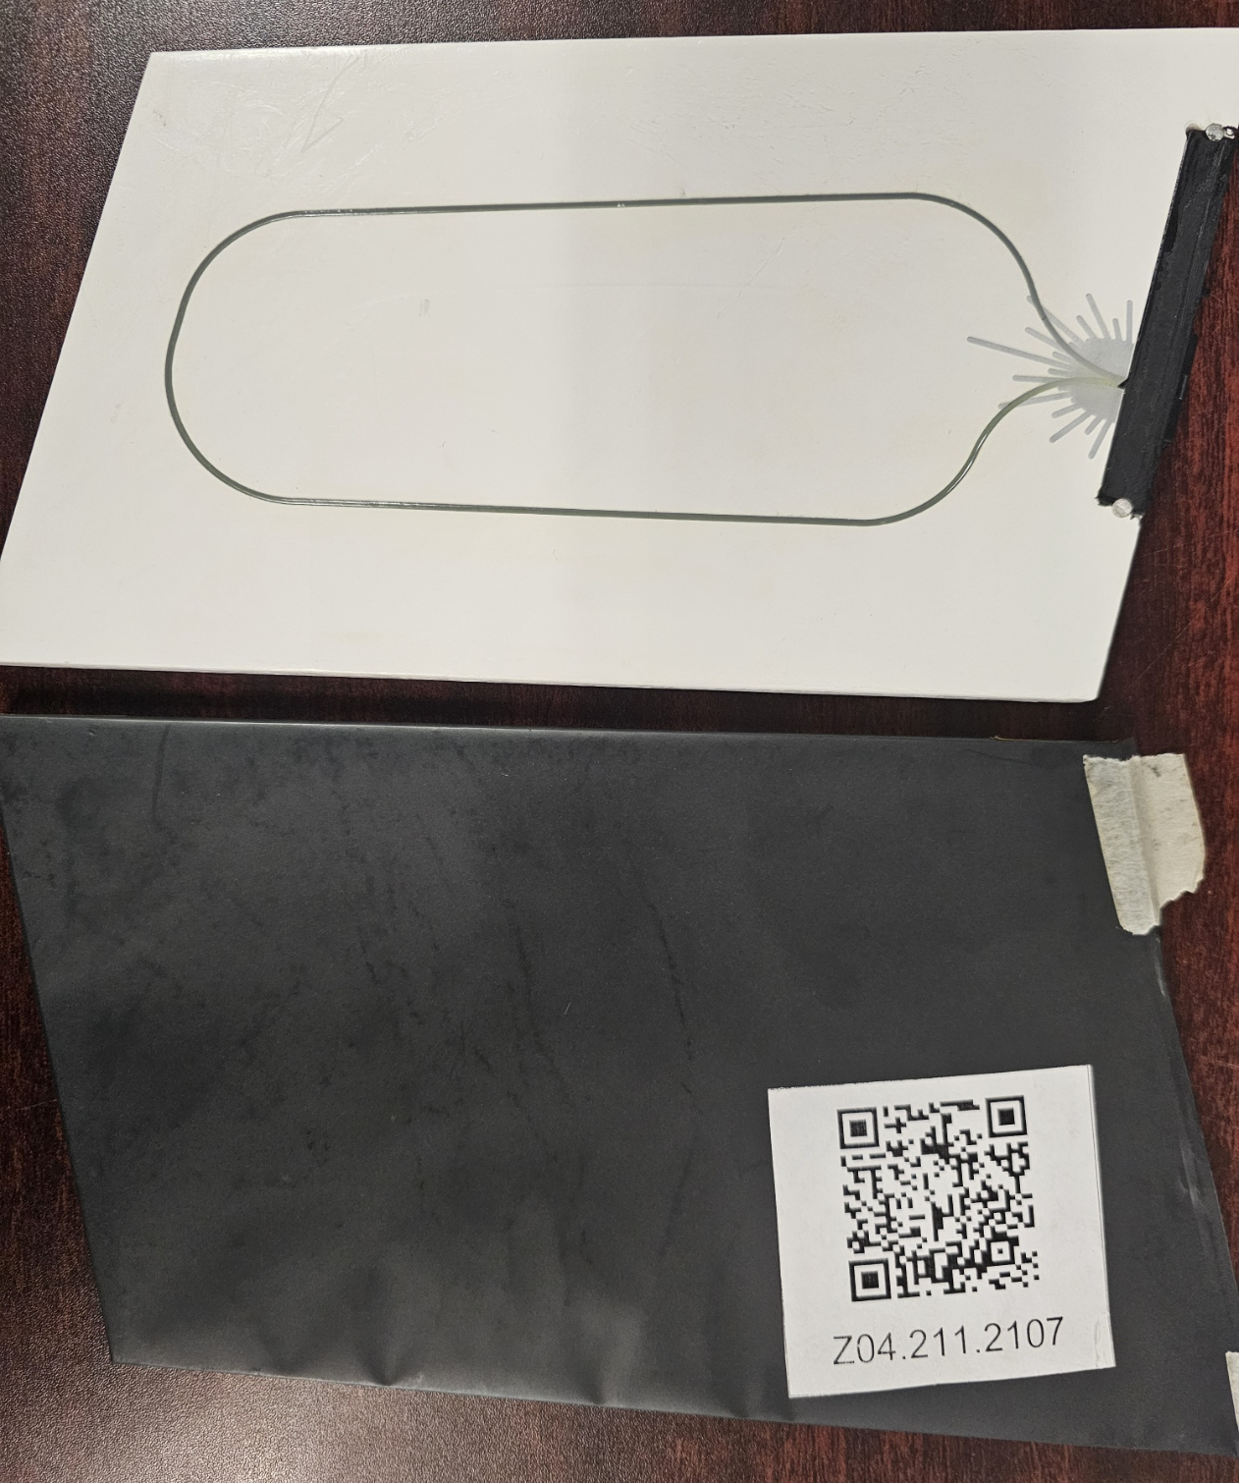
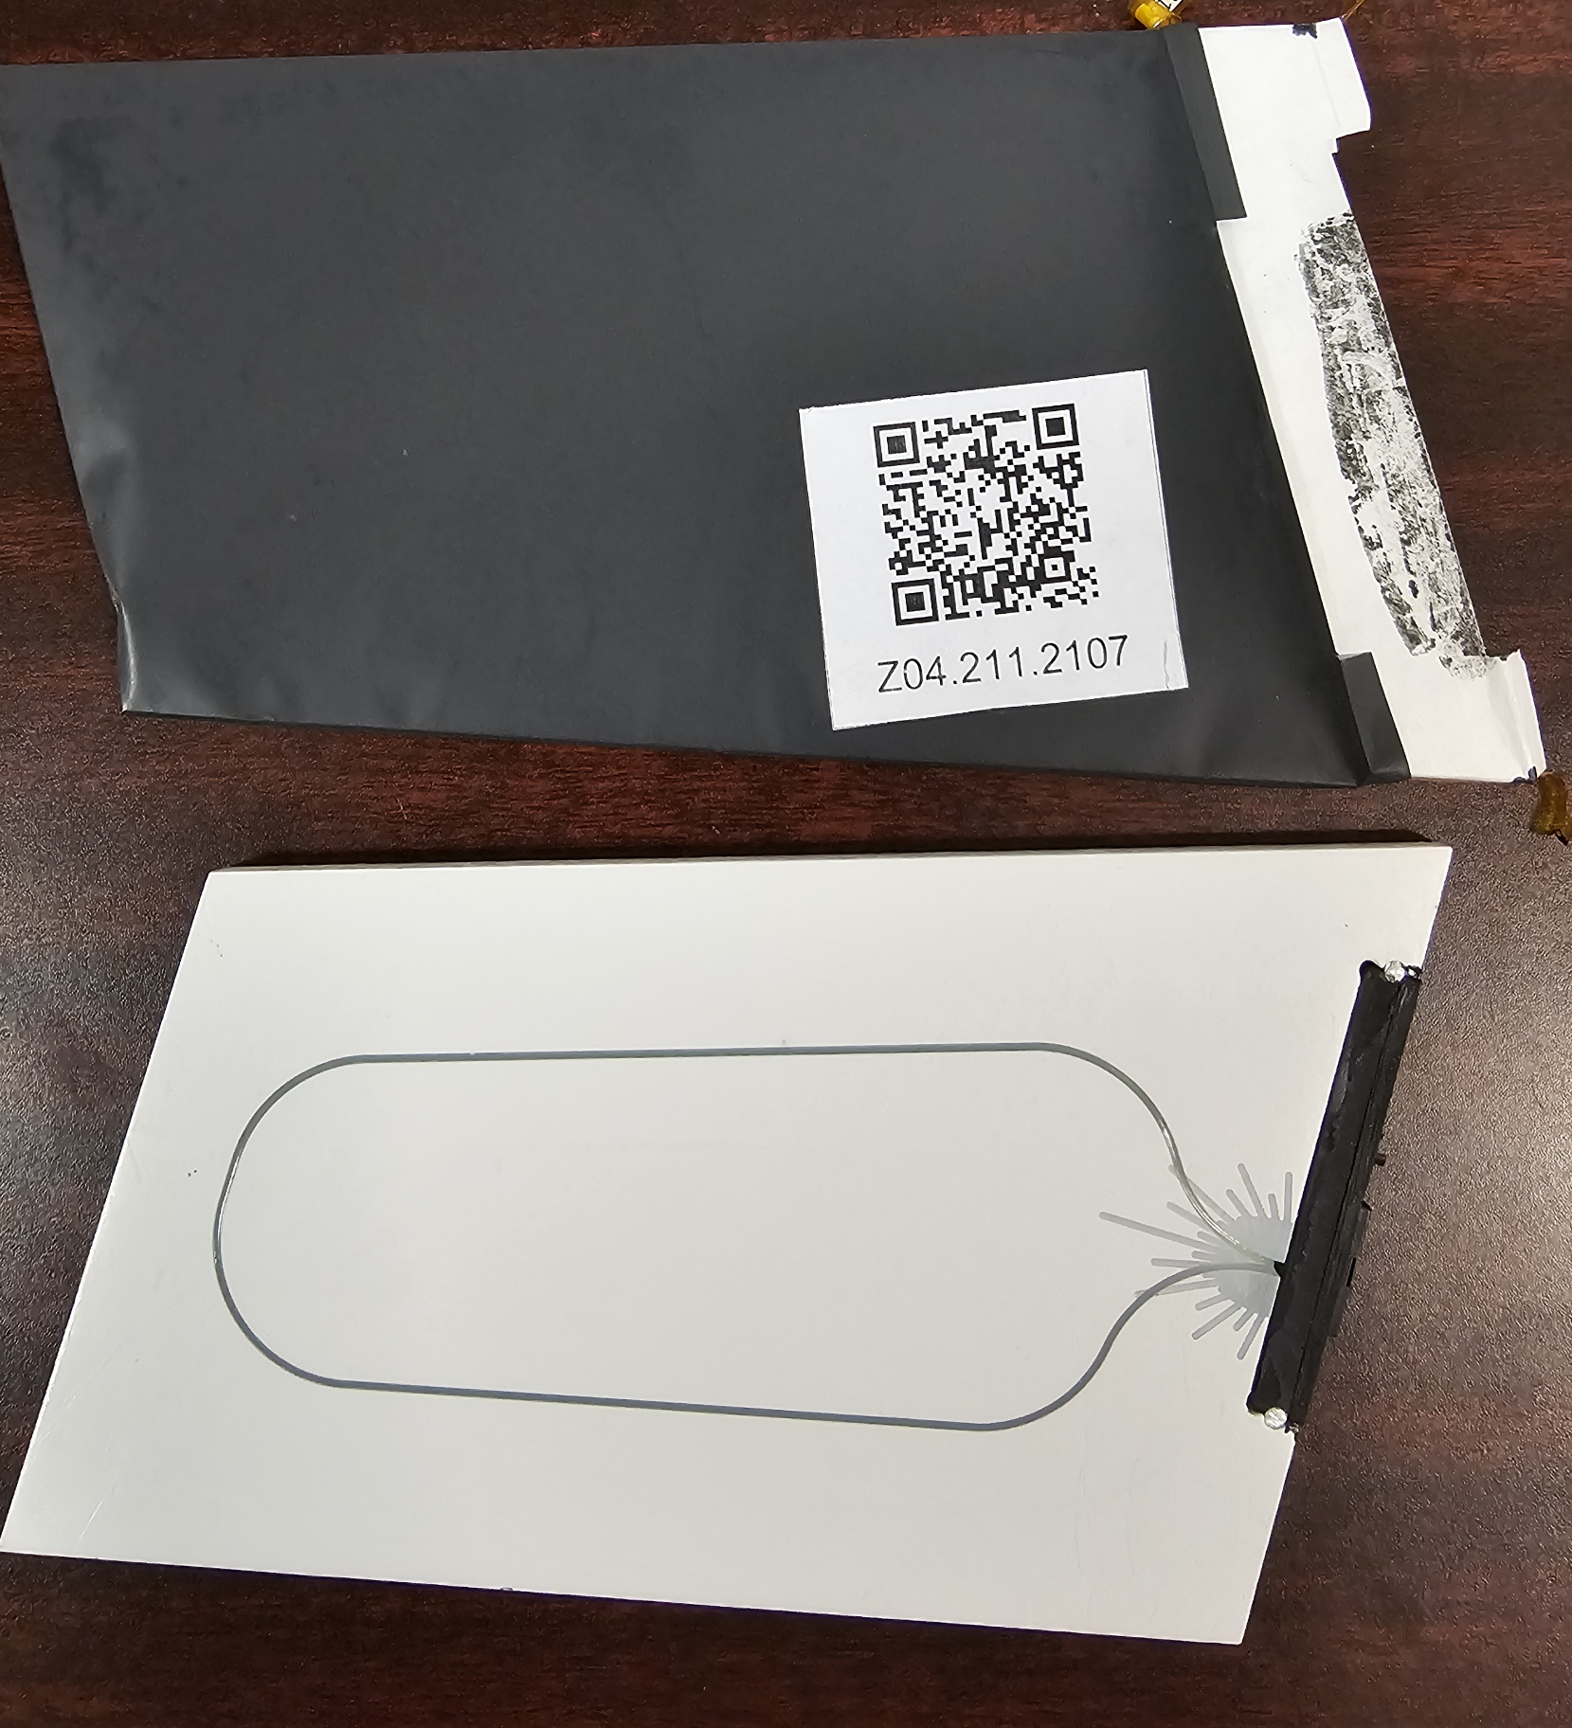
Yellowing around the fiber groove was observed on the most recent tests.
7/12/24
9/2/24

Slide 9
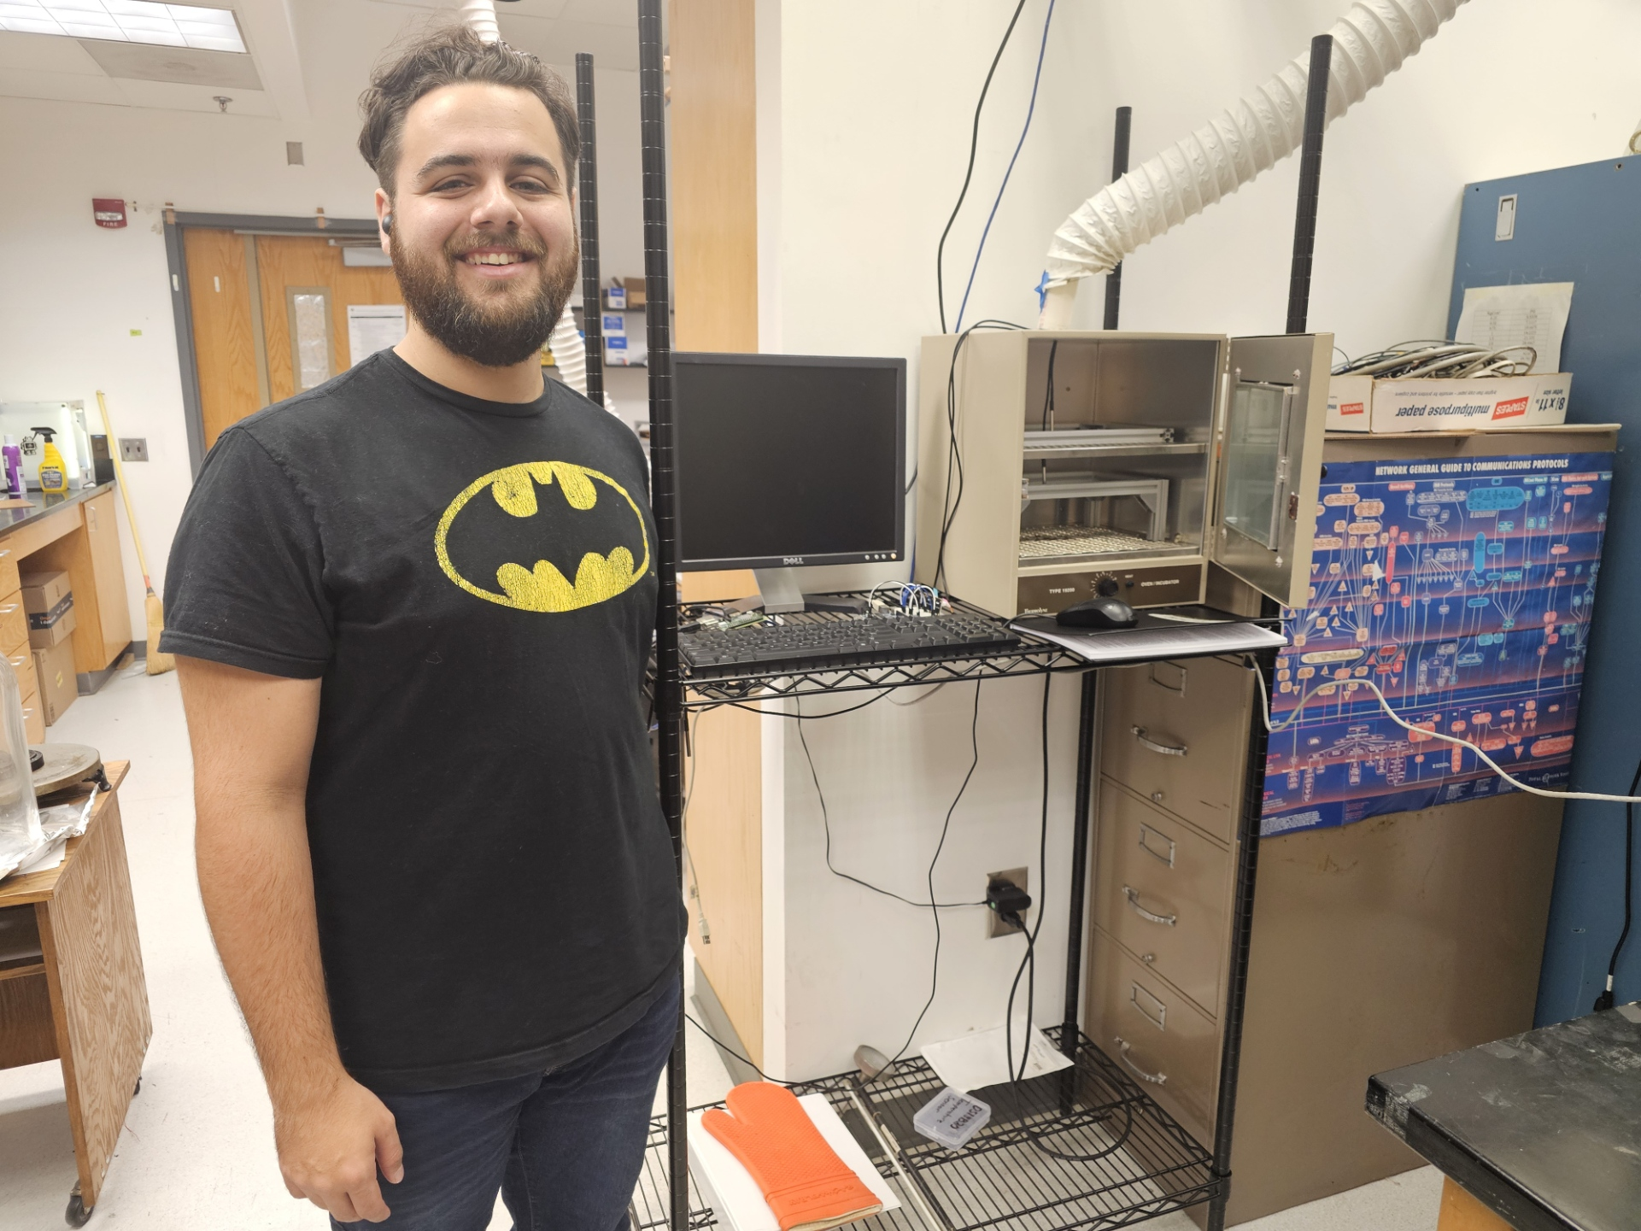
Summary
Results are showing signs of degradation after 10 years of aging, similar to the ATLAS study.
New complications to be solved/understood:
Oven temp spikes
Tile yellowing
Tile position in oven affecting its degradation rate despite similar temperatures

Slide 10
Refrences
[1] J. Abdallah, et al., The production and qualification of scintillator tiles for the ATLAS hadronic calorimeter, ATLAS note ATL-TILECAL-PUB-2007-010, (2007)
[2] Aidala, C.A. Design and Beam Test Results for the sPHENIX Electromagnetic and Hadronic Calorimeter Prototypes. arXiv:1704.01461 [physics.ins-det] (2017)
[3] J. Tutterow, Aging Studies of sPHENIX Hadronic Calorimeter Scintillating Tiles (2021)
[4] S. Ali, Effects of aging on scintillating hadronic calorimeter tiles (2018)

Slide 11
Questions?

