Slide 1
Tutorial for multiloop calculations
BNL Lunch Talk
06.12.2024
Marvin Schnubel

Slide 2
Motivation
Multiloop calculations are necessary for precise predictions for many observables
Expressions beyond 1 loop are often too long and/or complicated to be computed by hand and no automated procedure exists till now (compare 1 loop computation by Package X etc.)
Many tools exist to help with various steps within the process
Idea is here to give a rough overview together with exemplary Mathematica notebook

Slide 3
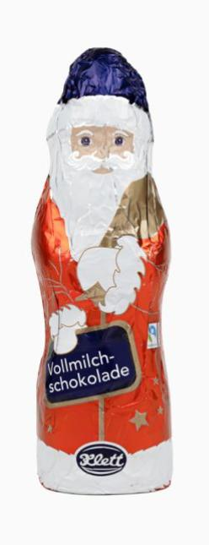
Step by step guideline
Reduce to Master Integrals
Create diagrams
Get expressions
Solve Master Integrals
Done!
M Schnubel - Tutorial for Multiloop Calculations
Could be difficult, in practice easy
automated
Varying difficulty,
Not automated
Easy,
automated
Easy,
automated
3

Slide 4
1) Create diagrams & 2) Get expressions
Generation of diagrams is in principle a combinatorial task with set rules, automated in various programs (FeynArts, Qgraf, etc.)
Getting the expressions from the diagrams follows simple Feynman rules → can be automated straight forwardly e.g. with FeynCalc
Reduction programs can only solve for scalar integrals → project out correct Dirac and Lorentz structure

Slide 5
3) IBP Reduction
Integration by Parts relation:
With cut propagators: inverse unitarity
Large and sparse system, can be reduced to a set of Master Integrals
Can be solved by algorithms (AIR, FIRE, Kira, Reduze, LiteRed, Blade…)
v: combination of propagators and ext. momenta

Slide 6
4) Solve Master Integrals
Numerically automated (DiffExp, AMFlow…)
Often analytically possible!
If computation with Feynman parameters doesn’t work, can try using differential equations
E.g.
This can be again reduced to MIs → system of coupled DEQs

Slide 7
4) Solve Master Integrals
If solving MIs fully is too complicated, often the ε - expansion is sufficient
Especially straight-forward if DEQ is in canonical form (CANONICA, Fuchsia…)
Solution is then given by Chen iterated integrals

Slide 8
4) Solve Master Integrals
Solution can be expressed in „easy“ functions (Goncharov polylogs) if
Finding correct boundary conditions can be further challenging, for massive integrals find often the result for the massless case in the literature.

Slide 9
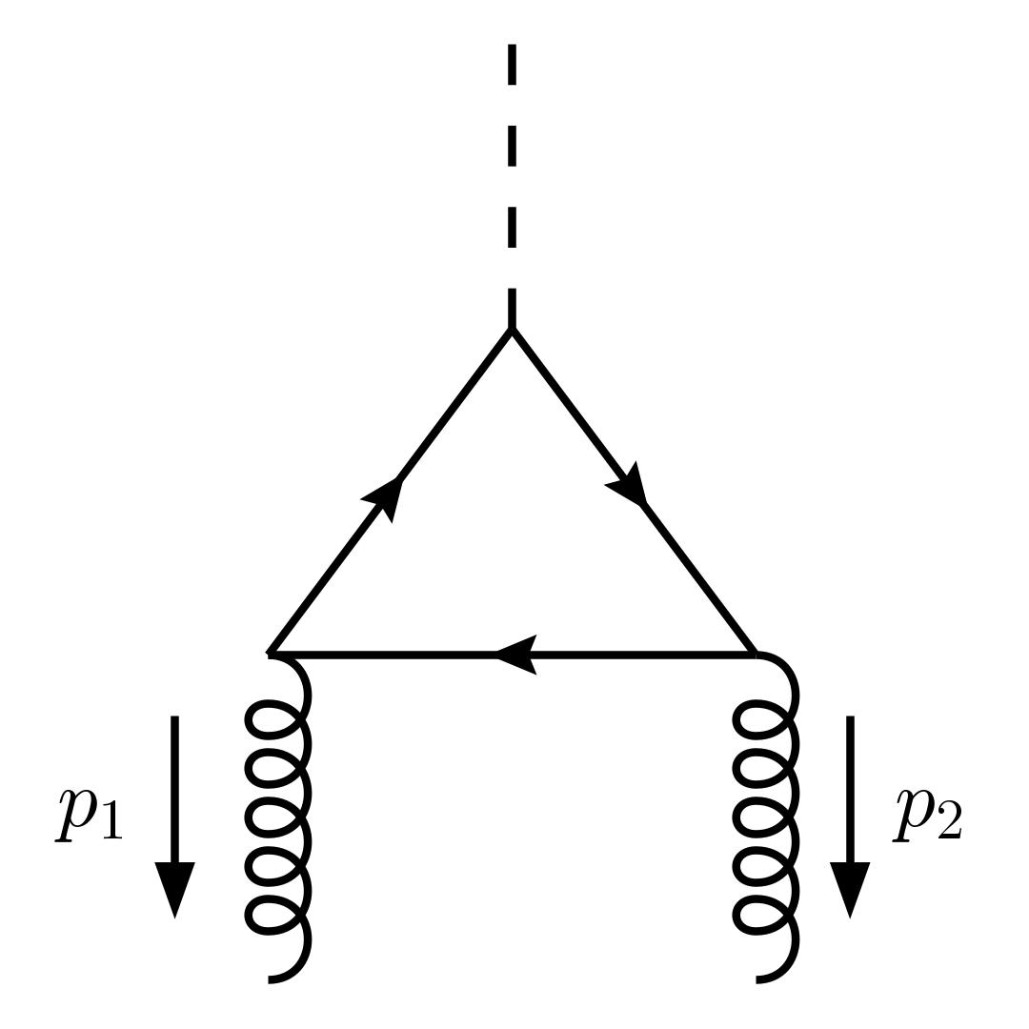
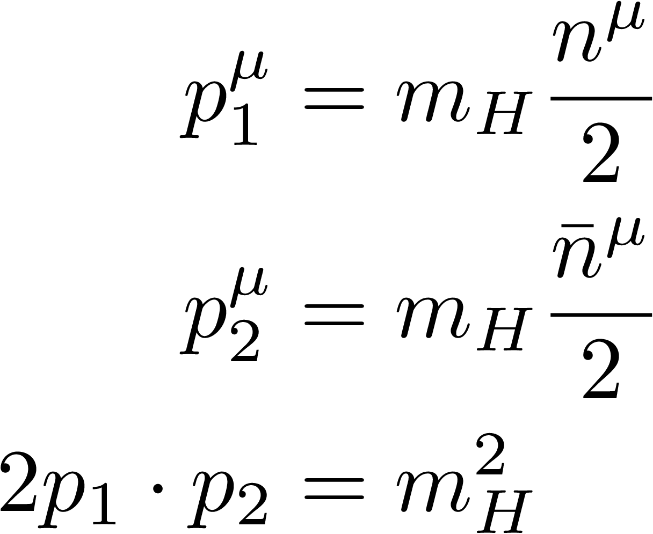
Example
Gluon-gluon to Higgs fusion via light quarks, hard matching coefficient, leading m_{b} behavior

