Slide 1
MOSAIX, EIC-LAS and AncASIC Updates
Notes:
The abstract pattern can be removed or repositioned if required. Be careful to ‘Send to Back’ so that it does not obscure any important information.

Slide 2
Introduction
MOSAIX
Background and Overview
MOSAIX
Stitching
Overview of MOSAIX (Plenary)
Latest Power Consumption (Engineering Review)
Progress
EIC-LAS
Estimating EIC-LAS Power based on MOSAIX
Estimating EIC-LAS Data Rates based on MOSAIX
MOSAIX – EIC-LAS Changes
Progress
AncASIC
Background and Features
Caveats
NVG
SLDO
AncASIC Power and Thermal Studies
Progress

Slide 3
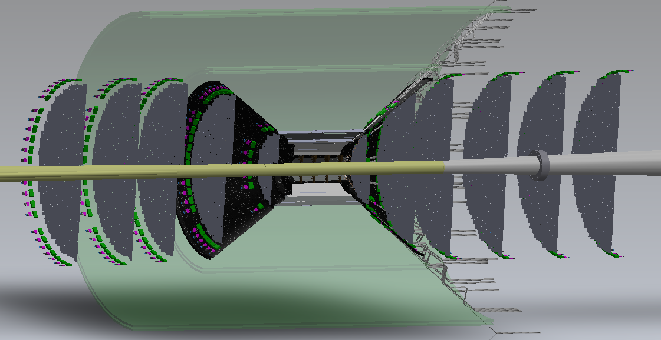
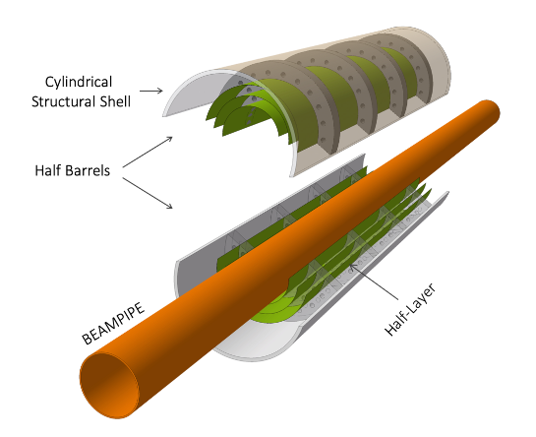
Introduction
Outer Barrel and Discs
Smaller Verion of MOSAIX with minimal changes (EIC-LAS)
Supporting AncASIC
Inner Barrel
Thinned silicon bent around beampipe
USE MOSAIX from ITS3

Slide 4
Introduction
Three strands
Partner with ITS3 for MOSAIX access
Develop EIC-LAS based on MOSAIX
Develop AncASIC to support EIC-LAS
Requirement for ePIC | Work currently under way | Institutes involved
Partner with ITS3 | LLDFM logic cells Cross-RSU data transmission VFM ADC SRAM Digital design – RSU serialiser | RAL, LBNL BNL BNL MIT
Reduced number of RSUs | N/A – requires database | BNL - Joao
Multiplexing to single data link | N/A – requires database | Oxford – Jaya John ????
TX Voltage reduction for SP | N/A – requires database | TBD
Multiplexed slow control | Definition | BNL
Serial powering | 65nm first schematic complete | RAL/Oxford/LBNL
Negative bias generation | Start design in 110nm | BNL
ITS3 Partnership (WBS 1.1)
EIC-LAS (TPSCo 65nm)
(WBS 1.2)
Ancillary Chip (XFAB 110nm)
(WBS 1.3/4/5/6)

Slide 5
MOSAIX
Notes:
The abstract pattern can be removed or repositioned if required. Be careful to ‘Send to Back’ so that it does not obscure any important information.

Slide 6
MOSAIX Overview
Stitching is key to MOSAIX
CMOS fabrication is a lithographic process
Wafer are exposed to light through a reticule mask of limited size (~2.5x2.5cm)
Typically this makes thousands of chips per wafer
To make 1 Die-per-Wafer (1DPW) sub-divide reticule and repeatedly re-expose
Challenges and Advantages
Addressing can be tricky
Yield is a major issue
Multiple products can be made with the same mask set. This is basis of the EIC-LAS...

Slide 7
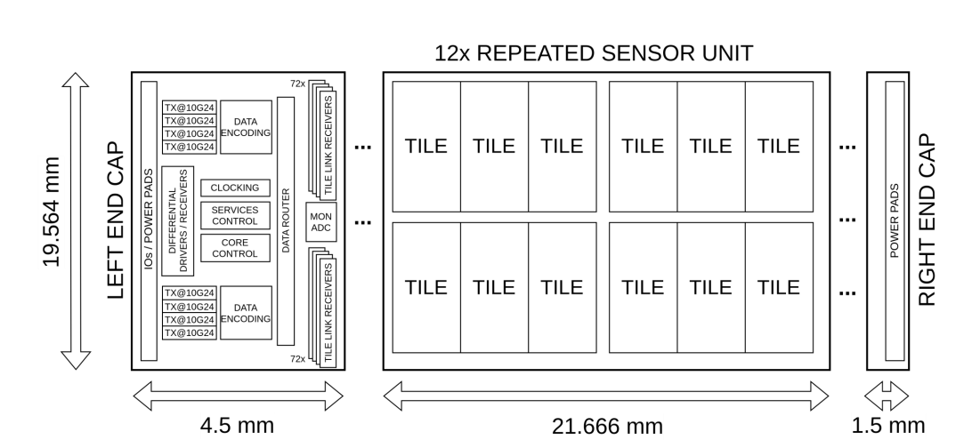
MOSAIX Overview

Slide 8
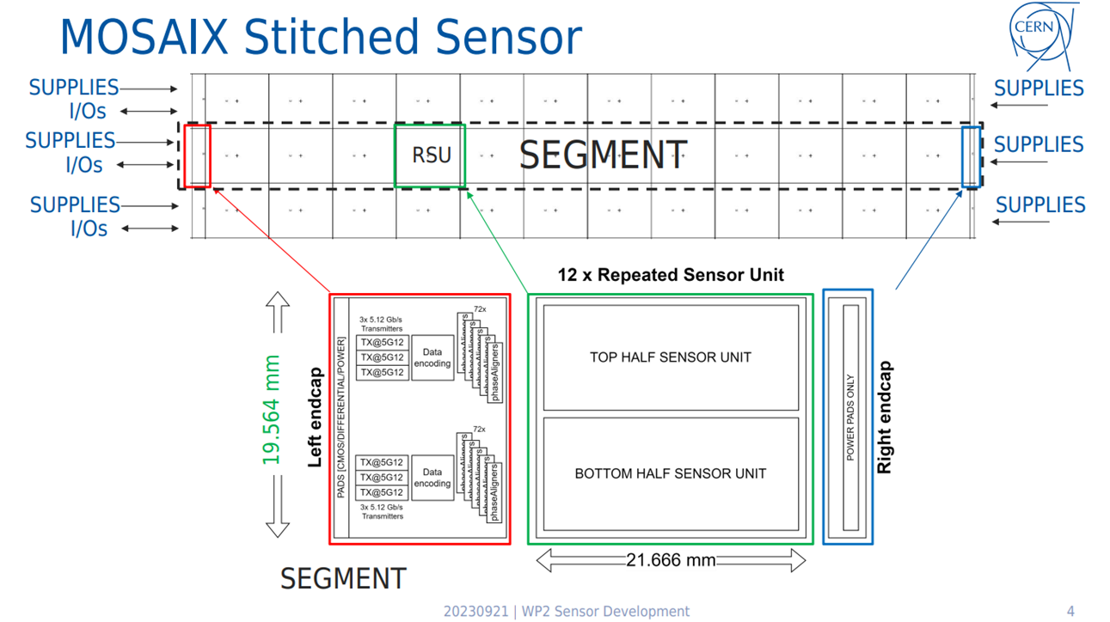
MOSAIX Overview
Data Rates
Tile Link Capacity – 23.04Gbps
Average Data Rate – 15.55Gbps
3 links @ 10.24Gbps
5 links @ 5.12Gbps
8 links total exist

Slide 9
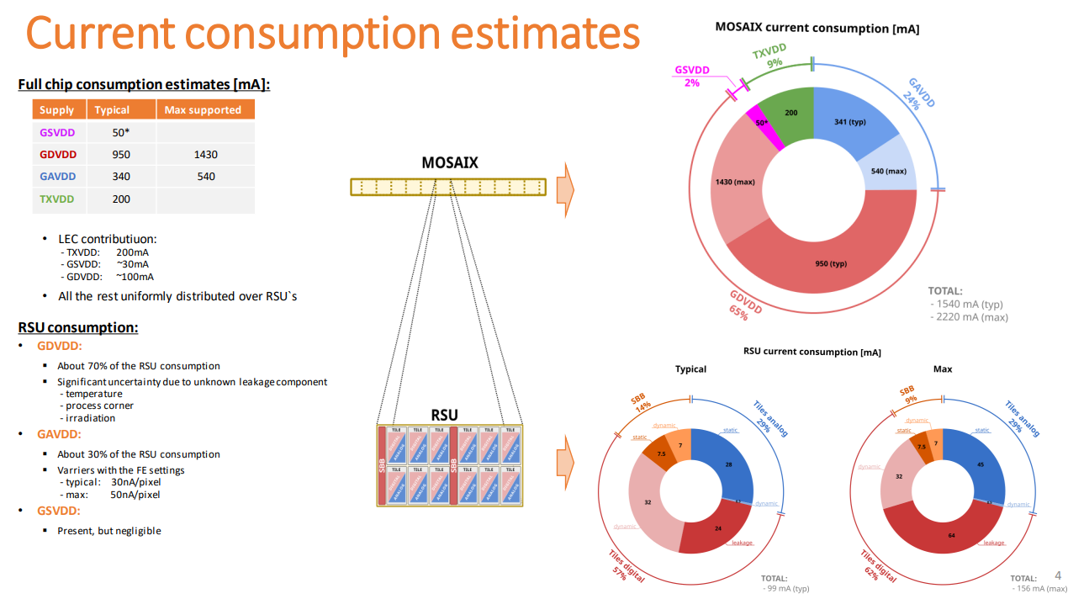
MOSAIX Power Consumption
MOSAIX Engineering Specification Review
Current consumption numbers for MOSAIX were updated in the engineering review.

Slide 10
MOSAIX Progress
Progress
ER1 has been taped out and is in testing
Development of a Stitched Monolithic Pixel Sensor prototype (MOSS chip) towards the ITS3 upgrade of the ALICE Inner Tracking System
The Monolithic Stitched Sensor (MOSS) Prototype for the ALICE ITS3 and First Test Results
Power distribution over the wafer-scale monolithic pixel detector - MOSAIX for ALICE ITS3
Development of the MOSAIX chip for the ALICE ITS3 upgrade
Yield Characterisation and Failure Analysis of the Monolithic Stitched Sensor MOSS for ALICE ITS3
Evaluation of efficiency, radiation hardness, and timing performance of the Analogue Pixel Test Structure for ALICE ITS3
ER2 (the first MOSAIX chip) is currently being finalised. Tapeout Q4 23/Q1 24

Slide 11
EIC-LAS
Notes:
The abstract pattern can be removed or repositioned if required. Be careful to ‘Send to Back’ so that it does not obscure any important information.

Slide 12
LAS Power Consumption and Data Rates
Converting Power Numbers to EIC-LAS
Assume 6 RSU LAS
Numbers in red do not have “Max” estimates in the MOSAIX data, so assumed +50% on typ number (since this is true for supplies that do have it)
EIC-LAS is one LEC and 6 RSU
 | Typ Current Consumption (mA) |  |  | Max Current Consumption (mA) |  |  |  | Voltage (V)
 | RSU | LEC | EIC-LAS | RSU | LEC | EIC-LAS
GAVDD | 28 |  | 168 | 45 |  | 270 |  | 1.32
GDVDD | 71 | 100 | 526 | 111 | 150 | 816 |  | 1.32
GSVDD | 1.6 | 30 | 40 | 2.4 | 45 | 59.4 |  | 1.32
TXVDD |  | 200 | 200 |  | 300 | 300 |  | 1.8
Total |  |  | 934 |  |  | 1445

Slide 13
LAS Power Consumption and Data Rates
Converting Data Rates Numbers to EIC-LAS
Remember data rates for MOSAIX from Intro
Tile Link Capacity – 23.04Gbps
3 links @ 10.24Gbps
5 links @ 5.12Gbps
ePIC expects 35Gbps for the whole SVT.
Therefore plan to reduce to a single link for mass reasons.

Slide 14
MOSAIX to EIC-LAS
Changes to MOSAIX
Based on the last slide, we try and limit ourselves to three changes from MOSAIX to LAS:
Reduce number of RSUs
Edit data multiplexer to put everything on one link
Alter serialiser power scheme to match serial powering

Slide 15
EIC-LAS Progress
Progress
What we want to do is clear
Further understanding (esp. of the LEC) is needed to determine how to handle link reduction
Making any changes to the MOSAIX design other than stitching plan changes requires database access. Currently in negotiation at DOE-CERN level
Fallback options could exist in case this is not forthcoming or we have timeline/risk/effort issues:
Settle for non-optimal numbers of links
Different scheme to power serialiser

Slide 16
Ancillary ASIC
Notes:
The abstract pattern can be removed or repositioned if required. Be careful to ‘Send to Back’ so that it does not obscure any important information.

Slide 17
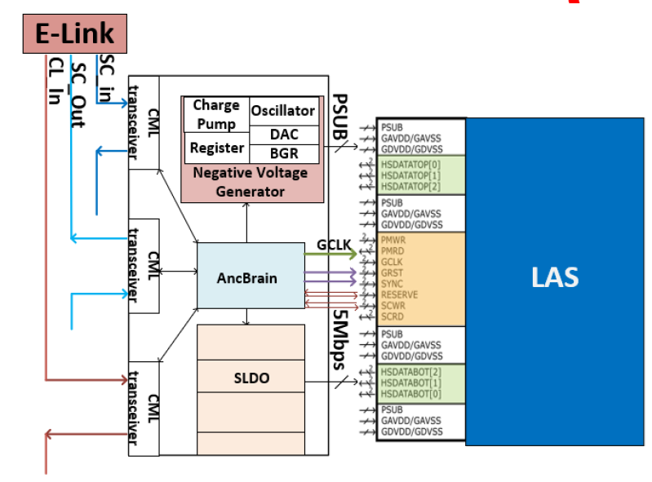
Ancillary ASIC
Background
Some features of EIC-LAS not amenable to stave operation:
Point-to-point slow control
Point-to-point powering
Adding these to the EIC-LAS/MOSAIX design is high risk, complex and perhaps technically unfeasible
Develop supporting ASIC instead

Slide 18
Ancillary ASIC
Features
Shunt-LDO (SLDO)
For serial powering
5 per AncASIC (4 EIC-LAS supplies and AncASIC)
Negative Voltage Generator (NVG)
MOSAIX/EIC-LAS need small negative back bias
AncBrain
Slow Control Multiplexing
Control of rest of AncASIC

Slide 19
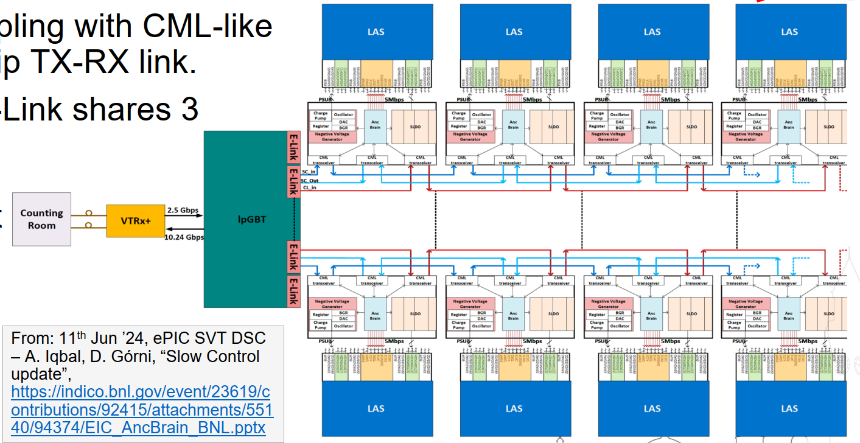
Ancillary ASIC Stave

Slide 20
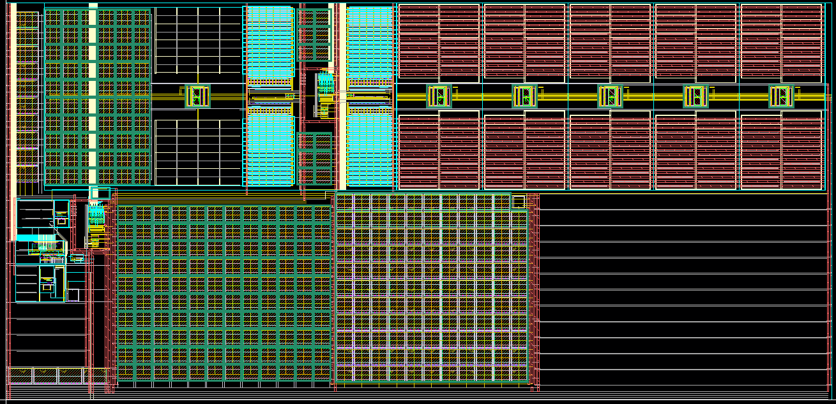
Negative Voltage Generator

Slide 21
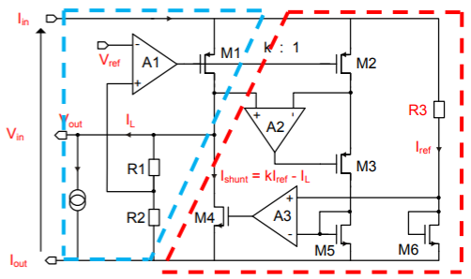
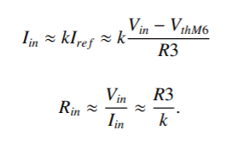
The Shunt-LDO
What is an SLDO?
The Shunt-LDO (SLDO) is a combination of a Low Drop Out (LDO) regulator and a Shunt Regulator.
The LDO loop keeps the output voltage constant and the shunt loop ensures the correct corresponding load current is supplied.
The LDO loop keeps Vout constant by dropping the difference between the desired output voltage and the input voltage across a pass transistor.
The shunt regulator loop makes sure the same current is always drawn by the SLDO by shunting the difference between the load and input current.
The SLDO has an ohmic IV characteristic.
[1]

Slide 22
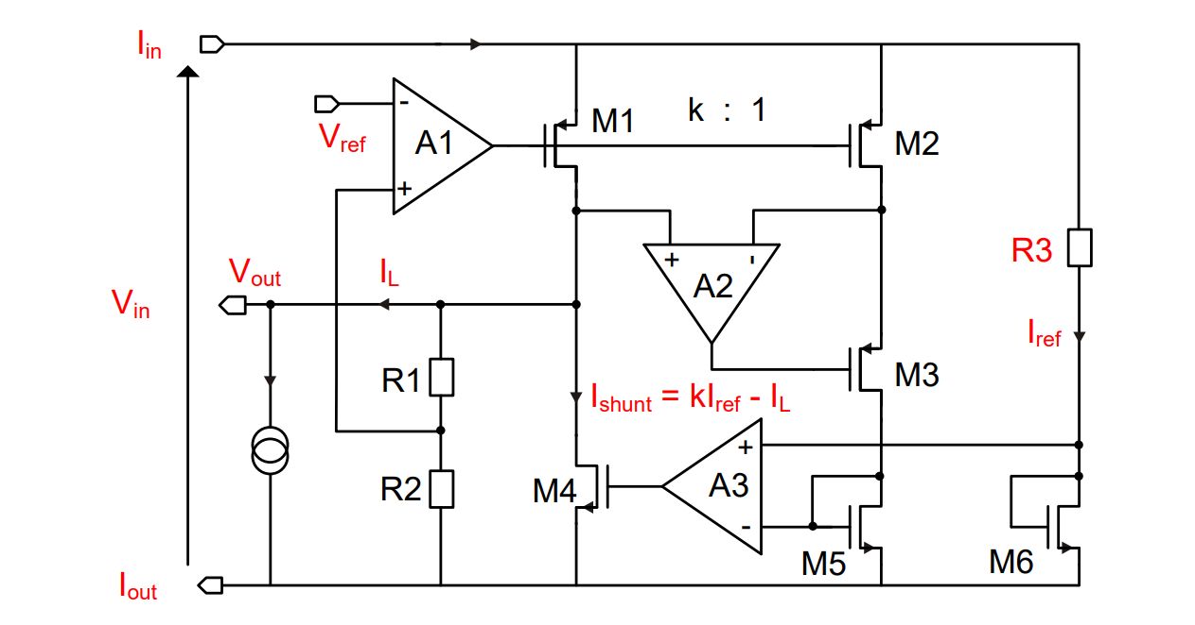
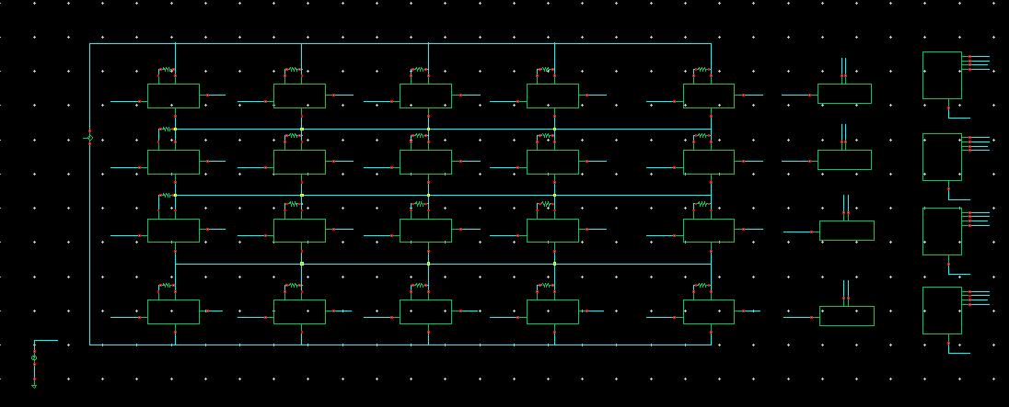
AncASIC Power Consumption
+10% shunt overhead based on https://cds.cern.ch/record/2292628/files/CR2017_385.pdf
LAS<3>
LAS<2>
LAS<1>
Programmable Output Voltage
Compared to earlier presentations (v7 and before), need to simulate case where GA=GD=Services=1.32V and Serialiser=1.2V. Requires adjustable SLDO output.
Implemented 4 bit variability. Should give swing between 1.1 – 1.5V
LAS<0>
Services
Serialiser
GlobalDigital
GlobalAnalog
AncASIC (0A)

Slide 23
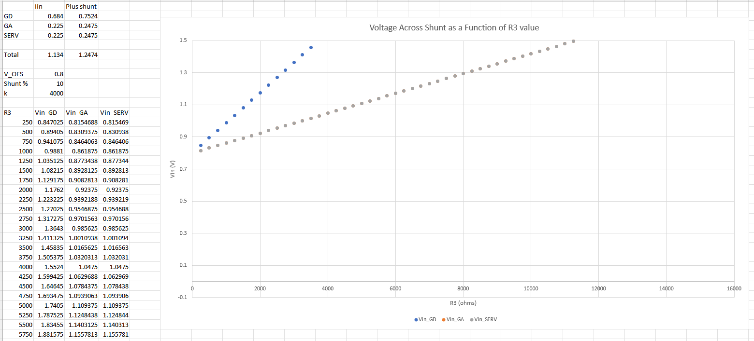
Balancing currents with R3
Power Optimisation
R3 must be different per supply
Otherwise current divides evenly and is very power in-efficient (extra is shunted)
Also different for different LAS power conditions
Will require real world tuning (perhaps per stave?)
Include MOSAIX to check if testing ER2 with SLDO will be possible (no plan for IB serial powering)
Supply | R3 Typ | R3 Max | R3 MOSAIX
Global Analog | 17k | 11k | 8.5k
Global Digital | 5.5k | 3.5k | 3k
Services | 72k | 48k | 58k
Serialiser | 14.4k | 9.6k | 14.4k

Slide 24
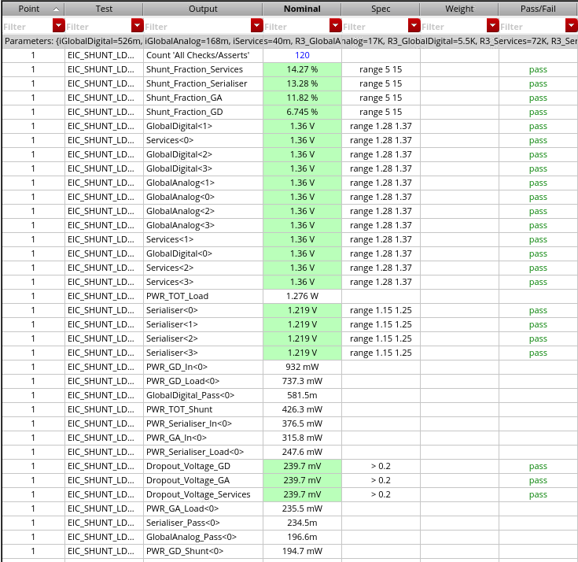
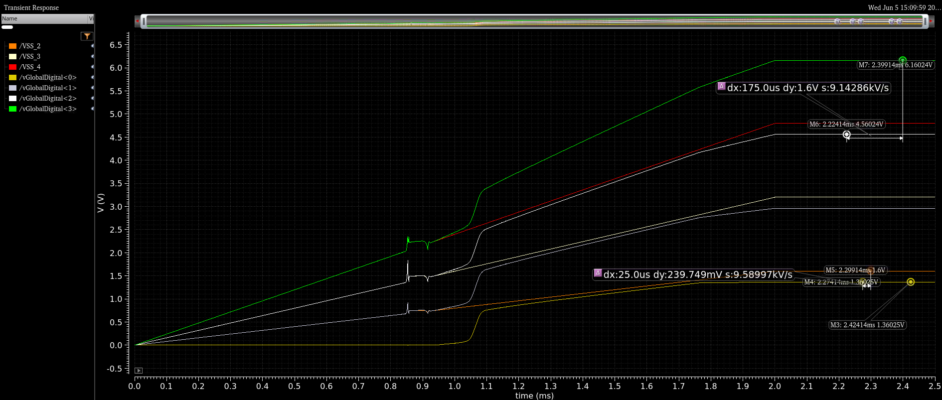
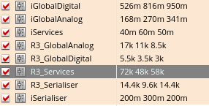
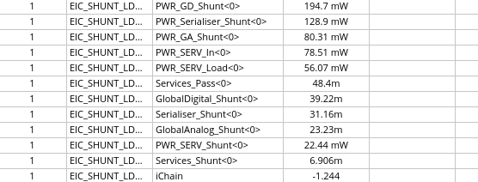
Ancillary Chip Power Consumption

Slide 25
Overall Power Consumption
 |  | AncASIC |  | EIC-LAS
 | Unit | Expected 25 | Max 45 | Expected 25 | Max 45
Global Analog | mW | 80 | 105 | 235 | 378
Global Digital | mW | 195 | 279 | 737 | 1144
Services | mW | 22 | 32 | 56 | 84
Serialiser | mW | 129 | 188 | 248 | 371
Total | mW | 426 (33%) | 604 (31%) | 1276 | 1977
Chain Current | A | 1.5 | 2.5 | N/A | N/A
- PSRR trade-off with drop out voltage/power
- All still simulated in 65nm process
- Low dropout at high current is not free…
- RD53B PT: 22,500um²
- AncASIC PT: 36,480um² (0.00036cm²)
Improvement of ~60% in AncASIC power and 30% in EIC-LAS power c.f previous (GA=GD=Serialiser=1.2V and TDR currents) case

Slide 26
Power Caveats…
Caveats to the numbers
Best estimate from MOSAIX. Not a warranty.
Possibility that LEC value will rise (additional functions)
For GAVDD, it is likely that EIC-LAS will be in the Max case, since we want the fastest frontend speed
We may be able to reduce TXVDD consumption if we don’t need all the transmitters (or can run slower)
Need to add consumption of non-SLDO AncASIC
Mis-match in GAVDD, GDVDD consumption may require different input voltages (waste of power in serial powering chain)
Irradiation
Future Updates
May be future releases from MOSAIX
AncASIC will need to be updated once porting to XT011 is completed
Test results from ER2

Slide 27
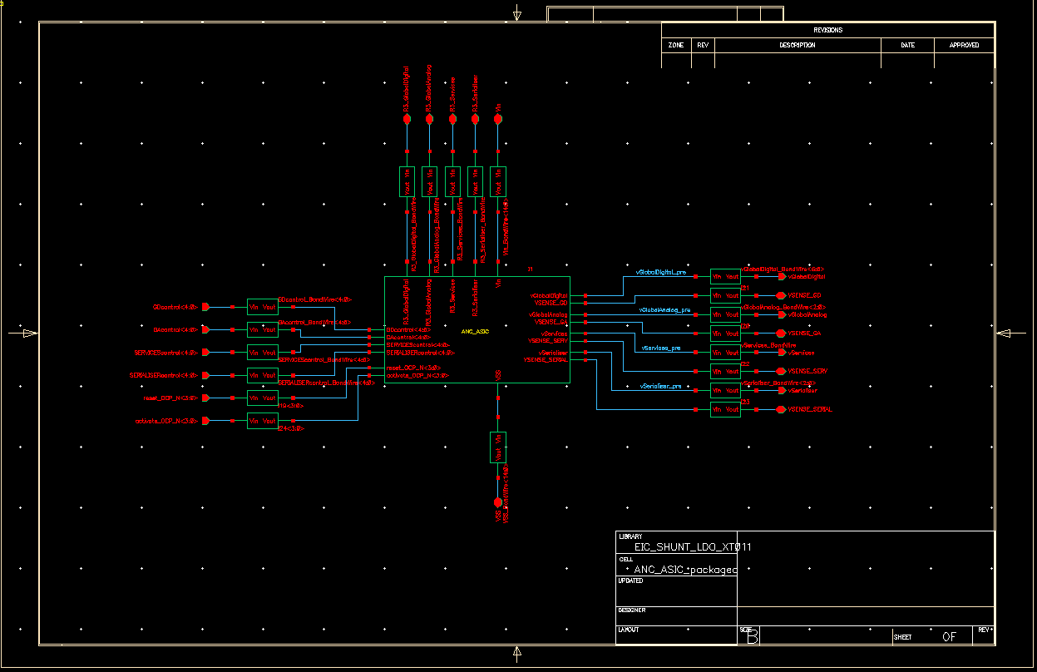
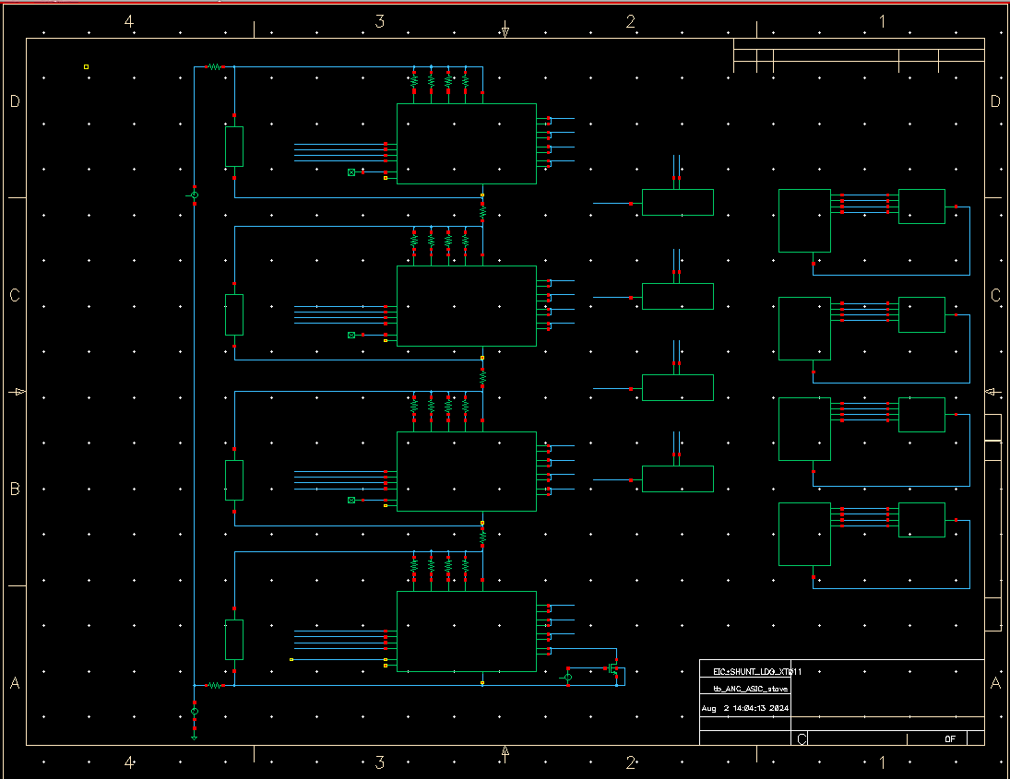
SLDO Current Work and Updates
Coming Updates
Porting to XT011 complete
Simulation under way
Added realism
Additional features (over current protection, digital control etc.)
Layout under way towards November submission

Slide 28
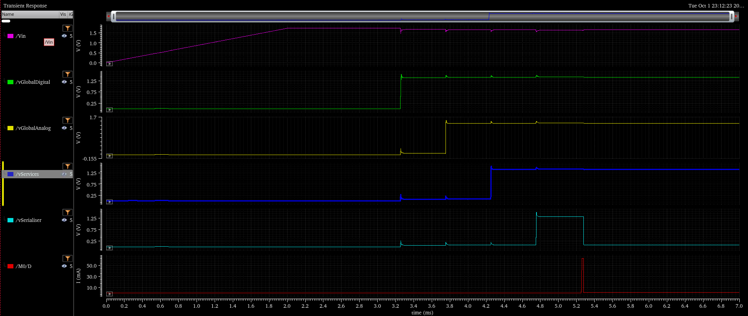
SLDO Current Work and Updates
Supply Ramping
GD Enabled
GA Enabled
SERV Enabled
SERIAL Enabled
Serial Over-current

Slide 29
AncASIC Size
500um
500um
500um
PADS
???
???
Slow Control
>1.5mm
PADS
PADS
1mm
???
200um
SLDO
SLDO
SLDO
SLDO
SLDO
NVG
500um
PADS
>7mm
Preliminary – Treat as fully subject to change

Slide 30
Size Caveats
Very preliminary
Only producing at this stage to assist with requests for stave design
Not discussed with other designers yet
Chip has 3 components:
Negative Voltage Generator
Size unknown
Slow Control Multiplexing
Size unknown
SLDO
Size unknown, but will probably dominate
Size dominated by a few transistors, so some guess at chip size can be made
However:
Design at early stage
Sizes taken from 65nm design (not 110nm)
Of course, this also means we can be open to comments
Need someone to do thermal FEA – now that size and power are known
Preliminary – Treat as fully subject to change

Slide 31
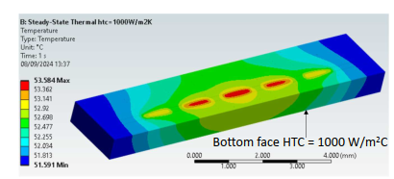
Thermal Studies
All Stephanie’s work. See later! ☺

Slide 32
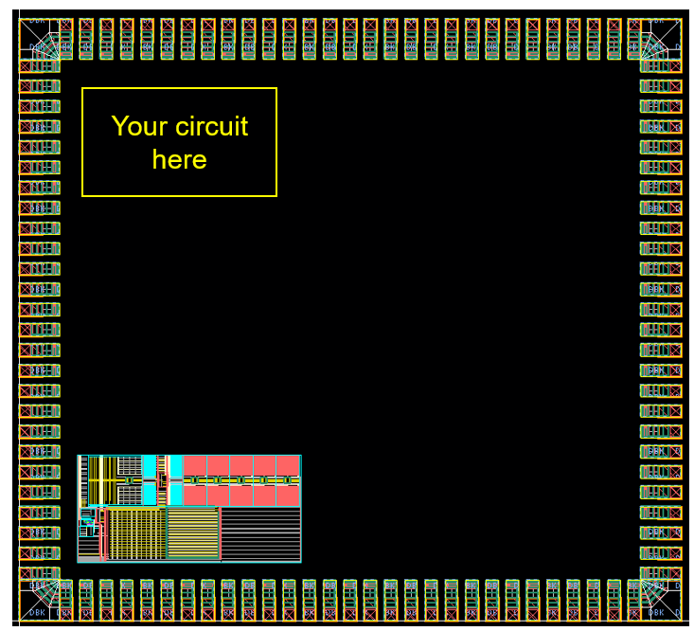
AncASIC Progress
Progress
A lot of work in simulation and estimation to allow mechanical/thermal design to proceed
Target schedule of submissions towards AncASIC
NVG: Simulated and layout well underway. Virtually complete for November run
SLDO: Verification sims still ongoing. Layout started. Targeting November but very resource challenged.
Slow Control: Conceptual. BNL plan to have funding next FY to start design on FPGA
In general, many legal and procedural hurdles at the moment.

Slide 33
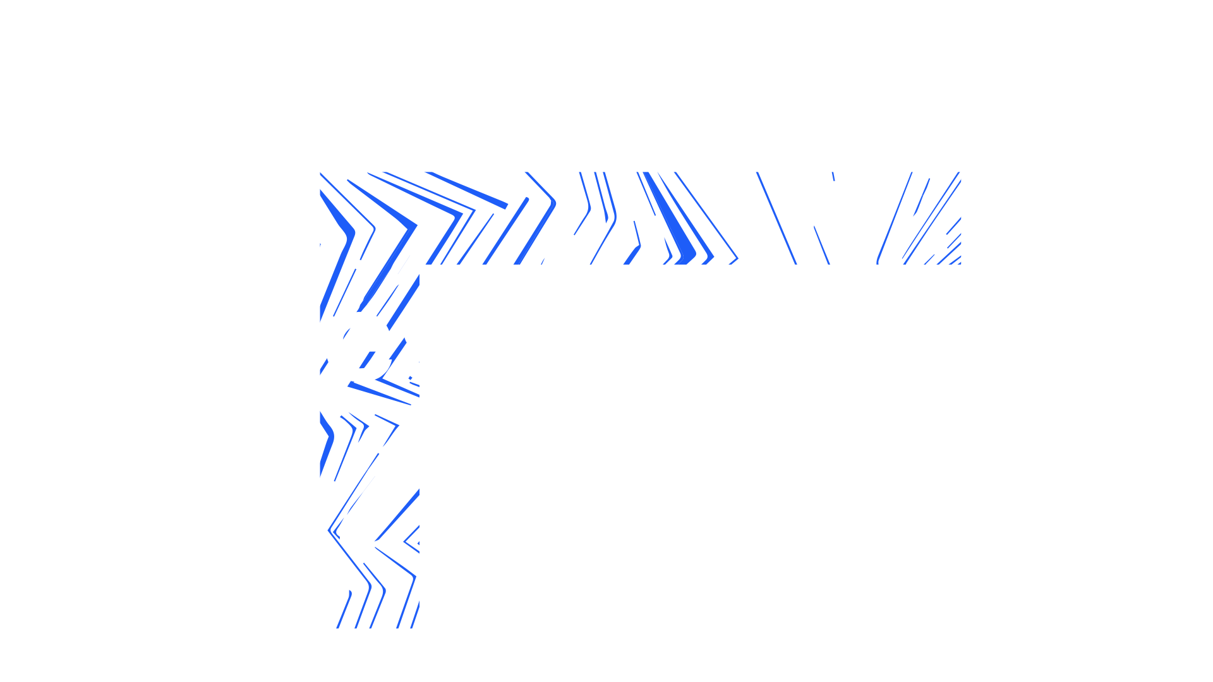
Notes:
The abstract pattern can be removed or repositioned if required. Be careful to ‘Send to Back’ so that it does not obscure any important information.

Slide 34
Backup

Slide 35
MOSAIX Supply Complexities
GA, GD and Services
Remaining voltages are all driven at 1.32V
It is necessary that services should always be above the other two, but this is handled internally by assuming that only GA and GD droop.
Therefore we assume GA, GD and Services at 1.32V.
Testing MOSAIX with AncASIC
James suggested it would be useful to be able to test the AncASIC powering MOSAIX when ER2 returns
Ran some simulations to check if it is possible
Seems that it is (for the Expected 25 case) because designing for Max45 EIC-LAS leaves a lot of headroom

Slide 36
MOSAIX Supply Complexities…
The 1.8V Problem…
MOSAIX requires not just a 1.2V supply, but also 1.8V to run the serialisers
The AncASIC itself will need a 1.8V supply for logic and the NVG
However, all SLDOs need to be in parallel, and if we run them at 1.8V, the 1.2V supplies will waste considerable power
What can we do?
Run the SLDOs at 1.8V
Two serial powering chains
Use the NVG?
Tap power from the next stage?
Remove serialiser LDO from 65nm IP (serialiser itself is 1.2V)
Supply 1.8V externally to each LAS
Considerable waste of power - ~1.1W
Impossible – shared ground at various points
Could it step 1.2V up to 1.8V? Noise issues?
Routing complexity. Stability? Still a power waste - ~300mW. What about the last one?
1.2V
1.2V
0.4V
EIC-LAS
Would need 8 lines (supply and return for each of 4 LAS).
V= ~1.4V
1.2V
1.2V
EIC-LAS
V=0V

Slide 37
MOSAIX Supply Complexities…
The 1.8V Solution?
João’s idea to edit the 65nm database to skip the LDO seems like a good one.
We do not yet have a solution to powering the AncASIC circuits that run at 1.8V.
It does seem that the serialiser could be separated from it’s LDO
So for the rest of this presentation, I will assume that the serialiser can be powered at 1.2V in order to get an overall power number.
We should perhaps suggest to the higher SVT that they think about point-to-point powering of the 1.8V system just in case (would mean 8 extra wires)
https://indico.cern.ch/event/1376523/contributions/5785064/attachments/2789901/4865135/ALPIDE_65_30_01_2024.pdf

Slide 38
LAS Power Consumption – Earlier Estimates
 |  | Power Consumption
 | Unit | 5 RSU LAS | 6 RSU LAS | MOSAIX
LEC | mW | 696 | 696 | 696
RSUs | mW | 543 | 651 | 1303
Total | mW | 1240 | 1348 | 2000
Expected 25
2 published sources of data (power densities, and supply current breakdown)
LEC does not vary at all in the power density figures
Separation into supplies does not include Expected/Max variation
How to reconcile?
 |  | Power Consumption
 | Unit | 5 RSU LAS | 6 RSU LAS | MOSAIX
LEC | mW | 696 | 696 | 696
RSUs | mW | 889 | 1066 | 2133
Total | mW | 1585 | 1763 | 2829
Max 25
 |  | Power Consumption
 | Unit | 5 RSU LAS | 6 RSU LAS | MOSAIX
LEC | mW | 696 | 696 | 696
RSUs | mW | 1280 | 1536 | 3072
Total | mW | 1976 | 2235 | 3768
Max 45

Slide 39
LAS Power Consumption – Earlier Estimates
Towards individual supply estimates
Can only really make worst case assumptions:
6 RSU LAS
Expected 25 to Max 45 is 65% variation.
Apply this also to the LEC and assume published number is Expected 25.
Worst case numbers are then 1536mW for the RSUs and 1148mW for the LEC.
Total 2684mW
How does this compare to the published supply numbers (MOSAIX – 12RSU)?
N.B. We can make better case assumptions if we like, but we should do it consciously
Scale to EIC-LAS ->
+65% ->
272mW
648mW
1643mW
360 mW
XXXXXX
272mW
270mW
821mW
360 mW
XXXXXX
449mW
445mW
1354mW
594 mW
XXXXXXX
Total: 2923mW 1723mW 2842mW
Good match to our worst case Max45 estimate, so can probably assume the original numbers are for the Expected 25 case

Slide 40
LAS Power Consumption – Earlier Estimates
LAS, Best and Worst
Knowing the EIC-LAS current requirements is key for the SLDO design
Since the SLDO dominates the AncASIC (we need a better name…) power consumption, it is also key to get a power number for that chip
Current numbers needed for simulation
Power
Voltage
Current
Expected 25
Max 45
Expected 25
Max 45
Services
Global Analog
Global Digital
Serialisers
272mW
270mW
821mW
360 mW
449 mW
445 mW
1354 mW
594 mW
1.32V
1.32V
1.32V
1.2V
206 mA
205 mA
622 mA
300 mA
340 mA
337 mA
1026 mA
495 mA
Assume 1.2V for serialisers (if we can skip the on-chip LDO)

Slide 41
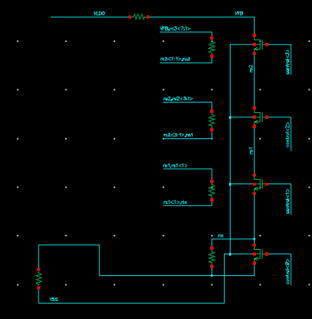
Ancillary Chip Adjustability
Programmable Output Voltage
Compared to earlier presentations (v7 and before), need to simulate case where GA=GD=Services=1.32V and Serialiser=1.2V. Requires adjustable SLDO output.
Since we also want some control over SLDO output to allow adjustment in real world, prefer to implement real circuit.
Implemented variable resistor (4bit) to allow this. Should give swing between 1.1 – 1.5V

