Slide 1
Stave Prototyping
Adam Huddart
Stephanie Yang
Georg Viehhauser

Slide 2
Introduction
Prototype scheme focused on L4 Stave
  Start with minimum required tooling to assembly a quarter length stave
    2 L4 (5 RSU modules) mounted on opposite faces
  Test structural, thermal performance and flow properties
  Manufacture remaining tooling required for full length L4 stave
  Move on to full length testing

Slide 3
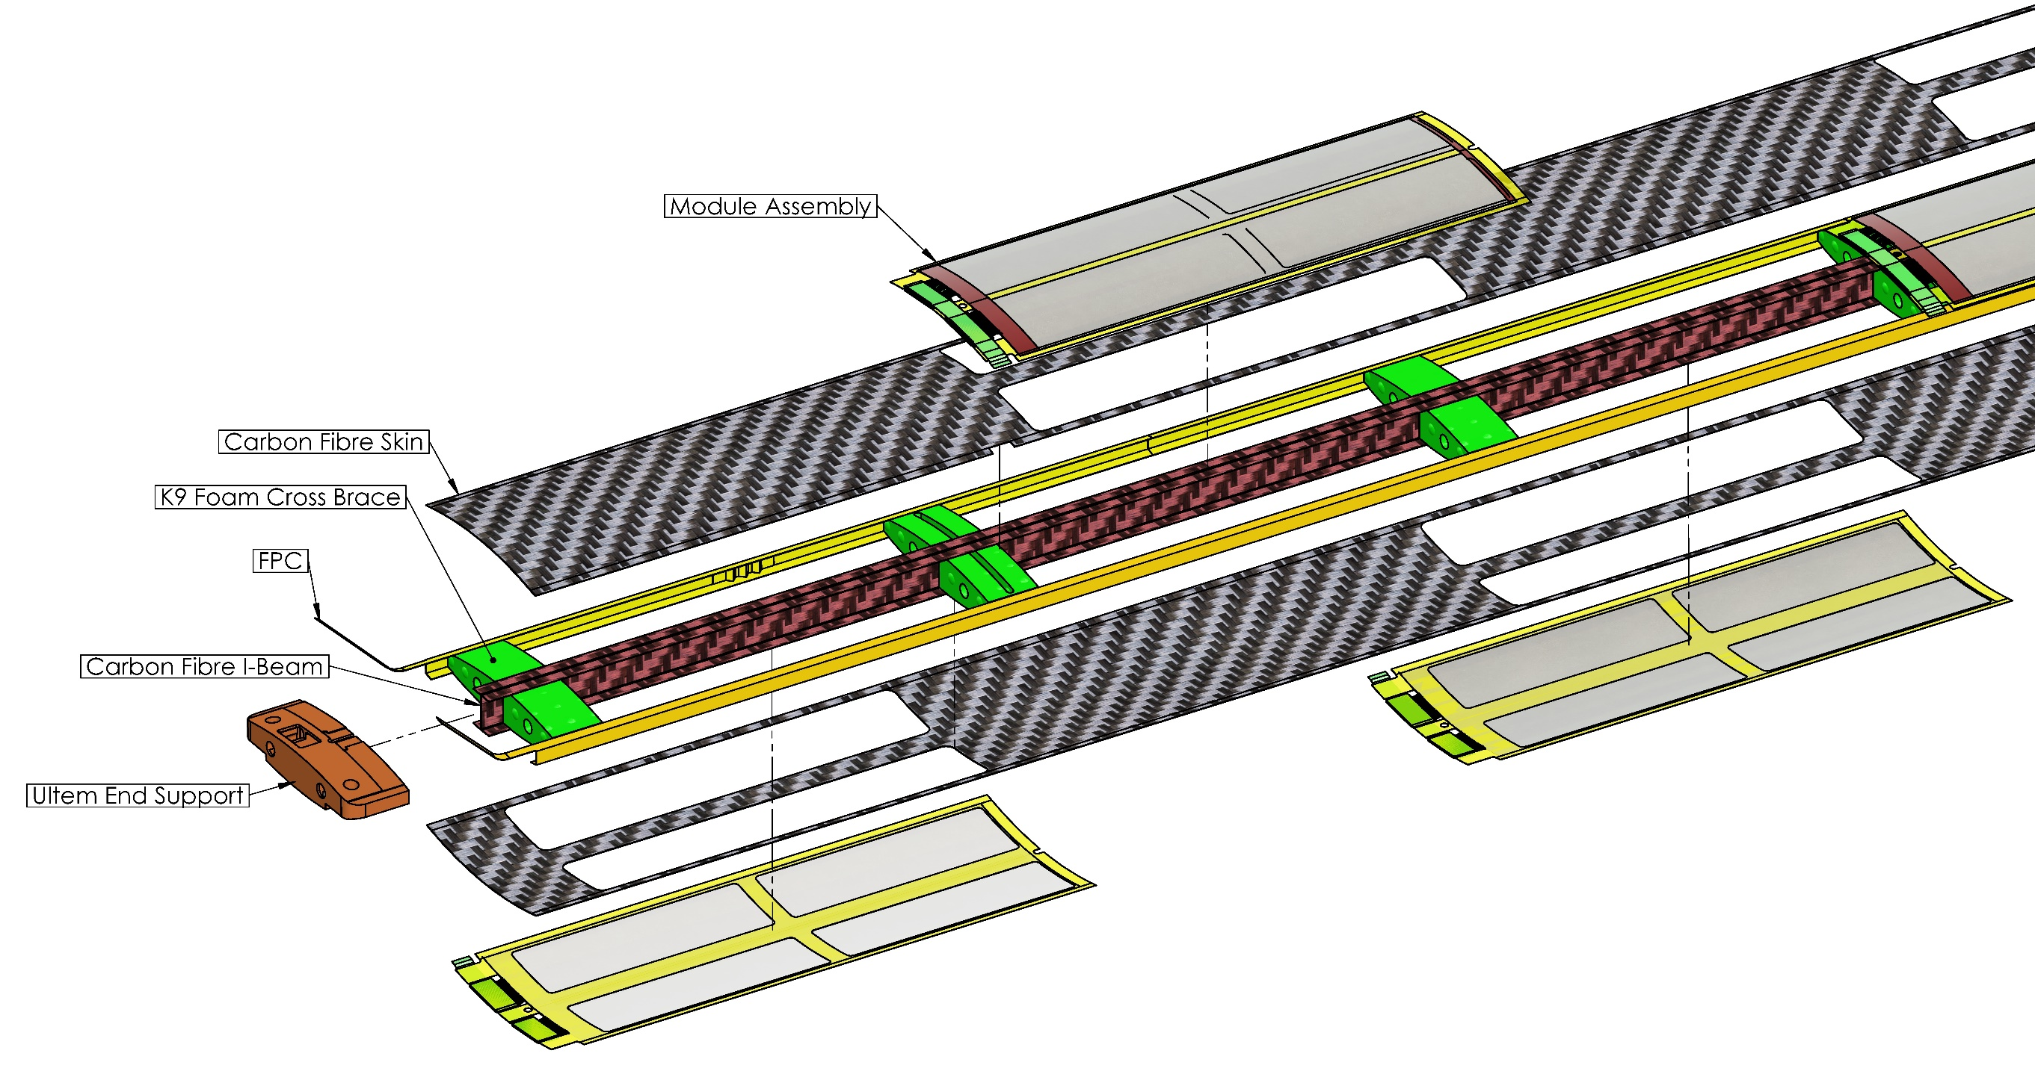
Stave Structure
¼ Length Stave End

Slide 4
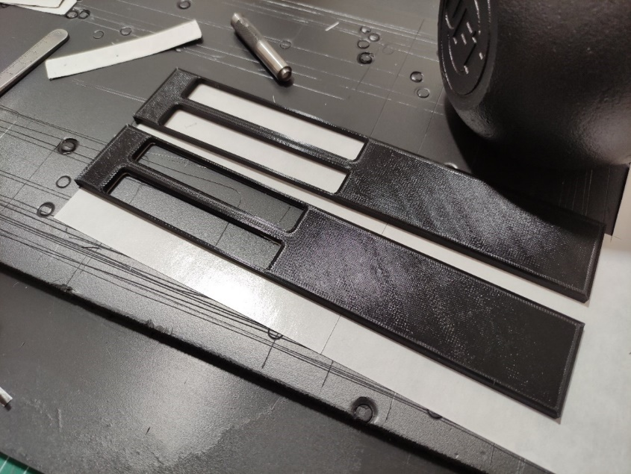
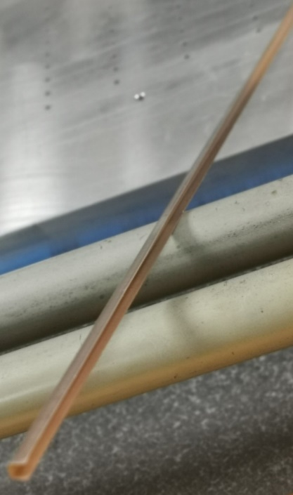
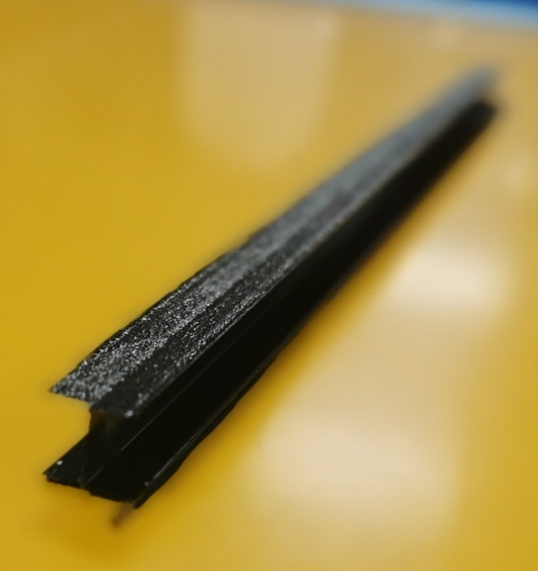
Prototype Components
Stave Components
Hand cut carbon fibre top/bottom skins (2 layers (90/0) of K13C2U/EX1515)
Pure Kapton FPC mock-ups
SLA 3D printed Stave End Supports
Production intent I-beam and K9 foam blocks

Slide 5
Prototype Components
Tooling
Co-curing tooling (for ¼ length stave)
  Carbon fibre I beam Tooling
  Kapton C-channel Tooling
  Internal formers
Sensor curve former
LAS curved carriers
Module assembly tooling
Module installation tooling (for full length L4)

Slide 6
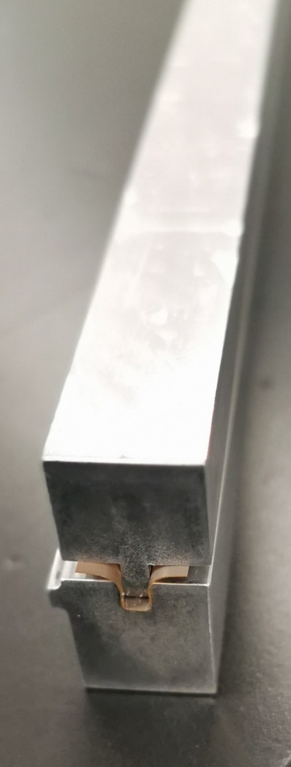
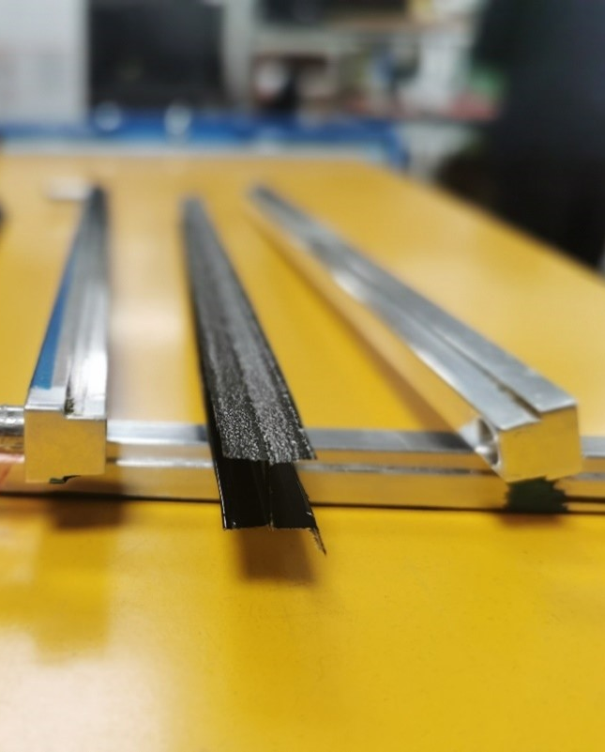
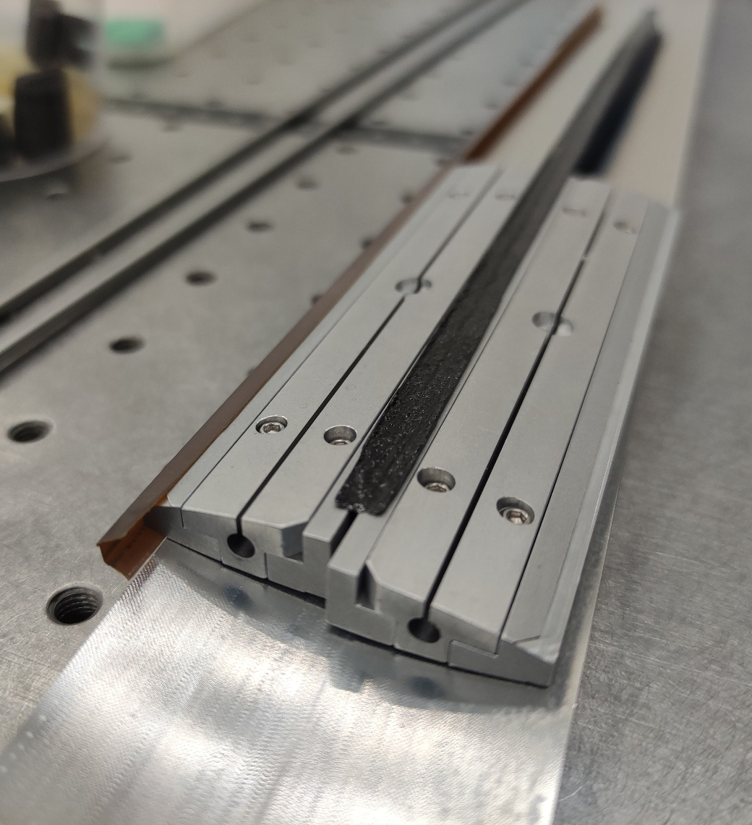
Stave Tooling Photos
Kapton Former
Carbon Fibre I-beam Mould
Internal Formers

Slide 7
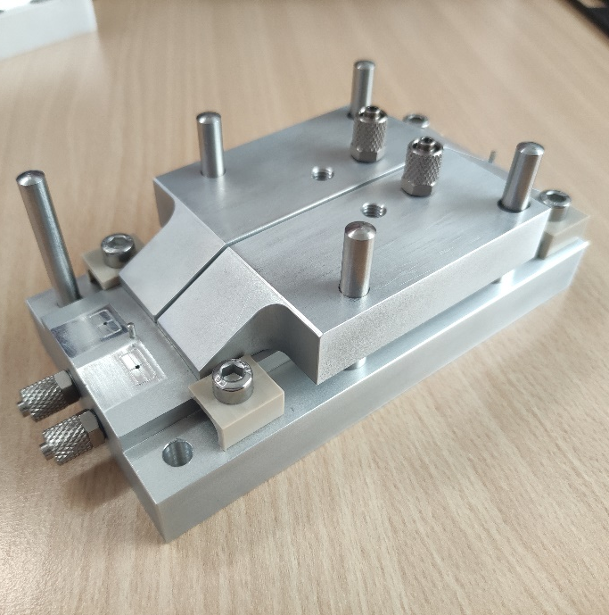
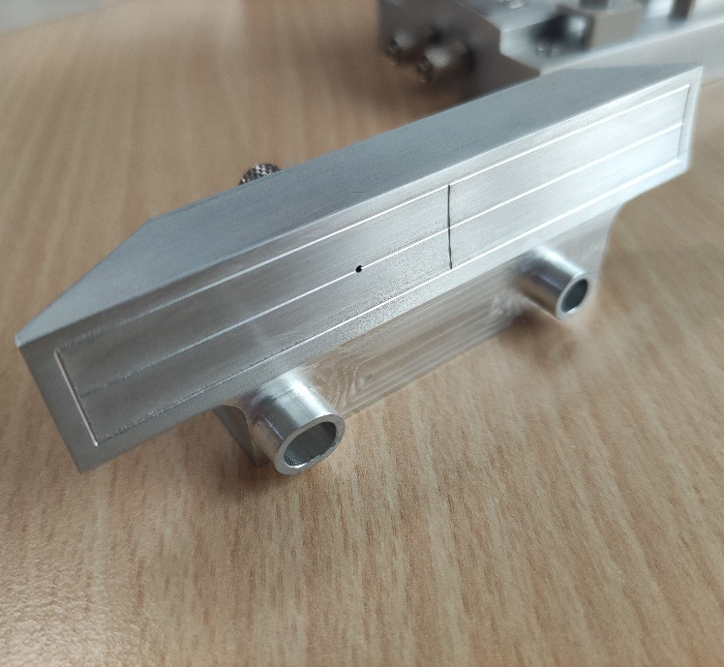
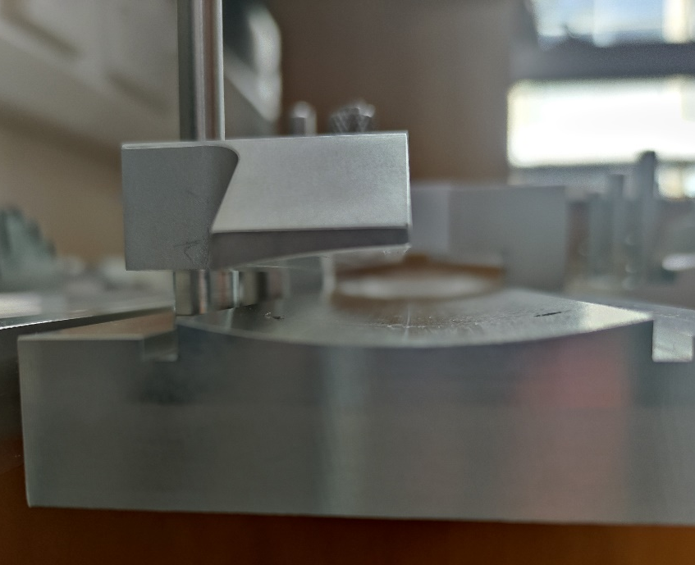
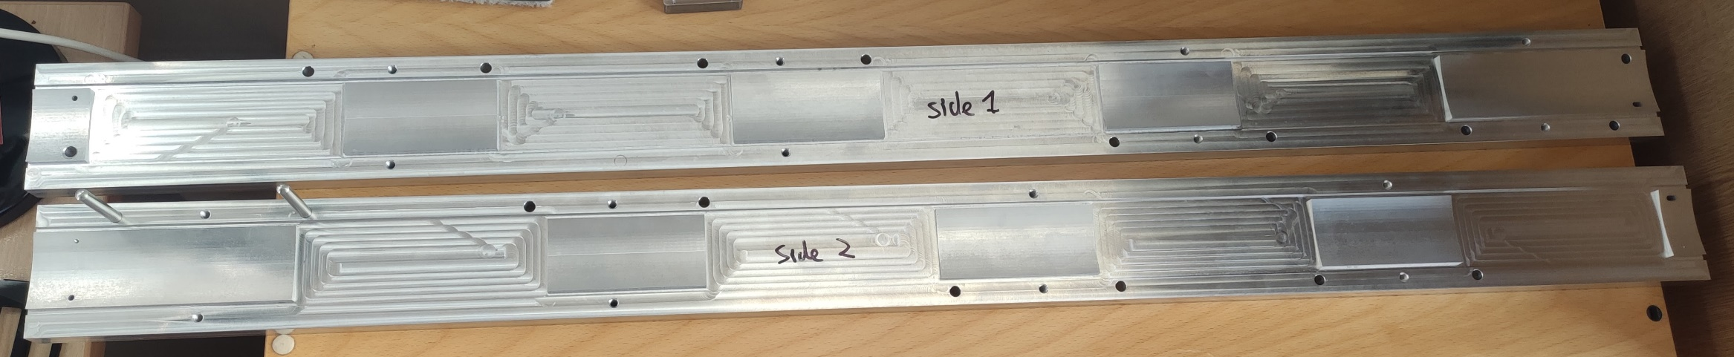
Module Tooling
Module Assembly Tool
LAS Vacuum Chuck
Vacuum Chuck on Module Installation Tooling

Slide 8
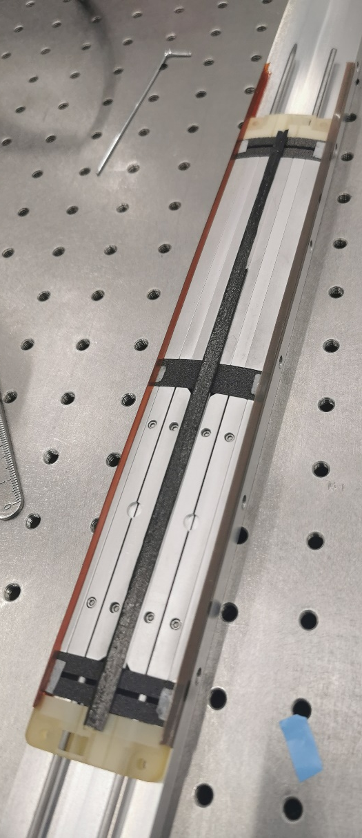
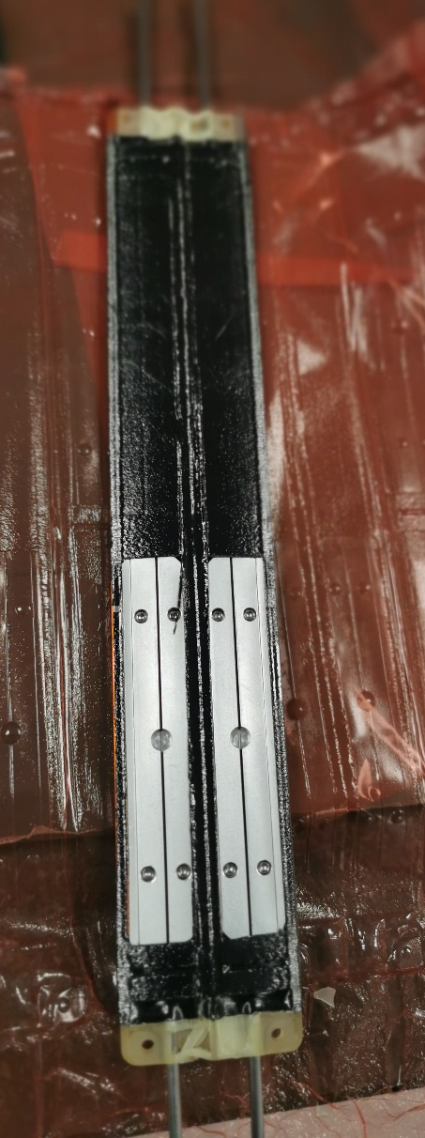
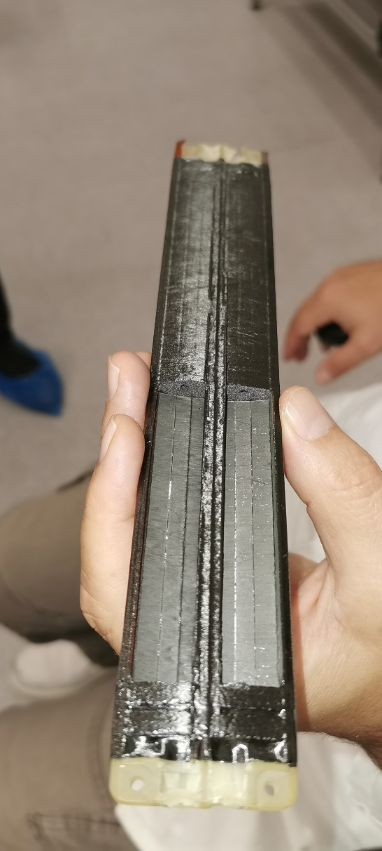
Take Aways from First Quarter Stave
No noticeable twist in stave
Internal tooling is a little fiddly to remove
  Epoxy can wick between the tooling sections
  Strategically placed threaded holes would allow for controlled removal of tooling
End supports deformed/failed
  Need reinforcement
Dimple in carbon skin over gap in K9 foam block
  If this is an issue it may be improved when using an intensifier

Slide 9
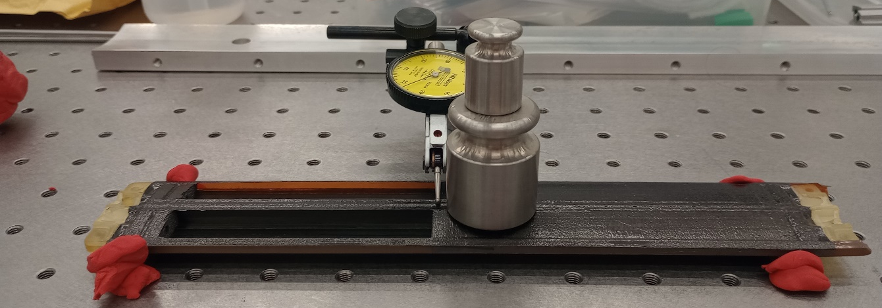
Quantitative Results
Mass estimate
3pt bend test
Measured: 8.95 g

Slide 10
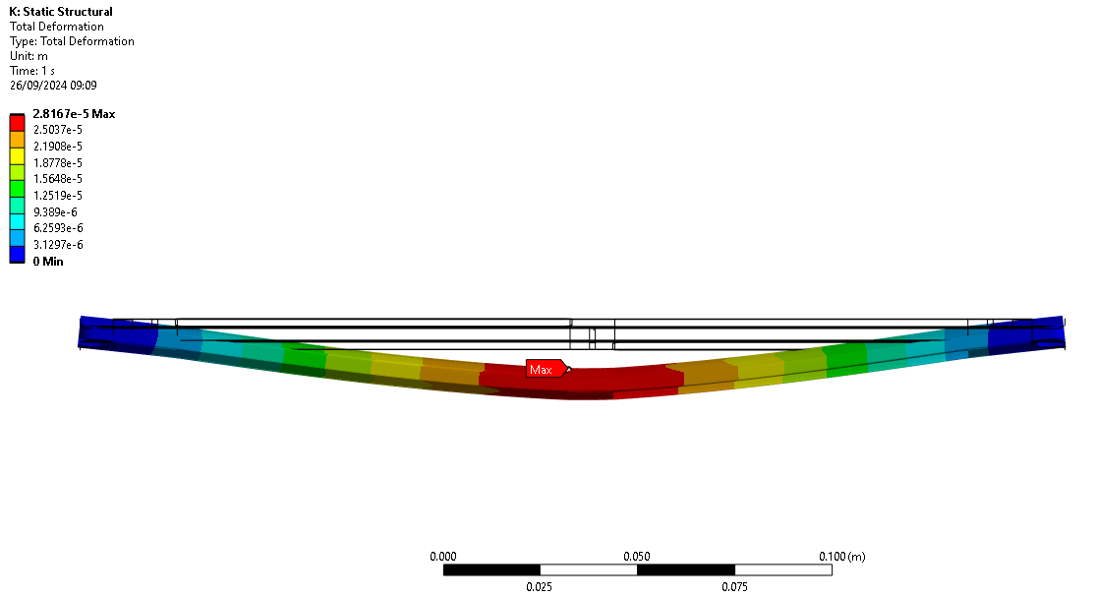
¼ Stave Finite Element Analysis
0.981N
Vertical load applied at central K9 foam block

Slide 11
Next steps
Cure another quarter stave
  Automated knife cutter
  Improved trimming of I-beam
  Cure with rubber sheets as intensifier
  More robust end pieces
Quarter Stave Tests
  Still waiting for vacuum chuck for extraction of mechanical dummy sensors
  Resonant frequencies (from FEA 97 Hz for single end supported (diving board) 841 Hz fully supported)
  Hence will close one quarter stave with Kapton to start flow tests
    Add dummy ancASIC study temperature with air flow
In parallel
Update drawings for remaining mould parts for full stave & manufacture
    This will include features to facilitate removal of mould parts after cure
Cure a full size L4 stave

Slide 12
Additional Slides

Slide 13
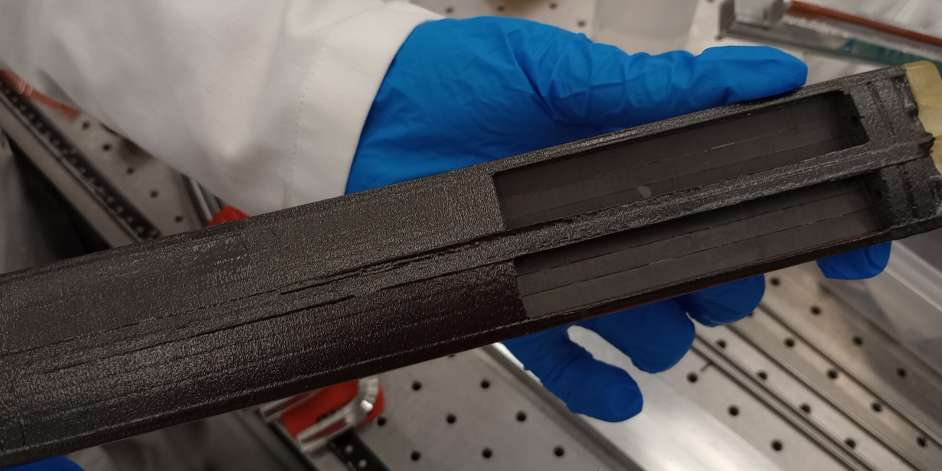
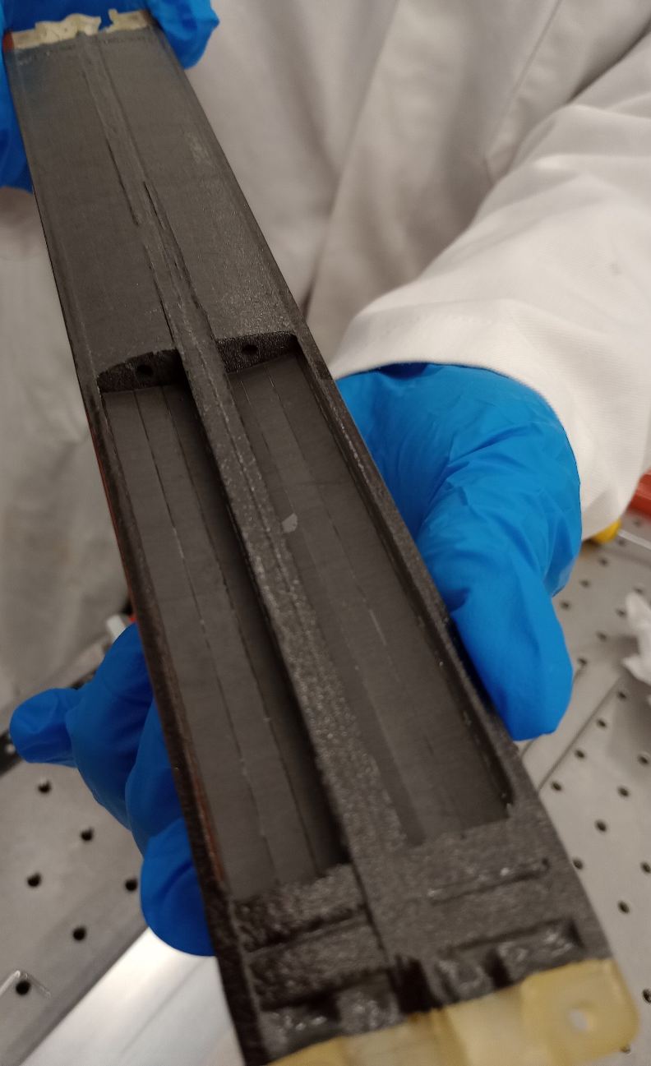
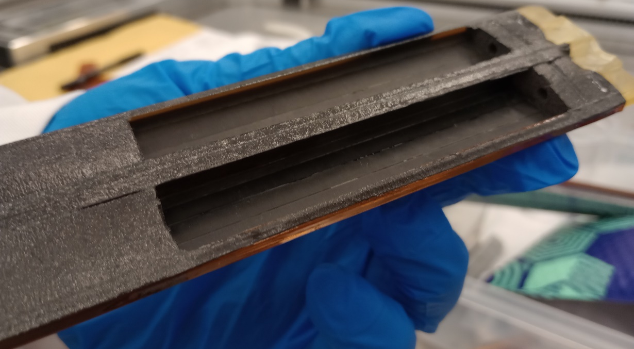
Pictures

Slide 14
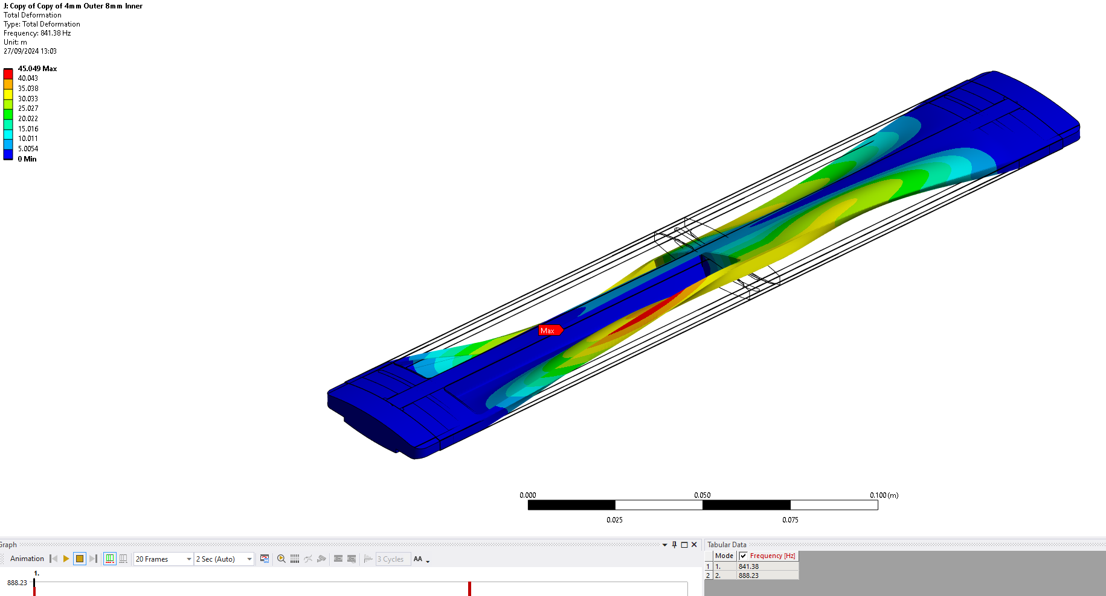

Slide 15
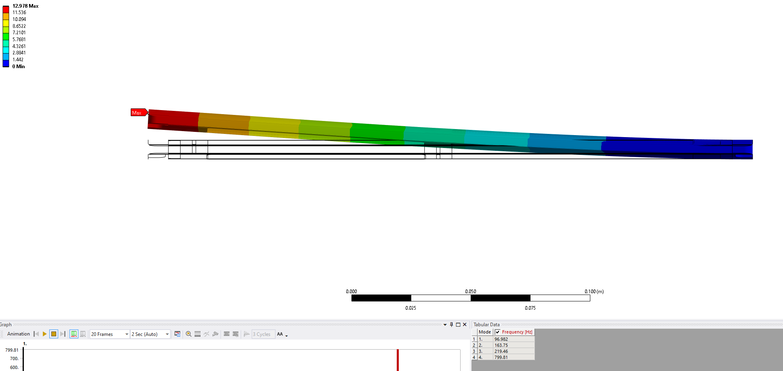

Slide 16
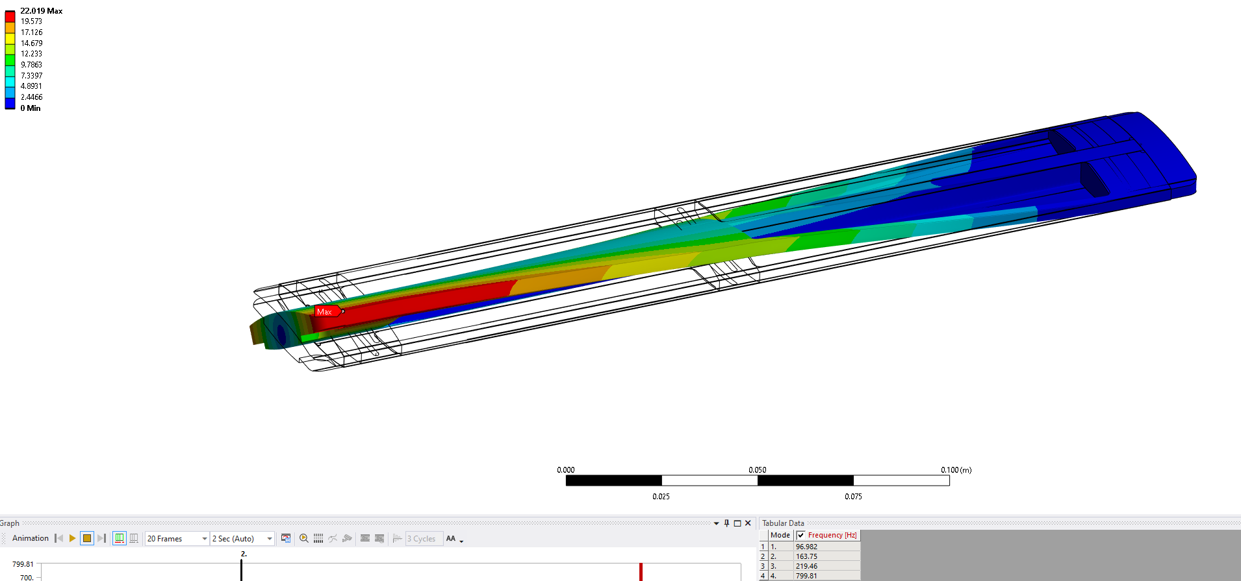

Slide 17
